Slide 1
ECE 576 – Power System Dynamics and Stability
Lecture 24: Renewable Energy Modeling
Prof. Tom Overbye
University of Illinois at Urbana-Champaign
overbye@illinois.edu

Slide 2
Announcements
Read Chapter 8
Homework 7 is due today
Homework 8 will be assigned April 29; should be completed before final but need not be turned in

Slide 3
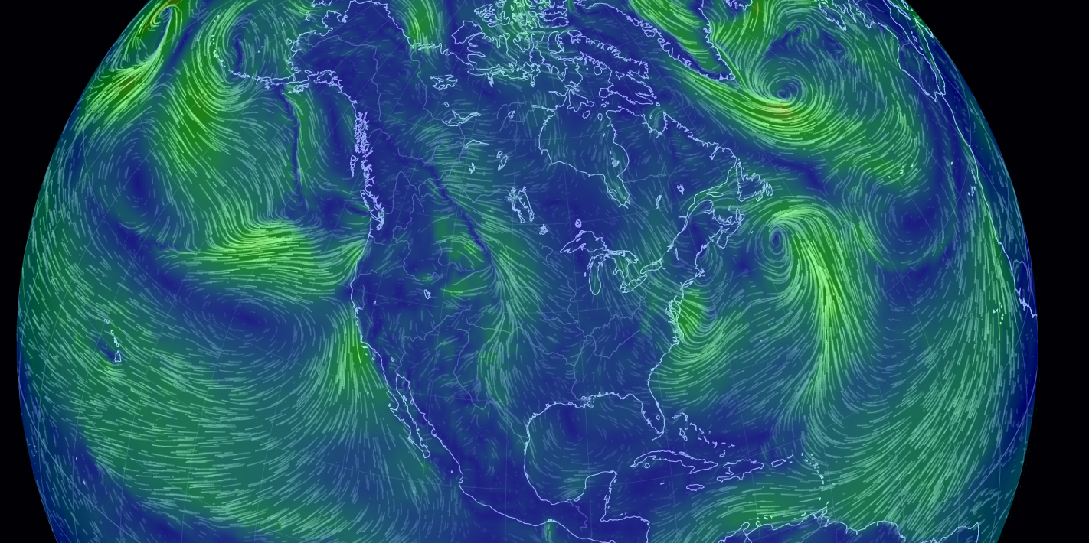
Global Wind Flow Visualization
Below is an interesting visualization of the global winds (thanks to Kenta for this link)
http://earth.nullschool.net/#current/wind/isobaric/1000hPa/orthographic=-39.01,24.31,333

Slide 4
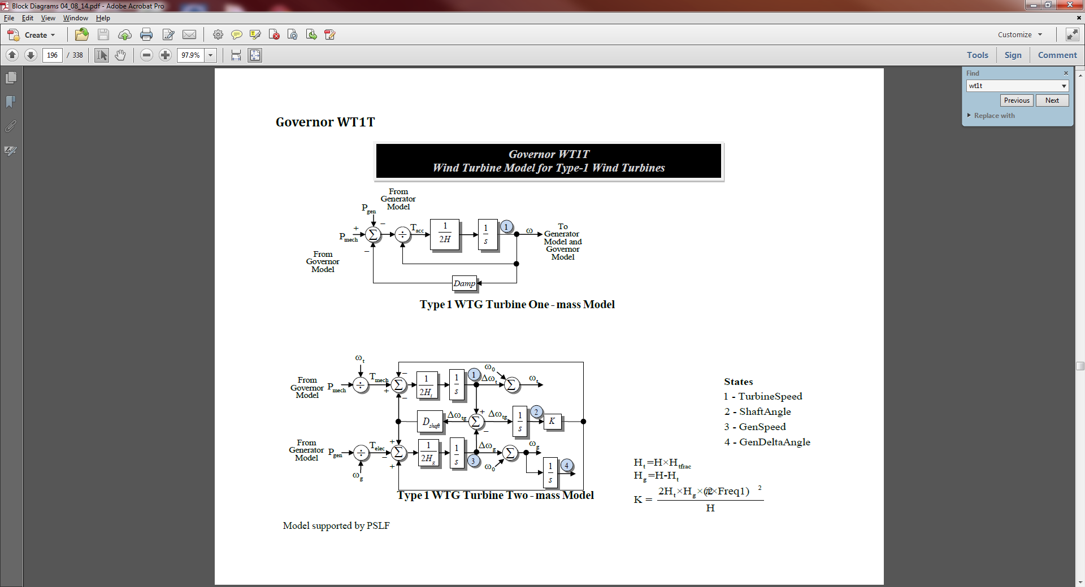
Type 1 Models
Type 1 models are just represented by an induction machine, with possible pitch control
  Usually represent older wind turbines
  No voltage control – just an induction generator
  Below is a one mass turbine model
Quite similar
to a synchro-
nous generator
swing equation

Slide 5
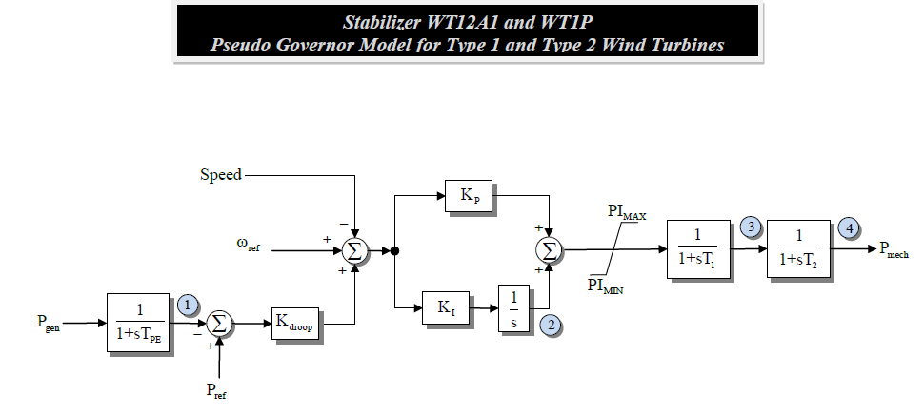
Type 1 Models
Below is a pseudo-governor model, modeling the change in the mechanical power input to the induction machine model
Modified to add non-windup limit on Ki

Slide 6
Type 1 Model Initialization
The initialization of the Type 1 models in the transient stability is very similar to what is done with induction motors
  P, Q and terminal voltages are inputs from the power flow
  Slip is calculated, with an additional capacitor used to make up the reactive power difference
  Slip is used to calculate the reference speed, with the slip usually negative, and hence the speed greater than synchronous
  Pmech is greater than Pelec because of the rotor losses

Slide 7
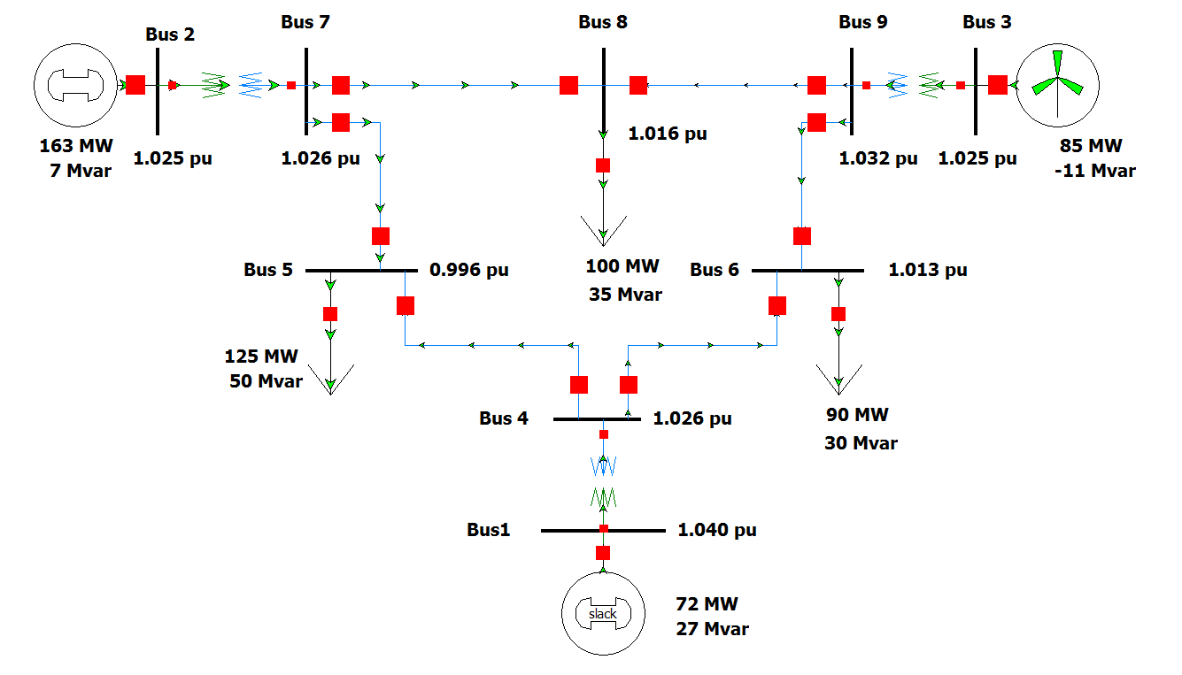
Type 1 Model Results
Wind turbine models will be demonstrated with the nine bus WSCC case with generator 3 represented as a wind turbine
Fault is
on the
line from
9 to 6,
right at
bus 6;
cleared by
opening the
line

Slide 8
Type 1 Model Results
Below graphs plot the generator 3 electrical and mechanical power, and slip

Slide 9
Governor and Inertia
Response Comments
Type 1 and 2 wind turbines have standard inertia response
They can always provide governor response if the frequency is too high by increasing the blade pitch to reduce their power output (except if the pitch angle is at its maximum)
They cannot provide addition sustained power if they are already at maximum power
  Similar to other types of generators
Commonly WTGs are operated at maximum power since their "fuel" is free

Slide 10
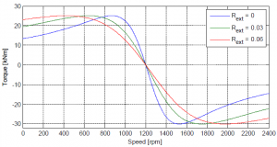
Type 2 Wind Turbines
As the wind speed varies, the speed of the induction machine wind turbines also varies
Type 2 models improve on the Type 1 design by varying the rotor resistance to achieve output power control
Image shows how
torque-speed curve
varies with changing
rotor resistance
Example Type 2 is a
Vestas v63
Image Source: www.uwig.org:8080/index.php?title=Modeling_of_Type_2_Wind_Turbine_Generators

Slide 11
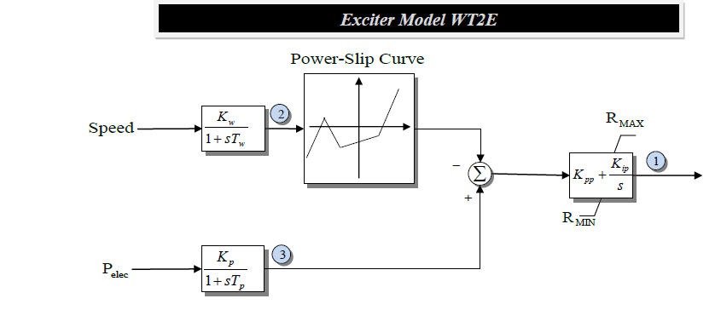
Type 2 Rotor Resistance Control
In the WT2E model the speed and electrical input are used to adjust the induction machine rotor resistance
Output is Rext (i.e., the external resistance)

Slide 12
Type 2 Model Results
Previous example is modified to represent generator 3 using a Type 2 model; same fault
Below graph shows the variation in Rext

Slide 13
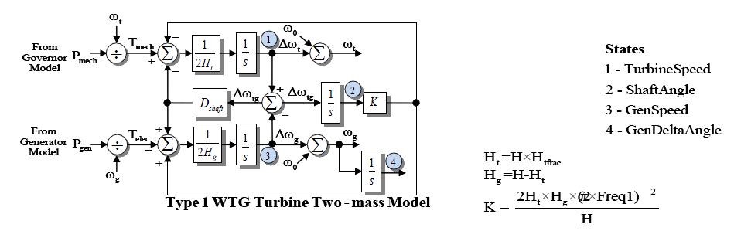
Type 1 and 2 Two Mass Model
Both the Type 1 and 2 models allow for a two mass model that represents the oscillations on the shaft between the blades and the induction generator
The two mass model is the default model for Types 1 and 2

Slide 14
Previous Type 2 Example with Two Mass Model
Graphs show mechanical input versus power output (for twenty seconds), and shaft mass speeds (for just the first five seconds)

Slide 15
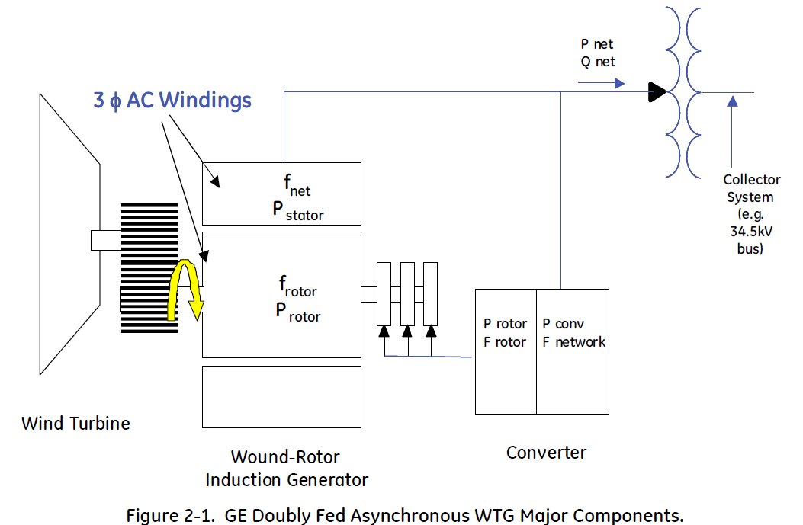
Type 3: Doubly Fed Asynchronous Generators (DFAG)
Doubly fed asynchronous generators (DFAG) are usually a conventional wound rotor induction generator with an ac-dc-ac power converter in the rotor circuit
  Power that would have been lost in external rotor resistance is now used
Electrical dynamics are
dominated by the voltage-
source inverter, which
has dynamics much
faster than the transient
stability time frame
Image Source: Figure 2.1 from Modeling of GE Wind Turbine-Generators for Grid Studies, version 4.6, March 2013, GE Energy

Slide 16
Type 3: Doubly Fed Asynchronous Generators (DFAG)
Doubly fed asynchronous generators (DFAG) are usually a conventional wound rotor induction generator with an ac-dc-ac power converter in the rotor circuit
  Power that would have been lost in external rotor resistance is now used
Electrical dynamics are
dominated by the voltage-
source inverter, which
has dynamics much
faster than the transient
stability time frame
Image Source: Figure 2.1 from Modeling of GE Wind Turbine-Generators for Grid Studies, version 4.6, March 2013, GE Energy

Slide 17
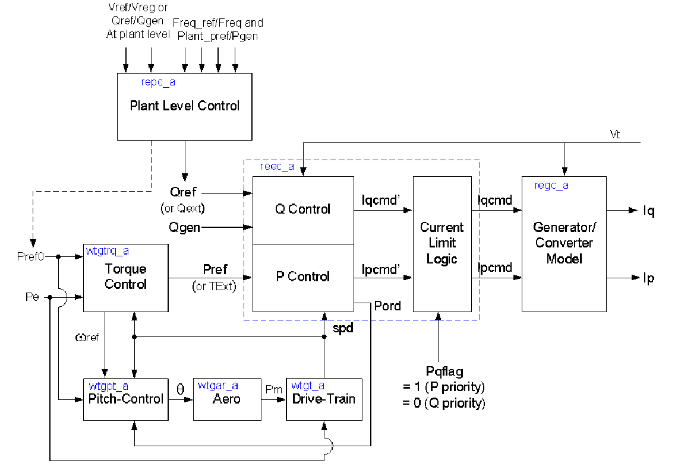
Overall Type 3 WTG Model
Transient stability
models are transitioning
Image Source: WECC Type 3 Wind Turbine Generator Model –Phase II, January 23, 2014, WECC TSS

Slide 18
Type 3 Converters
A voltage source converter (VSC) takes a dc voltage, usually held constant by a capacitor, and produces a controlled ac output
A phase locked loop (PLL) is used to synchronize the phase of the wind turbine with that of the ac connection voltage
  Operates much faster than the transient stability time step, so is often assumed to be in constant synchronism
Under normal conditions the WTG has a controllable real power current and reactive power current
WTG voltages are not particularly high, say 600V

Slide 19
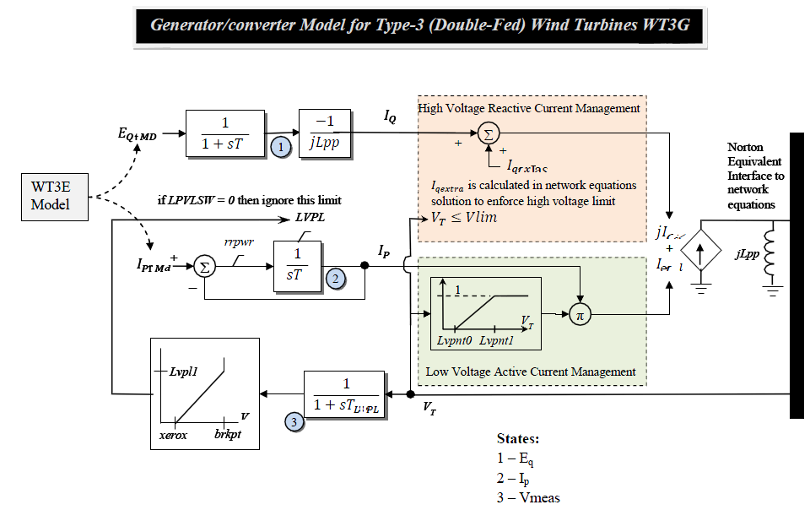
Type 3 WT3G Converter Model
Network interface
is a Norton current
in parallel with
a reactance jX"

Slide 20
Type 3 Converters
Type 3 machines can operate at a potentially widely varying slip
  Example, rated speed might be 120% (72 Hz for a 60 Hz system) with a slip of -0.2, but with a control range of +/- 30%
Control systems are used to limit the real power during faults (low voltage)
  Current ramp rate limits are used to prevent system stress during current recovery
Reactive current limits are used during high voltage conditions

Slide 21
Type 3 Voltage Control
Type 3 WTGs have the ability to regulate their reactive power output
They can be operated either as
  Constant power factor (so reactive power varies with real power)
  Constant reactive power
  Constant voltage control, which is more involved than with a single conventional synchronous generator since the reactive power response of many individual WTGs needs to be coordinated across the wind farm (plant)

Slide 22
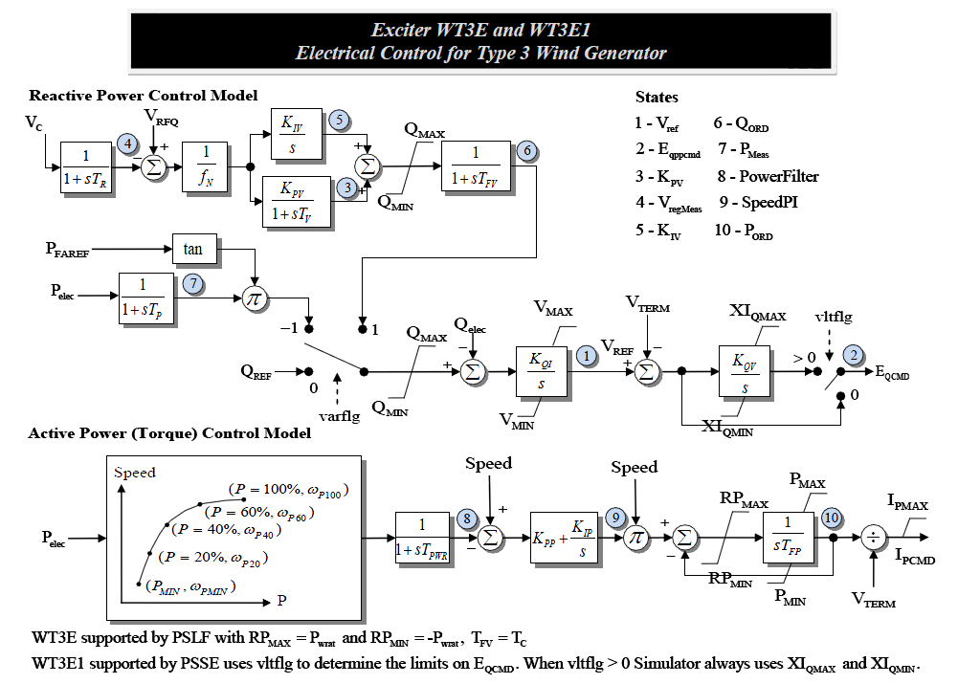
Type 3 Reactive Power Control

Slide 23
Aerodynamics
Type 3 and 4 models have more detailed models that directly incorporate the blade angle, so a brief coverage of the associated aerodynamics is useful
The power in the wind is given by
Modeling of GE Wind Turbine-Generators for Grid Studies, version 4.6, March 2013, GE Energy

Slide 24
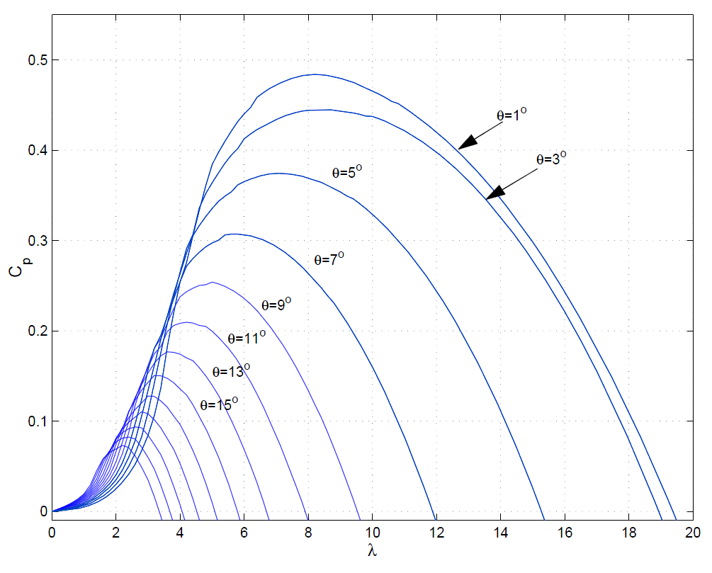
Aerodynamics
The C_{p}(θ,λ) function can be quite complex, with the GE 1.5 curves given below
If such a detailed curve is used, the initialization is from the power flow P. There are potentially three independent
variables, v_{w}, θ and ω. One approach is to fix ω at rated (e.g., 1.2) and θ at θ_{min}
Source: Modeling of GE Wind Turbine-Generators for Grid Studies, version 4.6, March 2013, GE Energy

Slide 25
Simplified Aerodynamics Model
A more simplified model is to approximate this curve as

Slide 26
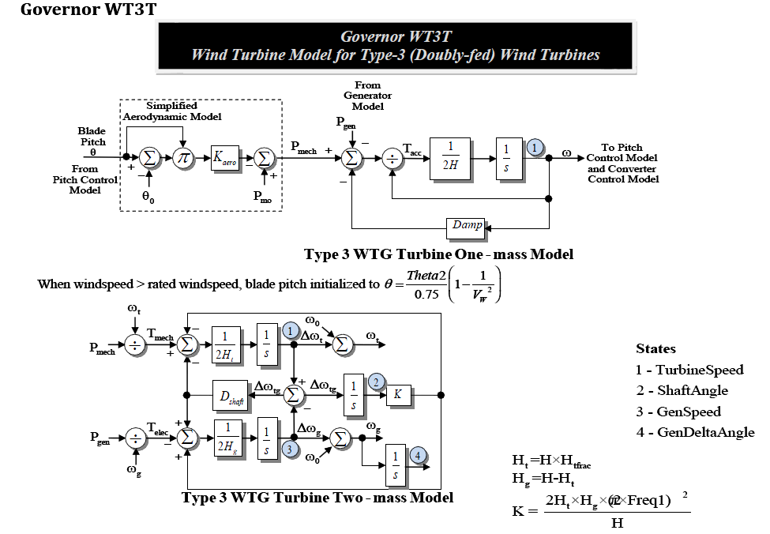
WT3T Model (Drive Train and Aero)

Slide 27
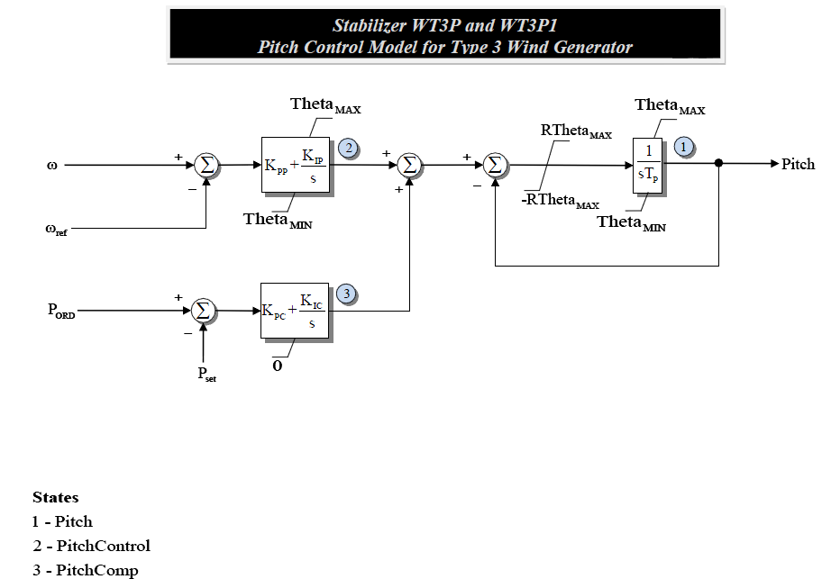
WT3P Model (Pitch Control)

Slide 28
Type 3 Example Case
Previous WSCC case, with the same line 6 to 9 fault, is modified so gen 3 is represented by a WT3G, WT3E, WT3T, and WT3P
Graph at left shows a
zoomed (2 second)
view of the gen 3
real power output,
with the value falling to
zero during the fault,
and then ramping
back up

Slide 29
Type 3 Example Case
Below graphs show the response of the WTG speed and blade angle

Slide 30
Type 4 Converters
Type 4 WTGs pass the entire output of the WTG through the ac-dc-ac converter
Hence the system characteristics are essentially independent of the type of generator
  Because of this decoupling, the generator speed can be as variable as needed
  This allows for different generator technologies, such as permanent magnet synchronous generators (PMSGs)
  Traditionally gearboxes have been used to change the slow wind turbine speed (e.g., 15 rpm) to a more standard generator speed (e.g., 1800 rpm); with Type 4 direct drive technologies can also be used

Slide 31
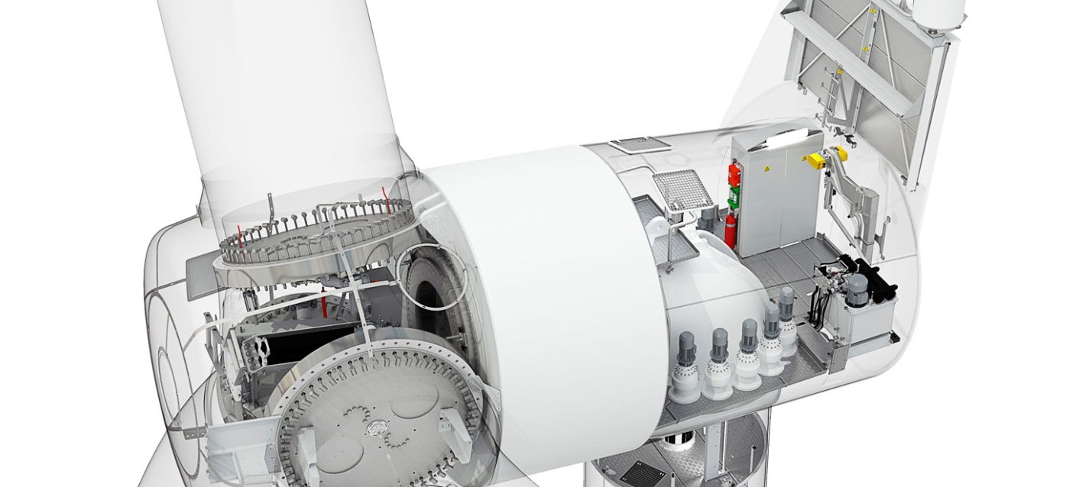
Example: Siemens SWT-2.3-113
The Siemens-2.3-113 is a 2.3 MW WTG that has a rotor diameter of 113m. It is a gearless design based on a compact permanent magnet generator
  No excitation power, slip rings or excitation control system
Image: www.siemens.com/press/pool/de/pressebilder/2011/renewable_energy/300dpi/soere201103-02_300dpi.jpg

Slide 32
Brief Energy Economics
With renewable sources like wind and solar in which the fuel is essentially free, capital costs dominate
As a minimum, the energy generated over the life of the device must be greater than its capital costs
  Simple analysis assumes zero interest and inflation

Slide 33
Brief Energy Economics
As an example, assume a wind farm project with a capacity factor of 40% and a lifetime of 25 years
  Capital costs are covered if the price is at least $11.4/MWh per $1,000,000 per MW (or $/watt)
Other wind costs include land rental (about $5000 per year per MW), taxes (about 400K per MW valuation in Illinois, which would be about $10,000 per year, give or take depending on the local tax rate), operations and maintenance (ballpark is $30,000 per year per MW)
  Total over 25 years is roughly $1,125,000 per MW

Slide 34
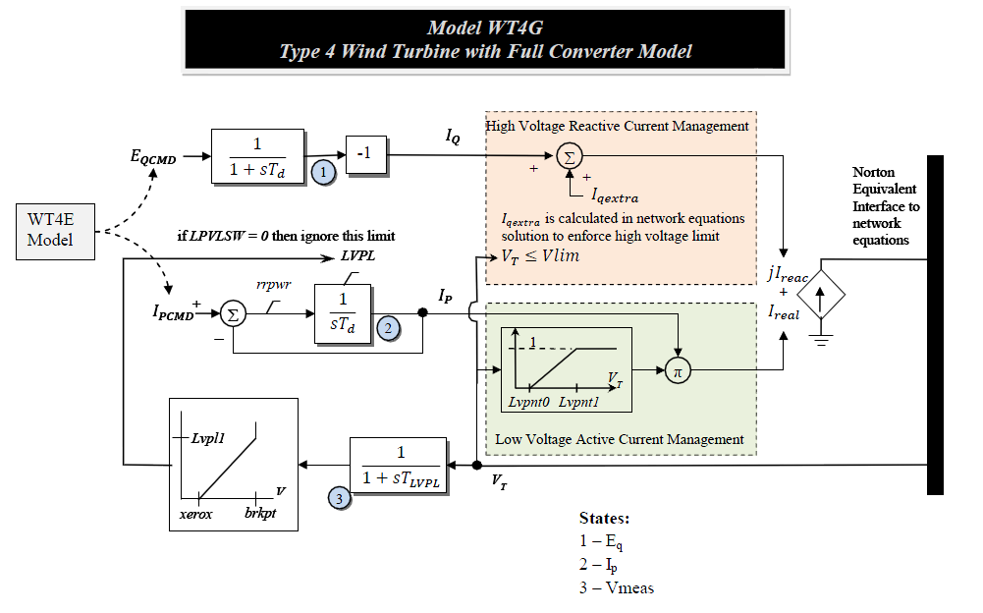
Type WTG4 Model
Very similar to the WTG3, except there is no X"

Slide 35
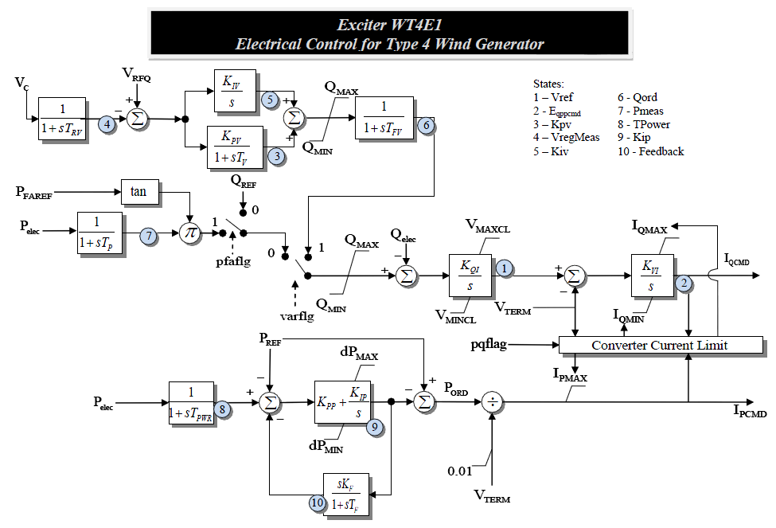
Type 4 Reactive Power Control
Also similar to the Type 3's, as are the other models

Slide 36
Solar Photovoltaic (PV)
Photovoltaic definition- a material or device that is capable of converting the energy contained in photons of light into an electrical voltage and current
Solar cells are diodes, creating dc power, which in grid applications is converted to ac by an inverter
For terrestrial applications, the capacity factor is limited by night, relative movement of the sun, the atmosphere, clouds, shading, etc
  A ballpark figure for Illinois is 18%
  "One sun" is defined a 1 kw/m²,which is the maximum insolation the reaches the surface of the earth (sun right overhead)

Slide 37
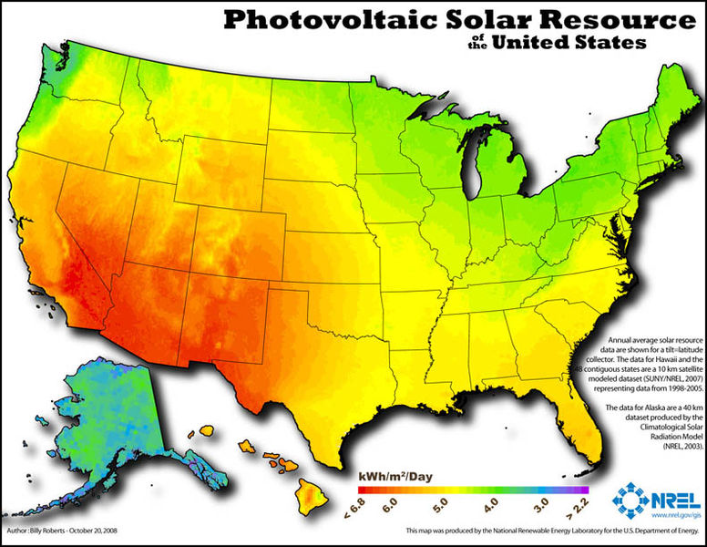
US Annual Insolation

Slide 38
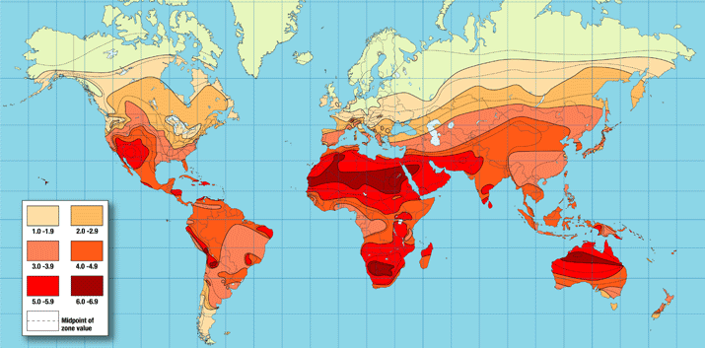
Worldwide Annual Insolation
In 2013 worldwide PV capacity was about 136 GW; by country (in GW)
the leaders are Germany (35.5), China (18.3), Italy (17.6), Japan (13.6),
US (12), Spain (5.6), France (4.6)
http://www.ren21.net/Portals/97/documents/GSR/GSR2012_low%20res_FINAL.pdf

Slide 39
US Electricity Sources, 2013
For 2013 the US percentage of electric energy by fuel source is
  Coal: 39.1%
  Natural Gas: 27.4%
  Nuclear: 19.4%
  Hydro: 6.63%
  Wind: 4.13%
  Wood: 0.98%
  Petroleum: 0.66%
  Geothermal: 0.40%
  Solar PV: 0.20%
  Solar Thermal: 0.02%
Other is about 1%.
Solar PV is still quite
small, but with a very
high growth rate > 100%!
Therefore its impact
needs to be considered
moving forward; about half
of the US total is in
California, which also has
some of the highest retail
electricity prices.
Data source: EIA Electric Power Monthly, Feb 2014

Slide 40
Modeling Solar PV
Since a large portion of the solar PV is distributed in small installations in the distribution system (e.g., residential rooftop), solar PV modeling is divided into two categories
  Central station, which is considered a single generation plant
  As part of the load model
The central station block diagram is

Slide 41
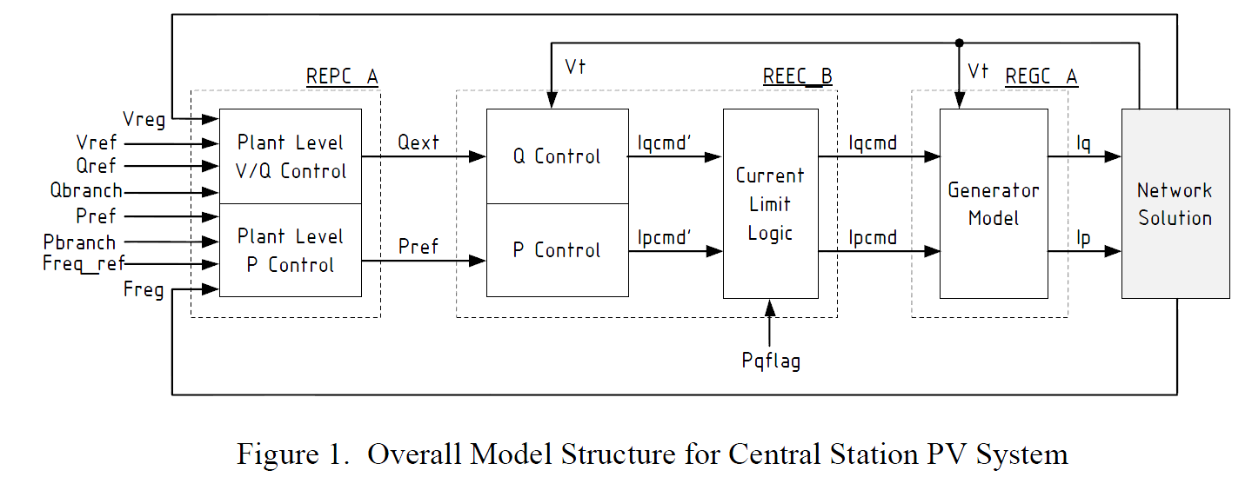
Central Station PV System Modeling
The below block diagram shows the overall structure
Solar PV has no inertia, and in contrast to wind there
is not even the ability to mimic an inertia response since
there is no energy storage in the system
Source: "Generic Solar Photovoltaic System Dynamic Simulation Model Specification," WECC Renewable Energy Modeling Task Force, Sept. 2012 (same source for figures on the next three slides)

Slide 42
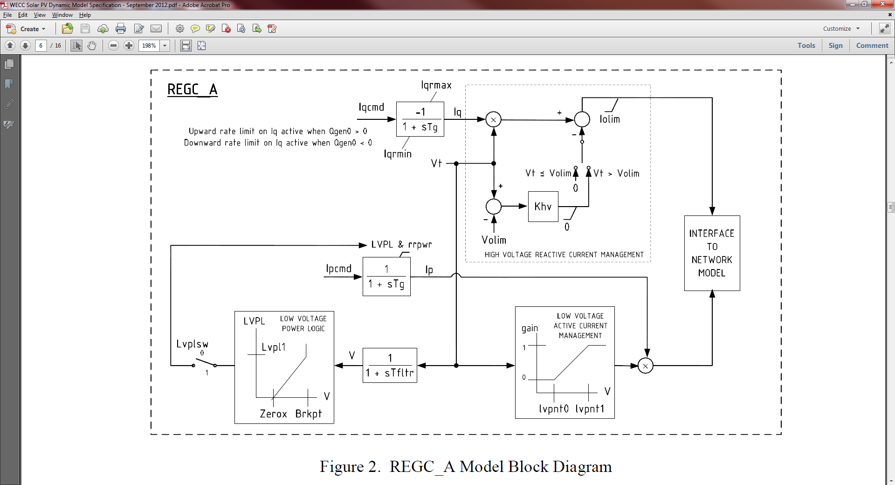
Central Station PV System Modeling
The generator model is similar to the Type 4 wind model, which is not surprising since this is modeling the converter operation
Source: "Generic Solar Photovoltaic System Dynamic Simulation Model Specification," WECC Renewable Energy Modeling Task Force, Sept. 2012

Slide 43
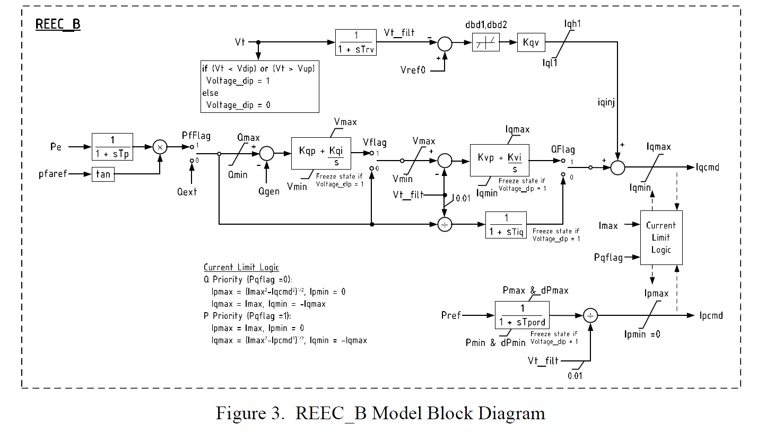
Central Station PV System Modeling
Reactive current control is also similar

Slide 44
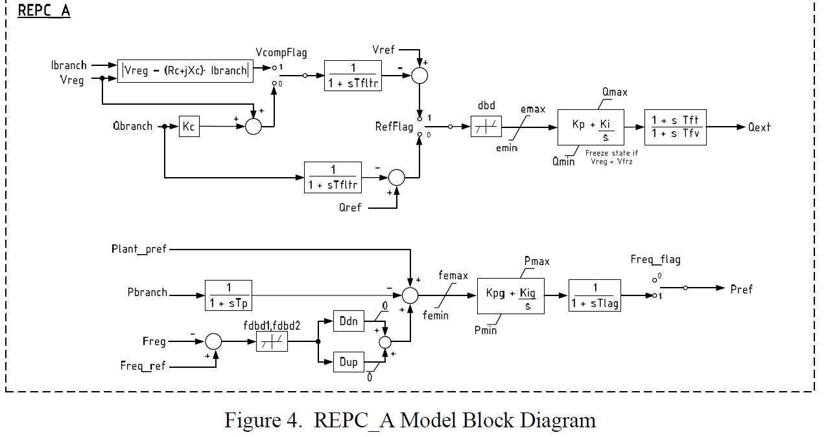
Central Station PV System Modeling
Usually regulation will be down only (i.e., responding only for over frequency) since it would be at max P

