Slide 1
ECE 576 – Power System Dynamics and Stability
Lecture 26: Modal Analysis, Power System Stabilizers (PSSs)
Prof. Tom Overbye
University of Illinois at Urbana-Champaign
overbye@illinois.edu
Special Guest Lecture by
TA Soobae Kim

Slide 2
Announcements
Read Chapters 8 and 9
Homework 8 should be completed before final but need not be turned in
Final is Wednesday May 14 at 7 to 10pm
Key papers for book's approach on stabilizers are
  F.P. DeMello and C. Concordia, "Concepts of Synchronous Machine Stability as Affected by Excitation Control, IEEE Trans. Power Apparatus and Systems, vol. PAS-88, April 1969, pp. 316-329
  W.G. Heffron and R.A. Philips, "Effects of Modern Amplidyne Voltage Regulator in Underexcited Operation of Large Turbine Generators," AIEE, PAS-71, August 1952, pp. 692-697

Slide 3
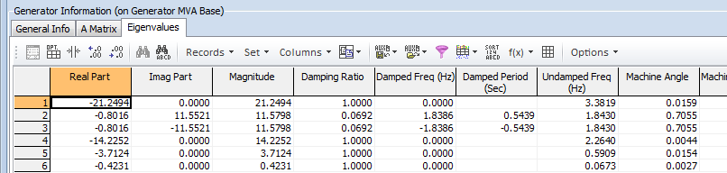
Example: Bus 4 with
GENROU Model
The eigenvalues can be calculated for any set of generator models
This example replaces the bus 4 generator classical machine with a GENROU model
  There are now six eigenvalues, with the dominate response coming from the electro-mechanical mode with a frequency of 1.83 Hz, and damping of 6.92%

Slide 4
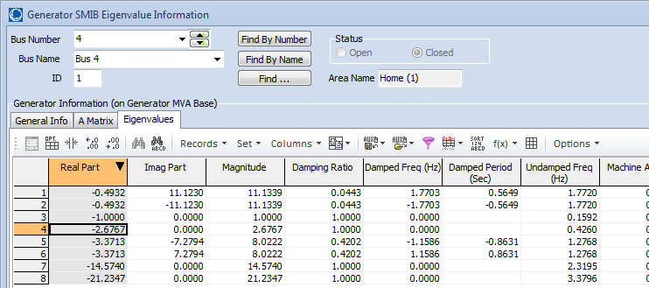
Example: Bus 4 with
GENROU Model and Exciter
Adding an relatively slow EXST1 exciter adds additional states (with K_{A}=200, T_{A}=0.2)
  As the initial reactive power output of the generator is decreased, the system becomes unstable
Case is saved as B4_GENROU_Sat_SMIB

Slide 5
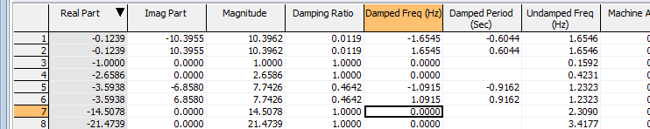
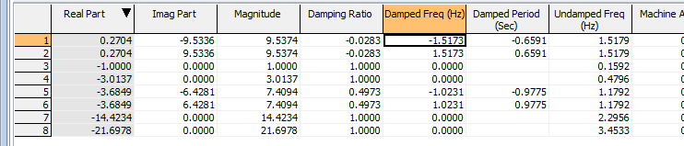
Example: Bus 4 with
GENROU Model and Exciter
With Q₄ = 25 Mvar the eigenvalues are
And with Q₄=0 Mvar the eigenvalues are

Slide 6
Example: Bus 4 with
GENROU Model and Exciter
Graph shows response following a short fault when Q4 is 0 Mvar
This motivates trying to get additional insight into how to increase system damping, which is the goal of modal analysis

Slide 7
Modal Analysis - Comments
Modal analysis or analysis of small signal stability through eigenvalue analysis is at the core of SSA software
In Modal Analysis one looks at:
  Eigenvalues
  Eigenvectors (left or right)
  Participation factors
  Mode shape
Power System Stabilizer (PSS) design in a multi-machine context is done using modal analysis method.
Goal is to
determine
how the various
parameters
affect the
response of
the system

Slide 8
Eigenvalues, Right Eigenvectors
For an n by n matrix A the eigenvalues of A are the roots of the characteristic equation:
Assume λ₁…λ_{n} as distinct (no repeated eigenvalues).
For each eigenvalue λ_{i} there exists an eigenvector such that:
v_{i} is called a right eigenvector
If λ_{i} is complex, then v_{i} has complex entries

Slide 9
Left Eigenvectors
For each eigenvalue λ_{i} there exists a left eigenvector w_{i} such that:
Equivalently, the left eigenvector is the right eigenvector of A^{T}; that is,

Slide 10
Eigenvector Properties
The right and left eigenvectors are orthogonal i.e.
We can normalize the eigenvectors so that:

Slide 11
Eigenvector Example
Right Eigenvectors

Slide 12
Eigenvector Example
Left eigenvectors
We would like to make
This can be done in many ways.

Slide 13
Eigenvector Example
It can be verified that W^{T}=V⁻¹ .
The left and right eigenvectors are used in computing the participation factor matrix.

Slide 14
Modal Matrices
The deviation away from an equilibrium point can be defined as
From this equation it is difficult to determine how parameters in A affect a particular x because of the variable coupling
To decouple the problem first define the matrices of the right and left eigenvectors (the modal matrices)

Slide 15
Modal Matrices
It follows that
To decouple the variables define z so
Then
Since Λ is diagonal, the equations are now uncoupled with
So

Slide 16
Modal Matrices
Thus the response can be written in terms of the individual eigenvalues and right eigenvectors as
Furthermore with
So z(t) can be written as using the left eigenvectors as
Note, we are
requiring that
the eigenvalues
be distinct!

Slide 17
Modal Matrices
We can then write the response x(t) in terms of the modes of the system
So C_{i} represents magnitude of excitation of the i^{th} mode resulting from the initial conditions.

Slide 18
Numerical example

Slide 19
Numerical example (contd)

Slide 20
Numerical example (contd)
Because of the initial condition, the 2nd mode does not get excited

Slide 21
Mode Shape, Sensitivity and Participation Factors
So we have
x(t) are the original state variables, z(t) are the transformed variables so that each variable is associated with only one mode.
From the first equation the Right Eigenvector gives the “mode shape” i.e. relative activity of state variables when a particular mode is excited.
For example the degree of activity of state variable x_{k} in v_{i} mode is given by the element V_{ki} of the the Right Eigenvector matrix V

Slide 22
Mode Shape, Sensitivity and Participation Factors
The magnitude of elements of v_{i} give the extent of activities of n state variables in the i^{th} mode and angles of elements (if complex) give phase displacements of the state variables with regard to the mode.
The left eigenvector w_{i} identifies which combination of original state variables display only the i^{th} mode.

Slide 23
Eigenvalue Parameter Sensitivity
To derive the sensitivity of the eigenvalues to the parameters recall Av_{i} = λ_{i}v_{i}; take the partial derivative with respect to A_{kj} by using the chain rule

Slide 24
Eigenvalue Parameter Sensitivity
This is simplified by noting that
by the definition of w_{i} being a left eigenvector
Therefore
Since all elements of are zero, except the k^{th} row, j^{th} column is 1
Thus

Slide 25
Sensitivity Example
In the previous example we had
Then the sensitivity of λ₁ and λ₂ to changes in A are
For example with

Slide 26
Participation Factors
The participation factors, P_{ki}, are used to determine how much the k^{th} state variable participates in the i^{th} mode
The sum of the participation factors for any mode or any variable sum to 1
The participation factors are quite useful in relating the eigenvalues to portions of a model
For the previous example P would be

Slide 27
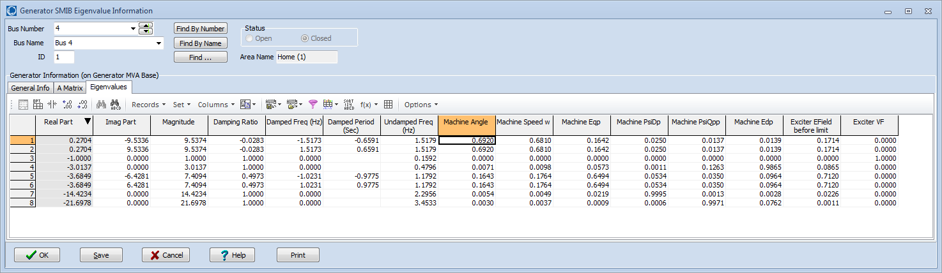
PowerWorld SMIB
Participation Factors
The magnitudes of the participation factors are shown on the PowerWorld SMIB dialog
The below values are shown for the four bus example with Q₄ = 0

