Slide 1
ECE 576 – Power System Dynamics and Stability
Lecture 27: Modal Analysis,
Direct Methods
Prof. Tom Overbye
University of Illinois at Urbana-Champaign
overbye@illinois.edu

Slide 2
Announcements
Read Chapters 8 and 9
Homework 8 should be completed before final but need not be turned in
Final is Wednesday May 14 at 7 to 10pm

Slide 3
Measurement Based Modal Analysis
With the advent of large numbers of PMUs, measurement based SSA is increasing used
  The goal is to determine the damping associated with the dominant oscillatory modes in the system
  Approaches seek to approximate a sampled signal by a series of exponential functions (usually damped sinusoidals)
Several techniques are available with Prony analysis the oldest
  Method, which was developed by Gaspard Riche de Prony, dates to 1795; power system applications from about 1980's
Here we'll consider a newer alternative, based on the variable projection method

Slide 4
Some Useful References
J.F. Hauer, C.J. Demeure, and L.L. Scharf, "Initial results in Prony analysis of power system response signals," IEEE Trans. Power Systems, vol.5, pp 80-89, Feb 1990
D.J. Trudnowski, J.M. Johnson, and J.F. Hauer, "Making Prony analysis more accurate using multiple signals," IEEE Trans. Power Systems, vol.14, pp.226-231, Feb 1999
A. Borden, B.C. Lesieutre, J. Gronquist, "Power System Modal Analysis Tool Developed for Industry Use," Proc. 2013 North American Power Symposium, Manhattan, KS, Sept. 2013

Slide 5
Variable Projection Method (VPM)
Idea of all techniques is to approximate a signal, y_{org}(t), by the sum of other, simpler signals (basis functions)
  Basis functions are usually exponentials, with linear and quadratic functions also added to detrend the signal
  Properties of the original signal can be quantified from basis function properties (such as frequency and damping)
  Signal is considered over an interval with t=0 at the beginning
Approaches work by sampling the original signal y_{org}(t)
Vector y consists of m uniformly sampled points from y_{org}(t) at a sampling value of ΔT, starting with t=0, with values y_{j} for j=1…m
  Times are then t_{j}= (j-1)ΔT

Slide 6
Variable Projection Method (VPM)
At each time point j, where t_{j} = (j-1)ΔT the approximation of y_{j} is

Slide 7
Variable Projection Method (VPM)
Error (residual) value at each point j is
  α is the vector containing the optimization variables
Function being minimized is
r(α) is the residual vector
Method iteratively changes α to
reduce the minimization function

Slide 8
Variable Projection Method (VPM)
A key insight of the variable projection method is that

Slide 9
Pseudoinverse of a Matrix
The pseudoinverse of a matrix generalizes concept of a matrix inverse to an m by n matrix, in which m >= n
  Specifically talking about a Moore-Penrose Matrix Inverse
Notation for the pseudoinverse of A is A⁺
Satisfies AA⁺A = A
If A is a square matrix, then A⁺ = A⁻¹
Quite useful for solving the least squares problem since the least squares solution of Ax = b is x = A⁺ b
Can be calculated using an SVD

Slide 10
VPM Example
Assume we'd like to determine the characteristics of the below SMIB angle response
For simplicity we'll just consider this signal from 1 to 2 seconds, and work with m=6 samples (ΔT=0.2, from 1 to 2 seconds); hence we'll set our t=0 as 1.0 seconds

Slide 11
VPM Example
Assume we know a good approximation of this signal (over the desired range) is
  How we got this will become apparent
Hence the zero error values would be
With ΔT=0.2, m=6 then

Slide 12
VPM Example
To verify
Giving
Which matches
the known
values!

Slide 13
VPM, cont.
This is an iterative process, requiring an initial guess of α, and then a method to update a until the residual vector, r, is minimized
  Solved with a gradient method, with the details on finding the gradient direction given in the Borden, Lesieutre, Gronquist 2013 NAPS paper
  Iterative until a minimum is reached
Like any iterative method, its convergence depends on the initial guess, in this case of α

Slide 14
VPM: Initial Guess of α
The initial guesses for α are calculated using a Matrix Pencil method
First, with m samples, let L=m/2
Then form a Hankel matrix, Y such that
And calculate its singular values with an economy SVD

Slide 15
VPM: Initial Guess of α
The ratio of each singular value is then compared to the largest singular value σ_{c}; retain the ones with a ratio > than a threshold (e.g., 0.16)
  This determines the modal order, M
  Assuming V is ordered by singular values (highest to lowest), let V_{p} be then matrix with the first M columns of V
Then form the matrices V₁ and V₂ such that
  V₁ is the matrix consisting of all but the last row of V_{p}
  V₂ is the matrix consisting of all but the first row of V_{p}
  NAPS paper equation is incorrect on this
Discrete-time poles are found as the generalized eigenvalues of the pair {V₂^{T}V₁, V₁^{T}V₁}

Slide 16
Generalized Eigenvalues
Generalized eigenvalue problem for a matrix pair (A,B) consists of determining values α_{k}, β_{k} and x_{k} such that
The generalized eigenvalues are then α_{k}/β_{k}
If B is nonsingular than these are the eigenvalues of
B⁻¹A
  That is the situation here
These eigenvalues are the discrete-time poles, z_{i} ,with the modal eigenvalues then
Recall the log of a complex
number z=r∠θ is ln(r) + jθ

Slide 17
Returning to Example
With m=6, L=3, and
In this example we retain all three singular values

Slide 18
Example
Which gives
And generalized eigenvalues of 1.0013, -0.741±j0.6854
Then with ΔT=0.2

Slide 19
Example
This initial guess of α is very close to the final solution
The iteration works by calculating the Jacobian, J(α) (with details in the paper), and the gradient
A gradient search optimization (such as Golden Section) is used to determine the distance to move in the negative gradient direction
For the example

Slide 20
Comments
These techniques only match the signals at the sampled time points
The sampling frequency must be at least twice the highest frequency of interest
  A higher sampling rate is generally better, but there is a computational limitation associated with the size of the Hankel matrix
  Aliasing is a concern since we are dealing with a time limited signal
Detrending can be used to remove a polynomial offset
Method can be extended to multiple signals

Slide 21
VPM: Example 2
Do VPM on speed for generator 2 from previous three bus small signal analysis case
  Calculated modes were at 1.51 and 2.02 Hz
Input data
here is the
red curve

Slide 22
VPM: Example 2
Below results were obtained from sampling the input data every 0.1 seconds (10 Hz)
Calculated frequencies
were 2.03 and
1.51 Hz with a dc offset;
the 2.03 frequency has
a value of almost
4 times that of the
1.51 Hz

Slide 23
VPM: Example 2
Results are quite poor if sampling is reduced to 1.5 Hz

Slide 24
Moving Forward with VPM
Not all signals exhibit such straightforward oscillations, since there can be other slower dynamics superimposed
How can this method be extended to handle these situations?

Slide 25
Moving Forward with VPM
Here are the results
This is made
up of five
signals with
frequencies
from 0.123
to 1.1 Hz, with
the highest
magnitude
at 0.634 Hz

Slide 26
Stability Phenomena and Tools
Large Disturbance Stability (Non-linear Model)
Small Disturbance Stability (Linear Model)
Structural Stability (Non-linear Model) Loss of stability due to parameter variations.
Tools
  Simulation
  Repetitive time-domain simulations are required to find critical parameter values, such as clearing time of circuit breakers.
  Direct methods using Lyapunov-based theory (Also called Transient Energy Function (TEF) methods)
    Can be useful for screening
  Sensitivity based methods.

Slide 27
Transient Energy Function (TEF) Techniques
No repeated simulations are involved.
Limited somewhat by modeling complexity.
Energy of the system used as Lyapunov function.
Computing energy at the “controlling” unstable equilibrium point (CUEP) (critical energy).
CUEP defines the mode of instability for a particular fault.
Computing critical energy is not easy.

Slide 28
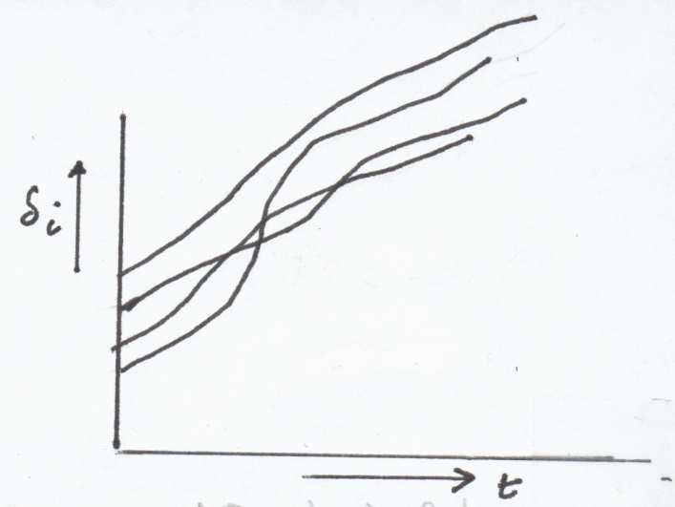
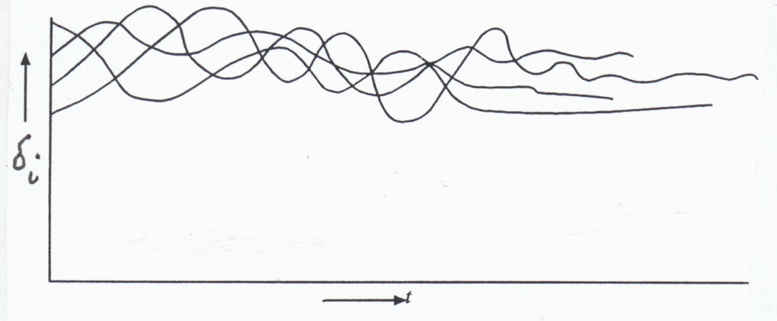
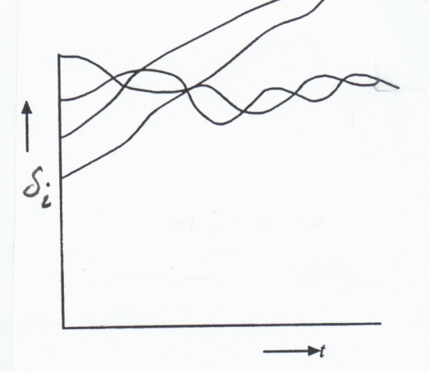
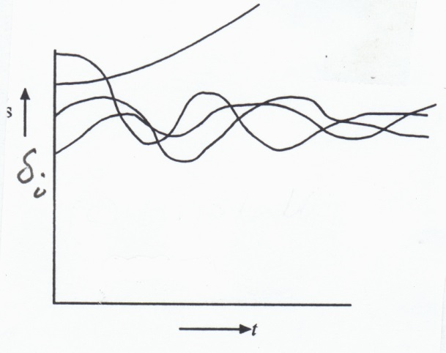
Judging Stability / Instability
Monitor Rotor Angles
(a) Stable
(b) Stable
(c) Unstable
(d) Unstable
Stability is judged by Relative Rotor Angles.

Slide 29
Mathematical Formulation
A power system undergoing a disturbance (fault, etc), followed by clearing of the fault, has the following model
  (1) Prior to fault (Pre-fault)
  (2) During fault (Fault-on or faulted)
  (3) After the fault (Post-fault)
T_{cl} is the clearing time
X
X
Post-Fault
(line-cleared)
Faulted

Slide 30
Critical Clearing Time
Assume the post-fault system has a stable equilibrium point x_{s}
All possible values of x(t_{cl}) for different clearing times provide the initial conditions for the post-fault system
  Question is then will the trajectory of the post fault system, starting at x(t_{cl}), converge to x_{s} as t → ∞
Largest value of t_{cl} for which this is true is called the critical clearing time, t_{cr}
The value of t_{cr} is different for different faults

Slide 31
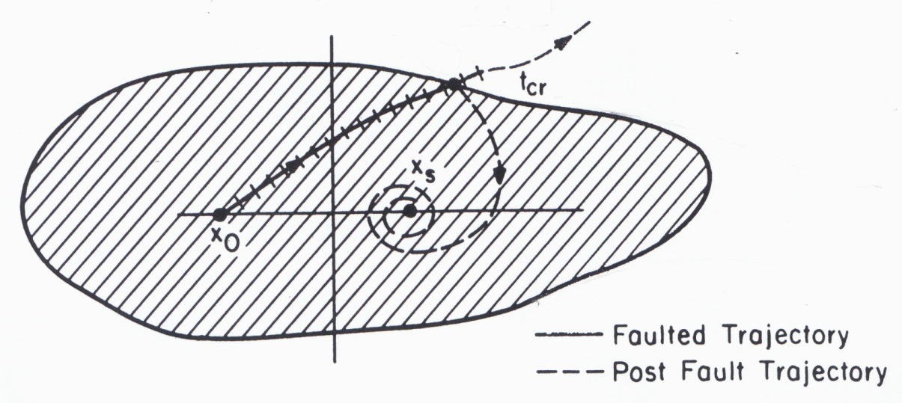
Region of Attraction (ROA)
All faulted trajectories cleared before they reach the
boundary of the ROA will tend to x_{s} as t→∞ (stable)
The region need not be closed; it can be open:
.
.

Slide 32
Methods to Compute RoA
Had been a topic of intense research in power system literature since early 1960’s.
The stable equilibrium point (SEP) of the post-fault system, x_{s}, is generally close to the pre-fault EP, x₀
Surrounding x_{s} there are a number of unstable equilibrium points (UEPs).
The boundary of ROA is characterized via these UEPs

Slide 33
Characterization of RoA
Define a scalar energy function V(x) = sum of the kinetic and potential energy of the post-fault system.
Compute V(x_{u,i}) at each UEP, i=1,2,…
Defined V_{cr} as
  RoA is defined by V(x) < V_{cr}
  But this can be an extremely conservative result.
Alternative method: Depending on the fault, identify the critical UEP, x_{u,cr}, towards which the faulted trajectory is headed; then V(x) < V(x_{u,cr}) is a good estimate of the ROA.

Slide 34
Lyapunov’s Method
Defining the function V(x) is a key challenge
Consider the system defined by
Lyapunov's method: If there exists a scalar function V(x) such that

Slide 35
Ball in Well Analogy
The classic Lyapunov example is the stability of a ball in a well (valley) in which the Lyapunov function is the ball's total energy (kinetic and potential)
For power systems, defining a true Lyapunov function often requires using restrictive models
UEP
UEP
SEP

Slide 36
Power System Example
Consider the classical generator model using an internal node representation (load buses have been equivalenced)
C_{ij} are the susceptance
terms, D_{ij} the conductance
terms

Slide 37
Constructing the Transient
Energy Function (TEF)
Relative rotor angle formulation.
COI reference frame.
It is preferable since we measure angles with respect to the “mean motion” of the system.
TEF for conservative system
With center of speed as
where
We then transform the variables to the
COI variables as
It is easy to verify

Slide 38
TEF
The swing equations with D_{i} = 0 become (omitting the algebra):
If one of the machines is an infinite bus, say, m whose inertia constant M_{m} is very large, then all variables can be referenced with respect to m, whose speed stays constant
In the literature m is simply taken as zero.
Equation is modified accordingly, and there will be only (m-1) equations after omitting the equation for machine m.

Slide 39
TEF
We consider the general case in which all M_{i}'s are finite. We have two sets of differential equations:
Let the post fault system has a SEP at
This SEP is found by solving

Slide 40
TEF
Steps for computing the critical clearing time are:
  Construct a Lyapunov (energy) function for the post-fault system.
  Find the critical value of the Lyapunov function (critical energy) for a given fault
  Integrate the faulted equations until the energy is equal to the critical energy; this instant of time is called the critical clearing time
Idea is once the fault is cleared the energy can only decrease, hence the critical clearing time is determined directly
Methods differ as to how to implement steps 2 and 3.

Slide 41
TEF
Integrating the equations between the post-fault SEP and the current state gives
C_{ij} are the susceptance
terms, D_{ij} the conductance
terms

Slide 42
TEF
contains path dependent terms.
Cannot claim that is p.d.
If conductance terms are ignored then it can be shown to be a Lyapunov function
Methods to compute the UEPS are
  Potential Energy Boundary Surface (PEBS) method.
  Boundary Controlling Unstable (BCU) equilibrium point method.
  Other methods (Hybrid, Second-kick etc)
(a) and (b) are the most important ones.

Slide 43
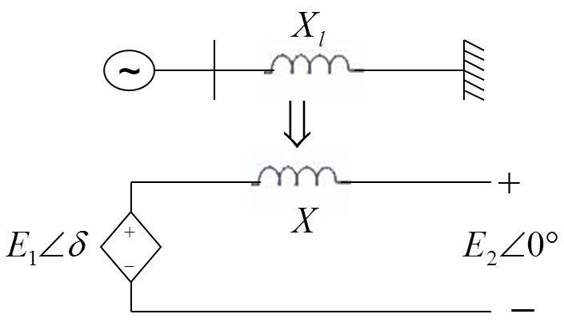
Equal Area Criterion and TEF
For an SMIB system with classical generators this reduces to the equal area criteria
  TEF is for the post-fault system
  Change notation from T_{m} to P_{m}

Slide 44
TEF for SMIB System
The right hand side of (1) can be written as ,where
Multiplying (1) by , re-write
since
i.e
i.e
Hence, the energy function is

Slide 45
TEF for SMIB System (contd)
The equilibrium point is given by
This is the stable e.p.
Verify by linearizing.
Eigenvalues on jω axis. (Marginally Stable)
With slight damping eigenvalues are in L.H.P.
TEF is still constructed for undamped system.

Slide 46
TEF for SMIB System
The energy function is
There are two UEP: δ^{u1} = π-δ^{s} and δ^{u2} = -π-δ^{s}
A change in coordinates sets V_{PE}=0 for δ=δ^{s}
With this, the energy function is
The kinetic energy term is

Slide 47
Energy Function
V(δ,ω) is equal to a constant E, which is the sum of the kinetic and potential energies.
It remains constant once the fault is cleared since the system is conservative (with no damping)
V(δ,ω) evaluated at t=t_{cl} from the fault trajectory represents the total energy E present in the system at t=t_{cl}
This energy must be absorbed by the system once the fault is cleared if the system is to be stable.
The kinetic energy is always positive, and is the difference between E and V_{PE}(δ, δ^{s})

Slide 48
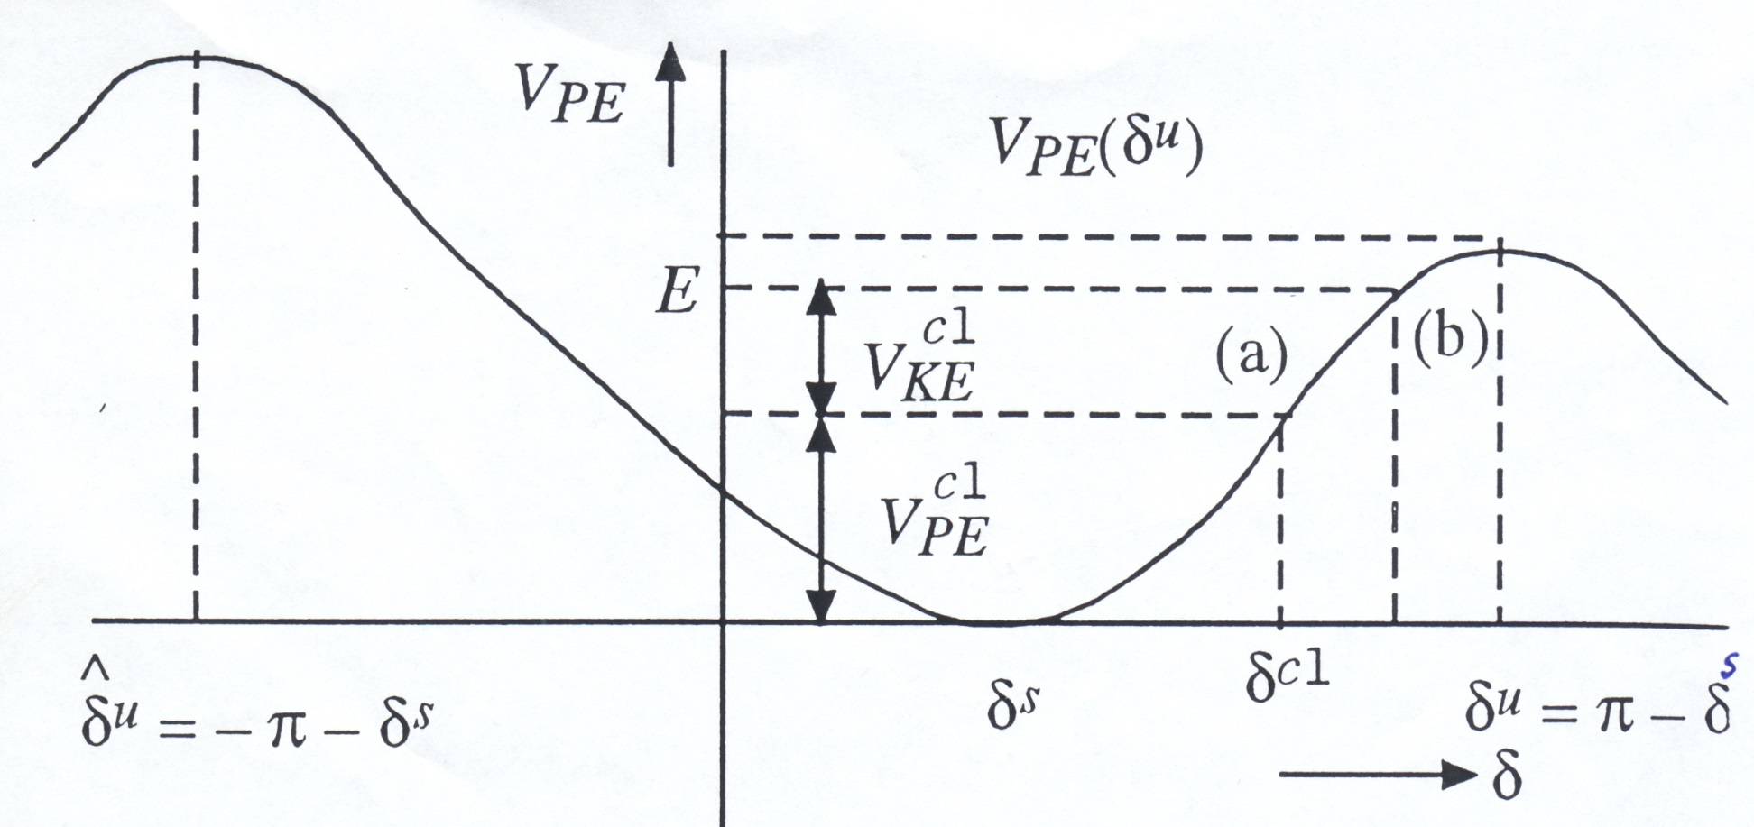
Potential Energy “well”
Potential energy “well” or P.E. curve
How is E computed?

Slide 49
Computation of E
E is the value of total energy when fault is cleared.
At δ=δ^{s} is the post-fault SEP, both V_{KE} and V_{PE} are is zero, since ω=0 and δ=δ^{s}
Suppose, at the end of the faulted period t=t_{cl} the rotor angle is δ^{cl} and the velocity is ω^{cl}
Then
This is the value of E.

Slide 50
UEPs
There are two other equilibrium points of
In general these
are the solutions
that satisfy the
network power
balance equations
(i.e. "low voltage"
power flow solutions)

Slide 51
Energy Functions for a
Large System
Need an energy function that at least approximates the actual system dynamics
  This can be quite challenging!
In general there are many UEPs; need to determine the UEPs for closely associated with the faulted system trajectory (known as the controlling UEP)
Energy of the controlling UEP can then be used to determine the critical clearly time (i.e., when the fault-on energy is equal to that of the controlling UEP)
For on-line transient stability, technique can be used for fast screening

