Slide 1
ECE 576 – Power System Dynamics and Stability
Lecture 28: Power System Stabilizer
Prof. Tom Overbye
University of Illinois at Urbana-Champaign
overbye@illinois.edu

Slide 2
Announcements
Read Chapters 8 and 9
Homework 8 should be completed before final but need not be turned in
Final is Wednesday May 14 at 7 to 10pm
Key papers for book's approach on stabilizers are
F.P. DeMello and C. Concordia, "Concepts of Synchronous Machine Stability as Affected by Excitation Control, IEEE Trans. Power Apparatus and Systems, vol. PAS-88, April 1969, pp. 316-329
W.G. Heffron and R.A. Philips, "Effects of Modern Amplidyne Voltage Regulator in Underexcited Operation of Large Turbine Generators," AIEE, PAS-71, August 1952, pp. 692-697

Slide 3
Functions of a PSS
PSS adds a signal to the excitation system proportional to speed deviation. This adds positive damping
Other inputs, like power, voltage or acceleration, can be used
Signal is generated locally from the shaft.
Both local mode and inter-area mode can be damped. When oscillation is observed on a system or a planning study reveals poorly damped oscillations, use of participation factors helps in identifying the machine(s) where PSS has to be located.
Tuning of PSS regularly is important.
Modal Analysis technique forms the basis for multi-machine systems.

Slide 4
Example PSS
An example single input stabilizer is shown below (IEEEST)
The input is usually the generator shaft speed deviation, but it could also be the bus frequency deviation, generator electric power or voltage magnitude
V_{ST} is an input into the exciter

Slide 5
Example PSS
Below is an example of a dual input PSS (PSS2A)
Combining shaft speed deviation with generator electric power is common
Both inputs have washout filters to remove low frequency components of the input signals
IEEE Std 421.5 describes the common stabilizers

Slide 6
PSS Tuning: Basic Approach
The PSS parameters need to be selected to achieve the desired damping through a process known as tuning
The next several slides present a basic method using a single machine, infinite bus (SMIB) representation
Start with the linearized differential, algebraic model with controls u added to the states
If D is invertible then

Slide 7
SMIB System (Flux Decay Model)
Process is introduced using an SMIB with a flux decay machine model and a fast exciter
~

Slide 8
Stator Equations
Assume Rs=0, then the stator algebraic equations are:

Slide 9
Network Equations
The network equation is (assuming zero angle at the infinite bus and no local load)
Simplifying,
~

Slide 10
Complete SMIB Model
Machine equations
Stator equations
Network equations
~

Slide 11
Linearization of SMIB Model
Notice this is equivalent to a generator at the infinite bus with modified resistance and reactance values

Slide 12
Linearization (contd)
Final Steps involve
Linearizing Machine Equations
Substitute (1) in the linearized equations of (2).

Slide 13
Linearization of Machine Equations
Symbolically we have
Substitute (3) in (2) to get linearized model.

Slide 14
Linearized SMIB Model
Excitation system is yet to be included.
K1 – K4 constants are defined on next slide

Slide 15
K1 – K4 Constants
K1 – K4 only involve machine and not the exciter.

Slide 16
Including Terminal Voltage
The change in the terminal voltage magnitude also needs to be include since it is an input into the exciter

Slide 17
Computing
While linearizing the stator algebraic equations, we had
Substitute this in expression for ΔV_{t} to get

Slide 18
Heffron–Phillips Model
Add a fast exciter with a single differential equation
Linearize
This is then combined with the previous three differential equations to give
SMIB Model

Slide 19
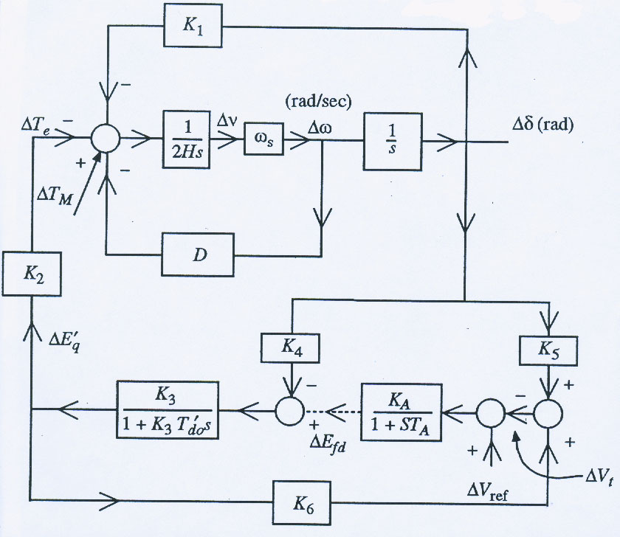
Block Diagram
K1 – K6 are affected by system loading and X_{e}

Slide 20
Numerical Example
Consider an SMIB system with Z_{eq} = j0.5, V_{inf} = 1.05, in which in the power flow the generator has S = 54.34 – j2.85 MVA with a V_{t} of 1∠15°
Machine is modeled with a flux decay model with (pu, 100 MVA) H=3.2, T'_{do}=9.6, X_{d}=2.5, X_{q}=2.1, X'_{d}=0.39, R_{s}=0, D=0
Saved as case B2_PSS_Flux (but only available in v18)

Slide 21
Initial Conditions
The initial conditions are

Slide 22
Add an EXST1 Exciter Model
Set the parameters to K_{A} = 400, T_{A}=0.2, all others zero with no limits and no compensation
Hence this simplified exciter is represented by a single differential equation
V_{s} is the input from the stabilizer, with an initial value of zero

Slide 23
Initial Conditions (contd)
From the stator algebraic equation,

Slide 24
Computation of K1 – K6 Constants
The formulas are used.

Slide 25
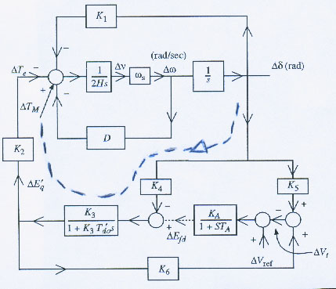
Effect of Field Flux on System Stability
With constant field voltage, i.e. ΔE_{fd}=0, from the block diagram
K₂, K₃, and K₄ are usually positive.
On diagram Δv is used to indicate what we've been calling Δω_{pu}

Slide 26
Effect of Field Flux on System Stability
For low frequencies and in steady-state, as s=jω goes to zero, then
Hence field flux variation due to Δδ feedback (armature reaction) introduces negative synchronizing torque

Slide 27
Effect of Field Flux on System Stability
At higher frequencies the denominator is dominated by the K₃T'_{do}s term so
This is a phase with Δω(jΔδ)
Hence E_{fd} results in a positive damping component.

Slide 28
Effect of Field Flux on System Stability
In general, positive damping torque and negative synchronizing torque due to E_{fd} at typical oscillation frequencies (1-3 Hz).

Slide 29
Effect of Field Flux
There are situations when K₄ can become negative.
Case1. A hydraulic generator without a damper winding, light load (δ is small) and connected to a line with high R_{e}/X_{e} ratio and a large system.
Case 2. Machine is connected to a large local load, supplied partly by generator and partly by remote large system.
If K₄ < 0 then the damping due to E_{fd} is negative

Slide 30
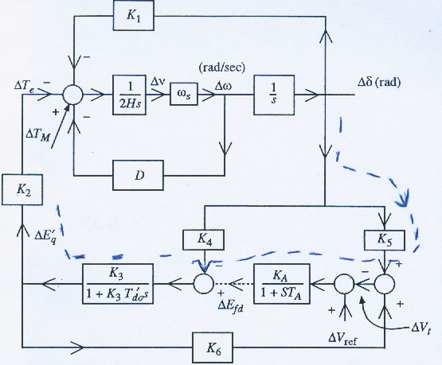
Effect of Excitation System
Ignore dynamics of AVR & K_{A} >> 0
Gain through T'_{do} is -(K₄+K_{A}K₅)K₃
If K₅ < 0 then gain becomes positive.
ΔV_{REF} = 0
Large enough K₅ may make system unstable

Slide 31
Numerical Example (Effect of K₅)
Test system 1 Test System 2
Eigen Values
Test System 1 Test System 2
unstable

Slide 32
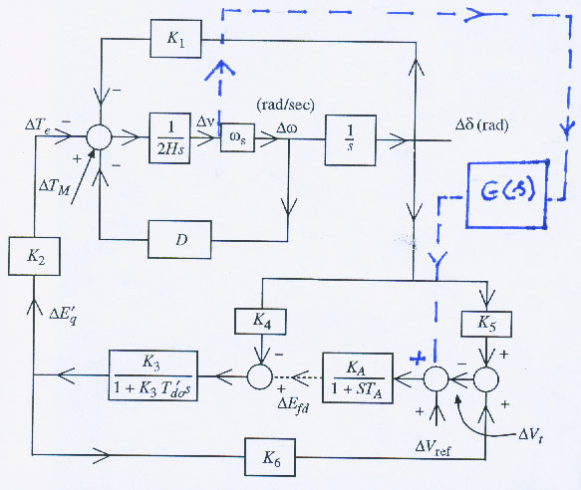
Addition of PSS Loop
The impact of a PSS can now be considered in which the shaft speed signal is fed through the PSS transfer function G(s) to the excitation system.
To analyze effect of PSS signal assume Δδ, ΔV_{REF}=0

Slide 33
PSS Contribution to Torque
(for usual range
of constants)

Slide 34
PSS Contribution to Torque
For high gain K_{A}
If PSS were to provide pure damping (in phase with ω_{pu}), then ideally,
Practically G(s) is a combination of lead and lag blocks.
i.e. pure lead function

Slide 35
PSS Block Diagram
Provide damping over the range of frequencies (0.1-2 Hz)
“Signal wash out” (T_{w}) is a high pass filter
TW is in the range of 5 to 20 seconds
Allows oscillation frequencies to pass unchanged.
Without it, steady state changes in speed would modify terminal voltage.

Slide 36
Criteria for Setting PSS Parameters
K_{PSS} determines damping introduced by PSS.
T₁, T₂, T₃, T₄ determine phase compensation for the phase lag present with no PSS.
A typical technique is to compensate for the phase lag in the absence of PSS such that the net phase lag is:
Between 0 to 45 from 0.3 to 1 Hz.
Less than 90 up to 3 Hz.
Typical values of the parameters are:
K_{PSS} is in the range of 0.1 to 50
T₁ is the lead time constant, 0.2 to 1.5 sec
T₂ is the lag time constant, 0.02 to 0.15 sec
T₃ is the lead time constant, 0.2 to 1.5 sec
T₄ is the lag time constant, 0.02 to 0.15 sec

Slide 37
Design Procedure
The desired stabilizer gain is obtained by finding the gain at which the system becomes unstable by root locus study.
The washout time constant T_{W} is set at 10 sec.
K_{PSS} is set at (1/3)K*_{PSS}, where (1/3)K*_{PSS} is the gain at which the system becomes unstable.
There are many ways of adjusting the values of T₁, T₂, T₃, T₄
Frequency response methods are recommended.

Slide 38
Design Procedure Using the Frequency-Domain Method
Step 1: Neglecting the damping due to all other sources, find the undamped natural frequency in rad/sec of the torque - angle loop from:
Step 2: Find the phase lag of

Slide 39
PSS Design (contd)
Step 3:
Adjust the phase lead of G(s) such that
Ignoring the washout filter whose net phase
contribution is approximately zero.

Slide 40
PSS Design (contd)
Knowing ω_{n} and ∠GEP(j ω_{n}) we can select T₁. T₂ can be chosen as some value between 0.02 to 0.15 sec.
Step 4: Compute K*_{PSS}, the gain at which the system becomes unstable, using the root locus. Then have
Alternative Procedure
The char. equation is
The damping ratio is
X
X
Damping ratio

Slide 41
PSS Design (contd)
The characteristic roots are:

Slide 42
PSS Design (contd)
Since the phase lead of G(s) cancels phase lag due to GEP(s) at the oscillatory frequency, the contribution of PSS through GEP(s) is a pure damping torque with a damping coefficient D_{PSS}

Slide 43
PSS Design (contd)
The washout filter should not have any effect on phase shift or gain at the oscillating frequency.
A large value of T_{W} is chosen so that sT_{W} is much larger than unity.
Choose
Hence, its phase contribution is close to zero. The PSS will not have any effect on the steady state behavior of of the system since in steady state Δω_{pu}=0

Slide 44
Example
Without the PSS, the A matrix is
The electromechanical mode λ_{1,2} is poorly damped.
Instead of a two-stage lag lead compensator, assume a single-stage lag-lead PSS. Assume that the damping D in the torque-angle loop is zero.
The input to the stabilizer is Δω_{pu}. An extra state equation will be added. The washout stage is omitted.

Slide 45
Example (contd)
The added differential equation is then

Slide 46
Example (contd)
Note the improvement of the electromechanical mode λ_{1,2}

Slide 47
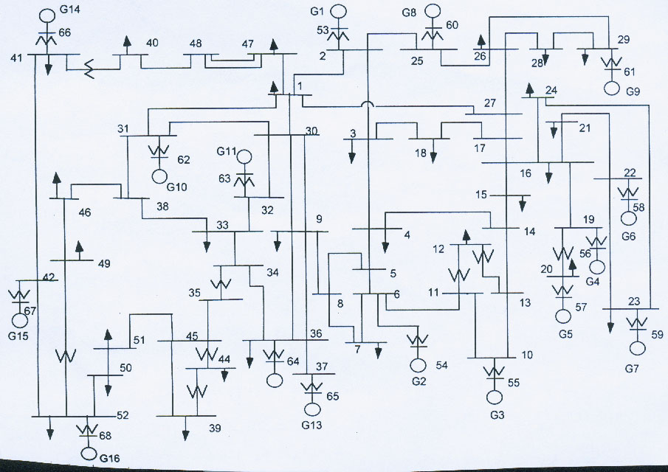
Example (industry)
CONVERT TO SMIB (RETAIN G16)

Slide 48
Example (contd)
Poorly damped
Exciter mode
well damped
E.M. Mode has f = 0.5688 Hz
The participator for this mode is
*
*
Convert these into
magnitudes
Turbine Governor States
Largest Participation by angle and speed states.

Slide 49
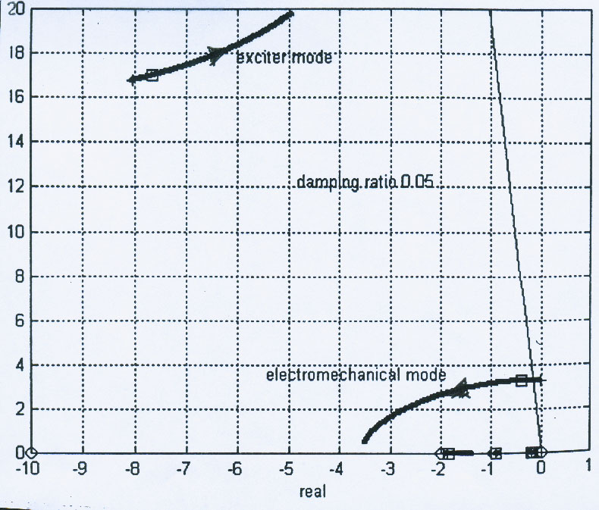
Root Locus
If G(s) (Transfer function of PSS) is a real gain, it will add pure damping Root Locus Study (with KPSS = 10).

Slide 50
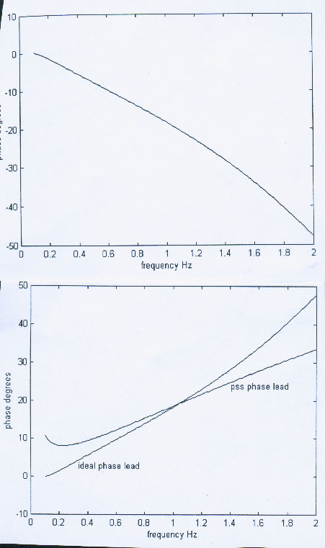
Phase Compensation
Ideal phase lead.
PSS phase lead.
Washout does not add
much phase lead.

Slide 51
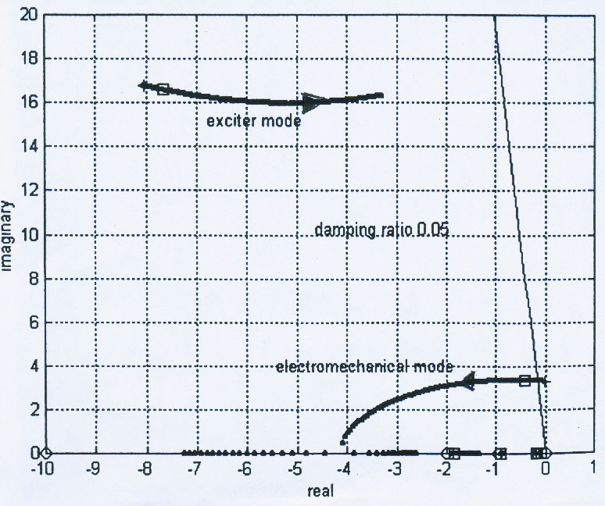
Root Locus with PSS

Slide 52
Eigenvalues with PSS
Note Improvement in Damping Ratio of E.M Mode
from 0.05 to 0.123

