Slide 1
ECE 576 – Power System Dynamics and Stability
Lecture 3: Electromagnetic Transients
Prof. Tom Overbye
Dept. of Electrical and Computer Engineering
University of Illinois at Urbana-Champaign
overbye@illinois.edu

Slide 2
Announcements
Be reading Chapters 1 and 2
Homework 1 is assigned today, due Feb 6; it is on the website
Classic reference paper on EMTP is H.W. Dommel, "Digital Computer Solution of Electromagnetic Transients in Single- and Multiphase Networks," IEEE Trans. Power App. and Syst., vol. PAS-88, pp. 388-399, April 1969

Slide 3
Numerical Integration with Trapezoidal Method
Numerical integration is often done using the trapezoidal method discussed earlier
  Here we show how it can be applied to inductors and capacitors
For a general function the trapezoidal is
Trapezoidal integration introduces error on the order of Δt³, but it is numerically stable

Slide 4
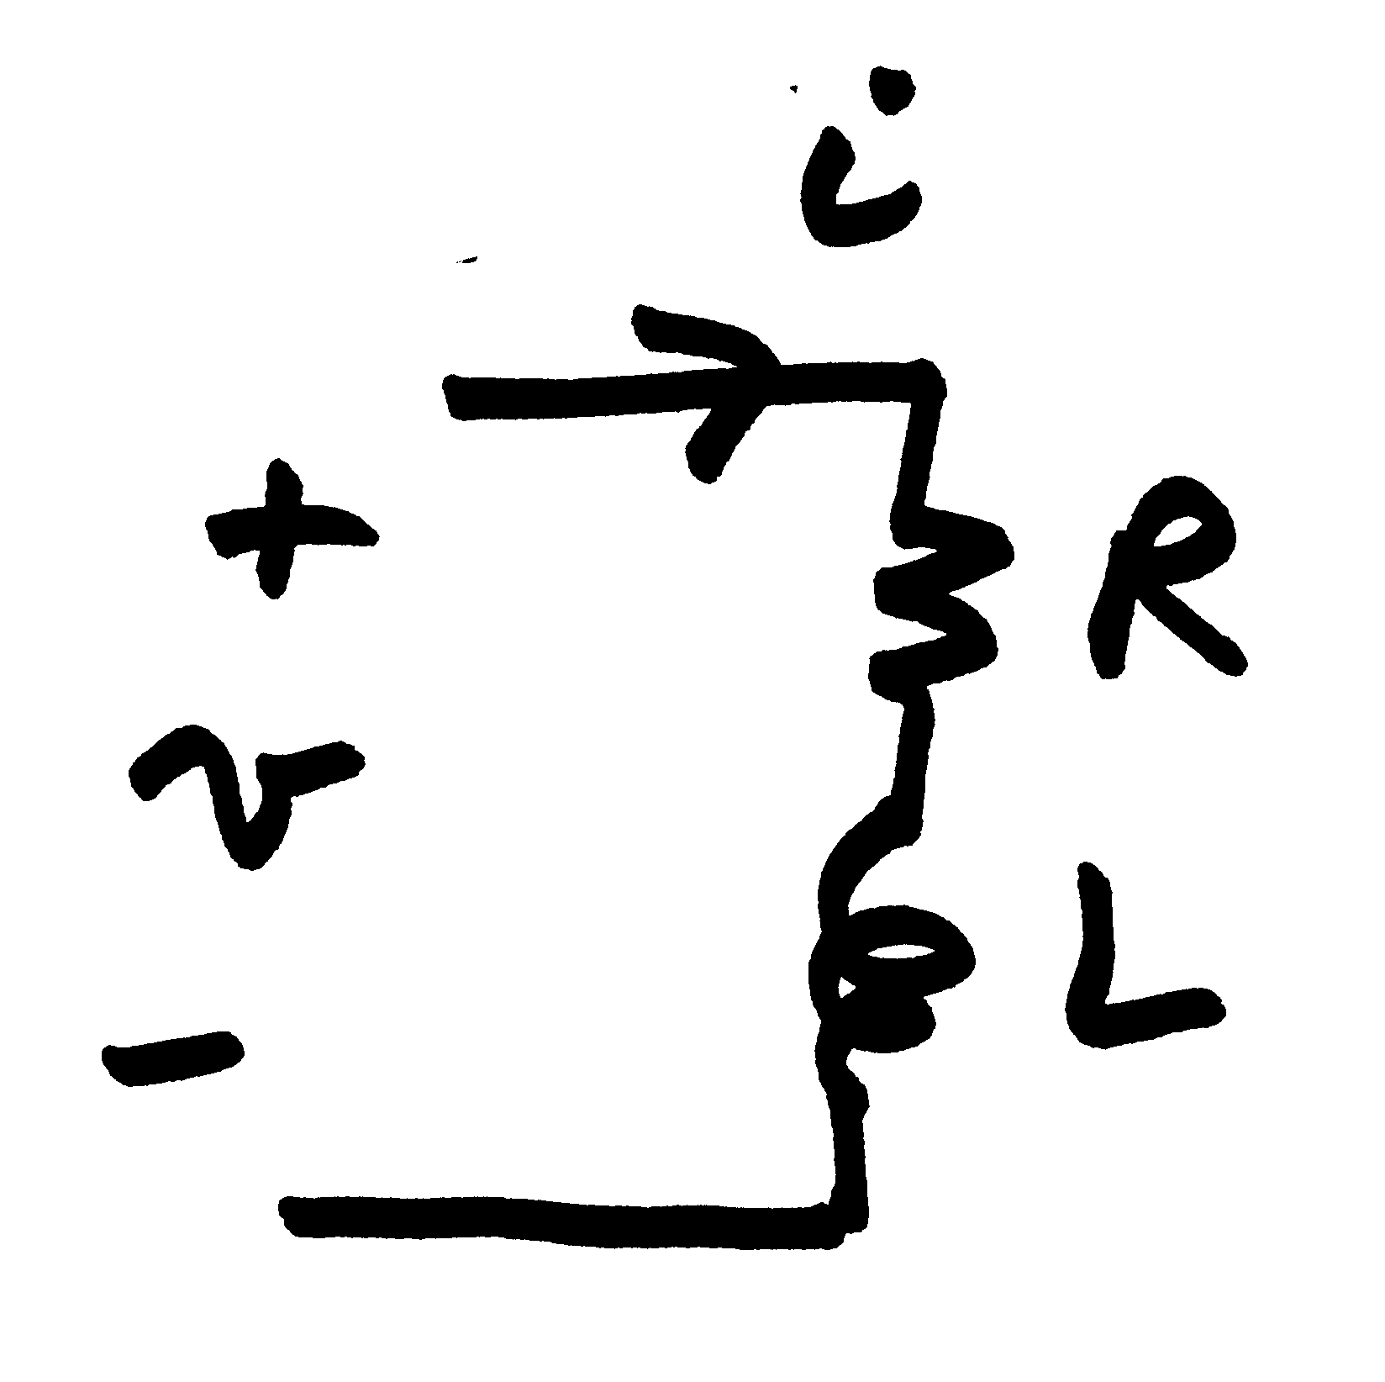
Trapezoidal Applied to Inductor with Resistance
For an inductor in series with resistance we have

Slide 5
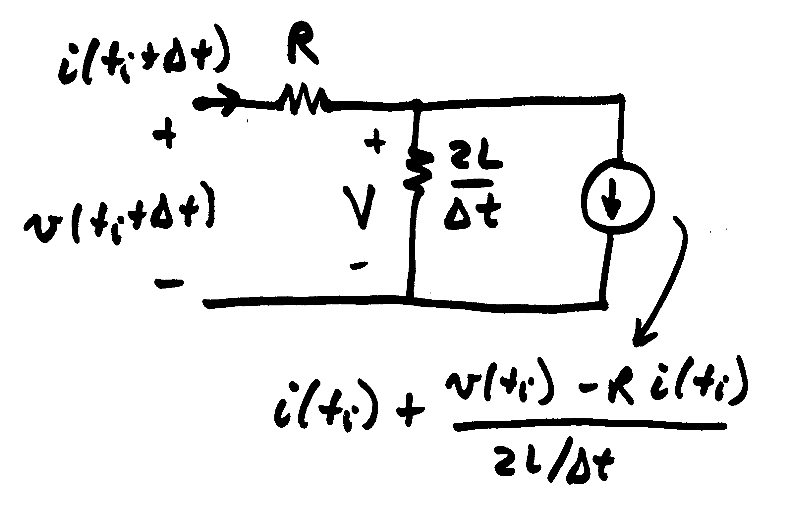
Trapezoidal Applied to Inductor with Resistance
This also becomes a Norton equivalent. A similar expression can be developed for capacitors

Slide 6
RL Example
Assume a series RL circuit with an open switch with R= 200Ω and L = 0.3H, connected to a voltage source with
Assume the switch is closed at t=0
The exact solution is
R/L=667, so the dc offset decays
quickly

Slide 7
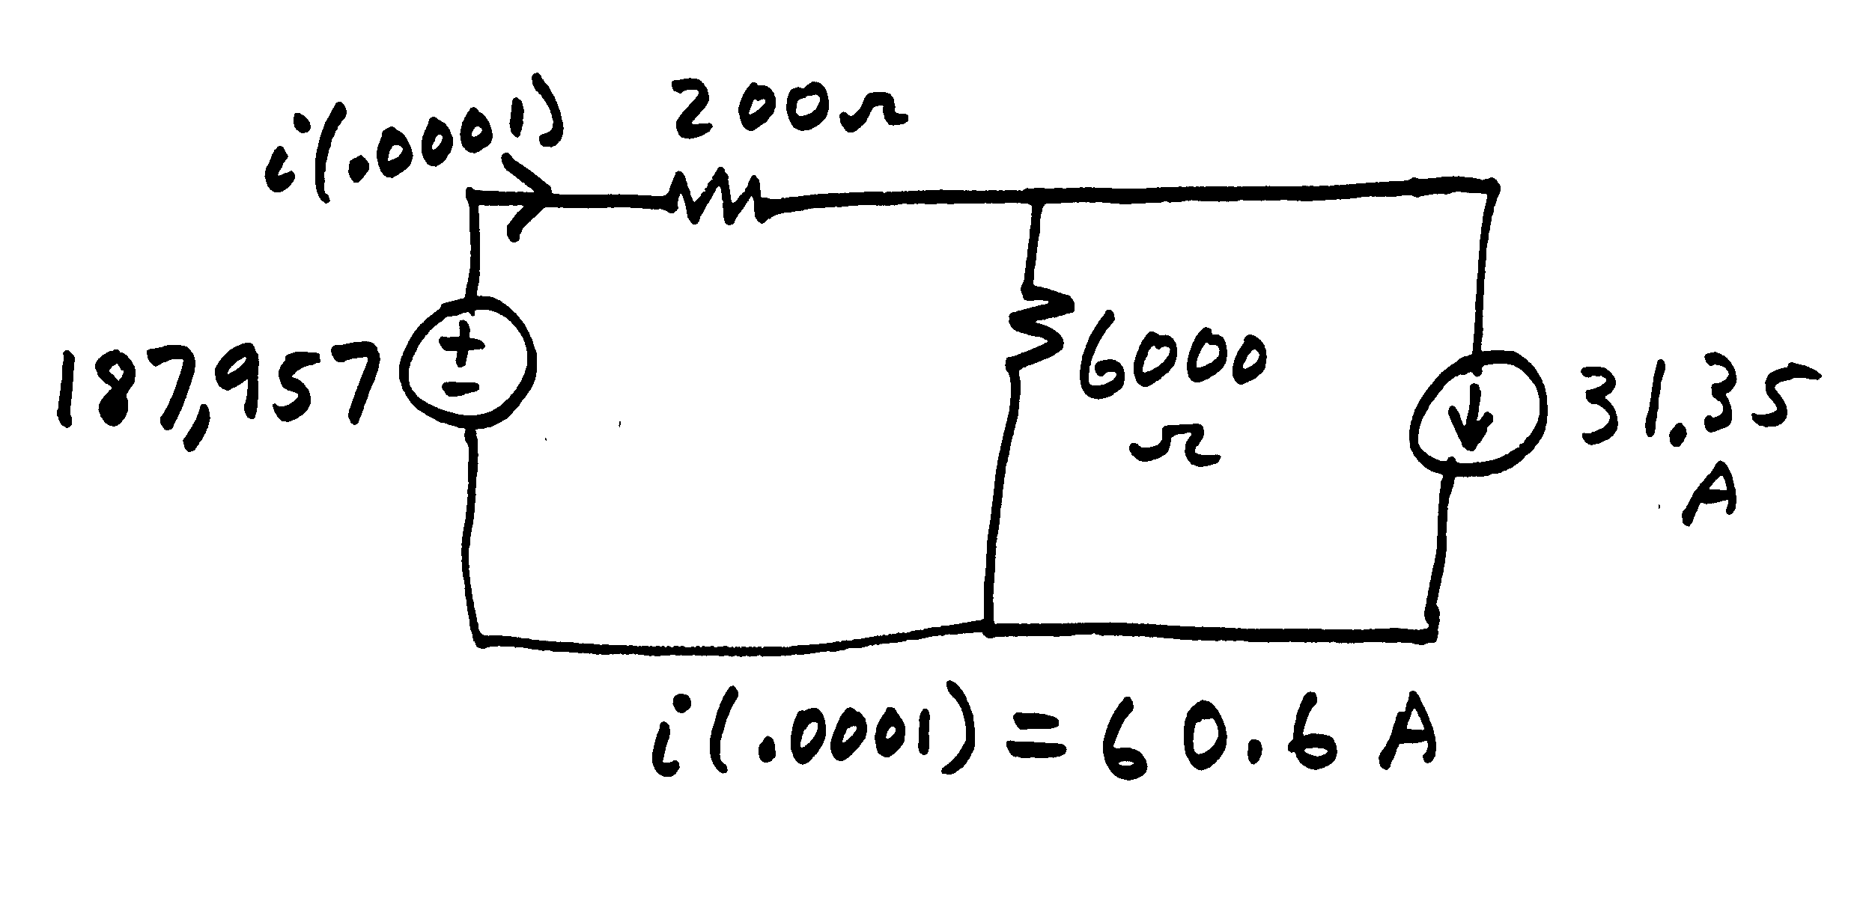
RL Example Trapezoidal Solution
Exact solution:

Slide 8
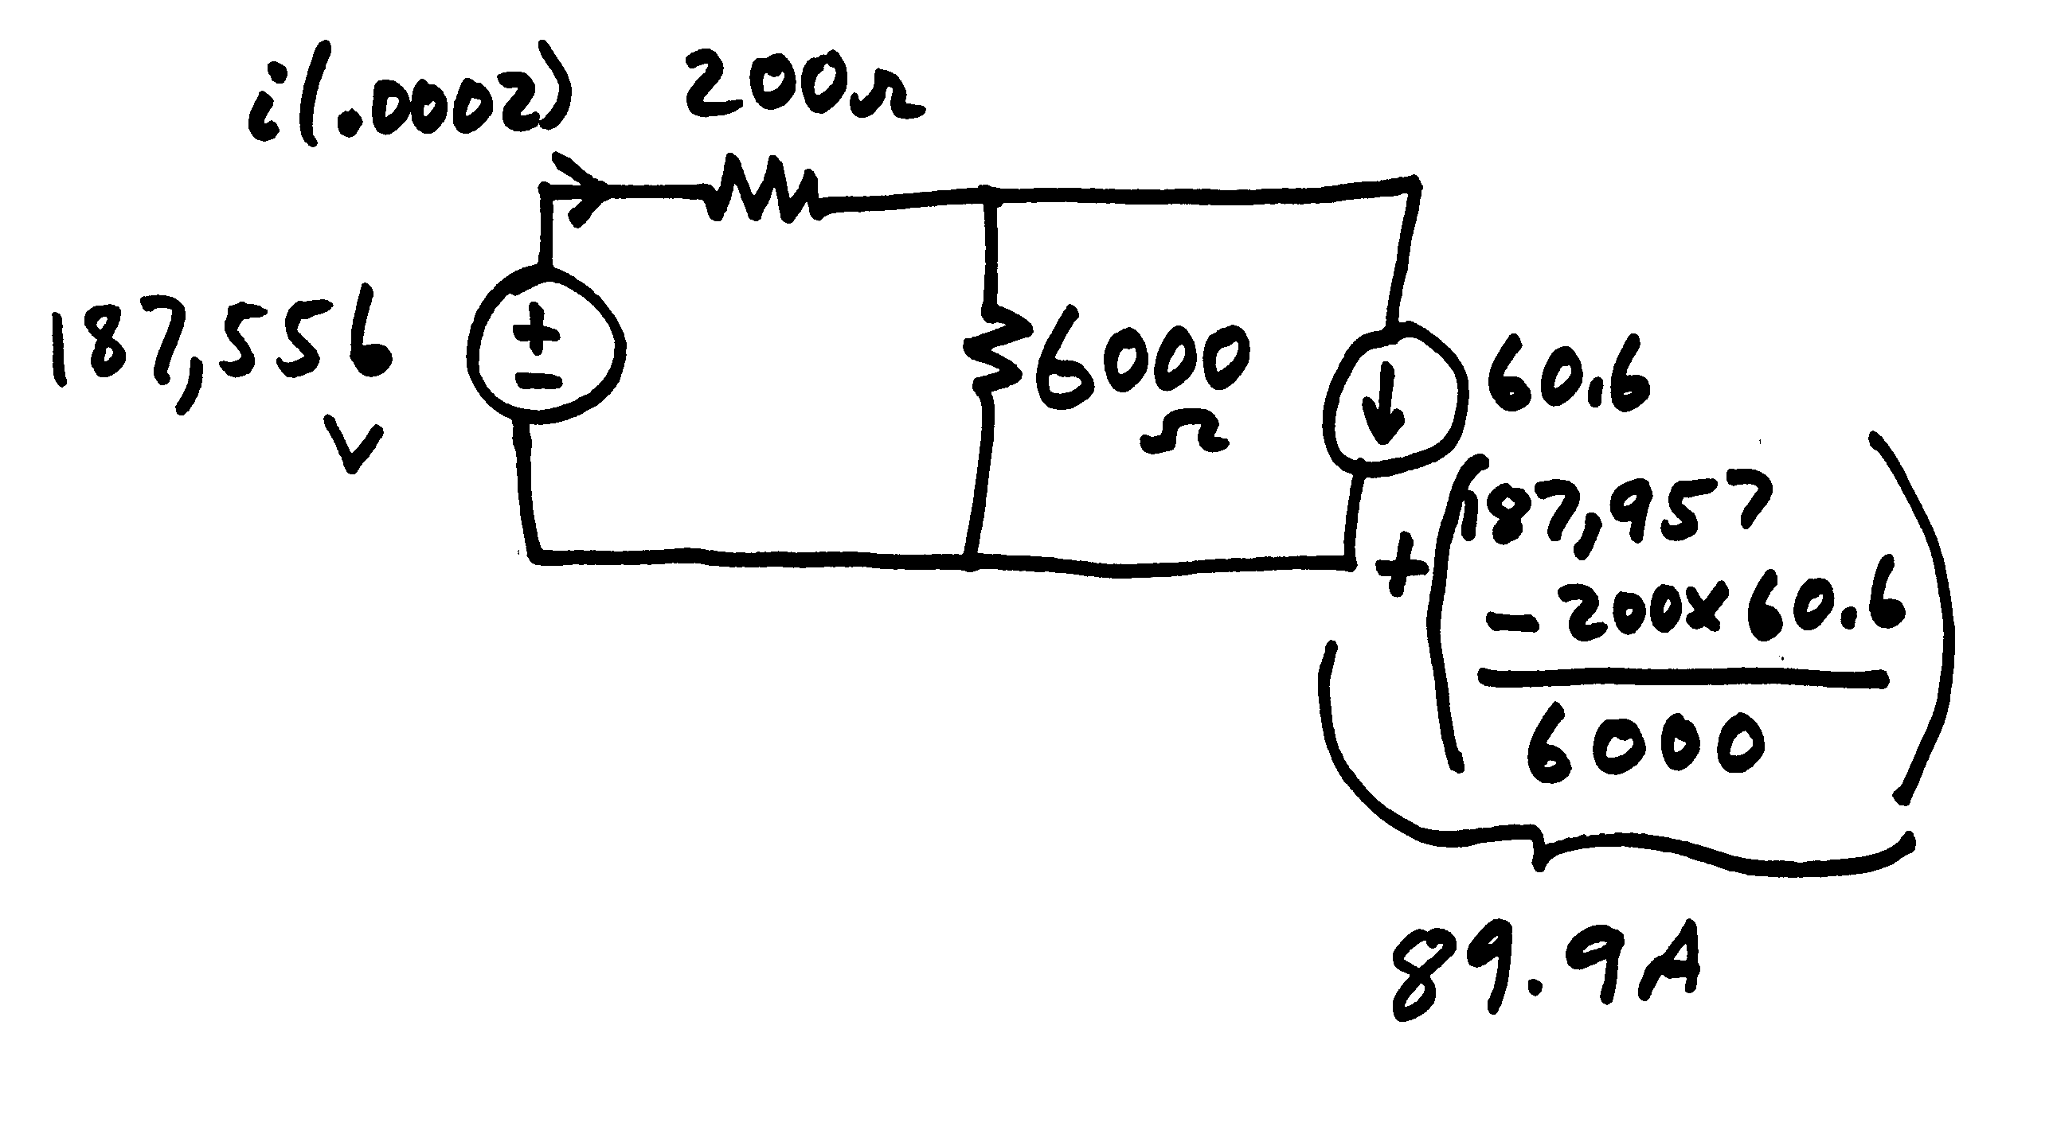
RL Example Trapezoidal Solution
t = .0002
Solving for i(.0002)
i(.0002) = 117.3A
Exact solution
i(.0002) = 117.3A

Slide 9
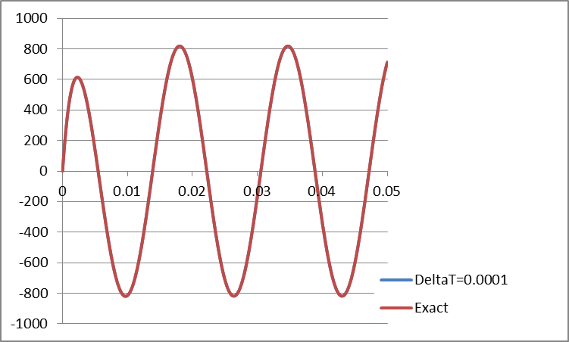
Full Solution Over Three Cycles

Slide 10
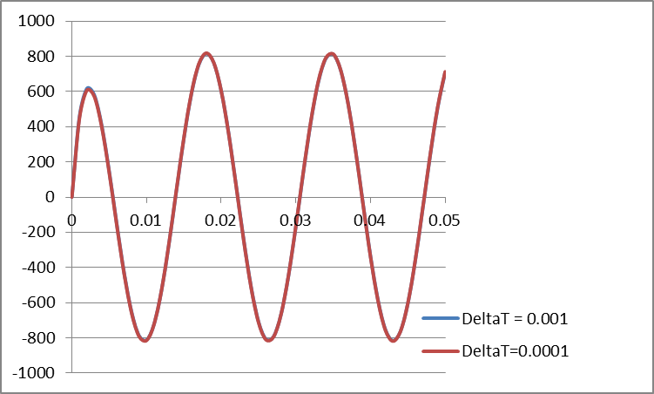
RL Example with Varying DeltaT

Slide 11
A Favorite Qual Problem: R=0 Case, with v(t) = Sin(2*pi*60)

Slide 12
Lumped Capacitance Model
The trapezoidal approach can also be applied to model lumped capacitors
Integrating over a time step gives
Which can be approximated by the trapezoidal as

Slide 13
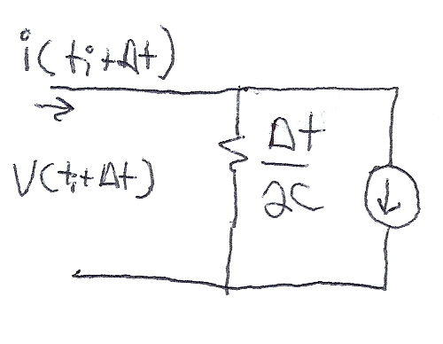
Lumped Capacitance Model
Hence we can derive a circuit model similar to what was done for the inductor

Slide 14
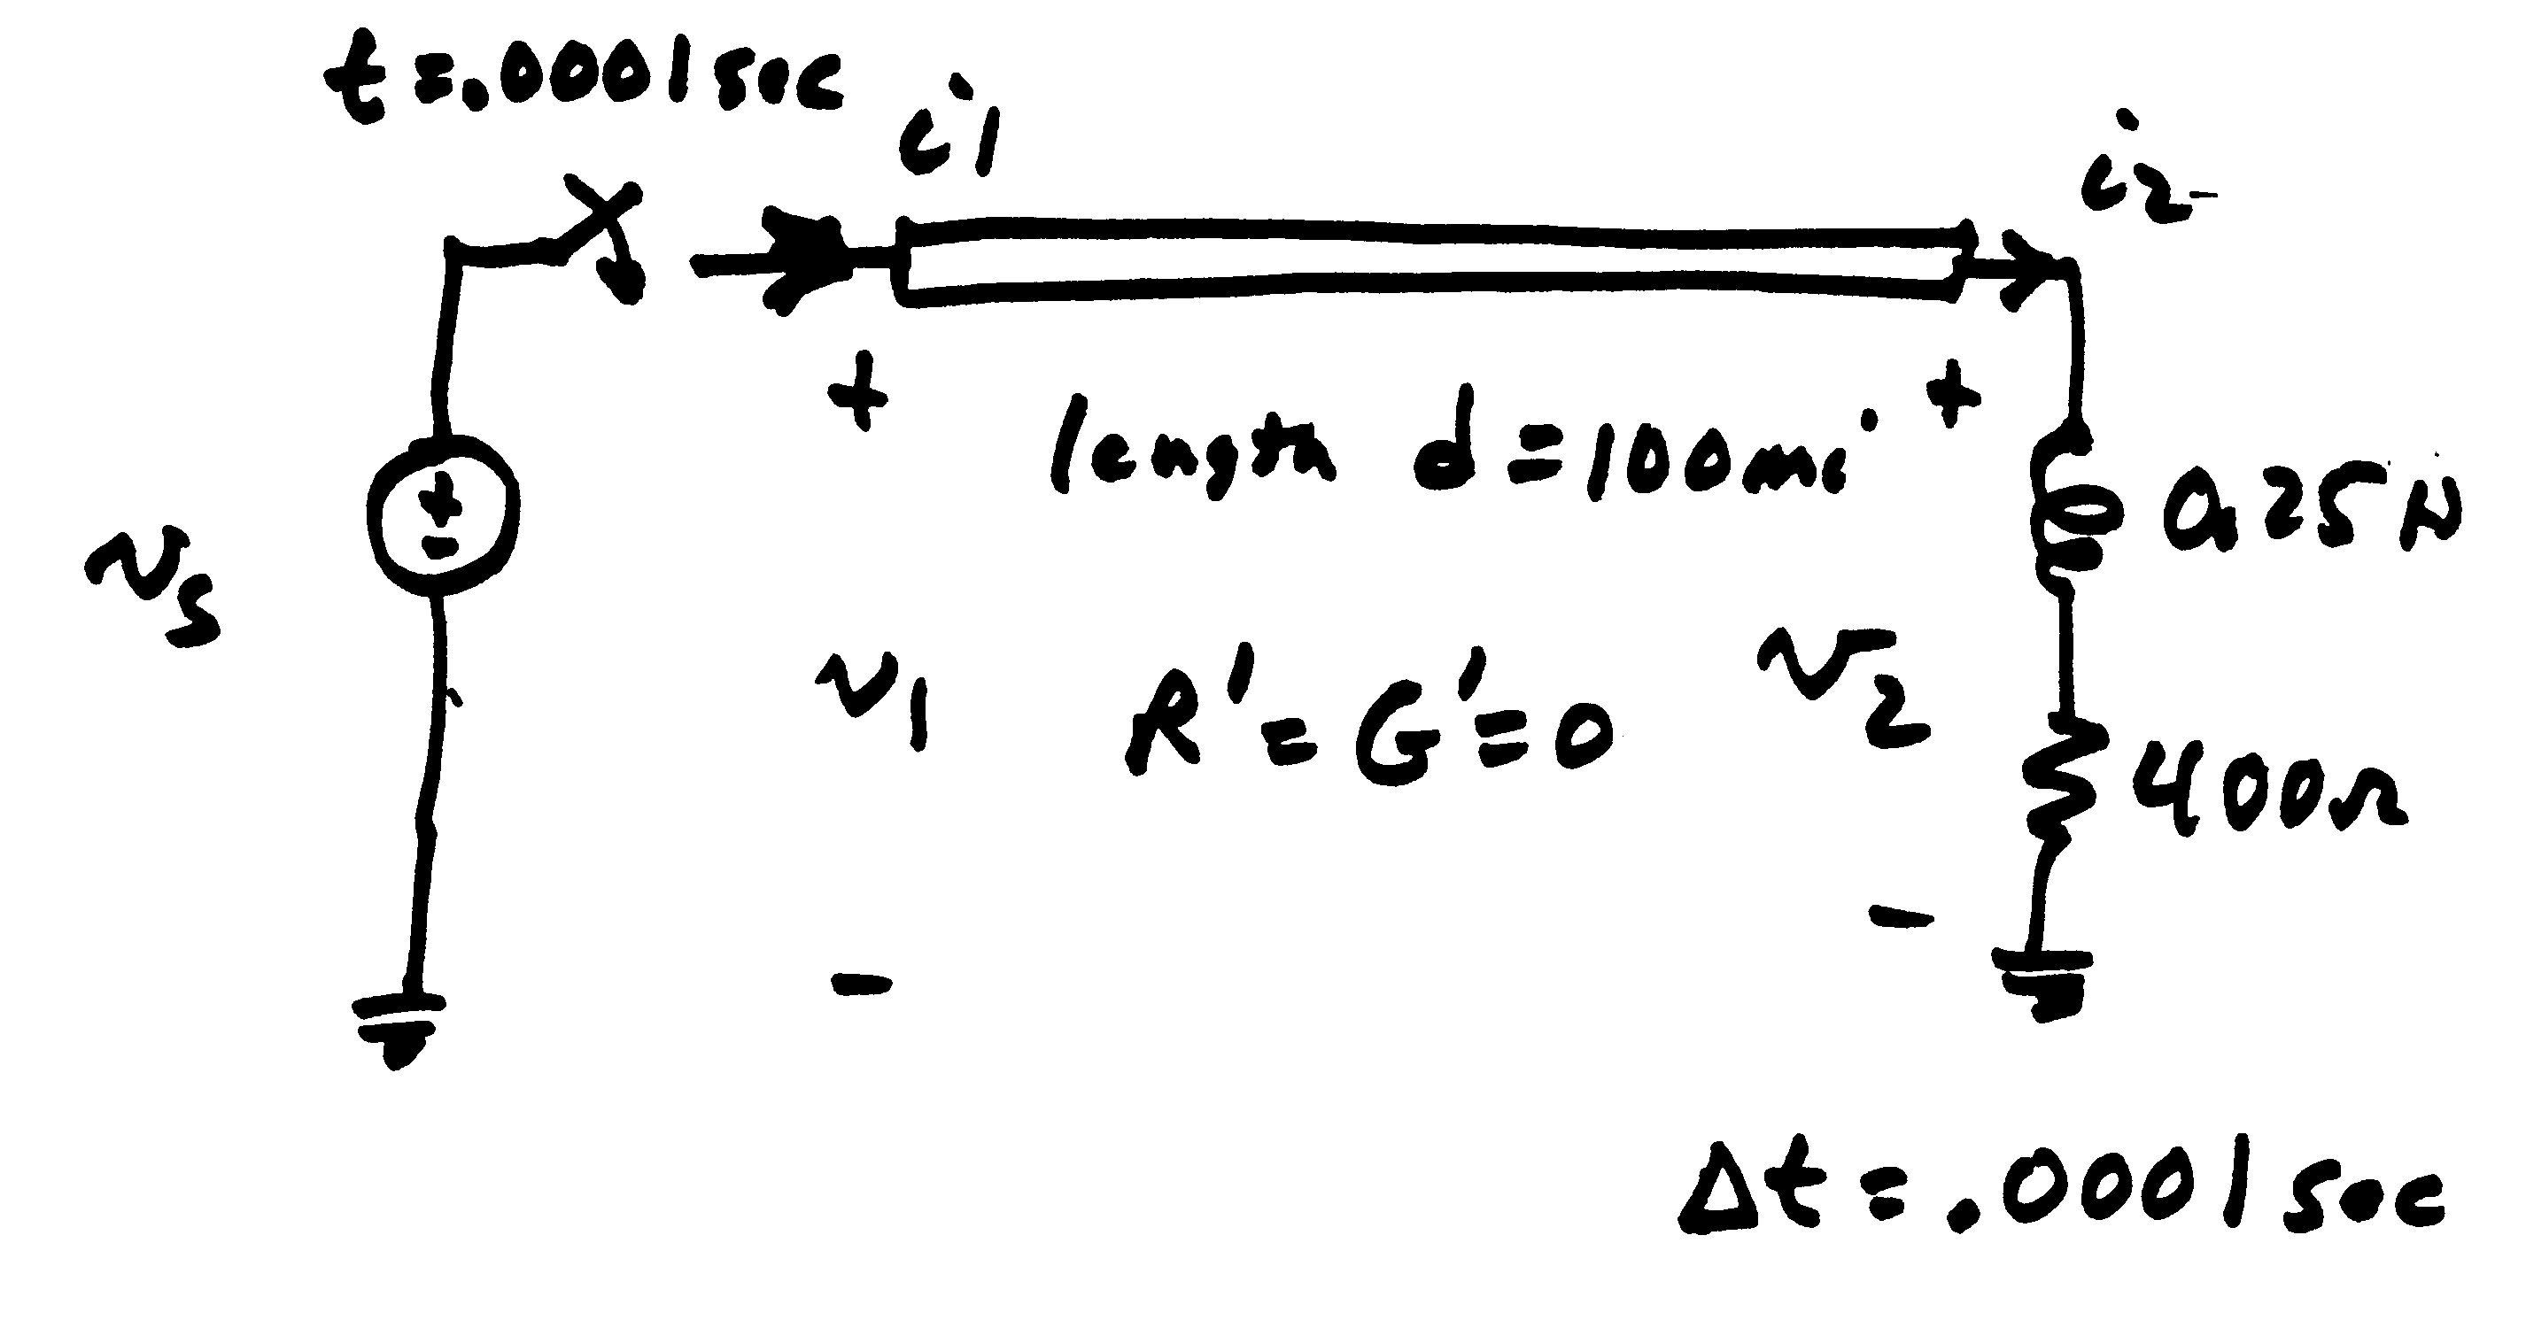
Example 2.1: Line Closing

Slide 15
Example 2.1: Line Closing
Initial conditions: i₁ = i₂ = v₁ = v₂ =0
for t < .0001 sec
Because of finite propagation speed, the receiving end of the line will not respond to energizing the sending end for at least 0.00055 seconds

Slide 16
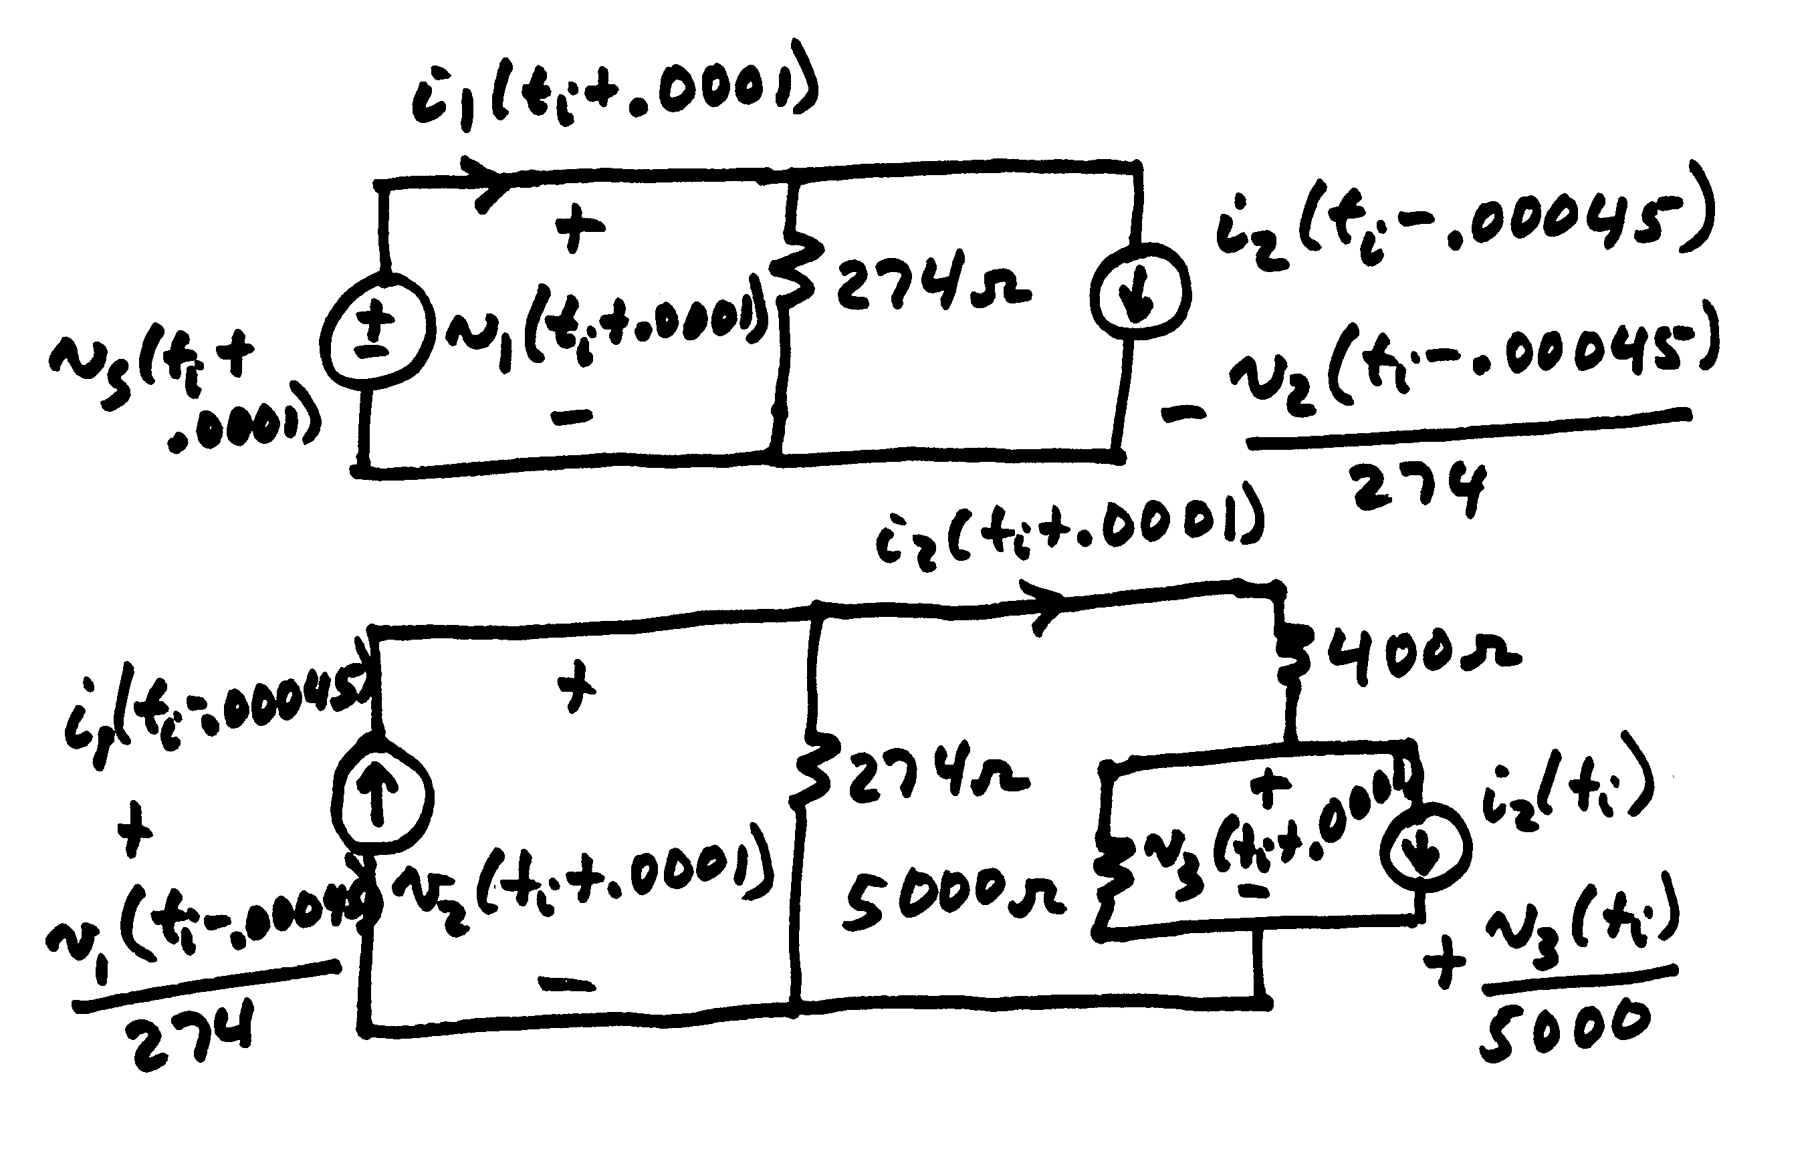
Example 2.1: Line Closing

Slide 17
Example 2.1: t=0.0001
Need:

Slide 18
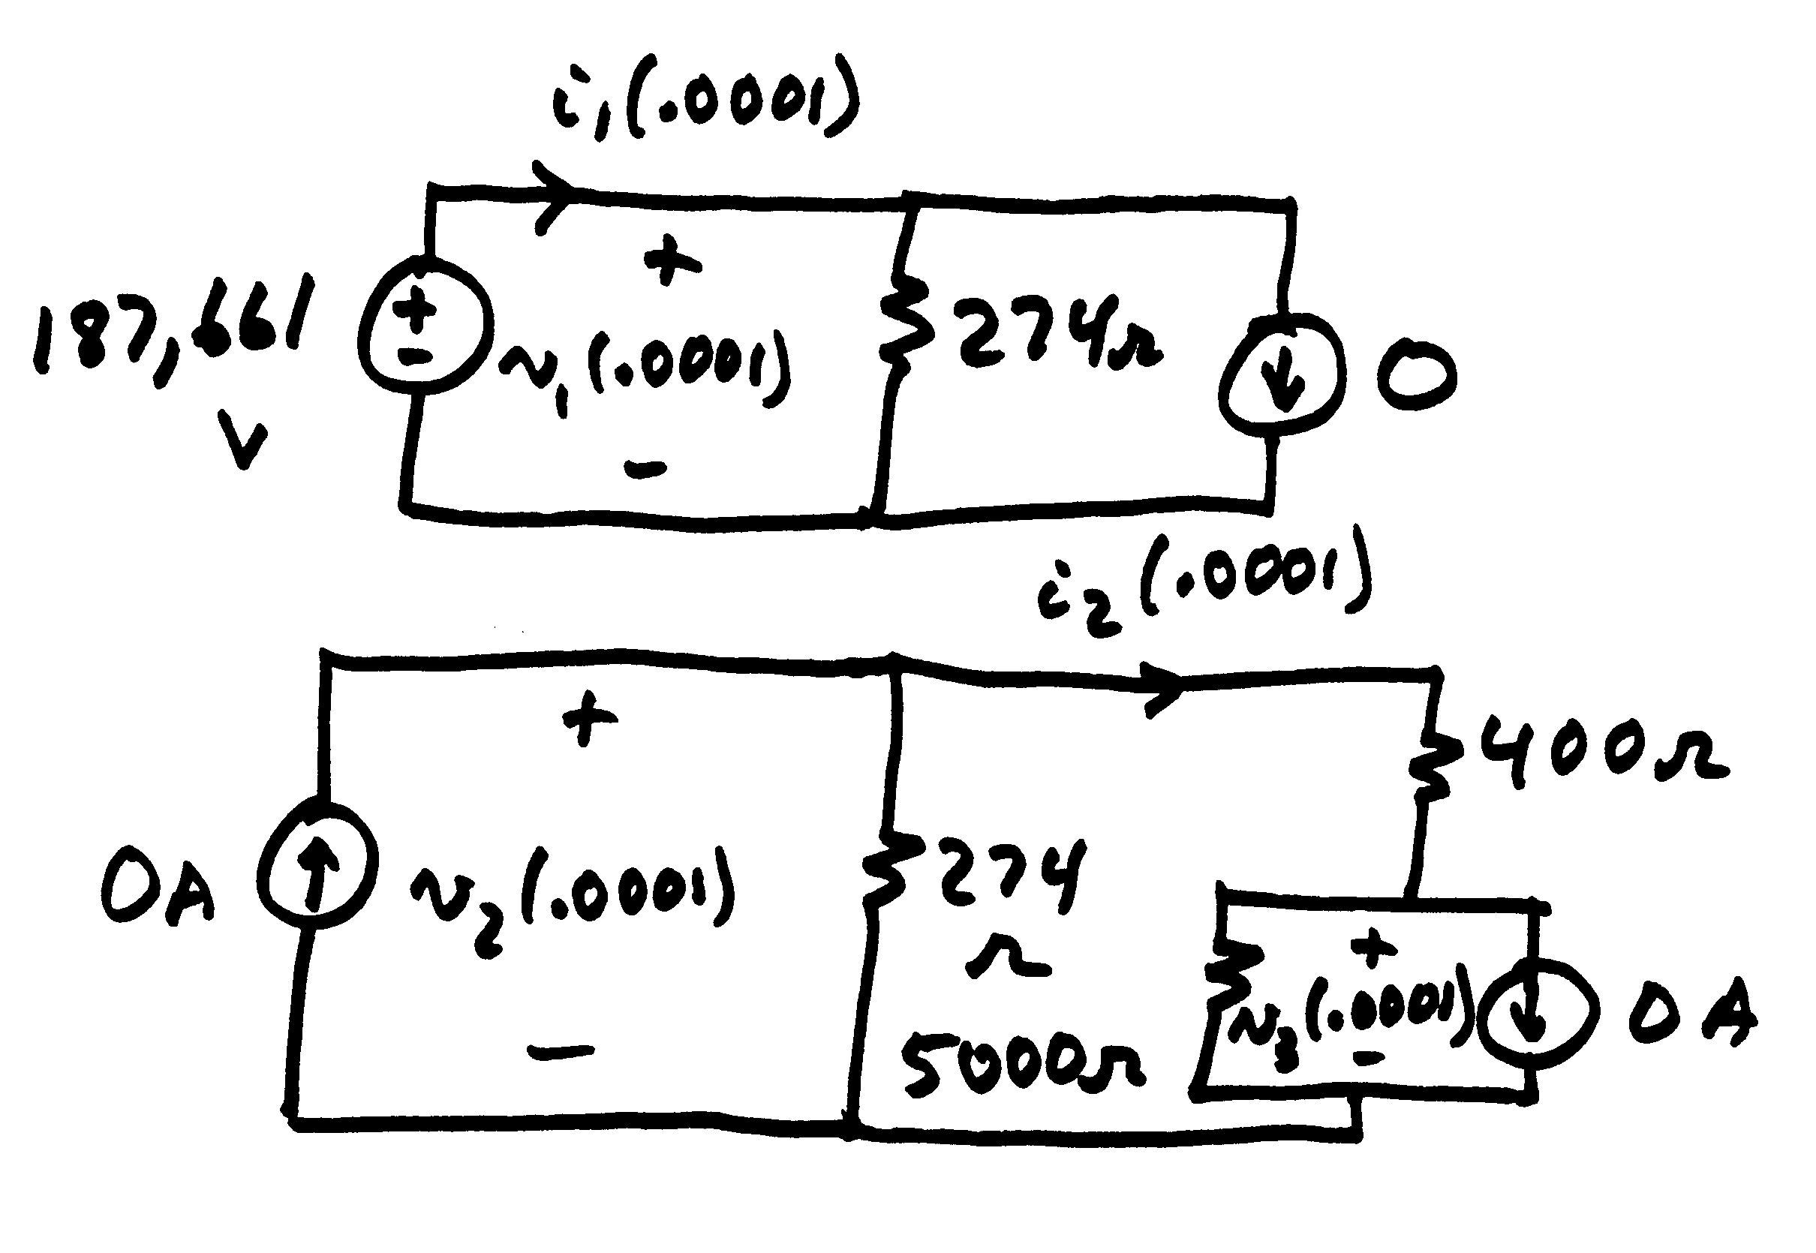
Example 2.1: t=0.0001

Slide 19
Example 2.1: t=0.0001
Instantaneously
changed from zero
at t = .0001 sec.

Slide 20
Example 2.1: t=0.0002
Need:
Circuit is essentially
the same
Wave is traveling
down the line

Slide 21
Example 2.1: t=0.0002 to 0.006
switch closed
With interpolation
receiving end
will see wave

Slide 22
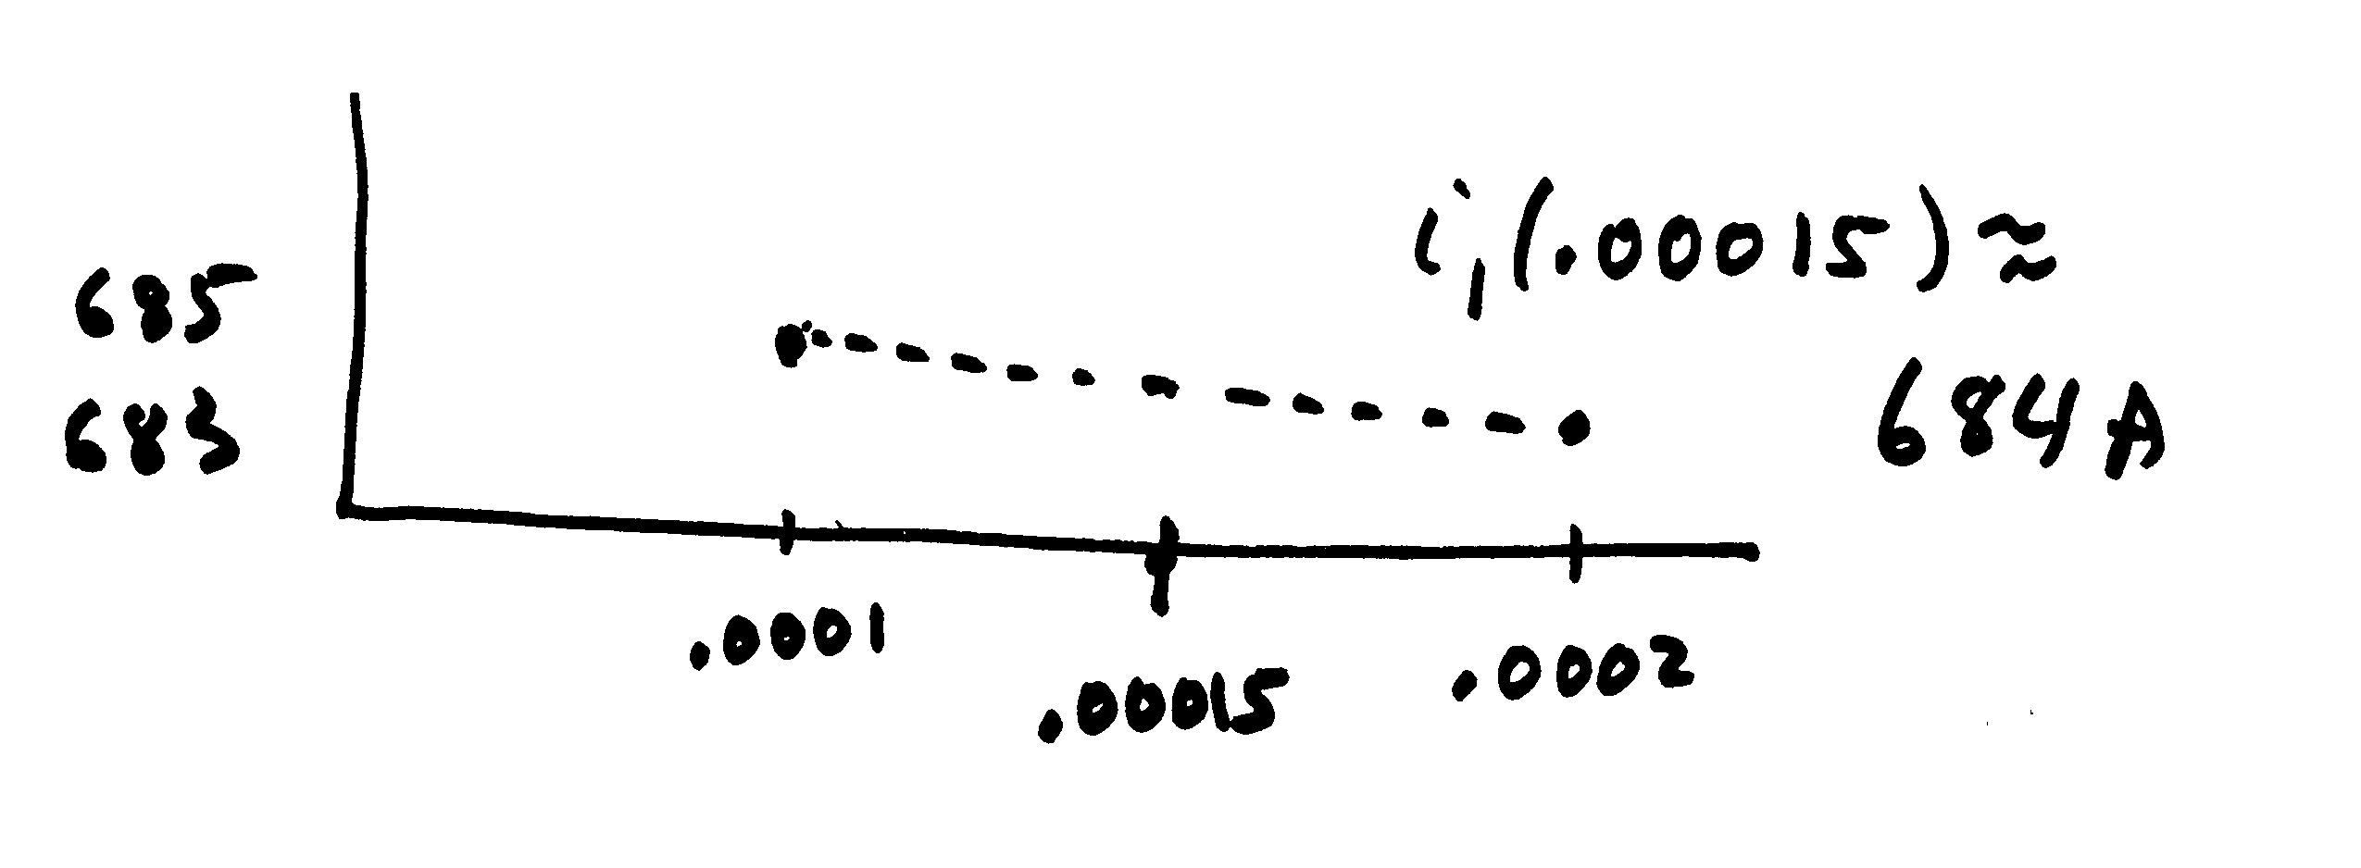
Example 2.1: t=0.0007
Need:
(linear interpolation)

Slide 23
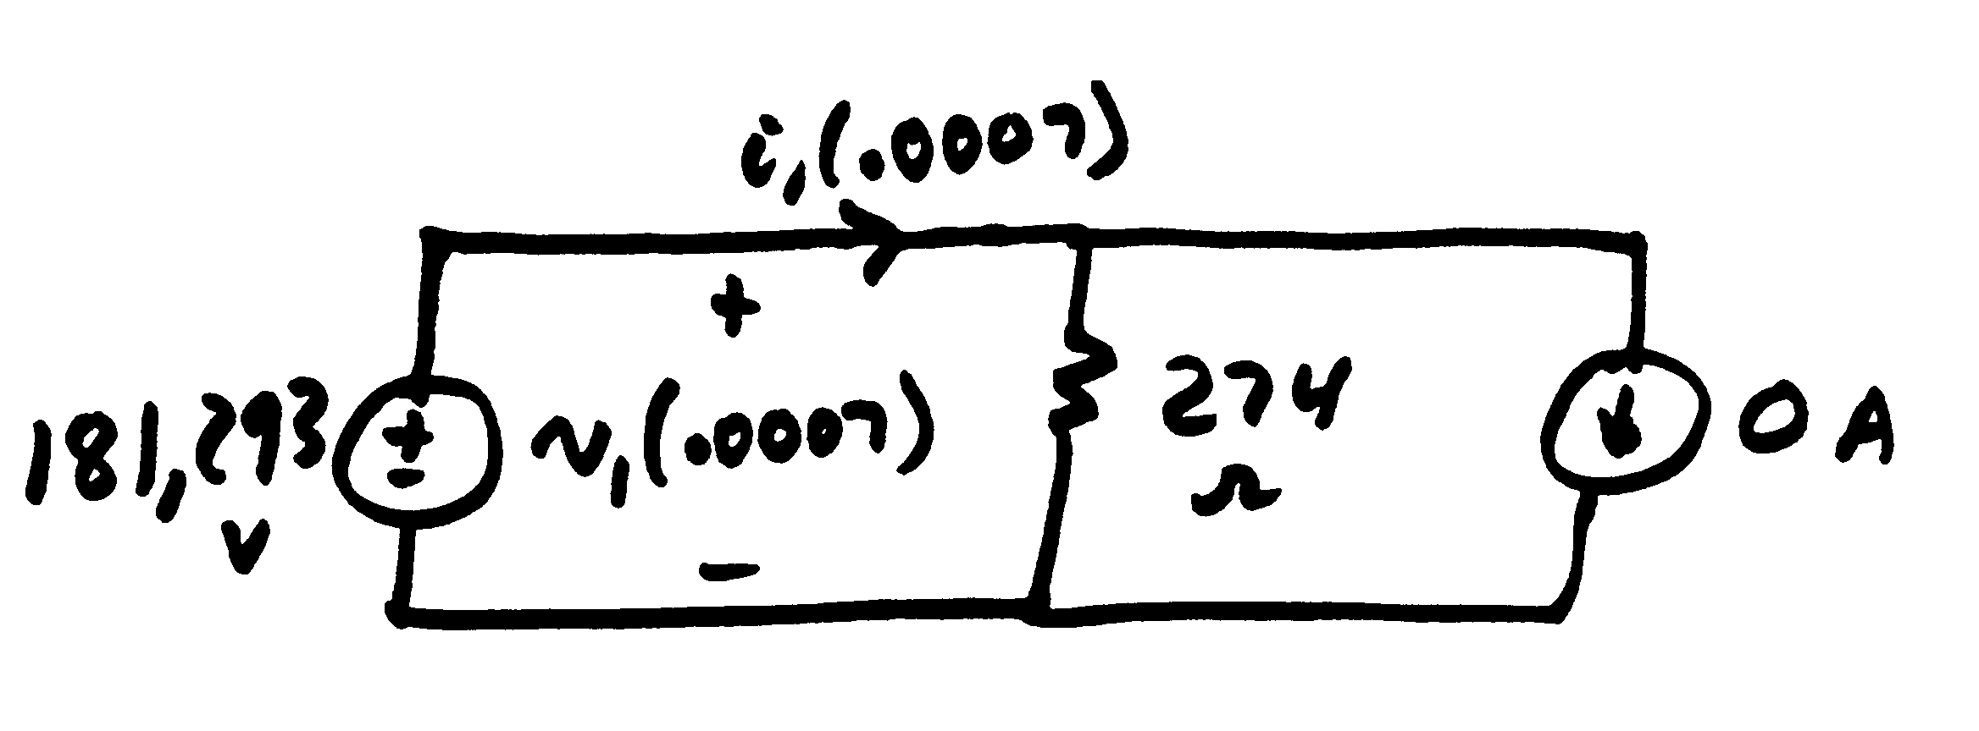
Example 2.1: t=0.0007
For t_{i} = .0006 (t = .0007 sec) at the sending end
This current source will stay zero until we get a response from the receiving end

Slide 24
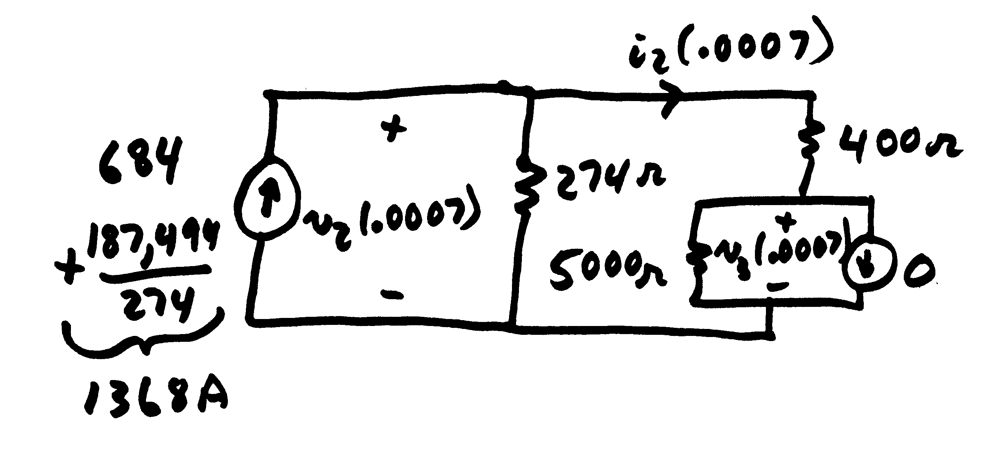
Example 2.1: t=0.0007
For t_{i} = .0006 (t = .0007 sec) at the receiving end

Slide 25
Example 2.1: First Three Cycles
Red is the
sending
end voltage (in kv),
while green
is the receiving end voltage. Note the near voltage doubling at the receiving end

Slide 26
Example 2.1: First Three Cycles
Graph shows the current (in amps) into the RL load over the first three cycles.
To get a ballpark value on the expected current, solve the
simple circuit assuming the transmission line is just an inductor

Slide 27
Three Node, Two Line Example
Graph shows the voltages for 0.02 seconds for the Example 2.1 case extended to connect another 120 mile line to the
receiving end with an identical load
Note that there is no longer an initial overshoot for the receiving (green) end since wave continues into the second line

Slide 28
Example 2.1 with Capacitance
Below graph shows example 2.1 except the RL load is replaced by a 5 μF capacitor (about 100 Mvar)
Graph on left is unrealistic case of resistance in line
Graph on right has R=0.1 Ω/mile

Slide 29
EMTP Network Solution
The EMTP network is represented in a manner quite similar to what is done in the dc power flow or the transient stability network power balance equations or geomagnetic disturbance modeling (GMD)
Solving set of dc equations for the nodal voltage vector V with
V = G⁻¹I
where G is the bus conductance matrix and I is a vector of the Norton current injections

Slide 30
EMTP Network Solution
Fixed voltage nodes can be handled in a manner analogous to what is done for the slack bus: just change the equation for node i to V_{i} = V_{i,fixed}
Because of the time delays associated with the transmission line models G is often quite sparse, and can often be decoupled
Once all the nodal voltages are determined, the internal device currents can be set
  E.g., in example 2.1 one we
  know v₂ we can determine v₃

Slide 31
Three-Phase EMTP
What we just solved was either just for a single phase system, or for a balanced three-phase system
  That is, per phase analysis (positive sequence)
EMTP type studies are often done on either balanced systems operating under unbalanced conditions (i.e., during a fault) or on unbalanced systems operating under unbalanced conditions
  Lightning strike studies
In this introduction to EMTP will just covered the balanced system case (but with unbalanced conditions)
  Solved with symmetrical components

Slide 32
Modeling Transmission Lines
Undergraduate power classes usually derive a per phase model for a uniformly transposed transmission line

Slide 33
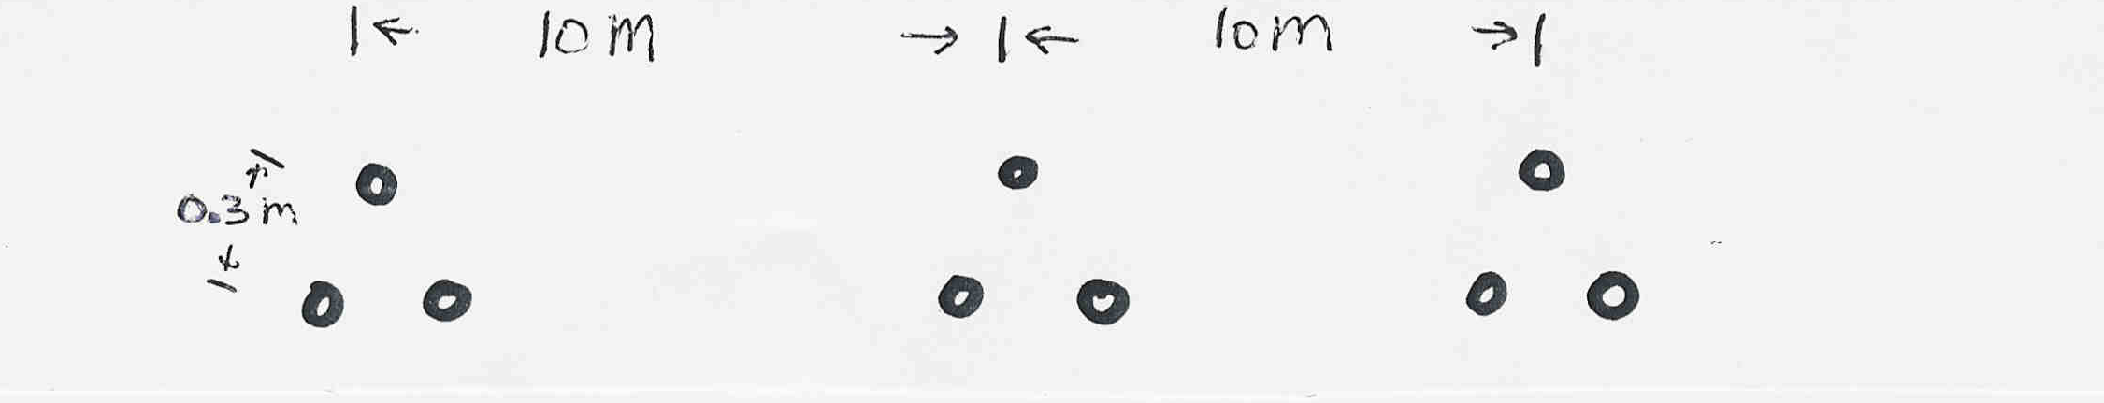
Modeling Transmission Lines
Resistance is just the Ω per unit length times the length
Calculate the per phase inductance and capacitance per km of a balanced 3φ, 60 Hz, line with horizontal phase spacing of 10m using three conductor bundling with a spacing between conductors in the bundle of 0.3m. Assume the line is uniformly transposed and the conductors have a 1.5 cm radius and resistance = 0.06 Ω/km

Slide 34
Modeling Transmission Lines
Resistance is 0.06/3=0.02Ω/km
  Divide by three because three conductors per bundle

Slide 35
Untransposed Lines with Ground Conductors
To model untransposed lines, perhaps with grounded neutral wires, we use the approach of Carson (from 1926) of modeling the earth return with equivalent conductors located in the ground under the real wires
  Earth return conductors have the same
  GMR of their above ground conductor
  (or bundle) and carry the opposite current
Distance between conductors is

Slide 36
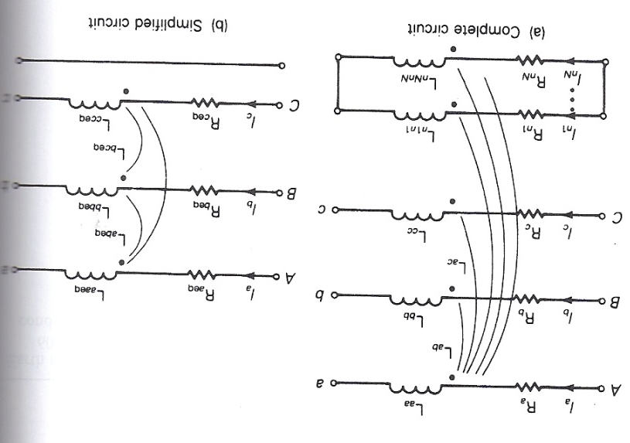
Untransposed Lines with Ground Conductors
The resistance of the equivalent conductors is
R_{k'}=9.869×10⁻⁷×f Ω/m with f the frequency, which is also added in series to the Rof the actual conductors
Conductors are mutually coupled; we'll be assuming
three phase conductors
and N grounded
neutral wires
Total current in
all conductors
sums to zero

Slide 37
Untransposed Lines with
Ground Conductors
The relationships between voltages and currents per unit length is
Where the diagonal resistance are the conductor resistance plus R_{k'} and the off-diagonals are all R_{k'}
The inductances are
with D_{kk} just the
GMR for the conductor (or bundle)
D_{kk'} is large so
D_{km'} ≈ D_{kk'}

Slide 38
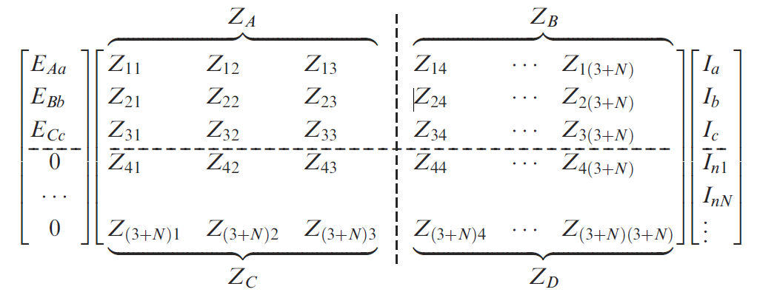
Untransposed Lines with
Ground Conductors
This then gives an equation of the form
Which can be reduced to just the phase values
We'll use Z_{p} with symmetrical components

