Slide 1
ECE 576 – Power System Dynamics and Stability
Lecture 6: Synchronous Machine Modeling
Prof. Tom Overbye
Dept. of Electrical and Computer Engineering
University of Illinois at Urbana-Champaign
overbye@illinois.edu
Special Guest: TA Soobae Kim

Slide 2
Announcements
Read Chapter 3

Slide 3
Synchronous Machine Modeling
Electric machines are used to convert mechanical energy into electrical energy (generators) and from electrical energy into mechanical energy (motors)
  Many devices can operate in either mode, but are usually customized for one or the other
Vast majority of electricity is generated using synchronous generators and some is consumed using synchronous motors, so that is where we'll start
Much literature on subject, and sometimes overly confusing with the use of different conventions and nominclature

Slide 4
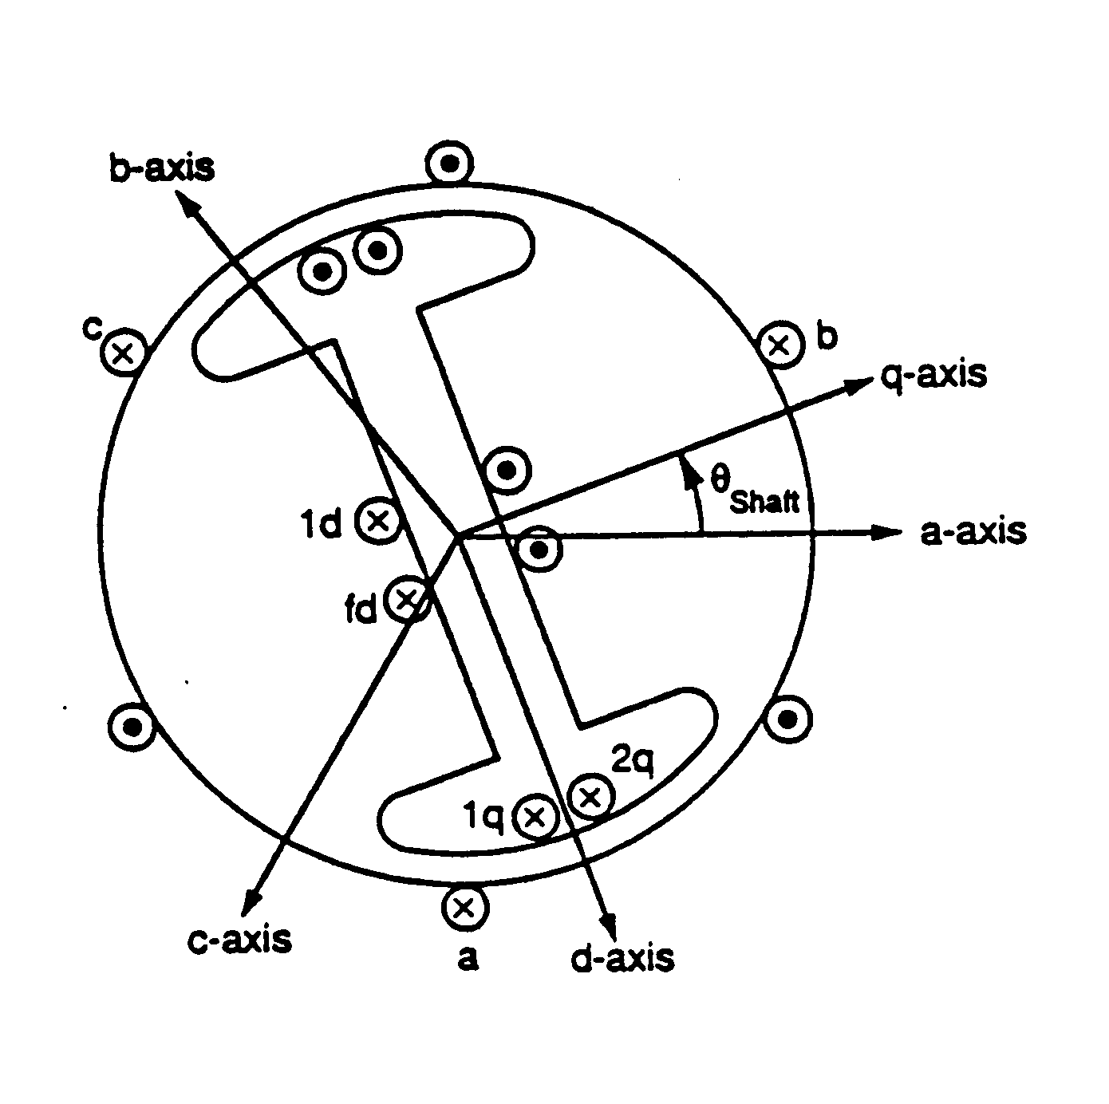
Synchronous Machine Modeling
3φ bal. windings (a,b,c) – stator
Field winding (fd) on rotor
Damper in “d” axis
(1d) on rotor
2 dampers in “q” axis
(1q, 2q) on rotor

Slide 5
Dq0 Reference Frame
Stator is stationary and rotor is rotating at synchronous speed
Rotor values need to be transformed to fixed reference frame for analysis
This is done using Park's transformation into what is known as the dq0 reference frame (direct, quadrature, zero)
Convention used here is the q-axis leads the d-axis (which is the IEEE standard)
  Others (such as Anderson and Fouad) use a q-axis lagging convention

Slide 6
Fundamental Laws
Kirchhoff’s Voltage Law, Ohm’s Law, Faraday’s Law, Newton’s Second Law
Stator
Rotor
Shaft

Slide 7
Dq0 transformations

Slide 8
Dq0 transformations
with the inverse,

Slide 9
Dq0 transformations
Note: This transformation is not power invariant. This means that some unusual things will happen when we use it.
Example: If the magnetic circuit is assumed to be linear
(symmetric)
Not symmetric if T is not power invariant.

Slide 10
Transformed System
Stator
Rotor
Shaft

Slide 11
Electrical & Mechanical Relationships
Electrical system:
Mechanical system:

Slide 12
Derive Torque
Torque is derived by looking at the overall energy balance in the system
Three systems: electrical, mechanical and the coupling magnetic field
  Electrical system losses in form of resistance
  Mechanical system losses in the form of friction
Coupling field is assumed to be lossless, hence we can track how energy moves between the electrical and mechanical systems

Slide 13
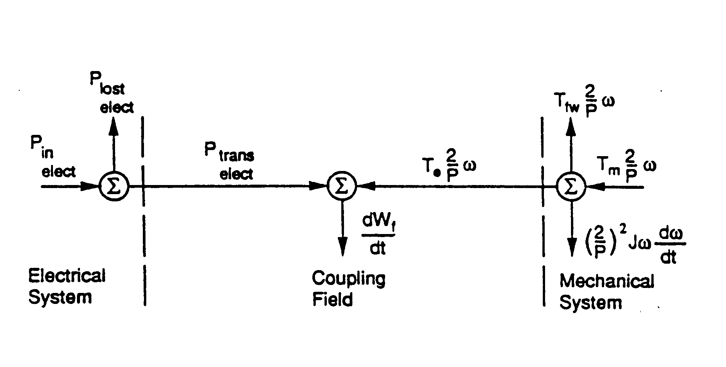
Energy Conversion
Look at the instantaneous power:

Slide 14
Change to Conservation of Power

Slide 15
With the Transformed Variables

Slide 16
With the Transformed Variables

Slide 17
Change in Coupling Field Energy
This requires the lossless coupling field assumption

Slide 18
Change in Coupling Field Energy
For independent states θ, λ_{a}, λ_{b}, λ_{c}, λ_{fd}, λ_{1d}, λ_{1q}, λ_{2q}

Slide 19
Equate the Coefficients
etc.
There are eight such “reciprocity conditions for this model.
These are key conditions – i.e. the first one gives an expression for the torque in terms of the coupling field energy.

Slide 20
Equate the Coefficients
These are key conditions – i.e. the first one gives an expression for the torque in terms of the coupling field energy.

Slide 21
Coupling Field Energy
The coupling field energy is calculated using a path independent integration
  For integral to be path independent, the partial derivatives of all integrands with respect to the other states must be equal
Since integration is path independent, choose a convenient path
  Start with a de-energized system so all variables are zero
  Integrate shaft position while other variables are zero, hence no energy
  Integrate sources in sequence with shaft at final θ_{shaft} value

Slide 22
Do the Integration

Slide 23
Torque
Assume: i_{q}, i_{d}, i_{o}, i_{fd}, i_{1d}, i_{1q}, i_{2q} are independent of θ_{shaft} (current/flux linkage relationship is independent of θ_{shaft})
Then W_{f} will be independent of θ_{shaft} as well
Since we have

Slide 24
Define Unscaled Variables
ω_{s} is the rated
synchronous speed
d plays an important role!

Slide 25
Convert to Per Unit
As with power flow, values are usually expressed in per unit, here on the machine power rating
Two common sign conventions for current: motor has positive currents into machine, generator has positive out of the machine
Modify the flux linkage current relationship to account for the non power invariant “dqo” transformation

Slide 26
Convert to Per Unit
where V_{BABC} is rated RMS line-to-neutral stator voltage and

Slide 27
Convert to Per Unit
where V_{BDQ} is rated peak line-to-neutral stator voltage and

Slide 28
Convert to Per Unit
Hence the ψ variables are just normalized
flux linkages

Slide 29
Convert to Per Unit
Where the rotor circuit base voltages are
And the rotor circuit base flux linkages are

Slide 30
Convert to Per Unit

Slide 31
Convert to Per Unit
Almost done with the per unit conversions! Finally define inertia constants and torque

Slide 32
Synchronous Machine Equations

Slide 33
Sinusoidal Steady-State
Here we consider the
application
to balanced, sinusoidal
conditions

Slide 34
Transforming to dq0

Slide 35
Simplifying Using δ
Recall that
Hence
These algebraic equations can be written as complex equations,
The conclusion is
if we know δ, then
we can easily relate
the phase to the dq
values!

Slide 36
Summary So Far
The model as developed so far has been derived using the following assumptions
  The stator has three coils in a balanced configuration, spaced 120 electrical degrees apart
  Rotor has four coils in a balanced configuration located 90 electrical degrees apart
  Relationship between the flux linkages and currents must reflect a conservative coupling field
  The relationships between the flux linkages and currents must be independent of θ_{shaft} when expressed in the dq0 coordinate system

Slide 37
Assuming a Linear Magnetic Circuit
If the flux linkages are assumed to be a linear function of the currents then we can write
The rotor
self-
inductance
matrix
L_{rr} is
independent
of θ_{shaft}

Slide 38
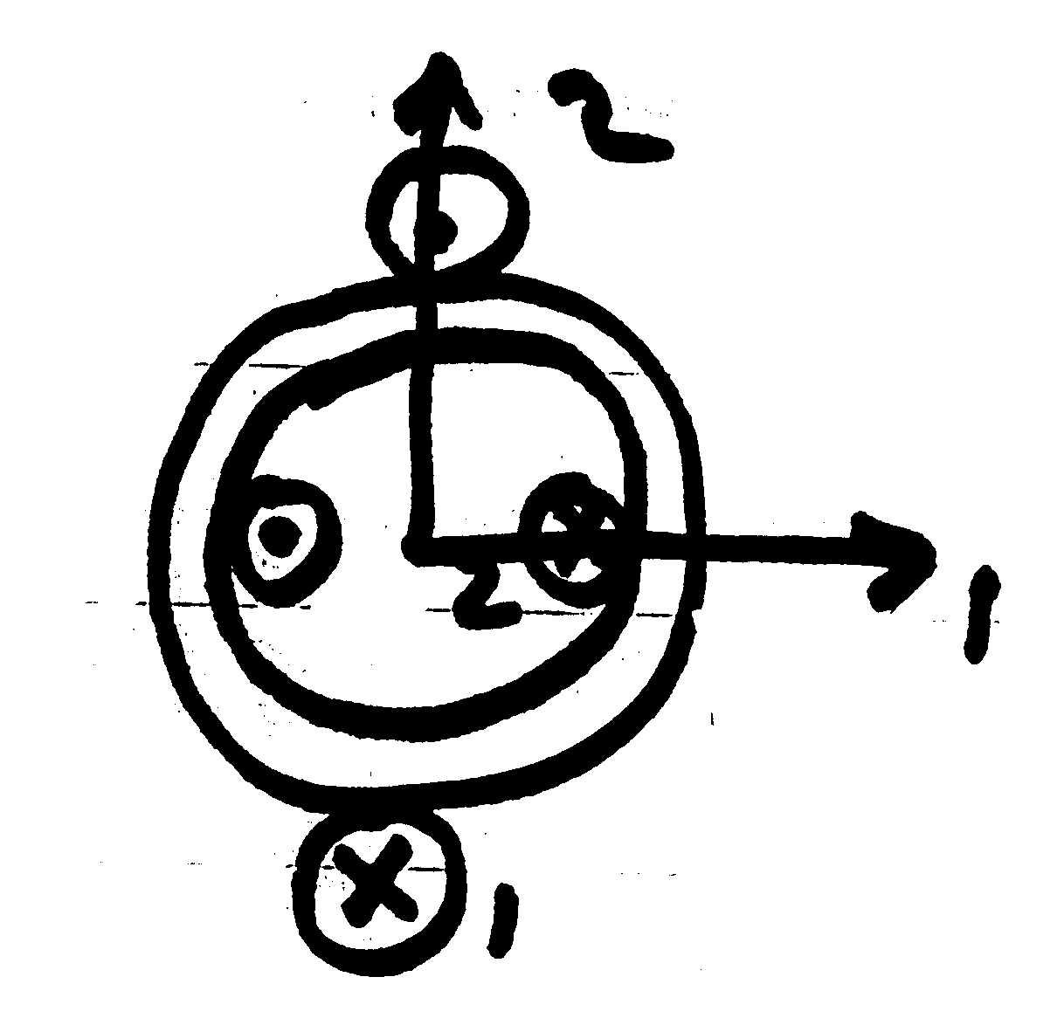
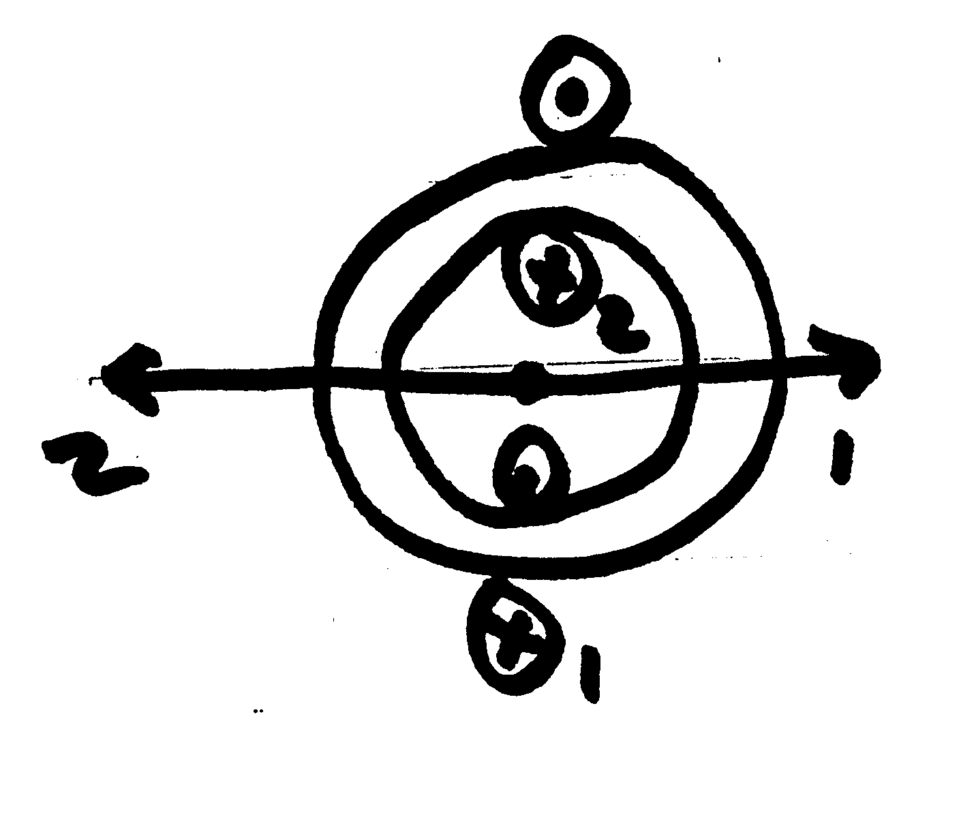
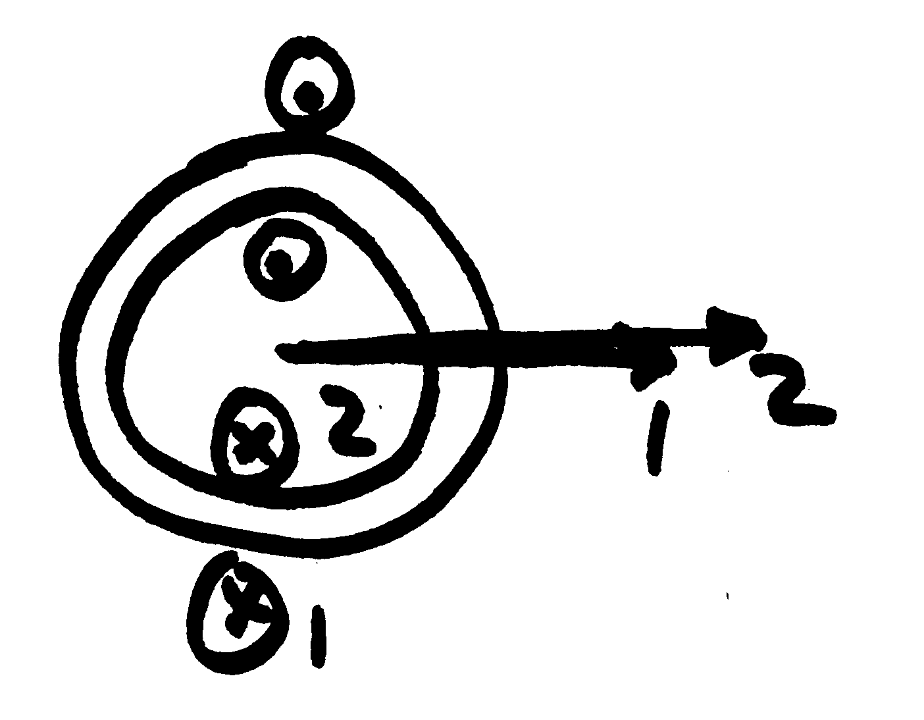
Inductive Dependence on Shaft Angle
L₁₂ = 0
L₁₂ = + maximum
L₁₂ = - maximum

Slide 39
Stator Inductances
The self inductance for each stator winding has a portion that is due to the leakage flux which does not cross the air gap, L_{ls}
The other portion of the self inductance is due to flux crossing the air gap and can be modeled for phase a as
Mutual inductance between the stator windings is modeled as
The offset angle
is either 2π/3 or
-2π/3

Slide 40
Conversion to dq0 for Angle Independence

Slide 41
Conversion to dq0 for Angle Independence

Slide 42
Convert to Normalized at f = ω_{s}
Convert to per unit, and assume frequency of ω_{s}
Then define new per unit reactance variables

Slide 43
Normalized Equations

