Slide 1
ECE 576 – Power System Dynamics and Stability
Lecture 8: Synchronous Machine Modeling
Prof. Tom Overbye
Dept. of Electrical and Computer Engineering
University of Illinois at Urbana-Champaign
overbye@illinois.edu

Slide 2
Announcements
Homework 2 is posted on the web; it is due on Thursday Feb 20
Skim Chapter 4; we'll be returning to this in greater detail later
  Commercial transient stability packages uses a number of different models to represent types of exciters and governors
Read Chapter 5 and Appendix A

Slide 3
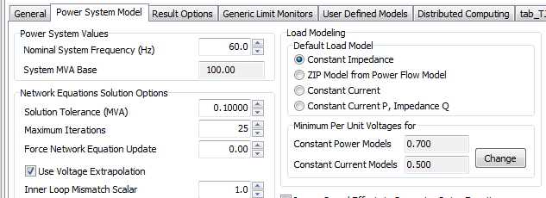
Load Modeling
The load model used in transient stability can have a significant impact on the results
By default PowerWorld uses constant impedance models but makes it very easy to add more complex loads.
The default (global) models are specified on the Options, Power System Model page.
These models are used only
when no other models are
specified.

Slide 4
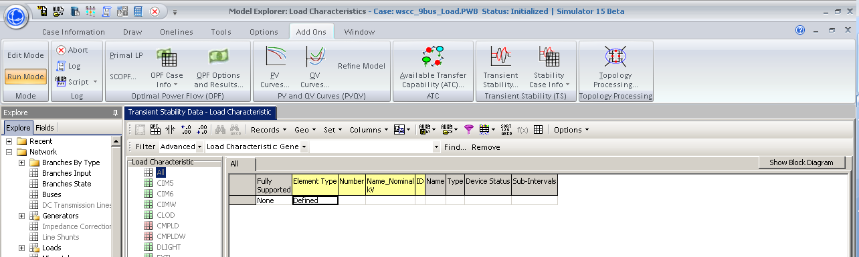
Load Modeling
More detailed models are added by selecting “Stability Case Info” from the ribbon, then Case Information, Load Characteristics Models.
Models can be specified for the entire case (system), or individual areas, zones, owners, buses or loads.
To insert a load model click right click and select insert
to display the Load Characteristic Information dialog.
Right click
here to get
local menu and
select insert.

Slide 5
Dynamic Load Models
Loads can either be static or dynamic, with dynamic models often used to represent induction motors
Some load models include a mixture of different types of loads; one example is the CLOD model represents a mixture of static and dynamic models
Loads models/changed in PowerWorld using the Load Characteristic Information Dialog
Next slide shows voltage results for static versus dynamic load models
Case Name: WSCC_9Bus_Load

Slide 6
WSCC Case Without/With Complex Load Models
Below graphs compare the voltage response following a fault with a static impedance load (left) and the CLOD model, which includes induction motors (right)

Slide 7
Under-Voltage Motor Tripping
In the PowerWorld CLOD model, under-voltage motor tripping may be set by the following parameters
  Vi = voltage at which trip will occur (default = 0.75 pu)
  Ti (cycles) = length of time voltage needs to be below Vi before trip will occur (default = 60 cycles, or 1 second)
In this example as you move the clearing time from 0.033 up to 0.040, you will see the motors tripping out on buses 5, 6, and 8 (the load buses) – this is especially visible on the bus voltages plot. These trips allow the clearing time to be a bit longer than would otherwise be the case.
Set Vi = 0 in this model to turn off motor tripping.

Slide 8
37 Bus System
Next we consider a slightly larger, 9 generator, 37 bus system. To view this system open case GSO_37Bus. The system one-line is shown below.
To see summary
listings of the transient stability models in this case
select “Stability Case Info” from the ribbon, and then either “TS Generator
Summary” or “TS
Case Summary”

Slide 9
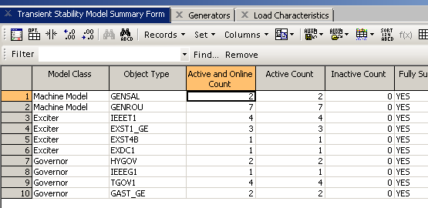
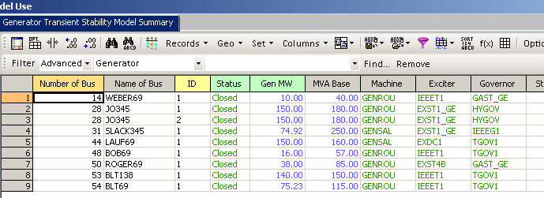
Transient Stability Case and Model Summary Displays
Right click on a line
and select “Show
Dialog” for more
information.

Slide 10
37 Bus Case Solution
Graph
shows the
generator
frequency
response
following
the loss
of one
generator

Slide 11
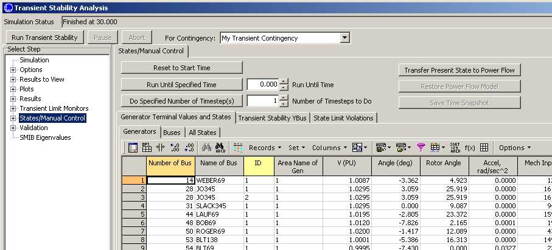
Stepping Through a Solution
Simulator provides functionality to make it easy to see what is occurring during a solution. This functionality is accessed on the States/Manual Control Page
Transfer results
to Power Flow
to view using
standard
PowerWorld
displays and
one-lines
See detailed results
at the Paused Time
Run a Specified Number of Timesteps or Run Until a Specified Time, then Pause.

Slide 12
Summary So Far
The model as developed so far has been derived using the following assumptions
  The stator has three coils in a balanced configuration, spaced 120 electrical degrees apart
  Rotor has four coils in a balanced configuration located 90 electrical degrees apart
  Relationship between the flux linkages and currents must reflect a conservative coupling field
  The relationships between the flux linkages and currents must be independent of θ_{shaft} when expressed in the dq0 coordinate system

Slide 13
Two Main Types of Synchronous Machines
Round Rotor
  Air-gap is constant, used with higher speed machines
Salient Rotor (often called Salient Pole)
  Air-gap varies circumferentially
  Used with many pole, slower machines such as hydro
  Narrowest part of gap in the d-axis and the widest along the q-axis

Slide 14
Assuming a Linear Magnetic Circuit
If the flux linkages are assumed to be a linear function of the currents then we can write
The rotor
self-
inductance
matrix
L_{rr} is
independent
of θ_{shaft}

Slide 15
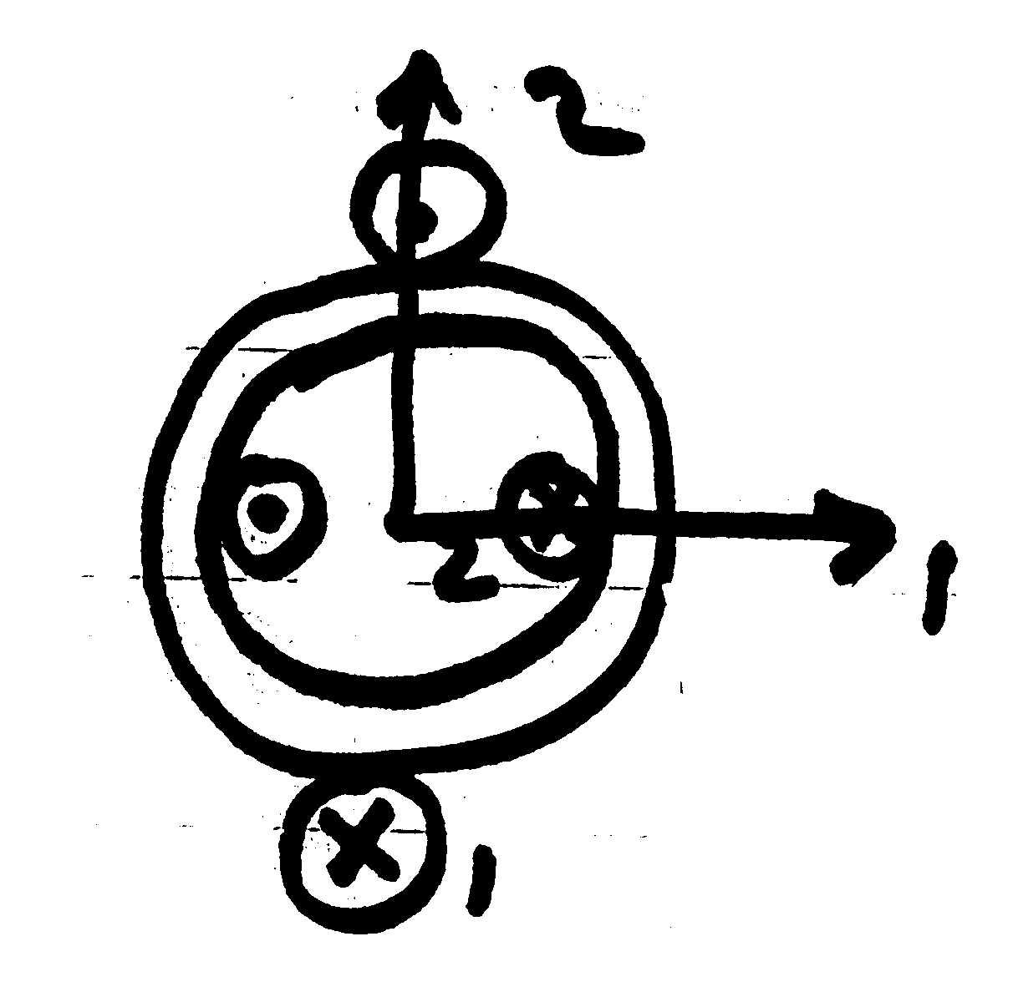
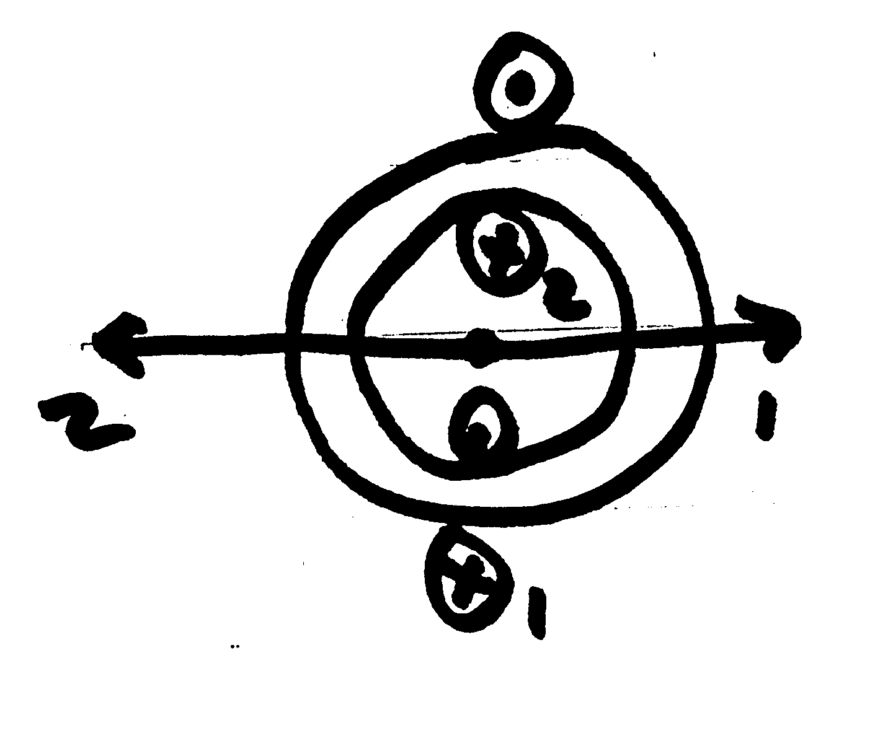
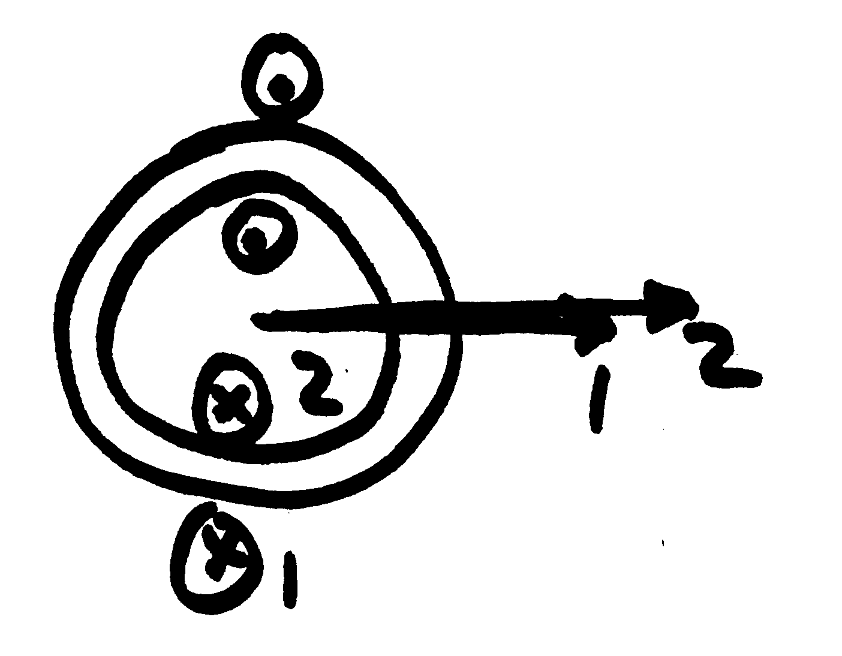
Inductive Dependence on Shaft Angle
L₁₂ = 0
L₁₂ = + maximum
L₁₂ = - maximum

Slide 16
Stator Inductances
The self inductance for each stator winding has a portion that is due to the leakage flux which does not cross the air gap, L_{ls}
The other portion of the self inductance is due to flux crossing the air gap and can be modeled for phase a as
Mutual inductance between the stator windings is modeled as
The offset angle
is either 2π/3 or
-2π/3

Slide 17
Conversion to dq0 for Angle Independence

Slide 18
Conversion to dq0 for Angle Independence
For a round rotor
machine L_{B} is small
and hence L_{md} is
close to L_{mq}. For a
salient pole machine
L_{md} is substantially
larger

Slide 19
Convert to Normalized at f = ω_{s}
Convert to per unit, and assume frequency of ω_{s}
Then define new per unit reactance variables

Slide 20
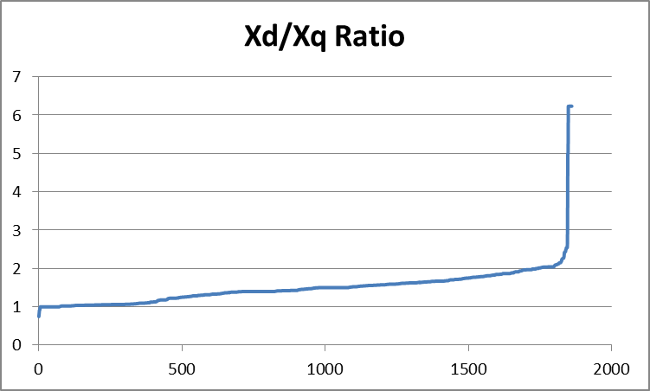
Example Xd/Xq Ratios for a
WECC Case

Slide 21
Normalized Equations

Slide 22
Key Simulation Parameters
The key parameters that occur in most models can then be defined the following transient values
These values
will be
used in
all the
synchronous
machine
models
In a salient rotor machine
X_{mq} is small so X_{q} = X'_{q;}
also X_{1q} is small so
T'_{q0} is small

Slide 23
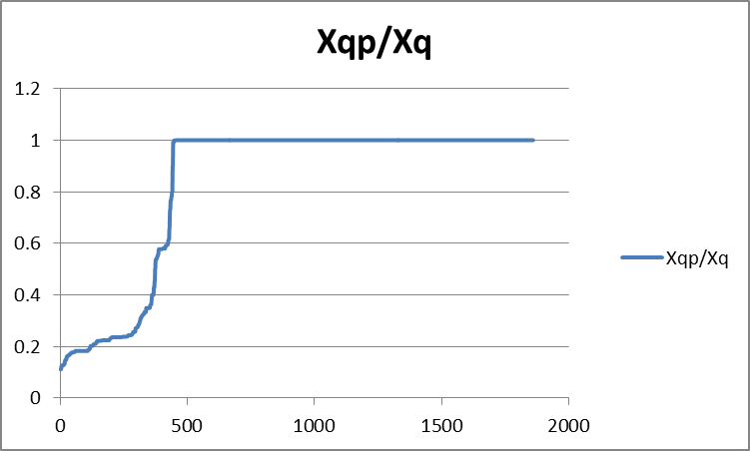
Example X'q/Xq Ratios for a
WECC Case
About 75% are Clearly Salient Pole Machines!

Slide 24
Key Simulation Parameters
And the subtransient parameters
These values
will be used in the
subtransient machine
models. It is common
to assume X"_{d} = X"_{q}

Slide 25
Internal Variables
Define the following variables, which are quite important in subsequent models
Hence E'_{q} and E'_{d} are
scaled flux linkages
and E_{fd} is the scaled
field voltage

Slide 26
Dynamic Model Development
In developing the dynamic model not all of the currents and fluxes are independent
  In the book formulation only seven out of fourteen are independent
Approach is to eliminate the rotor currents, retaining the terminal currents (I_{d}, I_{q}, I₀) for matching the network boundary conditions

Slide 27
Rotor Currents
Use new variables to solve for the rotor currents

Slide 28
Rotor Currents

Slide 29
Final Complete Model

Slide 30
Final Complete Model
T_{FW} is the friction
and windage
component that
we'll consider
later

Slide 31
Final Complete Model

Slide 32
Single-Machine Steady-State
Previous derivation was done assuming a linear magnetic circuit
We'll consider the nonlinear magnetic circuit (section 3.5) but will first do the steady-state condition (3.6)
In steady-state the speed is constant (equal to ω_{s}), δ is constant, and all the derivatives are zero
Initial values are determined from the terminal conditions: voltage magnitude, voltage angle, real and reactive power injection

Slide 33
Single-Machine Steady-State
The key variable
we need to
determine the
initial conditions
is actually δ, which
doesn't appear
explicitly in these
equations!

Slide 34
Field Current
The field current, I_{fd}, is defined in steady-state as
However, what is usually used in transient stability simulations for the field current is
So the value of X_{md} is not needed

Slide 35
Determining δ without Saturation
In order to get the initial values for the variables we need to determine δ
We'll eventually consider two approaches: the simple one when there is no saturation, and then later a general approach for models with saturation
To derive the simple approach we have

Slide 36
Determining δ without Saturation
Recalling the relation between δ and the stator values
We then combine the equations for V_{d} and V_{q} and get

Slide 37
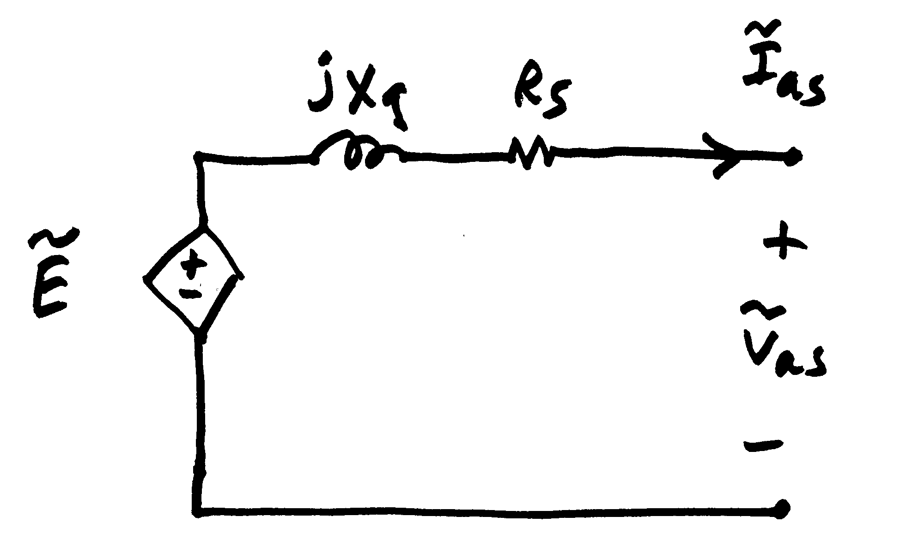
Determining δ without Saturation
Then in terms of the terminal values

