Slide 1
HVDC Modeling and Analysis in Transient Stability
March 18, 2014
Kate Davis, Ph.D.

Slide 2
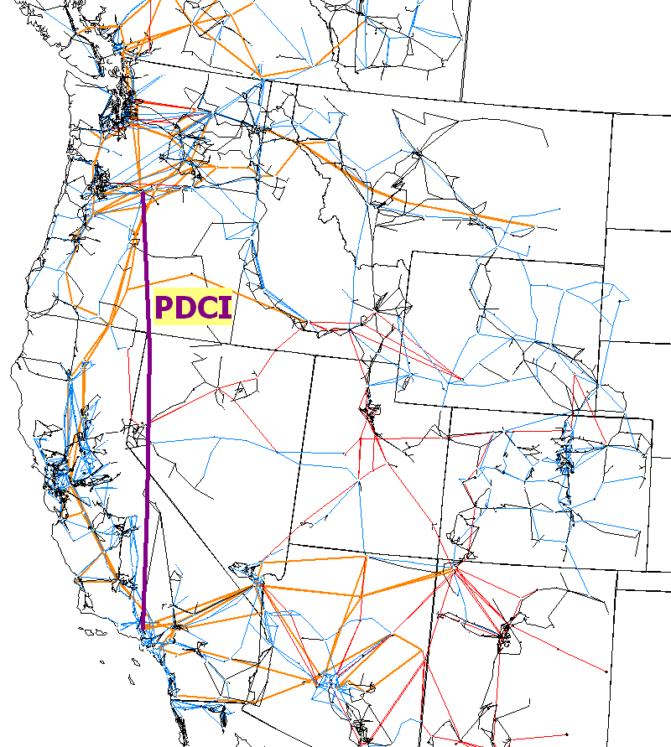
HVDC Lines and Stability
HVDC lines can rapidly control the transmitted power so they need to be modeled in transient stability
Rectifier
Terminals
Inverter Terminals

Slide 3
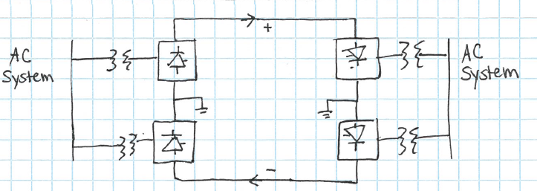
HVDC Overview
HVDC lines are often configured using a bipolar link
  Made up of groups of transformers, converters, and filters
Modeled as a single record, two-terminal DC line, in transient stability software
Each terminal has two converters of equal rating
  The junction between the converters is grounded
  Normally, there is no ground current

Slide 4

Transient Stability Modeling Reference
The most comprehensive book on this type of analysis is by Prabha Kundar and is called Power System Stability and Control published in 1994.
Book is too detailed for a
classroom textbook, but it
is a really great as a reference
book once you’re working
Covers HVDC Transmission

Slide 5
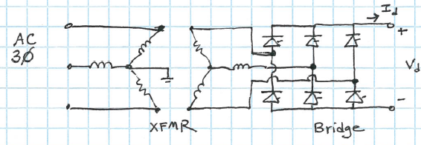
Three-Phase Bridge Converter
Converters control the power flow through the HVDC link
Refer to any power electronics book
For this analysis, assume
  Ideal AC voltage source in series with inductance
  Direct current I_{d} is ripple free due to smoothing reactor
  Ideal switches

Slide 6
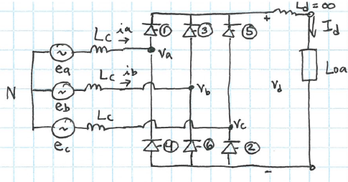

Simplified Bridge Model
Switches are labeled in firing order
$$e_{a}=E_{m}cos\left(ωt+60°\right)$$
$$e_{b}=E_{m}cos\left(ωt−60°\right)$$
$$e_{c}=E_{m}cos\left(ωt−180°\right)$$

Slide 7
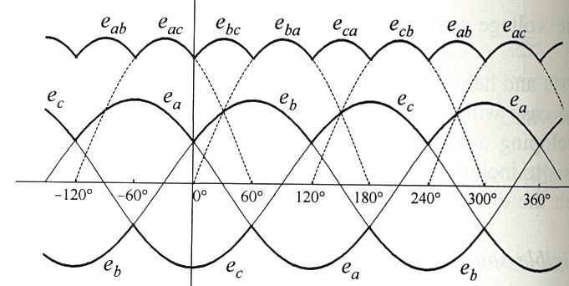










Bridge Firing Order
$$−120°<ωt<−60°$$
V_{a} is more positive than V_{b} and V_{c}, 1 conducts
$$+$$
$$−$$
$$+$$
$$e_{a}$$
$$e_{ab}$$
$$−$$
$$e_{b}$$
$$+$$
V_{b} is more negative than V_{c} and V_{a}, 6 conducts
$$−$$
Output voltage is e_{ab}

Slide 8




Bridge Firing Order
$$−60°<ωt<0°$$
V_{a} is more positive than V_{b} and V_{c}, 1 conducts
$$+$$
$$−$$
$$+$$
$$e_{a}$$
$$e_{ac}$$
$$−$$
$$e_{c}$$
$$+$$
V_{c} is more negative than V_{a} and V_{b}, 2 conducts
$$−$$
Output voltage is e_{ac}

Slide 9





Bridge Firing Order
$$0°<ωt<60°$$
$$+$$
$$−$$
$$e_{b}$$
$$+$$
$$e_{bc}$$
$$−$$
$$e_{c}$$
$$+$$
$$−$$

Slide 10







Bridge Firing Order
$$60°<ωt<120°$$
$$−$$
$$+$$
$$e_{a}$$
$$+$$
$$−$$
$$e_{b}$$
$$+$$
$$e_{ba}$$
$$−$$

Slide 11





Bridge Firing Order
$$120°<ωt<180°$$
$$−$$
$$+$$
$$e_{a}$$
$$+$$
$$e_{ca}$$
$$e_{c}$$
$$+$$
$$−$$
$$−$$

Slide 12






Bridge Firing Order
$$180°<ωt<240°$$
$$+$$
$$−$$
$$+$$
$$e_{cb}$$
$$e_{b}$$
$$e_{c}$$
$$+$$
$$−$$
$$−$$
$$etc…$$

Slide 13
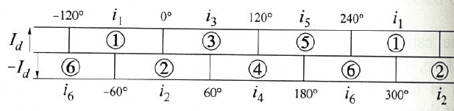
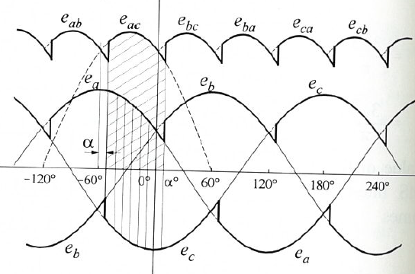
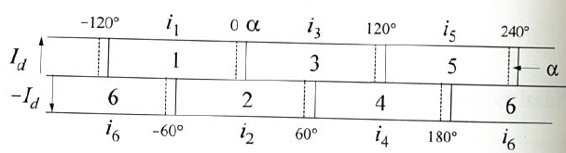


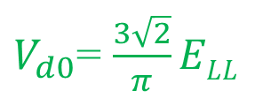

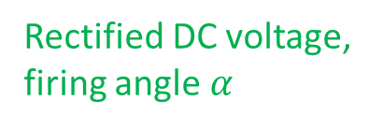
Bridge Firing with a Delay Angle
Firing can be delayed by α, causing current to lag the voltage
$$V_{d0}$$
Rectified DC voltage, no firing angle
$V_{d0}$= $\frac{3\sqrt{2}}{π}ELL$
$$0°<α<180°$$
$${V_{d}=V}_{d0}cosα$$
Rectified DC voltage, firing angle $α$
Notes:
ELL = line-to-line RMS source

Slide 14
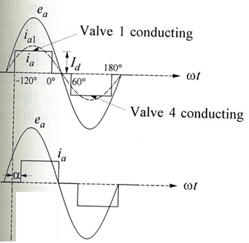
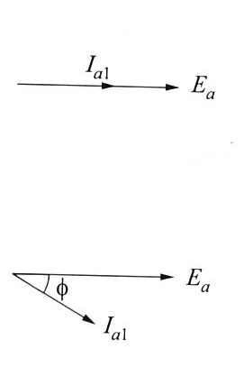
Power Factor Angle
As α varies, the phase displacement between the voltage and current also varies
0<α<90, P decreases and Q increases

Slide 15
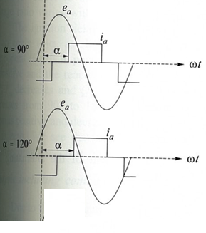
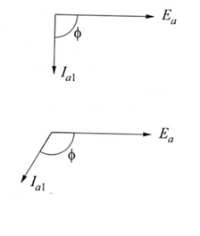
Power Factor Angle
The converter always draws reactive power from the AC system
α=90, P is zero, Q is max
90<α<180, P increases, Q decreases

Slide 16
Commutation Overlap
The analysis so far assumes there are always exactly two switches on at one time
In reality, there is some overlap
  Denoted by commutation angle µ
  0<µ<60, typically µ is 15 to 25
Commutation begins after α and ends after extinction angle δ=µ+α
Source inductances matter here
Notes:
See references for details

Slide 17
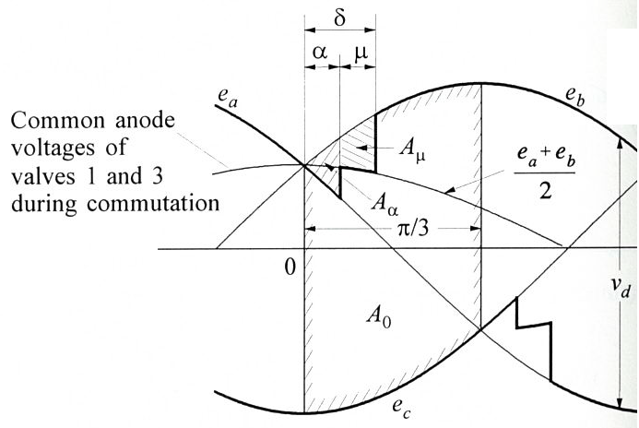


Commutation Overlap
Voltage Waveforms
Effect of commutation overlap is a voltage drop
$∆V_{d}=\frac{3}{π}I_{d}ωL_{c}$ $I_{d}=\frac{\sqrt{3}E_{m}}{2ωL_{C}}\left(cosα−cosδ\right)$
$${V_{d}=V}_{d0}cosα−∆V_{d}$$

Slide 18
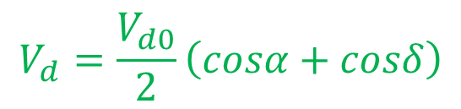

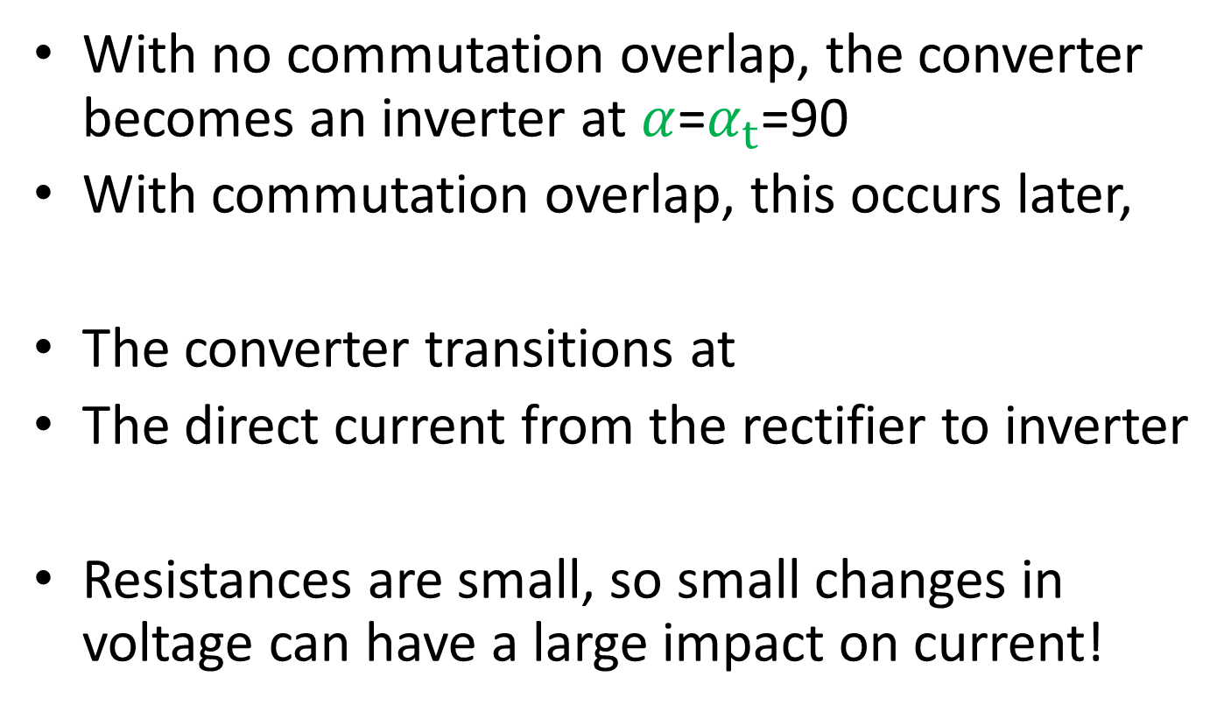
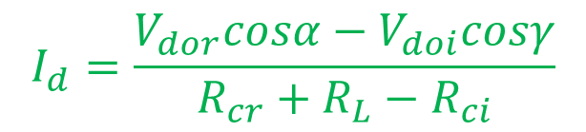


Rectifier vs. Inverter
With no commutation overlap, the converter becomes an inverter at $α$=$α_{t}$=90
With commutation overlap, this occurs later,
The converter transitions at
The direct current from the rectifier to inverter
Resistances are small, so small changes in voltage can have a large impact on current!
$$V_{d}=V_{d0}cosα$$
$$V_{d}=\frac{V_{d0}}{2}\left(cosα+cosδ\right)$$
$$cosα+cosδ=0$$
$$α_{t}=\frac{π−μ}{2}$$
$$I_{d}=\frac{V_{dor}cosα−V_{doi}cosγ}{R_{cr}+R_{L}−R_{ci}}$$

Slide 19
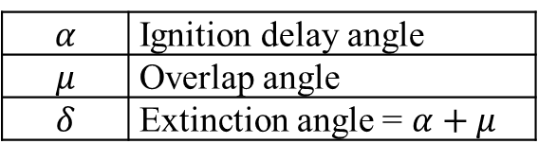
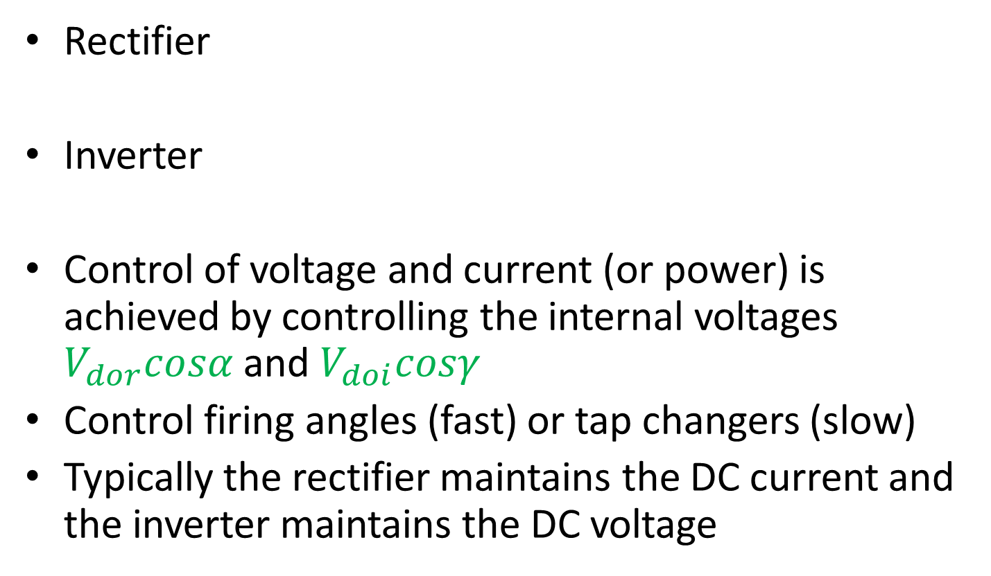
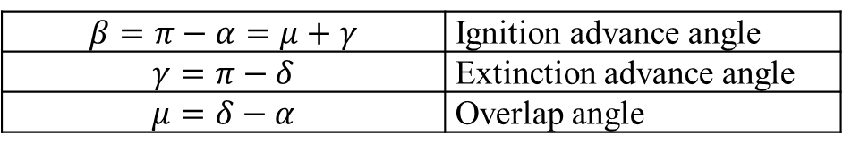
Summary of Angles
Rectifier
Inverter
Control of voltage and current (or power) is achieved by controlling the internal voltages $V_{dor}cosα$ and $V_{doi}cosγ$
Control firing angles (fast) or tap changers (slow)
Typically the rectifier maintains the DC current and the inverter maintains the DC voltage
$$α$$ | Ignition delay angle
$$μ$$ | Overlap angle
$$δ$$ | Extinction angle = $α+μ$
$$β=π−α=μ+γ$$ | Ignition advance angle
$$γ=π−δ$$ | Extinction advance angle
$$μ=δ−α$$ | Overlap angle

Slide 20
Generic PowerWorld Converter Model
Fixed parameters and setpoints of the converter
 | number of bridges at rectifier/inverter
 | commutating resistance and reactance in Ohms per phase
 | base AC voltage and DC voltage in kV
 | ratio of DCBase to ACBase
 | fixed AC tap
 | step size for the variable AC tap
 | Each converter has a single setpoint value. This value depends on the mode of the converter. The mode is either Current – a desired current in Amps Power – a desired power in MW Voltage – a desired DC voltage in kV Note that there can be only one voltage controlling converter

Slide 21
Generic Converter Model
Limiting parameters of the converter
 | Minimum/maximum values for the variable AC tap
 | Minimum/maximum firing angle limits at converter
 | Maximum current allowed through the converter
 | Converter participation factor
 | Rectifier margin (only used at rectifier converters).
Variables calculated in AC power balance equations
 | AC real power injection at the converter
 | AC reactive power injection at the converter
 | Voltage in the AC system in per units.
Variables calculated in DC system
 | DC system voltage and current in kV and kAmps
 | firing angle at rectifier/inverter
 | Variable AC tap

Slide 22
Bridge Equivalent Circuits

Slide 23
Summary of Equations

Slide 24
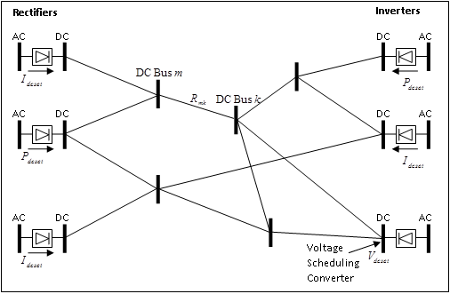
Generic DC Network
A completely general multi-terminal DC network can be modeled
Challenge is fault clearing

Slide 25
Generic DC Network
Each converter is given a setpoint: voltage, current, or power
Only one bus can have a voltage set point
Solve using Newton’s method
Assumes unconstrained operation
Then account for limits and update AC equations

Slide 26

Multi-Terminal DC Line
Dynamic Model for the Pacific DC Intertie

Slide 27
PDCI Model
Now only one converter here

Slide 28
PDCI Model
Documentation
  Existing text files contained the actual user-defined model implementation of the PDCI model (pdci_ns3.p and pdci_sn3.p)
  Dmitry Kosterev provided partial documentation describing the pdci_sn3.ps file. Most helpful for the newer CELILO 500 kV converters which had recently been upgraded
PowerWorld took the actual 1,300 lines of code in the pdci_ns3.p file and determined the block diagram being modeled for this important device (also looked through pdci_sn3.p)
The pdci_ns3.p code encompasses a model for controlling the firing angle on two converters at Celilo and one converter at Sylmar

Slide 29
PowerWorld Implementation and User Experience
Code Implementation
  Simulator’s internal code has been written to make the interaction of the dynamic multi-terminal DC line model and converters with the network boundary equations generic
    This will make adding new DC line models much easier
    Also will permit the creation of an interface to a user-defined multi-terminal DC line model
For immediate use, the user need only check a box asking that this model be used
  Simulator will look for the PDCI in the case and automatically include the dynamic model if appropriate
  All parameters of the model are hard-coded then
Version 17 allows the user to explicitly add the dynamic models and also see the internal states of these models if desired
  All parameters of the model will remain hard-coded for model
  May change this eventually if desired

Slide 30
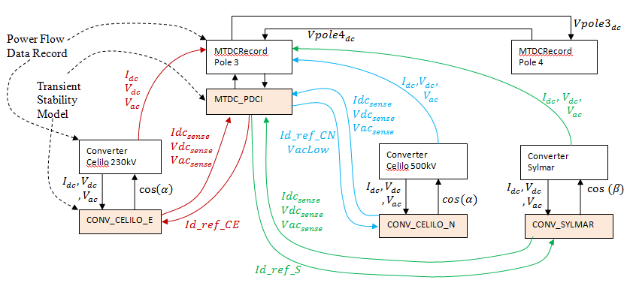
Implementation Overview in Simulator
Assign dynamic model MTDC_PDCI to the multi-terminal DC Line record
Assign appropriate dynamic converter models to the various DC converters: CONV_CELILO_E, CONV_CELILO_N, CONV_SYLMAR

Slide 31
MTDC_PDCI
The model is assigned to one Multi-Terminal DC record
  For the PDCI, two separate MTDC records are modeled, one for each pole of the PDCI
Inputs
  From DC Converters: States of the sensed DC Current, DC Voltage, and AC Voltage at each converter
  AC Network: Direct access to network boundary equation AC voltages is also used
  Other MTDC_PDCI: There is some feedback between the two poles in the DC voltage measurement
Outputs
  Feeds a reference current to each DC Converter model: id_ref_CN, id_ref_CE, and id_ref_S
  Also feeds a flag for VacLow as needed to the CONV_CELILO_N

Slide 32
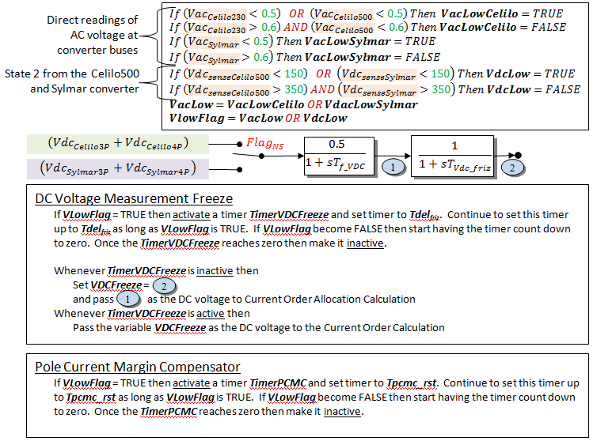
MTDC_PDCI:
Low Voltage Detection
Average DC voltage across both poles of the MTDC

Slide 33
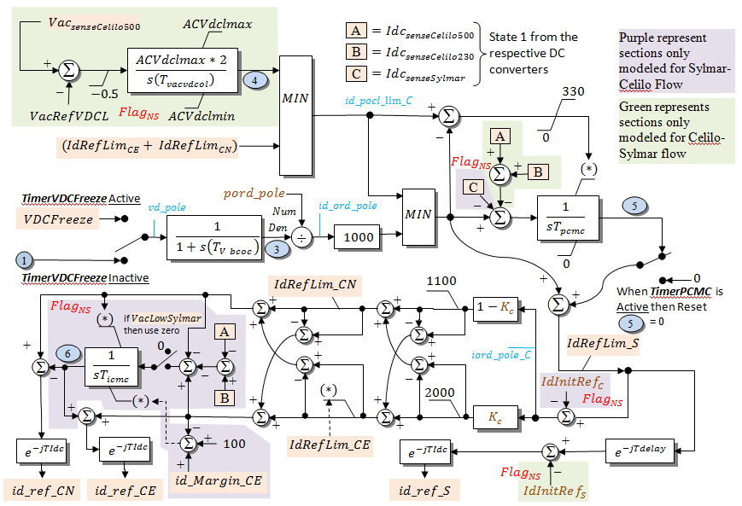
MTDC_PDCI:
Current Order Allocation
Outputs

Slide 34
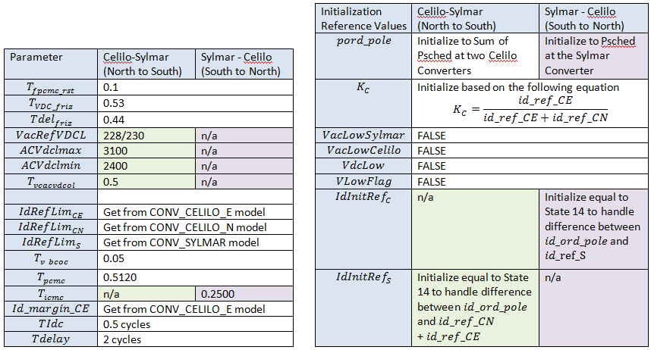
MTDC_PDCI:
Parameters and Initialization
Parameters and initialization depends on flow direction on the PDCI (North to South) or (South to North)

Slide 35
CONV_CELILO_E
Model assigned to the converter at the 230 kV bus at Celilo – the “Existing” Control
Inputs
  Reference current id_ref_CE from MTDC_PDCI
  Network boundary equation converter values: Idc, Vdc, Vac
Output
  Cosine of the control angle (Alpha or Beta as appropriate)

Slide 36
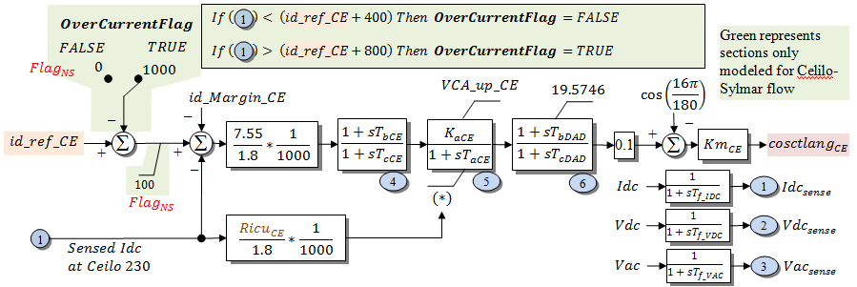
CONV_CELILO_E

Slide 37
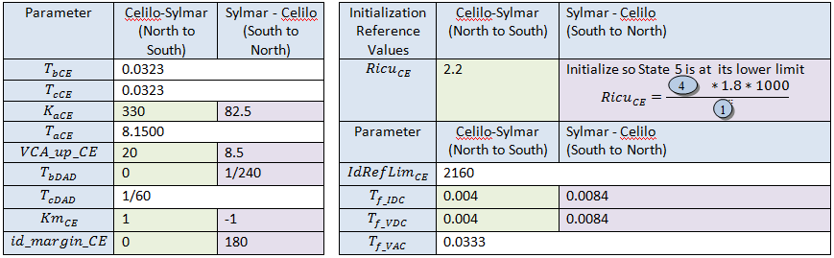
CONV_CELILO_E
Parameters and Initialization
Parameters and initialization depends on flow direction on the PDCI (North to South) or (South to North)

Slide 38
CONV_CELILO_N
Model assigned to the converter at the 500 kV bus at Celilo – the “New” Control
Inputs
  Reference current id_ref_CN from MTDC_PDCI
  VacLow from MTDC_PDCI
  Network boundary equation converter values: Idc, Vdc, Vac
Output
  Cosine of the control angle (Alpha or Beta as appropriate)

Slide 39
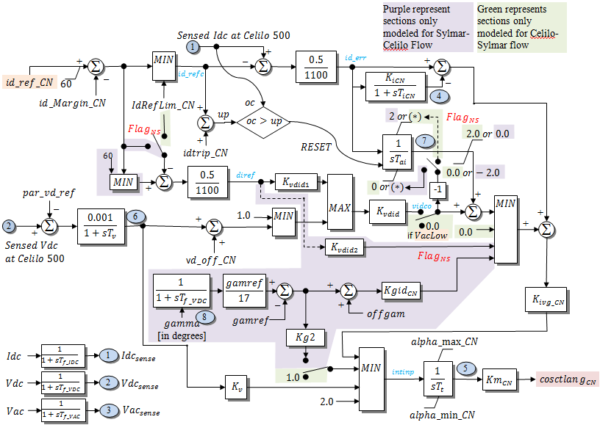
CONV_CELILO_N

Slide 40
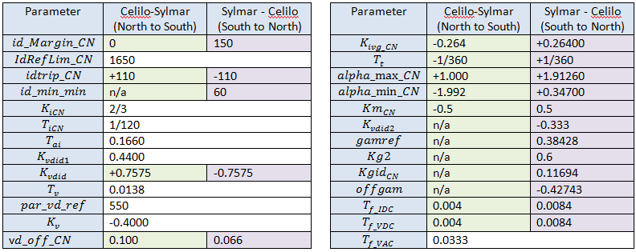
CONV_CELILO_N
Parameters and Initialization
Parameters and initialization depends on flow direction on the PDCI (North to South) or (South to North)

Slide 41
CONV_SYLMAR
Model assigned to the converter at the Sylmar
Inputs
  Reference current id_ref_S from MTDC_PDCI
  Network boundary equation converter values: Idc, Vdc, Vac
Output
  Cosine of the control angle (Alpha or Beta as appropriate)

Slide 42
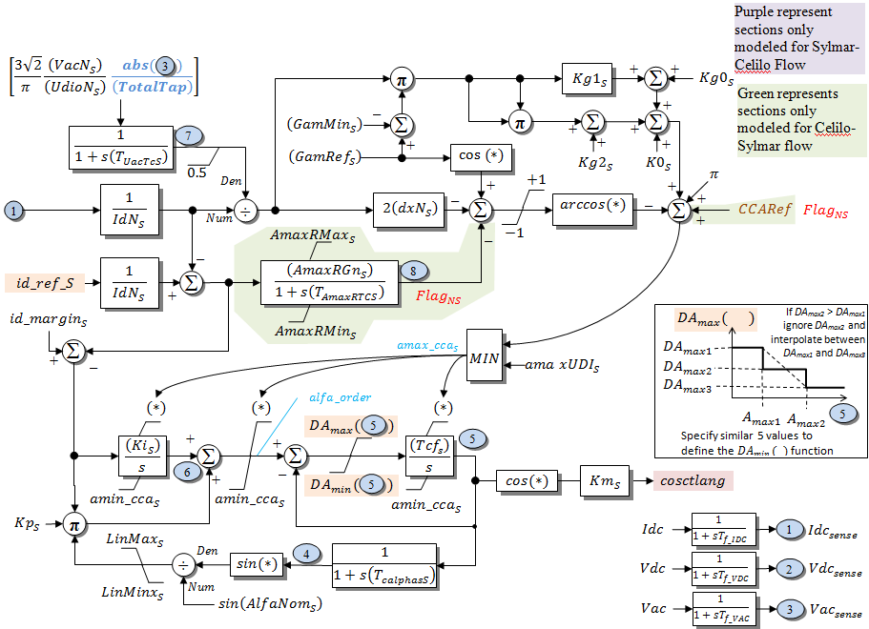
CONV_SYLMAR

Slide 43
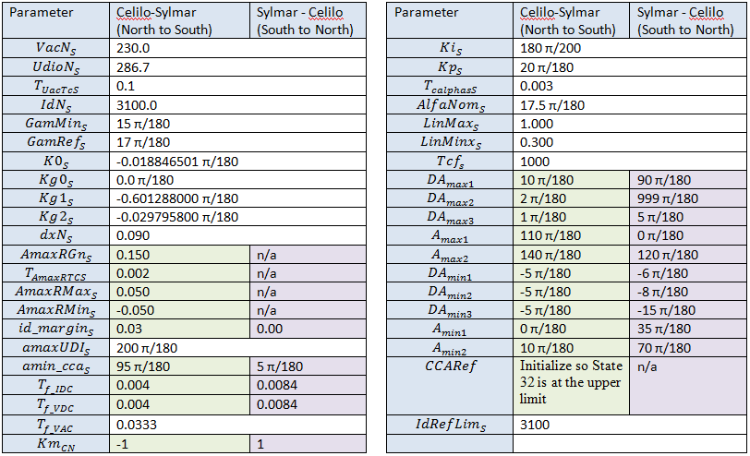
CONV_SYLMAR
Parameters and Initialization
Parameters and initialization depend on flow direction on the PDCI (North to South) or (South to North)

Slide 44
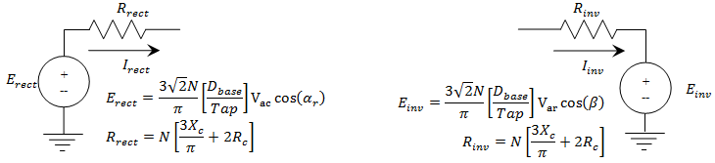
Handling of the Interaction with Network Boundary Equations
DC Converter equations
  Written in terms of Alpha at rectifiers
  Written in terms of Beta at inverters
    “Beta” is different than the Gamma traditionally used when writing the static power flow equations
  Equations are as follows
    Also force currents to be positive

Slide 45
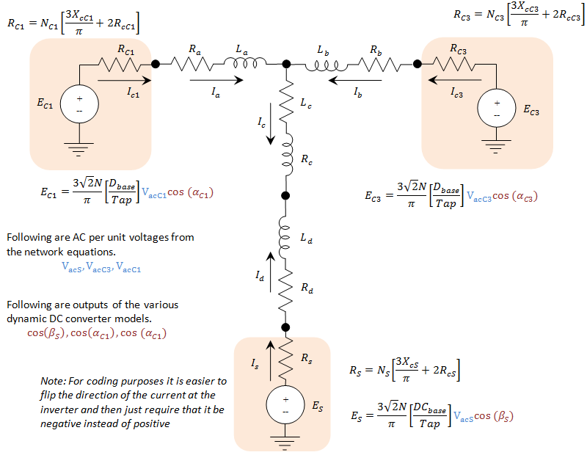
DC Network Model

Slide 46
What is Different Than a Power Flow Solution?
In static power flow solutions, DC converter control is instantaneous
  Power Flow Firing Angles (Alpha and Gamma) are assumed to move instantaneously
  PDCI model does not make this assumption, it models the dynamics of the firing angle control
Power flow solutions also ignore the inductance of the DC transmission line
  In power flow, DC currents change instantaneously
  PDCI models inductance, so DC currents become state variables
  Note: can also be capacitance in the DC transmission lines
    We are NOT modeling in the PDCI presently
    For cable DC lines (underwater for instance), the capacitance may become large enough that modeling will be important

Slide 47
Traditional Explicit Numerical Integration Routines
Always use the initial algebraic variables to back-solve and obtain the initial values of all dynamic states
PowerWorld’s transient stability tool then uses explicit integration (2nd order Runga-Kutta)
  Use numerical integration (with a time-step) to update dynamic state
  Update algebraic variables such as the AC system voltage and angle (by solving network boundary equations)
  Go back to 2 and repeat until simulation finished
  Multi-terminal DC simulation will be inserted between steps 1 and 2

Slide 48
Implementation in Numerical Solution Engine of MTDC
Numerical integration → integrate the MTDC_PDCI, CONV_CELILO_E, CONV_CELILO_N, and CONV_SYLMAR model states
    Updated variables are cos(α) and cos(β)
Take the cos(α) and cos(β) terms and use them to model a step change in the DC voltages seen by the DC network equations. Use numerical integration to solve for new DC voltages and DC currents
    Updated variables are DC voltage and DC Currents
Solving normal AC network boundary equations except modify DC line equations to assume that cos(α) and cos(β) , and DC currents are a constant. When network boundary equations are solved update the DC voltages
    Updated variables are DC voltages
Back to Step 1 and repeat

Slide 49
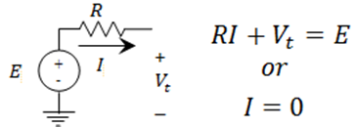
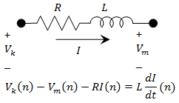
Step 2: Numerical Integration of DC Network Equations
DC Converter Model
  Constant angle so model as
  a constant voltage source
DC Transmission Line Model
  Model as RL circuit using trapezoidal rule
DC Bus Equation
  Just use Kirchoff’s Current Law

Slide 50
Step 2: Numerical Integration of DC Network Equations
Solve the previous set of equations using sub-interval integration
Assume at beginning that no converters are stuck at the zero current limit
At each sub-interval, if the calculation yields a converter current with the wrong sign then redo the sub-interval replacing the DC converter equation with the equation I=0
Assume that once a current goes to zero it remains zero during the remaining sub-interval time-steps

Slide 51
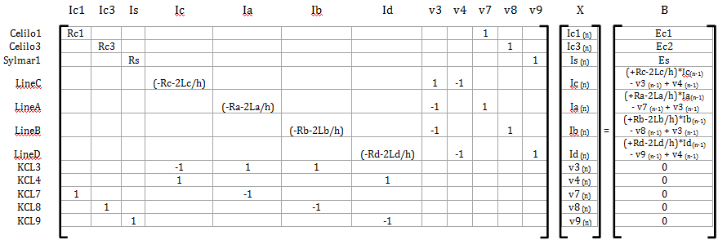
Step 2: Numerical Integration of DC Network Equations: Matrices
The following is an example matrix setup for the PDCI
If Celilo1 current becomes negative, then replace equation with the following

Slide 52
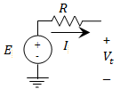



Step 3: Solution of algebraic change in DC voltages
DC Converter Model
  Constant angle and constant current
DC Transmission Line Model
  Model as RL circuit, but current is constant
  dI/dt is the unknown variable
DC Bus Equation
  Just use Kirchoff’s Current Law, but for the derivatives

Slide 53
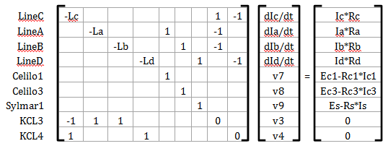
Step 3: Solution of algebraic change in DC voltages: Matrices
The following is a sample of the matrix setup for the PDCI

Slide 54
Summary
Basics of HVDC operation and modeling
PowerWorld models in steady state and in transient stability
Brief overview of PDCI example
Resources available to find more information

