Slide 1
ECE 590 SIP – Spectrogram Reading – February 28, 2018
How to Create a Spectrogram you can Read
Create spectrograms using standard software and at a standard resolution that you’re used to.
  I recommend exactly 1.5 seconds stretched out to the full length of the page, with 0.2s overlap between successive pages.
  Frequency axis truncated at 4500Hz.
  Window length 6ms, 2ms skip, 0.98 pre-emphasis.

Slide 2
The “Crossword Puzzle” Method for Decoding Spectrograms
First pass: Create a column of IPA symbols under each chunk of audio that you believe to be a phoneme.
First, go through and find all of the /ɻ/s and /ɝ/s (glides and vowels, respectively, with F3<2000), all of the /j/s (glides with F2>1800), and all of the /w/s (glides with F2<1000).
Second, identify all of the other consonants. For nasals, fricatives, and stops, for now, just write N, F, S to mark manner class.
  If it’s sonorant with a strong F2 at around 1000-1500 Hz, and with an F3 that vanishes during the sonorant closure, it might be N, or it might be an /l/
  Otherwise, try to estimate whether it’s F, S, or /w/. You can put any or all of these symbols that seem reasonable.
Third, for each vowel, look up its formants in Peterson & Barney. WARNING: Always write down at least the three IPA symbols whose formants are closest to the one you’re looking at.
Second pass: Like solving a crossword puzzle. Try to find a sequence of words that could be pronounced using one IPA symbol from each of the columns you’ve written, +/- first-pass errors.

Slide 3
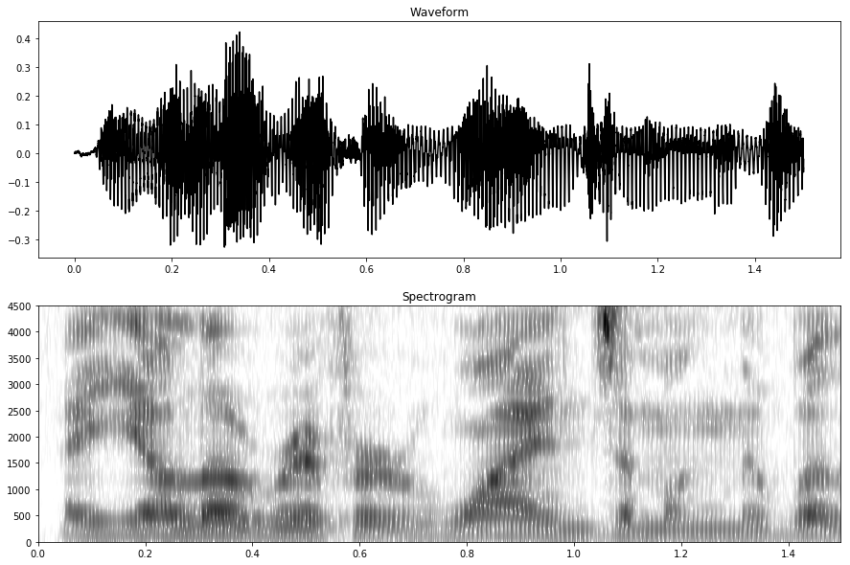

Slide 4
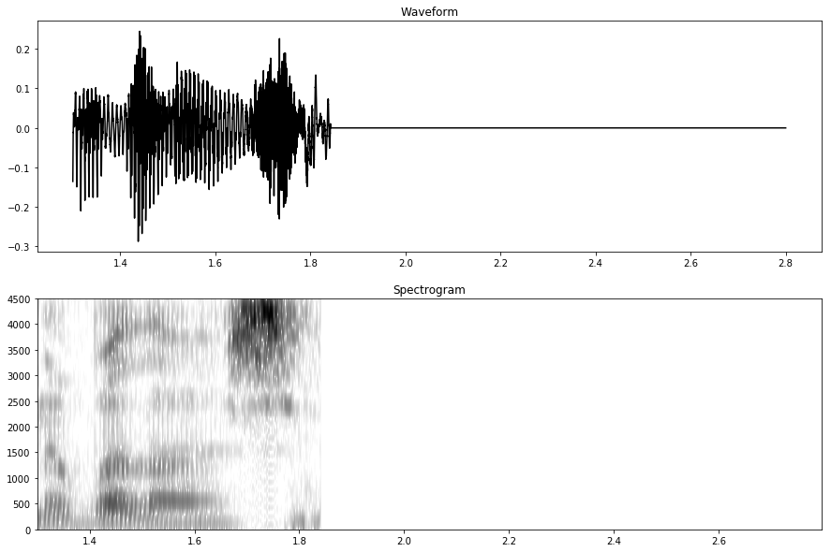

Slide 5
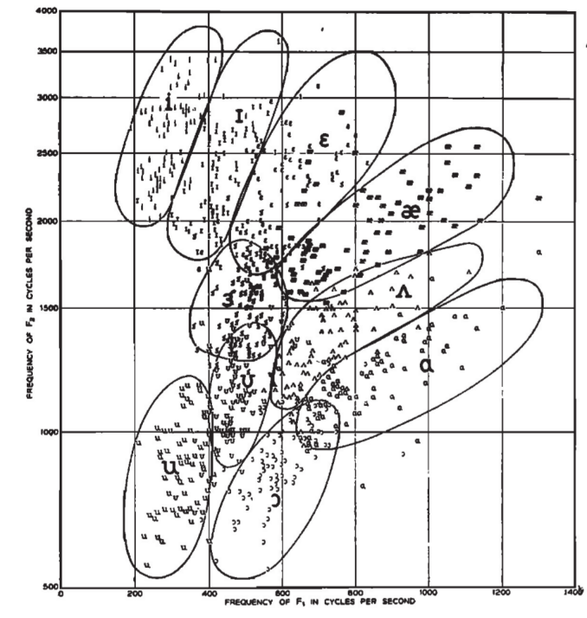
e,
ə,
o,

