Slide 1
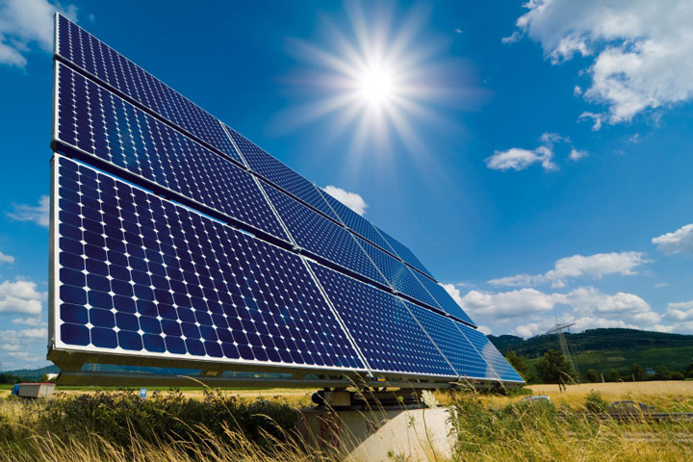
Phys 102 – Lecture 16
Electromagnetic wave energy & polarization

Slide 2
Today we will...
Learn about properties of electromagnetic waves
Energy density & intensity
Polarization – linear, circular, unpolarized
Apply those concepts
Linear polarizers
Optical activity
Circular dichroism

Slide 3
E & B field energy density
There is energy stored in an E & B field
B
A
d
Parallel plate capacitor
Solenoid
E
Recall Lect. 6
Volume containing E field
It is convenient to define energy density = energy per volume [J/m³]
These expressions are correct for any E & B field in a vacuum

Slide 4
EM wave energy
There is energy stored in an EM wave in oscillating E & B fields
E₀
B(t)
B₀
E(t)
Since E and B oscillate, we measure the average energy density
E & B field amplitudes
Recall that

Slide 5
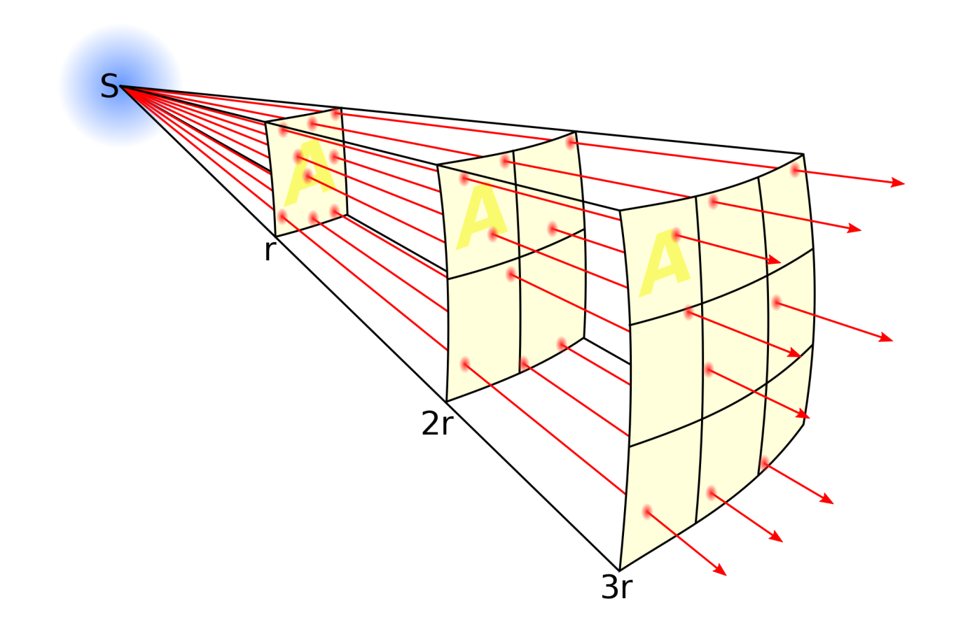
EM wave intensity
A source of light emits EM energy at a rate given by the power P:
Units: W
Same energy flows through surfaces at larger distances, but spread over a larger surface area A.
Energy flowing through surface in time Δt:
It is useful to define intensity:
Units: W/m²
Intensity corresponds to “brightness” of light

Slide 6
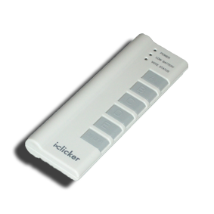
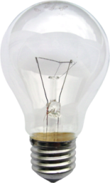
ACT: EM wave intensity
I_{P} is the light intensity at a point P a distance r from a point source, a 60 W light bulb.
(Assume all electric power goes into EM wave)
I_{P}
r
?
2r
What is the light intensity at a distance 2r?
2I_{P}
I_{P}
I_{P}/2
I_{P}/4

Slide 7
Calculation: EM power
A light bulb emits an average 60 W of power. Calculate E_{rms} & B_{rms} at a distance r = 2 m from bulb.
(Assume all electric power goes into EM wave)
By energy conservation, power emitted = power through spherical surface at r = 2 m
r = 2 m

Slide 8
CheckPoint 1.1–1.7
Longitudinal waves: oscillations are || to direction or propagation
Transverse waves: oscillations are ⊥ to direction of propagation
λ
DEMO
λ
Ex: Sound
Ex: Light
Radio waves
X-rays
Microwaves
Water waves
“The wave”
All EM waves!
Compressed air
Expanded air
E
B
Notes:
DEMO 353: Slinky
http://www.youtube.com/watch?v=5CAYNTBrczo

Slide 9
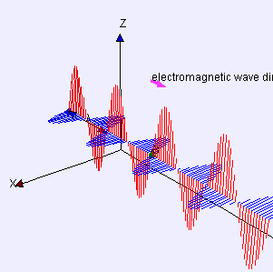
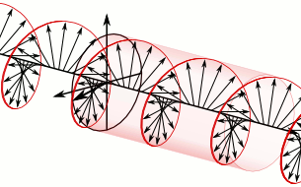
Polarization
EM waves are transverse and have polarization – by convention, the direction of the E field oscillation
z
z
E
Linear
y
x
B
x
Ex: “Vertical” polarization
z
E
z
Circular
y
x
x
B
Ex: “Left” circular polarization
Unpolarized – direction is random
For convenience we will stop showing the B field

Slide 10
Linear polarizers
Linear polarizers consist of || metal lines that absorb || E field.
Transmission axis (TA) is defined in direction that E field passes
TA
E
E ⊥ TA: no light passes
TA
E
E || TA: light passes
What happens for other angles between polarization and TA?

Slide 11
Law of Malus
Given angle θ between TA and polarization of incident EM wave:
E_{inc}
E_{inc}
θ
θ
E_{trans}
TA
TA
Component of E field ⊥ to TA axis is absorbed:
I_{trans}
TA
I_{inc}
Since
θ
θ
0
180
360
Light emerges with polarization || to TA axis

Slide 12
ACT: polarizer
A vertically polarized EM wave passes through a linear polarizer with TA at 45°
E_{inc}
TA
What is the direction of the B field after the polarizer?
B. C. D.
What is the magnitude?

Slide 13
Calculation: unpolarized light
Unpolarized light is incident on a linear polarizer. What is the transmitted intensity?
TA
E_{inc}
E_{trans}
Unpolarized light has an equal mixture of all possible θ’s
I_{trans}
I_{inc}
average over all θ:
I_{inc}/2
θ
0
180
360
Light emerges with polarization || to TA axis

Slide 14
ACT: CheckPoint 2.1
Unpolarized light passes through a linear polarizer with a vertical TA.
I₀
TA
What is the intensity of light when it emerges?
zero
1/2 what it was before
1/4 what it was before
1/3 what it was before

Slide 15
ACT: CheckPoint 2.2
Now the light that emerged from the previous polarizer passes through a second linear polarizer with a horizontal TA.
1
2
I₀
TA
TA
What is the intensity of light when it emerges?
zero
1/2 what it was before
1/4 what it was before
1/3 what it was before

Slide 16
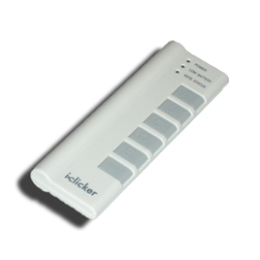
ACT: 3 polarizers
Now suppose we add a third polarizer between the two outer polarizers. The polarizer TA is tilted from vertical.
1
3
2
I₀
TA
TA
TA
What is the intensity of the light that emerges?
DEMO
zero, same as before
more than what it was before
need more information
Notes:
Demo

Slide 17
Calculation: 3 polarizers
1
3
2
I₀
TA
TA
TA

Slide 18
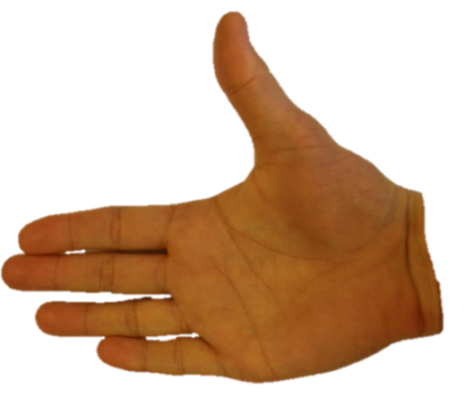
Chirality & optical activity
Many organic molecules are chiral – they have “handedness”
L-alanine
D-alanine (unnatural enantiometer)
Chiral molecules rotate linearly polarized light – optical activity
DEMO
“Dextrorotary” CW rotation
“Levorotary” CCW rotation

Slide 19
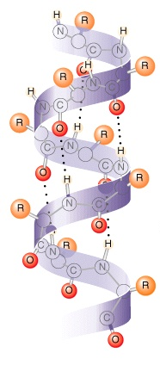
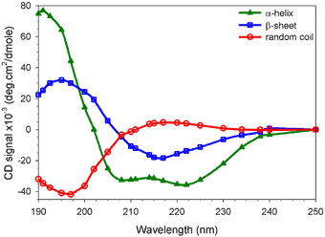
Circular dichroism
Chiral molecules also absorb left vs. right circularly polarized light differently
Circular dichroism (CD) measures difference in absorption
Tool to distinguish chiral features in biomolecules
CD spectra
α-helix (right-handed helix)

Slide 20
ACT: Law of Malus
A
θ₀₁ = 60°
B
θ₀₁ = 60°
I₀
I₀
1
1
2
2
TA
TA
TA
TA
Compare the light emerging from the two polarizers in A and B:
A. I₂^{A} > I₂^{B} B. I₂^{A} = I₂^{B} C. I₂^{A} < I₂^{B}

Slide 21
Summary of today’s lecture
Electromagnetic waves
Carry energy in E and B fields – energy density & intensity
Are transverse & polarized – linear, circular, unpolarized
Applications
Linear polarizers – Law of Malus
Optical activity
Circular dichroism

