Slide 1
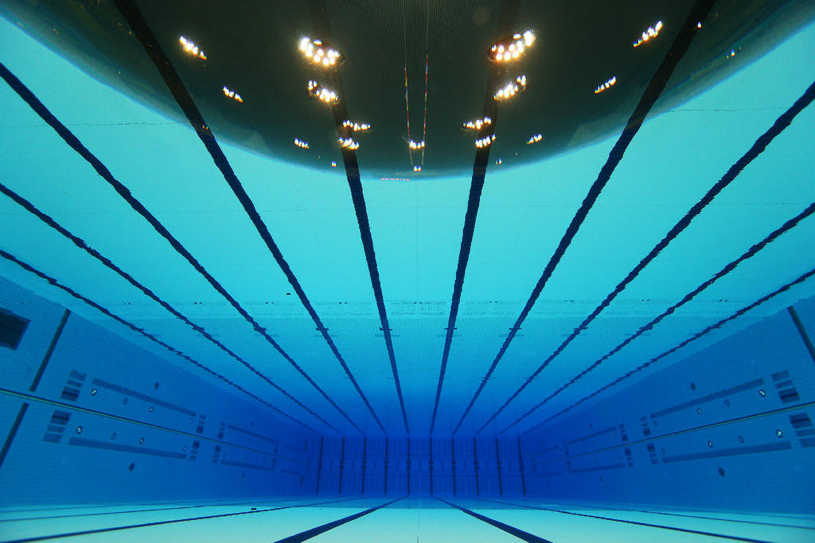
Phys 102 – Lecture 19
Refraction & lenses

Slide 2
Today we will...
Review refraction
Snell’s law
Learn applications of refraction
Total internal reflection
Converging & diverging lenses
Learn how lenses produce images
Ray diagrams – principal rays
Lens & magnification equations

Slide 3
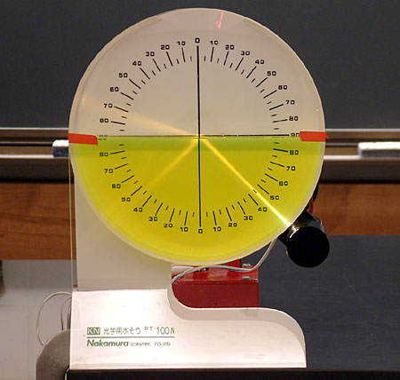
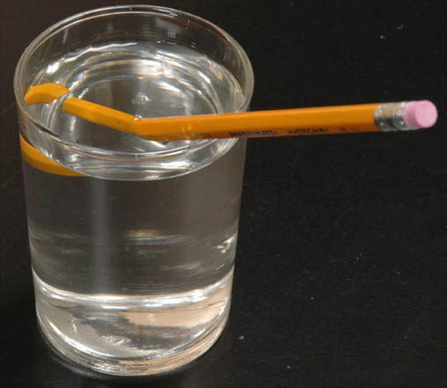
Review: Snell’s Law
Light bends when traveling into material with different n
If n₁ > n₂ then θ₂ > θ₁
refracted
Light bends away from normal as it goes into a medium with lower n
θ₂
n₂
n₁ > n₂
θ_{r}
θ₁
reflected
incident

Slide 4
Total internal reflection
From Snell’s law, if n₁ > n₂ then θ₂ > θ₁
So,
Light incident at critical angle θ₁= θ_{c} refracts || to surface (θ₂ = 90°)
θ₁
= 90°
θ_{r}
Light incident at angle θ₁> θ_{c} will only have reflection (θ₁ = θ_{r})!
n₂
n₁ > n₂
θ₂
= θ_{c}

Slide 5
Calculation: underwater view
Explain why the diver sees a circle of light from outside surrounded by darkness
n_{air} = 1
θ_{i}
θ_{c}
n_{water} = 1.33

Slide 6
ACT: CheckPoint 1.1
Can the person standing on the edge of the pool be prevented from seeing the light by total internal reflection?
A. Yes B. No

Slide 7
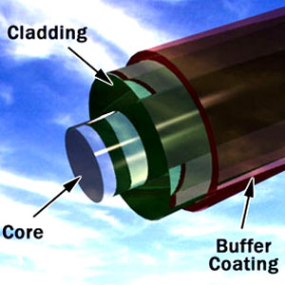
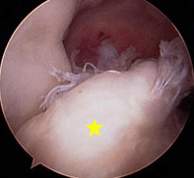
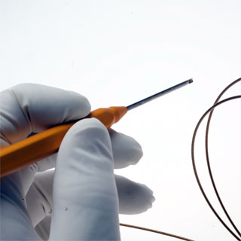
Fiber Optics
Optical fibers consist of “core” surrounded by “cladding” with n_{cladding} < n_{core}. Light hits core-cladding interface at θ_{i} > θ_{c}, undergoes total internal reflection and stays in the fiber.
θ_{i} > θ_{c}
Core
Cladding
Only works if n_{cladding} < n_{core}
Telecommunication
Arthroscopy
Laser surgery
DEMO

Slide 8
Converging lens
Lenses use refraction and curved surface(s) to bend light in useful ways
If n₁ > n₂ then θ₂ > θ₁
θ₂
θ₁
f
p.a.
DEMO
“Focal length”
Converging lens – rays || to p.a. refract through focal point f after lens

Slide 9
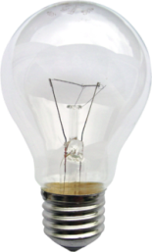
CheckPoint 2.1
A beacon in a lighthouse produces a parallel beam of light. The beacon consists of a bulb and a converging lens. Where should the bulb be placed?
p.a.
f
At f
Inside f
Outside f
f
p.a.
f

Slide 10
Diverging lens
Lenses use refraction and curved surface(s) to bend light in useful ways
If n₁ > n₂ then θ₂ > θ₁
θ₂
f
θ₁
p.a.
DEMO
Diverging lens – rays || to p.a. reflect as if they originated from focal point f before lens

Slide 11
Converging & diverging lenses
Converging lens:
Rays parallel to p.a. converge on focal point after lens
=
=
Converging = thick in the middle
“Plano-convex”
“Double convex”
“Concave-convex”
Diverging lens:
Rays parallel to p.a. diverge as if originating from focal point before lens
=
=
Diverging = thin in the middle
“Plano-concave”
“Double concave”
“Convex-concave”

Slide 12
ACT: Lens geometry
The following lenses are all made from the same material but have different geometry
Which lens has the shortest (positive) focal length?
A. B. C. D.

Slide 13
ACT: CheckPoint 3.1
A glass converging lens placed in air has focal length f.
n_{glass}
n_{water} = 1.33
n_{air} = 1.0
Now the lens is placed in water. Its focal length:
Stays the same
Increases
Decreases

Slide 14
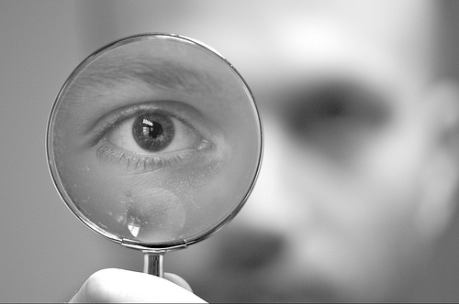
Images & lenses
Like mirrors, lenses produce images of objects
Key approaches:
Ray diagrams
Thin lens & magnification equations

Slide 15
Principal rays – converging lens
Ray from object traveling:
parallel to principal axis, refracts through f
through f, refracts parallel to principal axis
through C, travels straight
Object
f
f
2
3
Image
1
Image is:
Real (light rays cross)
Inverted (opposite direction as object)
Reduced (smaller than object)

Slide 16
Principal rays – diverging lens
Ray from object traveling:
parallel to principal axis, refracts through f
through f, refracts parallel to principal axis
through C, travels straight
1
2
Object
f
Image
f
Image is:
Virtual (light rays don’t really cross)
Upright (same direction as object)
Reduced (smaller than object)
3

Slide 17
ACT: CheckPoint 4.1
A converging lens produces a real image onto a screen. A piece of black tape is then placed over the upper half of the lens.
Object
f
f
Image
Which of the following is true:
Only the lower half of the object will show
Only the upper half of the object will show
The whole object will still show

Slide 18
Thin lens & magnification equations
Magnification
Image
Object
f
f
Thin lens equation
So,
Same as mirror equations!

Slide 19
Distance & magnification conventions
Object
Image
h_{o}
d_{i}
f
f
h_{i}
d_{o}
d_{o} = distance object is from lens:
> 0: object before lens
< 0: object after lens
h_{o} = height of object:
> 0: always
d_{i} = distance image is from lens:
> 0: real image (after lens)
< 0: virtual image (before lens)
h_{i} = height of image:
> 0: image is upright
< 0: image is inverted
f = focal length lens:
> 0: converging lens
< 0: diverging lens
|m| = magnification:
< 1: image is reduced
> 1: image is enlarged
Note similarities to mirror conventions

Slide 20
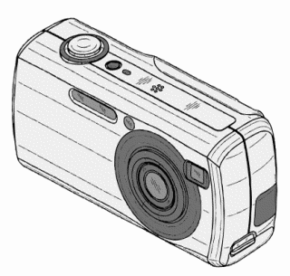
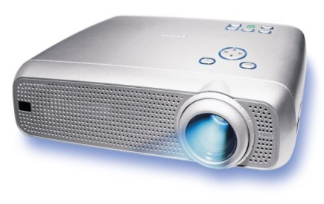
3 cases for concave mirrors
Object is:
Image is:
Object
Past 2f:
2f < d_{o}
Inverted: h_{i} < 0
Reduced: m < 1
Real: d_{i} > 0
Image
2f
f
f
2f
Between 2f & f:
f < d_{o} < 2f
Inverted: h_{i} < 0
Enlarged: m > 1
Real: d_{i} > 0
Object
Image
f
f
Image
Inside f:
d_{o} < f
Upright: h_{i} > 0
Enlarged: m > 1
Virtual: d_{i} < 0
f
Object
f
DEMO

Slide 21
ACT: Converging Lens
A candle is placed in front of a converging lens. The lens produces a well-focused image of the flame on a screen a distance d_{i} away.
f
d_{i}
p.a.
f
d_{o}
Screen
If the candle is moved farther away from the lens, how should the screen be adjusted to keep a well-focused image?
Closer to lens
Further from lens
At the same place

Slide 22
Calculation: diverging lens
A 6-cm tall candle is placed 12 cm in front of a diverging lens with a focal length f = –6 cm. Determine the image location, size, and whether it is upright or inverted
p.a.
f
f
4 cm
4 cm
Diagram should agree!

Slide 23
ACT: Diverging Lenses
Where in front of a diverging lens should you place an object so the image is real?
p.a.
f
f
Closer to lens
Further from lens
Diverging lens can’t create real image

Slide 24
Summary of today’s lecture
Total internal reflection
Lenses – principal rays
Parallel to p.a. –> refracts through f
Through f -> refracts parallel to p.a.
Through C -> straight through
Thin lens & magnification equations
Numerical answer consistent with ray diagram

