Slide 1
Phys 102 – Lecture 22
Interference

Slide 2
Physics 102 lectures on light
Light as a wave
Lecture 15 – EM waves
Lecture 16 – Polarization
Lecture 22 & 23 – Interference & diffraction
Light as a ray
Lecture 17 – Introduction to ray optics
Lecture 18 – Spherical mirrors
Lecture 19 – Refraction & lenses
Lecture 20 & 21 – Your eye & optical instruments
Light as a particle
Lecture 24 & 25 – Quantum mechanics

Slide 3
Today we will...
Learn how waves interfere
In phase vs. out of phase
Constructive vs. destructive interference
Apply these concepts
Young’s double slit interference
Multiple slit interference

Slide 4
Superposition of waves
Two waves are in phase when phase shift is 0
+
____
Wavelength λ
=
Waves remain in phase with shift of 1λ, 2λ ... mλ
Constructive interference – waves combine to give larger wave

Slide 5
Superposition of waves
Two waves are out of phase when phase shift is λ/2
Phase shift
+
____
Wavelength λ
=
With phase shift of ½ λ, 1½ λ, 2½ λ ... (m + ½)λ, waves are out of phase
Destructive interference – waves combine to give no wave

Slide 6
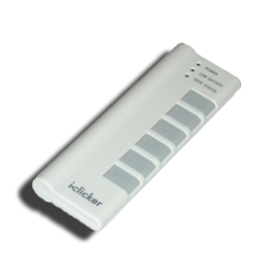
ACT: Superposition of waves
What kind of interference do these two waves produce?
+
____
=
A. Constructive B. Destructive C. Neither

Slide 7
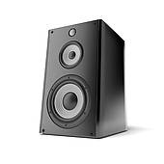
Demo: Interference for sound
Pair of speakers driven in phase, produce a tone of single f and λ:
r₁
Sound waves start in phase
Bottom wave travels extra λ/2, arrives out of phase, interferes destructively
r₂
Key is path difference between two waves |r₁ – r₂|

Slide 8
ACT: Sound interference
Two speakers are set up in a room and emit a single 680 Hz tone in phase.
r₁
Note: the speed of sound is 340 m/s
?
r₂
If you stand a distance r₁ = 4 m from one speaker and r₂ = 5 m from the other, how will the sound waves interfere?
A. Constructive B. Destructive C. Neither

Slide 9
Two-wave interference pattern
Interference depends on waves traveling different distances
Constructive interference
Destructive interference

Slide 10
Interference requirements
Interference is a property of waves. How do we get interference with light?
Need two (or more) waves
Must have same wavelength
Must be coherent
Use one light source with waves taking different paths:
Two slits
Two different refractive indices
Reflection off of two different surfaces
(waves must have definite phase relation)

Slide 11
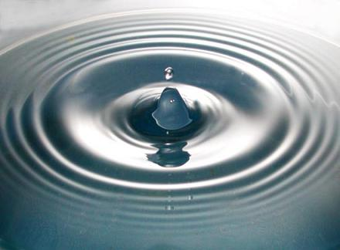
Recall: Huygens’ Principle
Every point on a wavefront acts as a source of tiny spherical “wavelets” that spread outward
“wavelet”
Planar wavefronts
Spherical wavefronts
The shape of the wavefront at a later time is tangent to all the wavelets

Slide 12
Young’s double slit
Coherent, monochromatic light passes through two narrow slits
Bottom wave travels extra 1λ
Both waves travel same distance
Top wave travels extra 1λ

Slide 13
Young’s double slit
Consider the interference pattern from a double slit on a screen far away
m = +2
r₁
m = +1
θ
θ
θ
d
r₂
m = 0
d
θ
m = –1
m = –2
Constructive:
Destructive:

Slide 14
CheckPoint 1.1
Now, the light coming to the lower slit has its phase shifted by ½λ relative to the light coming to the top slit. Compared to the usual Young’s experiment, what happens?
The pattern is the same
Maxima & minima become minima & maxima

Slide 15
Checkpoint 1.2
In the Young’s double slit experiment, is it possible to see interference maxima when the distance d between slits is less than the wavelength of light λ?
A. Yes B. No

Slide 16
ACT: Interference & intensity
The two waves are interfering constructively at the point shown. If the intensity of each is I₀, what is the total intensity on screen?
m = +2
m = +1
d
m = 0
m = –1
A. I₀ B. 2I₀ C. 4I₀
m = –2

Slide 17
ACT: CheckPoint 2.1
When this Young’s double slit experimental setup is placed under water, the separation y between minima and maxima:
m = +2
m = +1
θ
d
m = 0
m = –1
m = –2
Increases
Remains the same
Decreases

Slide 18
Calculation: Young’s double slit
Light of wavelength λ = 650 nm passes through two narrow slits separated by d = 0.25 mm. Determine the spacing y between the 0th and 3nd order bright fringe on a screen L = 2m away.
m = +3
y
θ₃
d
m = 0
L
Since L >> d, angles θ_{m} are small:

Slide 19
ACT: CheckPoint 3.1
Light is incident on three evenly separated slits. If wave 1 and 2 interfere constructively at angle θ, what appears on the screen?
?
1
2
θ
d
d
3
Interference maximum
Interference minimum
Somewhere in between

Slide 20
ACT: CheckPoint 3.3
Light is incident on three evenly separated slits. If wave 1 and 2 interfere destructively at angle θ, what appears on the screen?
?
1
2
θ
d
d
3
Interference maximum
Interference minimum
Somewhere in between

Slide 21
Interference pattern vs. slit number
As number of slits N increases (d remaining the same) angles for interference maxima are unaffected:
m = +1
m = 0
m = –1
N = 2
3
4
10
100
As N increases, more minima appear and bright fringes narrow
DEMO

Slide 22
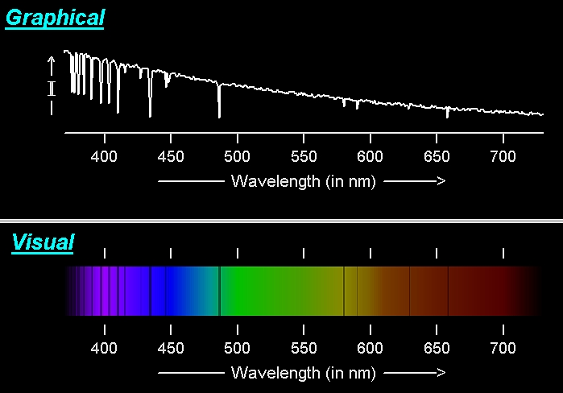
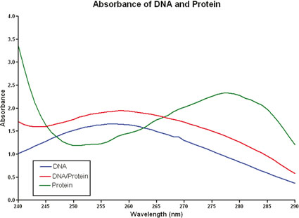
Diffraction grating
A diffraction grating has a large number N (>100) of evenly spaced slits
Astronomy
Biochemistry
Ex: 1/d = 500 lines/mm
Used in spectroscopy – analysis of absorption/emission spectra

Slide 23
ACT: Diffraction grating
White light passes through a diffraction grating and is projected on a screen. Which diagram most accurately represents the pattern on the screen?
A. B. C.
m = +1
m = 0
m = –1
DEMO

Slide 24
Summary of today’s lecture
Constructive vs. destructive interference
Constructive if waves are in phase (phase shift = 0, λ, 2λ ...)
Destructive if waves are out of phase (phase shift = ½λ, 1½λ ...)
Two slit interference
Interference maxima:
Interference minima:
Multiple slit interference
Interference maxima:
Key is path length difference

