Slide 1
Phys 102 – Lecture 27
The strong & weak nuclear forces

Slide 2
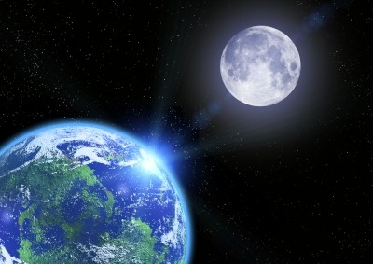
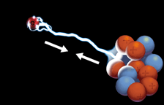
4 Fundamental forces of Nature
Gravitational force (solar system, galaxies)
Electromagnetic force (atoms, molecules)
Strong force (atomic nuclei)
Weak force (radioactive decay)
Today
<
<
<
Gravitational
Weak
Electromagnetic
Strong
weakest
strongest

Slide 3
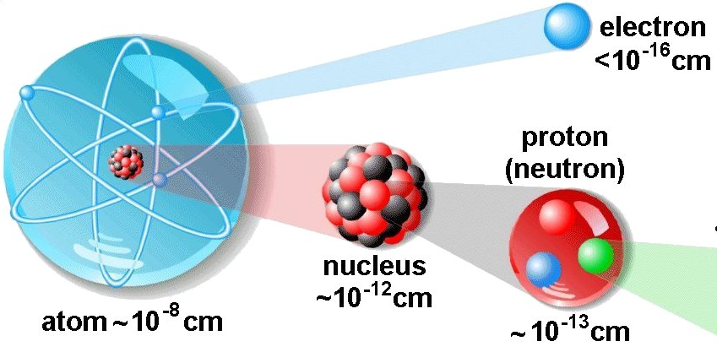
The nucleus
All + charge of the atom is inside a small nucleus, which is made up of protons and neutrons (“nucleons”)
Particle
Mass (MeV/c²)
Charge
electron 0.511 –e
proton 938.3 +e
neutron 939.5 0

Slide 4
Nuclear nomenclature
A nucleus is composed of Z protons and N neutrons (“nucleons”)
A = “atomic mass number”
Element name
Z = “atomic number”
A = nucleon number (gives mass of nucleus since )
Z = proton number = electron number (gives element name & chemical properties)
Ex: Elements with different nuclei are known as isotopes
+
+
+
“protium”
“deuterium”
“tritium”

Slide 5
ACT: CheckPoint 1.1
A material is known to be made from an isotope of lead (Pb).
Based on this information which of the following can you specify?
The atomic mass number
The neutron number
The proton number

Slide 6
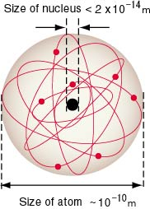
Nucleus size
Mass densities of nuclei are approximately the same
and
so
fm “femtometer”
Ex: deuterium (1 proton + 1 neutron)
Ex:
10⁴ – 10⁵
Compared to size of atom (outer e– shell)
How do protons not repel each other inside nucleus?

Slide 7
Strong nuclear force
Electric potential energy of two protons in 1 fm nucleus:
Strong nuclear force binds nucleons together, overcomes Coulomb repulsion at fm distances
E
Ex: deuterium (1 proton + 1 neutron)
Coulomb repulsion
10⁵
Attractive strong force
r
~fm
~MeV
DEMO

Slide 8
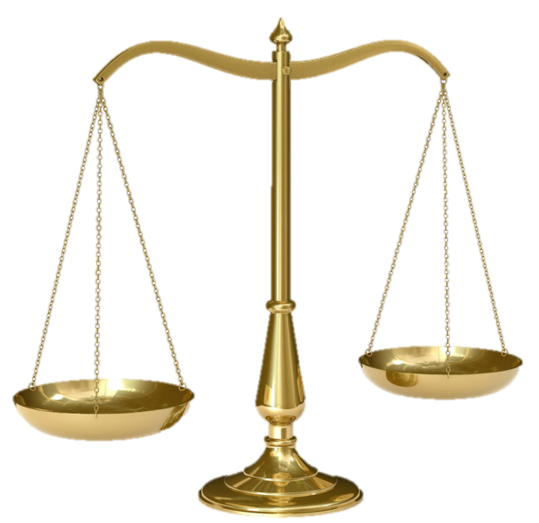
Binding energy & mass defect
Nuclear binding energy decreases mass of nucleus
Einstein’s equation:
Equivalence of mass and energy
“Mass defect”
Ex: deuteron = 1 proton + 1 neutron
+
+

Slide 9
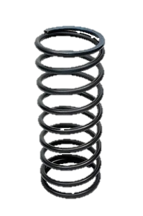
ACT: Binding Energy
Which system “weighs” more?
A
B
Two balls attached by a relaxed spring
Two balls attached by a stretched spring
They have the same weight

Slide 10
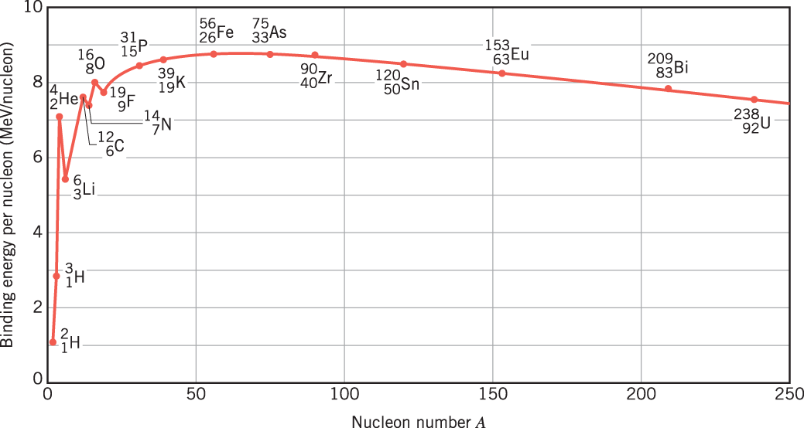
Binding energy plot
Binding energy per nucleon increases with A due to higher strong force, then decreases due to Coulomb repulsion
FISSION
FUSION
Fission = Breaking large nuclei into small
(ex: nuclear reactors)
Fusion = Combining small nuclei into large
(ex: stars)

Slide 11
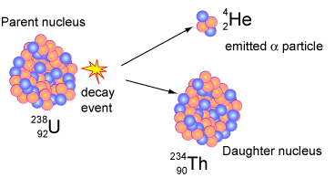
ACT: Uranium mass
²³⁸U is long-lived but ultimately unstable. Eventually, it will spontaneously break into a ⁴He and ²³⁴Th nucleus, and release a tremendous amount of energy:
What must be true about the masses of the nuclei?
A.
B.
C.

Slide 12
Radioactive decay
There are 3 types of radioactive decay:
α particle: nucleus
β– particle: electron
Easily stopped
Stopped by metal
γ radiation: photon (more energetic than x-rays)
Penetrate

Slide 13
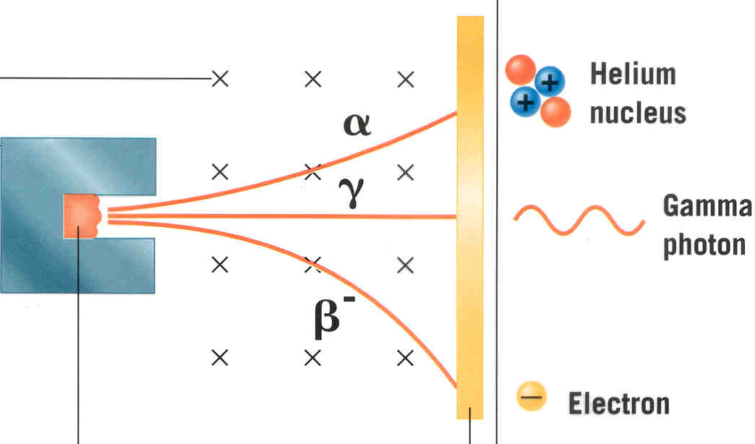
ACT: Types of radioactivity
Consider the following trajectories from α, β–, and γ sources
B field into page
1
2
3
Radioactive sources
detector
Which of the trajectories must belong to an α particle?
A. 1 B. 2 C. 3

Slide 14
Radioactive decay rules
Nucleon Number (A) is conserved.
Atomic Number (Z) is conserved.
Energy and momentum are conserved.
α decay:
α particle has 2 protons, 2 neutrons: A = 4
Charge is +2e: Z = +2
β– decay:
Electron is not a nucleon: A = 0
Charge is –1e: Z = –1
γ decay:
Photon is not a nucleon: A = 0
Charge is 0: Z = 0
“nuclear isomer” excited state

Slide 15
ACT: Checkpoint 2.1
A nucleus undergoes α decay. Which of the following is FALSE?
Nucleon number decreases by 4
Neutron number decreases by 2
Charge on nucleus increases by 2

Slide 16
ACT: Checkpoint 2.2
The nucleus undergoes β– decay. Which of the following is true?
The number of protons in the daughter nucleus increases by one.
The number of neutrons in the daughter nucleus increases by one

Slide 17
ACT: Decay reactions
Which of the following decays is NOT allowed?
A.
B.
C.
D.

Slide 18
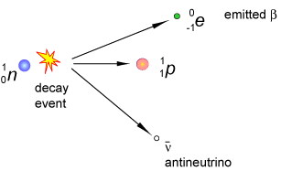
Weak nuclear interaction
α decay is a fission reaction (strong force vs. Coulomb repulsion)
γ decay is transition between nuclear energy levels
β– decay converts a neutron into a proton:
=
“Weak” interaction is mechanism behind this decay process
Range only 10^{–18} m and 10^{–6}× weaker than strong interaction!

Slide 19
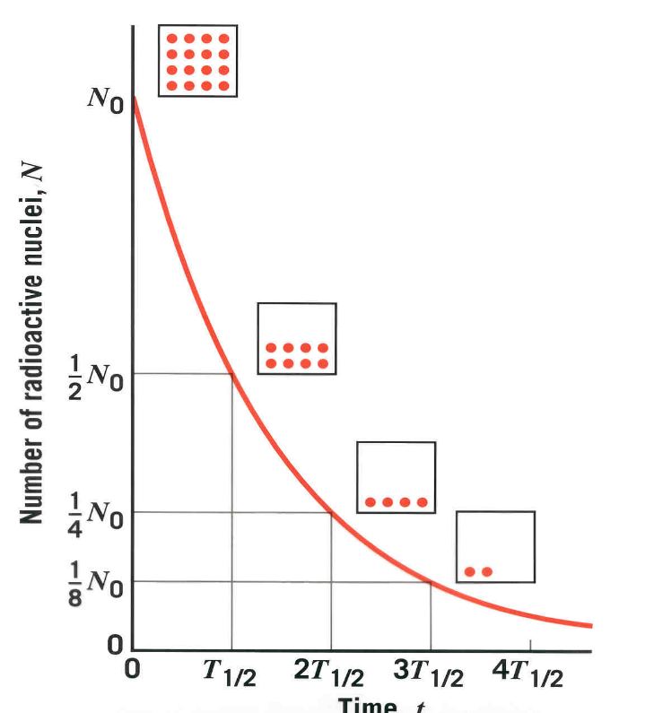
Radioactive decay rates
Decay reactions are probabilistic
Number of un-decayed nuclei
“Activity” or rate of decay
Units: “Becquerel” (1 Bq ≡ 1 decay/s)
Decay constant
“Half-life” = time for ½ of the nuclei to decay
Ex: At t = T_{1/2}, ½ the nuclei survived & the activity decreased by ½
At t = 2T_{1/2}, ¼ the nuclei survived & the activity decreased by ¼

Slide 20
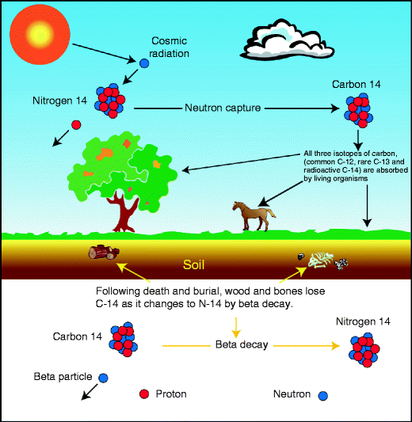
Calculation: carbon dating
1 in ~8 × 10¹¹ C atoms is ¹⁴C and β– decays with a T_{1/2} of 5730 years. Determine how many decays/s per gram of carbon occur in a living organism.
Decay constant:
Number N of ¹⁴C atoms per gm:

Slide 21
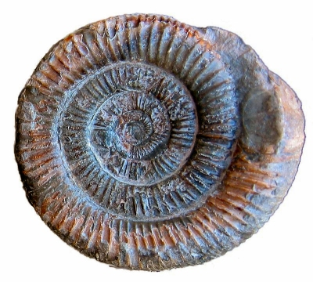
ACT: Carbon dating
In the previous example we found that the ¹⁴C activity in living organisms is 0.24 Bq per gram of sample.
The half-life for β– decay of ¹⁴C is ~6,000 years. You test a fossil and find that its activity is 0.06 Bq/gm. How old is the fossil?
3,000 years
6,000 years
12,000 years

Slide 22
Summary of today’s lecture
Nuclear atom
Nuclei composed of neutrons & protons (nucleons)
Strong force binds nucleons together -> “mass defect”
Radioactive decay
Three types: α (He nucleus), β– (electron), γ (photon)
Nucleon number, charge, energy/momentum conserved
Decay rate
T_{1/2} is time for ½ of nuclei to decay & for activity to decrease by ½

