Slide 1
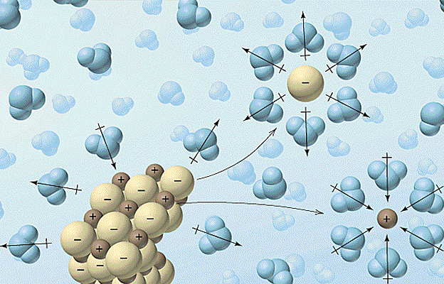
Phys 102 – Lecture 2
Coulomb’s Law & Electric Dipoles

Slide 2
Today we will...
Get practice using Coulomb’s law & vector addition
Learn about electric dipoles
Apply these concepts!
Molecular interactions
Polar vs. nonpolar molecules
Hydrophilic vs. hydrophobic
Permanent vs. induced dipole
Chemistry!

Slide 3
Recall: Coulomb’s Law
Force between charges q₁ and q₂ separated a distance r:
“Coulomb constant”
Magnitude
“Force on q₁ due to q₂”
“Permittivity of free space”
Direction
Opposite charges attract, like charges repel

Slide 4
Superposition principle
Total force on charge due to other charges = sum of individual forces
Ex: what is the force on q₁ due to q₂, q₃, and q₄?
q₁
q₂
q₄
q₃
Order does not matter!

Slide 5
Calculation: four charges
Calculate the total force on charge q₁ = +2 μC due to charges q₂ = +7 μC, q₃ = –3.5 μC
Fundamental concept: Superposition
q₁
Approach:
Draw forces
Calculate magnitudes of forces
Add vectors
Decompose into x-, y-components
Add like components
4 m
q₂
q₃
May need geometry, trigonometry
3 m
3 m

Slide 6
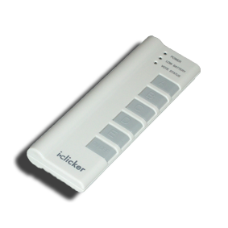
ACT: four charges
Which vector best represents the total force on charge q₁ = +2 μC due to charges q₂ = +7 μC and q₃ = –3.5 μC?
q₁
q₂
q₃

Slide 7
Calculation: four charges
Calculate the total force on charge q₁ = +2 μC due to charges q₂ = +7 μC and q₃ = –3.5 μC
Calculate magnitudes of forces
q₁
4 m
q₂
q₃
3 m
3 m

Slide 8
ACT: components
What is the x-component of , F_{12,x}?
A. 3/4 F₁₂ B. 3/5 F₁₂ C. –4/5 F₁₂
y
Decompose vectors into components
x
q₁
4 m
q₂
q₃
3 m
3 m

Slide 9
ACT: components
What is the y-component of , F_{13,y}?
A. 3/4 F₁₃ B. 3/5 F₁₃ C. –4/5 F₁₃
y
Decompose vectors into components
x
q₁
4 m
q₂
q₃
3 m
3 m

Slide 10
Calculation: four charges
Calculate the total force on charge q₁ = +2 μC due to charges q₂ = +7 μC and q₃ = –3.5 μC
Add like components
q₁
4 m
q₂
q₄
3 m
3 m

Slide 11
Calculation: four charges
Calculate the total force on charge q₁ = +2 μC due to charges q₂ = +7 μC and q₃ = –3.5 μC
Magnitude of total force
q₁
Direction of total force
4 m
q₂
q₃
3 m
3 m

Slide 12
ACT: CheckPoint 1.1
Consider three charges on a circular ring, q₁ = +2q, q₂ = q₃ = +q. A charge +Q is placed at the center of the circle.
1
y
What is the x-component of the total force on Q?
2q
x
F_{x} > 0
F_{x} = 0
F_{x} < 0
Q
2
3
q
q

Slide 13
ACT: CheckPoint 1.2
Consider three charges on a circular ring, q₁ = +2q, q₂ = q₃ = +q. A charge +Q is placed at the center of the circle.
1
y
What is the y-component of the total force on Q?
2q
x
F_{y} > 0
F_{y} = 0
F_{y} < 0
Q
2
3
q
q

Slide 14
Electric dipole & dipole moment
A positive and negative charge of equal magnitude q separated by a (usually small) distance d
+q
+q
d
=
=
–q
–q
Dipole moment is measure of separated + and – charges
Magnitude
Direction
From – to + charge (by convention)
Note: opposite from Lewis notation (Chemistry)
definition
What are examples of electric dipoles?

Slide 15
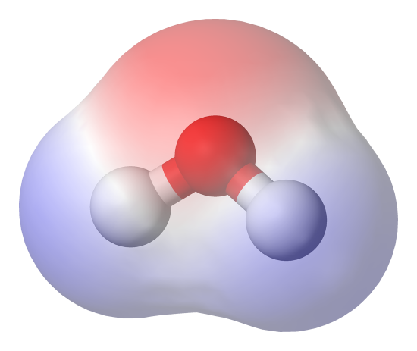
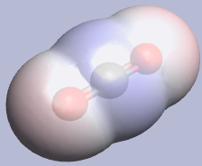
Molecular dipole
Electrons are not shared equally between chemically bonded atoms
Charge imbalance creates a bond dipole
Ex: HF (hydrofluoric acid)
Ex: H₂0 (water)
Slightly positive
Slightly negative
2δ-
Polar
p_{tot} > 0
δ+
δ-
δ+
δ+
Ex: CO₂ (carbon dioxide)
2δ+
δ-
Nonpolar
p_{tot} = 0
δ-

Slide 16
ACT: CheckPoint 2.1
An electric dipole is placed near a large positive charge +Q. In what direction is the net force on the dipole?
A. Left B. Zero C. Right
+q
+Q
–q
Notes:
This is why water is attracted to ions & why it aligns with respect to ions (depending on charge).

Slide 17
ACT: Dipole & 2 charges
Consider an electric dipole placed an equal distance from a +Q and a –Q charge. Does the dipole move?
+q
+Q
–Q
–q
A. Yes B. No

Slide 18
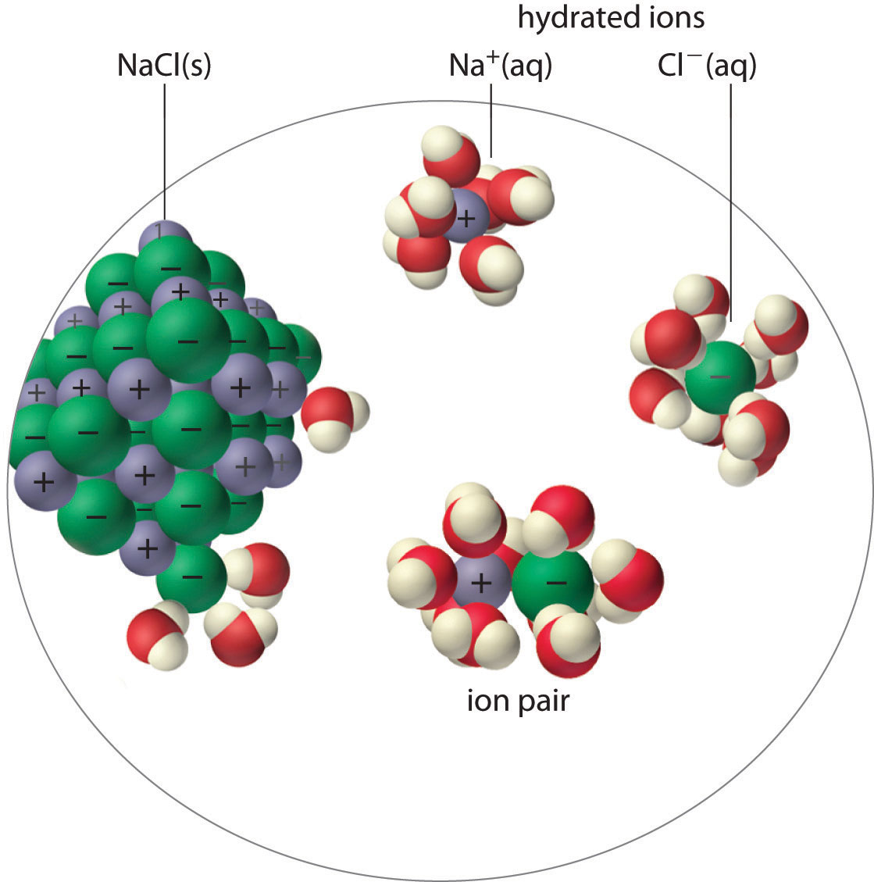
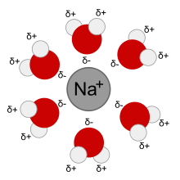
Ion-dipole interactions
Polar molecules are attracted to ions
Dipole moment aligns away from + charge, toward – charge
Ex: ions in water & solubility
“Hydration shell”
Ionic compounds (ex: salts) dissolve in water

Slide 19
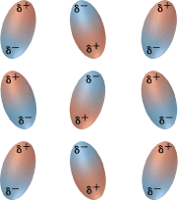
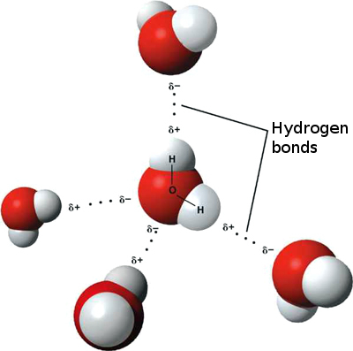
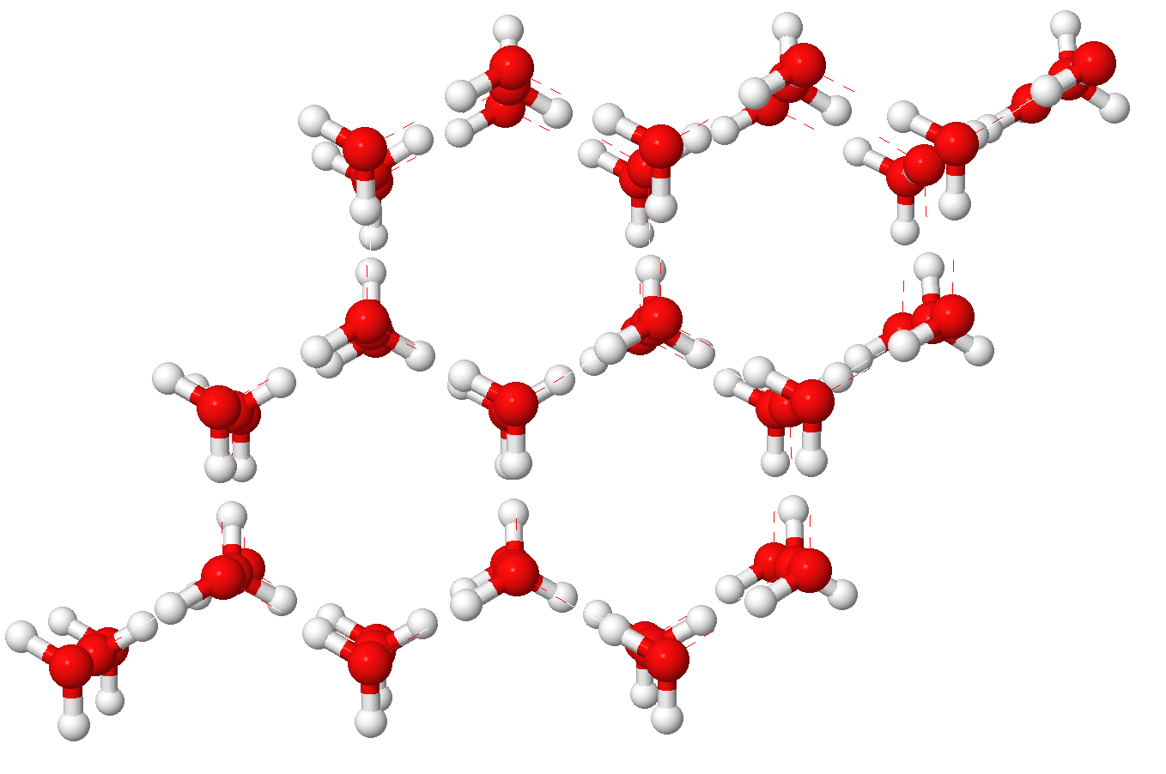
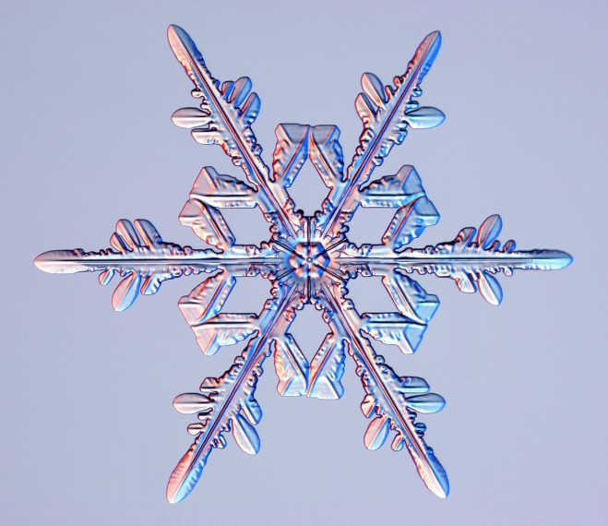
Dipole-dipole interactions
Polar molecules interact together
Dipole moments align end-to-end + to –
Like magnets!
Ex: hydrogen bond is a dipole-dipole interaction between water molecules
Hydrogen bond
Structure of ice
Snowflake

Slide 20
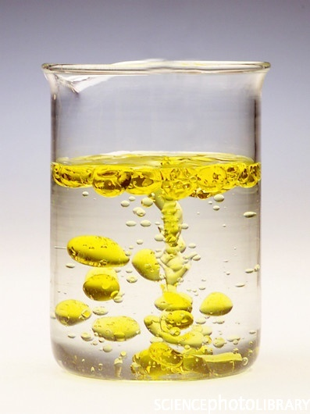
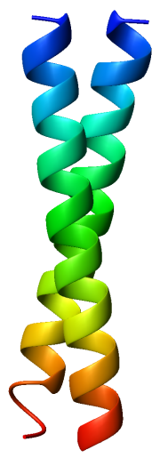
Hydrophilic vs. hydrophobic
Polar molecules interact with charged & polar molecules
Ex: charged & polar molecules attract water, nonpolar molecules do not
Hydrophilic
“attract water”
Hydrophobic
“repel water”
Hydrophilic
Nonpolar inside
Nonpolar
Polar outside
Polar
“coiled coil”
Hydrophobic
Protein structure
Oil and water
Cell membranes

Slide 21
ACT: Charge & conductor
An uncharged conducting sphere is placed next to a fixed + charge. What happens when the uncharged sphere is released?
+
DEMO
A. Nothing B. Attracted to + sphere C. Repelled from + sphere

Slide 22
Molecular interactions
Interactions between molecules are understood in terms of charges and electric dipoles interacting by Coulomb’s law
Ion-dipole
Dipole-induced dipole
Dipole-dipole
Induced dipole-induced dipole?
Ion-induced dipole
Yes! Two nonpolar molecules can induce dipoles in each other and interact!
London dispersion or van der Waals force

Slide 23
Summary of today’s lecture
Coulomb’s law
Superposition principle
Electric dipole & dipole moment
Permanent vs. induced dipole

