Slide 1
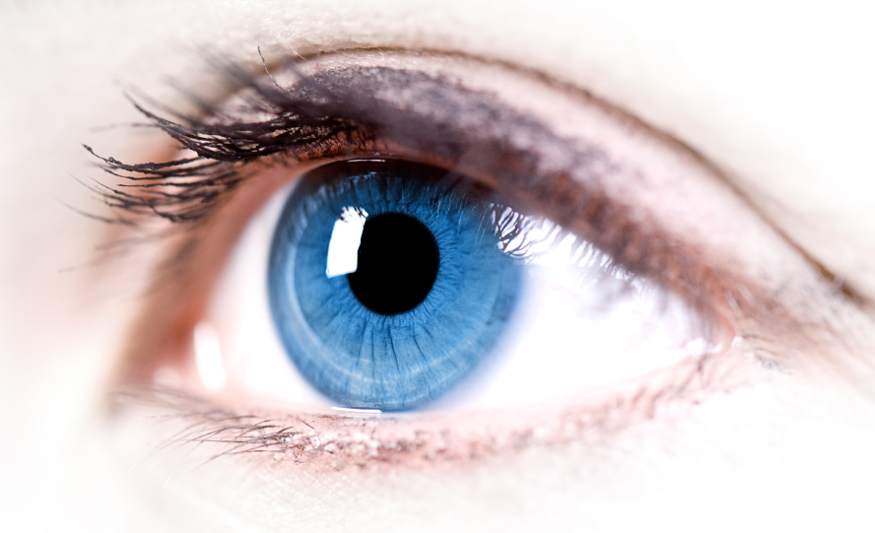
Phys 102 – Lecture 20
The eye & corrective lenses

Slide 2
Today we will...
Apply concepts from ray optics & lenses
Simple optical instruments – the camera & the eye
Learn about the human eye
Accommodation
Myopia, hyperopia, and corrective lenses
Learn about perception of size
Angular size
Magnifying glass & angular magnification

Slide 3
The Camera
Cameras are one of simplest optical instruments, produce real image onto sensor
Pinhole camera (“camera obscura”)
Modern camera
Pinhole
Imaging lens
DEMO
Not a true imaging system. Each point from object creates a circle of light on screen.
True imaging system. Each point from object has a corresponding point on screen.
Notes:
Demo 443: pinhole camera

Slide 4
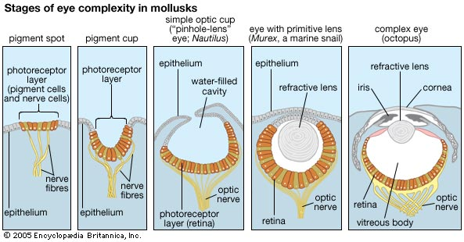
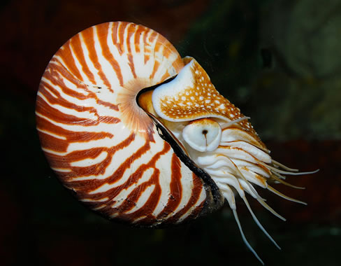
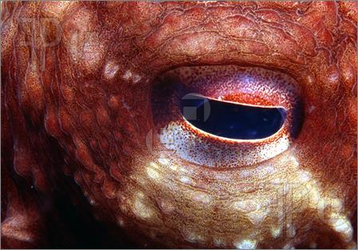
Evolution of the eye
The eye is like a camera
Pinhole eye
Complex eye
Nautilus
Octopus

Slide 5
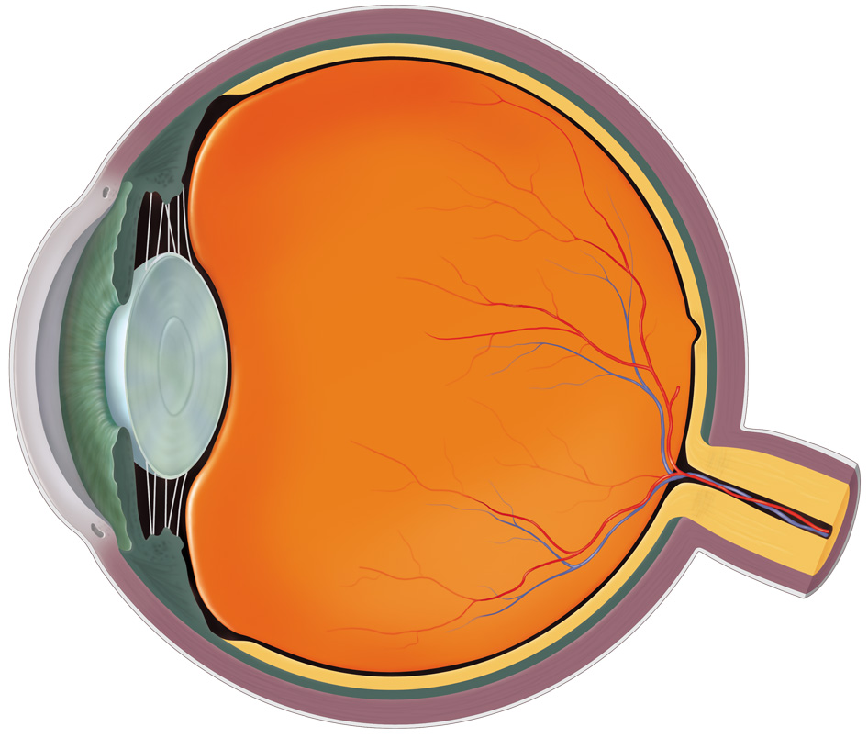
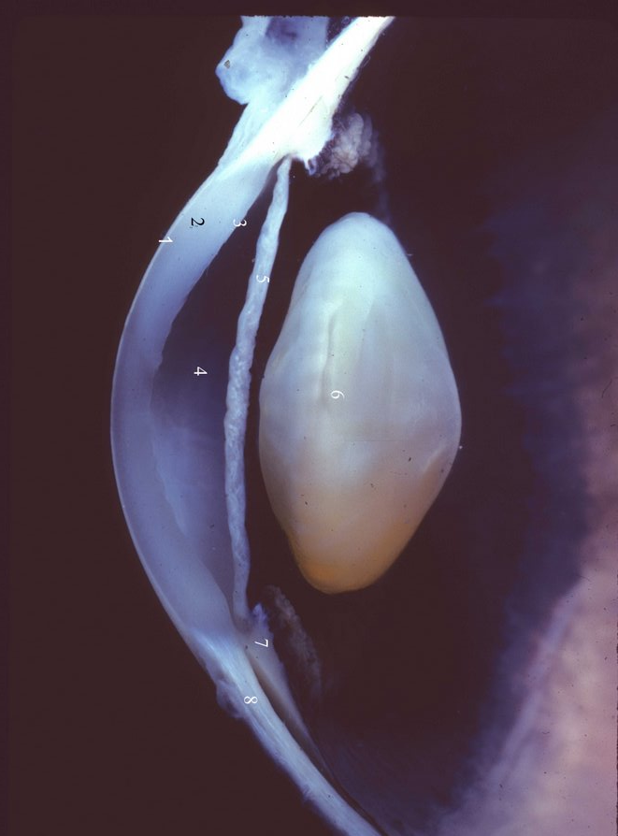
Anatomy of the human eye
As in a camera, eye lens creates image of object onto retina
Ciliary muscles
Vitreous fluid
Part of eye
n
Cornea
Cornea 1.351
Lens 1.437
Vitreous fluid 1.333
Pupil
Retina
Lens
Iris
Optic nerve
DEMO
Pupil controls amount of light – diameter typically 2-8 mm
Retina has ~125 million photoreceptor cells (rods & cones)
Notes:
Demo 568: human eye model

Slide 6
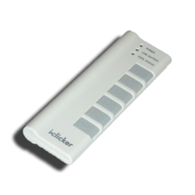
ACT: Anatomy of the Eye
Which part of the eye is responsible for most of the bending of light?
Vitreous fluid
Cornea
Part of eye
n
Retina
Cornea 1.351
Lens 1.437
Vitreous fluid 1.333
Laser eye surgery changes cornea!
Lens
A. Lens B. Cornea C. Retina D. Vitreous fluid
Shape and index of refraction mismatch determine how much light bends:
Lens and cornea have similar shape and n
Most of bending occurs at air-cornea interface

Slide 7
Accommodation
Ciliary muscles around lens change its shape and focal length
The eye can focus on objects both close and far
Ciliary muscles
≈
Image
Distant object
Close object
“Relaxed”
“Tensed”
lens
The “far point” and “near point” are the maximum and minimum object distances where the image remains in focus
Far point: d_{o,far} = ∞
Normal adult
DEMO
Near point: d_{o,near} = 25 cm

Slide 8
Calculation: focal length of the eye
An adult with normal eyesight will see a focused image over a wide range of object distances:
“Far” point: d_{o,far} = ∞
Object
“Near” point: d_{o,near} = 25 cm
d_{i}
d_{o}
Image
Typical lens-retina distance = 2.0 cm
What are the focal lengths of the relaxed and tensed eye?
Small change in f yields large charge in d_{o}!

Slide 9
ACT: CheckPoint 1
A person with almost normal vision (near point at 26 cm) is standing in front of a plane mirror.
What is the closest distance to the mirror where the person can stand and still see himself in focus?
13 cm
13 cm
47 %
44 %
8 %
13 cm
26 cm
52 cm
Image from mirror becomes object for eye!

Slide 10
Near Point, Far Point
Eye’s lens changes shape (changes f )
Object at any d_{o} should produce image at retina (d_{i} ≈ 2.0 cm)
Lens can only change shape so much
“Far Point”
Furthest d_{o} where image can be at retina
Normally, d_{far} = ∞ (if nearsighted then closer)
“Near Point”
Closest d_{o} where image can be at retina
Normally, d_{near} ≈ 25 cm (if farsighted then further)

Slide 11
Myopia (nearsightedness)
If nearsighted, far point d_{far} < ∞
Image
Distant object
Far point
Object at d_{o} > d_{far} creates image in front of retina
Corrective lens creates image of distant object at the far point of the nearsighted eye
Diverging lens!
f_{lens} such that distant object at ∞ (“normal” far point) is in focus
DEMO
Notes:
New Demo: human eye model
DEMO 1089: corrective lens demo

Slide 12
Hyperopia (farsightedness)
If farsighted, near point d_{near} > 25 cm
Image
Near point
Close object
Object at d_{o} < d_{near} creates image behind retina
Corrective lens creates image of close object at the near point of the farsighted eye
so
f_{lens} such that object at 25 cm (“normal” near point) is in focus
Converging lens!
DEMO
Notes:
New Demo: human eye model
DEMO 1089: corrective lens demo

Slide 13
ACT: Corrective lenses
For which type of eye correction is the image always virtual?
Nearsighted eye
Farsighted eye
Nearsighted
Farsighted
Both
Neither
In both cases the image is formed before the lens, so it is virtual!
Also, image is upright,
reduced (diverging lens) or enlarged (converging lens)

Slide 14
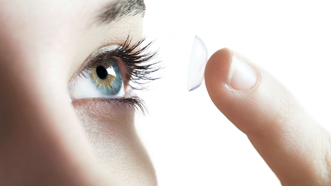
Calculation: Refractive Power
Optometrists use refractive power P instead of focal length f
Units: “Diopters” (D) ≡ 1/meters
Your friend’s contact lens prescription is –3.3 diopters. What is the focal length? Is your friend near- or farsighted?
A diverging lens!
Your friend is nearsighted
Notes:
My eyes: 6.5 diopters, implies f=-0.15 m (my far point is 0.15 m, or 6”, or 15 cm)
Big # means smaller f, more bending (worse eyesight)

Slide 15
ACT: Refractive power
A relaxed, normal eye has a refractive power P_{norm}:
How does the refractive power P_{myopic} of a relaxed, nearsighted eye compare?
Nearsighted eye forms an image of a distant object in front of retina so f must be smaller, P larger
P_{myopic} > +50 D
P_{myopic} = +50 D
P_{myopic} < +50 D
Alternately,

Slide 16
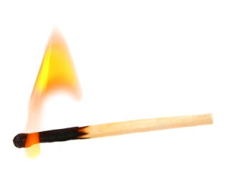
ACT: CheckPoint 2
Two people who wear glasses are camping. One of them is nearsighted and the other is farsighted. Which person’s glasses will be useful in starting a fire with the sun’s rays?
Nearsighted B. Farsighted
33 % 67 %
Farsighted person’s glasses are converging – like magnifying glass!
Notes:
61%, 39%

Slide 17
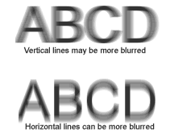
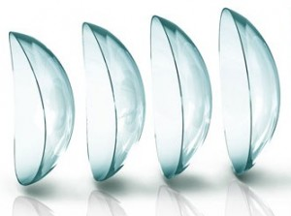
Astigmatism
A normal eye is spherical, curved the same in every direction
An astigmatic eye is distorted (oval) along one direction
Rays from vertical object
Vertical Image
Horizontal Image
Rays from horizontal object
So, an astigmatic eye has a different f along different directions
Images are blurry in one direction
Corrected with toric lens
Notes:
New Demo: human eye model

Slide 18
Angular Size: CheckPoint 3.1-3.2
Angular size refers to how large the image is on your retina, and how big it appears to be.
h_{o}
θ
θ
θ'
θ'
d_{o}
Both objects are same size, but nearer one looks bigger.
(in radians) if angle is small
What is the maximum possible angular size?

Slide 19
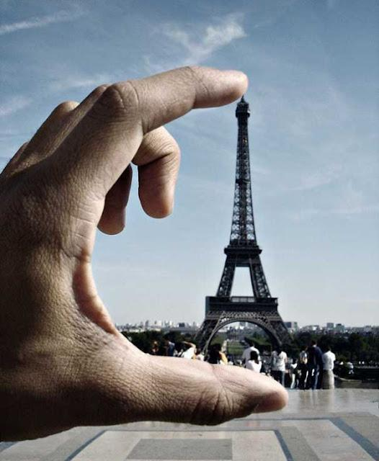
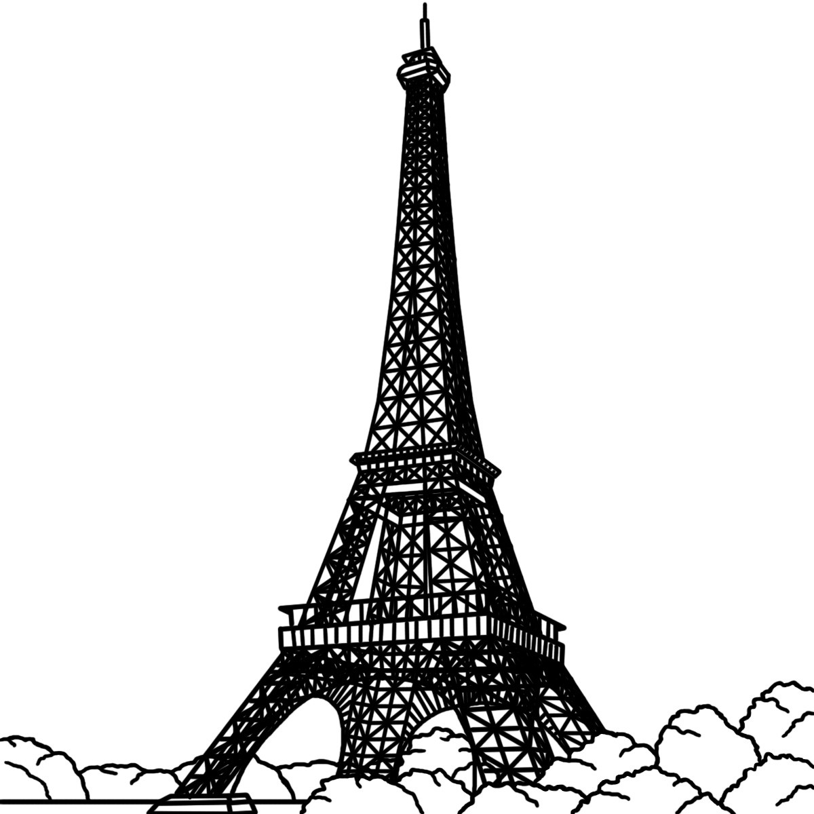
Calculation: Angular size
A cameraman takes a trick shot of the Eiffel tower, which is 300 m tall.
How far is the cameraman from the Eiffel tower? (Assume the camera is 30 cm from his hand.)
h = 10 cm
300m
θ
h = 0.1m
0.3m
x

Slide 20
Magnifying glass
A magnifying glass produces a virtual image behind object, allowing a closer object d_{o} < d_{near} and a larger θ′
≈
h_{i}
Virtual image
≈
h_{o}
θ'
θ_{max}
θ_{max}
Near point
d_{o}
–d_{i}
Angular magnification gives how much angular size increases:
Typically set image at d_{i} = ∞, for a relaxed eye (so d_{o} = f)
Notes:
DEMO 708: magnifying glass

Slide 21
ACT: Magnifying glass
A person with normal vision (d_{near} = 25 cm, d_{far} = ∞) has a set of lenses with different focal lengths. She wants to use one as a magnifying glass.
Which of the following focal lengths will magnify the image?
f = 50 cm
f = 2.5 cm
f = –6 cm
f = –40 cm
Magnifying glass is a converging lens (f > 0)
Want f < d_{near} to magnify
DEMO
Notes:
DEMO 708: magnifying glass & extra lenses

Slide 22
Summary of today’s lecture
Accommodation – eye lens changes shape
Near point – closest object (~25 cm, further if farsighted)
Far point – furthest object (∞, closer if nearsighted)
Corrective lenses
Nearsighted – diverging lens creates virtual image at far point
Farsighted – converging lens creates virtual image at near point
Angular size & angular magnification
Magnifying glass creates virtual image of object placed closer than near point

