Slide 1
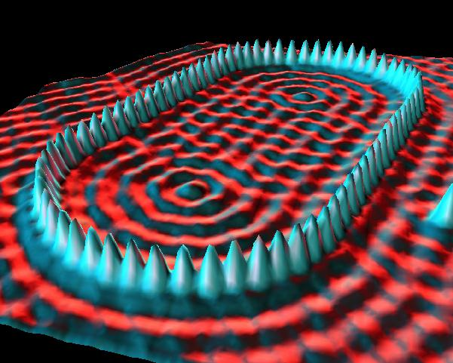
Phys 102 – Lecture 24
The classical and Bohr atom

Slide 2
State of late 19th Century Physics
Two great theories
Newton’s laws of mechanics & gravity
Maxwell’s theory of electricity & magnetism, including EM waves
But... some unsettling problems
Stability of atom & atomic spectra
Photoelectric effect
...and others
New theory required
“Classical physics”
Quantum mechanics

Slide 3
Stability of classical atom
Prediction – orbiting e– is an oscillating charge & should emit EM waves in every direction
Recall Lect. 15 & 16
+
–
EM waves carry energy, so e– should lose energy & fall into nucleus!
Classical atom is NOT stable!
Lifetime of classical atom = 10^{–11} s
Reality – Atoms are stable

Slide 4
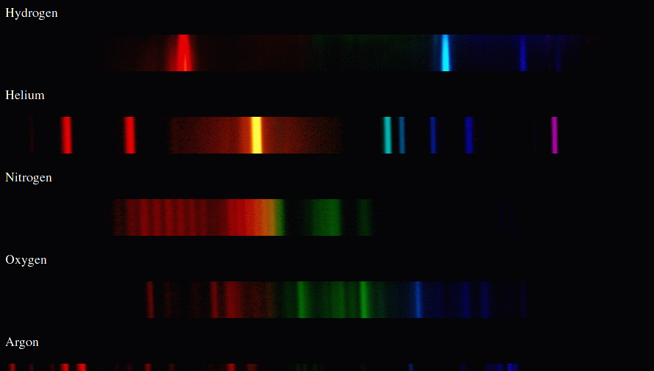
Atomic spectrum
Prediction – e– should emit light at whatever frequency f it orbits nucleus
Discharge tube
Recall Lecture 22
Diffraction grating
Screen
Hydrogen
Reality – Only certain frequencies of light are emitted & are different for different elements
Helium
Nitrogen
Oxygen
Frequency

Slide 5
Quantum mechanics
Quantum mechanics explains stability of atom & atomic spectra (and many other phenomena...)
QM is one of most successful and accurate scientific theories
Predicts measurements to <10^{–8} (ten parts per billion!)
Wave-particle duality – matter behaves as a wave
Particles can be in many places at the same time
Processes are probabilistic not deterministic
Measurement changes behavior
Certain quantities (ex: energy) are quantized

Slide 6
Matter waves
Matter behaves as a wave with de Broglie wavelength
Planck’s constant
Wavelength of matter wave
Momentum mv of particle
Ex: a fastball (m = 0.5 kg, v = 100 mph ≈ 45 m/s)
20 orders of magnitude smaller than the proton!
Ex: an electron (m = 9.1×10^{–31} kg, v = 6×10⁵ m/s)
X-ray wavelength
How could we detect matter wave?
Interference!

Slide 7
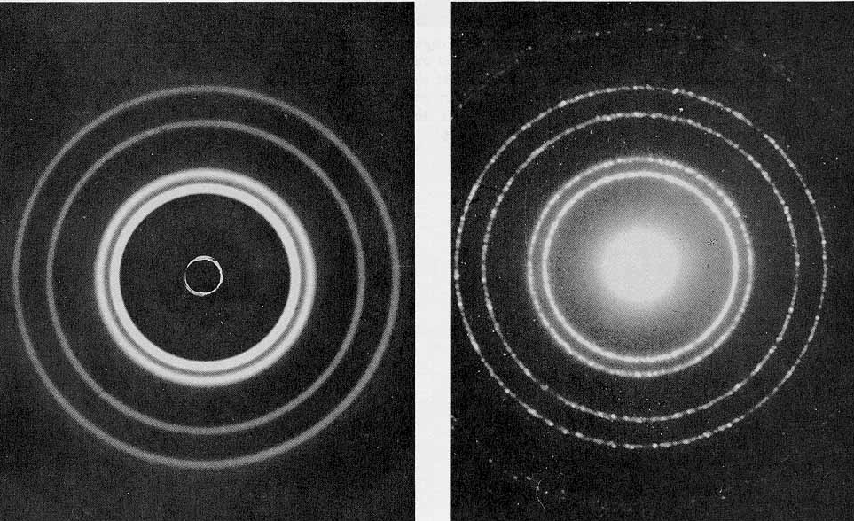
X-ray vs. electron diffraction
X-ray diffraction
e– diffraction
DEMO
Identical pattern emerges if de Broglie wavelength of e– equals the X-ray wavelength!

Slide 8
Electron diffraction
Beam of mono-energetic e– passes through double slit
Interference pattern = probability
–
–
–
–
–
–
–
Wait! Does this mean e– passes through both slits?
What if we measure which slit the e– passes through?
Merli – 1974
Tonomura – 1989

Slide 9
ACT: Double slit interference
Consider the interference pattern from a beam of mono-energetic electrons A passing through a double slit.
Now a beam of electrons B with 4x the energy of A enters the slits. What happens to the spacing Δy between interference maxima?
Δy
L
Δy_{B} = 4 Δy_{A}
Δy_{B} = 2 Δy_{A}
Δy_{B} = Δy_{A}
Δy_{B} = Δy_{A} / 2
Δy_{B} = Δy_{A} / 4

Slide 10
The “classical” atom
Negatively charged electron orbits around positively charged nucleus
Orbiting e– has centripetal acceleration:
so,
Total energy of electron:
r
+
–
E_{tot}
0
r
Hydrogen atom
Recall Lect. 4

Slide 11
The Bohr model
e– behave as waves & only orbits that fit an integer number of wavelengths are allowed
Orbit circumference
+
Angular momentum is quantized
“h bar”

Slide 12
ACT: Bohr model
What is the quantum number n of this hydrogen atom?
n = 1
n = 3
n = 6
n = 12
+

Slide 13
Energy and orbit quantization
Angular momentum is quantized
+
E
n = 1
Free electron
n = 2
n = 3
r
n = 4
n = 3
n = 2
Radius of orbit is quantized
Energy is quantized
Smallest orbit has energy –E₁
“ground state”
“Bohr radius”
n = 1

Slide 14
ACT: CheckPoint 3.2
Suppose the charge of the nucleus is doubled (+2e), but the e– charge remains the same (–e). How does r for the ground state (n = 1) orbit compare to that in hydrogen?
For hydrogen:
+
–
+2e
1/2 as large B. 1/4 as large C. the same

Slide 15
ACT: CheckPoint 3.3
There is a particle in nature called a muon, which has the same charge as the electron but is 207 times heavier. A muon can form a hydrogen-like atom by binding to a proton.
How does the radius of the ground state (n = 1) orbit for this hydrogen-like atom compare to that in hydrogen?
207× larger B. The same C. 207× smaller

Slide 16
Atomic units
At atomic scales, Joules, meters, kg, etc. are not convenient units
“Electron Volt” – energy gained by charge +1e when accelerated by 1 Volt:
1e = 1.6×10^{–19} C, so 1 eV = 1.6×10^{–19} J
Planck constant: h = 6.626 × 10^{–34} J∙s
Speed of light: c = 3 × 10⁸ m/s
Electron mass: m = 9.1 × 10^{–31} kg
Since , ke² has units of eV∙nm like hc
“Fine structure constant” (dimensionless)

Slide 17
Calculation: energy & Bohr radius
Energy of electron in H-like atom (1 e–, nuclear charge +Ze):
Radius of electron orbit:

Slide 18
ACT: Hydrogen-like atoms
Consider an atom with a nuclear charge of +2e with a single electron orbiting, in its ground state (n = 1), i.e. He⁺.
How much energy is required to ionize the atom totally?
13.6 eV
2 × 13.6 eV
4 × 13.6 eV

Slide 19
Heisenberg Uncertainty Principle
e– beam with momentum p₀ passes through slit will diffract
p_{f}
Δy =
Δp_{y}
a
–
p₀
p₀
e– passed somewhere inside slit.
Uncertainty in y
Momentum was along x, but e– diffracts along y.
Uncertainty in y-momentum
If slit narrows, diffraction pattern spreads out
Uncertainty in y
Uncertainty in y-momentum

Slide 20
ACT: CheckPoint 4
The Bohr model cannot be correct! To be consistent with the Heisenberg Uncertainty Principle, which of the following properties cannot be quantized?
Energy is quantized
Angular momentum is quantized
Radius is quantized
Linear momentum & velocity are quantized
All of the above
#1 & 2
#3 & 4

Slide 21
Summary of today’s lecture
Classical model of atom
Predicts unstable atom & cannot explain atomic spectra
Quantum mechanics
Matter behaves as waves
Heisenberg Uncertainty Principle
Bohr model
Only orbits that fit n electron wavelengths are allowed
Explains the stability of the atom
Energy quantization correct for single e– atoms (H, He⁺, Li⁺⁺)
However, it is fundamentally incorrect
Need complete quantum theory (Lect. 26)

