Slide 1
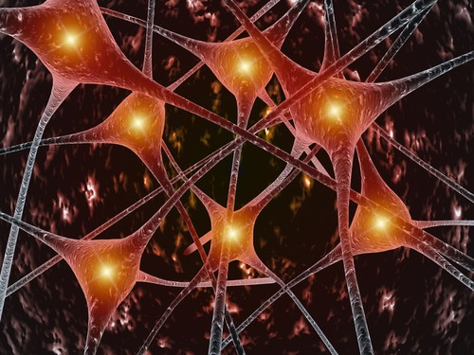
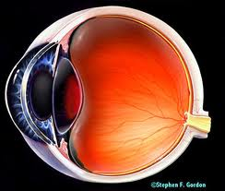
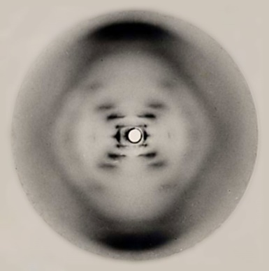
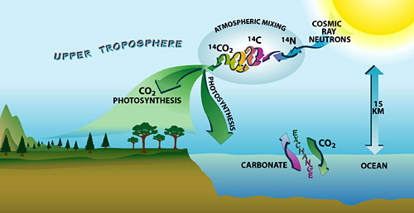
Welcome to Physics 102!
Electricity & Magnetism
(forces that hold atoms & molecules together,
living cells)
Light
Atomic & Nuclear Physics

Slide 2
Course content
Prerequisite!
Physics 101
Physics 102
Macroscopic
Microscopic
Kinematics
Forces
Energy
Fluids
Waves (Sound)
Electricity & circuits
Magnetism & induction
Optics
Modern Physics

Slide 3
Meet the course directors
Lecturer:
Research:
Office Hours:
Discussion coordinator:
Lab & exam coordinator:

Slide 4
When emailing me:
Email must be sent from @illinois.edu
Subject line should begin with “PHYS102 question:”
Message should contain:
your full name, NetID, discussion section, TA name
Questions about physics:
Do not use email, use office hours (see course website)
Before emailing:
Verify information is not already on the course website
The course directors reserve the right to penalize your HW score if you ask questions via email that are answered on the website

Slide 5
Course Website
http://courses.physics.illinois.edu/phys102/
Course Description / Excused Absences
First Discussion:
First Lab:
Exam dates:
Required Materials:
Be sure to register your i>clicker prior to lecture

Slide 6
Course Philosophy
Think about it (pre-lecture & checkpoint)
Untangle it (lectures)
Play with it (labs)
Challenge yourself (homework)
Close the loop (discussion/quiz)
The order is important!

Slide 7
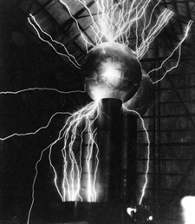
Phys 102 – Lecture 1
Electric charge & Coulomb’s law

Slide 8
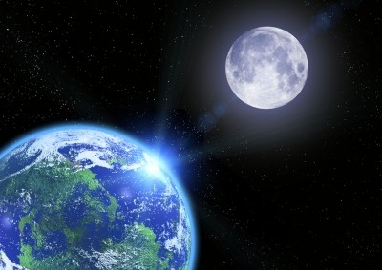
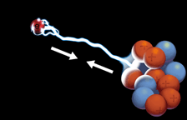
4 Fundamental forces of Nature
Phys. 101
Gravitational force (solar system, galaxies)
Electromagnetic force (atoms, molecules)
Strong force (atomic nuclei)
Weak force (radioactive decay)
Phys. 102
<
<
<
Gravitational
Weak
Electromagnetic
Strong
weakest
strongest

Slide 9
Electric charge
Charge is an intrinsic property of matter, like mass
EM force -> electric charge
Positive & negative charge
Opposite charges attract, like charges repel
Gravity -> mass
Mass always positive
Gravity always attractive
–
+
+
+
–
–
DEMO

Slide 10
Units of electric charge
Symbol: q or Q
Unit: [Coulomb] = [C]
Electron: –e = –1.6 x 10^{–19} C
Proton: +e = +1.6 x 10^{–19} C
+
–
How much charge is 1 C?
Imagine you could separate H⁺ and OH– ions in pure water (pH 7.0)
H⁺
OH–
H⁺
OH–
H⁺
OH–
H⁺
H⁺
OH–
H⁺
OH–
OH–
Phys. 102, Lecture 1, Slide 10

Slide 11
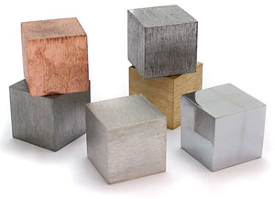
Conductors & insulators
Q: How do electrons behave in a perfect conductor?
–
–
–
–
–
–
–
–
–
–
–
–
–
+
+
–
+
+
–
Q: How do electrons behave in a perfect insulator?
–
–
+
–
+
+
+
–
–
–
Most things are in between perfect conductor / insulator

Slide 12
ACT: Conductors
Electrons are placed on a neutral conducting sphere. Which of the following diagrams correctly depicts how the charges are distributed?
A. At the bottom
B. Spread uniformly
C. On the surface
–
–
–
–
–
–
–
–
–
–
–
–
–
–
–
–
–
–
–
–
–
–
DEMO

Slide 13
Conservation of charge
Charges are physical entities (ex: electrons, protons)
Cannot be created or destroyed
+
The net charge in a closed system is conserved
–
However, charges (often electrons) can be transferred from one object to another

Slide 14
Demo: electroscope
Charging by conduction
Charged rod is brought near scope
Charged rod touches scope transferring some charge
Scope is left with same charge as rod
+
Conducting sphere
–
–
–
–
–
–
–
–
–
–
–
–
–
–
–
+
–
–
–
–
–
–
–
–
–
–
–
–
–
+
–
–
Insulating cage
+
–
+
Gold leaves
+
–

Slide 15
Demo: electroscope
Charging by induction
Charged rod is brought near scope (but does NOT touch)
Scope is briefly grounded allowing charge to flow on (or off)
Scope is left with opposite charge as rod
+
–
–
–
–
–
–
–
–
+
–
–
–
–
–
–
–
+
–
Ground wire
–
+
–
–
+
+
+
+
–
–

Slide 16
ACTs: Electroscope
A positively charged rod is used to charge an electroscope by induction. What is the resulting net charge on the electroscope?
A. positive B. zero C. negative
If the conducting electroscope were replaced by an insulating ball and then charged by induction as above, what would be the net charge on the ball?
A. positive B. zero C. negative

Slide 17
Coulomb’s Law
(1785)
Force between charges q₁ and q₂ separated a distance r:
“Coulomb constant”
Magnitude
“Permittivity of free space”
Or:
Direction
Opposite charges attract, like charges repel

Slide 18
Coulomb’s Law
What is the magnitude of the force on the proton due to the electron in hydrogen?
Proton
q_{p} = 1.6 x 10^{–19} C
+
–
Electron
q_{e} = –1.6 x 10^{–19} C
r = 0.53 x 10^{–10} m
Compare to gravitational force between them (Phys. 101)

Slide 19
ACT: Coulomb’s Law
What is the direction of the force on the proton due to the electron in the hydrogen atom?
+
–
proton
electron
A. Left B. Right C. Zero
What is the direction of the force on the electron due to the proton?

Slide 20
ACT: Coulomb’s Law
Two charges q₁ = +1 μC and q₂ = +10 μC are placed near each other. Which of the following diagrams correctly depicts the forces acting on the charges?
q₂ = +10 μC
q₁ = +1 μC

Slide 21
Summary of Today’s Lecture
Electric charge
Conservation of charge
Conductors and insulators
Coulomb’s Law for the force between charges
Much more on Coulomb’s Law in next lecture

