Slide 1
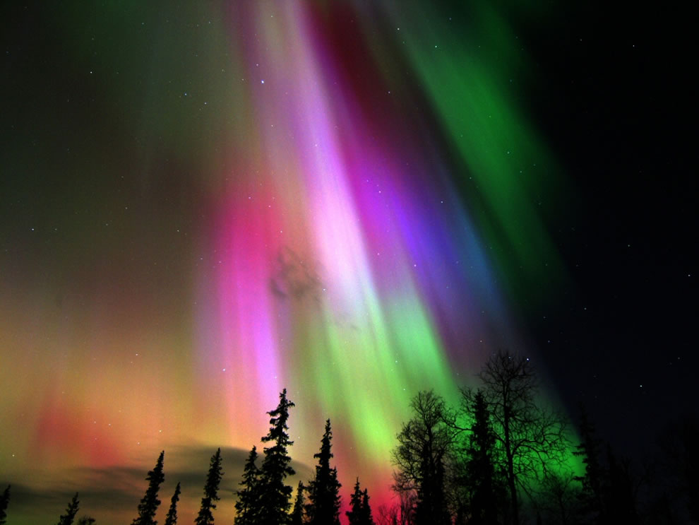
Phys 102 – Lecture 10
Magnetic fields & forces

Slide 2
Today we will...
Learn about the magnetism
Magnetic field B
Magnetic force F on moving charge
Apply these concepts!
Charged particle motion in a magnetic field
Mass spectrometry
Earth’s magnetic field & northern/southern lights

Slide 3
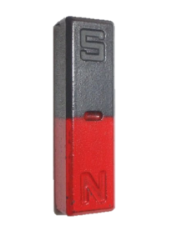
Electricity vs. magnetism
Electricity
Positive & negative charge
Opposite charges attract, like charges repel
Magnetism
N & S poles
N & S always together as dipole (NO “magnetic charge”)
Opposite poles attract, like poles repel
–
+
N
S
N
S
+
+
N
S
S
N
–
–
S
N
N
S
DEMO

Slide 4
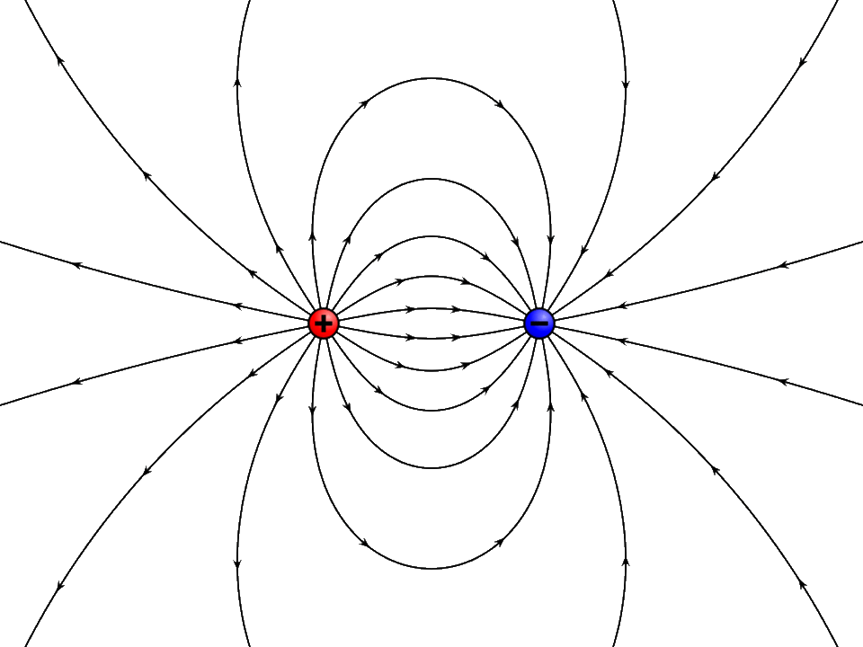
Electricity vs. magnetism
Electric field
Vector at location in space
Points from positive & negative Q
Units: N/C = V/m
Magnetic field
Vector at location in space
Points from N to S pole
Units: T (“Tesla”)
+
–
Electric dipole E field
Magnetic dipole B field
DEMO

Slide 5
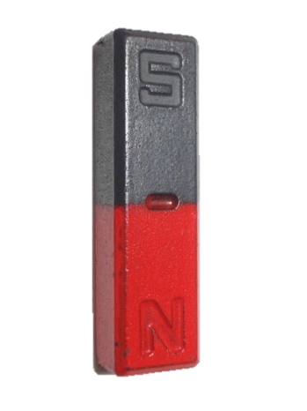
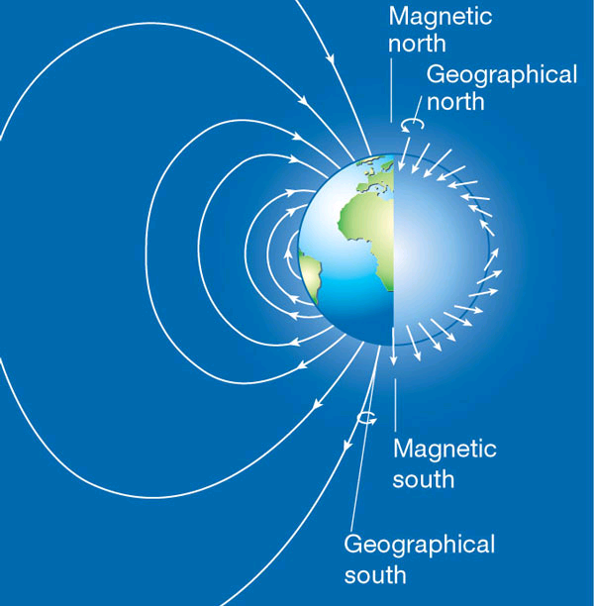
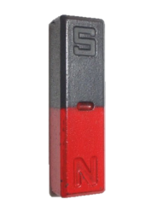
Sources of magnetic fields
There is no magnetic charge, so where do magnetic fields come from?
+
–
–
Geodynamo
Intrinsic magnetic dipole (“spin”)
Moving electric charge (current)
Lecture 25
Lecture 12

Slide 6
Magnetic force
Magnetic field B exerts a force on a moving charge q:
Angle between v and B
Magnitude
Speed of charge q
Magnetic field strength
Direction
“Right-hand rule” (RHR)
Thumb along
Fingers along
on + q is out of palm
θ
q
+
on – q is into palm
DEMO
F is ⊥ to both v and B

Slide 7
ACT: right hand rule practice
A + charge moving to the right in a uniform B field experiences a force F up. Which way does the B field point?
F
Up
Down
Into the page
Out of the page
v
q
+

Slide 8
ACT: right hand rule practice
A – charge moving out of the page in a uniform B field to the left experiences a force F in which direction?
Up
Down
Into the page
Out of the page
q
B
–
v
DEMO

Slide 9
ACT: Moving charges
The three charges below have equal charge and speed, but are traveling in different directions in a uniform magnetic field.
θ
3
θ
2
1
θ
Which particle experiences the greatest magnetic force?
A. 1 B. 2 C. 3 D. All same
The force on charge 3 is in the same direction as the force on 1
A. True B. False

Slide 10
Checkpoint 1.1
Each chamber has a unique magnetic field. A positively charged particle enters chamber 1 with velocity 75 m/s up, and follows the dashed trajectory.
v
1
2
+
v = 75 m/s q = +25 mC
What is the direction of the force on the particle just as it enters region 1?
up
down
left
right

Slide 11
ACT: Checkpoint 1.2
Each chamber has a unique magnetic field. A positively charged particle enters chamber 1 with velocity 75 m/s up, and follows the dashed trajectory.
v
1
2
+
v = 75 m/s q = +25 mC
What is the direction of the magnetic field in region 1?
up
down
into page
out of page

Slide 12
Checkpoint 1.4
Each chamber has a unique magnetic field. A positively charged particle enters chamber 1 with velocity 75 m/s up, and follows the dashed trajectory.
F
+
v
1
2
v = 75 m/s q = +25 mC
What is the direction of the magnetic field in region 2?
up
down
into page
out of page

Slide 13
ACT: Checkpoint 1.5
Each chamber has a unique magnetic field. A positively charged particle enters chamber 1 with velocity 75 m/s up, and follows the dashed trajectory.
1
2
+
v = 75 m/s q = +25 mC
How do the magnitudes of the B fields in region 1 and 2 compare?
|B₁| > |B₂|
|B₁| = |B₂|
|B₁| < |B₂|

Slide 14
Motion in uniform B field
Charged particle moves along x ⊥ to B field
Particle moves in a circle
+
v
F
R
Principle of mass spectrometer
y
B field does no work (since F ⊥ d)
Kinetic energy is constant
Speed is constant
B
x
DEMO

Slide 15
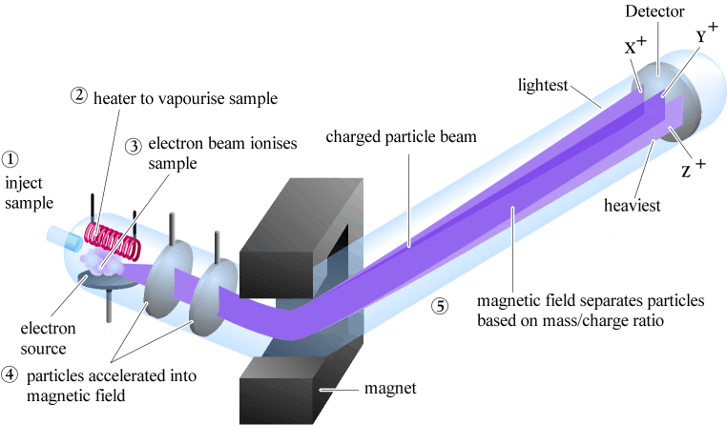
Mass spectrometer
Mass spectrometry uses a B field to analyze chemical compounds
Compound is vaporized into fragments & ionized, accelerated with a E field into a B field
Fragments separate according to mass to charge ratio (m/q)

Slide 16
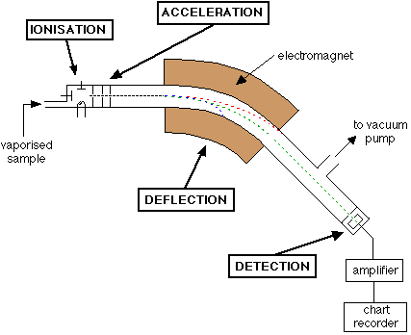
Calculation: Mass spectrometer
A mass spectrometer is used to separate different isotopes of carbon. Carbon ions are accelerated to a speed v = 10⁵ m/s; assume all have charge +1e = 1.6×10^{–19} C.
Find which C isotope travels along the green dotted path to the detector.
B = 0.2 T
¹³C⁺
v = 10⁵ m/s
FA13 EX2
R = 6.8 cm
¹³C⁺
Which way does the B field point?

Slide 17
ACT: Mass spectrometer I
The mass spectrometer isolates three C isotopes a, b, c. They move at a speed v = 10⁵ m/s entering the B field and follow the dashed paths.
Magnet
C ion beam
v = 10⁵ m/s
a
R
c
b
Detector
How do the speeds of the different isotopes a, b, c leaving the B field compare?
v_{a} > v_{b} > v_{c}
v_{a} = v_{b} = v_{c}
v_{a} < v_{b} < v_{c}

Slide 18
ACT: Mass spectrometer II
The mass spectrometer isolates three C isotopes a, b, c. They move at a speed v = 10⁵ m/s entering the B field and follow the dashed paths.
Magnet
C ion beam
v = 10⁵ m/s
a
R
c
b
Detector
How do the masses of the different isotopes a, b, c compare?
m_{a} > m_{b} > m_{c}
m_{a} = m_{b} = m_{c}
m_{a} < m_{b} < m_{c}

Slide 19
3-D motion in uniform B field
What if particle v has a component along B?
z
Charged particle moves in x-z plane, B field along z
B
+
v⊥
B
+
F
B
=
z
v||
y
v||
+
v
x
+
x
x
v⊥
y
F = 0
Component || to B remains constant
F = qBv⊥
Component ⊥ to B rotates in a circle
Charge moves in a helical trajectory

Slide 20
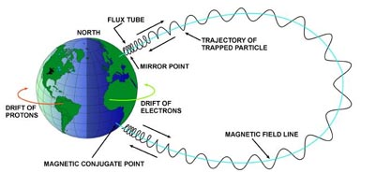
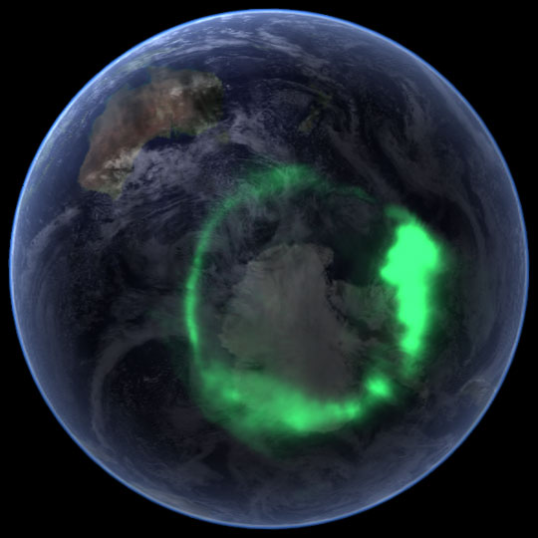
Aurora borealis & australis
Earth’s B field protects against stream of ions from sun (“solar wind”)
z
B
x
Aurora australis
“Southern lights”
y
B field directs ions to atmosphere in north and south hemispheres. Ions collide with particles in atmosphere and emit light: “aurora”

Slide 21
Summary of today’s lecture
Electric vs. magnetic forces
Force: Electric Magnetic
Source: Charge Moving charge
Act on: Charge Moving charge
Magnitude: F_{E} = q E F_{B} = q v B sin(θ)
Direction: || to E ⊥ to v, B
Work: W_{E} = qEd cos(θ) W_{B} = 0

Slide 22
v
v
F
B
B
F
v
F
B
F
v
B

