Slide 1
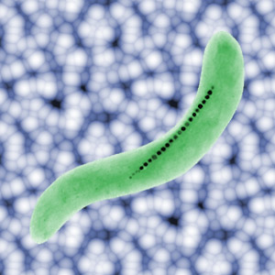
Phys 102 – Lecture 11
Magnetic dipoles & current loops

Slide 2
Today we will...
Learn how magnetic fields act on
Magnetic dipoles
Current loops
Apply these concepts!
Magnetotactic bacteria
Principles behind NMR/MRI, EPR/ESR
Magnetic materials (paramagnets and ferromagnets)

Slide 3
Magnetic dipole & dipole moment
A magnetic N and S pole make up a magnetic dipole
Recall: electric dipole
Magnetic dipole
N
+q
=
=
–q
S
Magnetic dipole moment is analogous to electric dipole moment
Direction
Vector from S to N pole (by convention)

Slide 4
Dipole in uniform field
Electric & magnetic dipole moments align parallel to field
Torque:
Lect. 3
Energy:
Lect. 4
+q
N
–q
N
S
+q
–q
S
N
+q
N
+q
–q
S
–q
S
+q
N
–q
S
DEMO

Slide 5
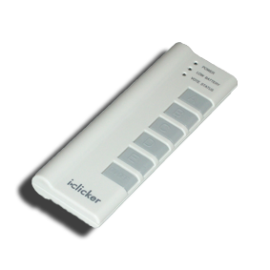
ACT: CheckPoint 1.1
Which of the three configurations of magnetic dipoles shown below has the highest potential energy?
A.
B.
C.
N
N
N
N
N
S
S
S
N
S
S
S

Slide 6
Calculation: magnetic bacteria
Magnetotactic bacteria grow a chain of magnets to align to the Earth’s B field
Room temperature kinetic energy tends to randomizes orientation
Dipoles are randomized
Magnetospirillum magnetotacticum
Dipoles tend to be aligned
Find minimum value of μ such that cells align to the Earth’s field

Slide 7
Spin & magnetic fields
Electrons, protons, & neutrons (and many others) have an intrinsic property called “spin” which gives them a magnetic dipole moment
Nuclear magnetic resonance (NMR) / magnetic resonance imaging (MRI)
+
+
Detects energy difference between nuclear spins (ex: ¹H) parallel and anti-parallel to B field
Electron paramagnetic resonance (EPR) / electron spin resonance (ESR) applies same principle with electron spin

Slide 8
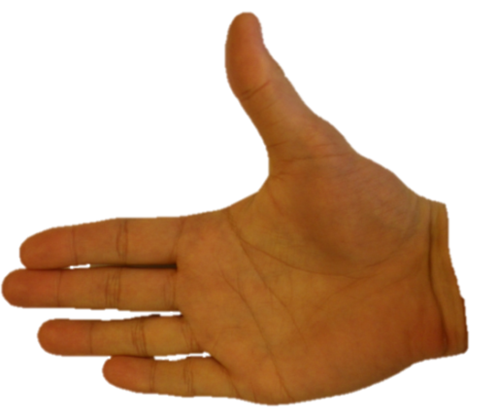
Magnetic force on current
Recall: B field exerts a force on a moving charge q
Current I is flow of + charge
Angle between I and B
Magnitude
Current
B field strength
Length of wire
Direction
“Right-hand rule” (RHR)
Thumb along I
L
Fingers along
on I is out of palm
θ
I
+
+

Slide 9
CheckPoint 2.1
A rectangular loop of wire is carrying current I as shown. There is a uniform magnetic field parallel to the sides a–b and c–d.
d
c
I
a
b
What is the direction of the force on section a–b of the wire?
force is zero
out of the page
into the page
...on section c–d of the wire?

Slide 10
ACT: CheckPoint 2.2
A rectangular loop of wire is carrying current I as shown. There is a uniform magnetic field parallel to the sides a–b and c–d.
d
c
I
a
b
What is the direction of the force on section b–c of the wire?
force is zero
out of the page
into the page

Slide 11
ACT: Force on loop
A rectangular loop of wire is carrying current I as shown. There is a uniform magnetic field parallel to the sides a–b and c–d.
d
c
I
a
b
What is the direction of the force on section d–a of the wire?
force is zero
out of the page
into the page

Slide 12
CheckPoints 2.3 & 2.4
So, does the loop move?
Compare magnitudes of forces:
d
c
w
I
a
b
DEMO

Slide 13
Torque on current loop
φ
F
Loop spins in B field
a
d
c
w
L
a
b
L
b
Top view
Side view
F
φ
B field generates a torque on the loop
Loop area

Slide 14
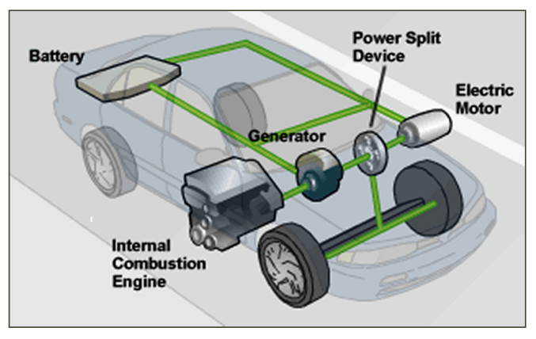
Electric motors
DC motors use a clever arrangement of current carrying coils and permanent magnets to turn a shaft:
DEMO

Slide 15
Current loop & magnetic dipole
B field exerts torque on loop
φ
a
d
c
normal
N
N
normal
S
S
φ
a
b
b
Top view
Side view
φ
Current loop behaves the same as magnetic dipole ⊥ to loop plane
Convenient to define a normal vector ⊥ to loop plane, || to dipole moment
Torque aligns normal vector || to B field

Slide 16
Magnetic dipole & current loop
A current loop behaves the same as a magnetic dipole
μ
N
I
=
=
A
S
I
Equivalent magnetic dipole moment:
Magnitude
True for flat loop of any shape
For a loop with N turns of wire
Direction
Another “right hand rule”:
Curl fingers along I
along thumb

Slide 17
ACT: Current loop practice
A loop is placed in a uniform B field. A current I flows around the loop as shown.
I
Which way does loop rotate?
Clockwise
Counterclockwise
The loop does not rotate

Slide 18
ACT: Torque on a loop
Compare the torque on loop 1 and 2, which have identical area A, and current I.
τ₁ > τ₂
τ₁ = τ₂
τ₁ < τ₂

Slide 19
Para- & ferromagnetism
In some materials, unpaired electron (spin & orbit) give atoms net magnetic moment
In paramagnets, atomic dipoles are randomly oriented
In ferromagnets, atomic dipoles interact and align together
N
N
N
N
N
N
S
S
S
S
S
S
N
N
N
N
N
N
S
S
S
S
S
S
N
N
N
N
N
N
S
S
S
S
S
S
Apply a B field and dipoles align!
Material now behaves as a magnet
Material is a permanent magnet

Slide 20
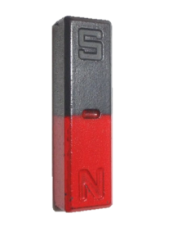
ACT: Magnetic materials
The N pole of a permanent magnet is brought near a paramagnetic ball bearing. What happens next?
The ball moves toward the magnet
The ball moves away from the magnet
The ball does not move
DEMO

Slide 21
Summary of today’s lecture
B fields exert torque on magnetic dipoles
B fields exert force on current-carrying wire
Current loops are equivalent to magnetic dipole
N
A
=
=
N
S
I

