Slide 1
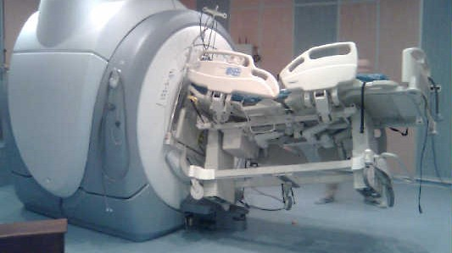
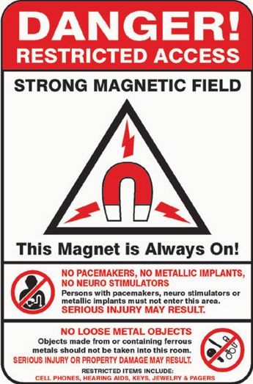
Phys 102 – Lecture 12
Currents & magnetic fields

Slide 2
Today we will...
Learn how magnetic fields are created by currents
Use specific examples
Long straight wire
Current loop
Solenoid
Apply these concepts
Electromagnets & MRI

Slide 3
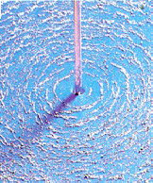
Currents generate B fields
A long straight wire carrying current I generates a B field
I
B
Current
Magnitude
B_{wire}
Distance from wire
Side view
I
“Permeability of free space”
(similar to ε₀ for electricity)
DEMO
B_{wire}
r
Direction
Right-hand rule for wire:
I
Thumb along I
Top view
Curl fingers along
B is ⊥ to r

Slide 4
Superposition principle
Total B field due to several charges = sum of individual B fields
Ex: what is the B field at point P due to I₁, I₂, and I₃?
P
I₁
I₃
Order does not matter!
I₂
Same approach as for E fields

Slide 5
Calculation: 2 wires
A long straight wires 1 carries current I₁ = 0.1 A out of the page. What must be the direction and magnitude of the current I₂ in wire 2 such that there is no net B field at point P?
I₁
I₂
P
?
2 cm
4 cm

Slide 6
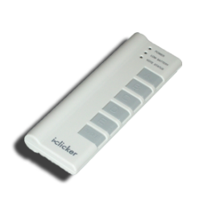
ACT: CheckPoint 1.1
Two long wires carry the same current I in opposite directions
P
I
I
What is the direction of the total B field above and midway between the two wires at point P?
A. Left B. Right C. Up D. Down E. Zero

Slide 7
Calculation: B field from 2 wires
Calculate the magnitude of the total B field from the 2 wires at P
P
2 cm
I = 0.1A
I = 0.1A
y
1
2
2 cm
x

Slide 8
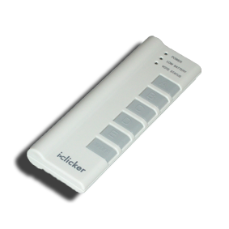
ACT: Current loop
A loop of wire carries current as shown. In what direction is the B field at the center of the loop?
I
A. Left B. Right C. Up D. Down E. Zero

Slide 9
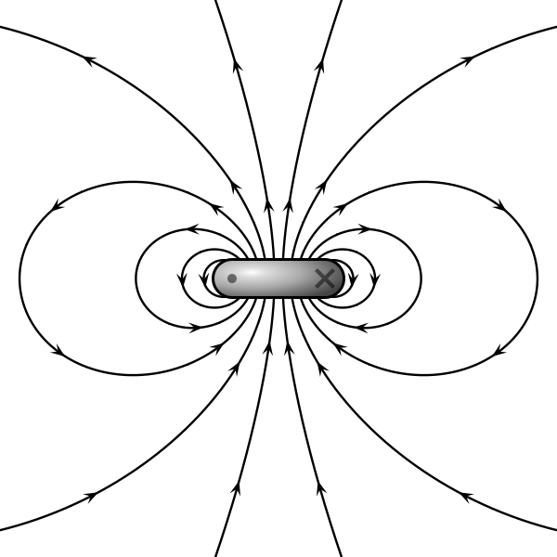
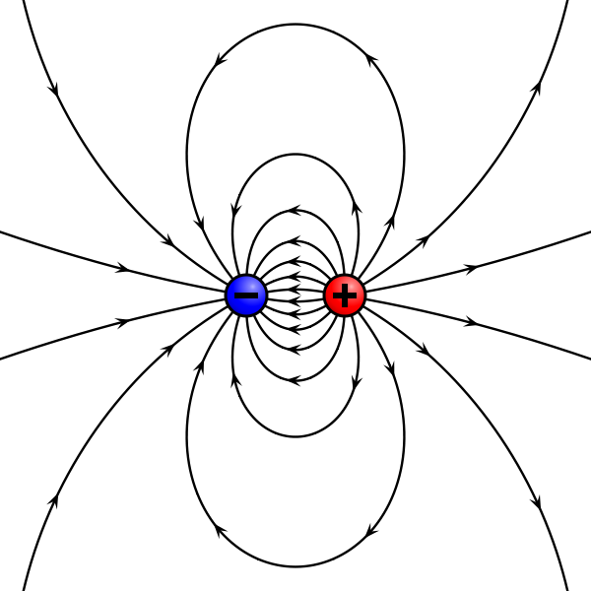
Current loops & magnetic dipoles
Recall Lect. 11: A current loop behaves like a magnetic dipole
Generates the same B field
N
N
=
S
S
μ
I

Slide 10
ACT: Many current loops
Which configuration of two loops generates a larger B field at point P midway between the loops?
I
I
P
P
I
I
A. Left B. Right C. Same

Slide 11
Solenoid
B
A solenoid is a long coil consisting of N turns of wire
I
Magnitude
Current
L
N
B field inside solenoid
Side view
Number of turns of wire per length (in m) N/L
I
Note there no dependence on r.
B field inside solenoid is uniform
B
Direction
Right-hand rule for loop(s):
I
Curl fingers along I
Top view
Thumb along

Slide 12
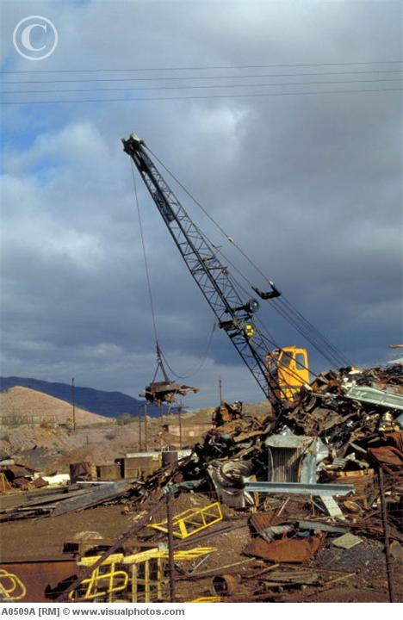
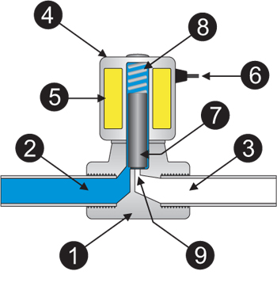
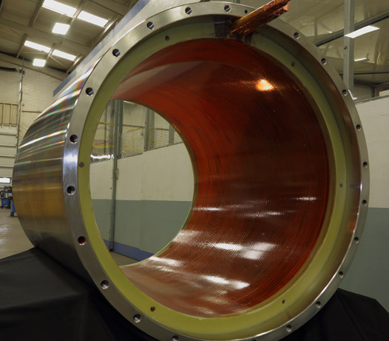
Electromagnets
Solenoids are a way to make powerful magnets that can be turned on and off!
spring
solenoid
piston
input
output
flow line
seal
Junkyard magnet
Solenoid valve
MRI magnet

Slide 13
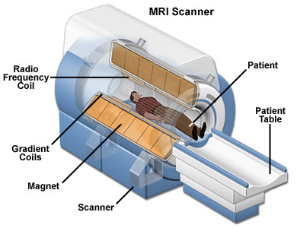
Calculation: MRI magnet
How many turns of wire are needed to generate a 1.5 T MRI magnet?
L = 2 m
d = 0.6 m
How much wire does that correspond to?

Slide 14
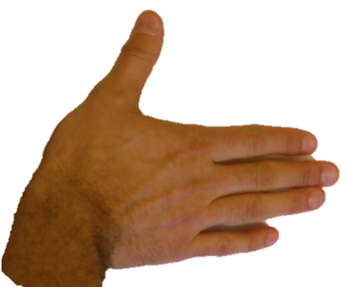
Magnetic field recap
B fields exert forces on moving charges
v, I
v
I
B
B
F
B
+
Moving charges generate B fields
B
I
I
B
N
L
I
I

Slide 15
ACT: CheckPoint 3.1
A long straight wire is carrying current I to the right. A distance r from the wire are 2 charges +q with speed v
v
q
q
+
(a)
+
v
(b)
r
r
I
Compare the magnitude of magnetic force on q for (a) vs. (b)
(a) has the larger force
(b) has the larger force
force is the same for (a) and (b)

Slide 16
CheckPoint 3.1
A long straight wire is carrying current I to the right. A distance r from the wire are 2 charges +q with speed v
v
q
q
+
(a)
+
v
(b)
r
r
I
Compare the direction of magnetic force on q for (a) vs. (b)

Slide 17
ACT: Force between wires
Current-carrying wires generate B fields, B fields exert force on current-carrying wires. So, wires must exert forces on each other!
The two wires 1 & 2 carry current in the same direction. In which direction does the force on wire 2 point?
I₁
I₂
Toward wire 1
Away from wire 1
The force is zero

Slide 18
Force between wires
Wires generate B fields, B fields exert force on wires. Therefore, wires exert forces on each other
Direction
I₁
I₂
I₁
I₂
r
r
Magnitude
DEMO

Slide 19
ACT: Force between wires
The two wires 1 & 2 carry current in perpendicular directions. In which direction does the force on wire 2 point?
I₂
I₁
Toward wire 1
Away from wire 1
The force is zero

Slide 20
Summary of today’s lecture
B fields are generated by currents
Long straight wire
Current loop
Solenoid
Current carrying wires exert forces on each other
Likes attract, opposites repel
Don’t confuse different RHRs!

