Slide 1
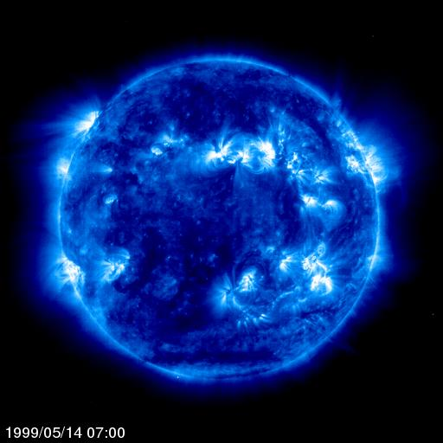
Phys 102 – Lecture 15
Electromagnetic waves

Slide 2
Today we will...
Introduce/review several key concepts
Changing B field generates E field
Changing E field generates B field
E and B field propagate in space at finite speed
Learn about electromagnetic waves
Relationship between E and B fields in EM waves
Properties of waves & spectrum of light
Learn applications
Antennas
Doppler effect

Slide 3
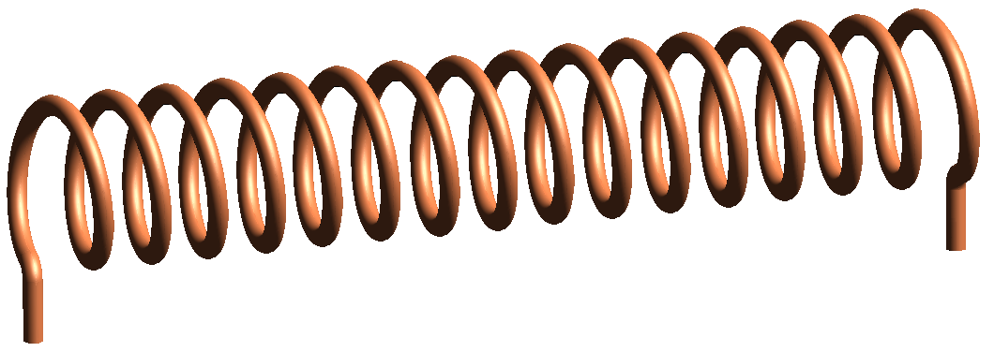
EM induction revisited
By Lenz’s law, if B field from solenoid increases, a clockwise current flows around loop. What drives current around loop?
B
It actually does not matter the size of the loop, or even if there is a loop at all!
E
E
B
Top view
Side view
Changing B field generates a E field

Slide 4
Changing E field creates B field?
Imagine two wires connected to a capacitor. Current drives charge on capacitor plates, increasing E field between plates.
I
Current generates B field around wires, but what about between capacitor plates?
B
B
E
E
Top view
Side view
Changing E field generates a B field

Slide 5
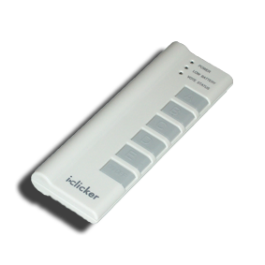
ACT: E fields create B fields
What are the E & B field magnitudes around the wires and capacitor plates after a long time charging?
I
B
E
|E| > 0, |B| > 0
|E| = 0, |B| = 0
|E| = 0, |B| > 0
|E| > 0, |B| = 0
Side view

Slide 6
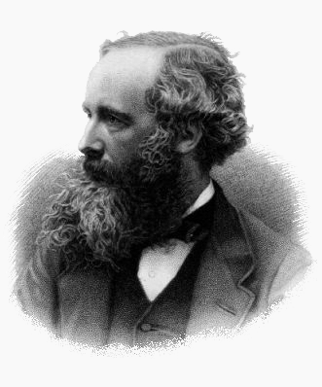
Maxwell’s equations
4 laws unify electricity & magnetism:
E field generated by electric charge
(Gauss’ Law – Lecture 3)
No magnetic charge
(Lecture 10)
E field generated by changing magnetic flux
(Faraday’s Law – Lecture 14)
B field generated by moving electric charge
& changing electric flux
(Ampere-Maxwell Law – Lecture 12 & 15)
James Maxwell
(1831-1879)

Slide 7
Electromagnetic waves
To recap:
3. Changing B field creates E field (even in absence of charges)
4. Changing E field creates B field (even in absence of currents)
It should be possible to establish a self-sustaining E and B field in empty space. Don’t need charges or currents!
E
B
This is achieved by electromagnetic waves (light!):
oscillating E and B field propagating in space and time

Slide 8
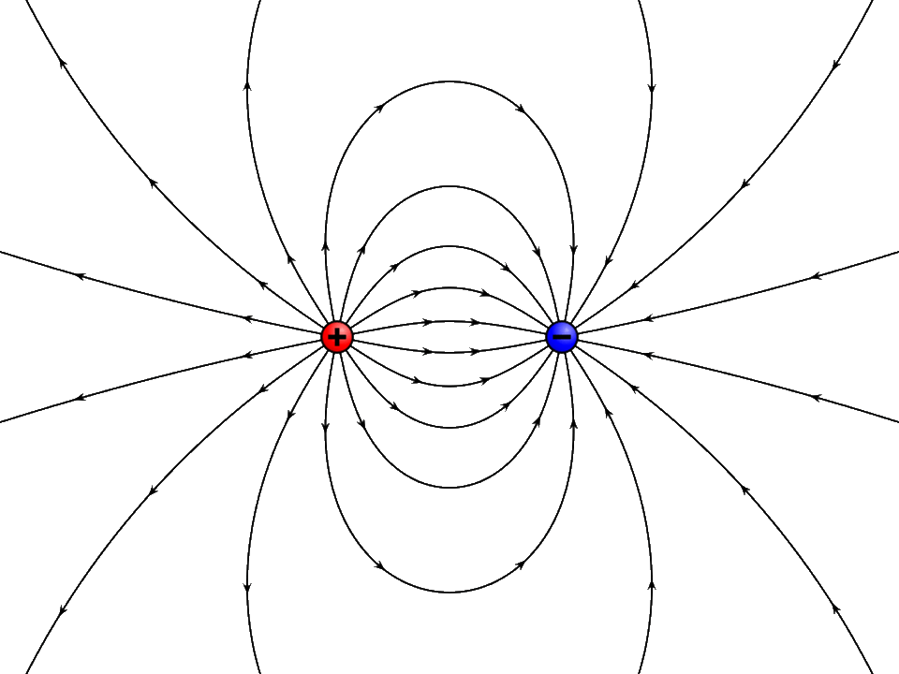
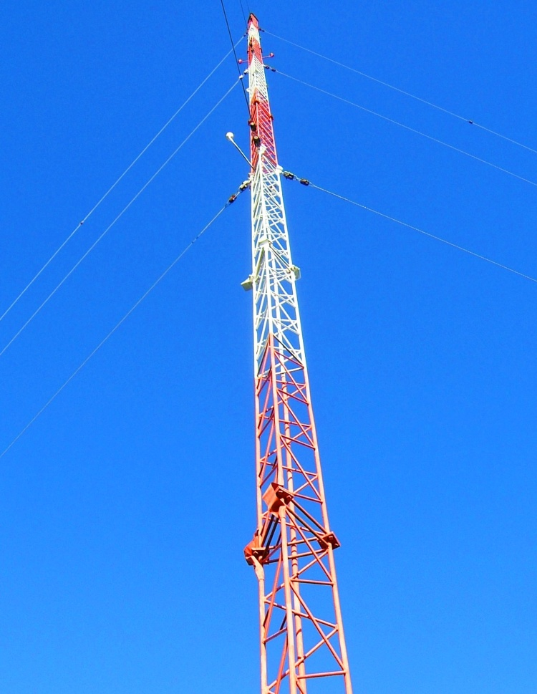
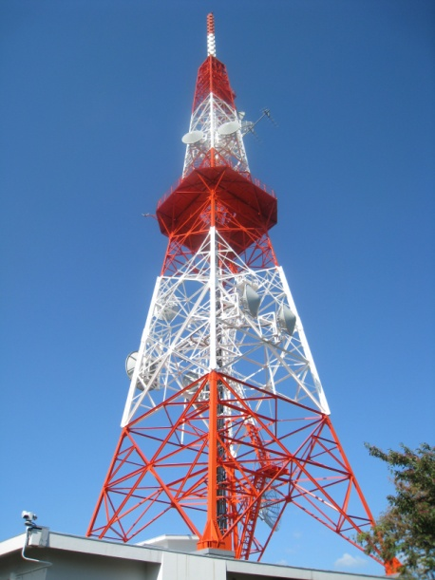
Antennas
Electric dipole antennas create oscillating E fields by oscillating + and – charge
Oscillating E field generates oscillating B field
I
I
AC generator
+
+
+
–
–
–
CAREFUL! E & B fields do NOT appear everywhere in space instantaneously! They propagate at a finite speed c

Slide 9
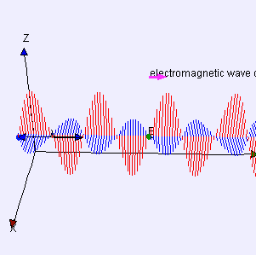
Electromagnetic radiation
Antenna generates oscillating E and B fields. Look along y axis:
Speed of light (in vacuum)
Frequency of AC generator
I
I
+
–
Wavelength of EM wave
+
–
+
–
–
+
B
y
EM wave
E
–
+
z
+
cT = λ
–
–
+
+
–
t = T (one full period)
= 1/f
y
x

Slide 10
CheckPoint 1.1-1.4: EM waves
E
z
v
v
y
x
B
EM wave can propagate in vacuum at speed v = c
No charges or current loops necessary for propagation
f and λ of EM wave are related
E and B oscillate in phase and are proportional
E & B field increase and decrease at same times
E and B are ⊥ to each other and propagation direction
Right hand rule:
Thumb along
Fingers along
Out of palm
Notes:
http://www.youtube.com/watch?v=5CAYNTBrczo

Slide 11
ACT: CheckPoint 2
An EM wave propagates along +z. At a point P, the E field points along +y.
y
v
z
P
x
In which direction does the B field point at P?
Along +x B. Along –x C. Along +z D. Along –z

Slide 12
ACT: magnetic dipole antenna
Another way to generate an EM wave is to oscillate current around a loop. This is called a magnetic dipole antenna.
z
P
y
x
In which direction do the E and B fields oscillate at point P?
B along z, E along x
B along x, E along y
B along y, E along z

Slide 13
Speed of EM wave
Recall fundamental constants of electricity and magnetism:
“Permittivity of free space” (electricity)
“Permeability of free space” (magnetism)
Now multiply them:
Speed of light in a vacuum
c =

Slide 14
Electromagnetic spectrum
Radio waves, visible light, x-rays, etc. are all electromagnetic waves
Visible light
Increasing λ
R O Y G B I V
Increasing f
700
600
500
400 nm

Slide 15
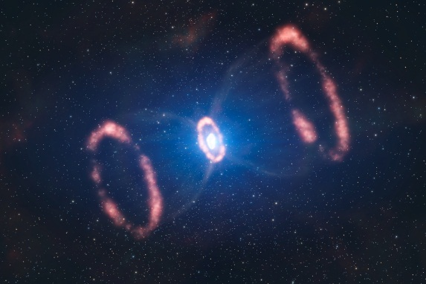
ACT: Supernova
A distant star goes supernova and emits in the X-ray (λ = 10 nm) and infrared (λ = 3000 nm) regions of the EM spectrum.
λ = 10 nm
λ = 3000 nm
Which light reaches the earth first?
X-ray B. Infrared C. Both arrive at the same time

Slide 16
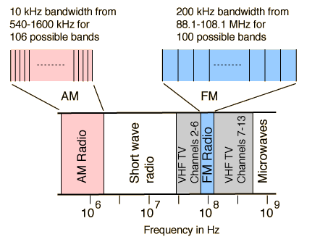
Calculation: EM wavelength
The U of I radio station is WPGU 107.1 FM. At what wavelength does the station broadcast its radio waves?
107.1 FM = 107.1 MHz = 107.1×10⁶ cycles/s
For comparison, cell phones typically operate at 1.9 GHz

Slide 17
Representing EM waves
This picture represents EM wave along one line only (y-axis) What about the rest of space?
z
Imagine a slice in x–z plane
E
y
B
x
E and B fields the same everywhere along plane
Wavefront = surfaces at crests of EM wave

Slide 18
ACT: Plane wave
Consider the plane EM wave below. Which of the following statements about the E field are TRUE?
z
P₁
E
P₂
y
x
B
P₃
E is the same at point P₁, P₂, and P₃
E = 0 at point P₂
E = 0 at point P₁ and P₃

Slide 19
Doppler effect
Now the police car moves to the left. The observed wavelength λ_{obs} is different
Wavefronts
λ_{obs} > λ_{emit}
λ_{obs} < λ_{emit}
v
Emitter moving toward observer: v_{rel} > 0,
λ_{obs} < λ_{emit}, f_{obs} > f_{emit}
Emitter moving away from observer: v_{rel} < 0,
λ_{obs} > λ_{emit}, f_{obs} < f_{emit}
If v_{rel} << c
Observed frequency
Emitted frequency
Speed relative to observer
Notes:
DEMO 1348

Slide 20
ACT: Doppler effect
You are driving at 85 mph along Highway 57. A police car is chasing you down at 100 mph.
v_{Ferrari} = 85 mph
v_{police} = 100 mph
In your rearview mirror, the frequency of the light from the police car siren appears:
Higher (more blue) B. Lower (more red)

Slide 21
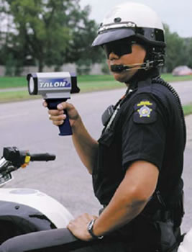
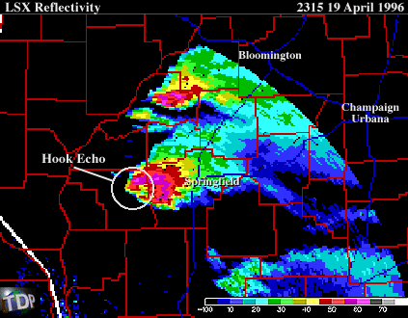
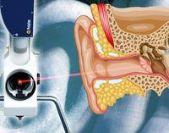
Doppler velocimetry
Technique uses Doppler shift of EM wave in moving source to determine speed of source
Radar gun
Weather radar
Bio-acousto-mechanics
Notes:
Most modern weather radars use the pulse-doppler technique to examine the motion of precipitation, but it is only a part of the processing of their data

Slide 22
Summary of today’s lecture
Electromagnetic waves
Changing B field generates E field
Changing E field generates B field
E and B field propagate in space at speed of light c
Properties of electromagnetic waves
Wavelength and frequency are related by c = λf
E and B fields are always ⊥ each other & propagation direction
E and B fields always oscillate in phase & E = cB

