Slide 1
Phys 102 – Lecture 25
The quantum mechanical model of light

Slide 2
Recall last time…
Problems with classical physics
Stability of atoms
Atomic spectra
Photoelectric effect
Quantum model of the atom
Bohr model – only orbits that fit n e– λ allowed
Angular momentum, energy, radius quantized
Today: Quantum model of light
Einstein’s photon model
Today

Slide 3
Atomic units
At atomic scales, Joules, meters, kg, etc. are not convenient units
“Electron Volt” – energy gained by charge +1e when accelerated by 1 Volt:
1e = 1.6×10^{–19} C, so 1 eV = 1.6×10^{–19} J
Planck constant: h = 6.626 × 10^{–34} J∙s
Speed of light: c = 3 × 10⁸ m/s
Electron mass: m = 9.1 × 10^{–31} kg

Slide 4
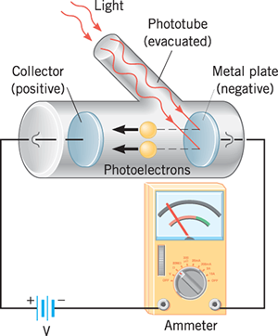
Photoelectric effect
Light shining on a metal can eject electrons out of atoms
(UV) Light
“Photoelectron”
Maximum kinetic energy of electron
Energy of EM wave
Work function of metal
Light must provide enough energy to overcome Coulomb attraction of electron to nuclei: W₀ (“Work function”)

Slide 5
Classical model vs. experiment
Classical prediction
Increasing intensity should increase E_{light}, K_{e}
Changing f (or λ) of light should change nothing
–
–
–
–
+
+
+
–
–
–
–
Experimental result
Increasing intensity results in more e–, at same K_{e}
Decreasing f (or increasing λ) decreases K_{e}, and below critical value f₀, e– emission stops
DEMO

Slide 6
Photon Model of Light
Einstein proposed that light comes in discrete packets called photons, with energy:
Frequency of EM wave
Photon energy
Planck’s constant
Ex: energy of a single green photon (λ = 530 nm, in vacuum)
Energy in a beam of green light (ex: laser pointer)
CheckPoint 2.1: Higher/lower λ = lower/higher E

Slide 7
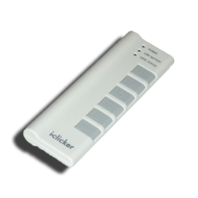
ACT: CheckPoint 2.2
A red and blue light emitting diode (LEDs) both output 2.5 mW of light power.
Which one emits more photons/second?
Red
Blue
The same

Slide 8
Photoelectric effect explained
Quantum model
Experimental result
Increasing intensity results in more photons of the same energy
Decreasing f (or increasing λ) decreases photon energy
More e– emitted at same K_{e}
Lower K_{e} and if hf_{photon} < hf₀ = W₀ e– emission stops
E
W₀
–

Slide 9
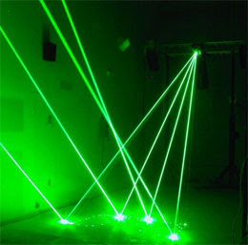
ACT: Photoelectric effect
You make a burglar alarm using infrared laser light (λ = 1000 nm) & the photoelectric effect. If the beam hits a metal detector, a current is generated; if blocked the current stops and the alarm is triggered.
Metal 1 – W₀ = 1 eV
Metal 2 – W₀ = 1.5 eV
Metal 3 – W₀ = 2 eV
You have a choice of 3 metals. Which will work?
1 and 2
2 and 3
1 only
3 only

Slide 10
Atomic spectra
Electrons in atom are in discrete energy levels
E
e– can jump from one level to another by absorbing or emitting a photon
r
Absorption (e– jumps up in energy)
n = 4
n = 3
n = 2
Emission (e– jumps down in energy)
Absorption
Emission
Energy is conserved
Only certain f (or λ) are emitted or absorbed -> spectral lines
DEMO
n = 1
–
Energy levels are different for elements, so spectra are different

Slide 11
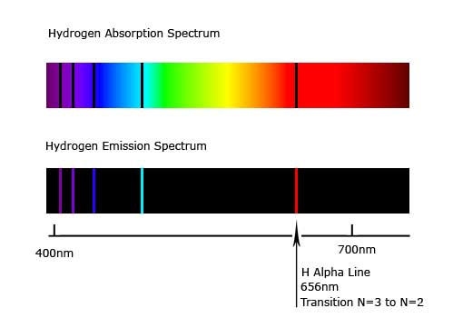
Calculation: H spectral lines
Calculate the wavelength of light emitted by hydrogen electrons as they transition from the n = 3 to n = 2 levels
E
Emission:
n = 4
n = 3
n = 2
Using
n = 1

Slide 12
Solar spectrum
Spectrum from celestial bodies can be used to identify its composition
Hydrogen
Solar spectrum
Sun radiates over large range of λ because it is hot (5800K). Black spectral lines appear because elements inside sun absorb light at those λ.
Notes:
DEMO 74: Spectral lines christmas tree

Slide 13
ACT: CheckPoint 3.1
Electron A falls from energy level n = 2 to n = 1. Electron B falls from energy level n = 3 to energy level n = 1.
E
Which photon has a longer wavelength?
n = 4
n = 3
Photon A
Photon B
Both the same
n = 2
n = 1

Slide 14
ACT: CheckPoint 3.2
The electrons in a large group of hydrogen atoms are excited to the n = 3 level.
E
How many spectral lines will be produced?
n = 4
n = 3
1
2
3
4
5
n = 2
n = 1

Slide 15
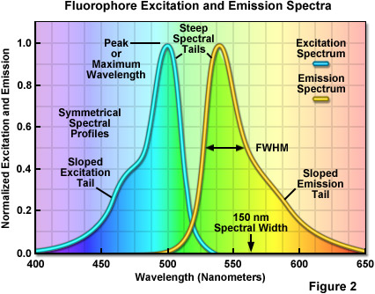
Fluorescence
Molecules, like atoms, have discrete energy levels. Usually many more, and organized in bands
E
Decay is non-radiative, usually goes into vibrational/rotational energy of molecule
Absorption
Emission
Fluorescent molecules that emit visible light absorb shorter λ (ex: UV)
Ground state
DEMO

Slide 16
Young’s double slit revisited
Light intensity is reduced until one photon passes at a time
Interference pattern = probability
Wait! Is light a wave or a particle?
Both!
What if we measure which slit the photon passes through?
Interference disappears!

Slide 17
ACT: Photons & electrons
A free photon and an electron have the same energy of 1 eV.
Therefore they must have the same wavelength.
True
False

Slide 18
Summary of today’s lecture
Quantum model of light
Light comes in discrete packets of energy
Light intensity is related to number of photons, not photon energy
Spectral lines
Transitions between energy levels
Wave-particle duality
Waves behave like particles (photons)
Particles behave like waves (electrons)

