Slide 1
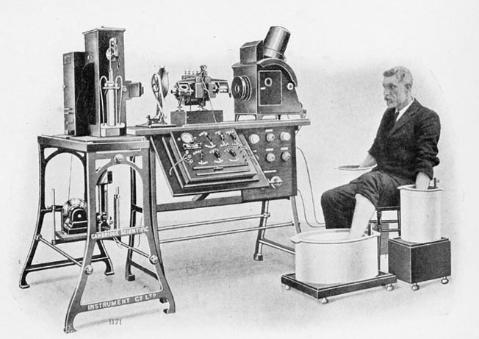
Phys 102 – Lecture 5
Electric potential

Slide 2
Today we will...
Learn about the electric potential
Use the principle of superposition
  Ex: point charges
Represent electric potential with equipotential lines
  Relation with electric field
Apply these concepts
  Ex: Electrocardiogram (ECG)

Slide 3



Recall last time
Gravitational potential energy
Electric potential energy
+
r
+
h
Height or altitude
Electric potential

Slide 4
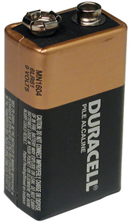
The electric potential
The electric potential is defined at a location in space around a charge or set of charges
EPE of a charge q at position P
Electric potential at position P
Charge q
Electric potential is 9 V higher at + end than – end
Units: J/C ≡ V (“volts”)
–
+
  Electric potential is a scalar (a number) NOT a vector. Signs matter!

Slide 5
Calculation: potential in H atom
What is the magnitude of the electric potential due to the proton at the position of the electron?
P
+
r = 0.53 x 10^{–10} m

Slide 6

Superposition principle
Total potential due to several charges = sum of individual potentials
Ex: what is the electric potential at point P due to q₁, q₂, and q₃?
P
Simple addition, no vectors!
Watch for signs, though!
q₁
+
q₃
+
q₂
–

Slide 7
Calculation: two charges
Calculate the electric potential at point P due to charges q₁ = +7 μC and q₂ = –3.5 μC
P
4 m
q₁
q₂
3 m
3 m
How much work do you do bringing a +2 μC charge from far away to point P?

Slide 8
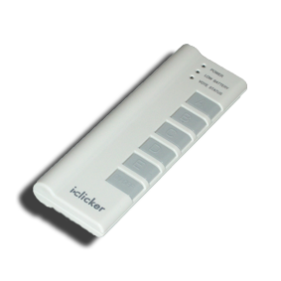
ACT: Electric potential
Two charges +2Q and –Q are placed on the x-axis. In which of the three regions I, II, or III on the x-axis can the electric potential be zero?
I
II
III
+2Q
–Q
I
II
III
II and III
I, II, and III

Slide 9

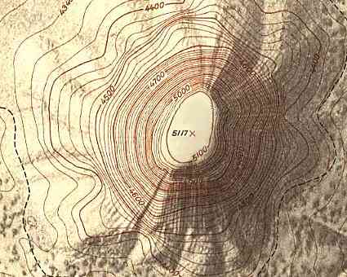
Equipotential lines
Devils tower, WY
Topographical map
Altitude is constant at every point on this line
High (low) value = uphill (downhill)
Dense lines = steeper ascent or descent
Gravitational potential energy
Electric potential energy
Height or altitude
Electric potential

Slide 10
Electric potential for a charge
Equipotential lines represent electric potential in space graphically
Electric potential is constant at every point on equipotential line
1V
+ Point charge
2
+
4
3
High (low) potential = “uphill” (“downhill”)
Dense lines = “steeper” ascent or descent

Slide 11
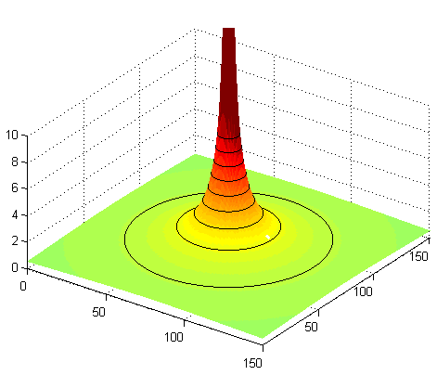
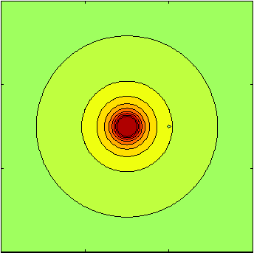
Equipotential & electric field lines
Equipotentials & electric field lines are geometrically related
Electric field points “downhill”, perpendicular to equipotential lines
+
1V
3
2
+
4
Dense equipotential lines = large E field
Positive charge moves “downhill”
Negative charge moves “uphill”

Slide 12
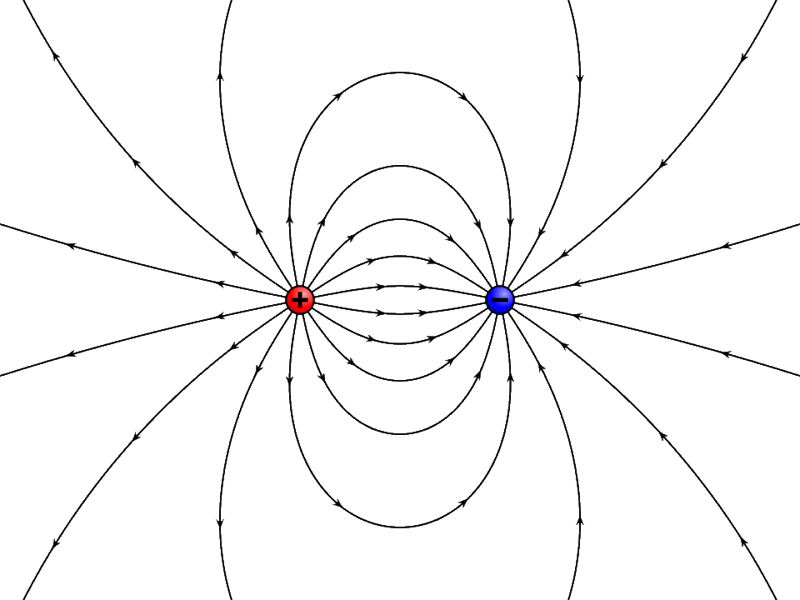

Electric potential for a dipole
+
+
–
–
DEMO

Slide 13
ACT: Uniform electric field
Which diagram best represents the equipotential lines corresponding to a uniform E field pointing to the right?
A.
B.
1
C.
2
3
4
1
2
3
4
5 V
5 V
5
4
3
2
1 V

Slide 14
Lect. 4 Checkpoint 1.2 (Revisited)
C
–
A
B
When a negative charge is moved from A to C, it moves along an equipotential line
positive work
zero work
negative work

Slide 15
ACT: Electric field gradient
Now consider an E field that decreases going to the right. Which diagram best represents the equipotential lines?
Large
Small
A.
B.
C.

Slide 16
ACT: CheckPoint 2.1
Points A and B lie in an ideal conductor inside a uniform E field
C
A
B
The electric potential at point A is _____ at point B
Greater than
Equal to
Less than

Slide 17
Electric potential difference
Note that the electric field and force depend on electric potential difference ΔV, NOT on electric potential V itself
5
Large
5
4
4
3
1 V
3
2
2
1 V
1 V
Small
Constant
This will be important starting next lecture with circuits

Slide 18
Relationship between F, E, U_{E}, V
Vector
Number (“scalar”)
F
[N]
U_{E}
[J]
Property of
interacting charges
Ex:
Ex:
E
[N/C]=[V/m]
V
[J/C]=[V]
Property of
point in space
Ex:
E points from high to low V
Ex:

Slide 19
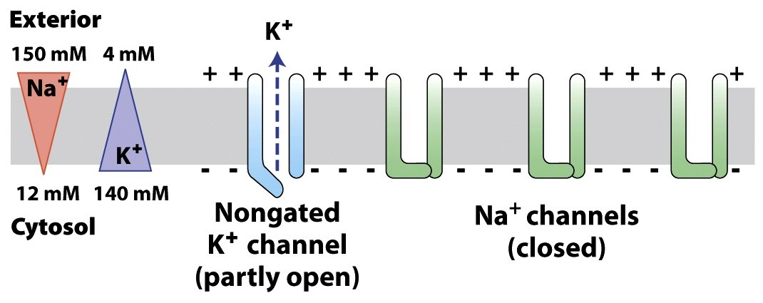
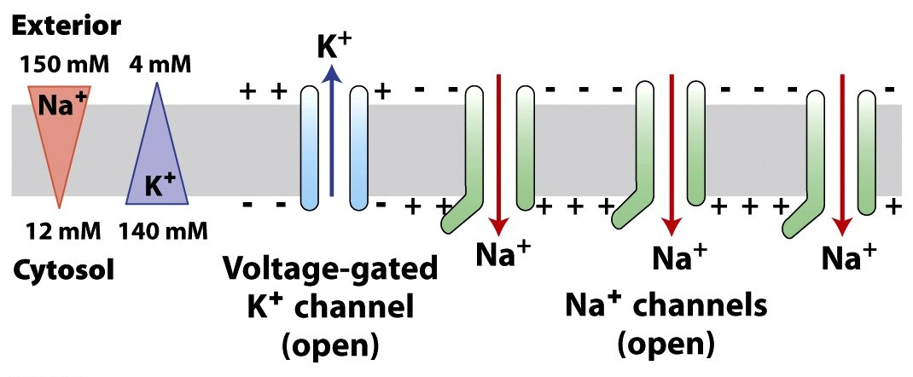
Electric potential in biology
Ion channels in cell membrane create a charge imbalance
Cells have an electric potential difference across membrane
Cells at rest are polarized
V_{outside} > 0
V_{inside} < 0
Some cell types (ex: neurons and muscle cells) depolarize when they fire
V_{outside} < 0
V_{inside} > 0

Slide 20
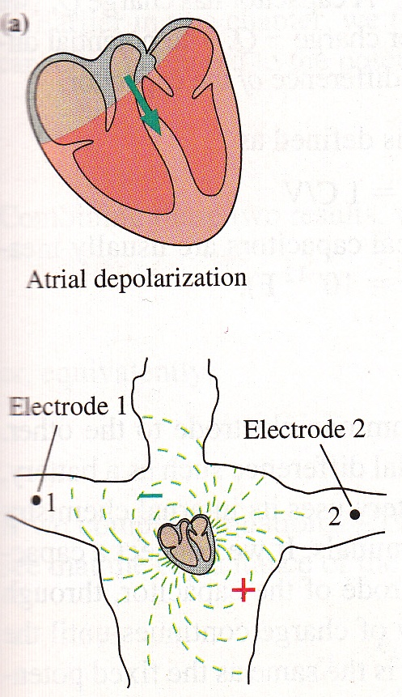
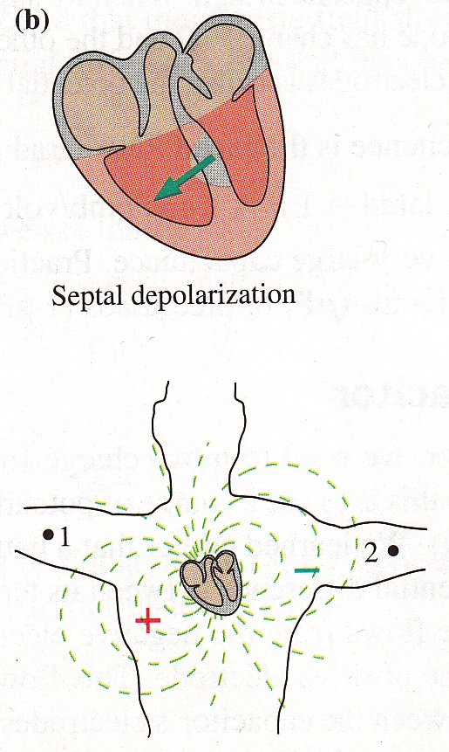
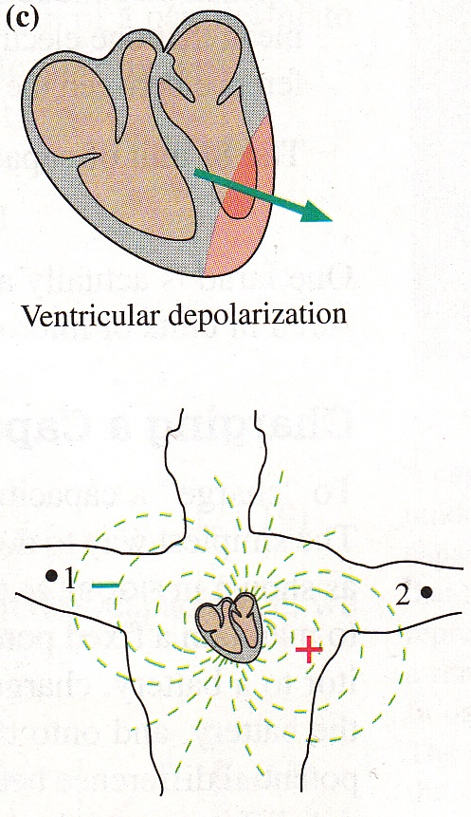
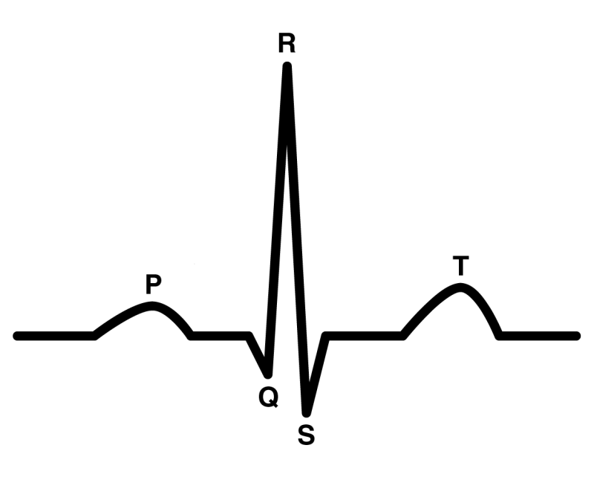
Electrocardiogram (ECG)
ECG detects electric potential difference from depolarization and polarization of cardiac tissue
–
–
+
–
+
–
+
+
–
V₂ – V₁
+
–
+
–
–
+
+
–
+
–
+
Atrial depolarization
Septal depolarization
Ventricular depol.
V₁
V₂
The heart behaves as time-varying electric dipole

Slide 21

ACT: Electrocardiogram
At a certain time during an ECG you measure a negative electric potential difference V₂ – V₁. Which diagram of the cardiac dipole could be correct?
A.
B.
C.
V₁
V₂
V₁
V₂
V₁
V₂

Slide 22
Summary of today’s lecture
Electric potential
  Superposition & point charges
Equipotential lines
  Relationship with electric field
  Ex: Uniform field, non-uniform field, conductor, ECG

