Slide 1
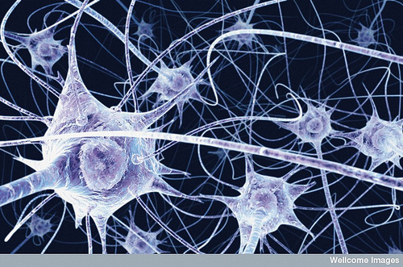
Phys 102 – Lecture 8
Circuit analysis and Kirchhoff’s rules

Slide 2
Recall from last time...
We solved circuits like...
by combining series & parallel components
R₁
Simplify
+
ε
+
ε
R₂
R₃
Expand
R_{tot}
What about a circuit like...
R₁
?
+
ε₁
+
ε₂
R₃

Slide 3
Kirchhoff’s loop rule
Element 2
Voltages around a loop sum to zero
Element 1
Element 3
Element 4
Is voltage positive or negative?
+
I
+
+
+Q
ε
R
C
–Q
–
–
Batteries: + end is always at higher potential
Resistors: higher/lower potential depends on current direction
Capacitors: higher/lower potential depends on which plate has +Q/–Q
Label +/– for higher/lower electric potential
Go around loop and write +V_{element} if electric potential increases –V_{element} if it decreases

Slide 4
Calculation: single loop practice
I
R₁ = 5 Ω
Calculate the current I in the circuit
+
–
+
ε₁ = 50 V
+
ε₂ = 10 V
+
+
–
–
R₂ = 15 Ω
–
+
–
+
What if we go around the loop the “wrong” way?
What if we’re not given the current direction?
What if we pick the “wrong” direction?

Slide 5
Calculation: single loop practice
How can the current be driven opposite battery 2?
R₁ = 5 Ω
I
I
IR₁
+
ε₁ = 50 V
+
ε₂ = 10 V
R₂ = 15 Ω
ε₁
I
ε₂
IR₂

Slide 6
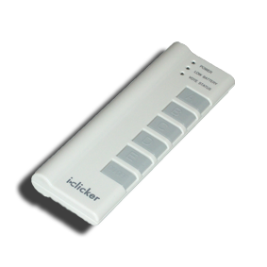
ACT: Checkpoint 1.1
I₁
R₁ = 10 Ω
Calculate the current through R₁.
ε₂ = 5 V
I₂
R₂ = 10 Ω
I₁ = 0.5 A
I₁ = 1.0 A
I₁ = 1.5 A
+
ε₁ = 10 V
I_{B}
+

Slide 7
ACT: Checkpoint 1.2
I₁
R₁ = 10 Ω
Calculate the current through R₂.
ε₂ = 5 V
I₂
R₂ = 10 Ω
I₂ = 0.5 A
I₂ = 1.0 A
I₂ = 1.5 A
+
ε₁ = 10 V
I_{B}
+

Slide 8
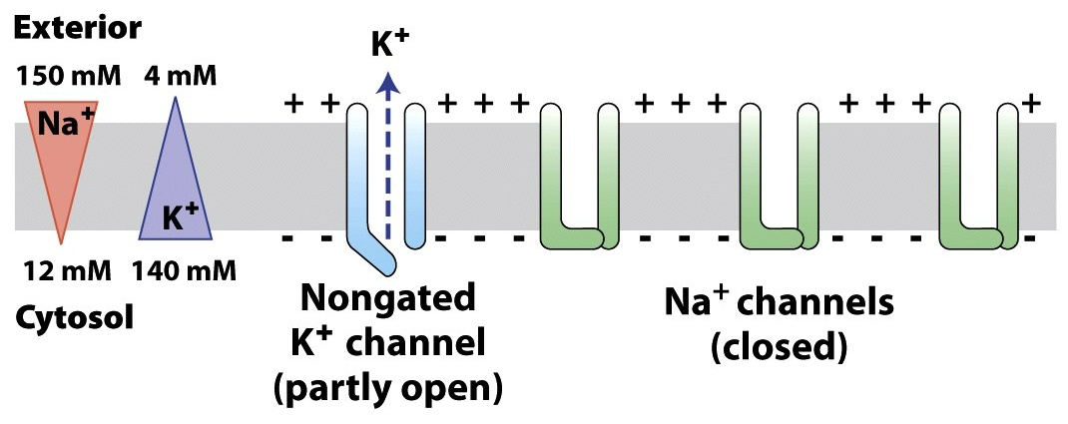
Nerve cell equivalent circuit
Neurons have different types of ion channels (K⁺, Na⁺, and Cl–) that pump current into and out of cell – act like batteries!
V_{out}
V_{in}
V_{out}
I_{K}
I_{Na}
I_{Cl}
S
R_{K}
R_{Cl}
C
R_{Na}
+
+
ε_{K}
ε_{Cl}
ε_{Na}
+
V_{in}

Slide 9
ACT: loop
Na⁺ channels have a “gate” (represented by the switch S) that allows or blocks ion flow. In its resting state, a Na⁺ channel is shut (i.e. switch S is open). Which equation is correct?
I_{K}
I_{Na}
I_{Cl}
S
R_{K}
R_{Cl}
R_{Na}
+
+
ε_{K}
ε_{Cl}
ε_{Na}
+

Slide 10
Calculation: electric potential
I
V_{out}
Find the electric potential difference across the cell V_{in} – V_{out}
(Assume V_{out} = 0 for reference)
B
C
R_{K}
R_{Cl}
ε_{K} = 80 mV, ε_{Na} = 60 mV, ε_{Cl} = 50 mV
R_{K} = 2 MΩ, R_{Na} = 0.2 MΩ, R_{Cl} = 5 MΩ
+
+
ε_{K}
ε_{Cl}
A
D
V_{in}
V
V_{out}= 0
or:
V_{in}
A
B
C
D
A

Slide 11
Kirchhoff’s junction rule
The sum of currents into a junction equals the sum of currents out of a junction
Example:
I₁
I₄
I₂
I₅
I₃

Slide 12
ACT: Checkpoint 1.3
I₁
R₁ = 10 Ω
Calculate the current through the battery I_{B}.
ε₂ = 5 V
I₂
R₂ = 10 Ω
I_{B} = 0.5 A
I_{B} = 1.0 A
I_{B} = 1.5 A
+
ε₁ = 10 V
I_{B}
+

Slide 13
Calculation: Kirchhoff’s laws
In the circuit, the current through R_{C} is 0. What is the current through R₃ and the value of R_{x}?
I₁
I_{x}
From EX1 FA13
R₁ = 10 Ω
R_{x}
R_{C}
+
I₂
I₃
ε = 12 V
R₂ = 20 Ω
R₃ = 30 Ω
No current flows through R_{C} so I₂ = I₃
and I₁ = I_{x}
No current flows through R_{C} so V_{C} = 0

Slide 14
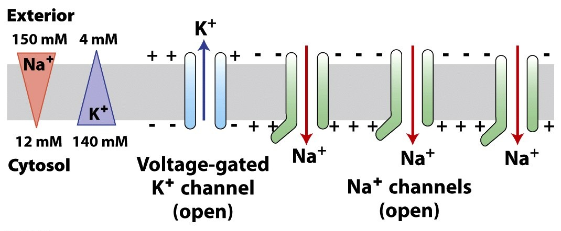
Nerve cell equivalent circuit
During nerve impulse, Na⁺ channels open (i.e. switch S closes) and allow Na⁺ to enter the cell
V_{out} = 0
V_{in} = – 70mV
?
I_{K}
I_{Na}
I_{Cl}
S
What happens to the currents through the channels and the potential in the cell?
R_{K}
R_{Cl}
R_{Na}
+
+
ε_{K}
ε_{Cl}
ε_{Na}
+

Slide 15
Calculation: two loop circuit
V_{out}
Given the circuit to the right, find I_{K}, I_{Na} and I_{Cl} and V_{in} – V_{out}.
ε_{K} = 80 mV, ε_{Na} = 60 mV, ε_{Cl} = 50 mV
R_{K} = 2 MΩ, R_{Na} = 0.2 MΩ, R_{Cl} = 5 MΩ
R_{K}
R_{Na}
R_{Cl}
+
+
ε_{K}
ε_{Na}
ε_{Cl}
+
V_{in}
Label all currents
Label +/– for all elements
Choose loop and direction
Write down voltage differences

Slide 16
ACT: Kirchhoff loop rule
What is the correct expression for “Loop 3” in the circuit below?
I_{K}
I_{Na}
I_{Cl}
Loop 3
R_{K}
R_{Na}
R_{Cl}
+
+
ε_{K}
ε_{Na}
ε_{Cl}
+

Slide 17
Calculation: two loop circuit
Loop 2
V_{out}
Given the circuit to the right, find I_{K}, I_{Na} and I_{Cl} and V_{in} – V_{out}.
I_{K}
I_{Na}
I_{Cl}
Loop 3
ε_{K} = 80 mV, ε_{Na} = 60 mV, ε_{Cl} = 50 mV
R_{K} = 2 MΩ, R_{Na} = 0.2 MΩ, R_{Cl} = 5 MΩ
R_{K}
R_{Na}
R_{Cl}
Loop 1
+
+
We have 3 unknowns, need 3 equations
ε_{K}
ε_{Na}
ε_{Cl}
+
V_{in}
Loop 1:
Loop 2:
Loop 3:
Write down junction rule

Slide 18
ACT: Kirchhoff junction rule
What is the correct expression for junction in the circuit?
I_{K}
I_{Na}
I_{Cl}
R_{K}
R_{Na}
R_{Cl}
+
+
ε_{K}
ε_{Na}
ε_{Cl}
+

Slide 19
Calculation: two loop circuit
Loop 2
V_{out}
Given the circuit to the right, find I_{K}, I_{Na} and I_{Cl} and V_{in} – V_{out}.
I_{K}
I_{Na}
I_{Cl}
ε_{K} = 80 mV, ε_{Na} = 60 mV, ε_{Cl} = 50 mV
R_{K} = 2 MΩ, R_{Na} = 0.2 MΩ, R_{Cl} = 5 MΩ
R_{K}
R_{Na}
R_{Cl}
Loop 1
+
+
3 equations, 3 unknowns, the rest is algebra!
ε_{K}
ε_{Na}
ε_{Cl}
+
V_{in}
(1)
(2)
(3)
Substitute Eq. (3) into Eq. (2) and rearrange
(2’)
Notes:
1) This will be given on the exam. Comment on 1 equation 2 unknowns. 2 eqs 3 unknowns finally 3 and 3

Slide 20
Calculation: two loop circuits
Now 2 equations (1 and 2’), 2 unknowns (I_{K} and I_{Na})
(1)
(2’)
Substitute I_{K} in Eq. (1) into Eq. (2’) and rearrange
Plug solution into Eq. (2’) to get I_{K}
Use junction Eq. (3) to get I_{Cl}

Slide 21
ACT: Kirchhoff junction rule
We found that I_{K} = 62 nA, I_{Na} = 81 nA and I_{Cl} = –19 nA. Which of the following statements is FALSE?
Outside
I_{K}
I_{Na}
I_{Cl}
I_{K} is out of the cell
I_{Na} is into the cell
I_{Cl} is into the cell
R_{K}
R_{Na}
R_{Cl}
+
+
ε_{K}
ε_{Na}
ε_{Cl}
+
Inside

Slide 22
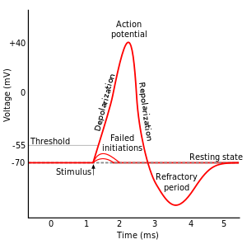
Calculation: two loop circuit
Find the new V_{in} – V_{out}:
V_{out} = 0
V_{out} = 0
I_{K}
I_{Na}
I_{Cl}
S
R_{K}
R_{Cl}
R_{Na}
+
+
ε_{K}
ε_{Cl}
V_{in} = – 70mV
ε_{Na}
+
V_{in}

Slide 23
Summary of today’s lecture
Two basic principles:
Kirchhoff loop rule
Voltages around circuit loop sum to zero (based on conservation of energy)
Kirchhoff junction rule
Currents into a circuit branch equal currents out (based on conservation of charge)

Slide 24
Summary of today’s lecture
Basic approach to solving complex circuits:
Label all currents
Label +/– for all elements
Choose loop(s) and direction(s)
Write down voltage differences
Write down junction rule
The rest is algebra!

