Slide 1
Bernoulli Vector Anemometer
Hrushikesha Athreya, Mason Camp, Eric Lee
PHYS 371: Design Like a Physicist

Slide 2
Introduction
Measuring wind speeds is easy with expensive devices, can we make it cheaper?
Bernoulli’s principle describes the inverse relationship between fluid velocity and pressure exerted by the fluid
Is it possible to precisely and accurately measure wind velocity from pressure differences?
Notes:
Mason

Slide 3
Goals and Considerations
Determine whether DPS310 Sensors can accurately and precisely measure wind velocity
Use inexpensive materials to prototype: Arduino, 3D printed varying cross-sectional wind channels, and DPS310 Sensors
Can be mass-produced if prototype proves viable
Easy to implement and analyze
Quick measurement rate
No moving parts
Notes:
Hrushi

Slide 4
Method
Indirectly measure wind velocity by measuring pressure differences at different points
DPS310 sensors are readily available
We can use Bernoulli’s principle to find a relationship between pressure differences and wind speed
Utilize perpendicular wind channels to determine the direction of wind
Notes:
Eric

Slide 5
DPS 310
Cost: ~$7.50
Operable range: 300hPa to 1200hPa, -40C to 85C
Accuracy: Absolute ±1 hPa, Relative ± 0.06hPa
Dimensions: 25.5mm x 17.7mm x 4.6mm
Supported Protocols: I2C and SPI
Notes:
Eric

Slide 6
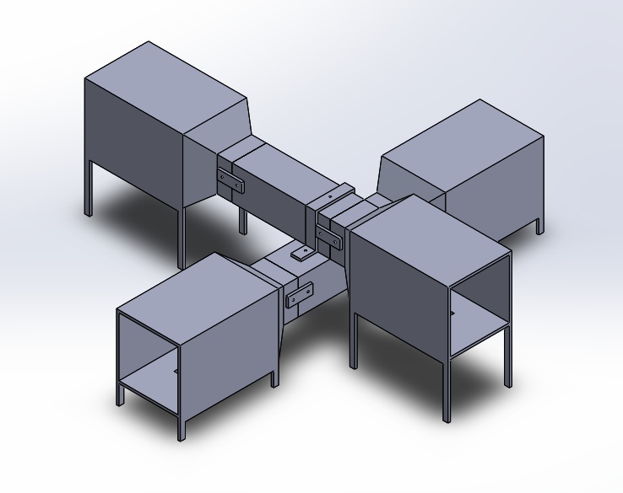
Varying Cross-Sectional Wind Channel Design
Notes:
Hrushi

Slide 7
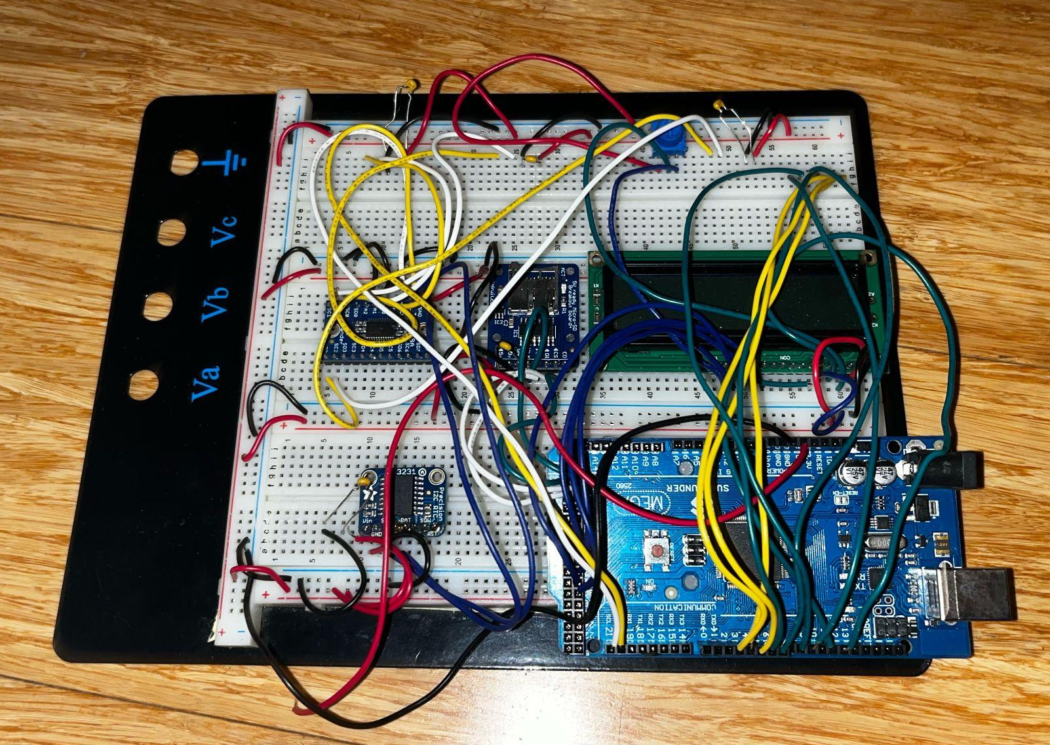
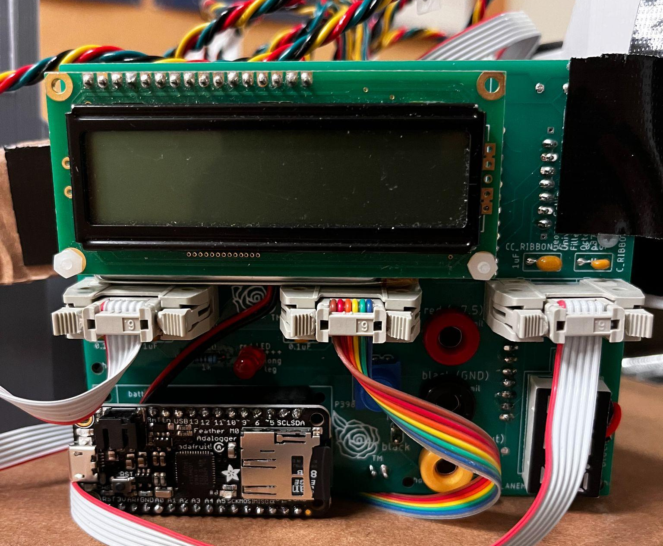
Hardware
Breadboard
PCB
Arduino, LCD, microSD breakout, DS3231 RTC, DPS310, TCA9548A, Ribbon cables
Notes:
Eric

Slide 8
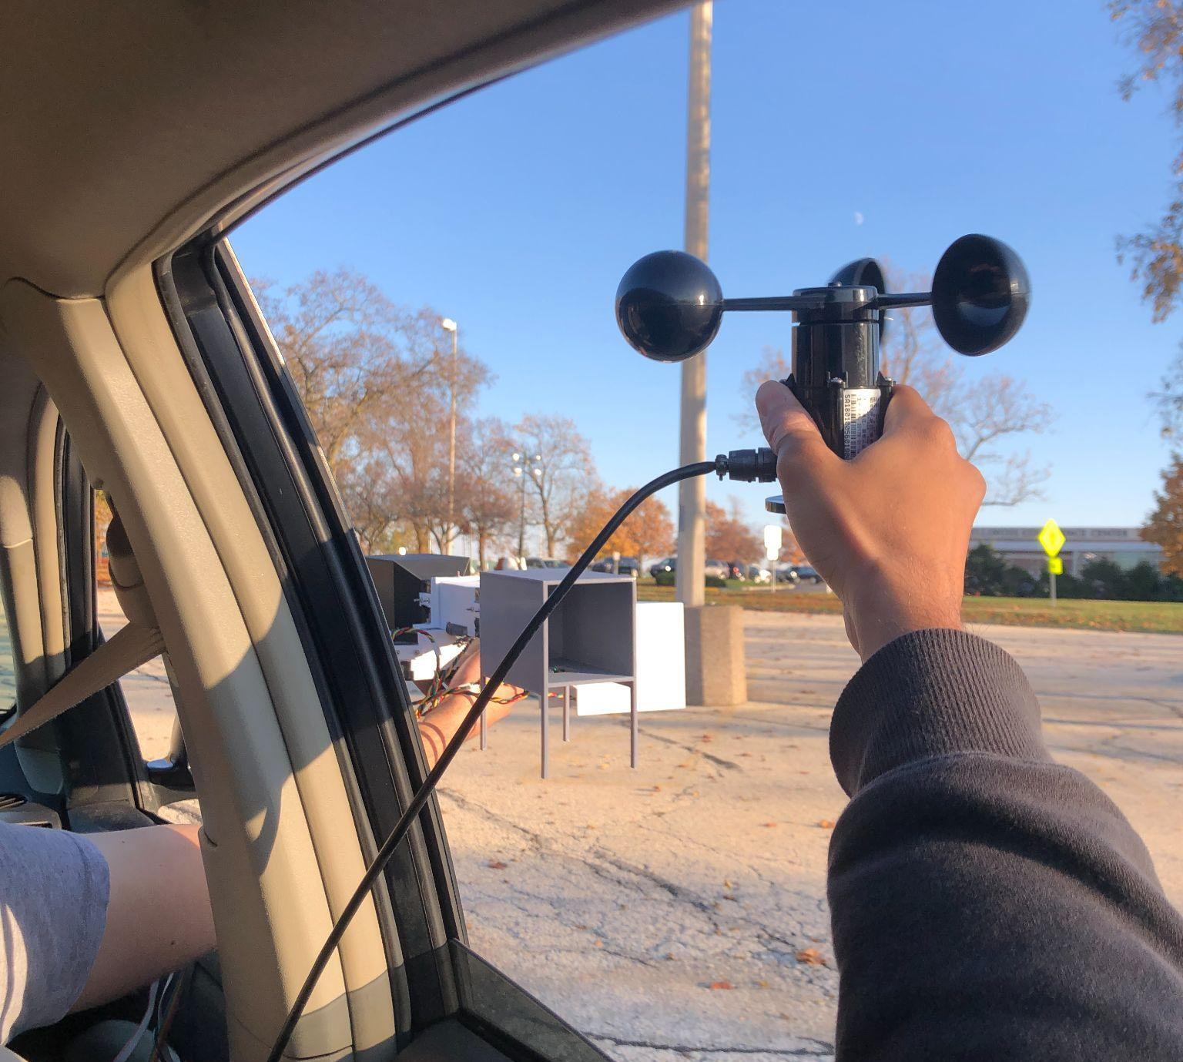
Setups: Car Setup
Singular wind channel
Line and circle path
3 different speeds: 5 mph, 10 mph, 15 mph
Days with low wind speeds
No fixed distance
Notes:
Eric

Slide 9
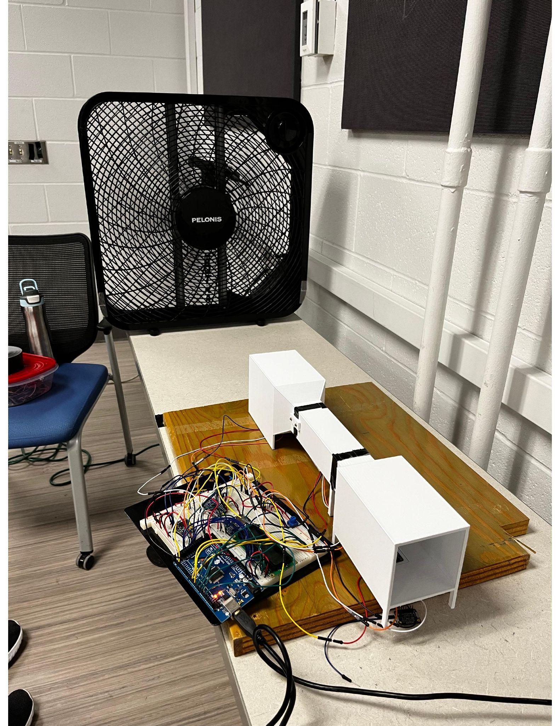
Setups: Box Fan Setup
Singular wind channel
0 to 90 degrees in 10 degree increments
Leading chamber stayed in front
3 different wind speeds: low, medium, high
Notes:
Eric

Slide 10
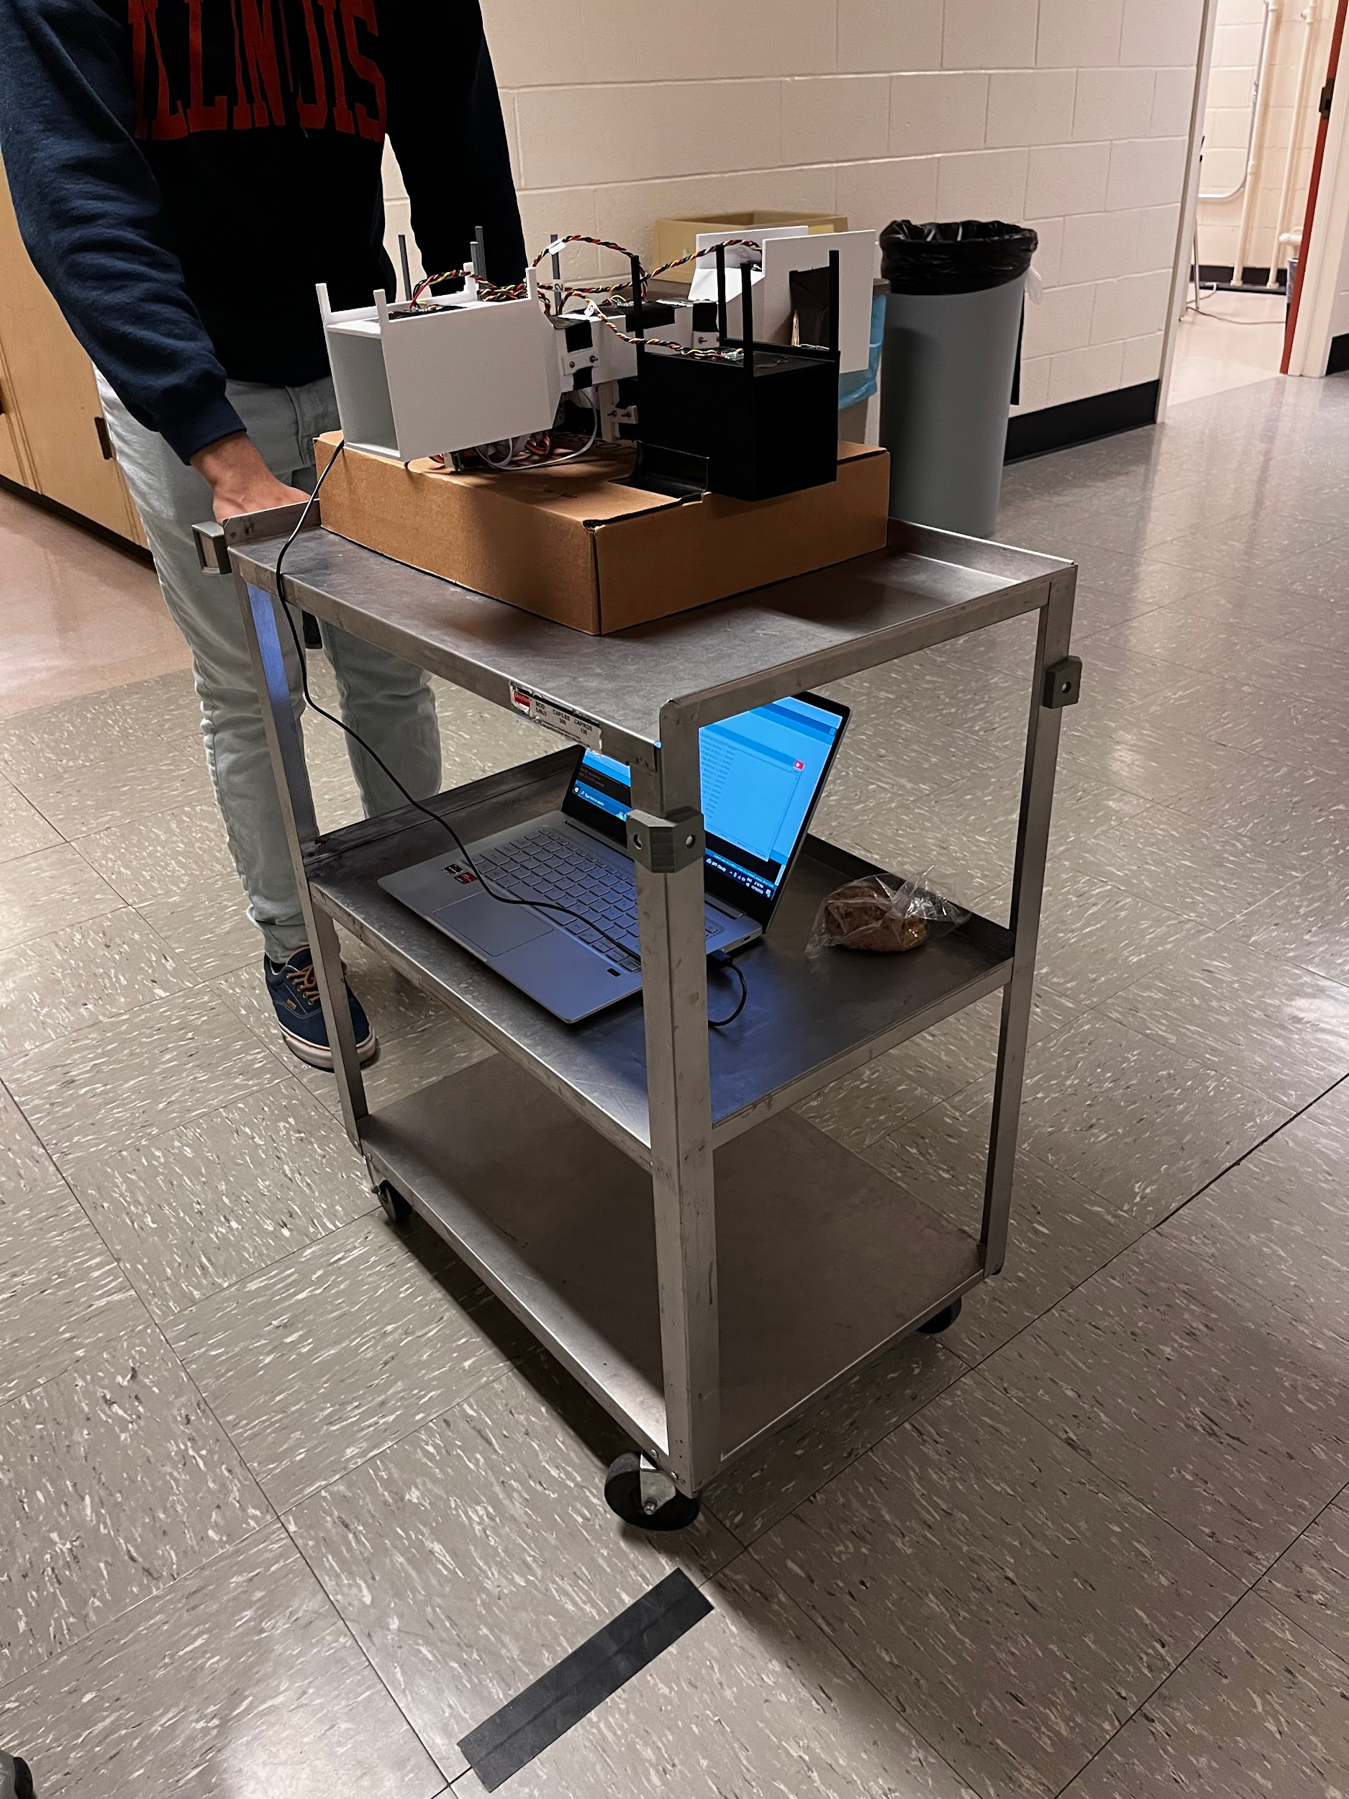
Setups: Hallway Setup
2 wind channels, 2D angular dependence
Empty, straight hallway
Fixed distance: 30.5m
3 different speeds: 2 m/s, 1.3 m/s, 1 m/s
0 to 45 degrees, 5 degree increments
0 to 180 degrees, 45 degree increments
Notes:
Eric

Slide 11
Assumptions
Air is an incompressible fluid
Flow of wind is inviscid
Flow of wind is steady and laminar
Flow of the wind is 2-dimensional
Density of the air is 1.122 kg/m³
Dynamic viscosity of the air is 18.6 μPa·s
Notes:
Hrushi

Slide 12
Independent Variables
Wind speed
Dependent Variables
Pressure values from the DPS310s
Voltage values from the cup anemometer
Control Variables
Density of the air
Dynamic viscosity of the air
Notes:
Hrushi

Slide 13
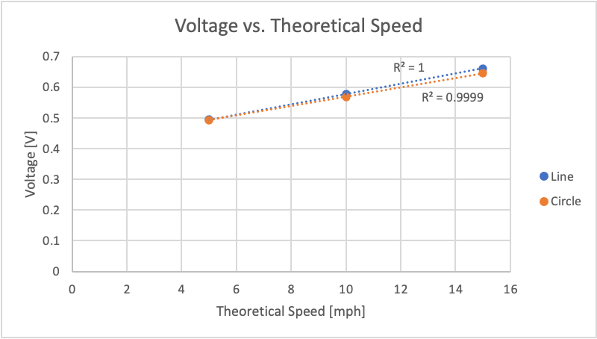
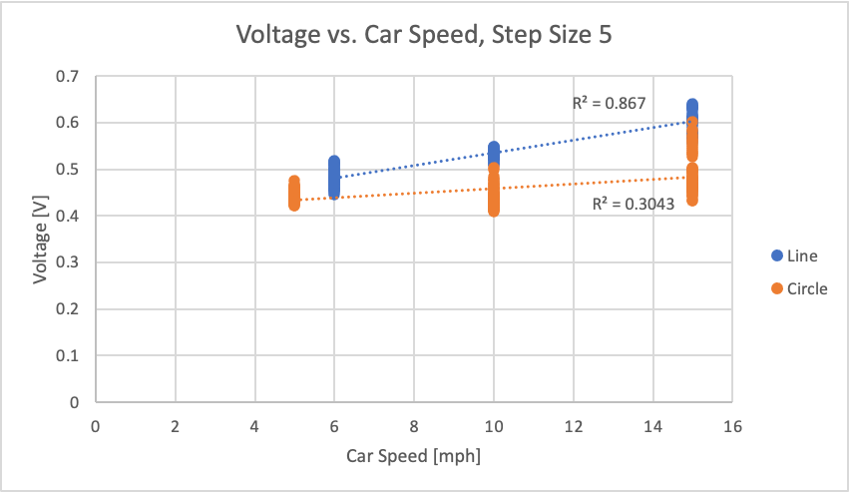
Results/Discussion: Car Trials, Cup Anemometer
Notes:
Hrushi

Slide 14
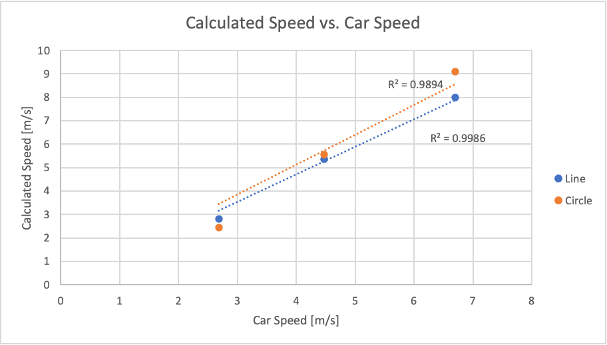
Results/Discussion: Car Trials, Wind Tunnel
Notes:
Hrushi

Slide 15
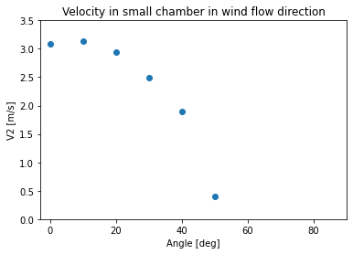
Results/Discussion: 1D Box Fan, Low Speed
Notes:
Mason

Slide 16
Results/Discussion: 1D Box Fan, Medium Speed
Notes:
Mason

Slide 17
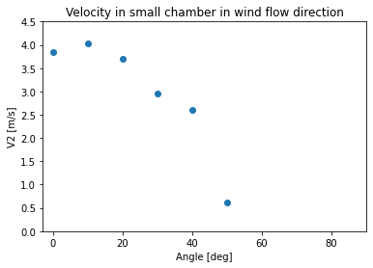
Results/Discussion: 1D Box Fan, High Speed
Notes:
Mason

Slide 18
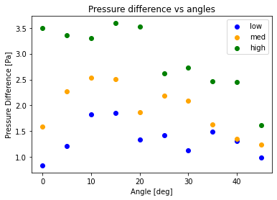
Results/Discussion: Hallway Test, Pressure Differences
Notes:
Mason

Slide 19
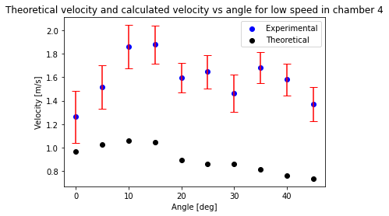
Results/Discussion: Hallway Test, Parallel Arm, Low Speed
Notes:
Mason

Slide 20
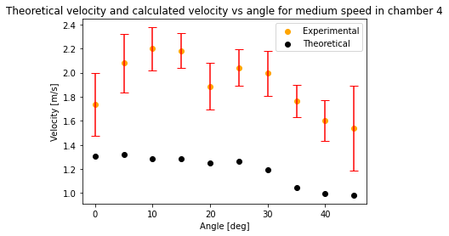
Results/Discussion: Hallway Test, Parallel Arm, Medium Speed
Notes:
Mason

Slide 21
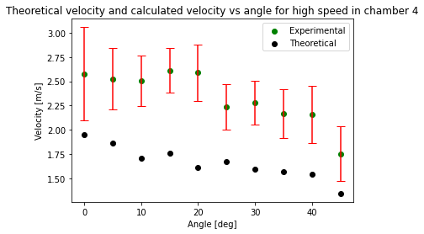
Results/Discussion: Hallway Test, Parallel Arm, High Speed
Notes:
Mason

Slide 22
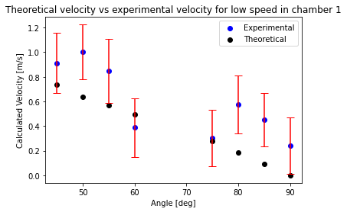
Results/Discussion: Hallway Test, Perpendicular Arm, Low Speed
Notes:
Mason

Slide 23
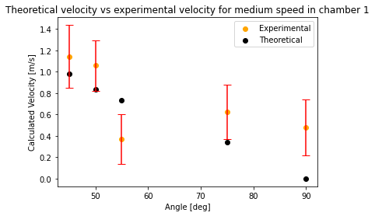
Results/Discussion: Hallway Test, Perpendicular Arm, Medium Speed
Notes:
Mason

Slide 24
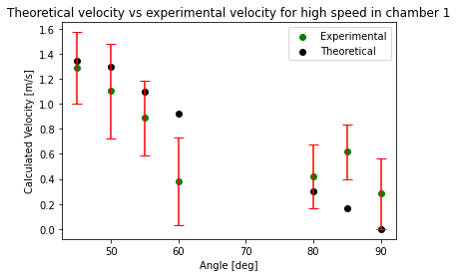
Results/Discussion: Hallway Test, Perpendicular Arm, High Speed
Notes:
Mason

Slide 25
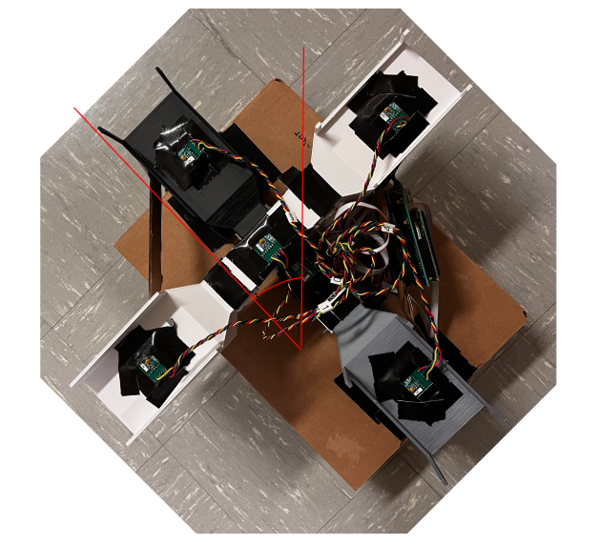
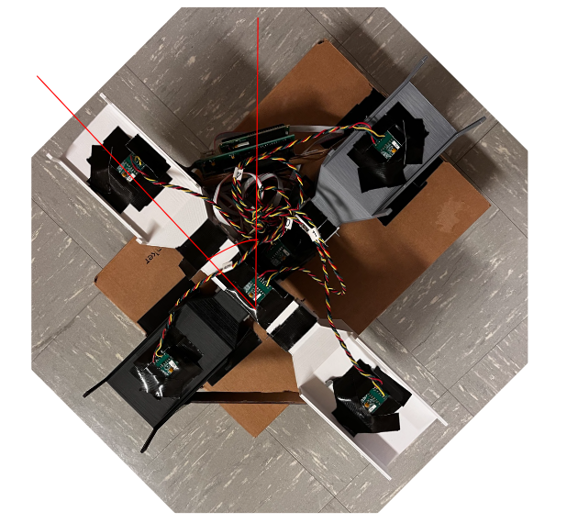
Results/Discussion: Symmetry

Slide 26
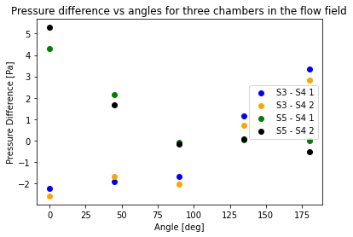
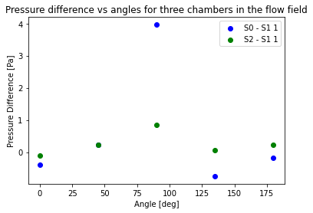
Results/Discussion: Symmetry
Notes:
Mason

Slide 27
Difficulties and Complications
Cup Anemometer
Inaccurate voltage
Breadboard to PCB
Code transition
Device and Setup
Device’s size was not suitable for certain setups
Notes:
Eric

Slide 28
Conclusion and Future Studies
Wind Channel is functional when parallel to the flow and at higher wind speeds
Speed factor parallel: low speed ~1.78, high speed ~1.40
Speed factor perpendicular: low speed ~1.54, high speed ~0.88
Symmetry of our devices allows for a direction accuracy of ± 45°
Clear relationship at higher speeds and smaller angles
Develop a strong platform to be placed outside car window
Use of diffuser for laminar flow
Notes:
Hrushi

Slide 29
Conclusion and Future Studies (continued)
Our Reynold’s number: Re = 3012
Critical Reynold’s number for flow over a rectangular plane: Re = 500,000
Can allow farmers prepare their crops for strong wind condition
Accessibility of a cheap vector anemometer
Notes:
Hrushi

Slide 30
Acknowledgement
We would like to personally thank Professor George Gollin and Anthony Mirasola for providing guidance needed to design and test our device. They went above and beyond to ensure we understood the concepts behind our experiment.
Notes:
Eric

Slide 31
Works Cited
“Bernoulli's Equation.” Encyclopedia.com, Encyclopedia.com, 1 Dec. 2022, www.encyclopedia.com/science-and-technology/physics/physics/bernoullis-principle.
“DPS310 Digital Barometric Pressure Sensors.” DigiKey, www.digikey.com/en/product-highlight/i/infineon/dps310-digital-barometric-pressure-sensors.
Industries, Adafruit. “Adafruit DPS310 Precision Barometric Pressure / Altitude Sensor.” Adafruit Industries Blog RSS, www.adafruit.com/product/4494.
“Leading Manufacturer of Data Loggers for Wind and Solar Measurement.” Kintech Engineering - Systems for Wind and Solar Measurement, www.kintech-engineering.com/.

