Slide 1
Impact Shock Reduction by Rubber Bands
PHYS371 Group 4
Jaime Almanza, Jiaxuan Zhang, Yiming Yu, Yuqing Zhai
12/02/2022

Slide 2
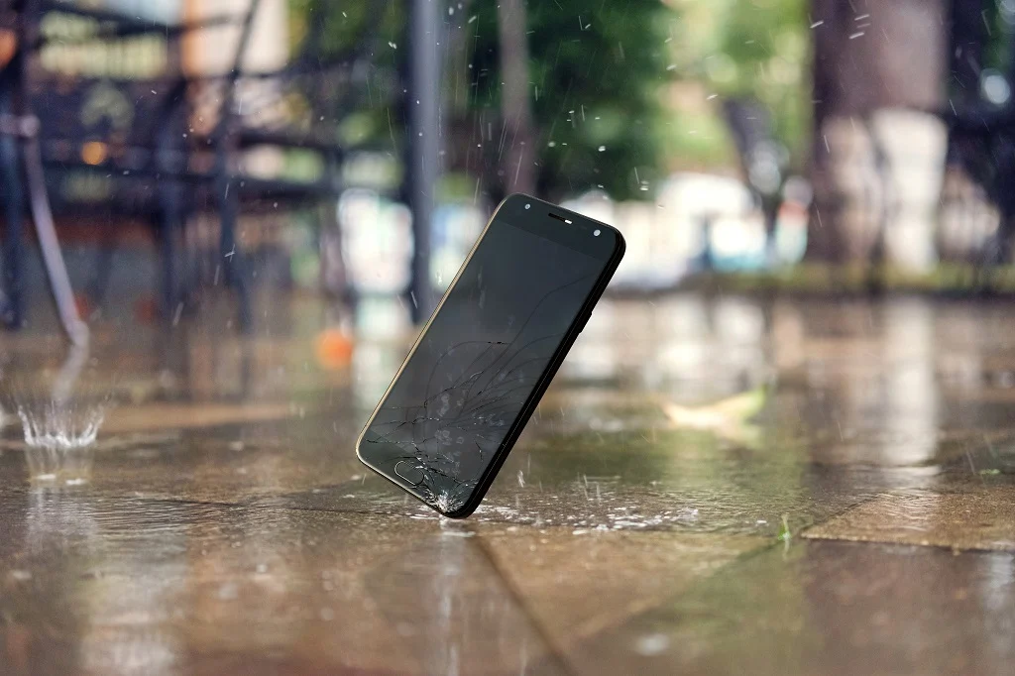
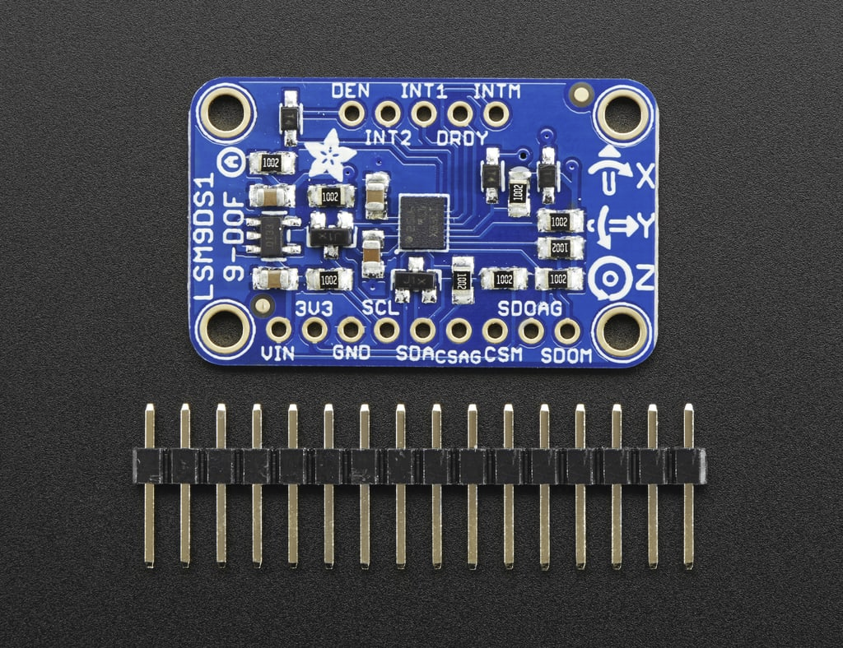
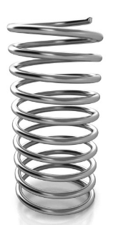
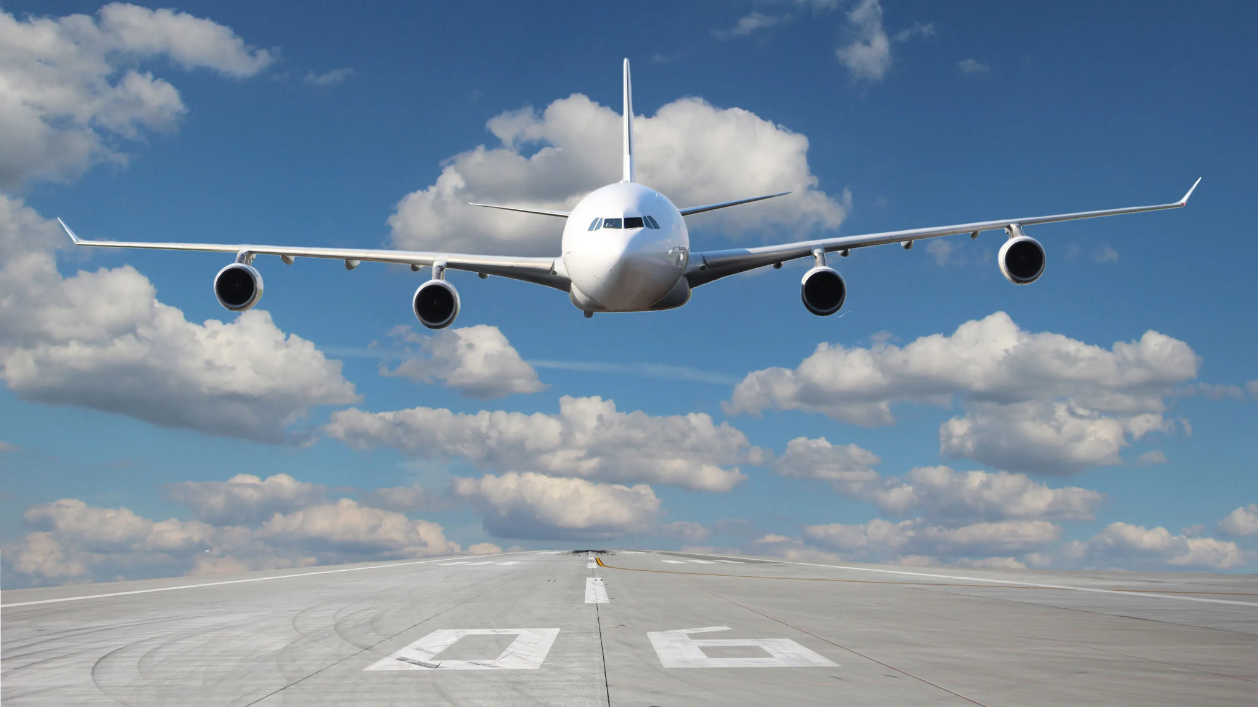
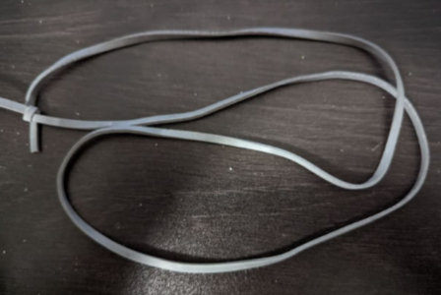
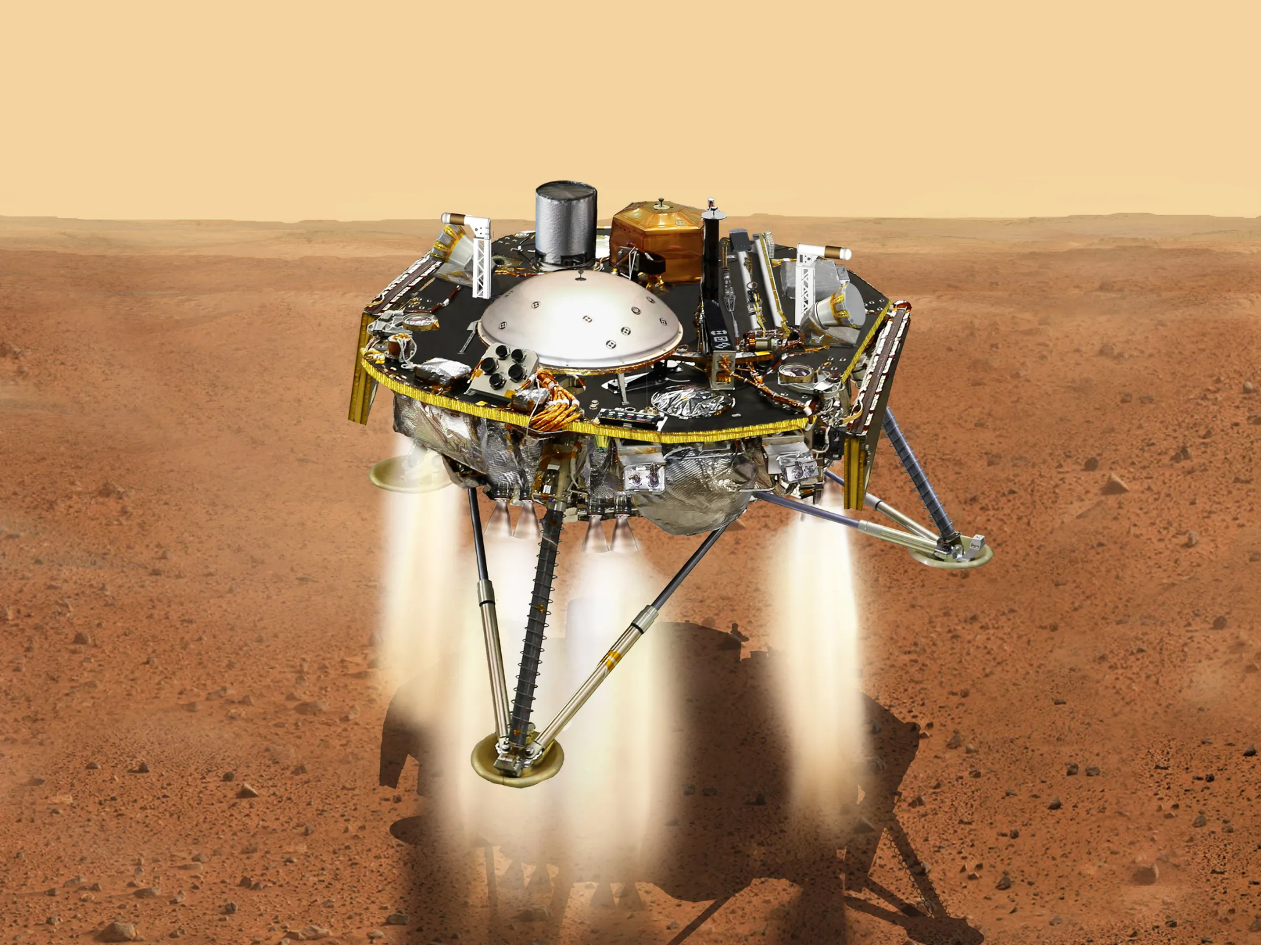
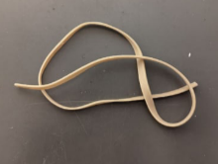
Protecting Falling object

Slide 3
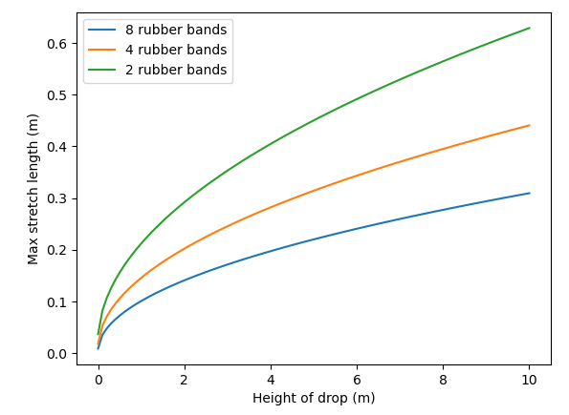
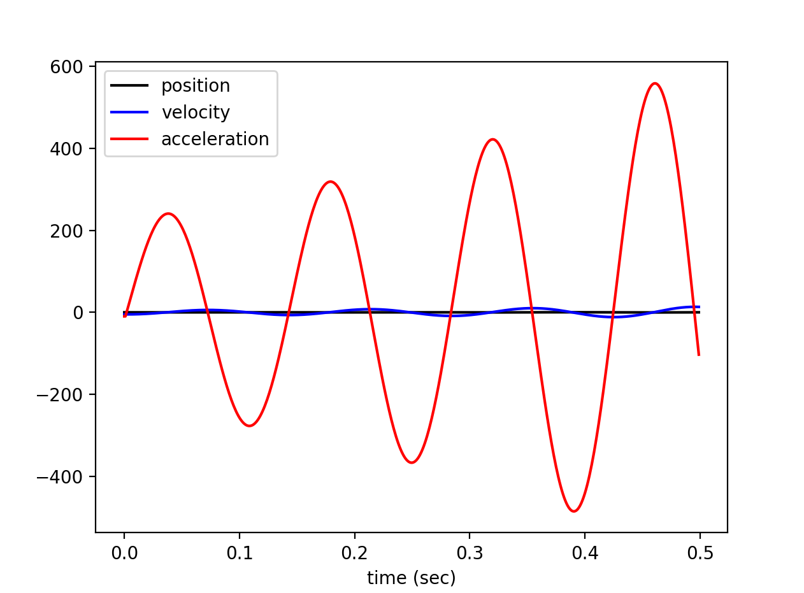
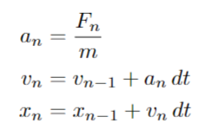
Math and Simulation
Maximum stretch length as a function of the height of the drop
Spring function

Slide 4
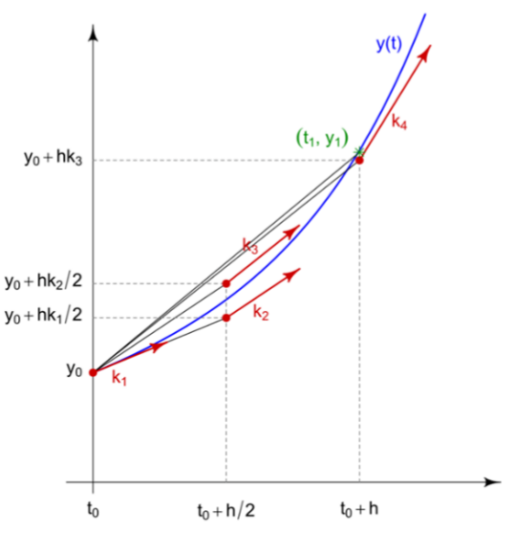
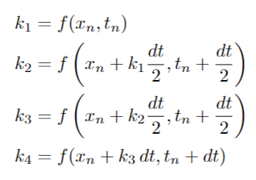
4th order Runge-Kutta Method
Reduce the error from dt to dt^4

Slide 5
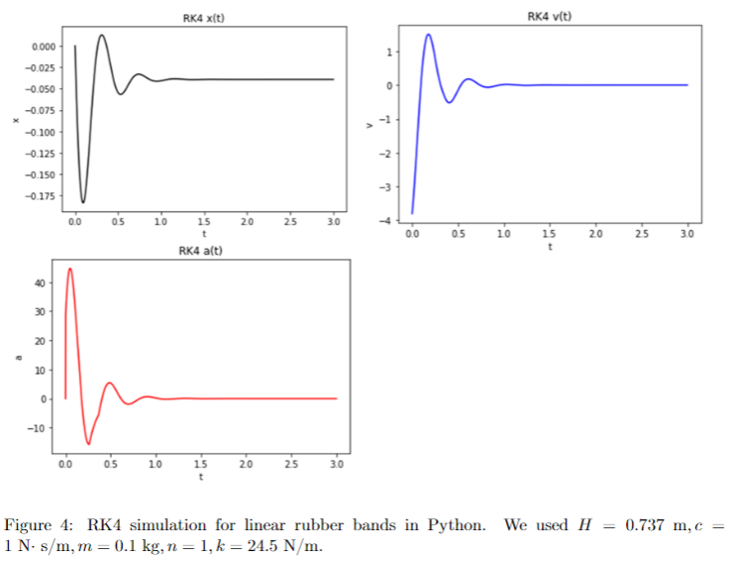
RK4 in Python

Slide 6
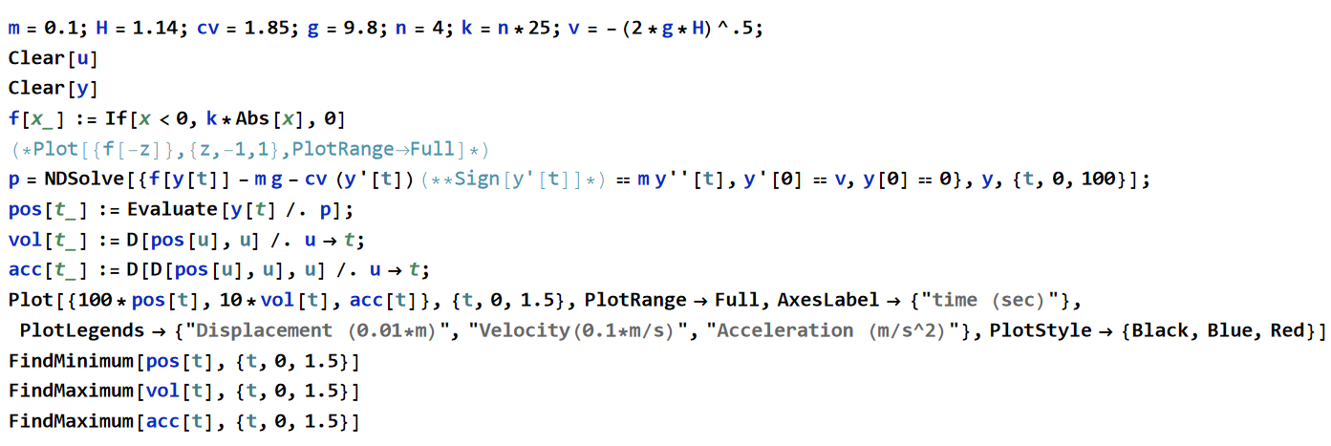
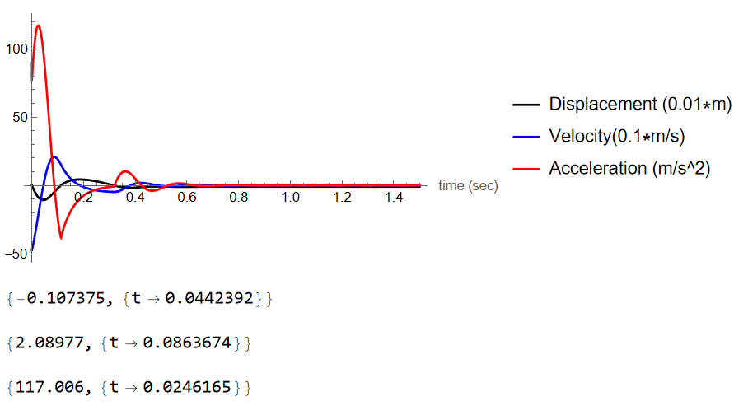
Simulation in Mathematica

Slide 7
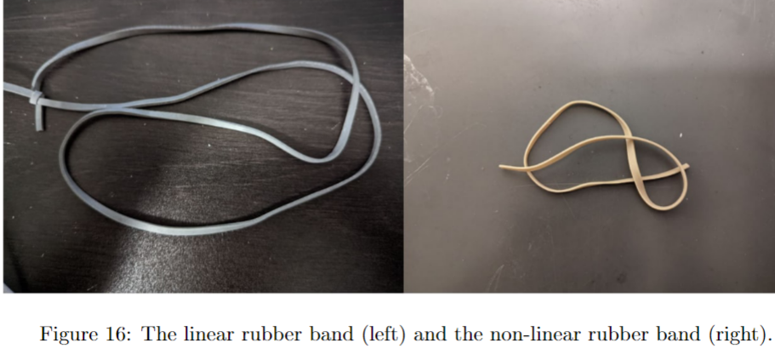
Linear and Non-linear Rubber bands
k = 24.5 N/m

Slide 8
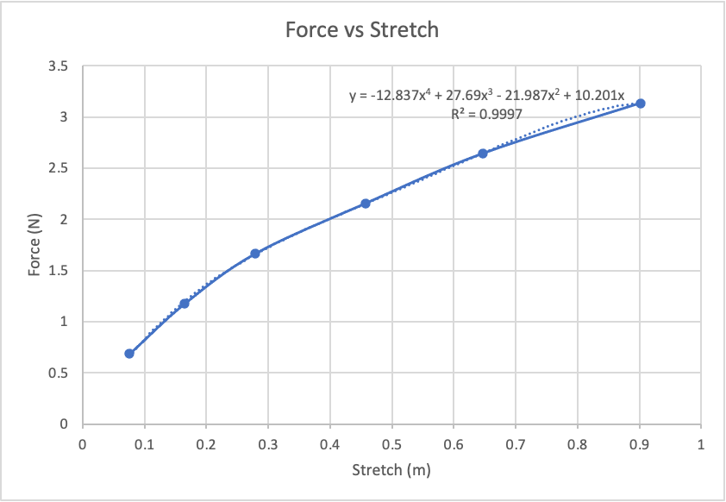
Non-linear Rubber Bands
Force values are shown and their dependence on how far the rubber band is stretched
We modeled the force in our simulations using a fourth-order polynomial
For values past the last stretch length we measured, we used a linear equation:
F(x) = 1.9291 |x| + 1.3965

Slide 9
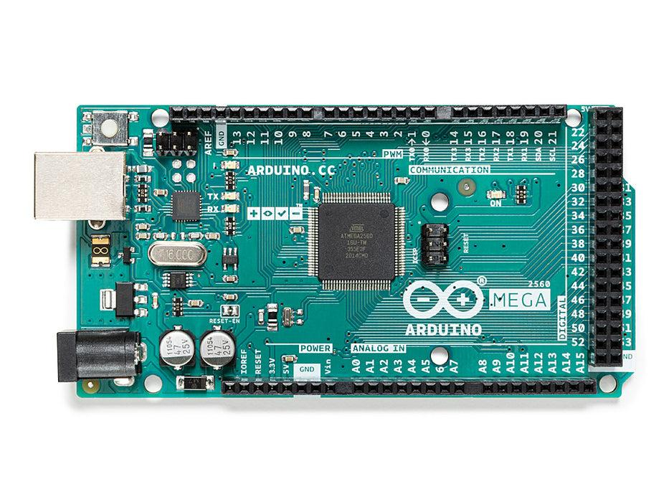
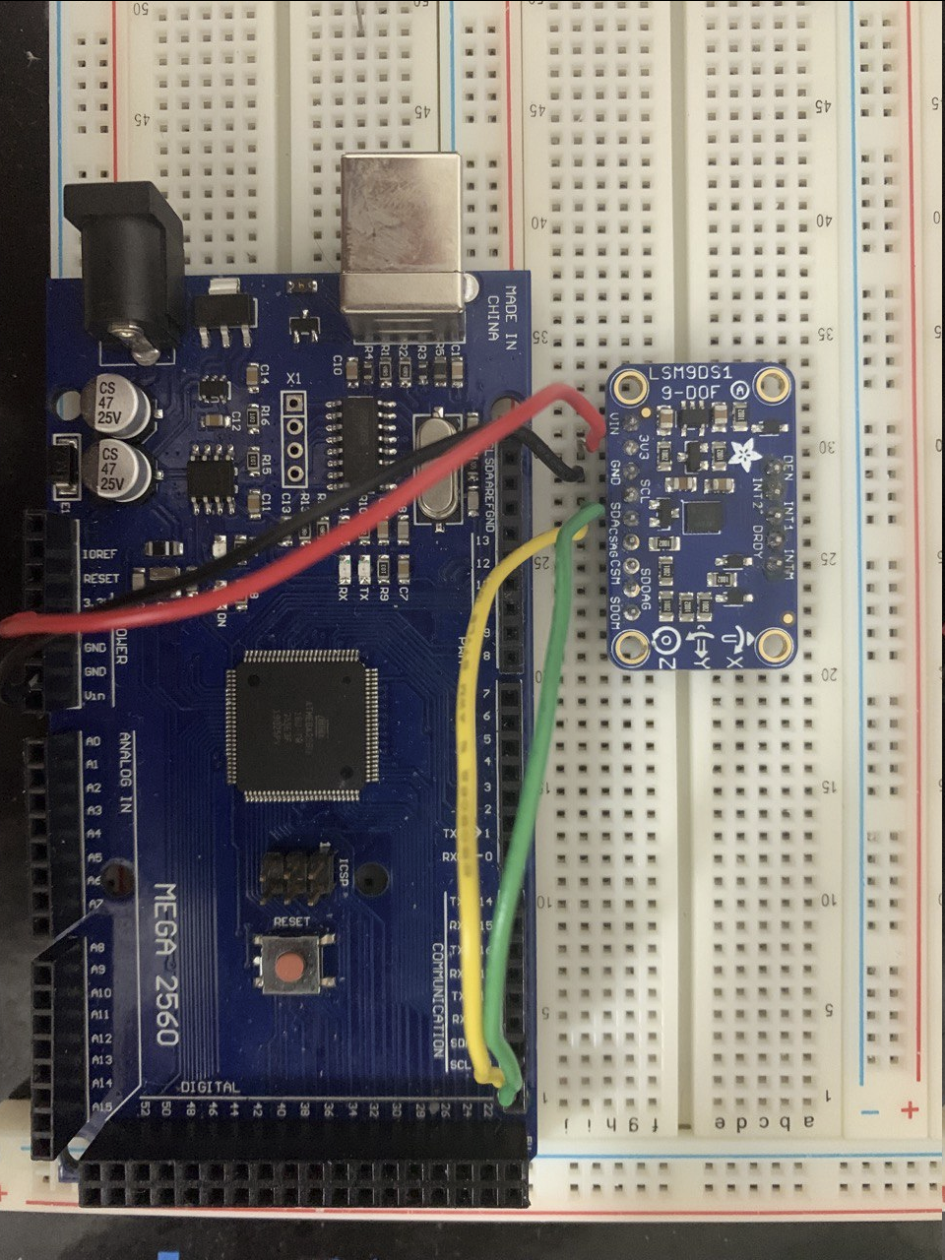
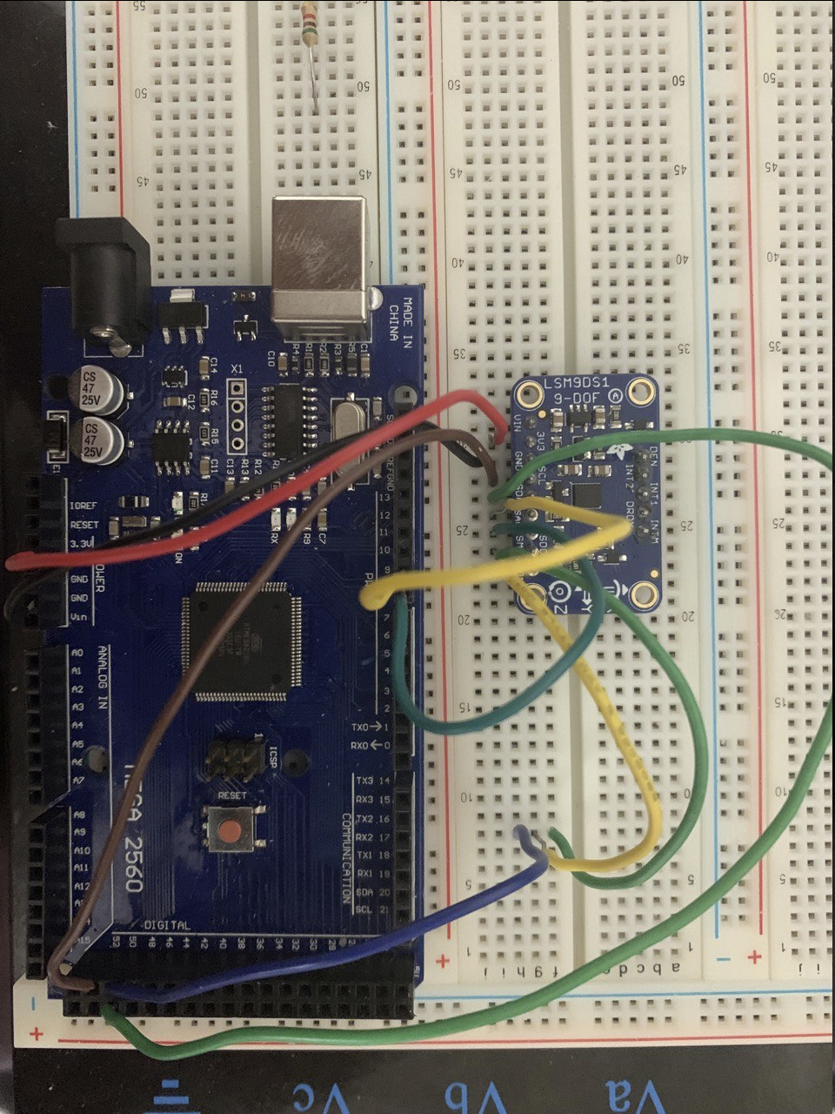
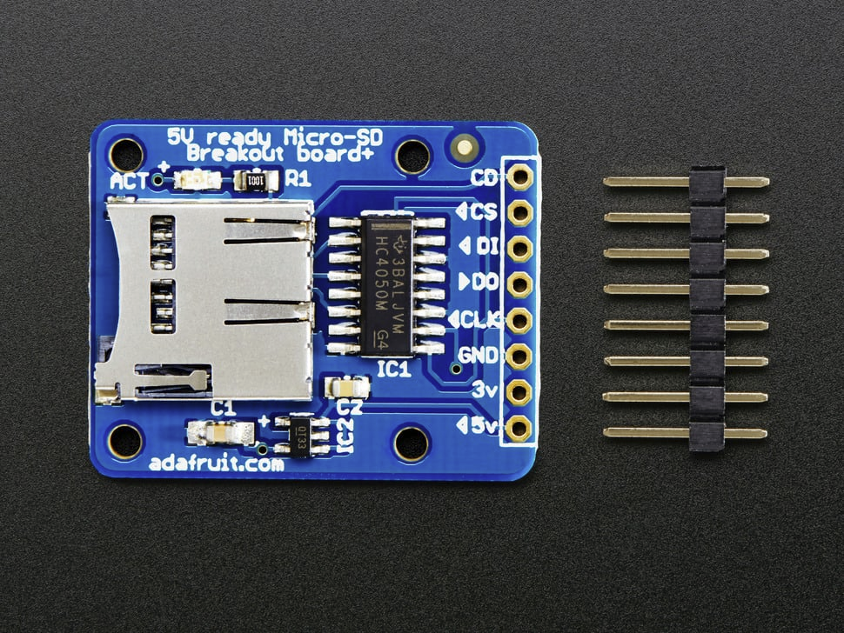
Hardware
Arduino Mega 2560
Clock Rate: 16MHz
LSM9DS1
Range: ±16g
SD breakout board
Connected via I2C
Connected via SPI
Notes:
Feather M0

Slide 10
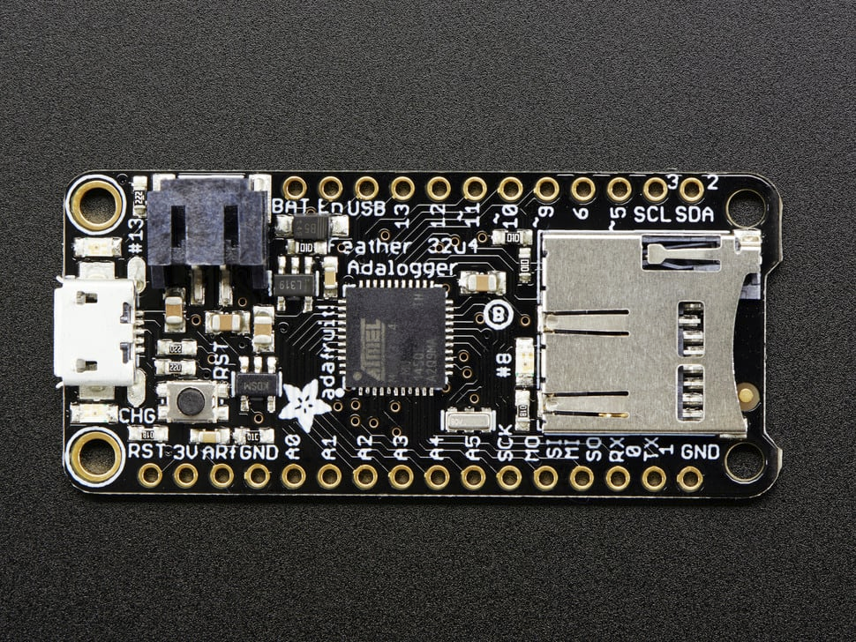
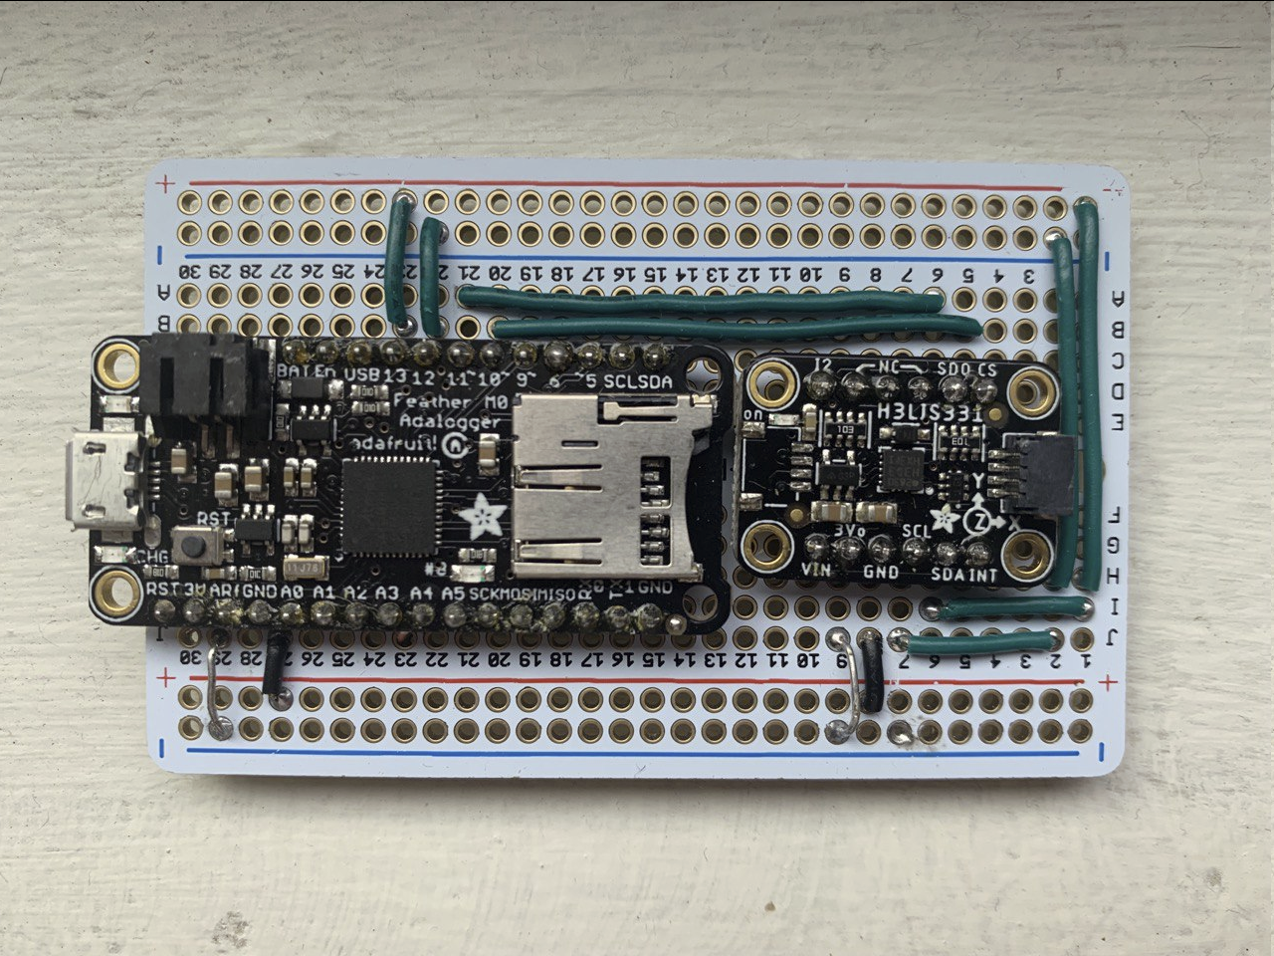
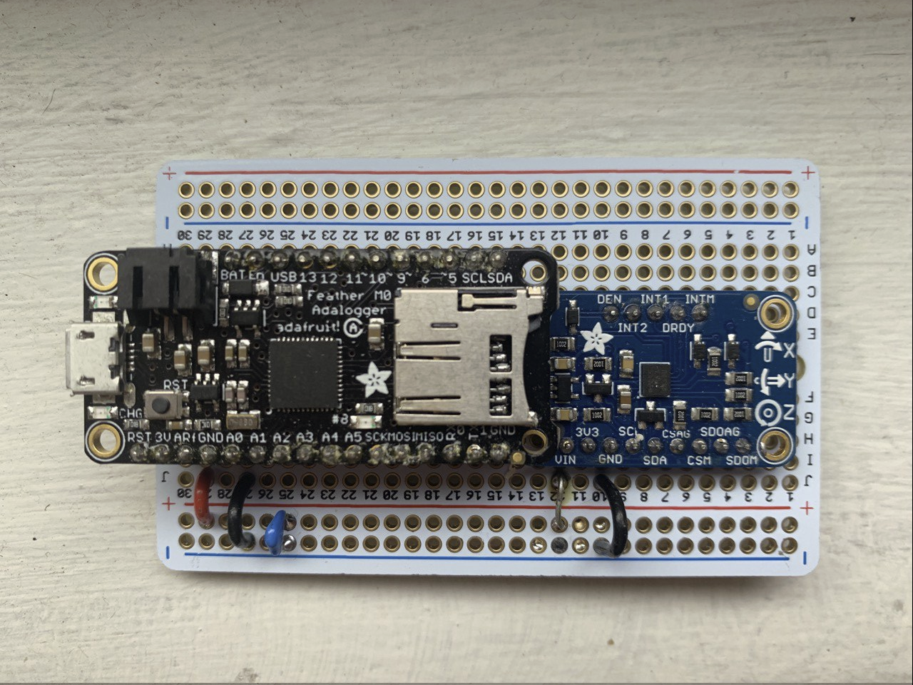
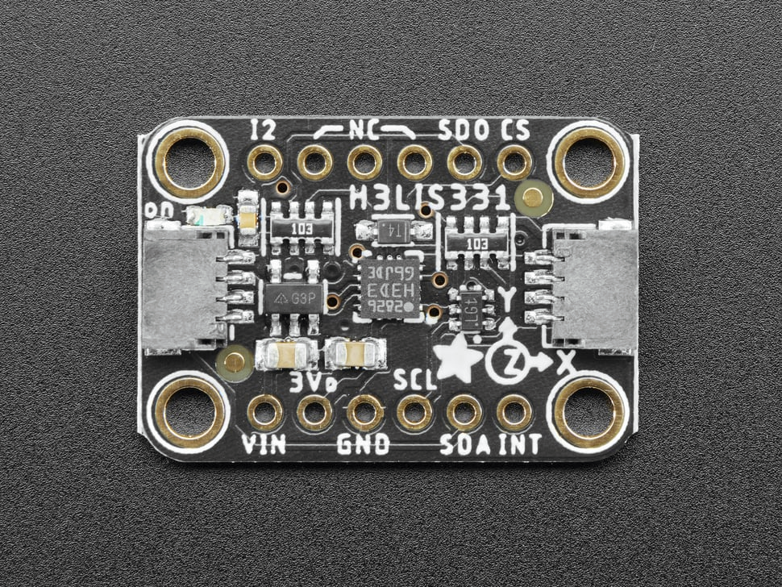
Hardware
Adafruit Feather M0 + H3LIS331
Connected Via SPI
Adafruit Feather M0
Clock Rate: 48MHz
Adafruit Feather M0 + LSM9DS1
Connected Via SPI
H3LIS331
Range: ±400g
Notes:
Feather M0 is Faster,
H3LIS331 has a bigger range, but noisy. (We calculate that if we want to drop the device from 10 meter high, we might need to use it) Even though we didn’t use it in the last.

Slide 11
Hardware
Adafruit Feather M0
H3LIS331
LSM9DS1
PCB Board. Connected Via SPI
Notes:
Feather M0

Slide 12
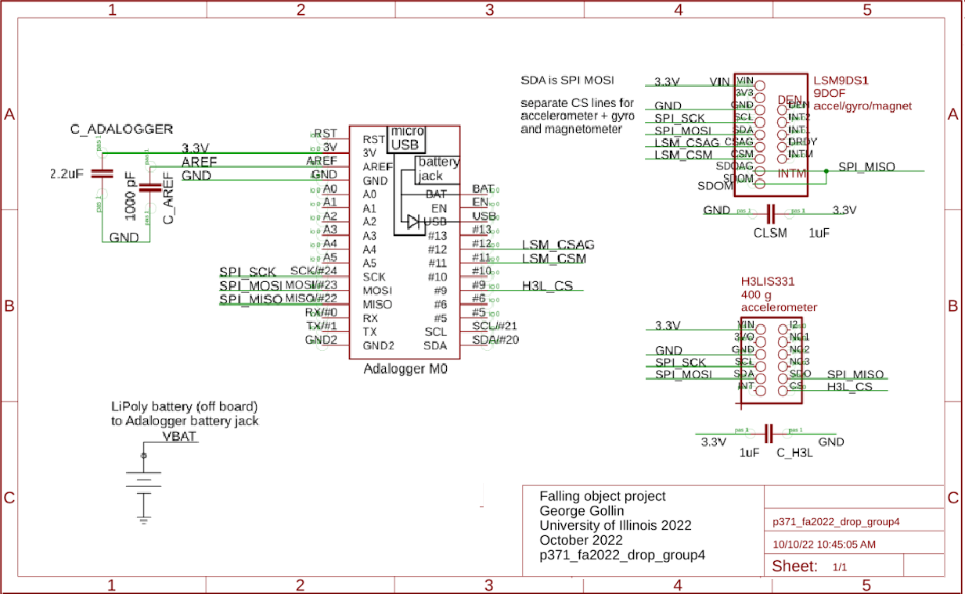
Hardware – Schematic

Slide 13
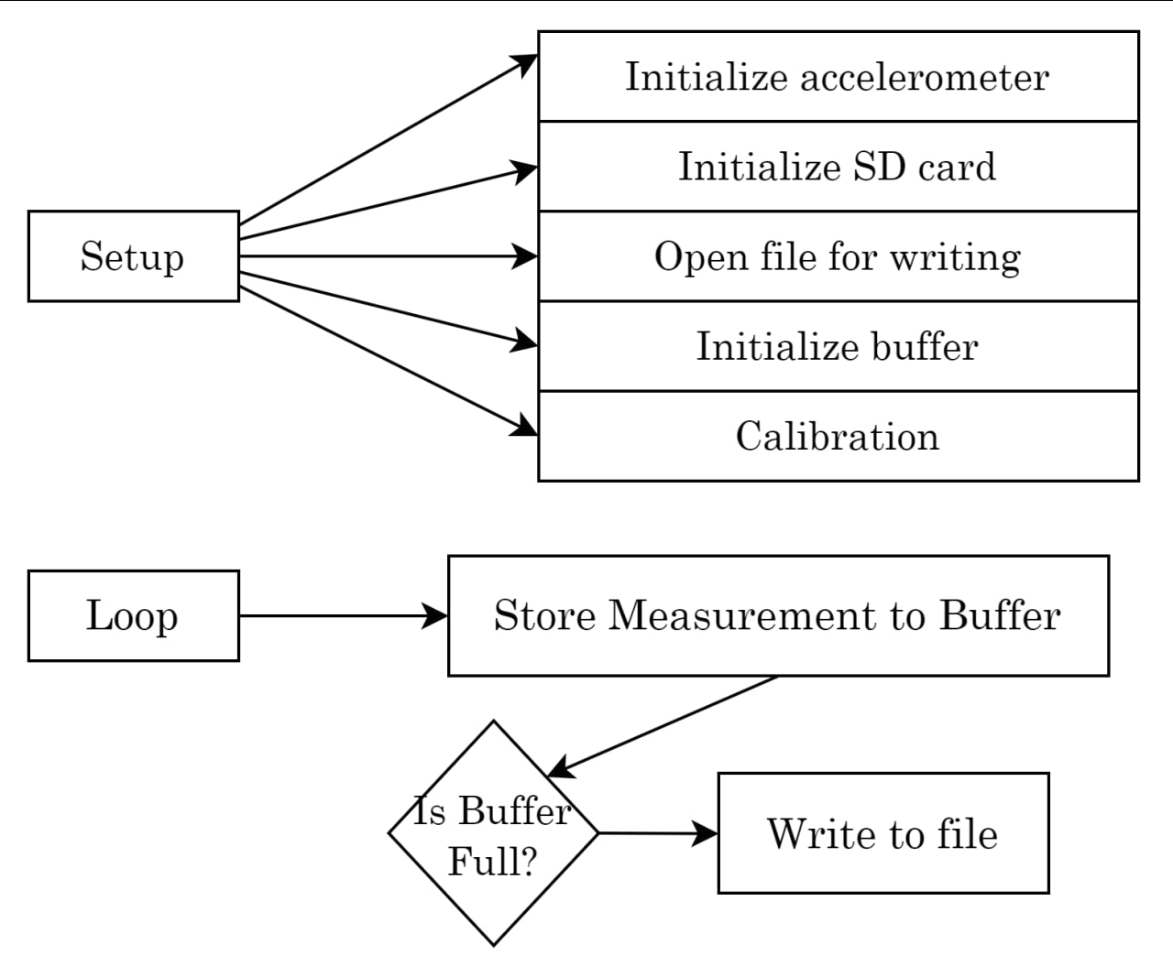
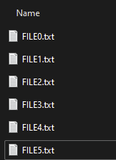
Software
Blocking write problem…

Slide 14
Software – Data format
Binary Format: Smaller, Faster

Slide 15
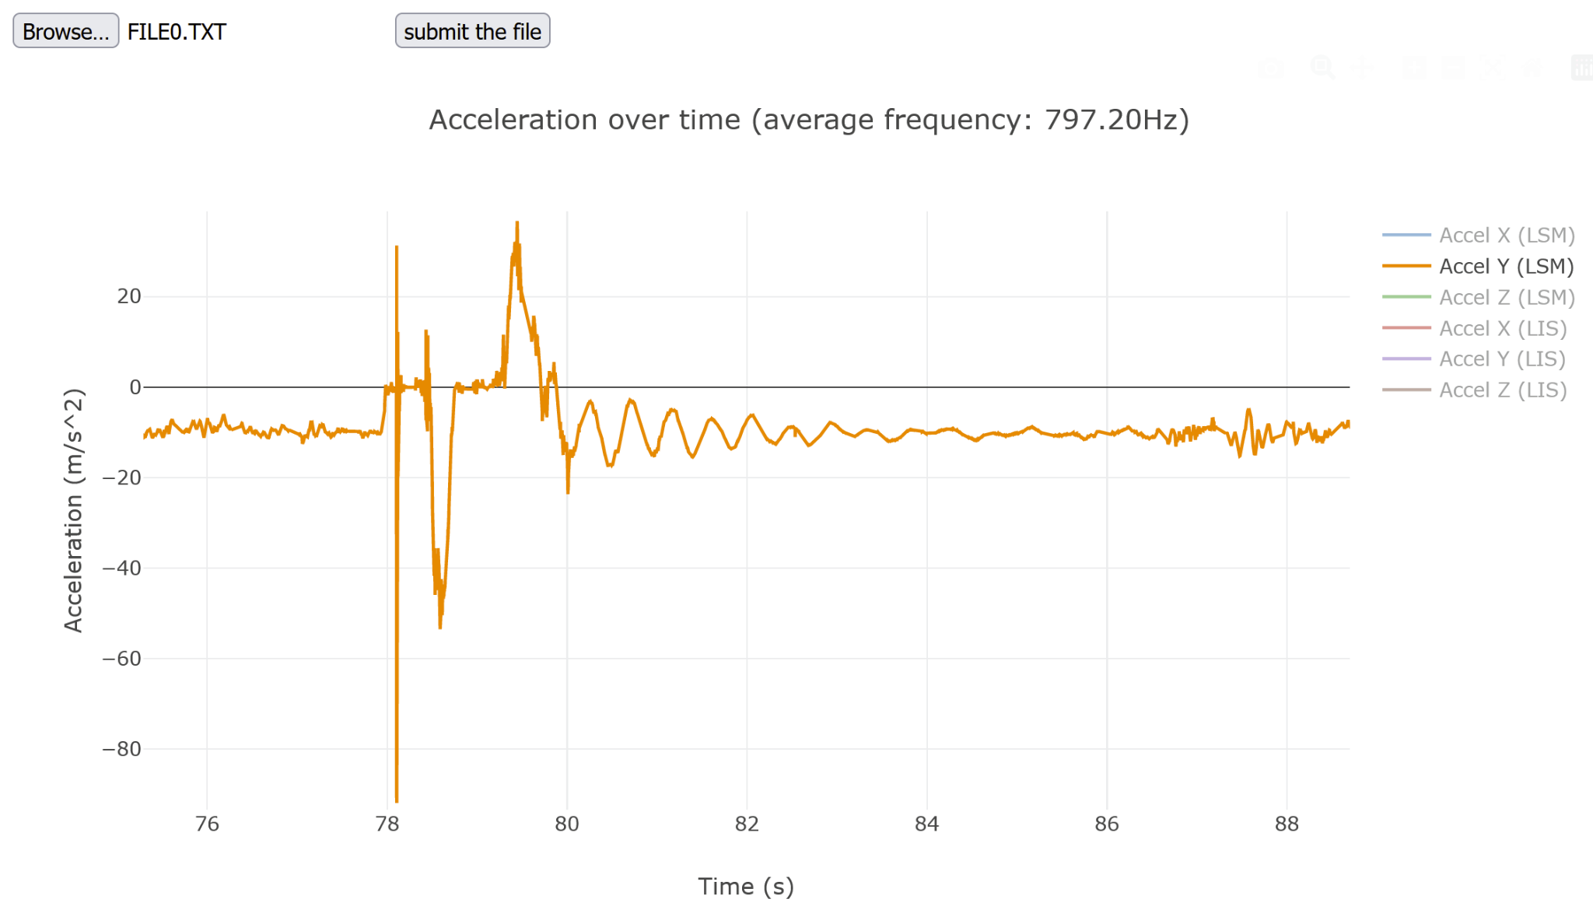
Software – Data Visualization
Upload the file
The interactive graph appears!

Slide 16
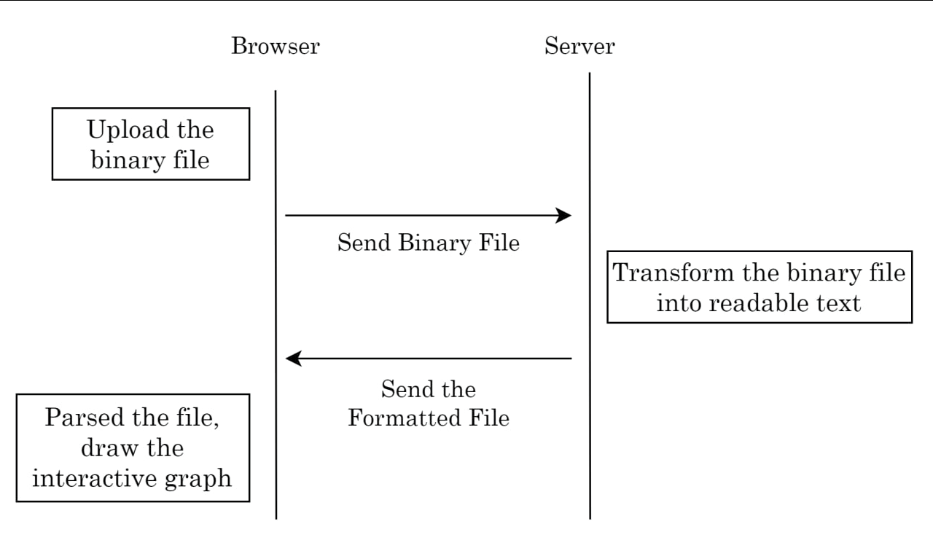
Software – Server / Browser

Slide 17
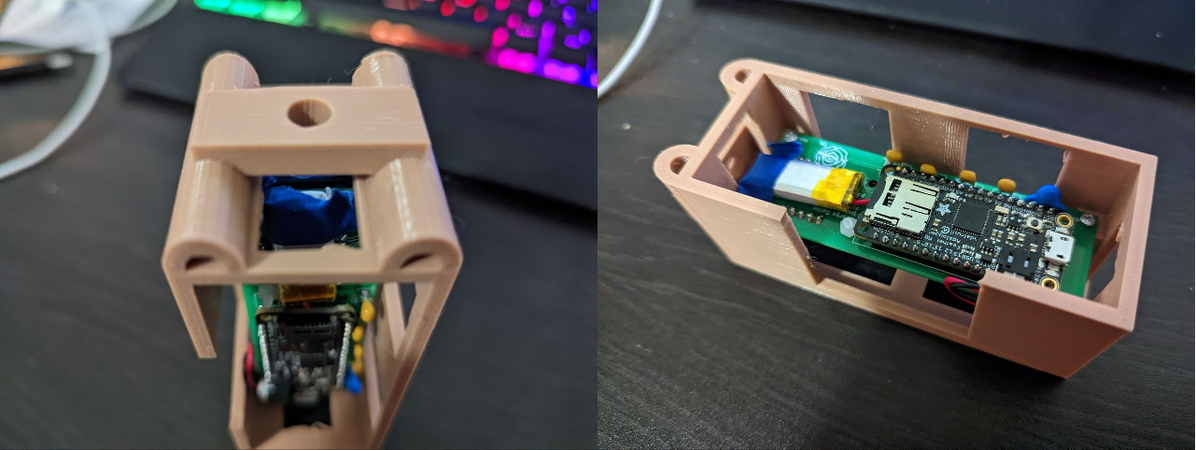
Experiment – Equipments
Plastic Box for Protection!

Slide 18
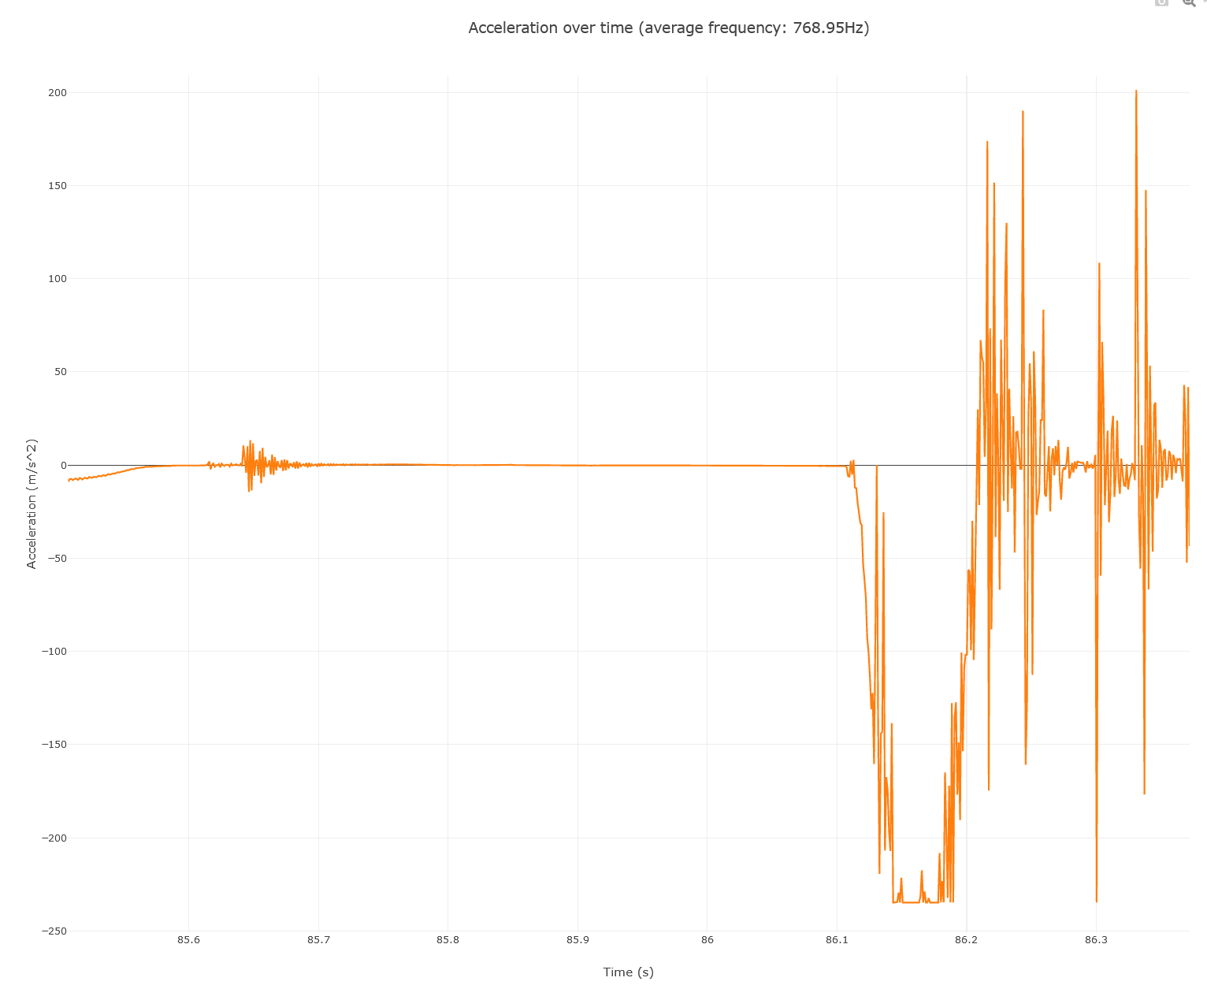
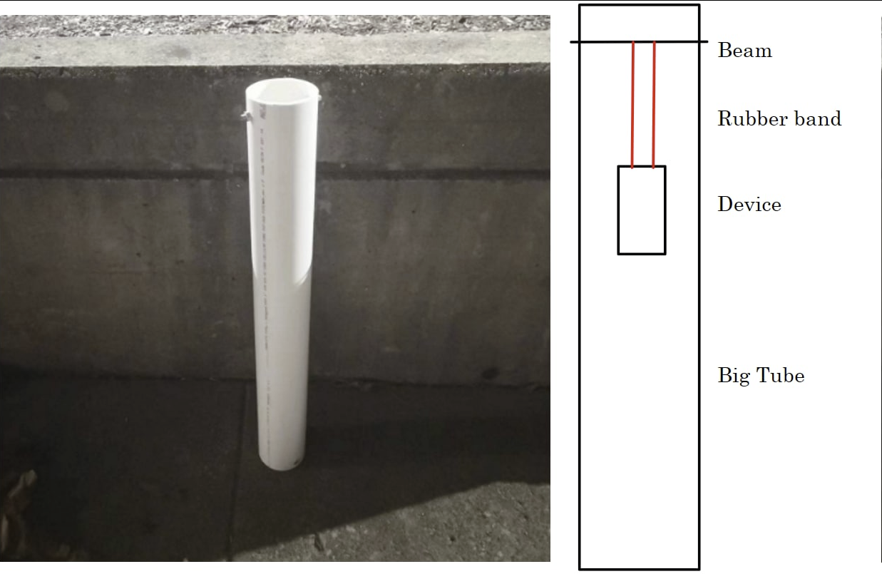
Experiment – Old
Constantly bumping to the wall. Too much noise!

Slide 19
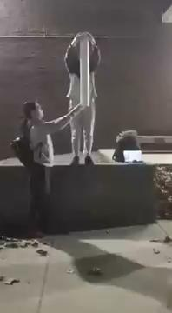
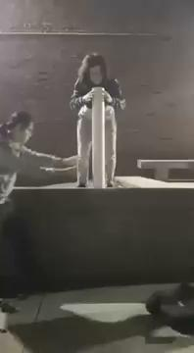
Experiment – Old (Video)

Slide 20
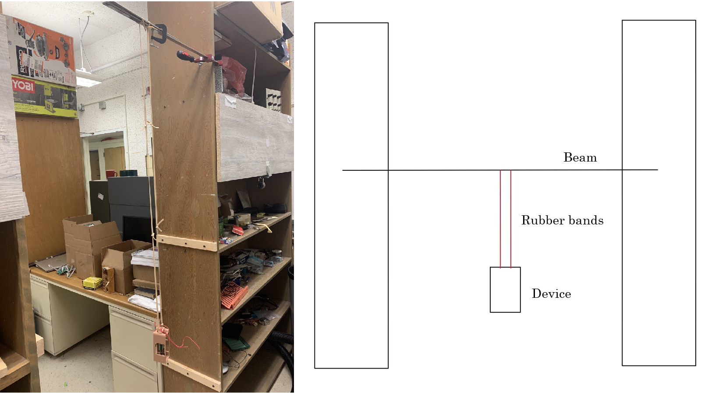
Experiment – New
Enough Room to avoid hitting the wall.

Slide 21
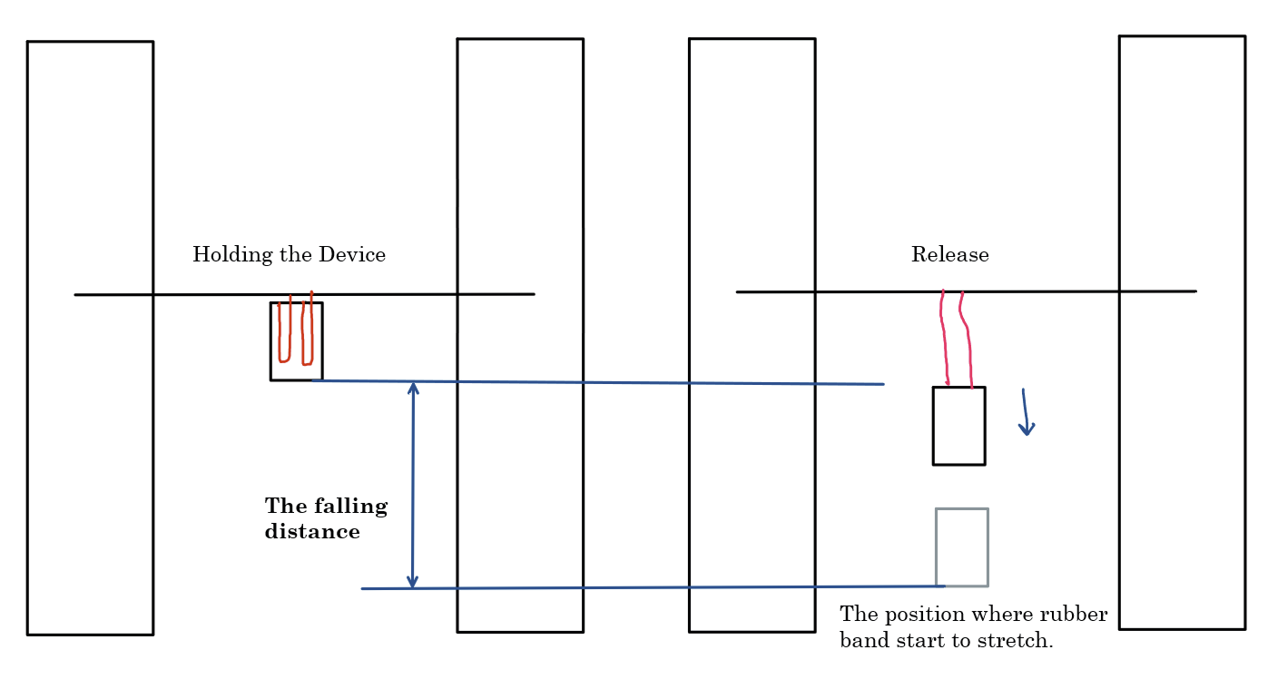
Experiment – New
The Illustration of the Experiment

Slide 22
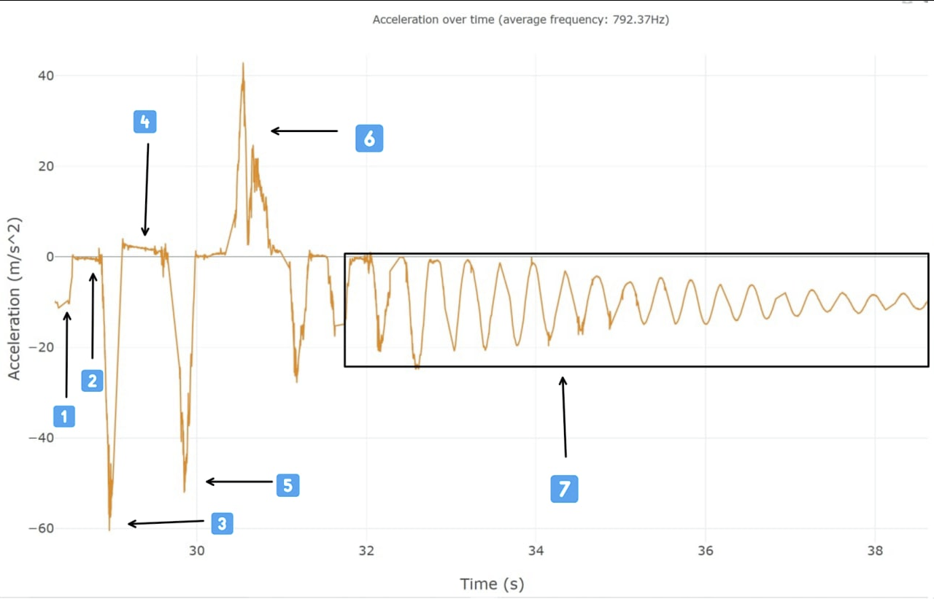
Result – Qualitative Analysis
Free Fall
At Rest
Rubber bands stretched

Slide 23
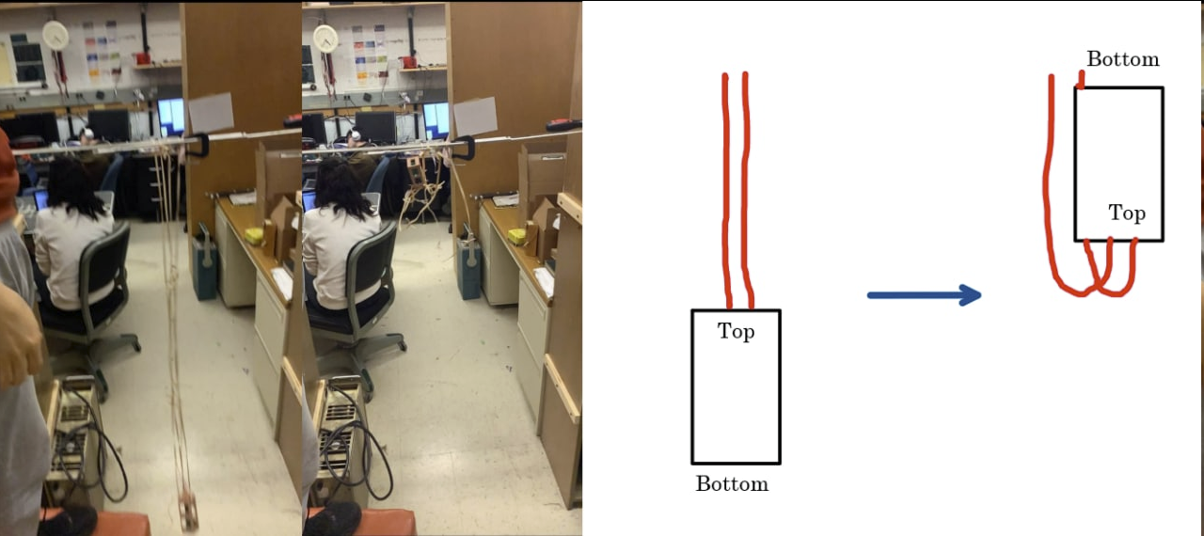
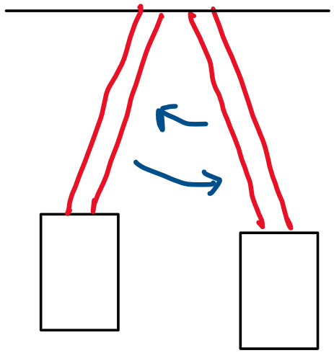
Result – Qualitative Analysis
Flip
Pendulum

Slide 24
Experiment – New (Video)

Slide 25
Experiment – New (Video)

Slide 26
Experiment – New (Video)

Slide 27
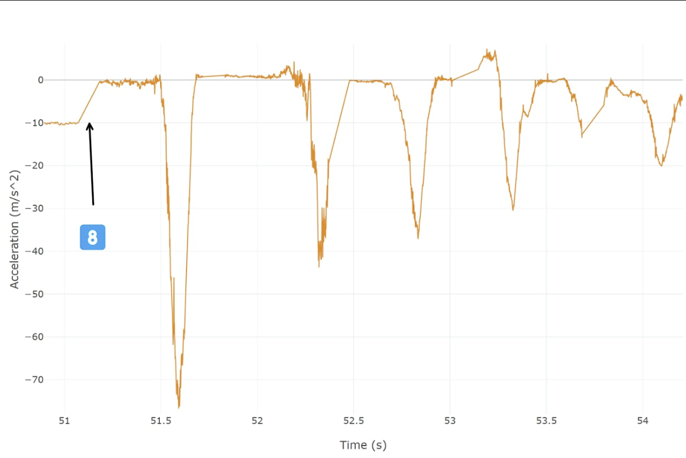
Result – Qualitative Analysis
Blocking Write

Slide 28
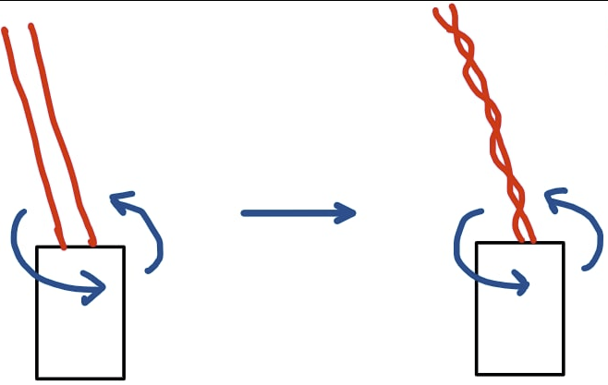
Result – Qualitative Analysis
Energy Lost:
Rotation
Pendulum Motion
Internal Energy

Slide 29
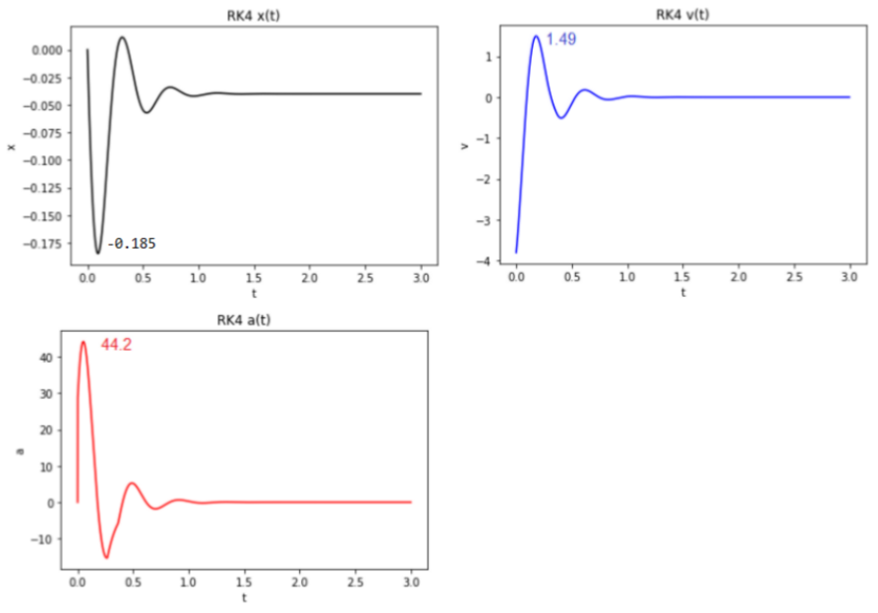
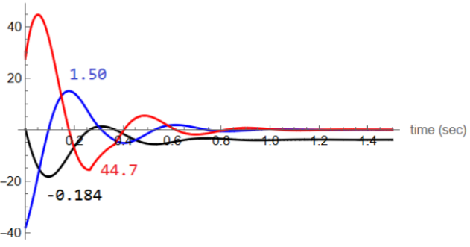
Results (Linear Simulation)

Slide 30
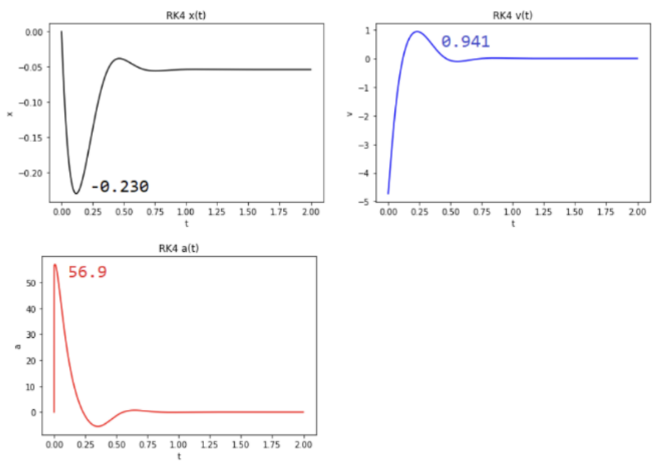
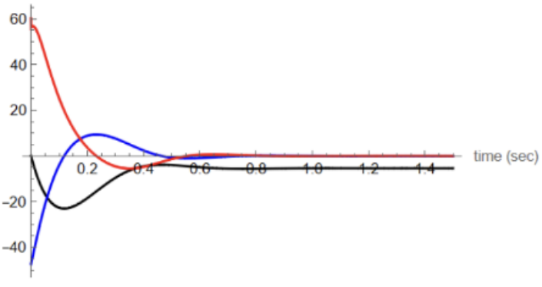
Results (Nonlinear Simulation)

Slide 31
Discussion
Biggest problem: 1D simulation cannot describe the random motion of the device.
Need to consider multiple different damping in simulation

Slide 32
Discussion
Need more data.
Need to do experiment with different kinds of cushions.
Need to write non-blocking SD write program

Slide 33
Conclusion
We studied the impact shock reduction provided by linear and nonlinear rubber bands in our project.
We used LSM9DS1 and Adafruit Feather M0 for measurement, and Arduino and JavaScript codes to collect and plot data.
A experimental setup is designed to prevent big noise in data when the device hit obstacles around it.
The motion of the device protected by elastic bands is not one-dimensional.
We generated simulations in Python and Mathematica to simulate the behavior of the device.

Slide 34
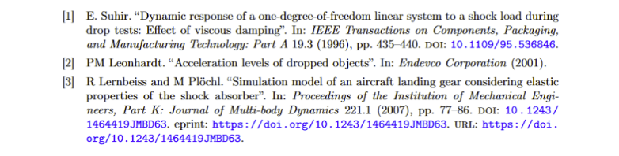
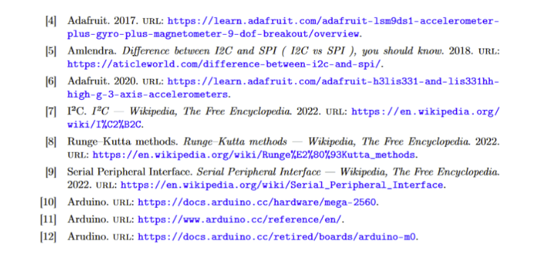
Reference

Slide 35
Thank you!

