Slide 1
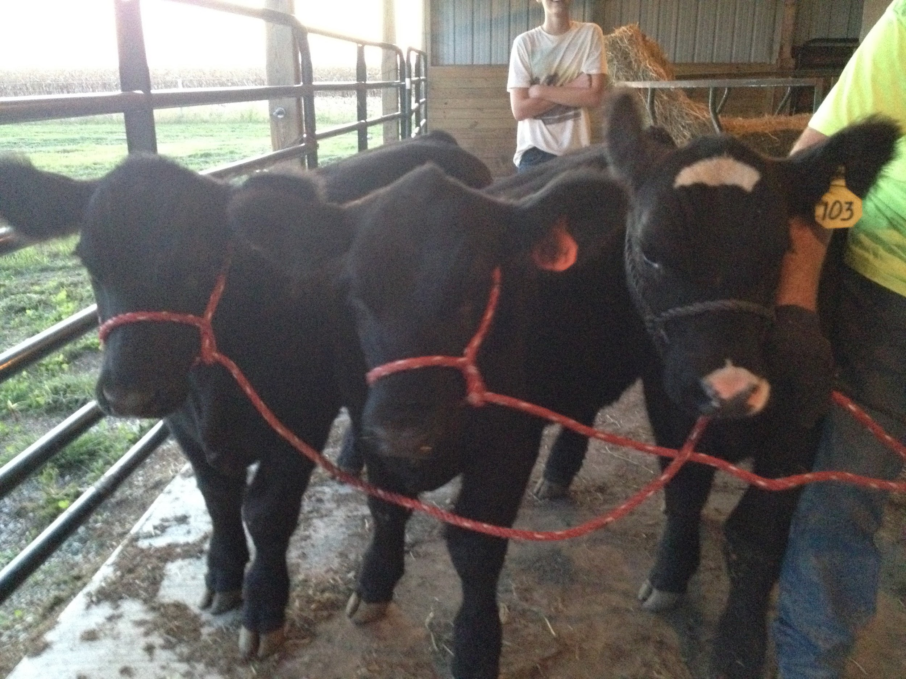
MEASURING METHANE PRODUCTION OF CATTLE IN A SEMI-CLOSED ENVIRONMENT

Slide 2
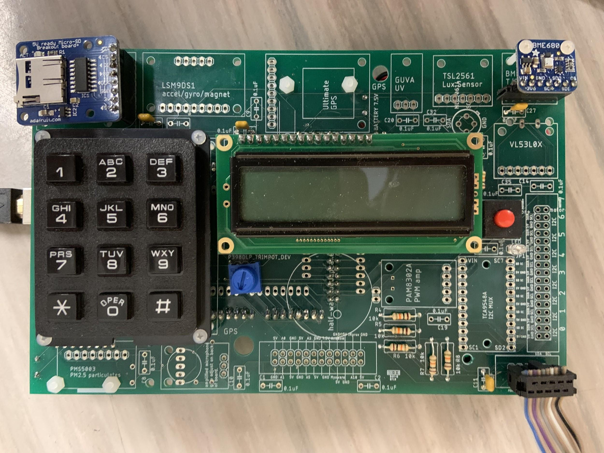
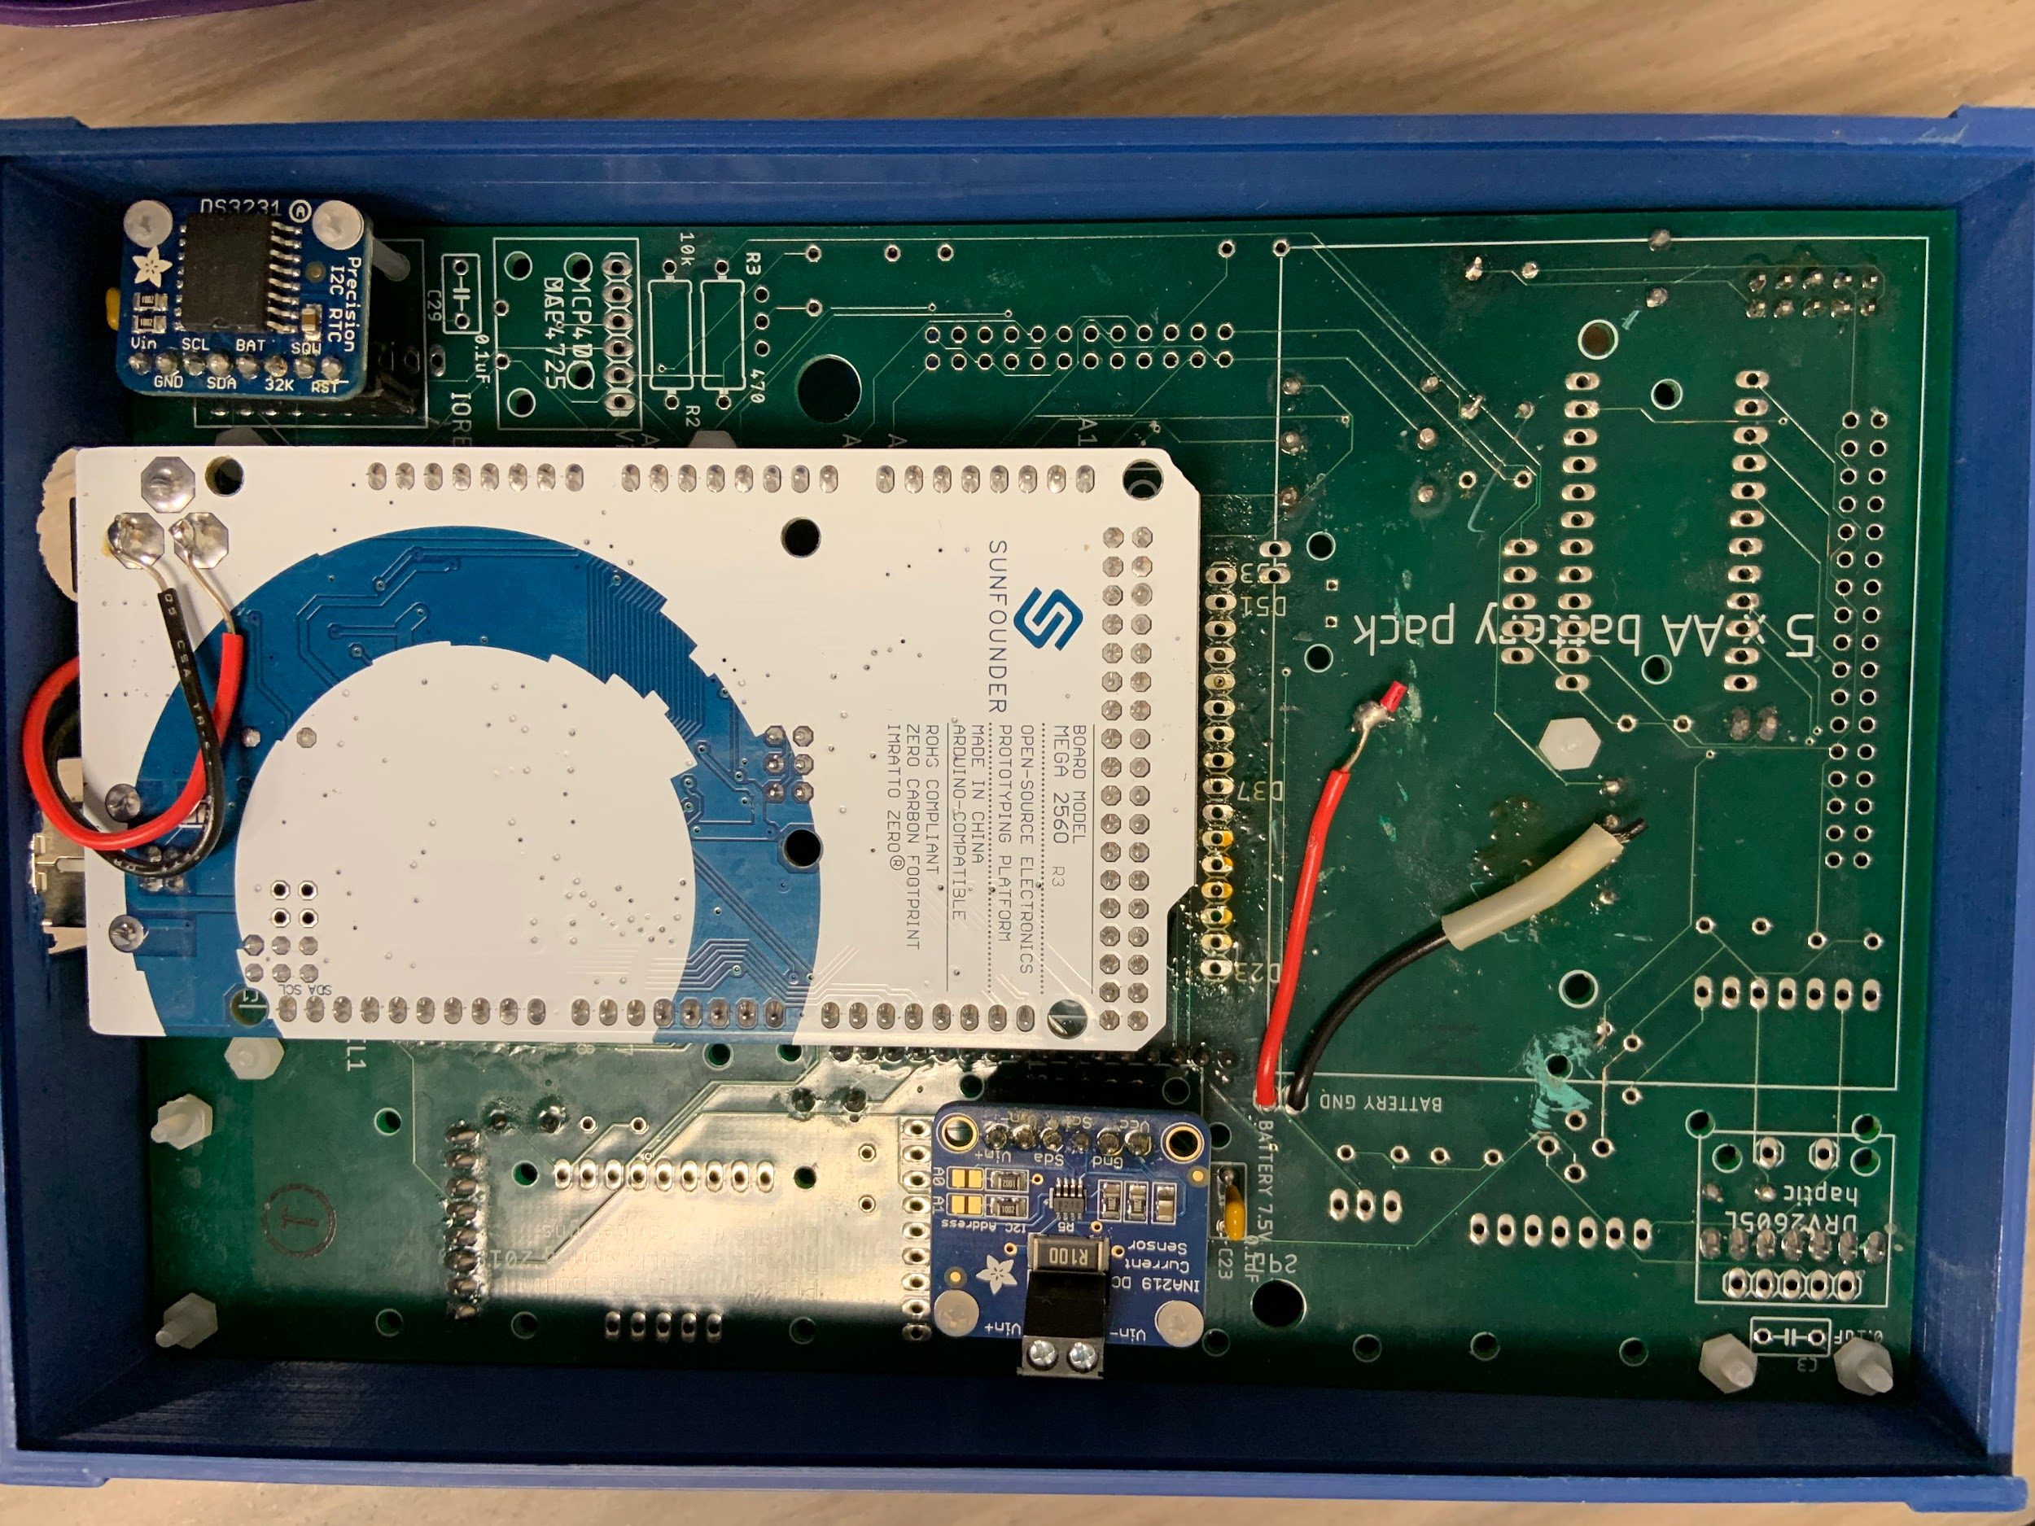
Hardware
Arduino Mega 2560
BME680
LCD
RTC
SD Breakout Board
Keypad
Current Sensor

Slide 3
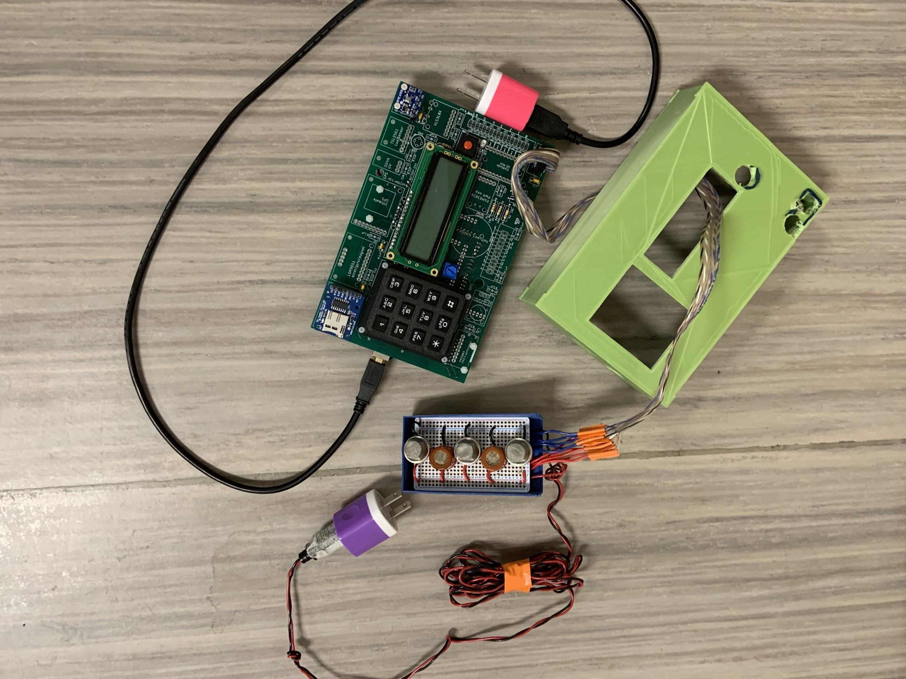
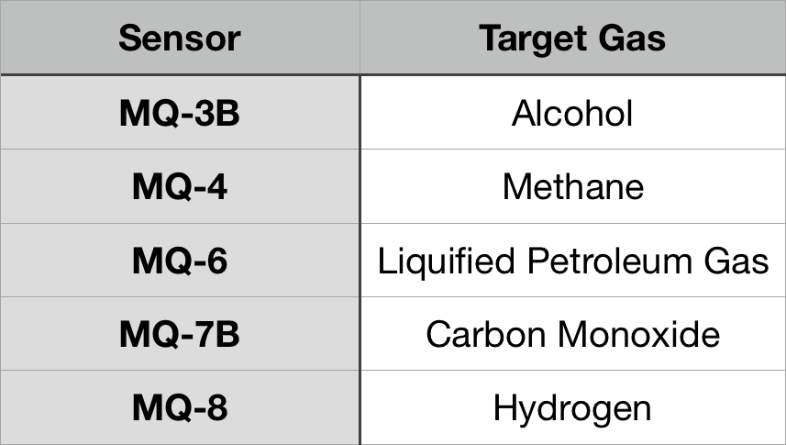
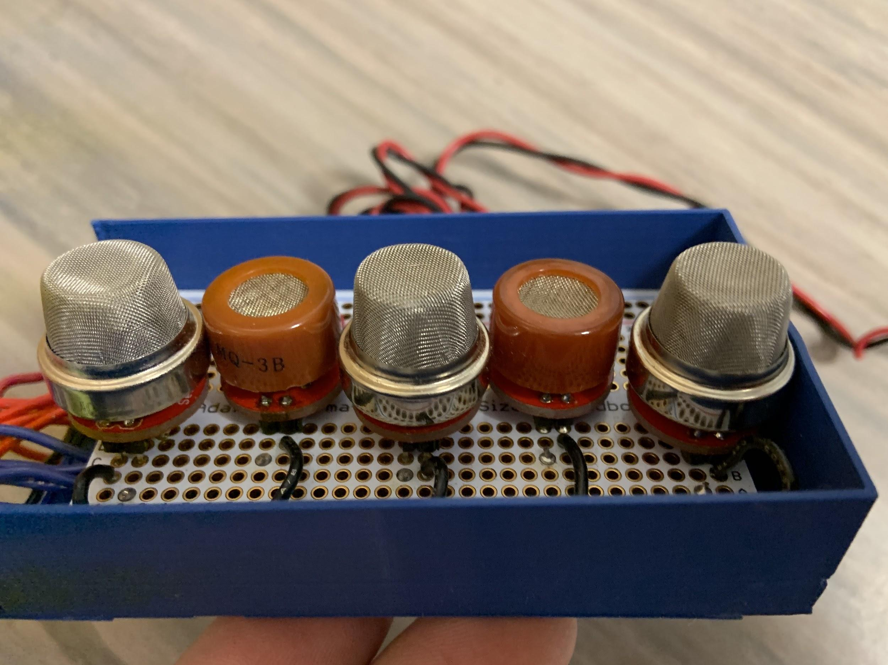
Sensors

Slide 4
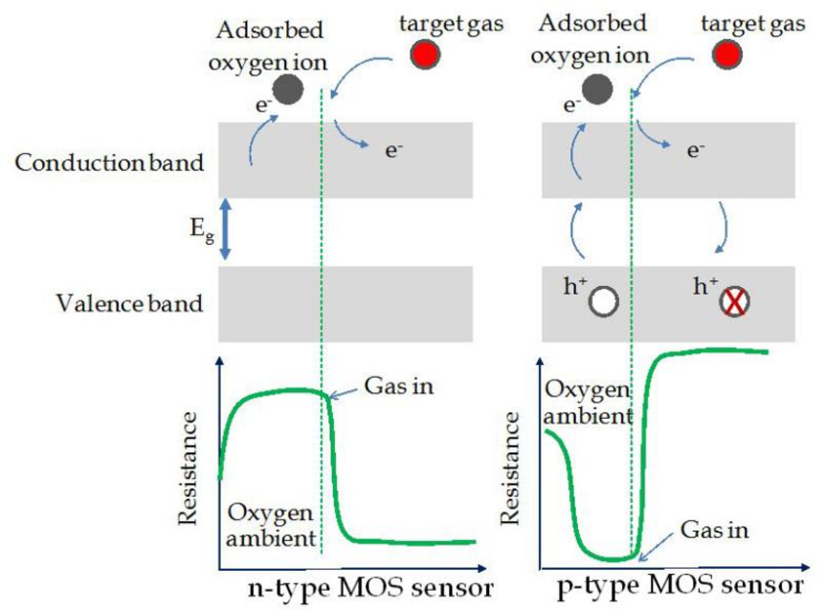
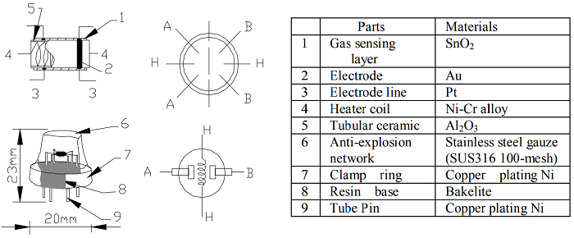
How do our sensors work ?

Slide 5
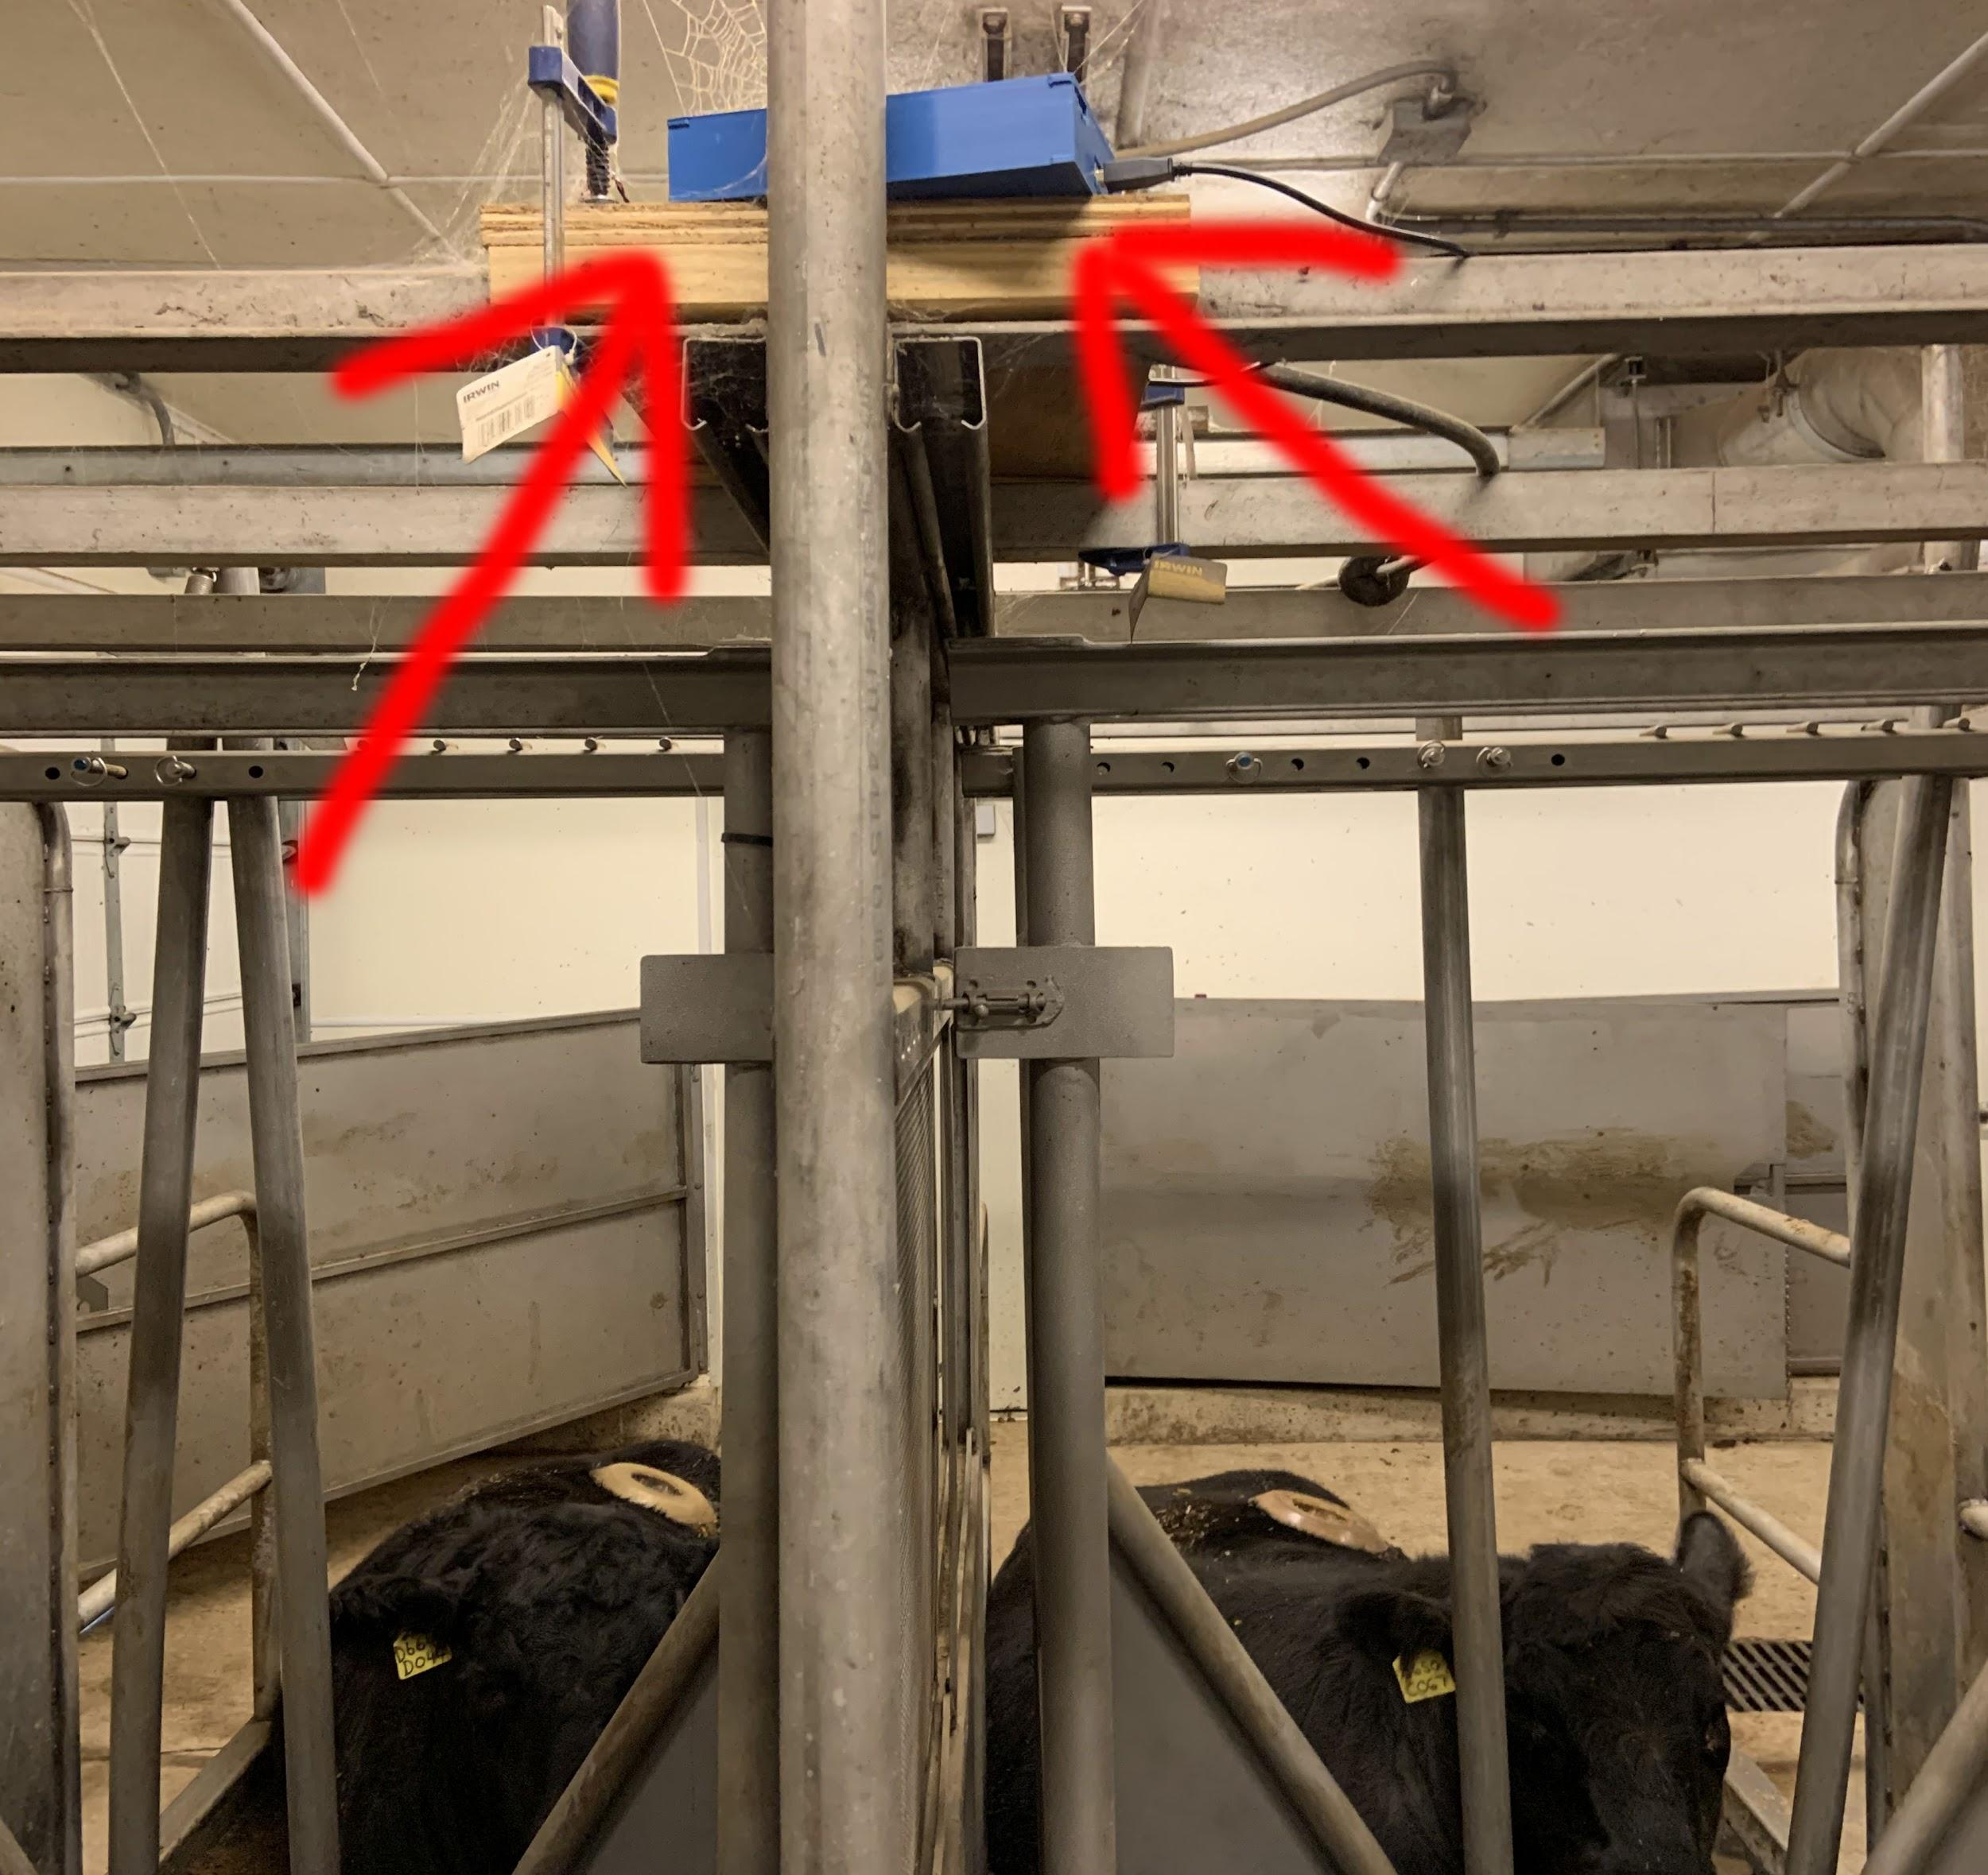
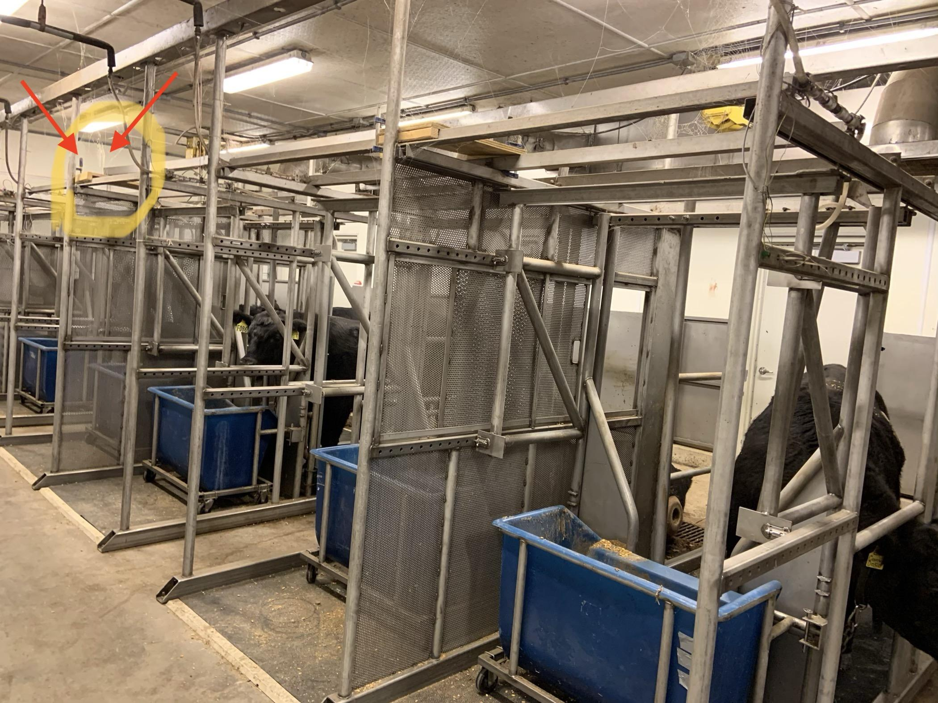
Methods: Data Collecting Devices directly above 6 cows
Notes:
Danylo

Slide 6
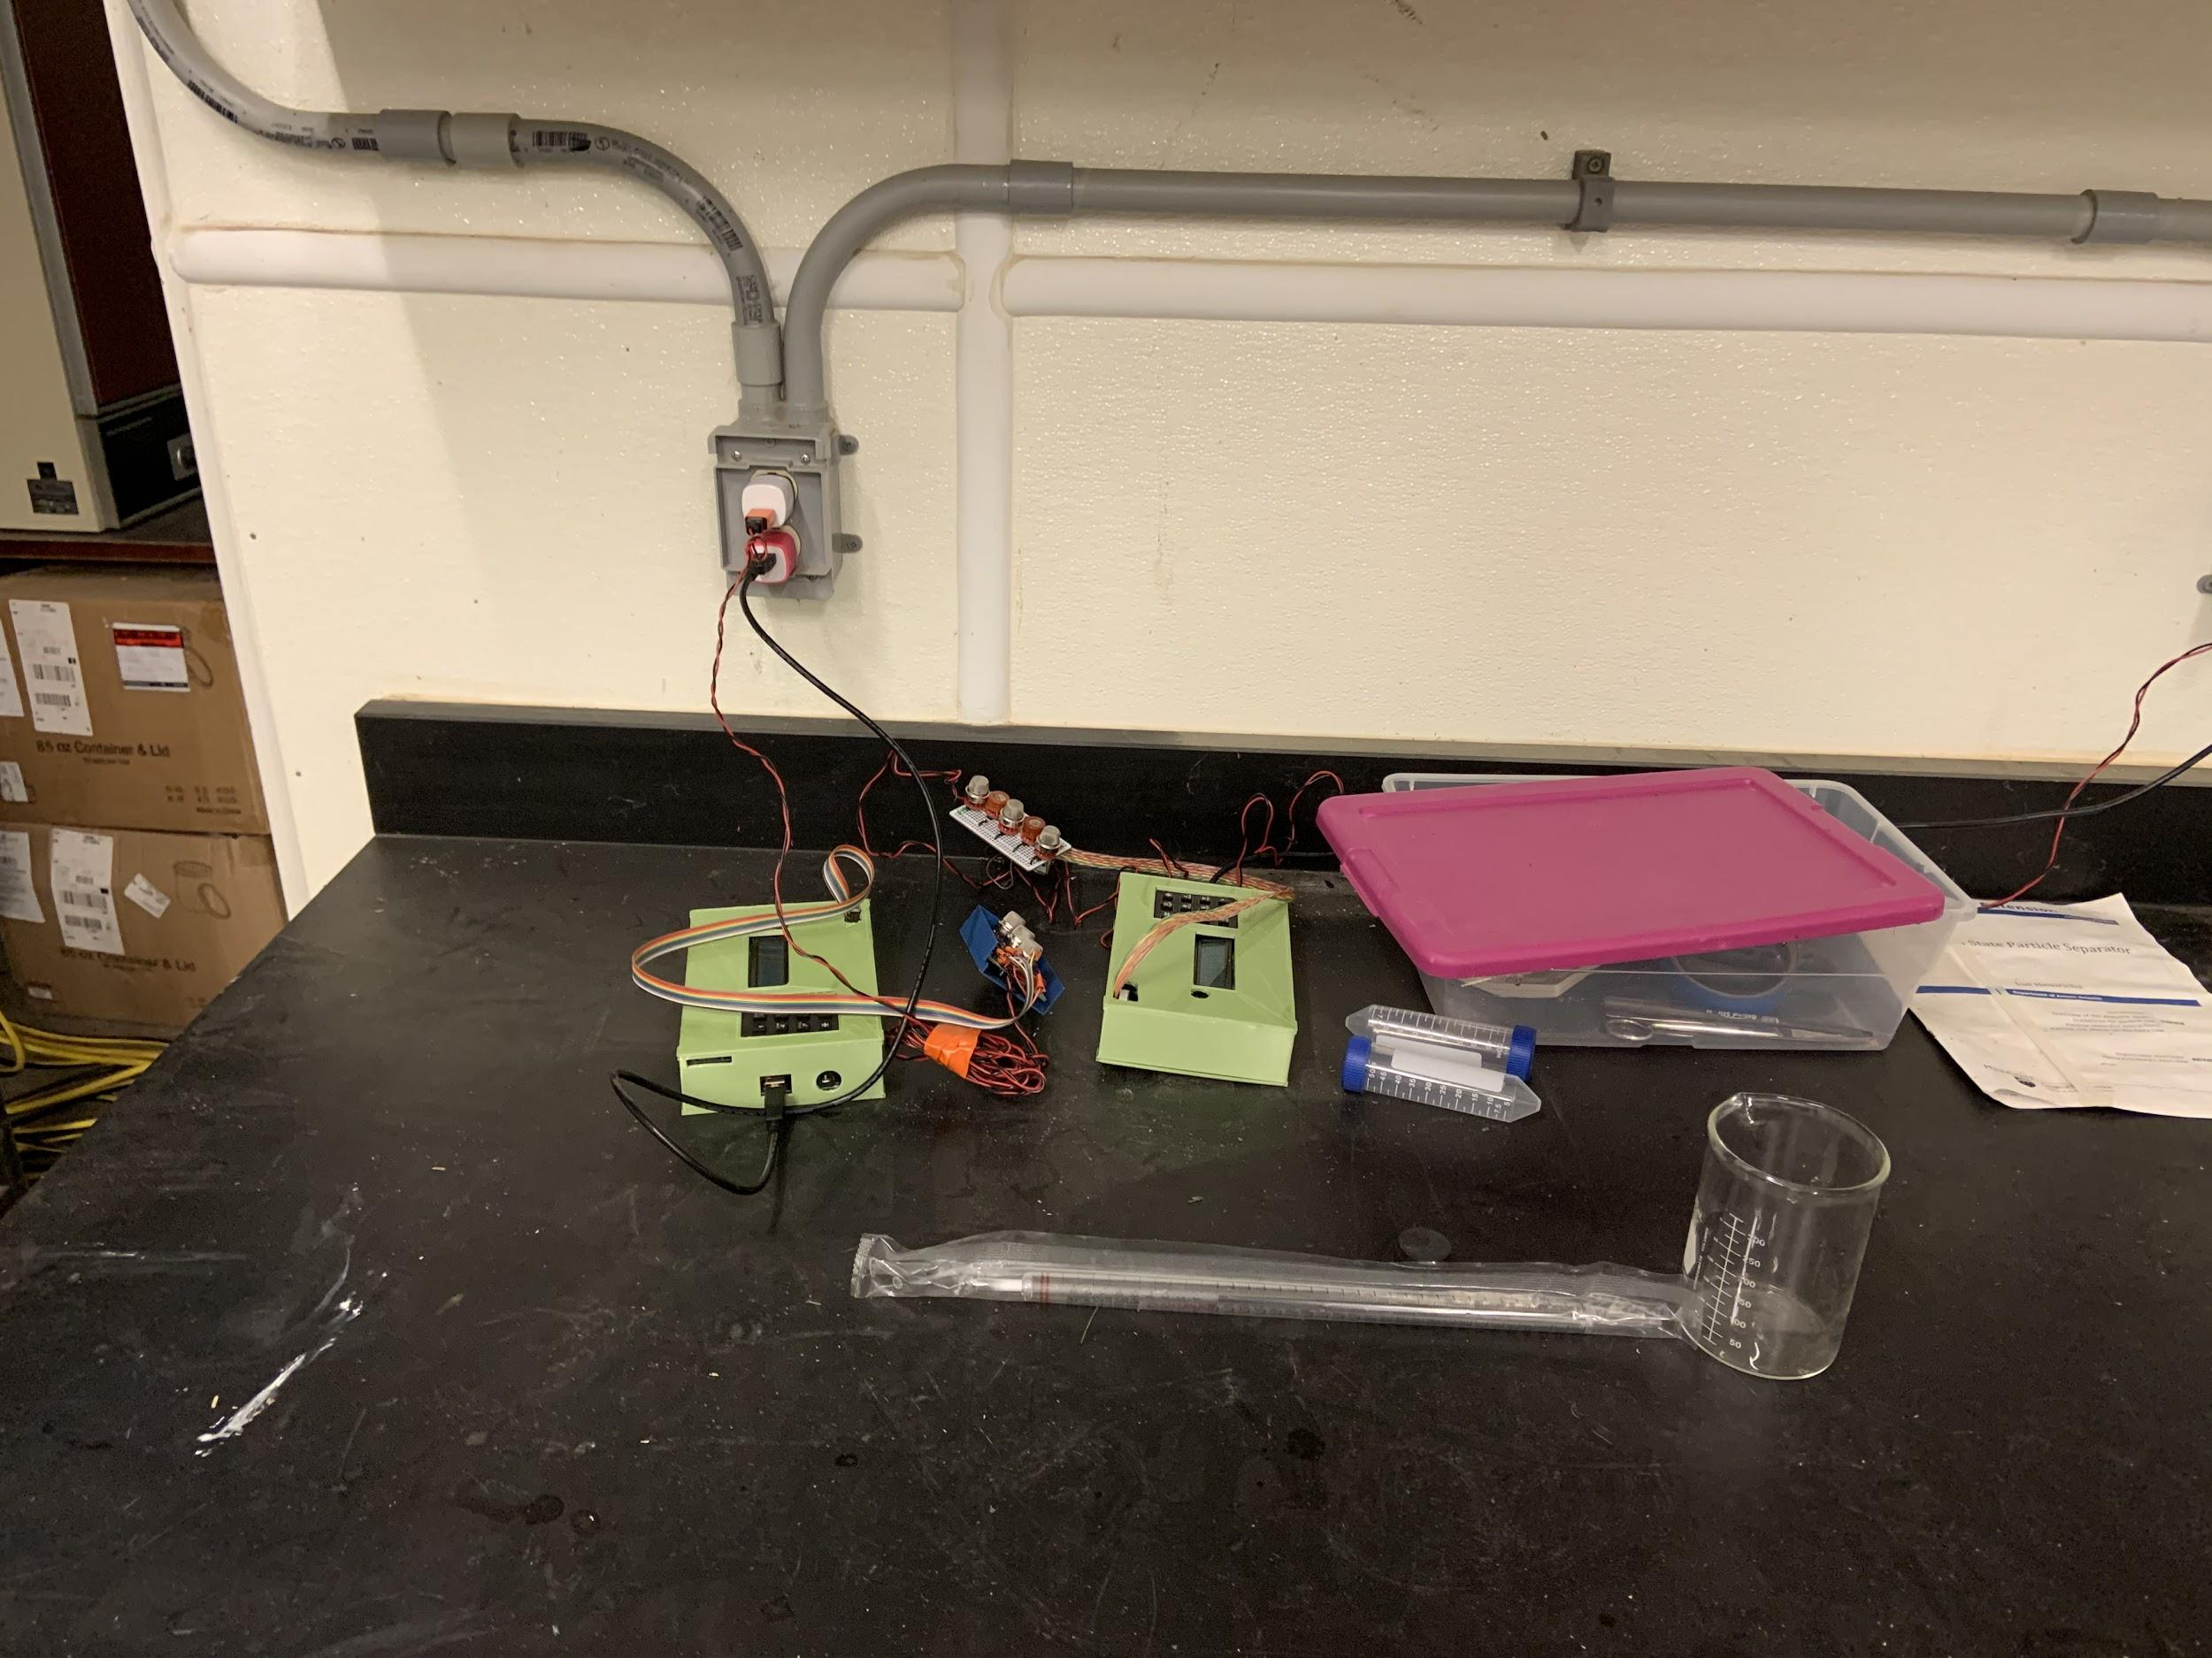
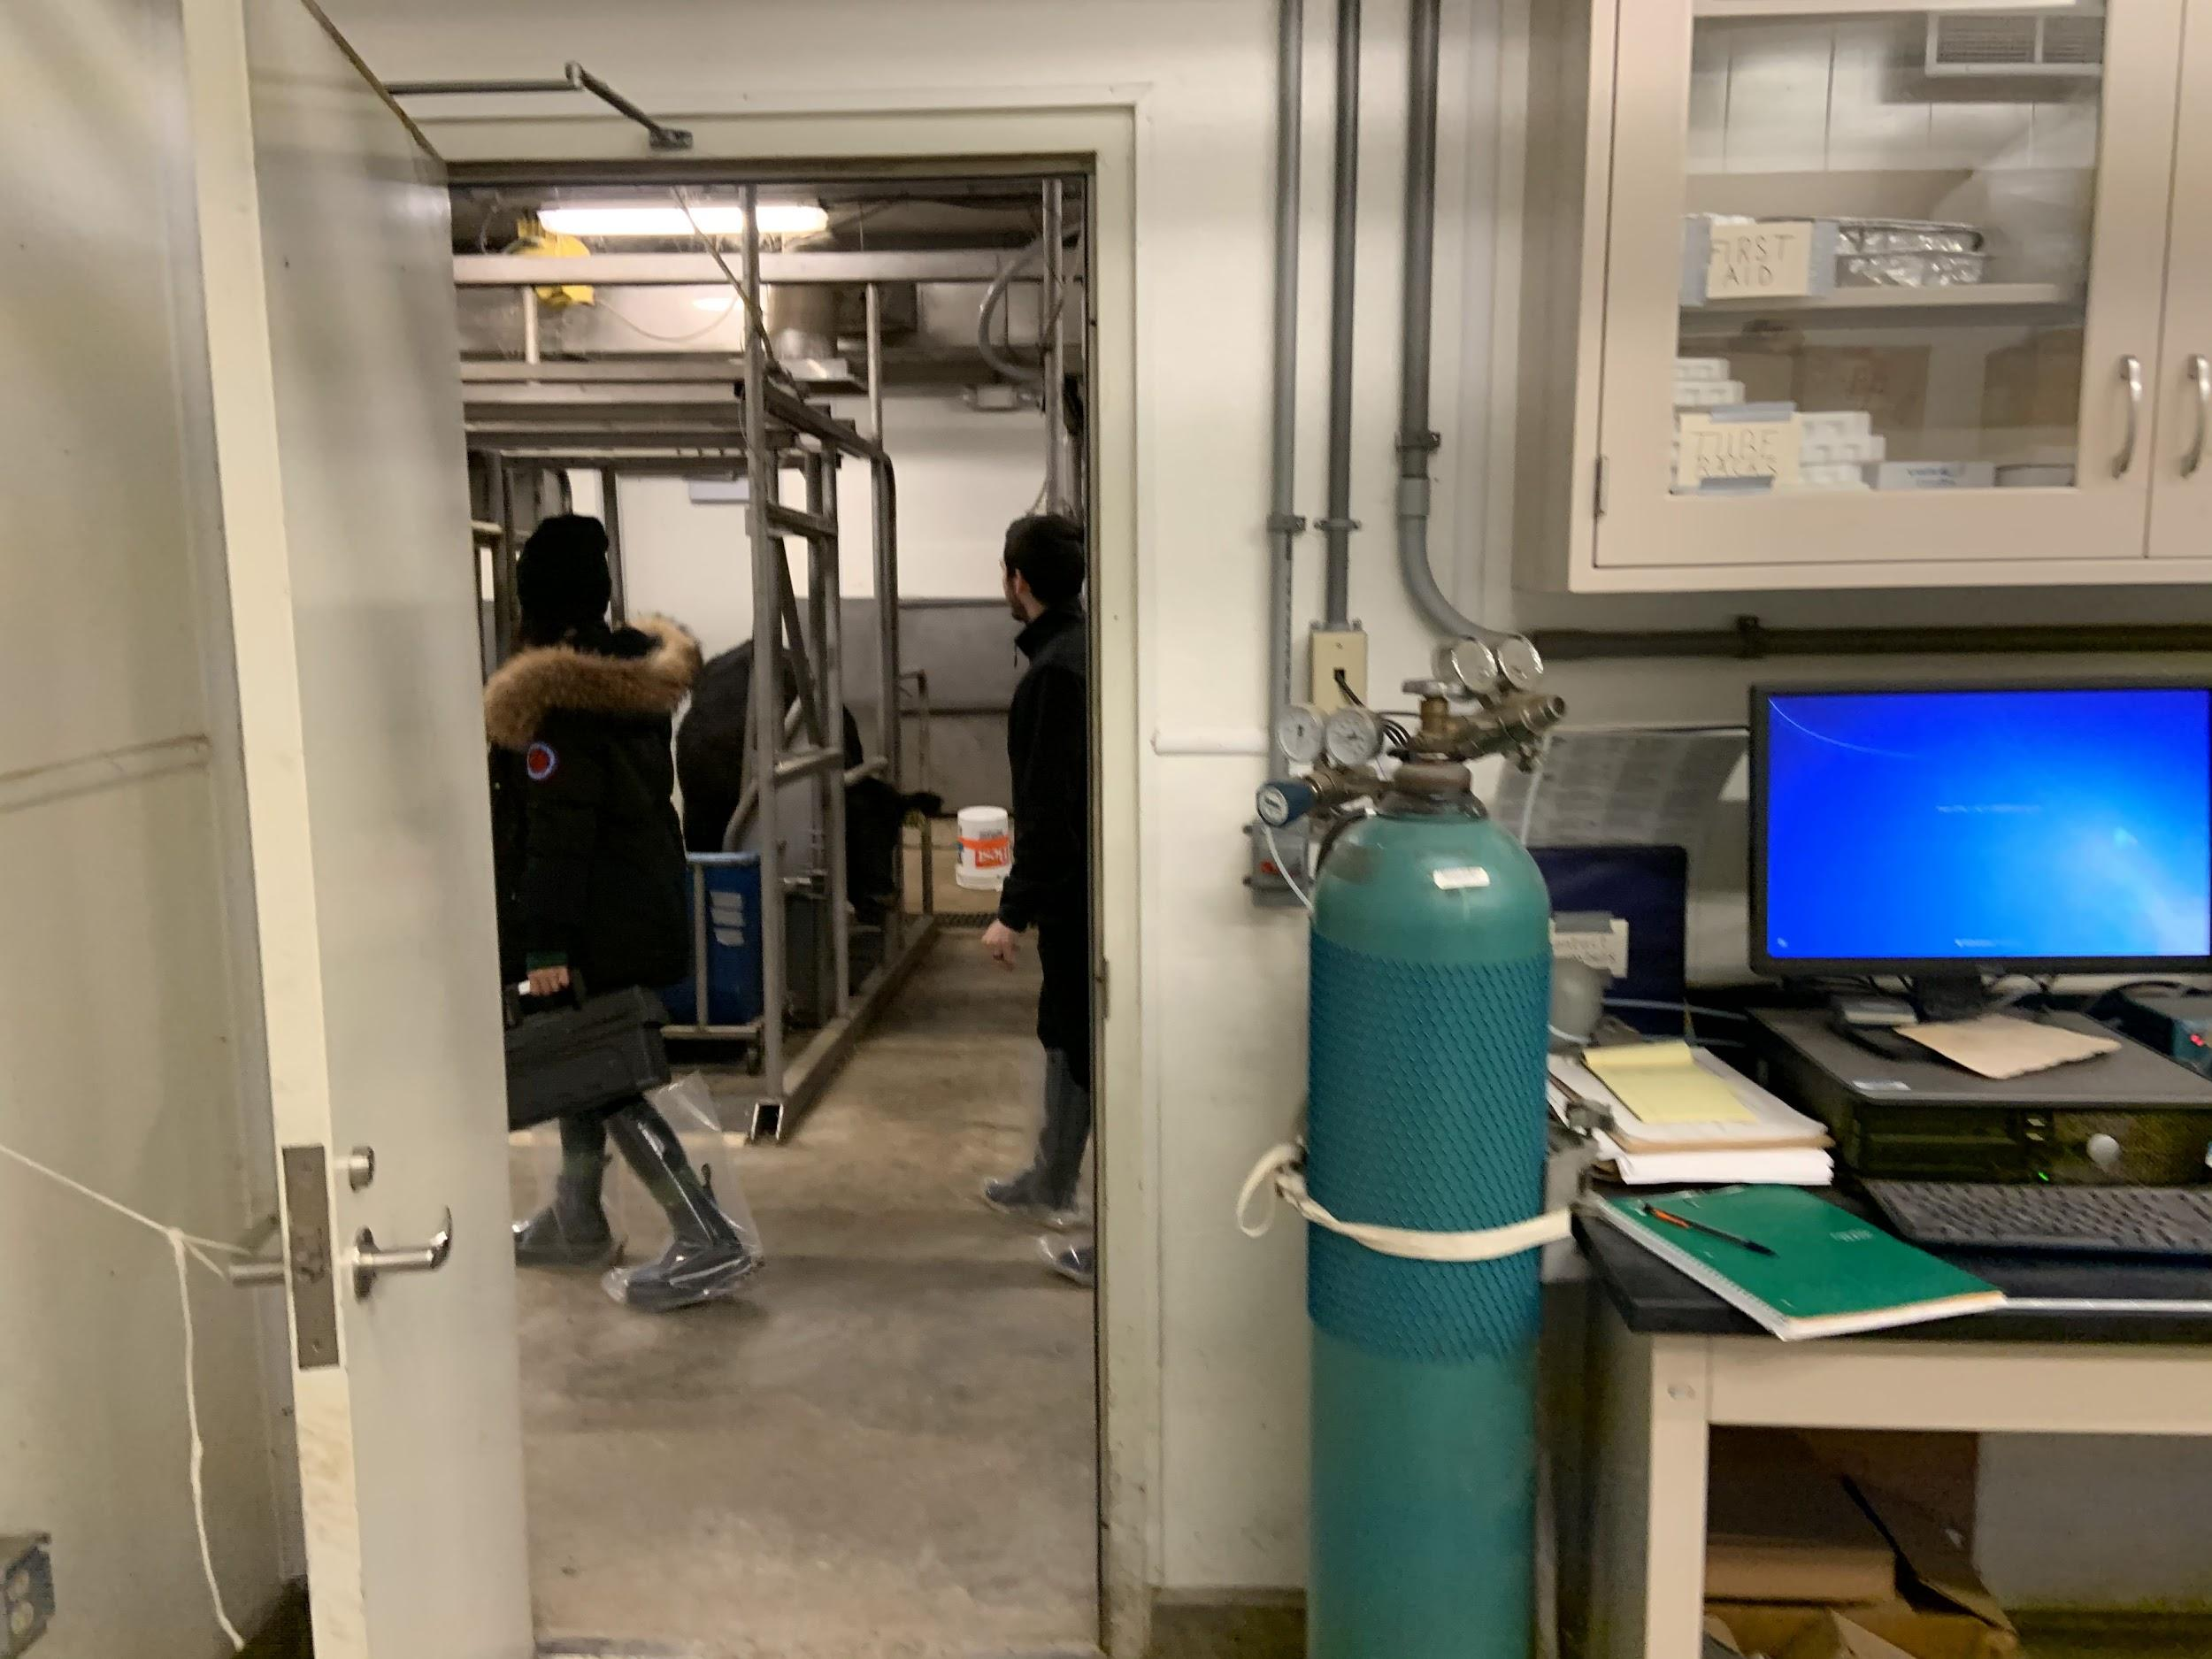
Methods: Control Devices
Notes:
Danylo

Slide 7
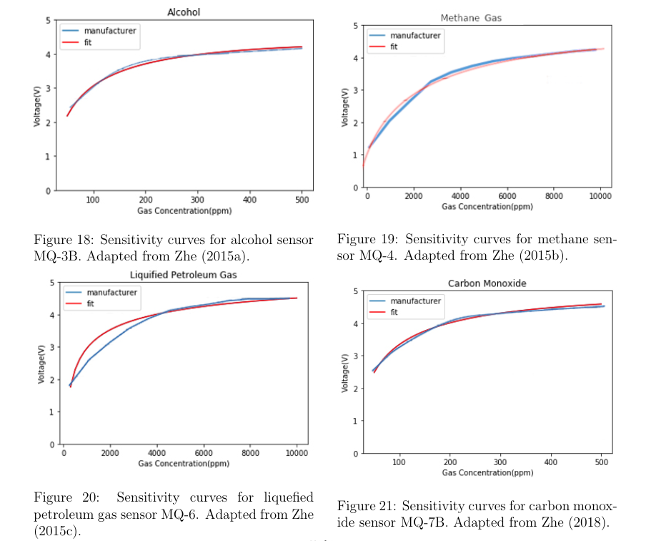
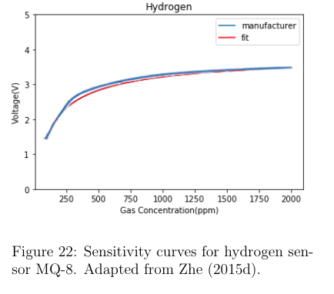
Fitting Voltage vs Concentration to the manufacturer’s plot

Slide 8
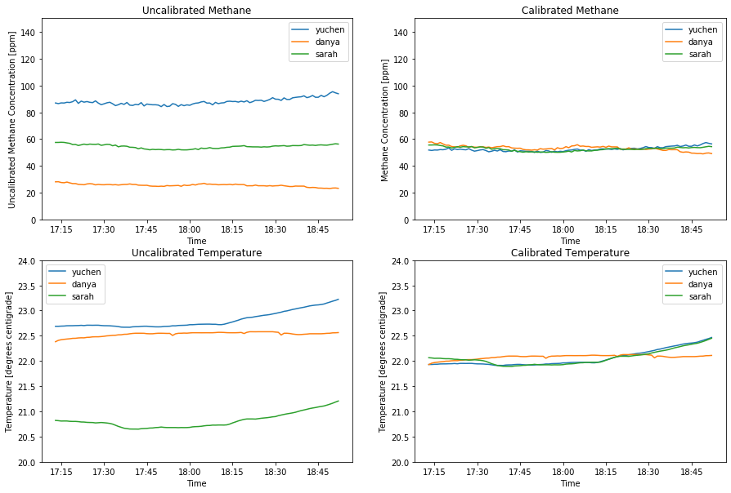
Cross-Calibration between our devices

Slide 9
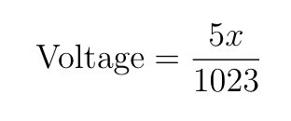
Converting the raw measurements to voltage
From ADC values from 0 to 1023, we get the voltage:
From plots on the previous slide, we derived following equations:

Slide 10
Software: Data Acquisition Program
Running the system diagnostic (checking if all components work)
Saves the measurements from the BME and RTC into a csv file
Saving gas sensors raw ADC measurements into a csv file with every measurement

Slide 11
Problems we encountered
After a few preliminary runs, we had to stop running the devices outside or in the open-air barn due to the cold.
Several of our sensors sustained internal damage for unknown reasons possibly related to the cold. We had to resolder most of our connections at least once due to problems with the ribbon cable wires snapping.
We also had to rewrite our DAQ to fix a recurring problem with the program not saving data if interrupted.
These problems, along with some unlucky data corruption, led to delays in taking data. As a result, we chose to eliminate the open-air barn environment.

Slide 12
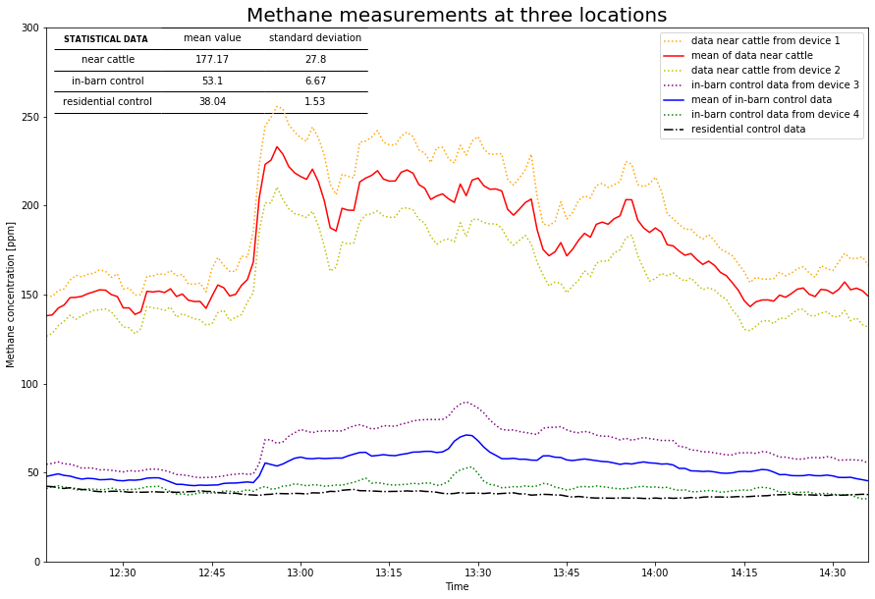
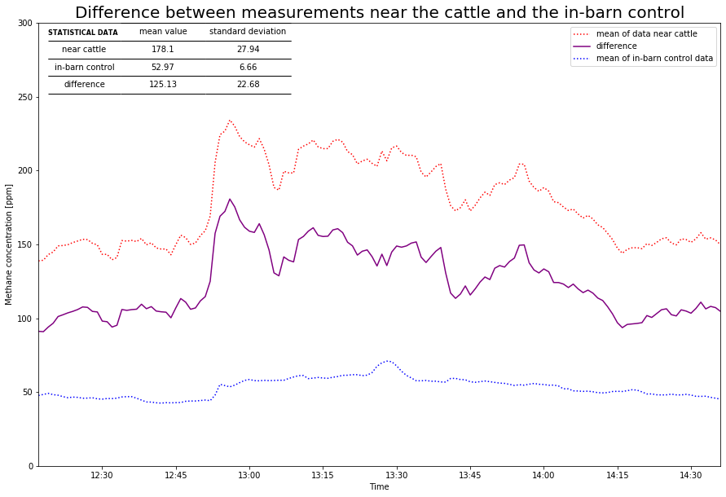
RESULTS!!!
The average concentration of methane measured above the stall was calculated to be 140.52
ppm, while the average control measured was 72.04 ppm. The difference in concentration due to
the proximity to steers was 68.48 ppm.

Slide 13
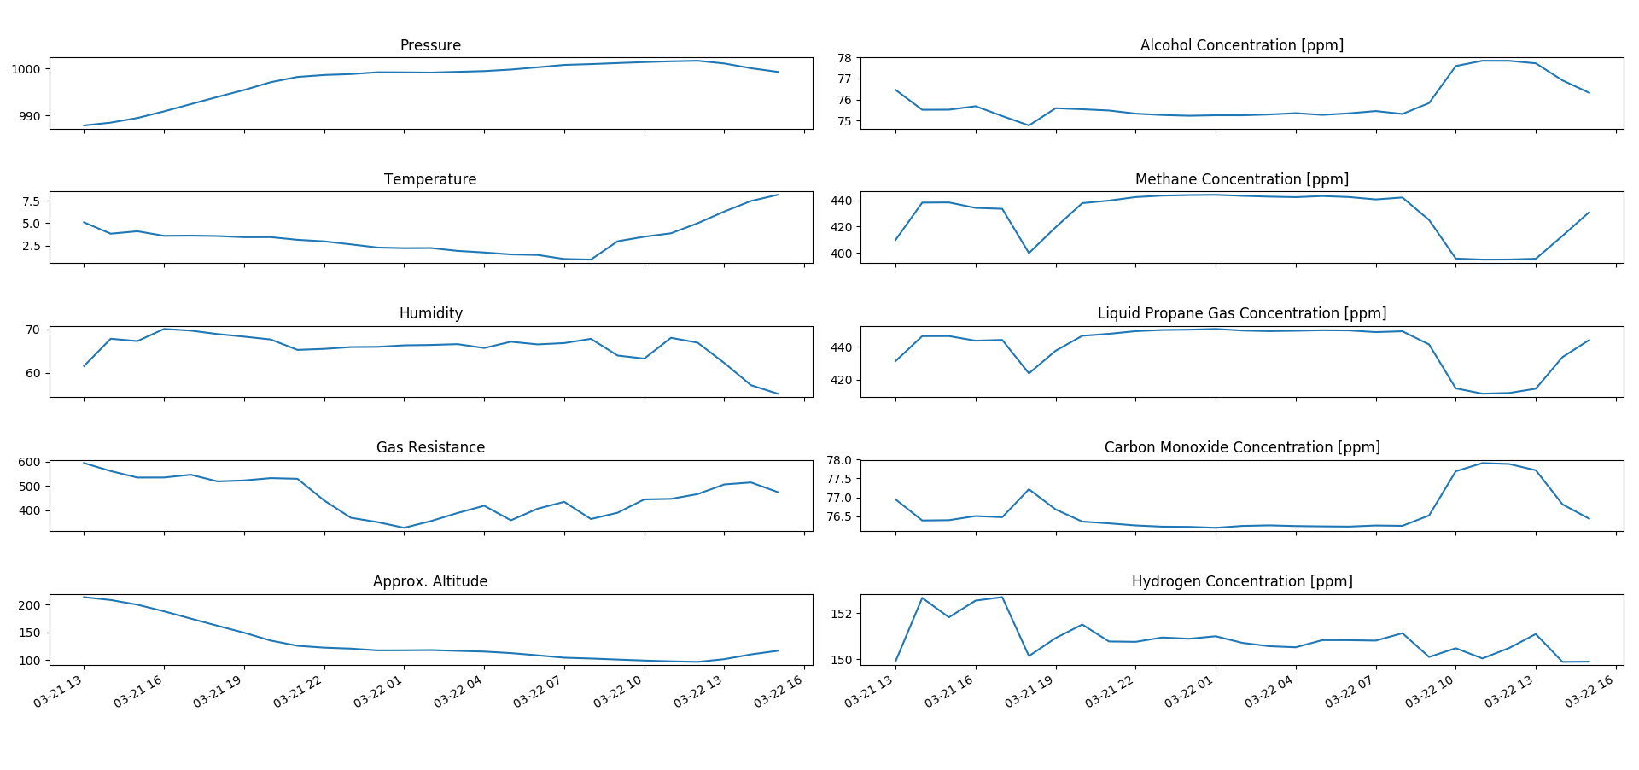
Discussion: Selectivity

Slide 14
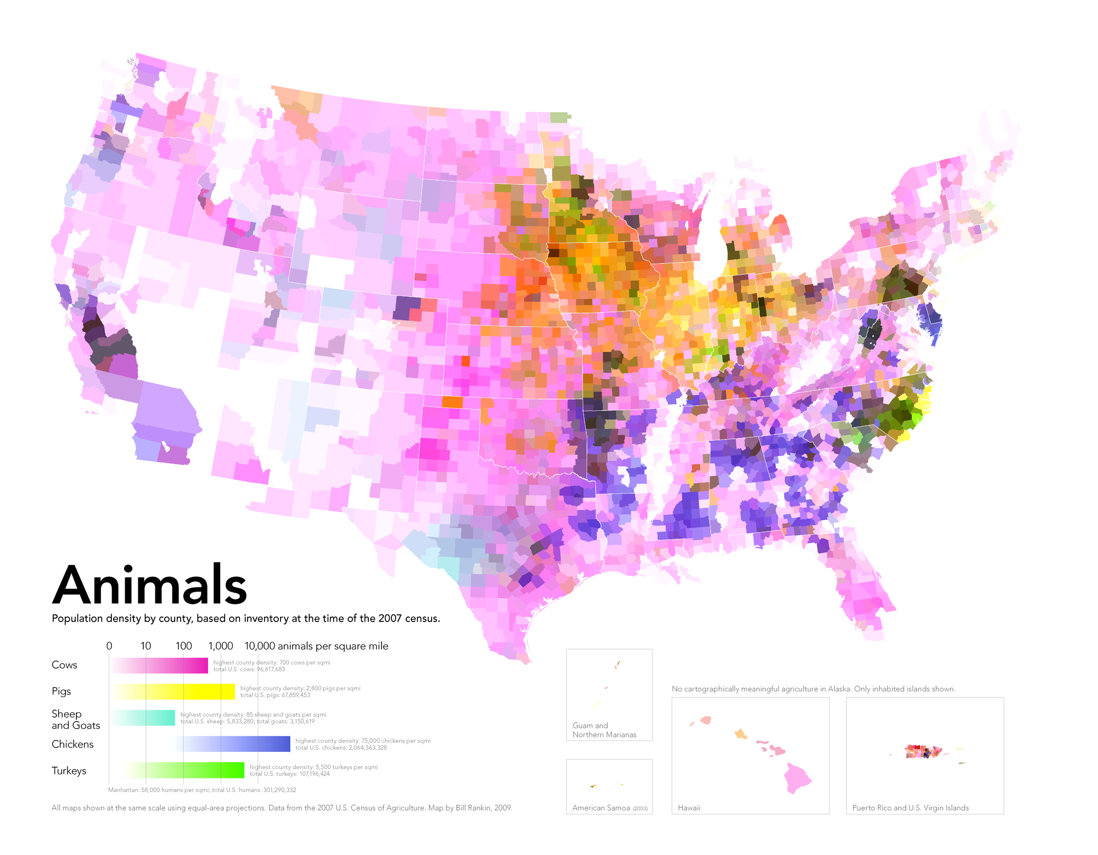

Slide 15
Discussion
These sensors are not the best for measuring gas concentrations in the atmosphere precisely
This is a low-cost experiment that allows to measure relative abundances of methane
With upgraded sensors, a similar device could be used by farmers to track relative methane output which could depend on cattle’s:
Diet
Set Up of the Barn
Manure Management
And more!
Notes:
Danylo

Slide 16
References
https://components101.com/sensors/mq-3-alcohol-gas-sensor
https://www.semanticscholar.org/paper/Room-Temperature-Gas-Sensing-Using-Pure-and-Metal-Wang
https://www.vox.com/a/explain-food-america

