Slide 1
398 Final Presentation
Zhenghai Liu & Ziyao Wang

Slide 2
Introduction
Hand dryers are objects in our daily life. Our research expands upon Keegan(2013) and uses an Arduino based device to investigate hand dryers' noise levels with respect to Sound Pressure Level (SPL) and frequency to see whether it can cause hearing loss for average college students.

Slide 3
Introduction
The noise level or ambient noise level, typically measured in dB (1dB corresponds to 20 mu Pa), indicates the background sound pressure level (SPL) from a specific source.
noise level is measured with a particular frequency weighting filter. A-weighting filter is defined as the standard weighting filter by the International standard IEC 61672:2003 to measure the SPL. The units of this measurement are written as dB(A)
In Occupational, Recreational, Educational, and Home Settings, NIOSH (National Institute for Occupational Safety and Health) has indicated that immediate hearing loss could occur if the noise exposure level is above 120 dBA.

Slide 4
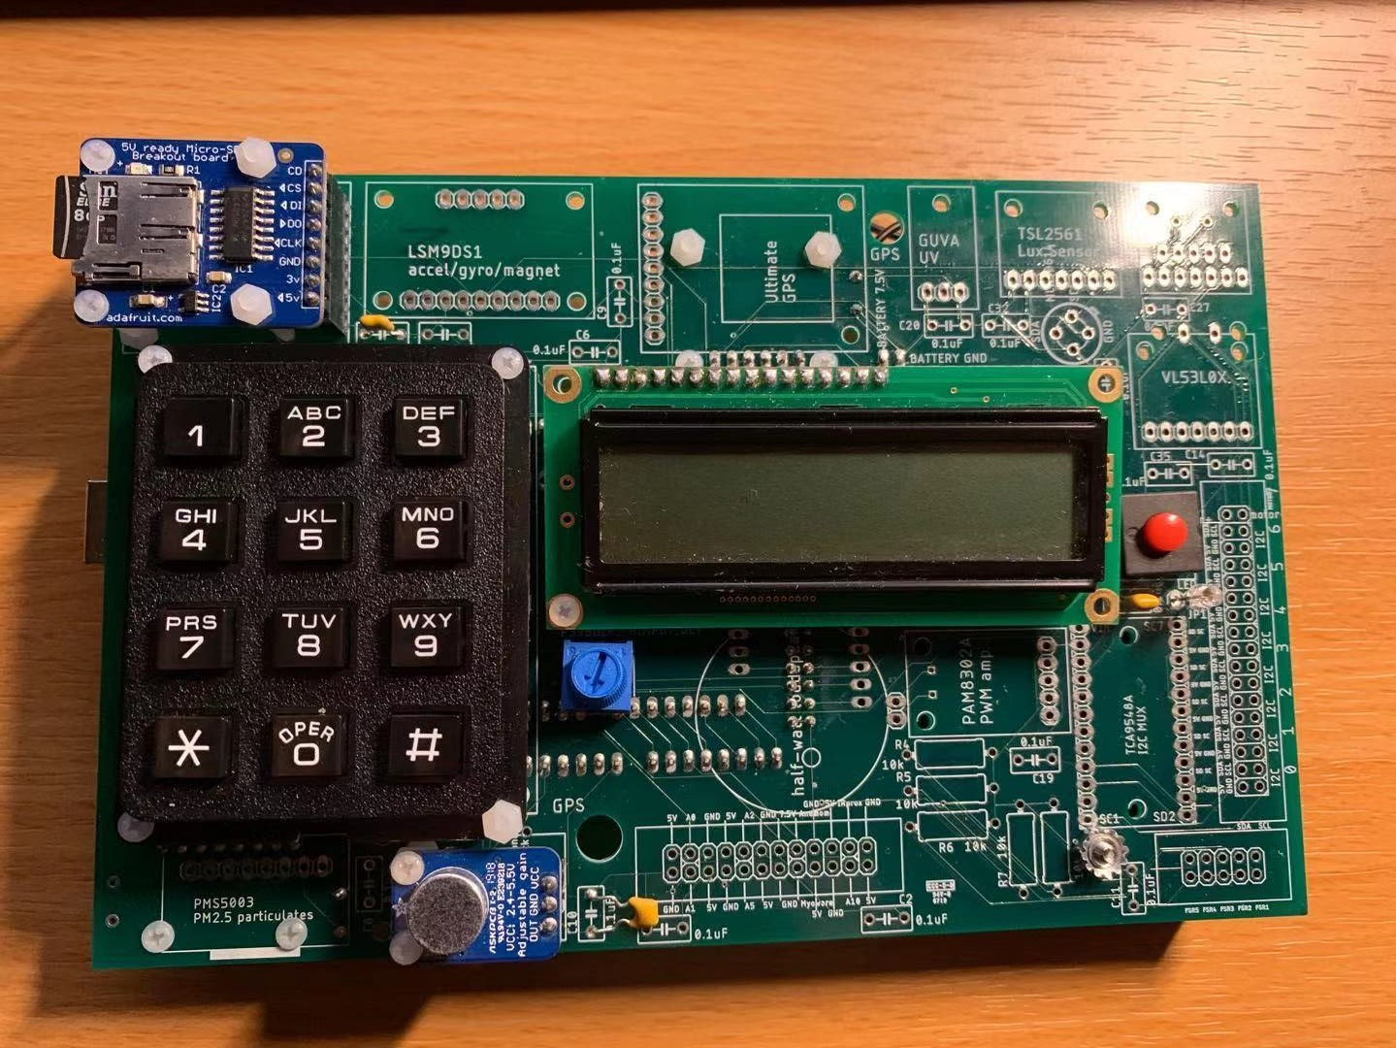
Test Devices
Keypad
LCD screen
Arduino MEGA 2560
INA219 DC Current Sensor
Microphone with MAX 4466 amplifier
SD card read

Slide 5
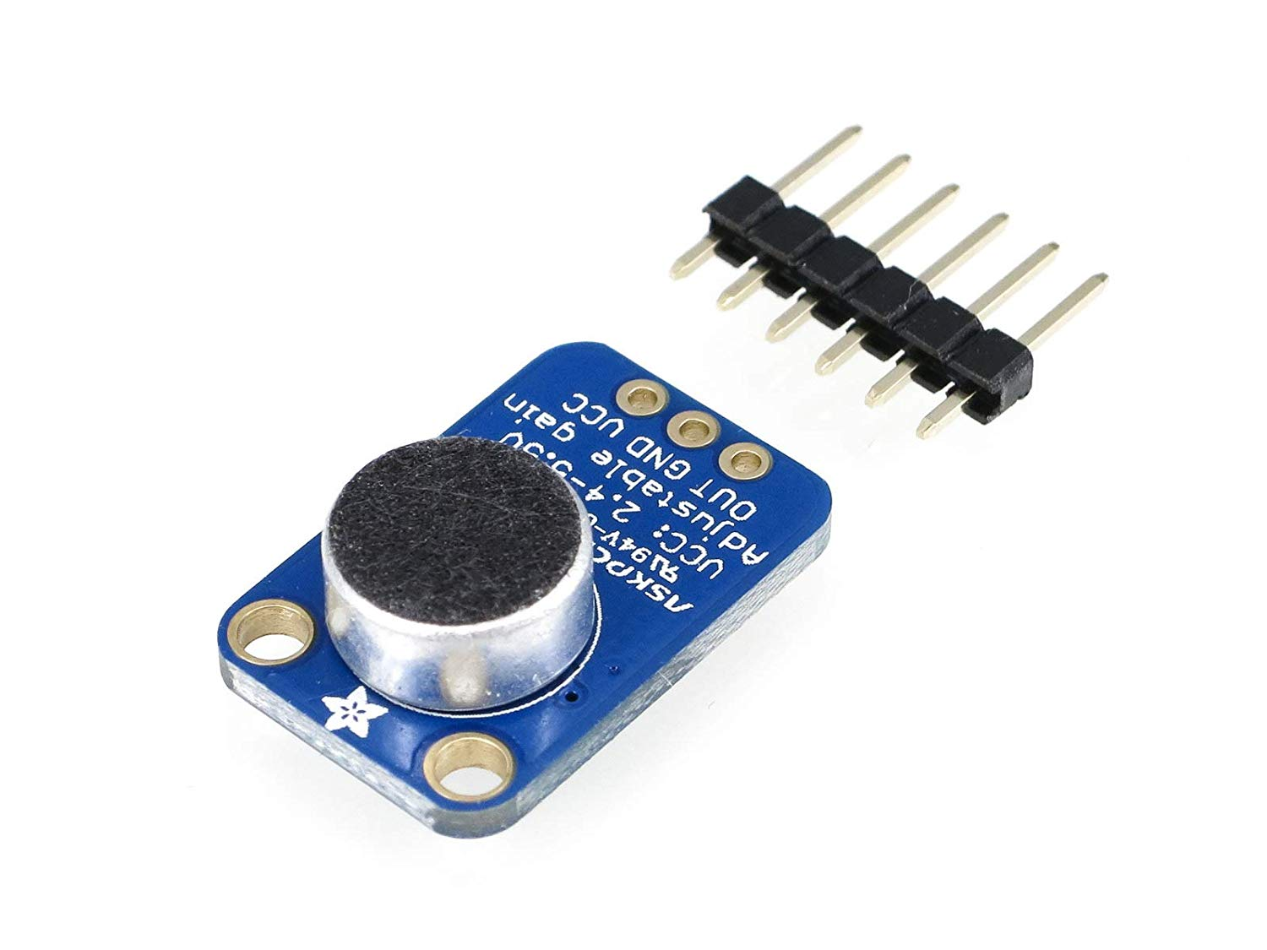
Microphone with MAX4466 Amplifier
There is a membrane in the Microphone,
and sound causes vibration. When the
membrane is pushed down, it causes
A voltage increase. The voltage difference
Is generally very small, so the amplifier
amplifies the voltage.

Slide 6
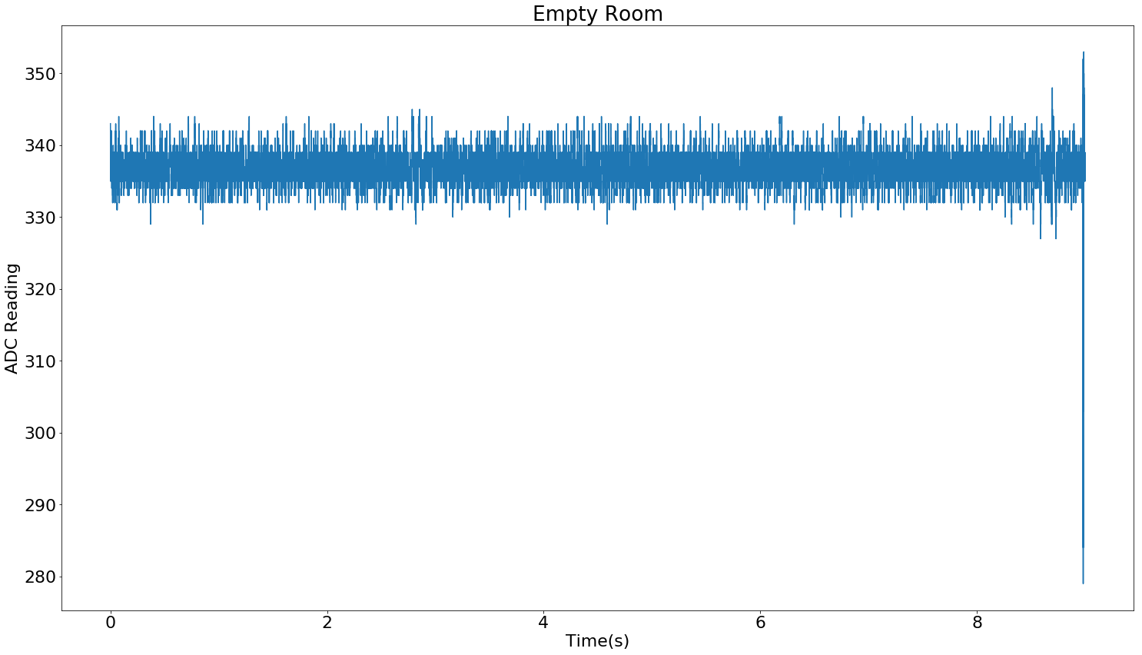
ADC readings at quiet environment
After the amplified voltage is passed to the Arduino, the Arduino changes the data to ADC readings. We uses the 5 volts standard of the ADC reading so the data will not overflow. At quiet level, the corresponding voltage is 1.65 volts, so the ADC reading of a completely quiet room is about 335.

Slide 7
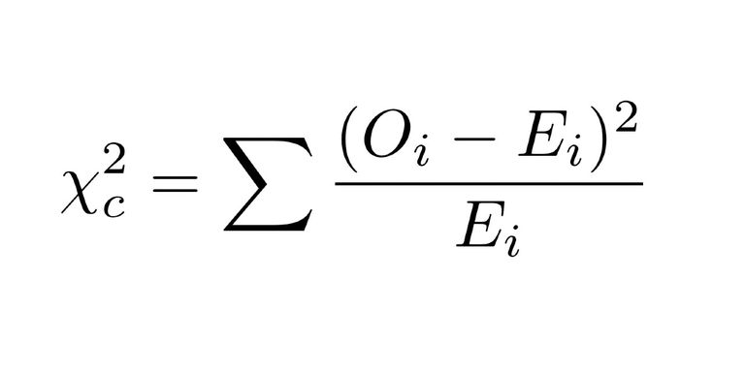
Device Calibration
To make sure the data is altered by hardwares, two devices take the same sound record. The ADC data from two devices are taken a Chi-Square test to make sure there is little differences between two results. Our result is 85 over over fifty thousand data points.

Slide 8
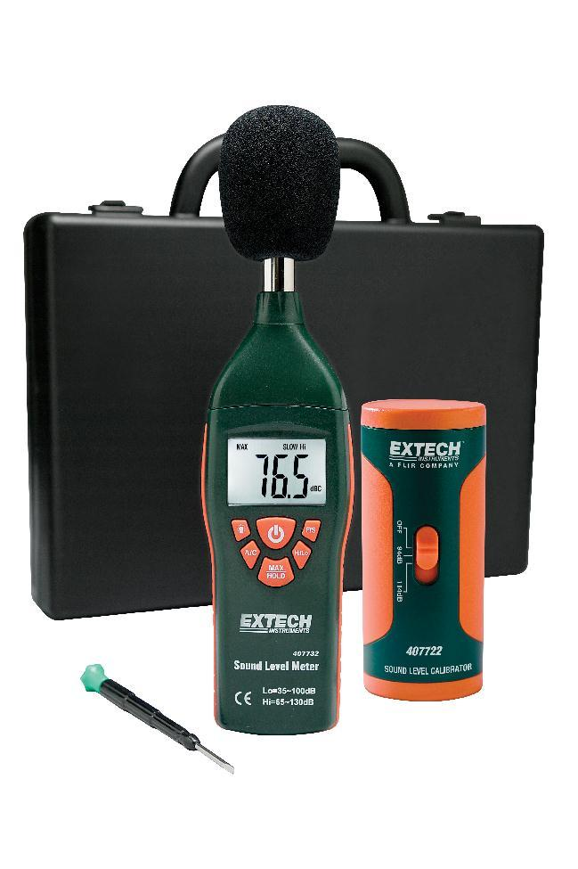
Device Calibration
To make the result accurate to the real result, we borrowed a sound meter from Krannert center and compare the results taken by our device and the sound meter.

Slide 9
Change ADC reading to sound pressure unit (dB)
We calculate the root mean square of the ADC results and use the formula below to calculate the dB. The reference here is 20 μPa.

Slide 10
Fast Fourier Transformation
We performed a fast Fourier Transformation on the ADC results. Fast Fourier transformation changes the time domain result to frequency domain result. The resulting graph after fast Fourier transformation has an independent variable of frequency and a dependent variable of energy. It shows the energy occupation of different frequencies of the sound recorded.
As the result of fast Fourier transformation contains imaginary numbers, we take the absolute value of the results and make them into graphs. The graph shows the occupation of different frequencies of a certain hand dryer sound.

Slide 11
Frequency Weighting
Octave Bands:
In order to analyze a source on frequency more efficiently, the whole range of frequency is divided into sets of frequencies called bands.
An octave band is a frequency band where the highest frequency is twice the lowest frequency.
For example, an octave filter with a centre frequency of 1kHz has a lower frequency of 707Hz and an upper frequency of 1.414kHz.

Slide 12
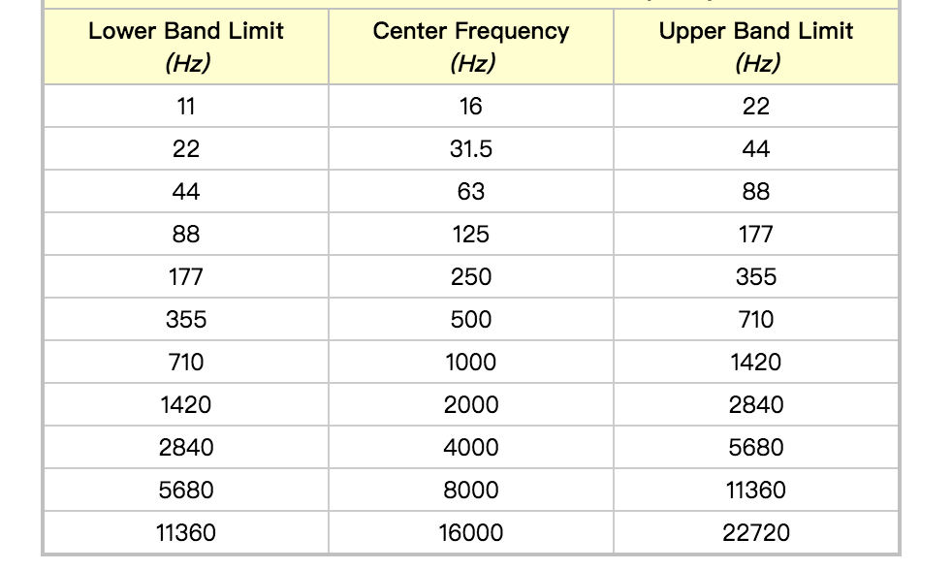
Frequency Weighting
Octave Bands:

Slide 13
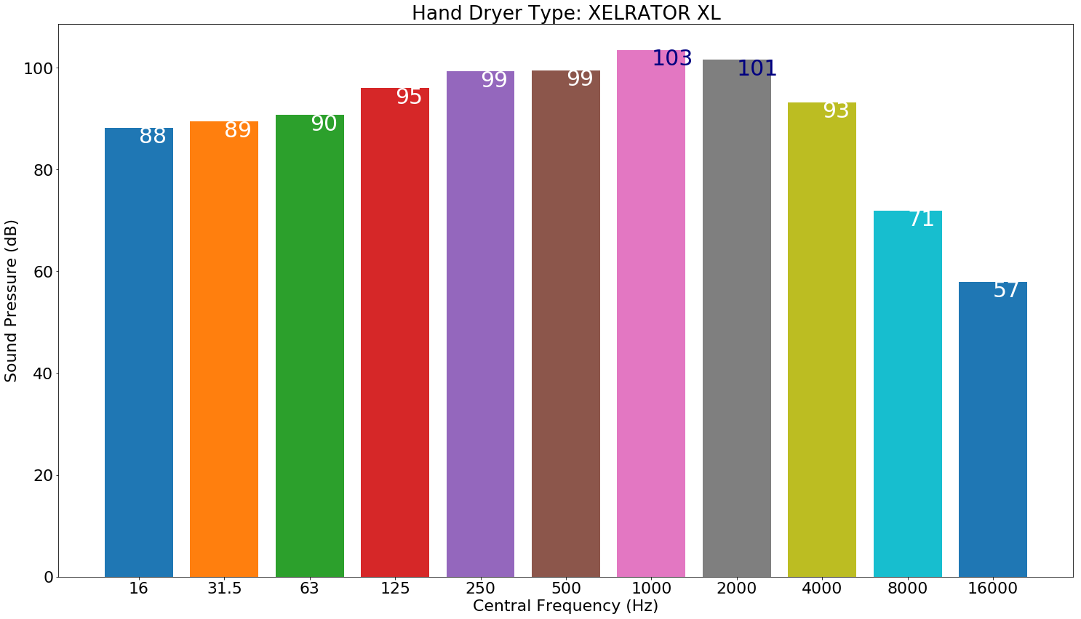
Frequency Weighting

Slide 14
Frequency Weighting
A-weighting:
To compare our data with the noise exposure limit introduced by OSHA and NIOSH, we also apply A-weighting to our FFT frequency spectrum. A-weighing is the most commonly used acoustic frequency weighting that relates to sound frequencies and human ear perception. Since human ears are more sensitive to sounds in specific frequencies, we may perceive some sound signals to be relatively louder.
It is employed by arithmetically adding a table of values, listed by octave or third-octave bands, to the measured sound pressure levels in dB.

Slide 15
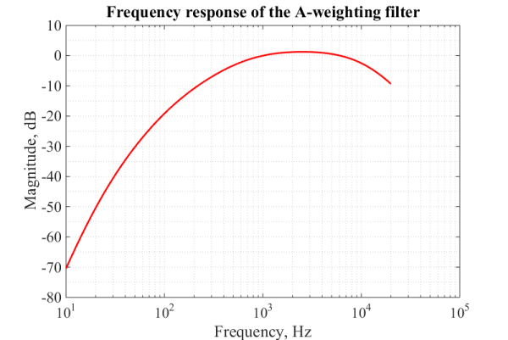
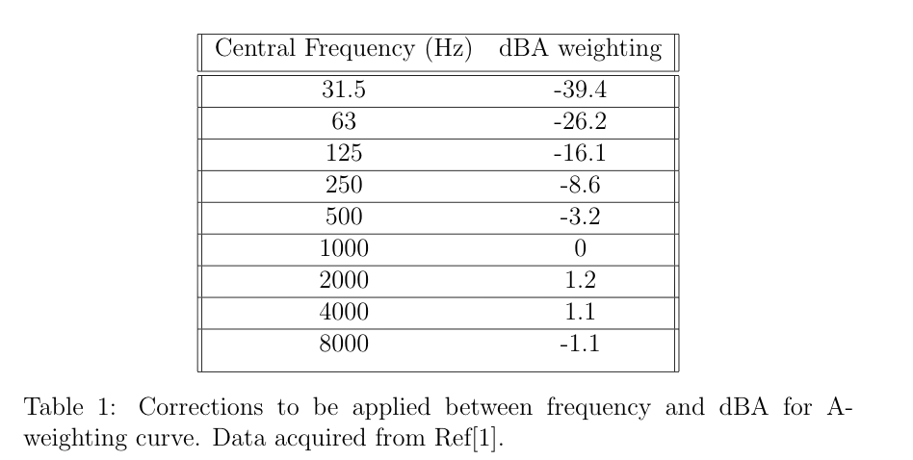
Frequency Weighting
A-weighting:

Slide 16
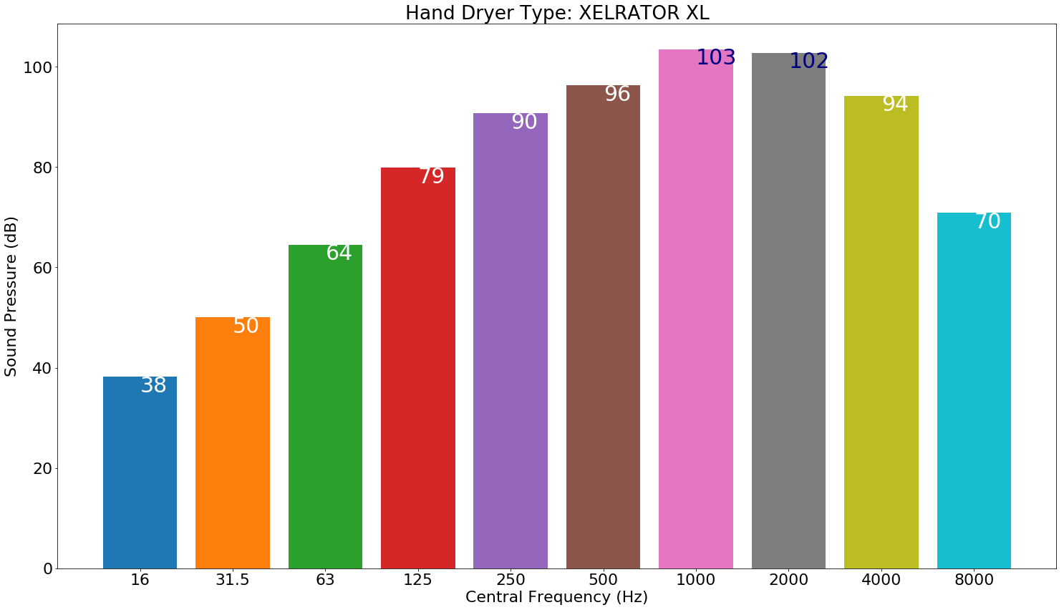
Frequency Weighting
The original dB-Octave band frequency plot is shown in the right. The A-weighting filtered plot is shown in the left.

Slide 17
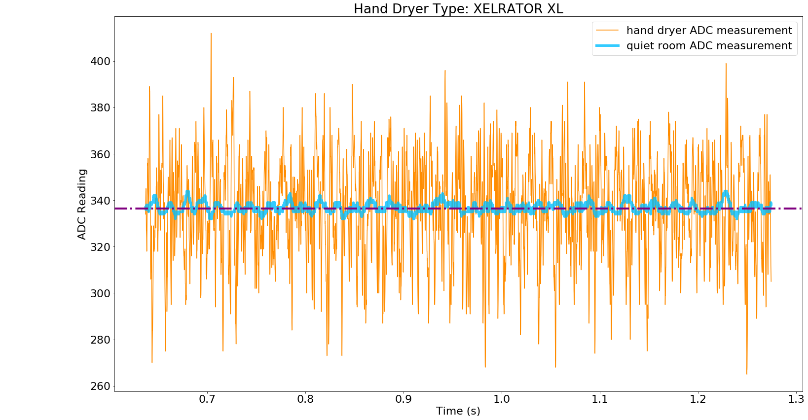
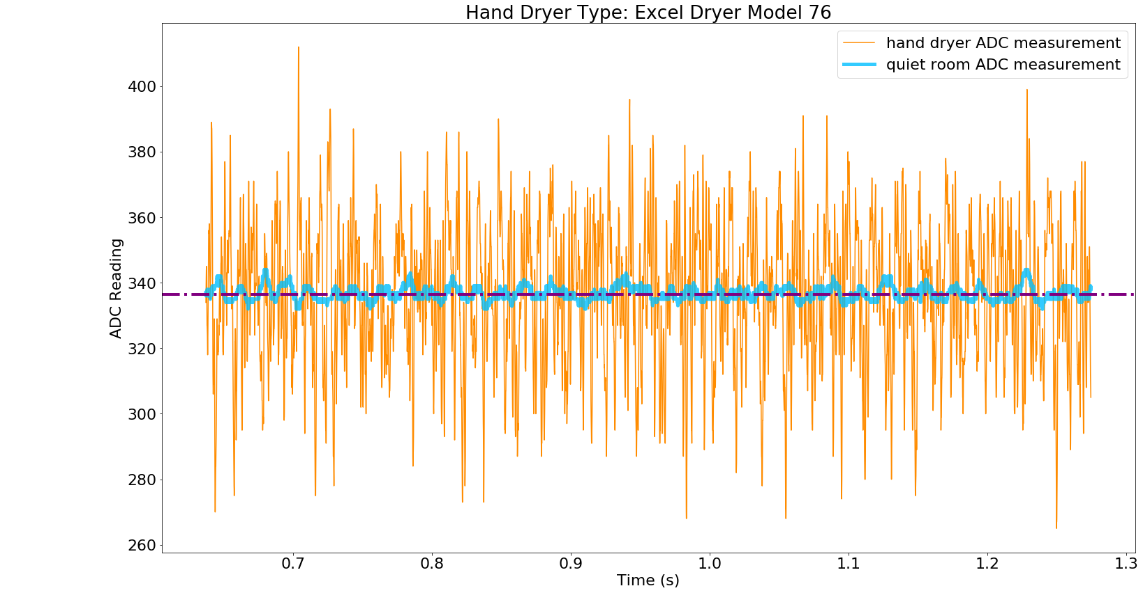
RAW ADC Reading

Slide 18
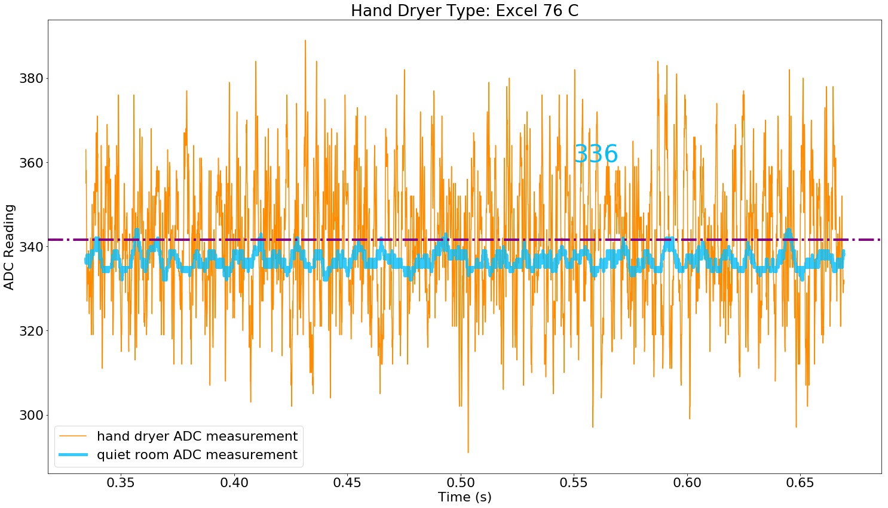
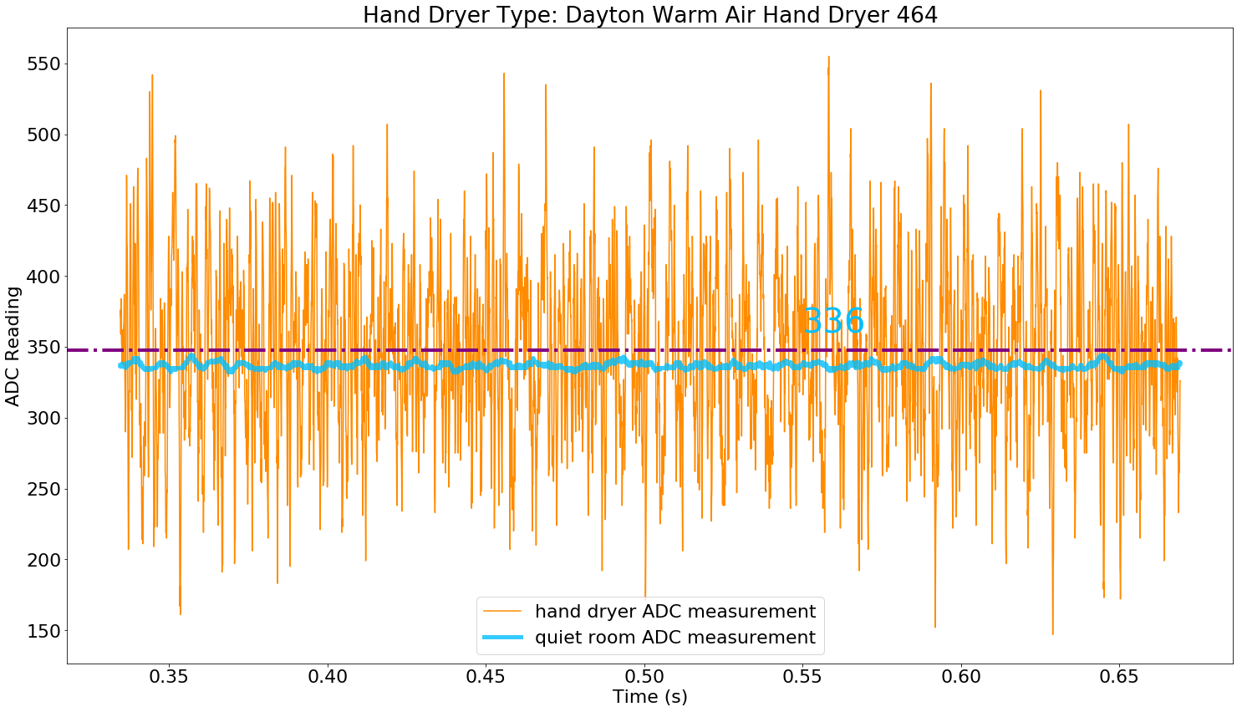
RAW ADC Reading

Slide 19
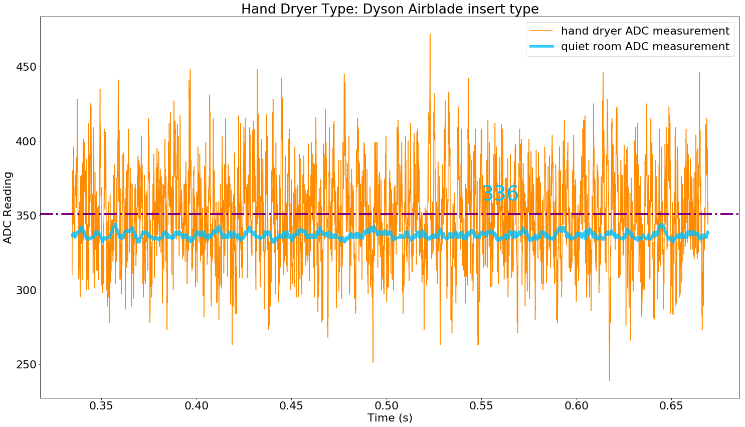
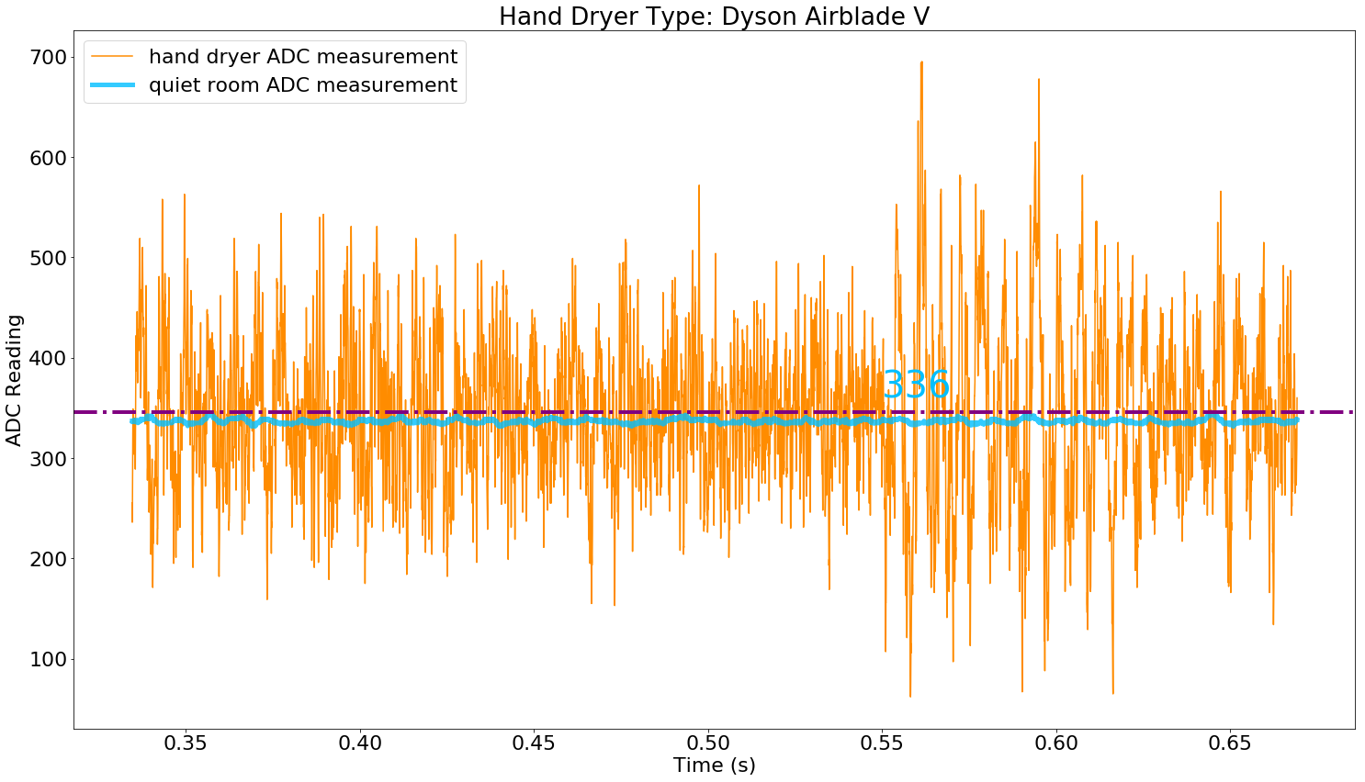
RAW ADC Reading

Slide 20
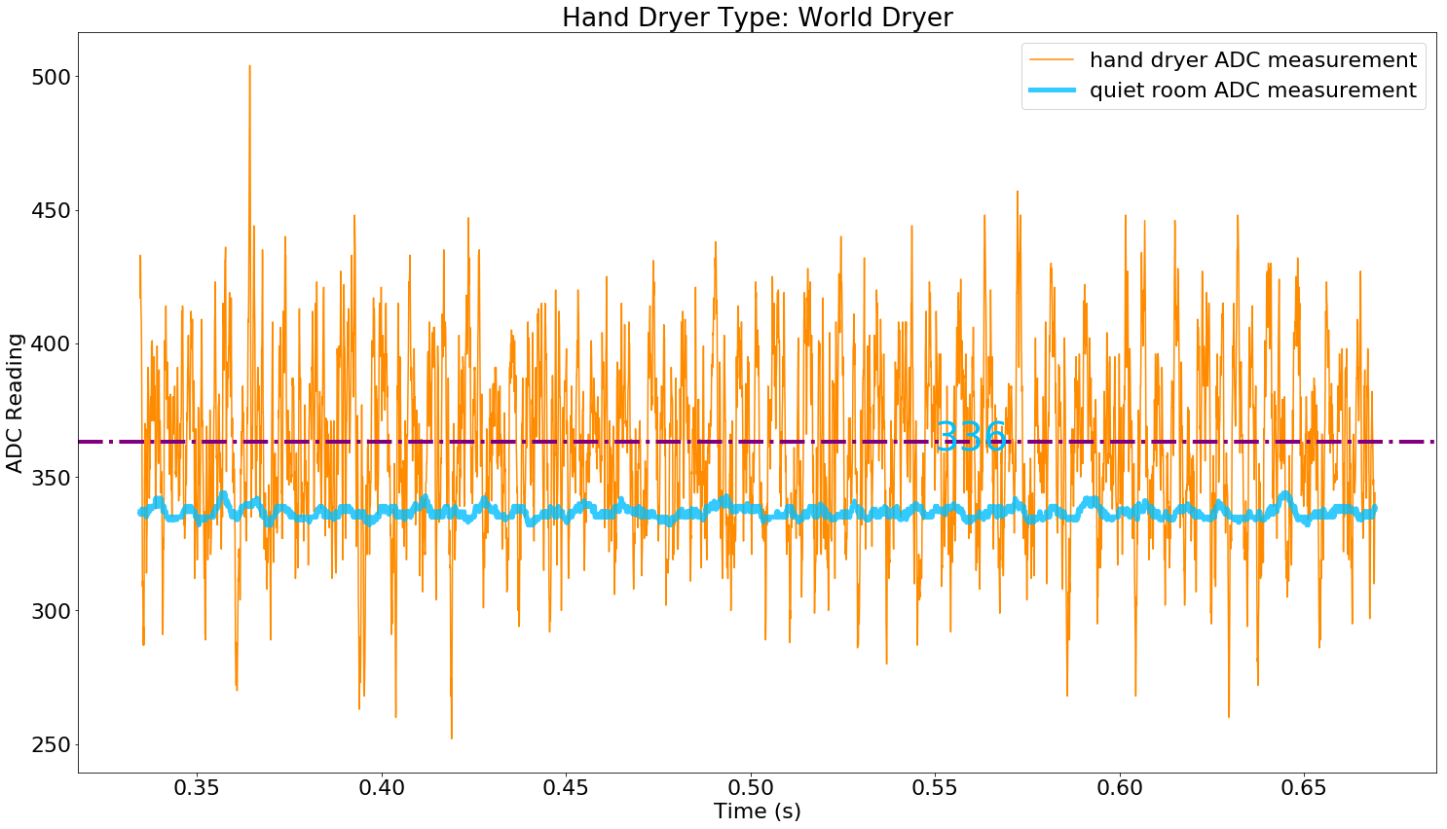
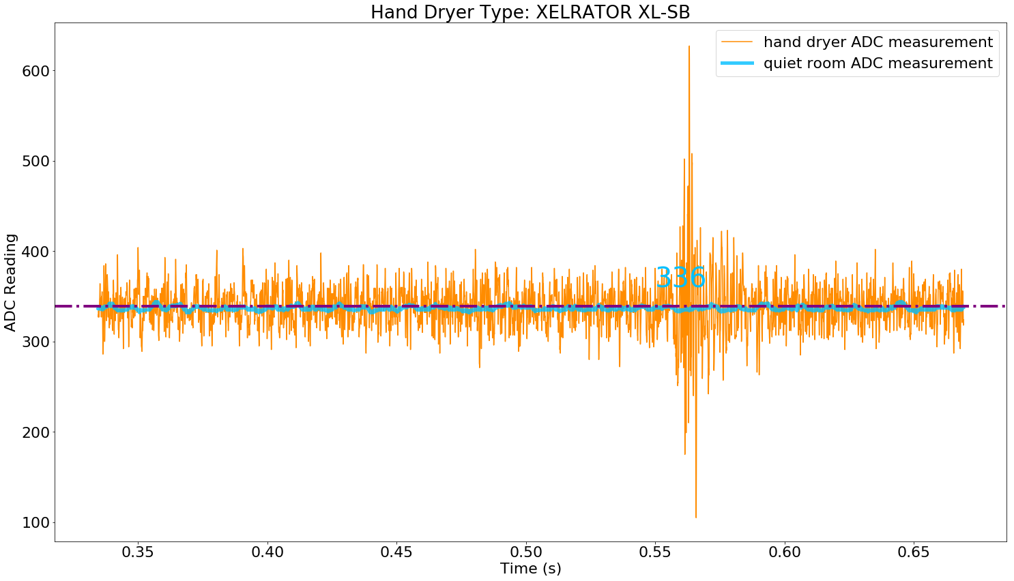
RAW ADC Reading

Slide 21
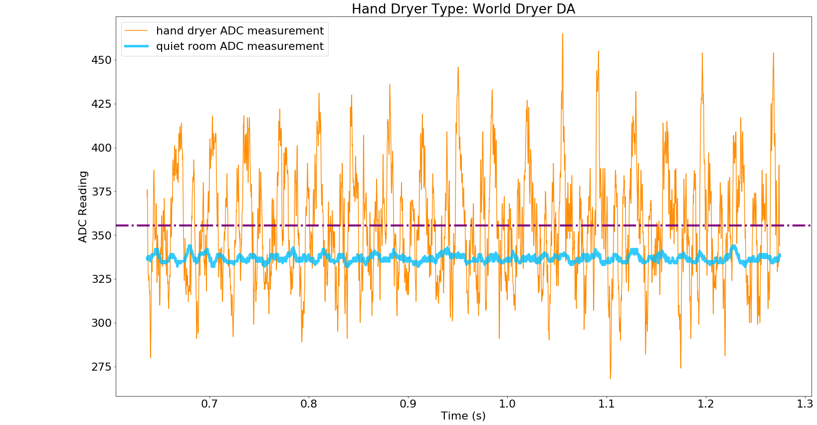
RAW ADC Reading

Slide 22
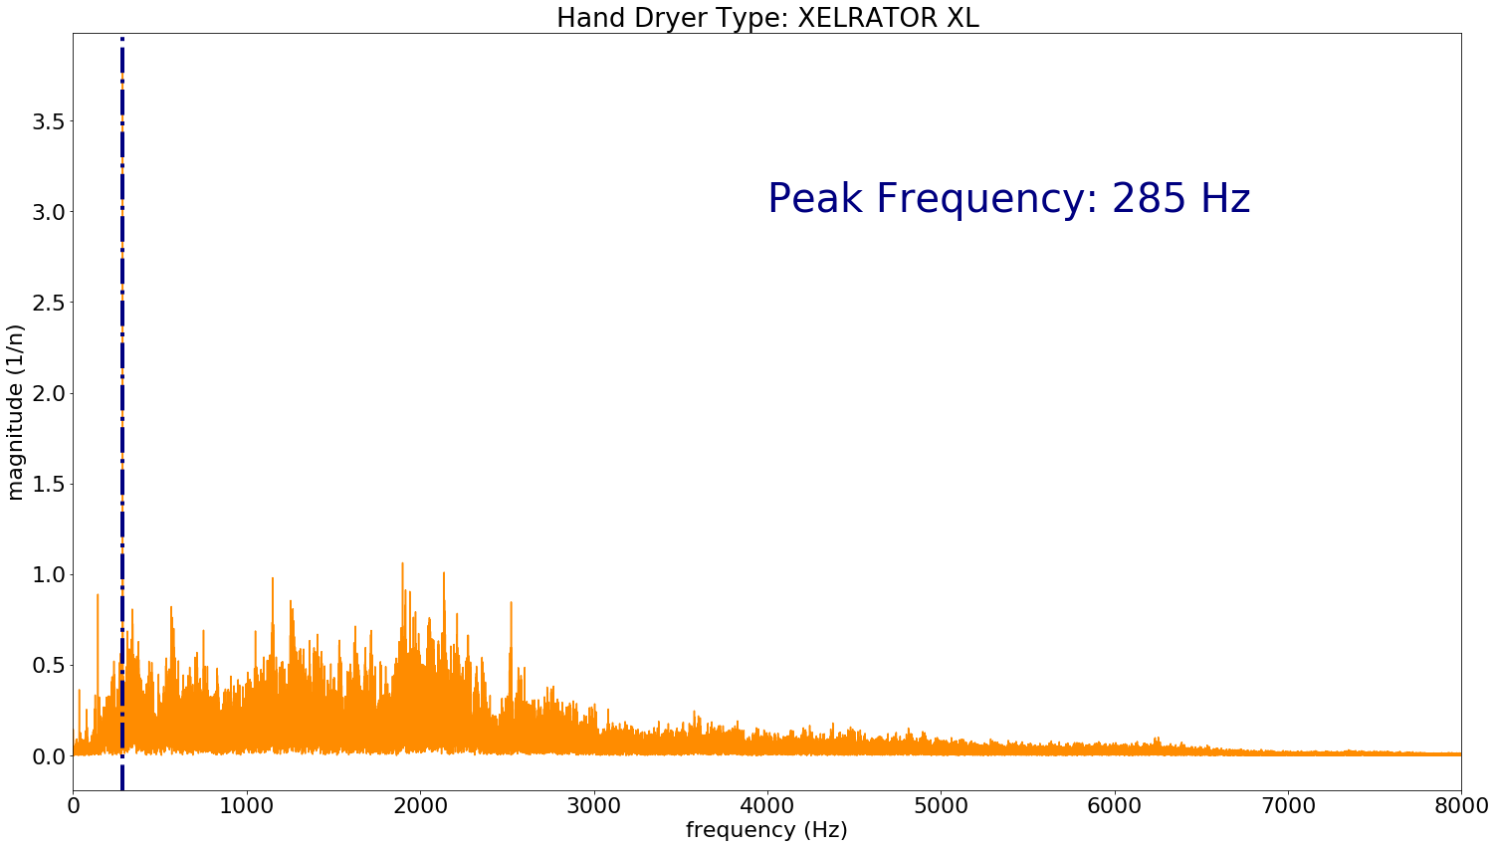
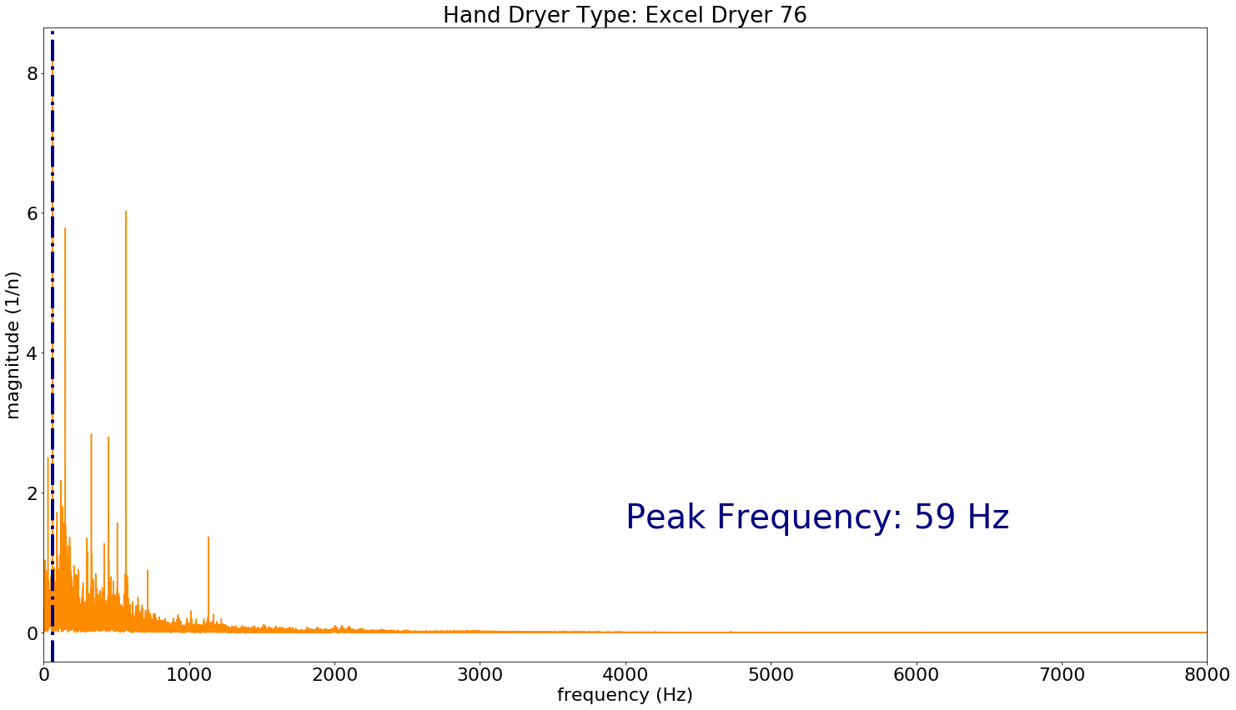
FFT Frequency Spectrum

Slide 23
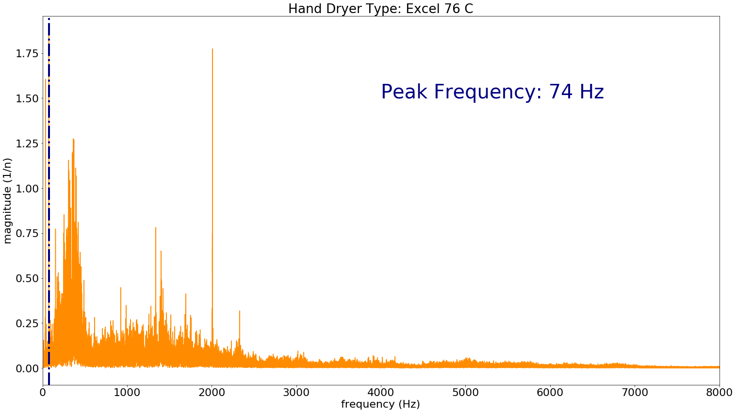
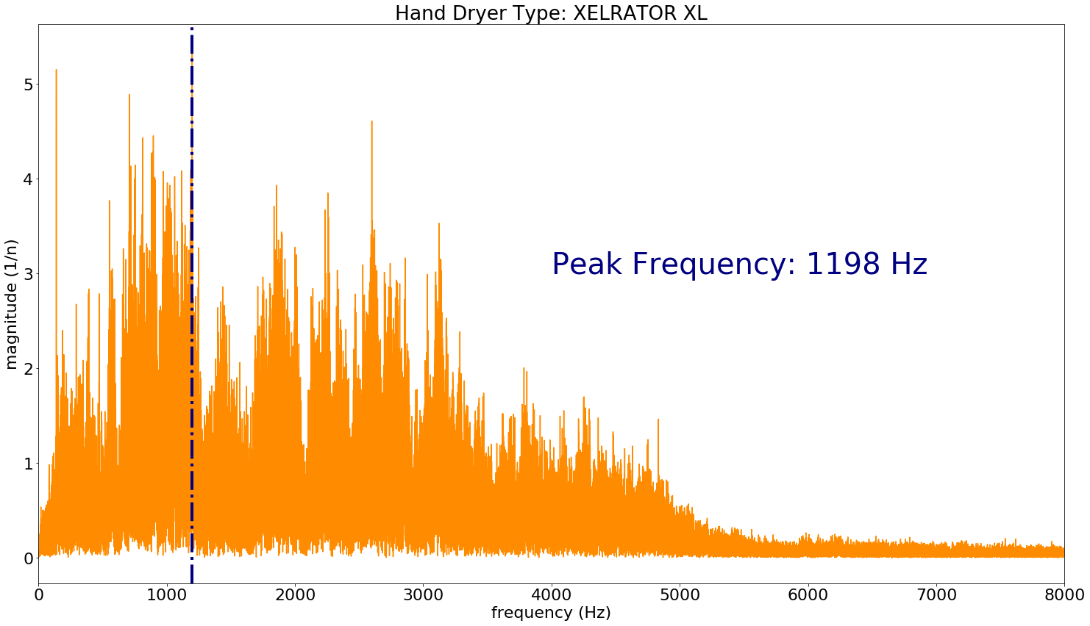
FFT Frequency Spectrum

Slide 24
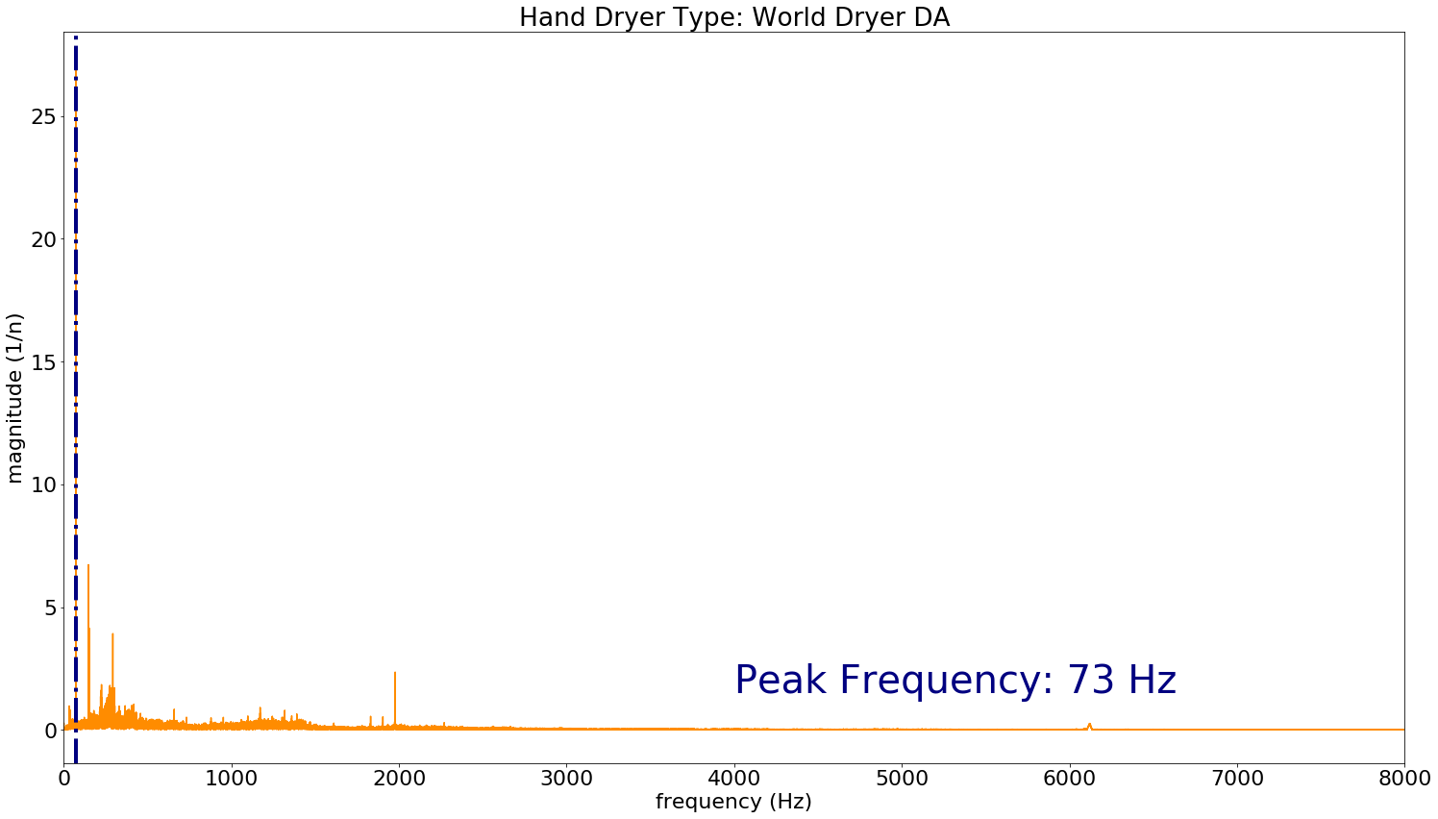
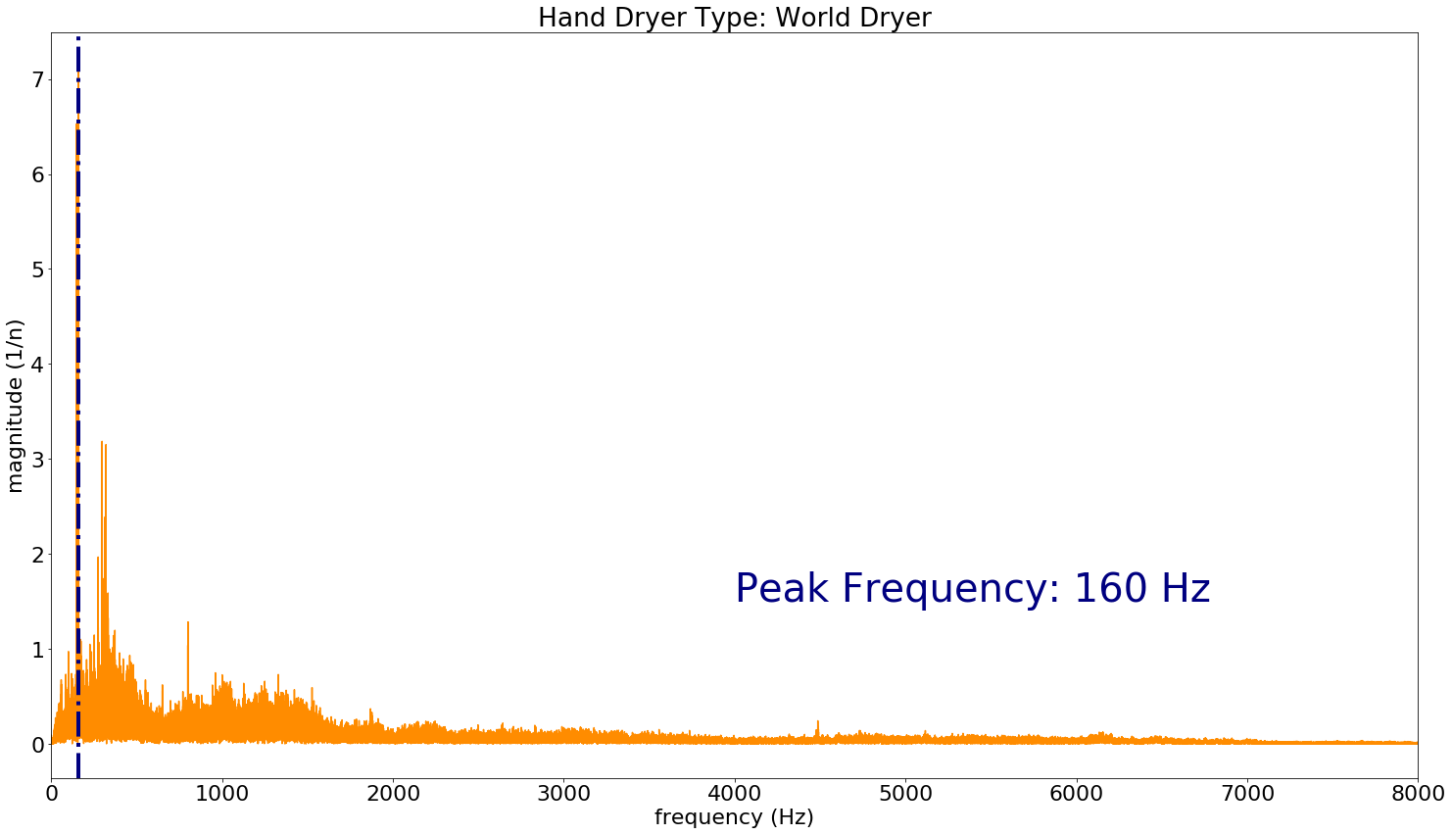
FFT Frequency Spectrum

Slide 25
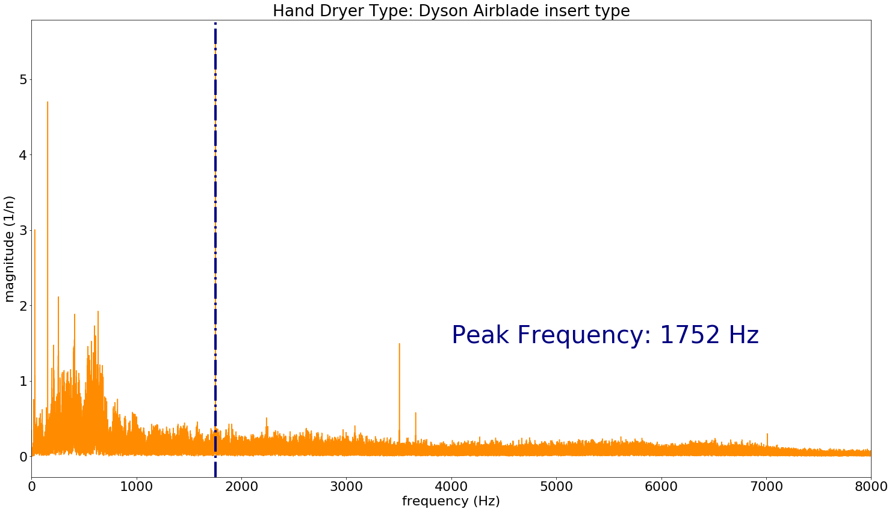
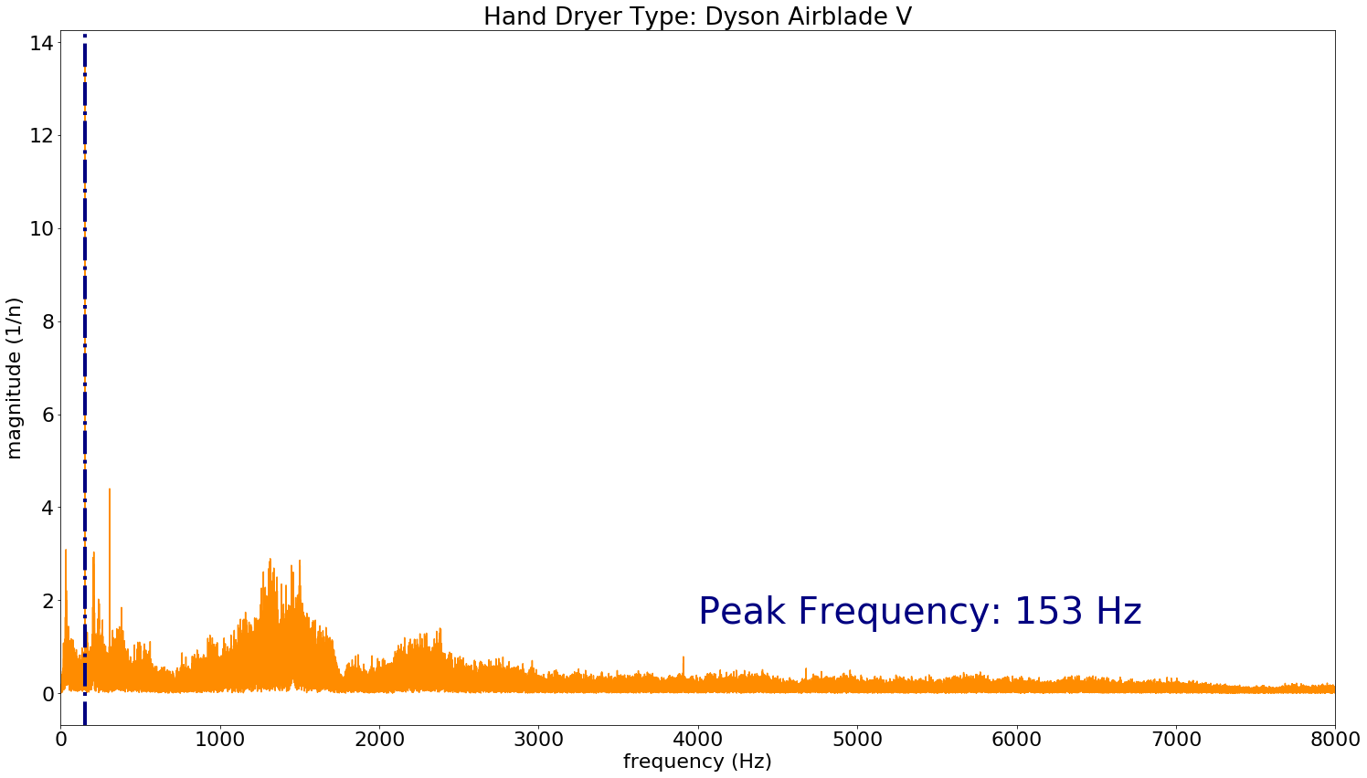
FFT Frequency Spectrum

Slide 26
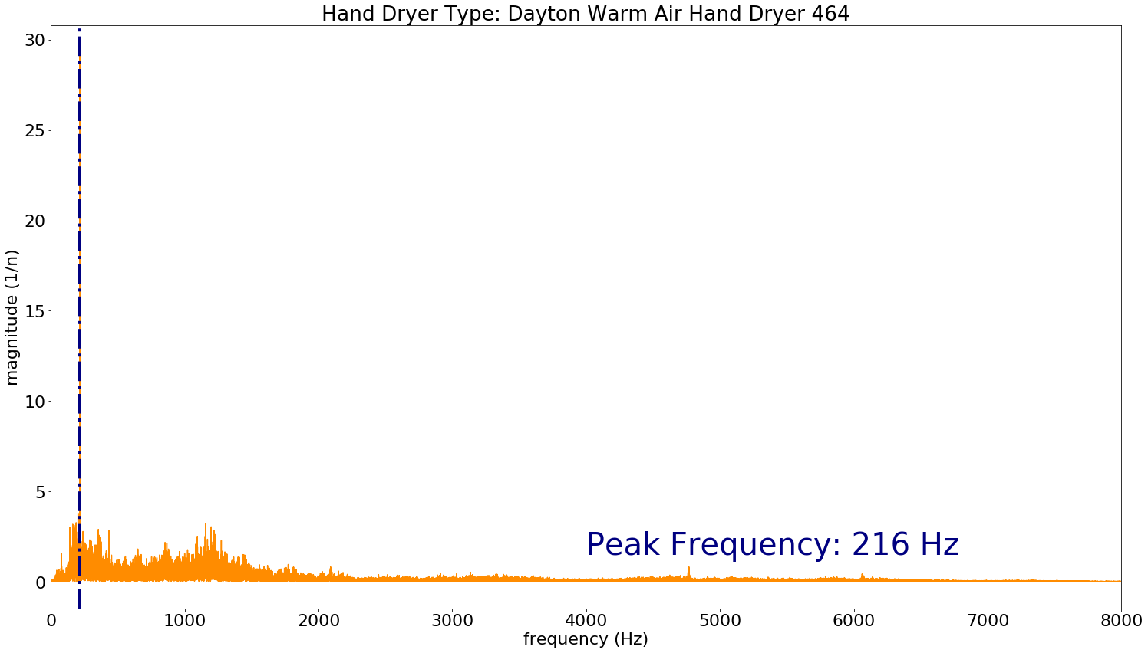
FFT Frequency Spectrum

Slide 27
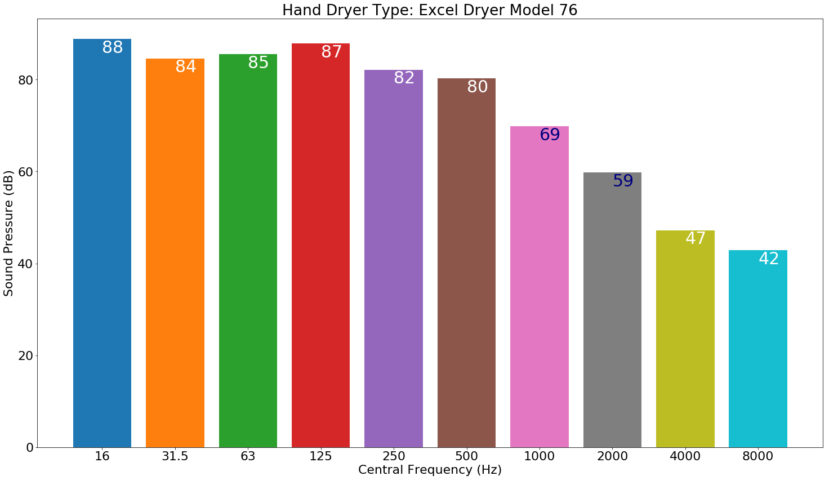
Octave Band (dB vs Frequency)

Slide 28
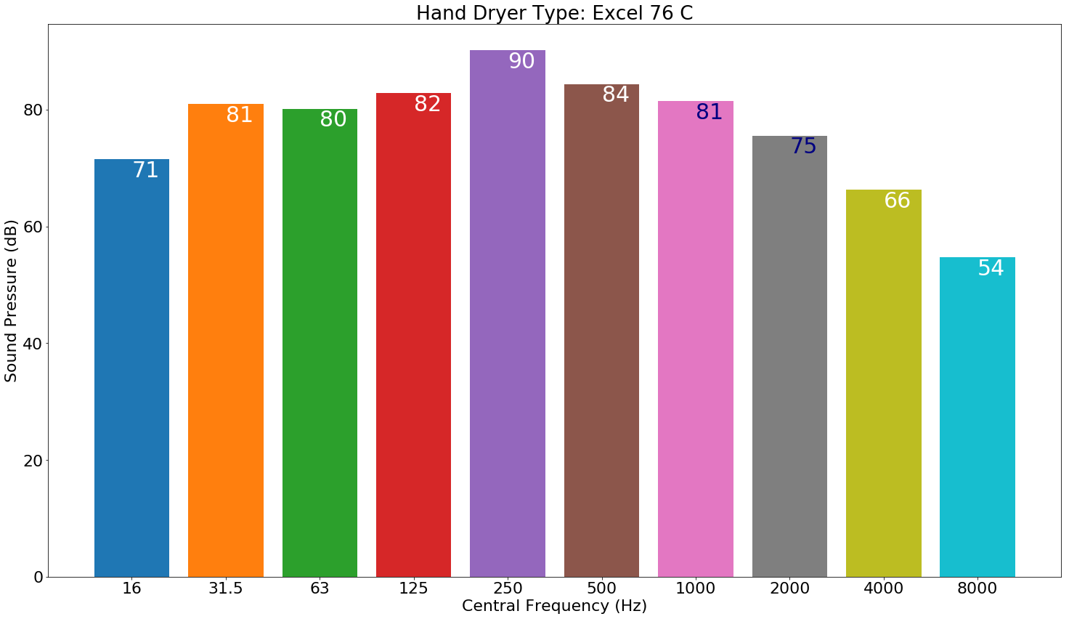
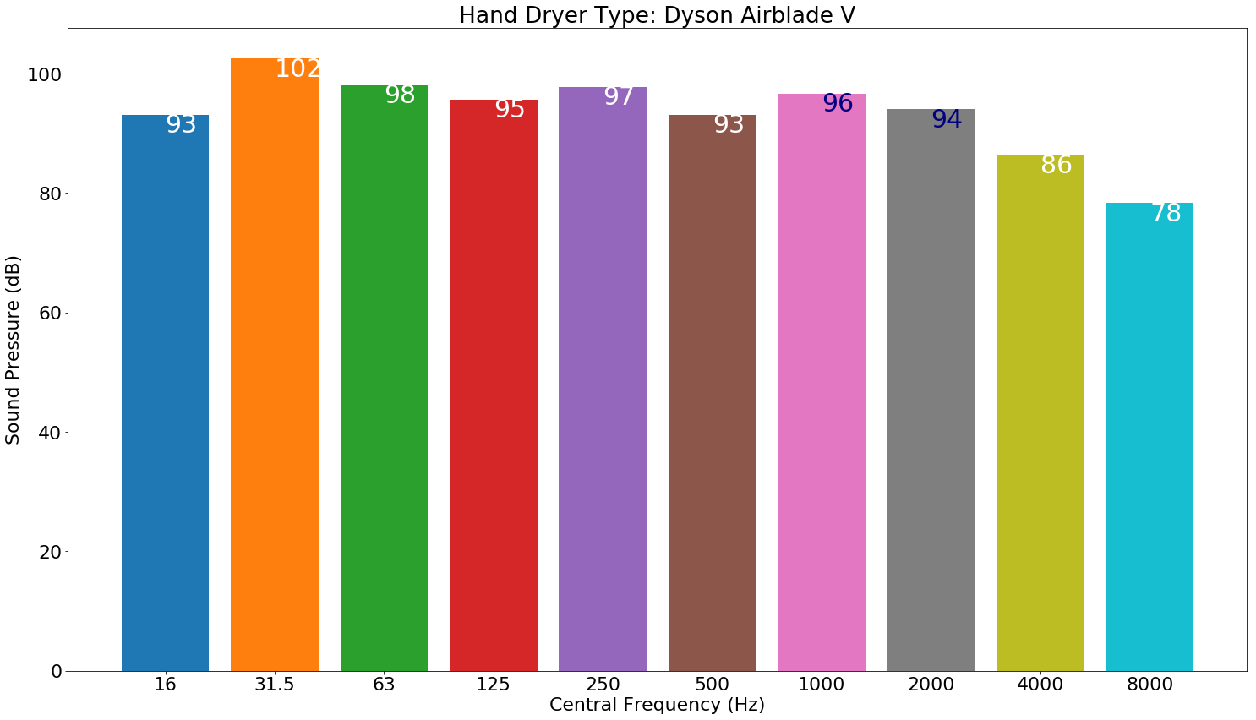
Octave Band (dB vs Frequency)

Slide 29
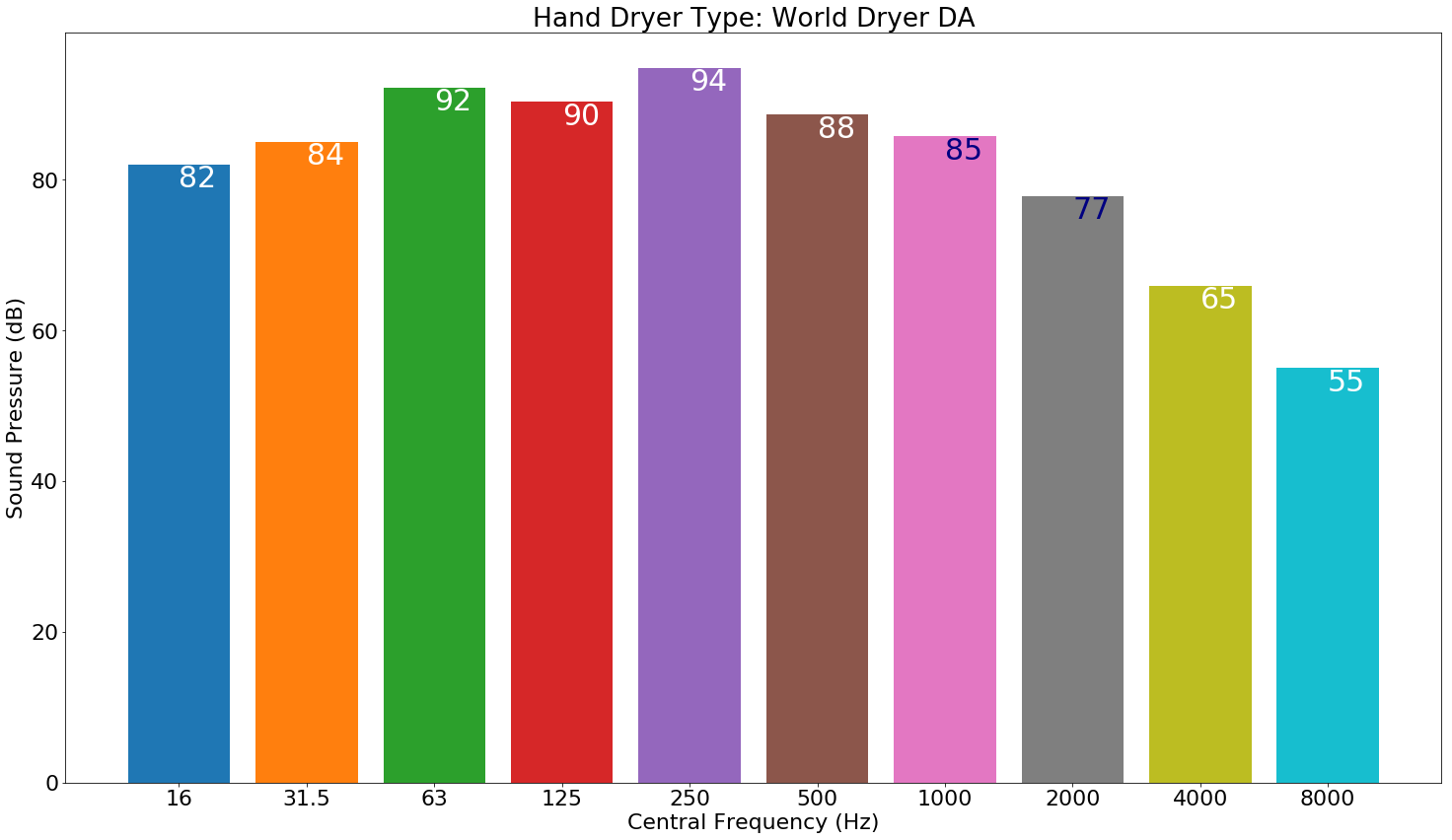
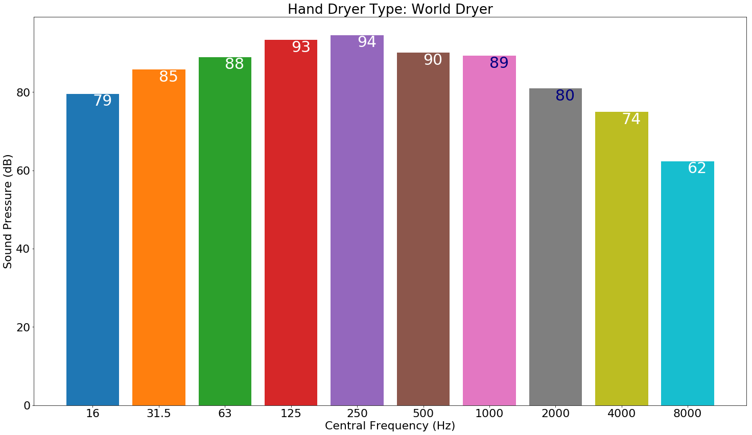
Octave Band (dB vs Frequency)

Slide 30
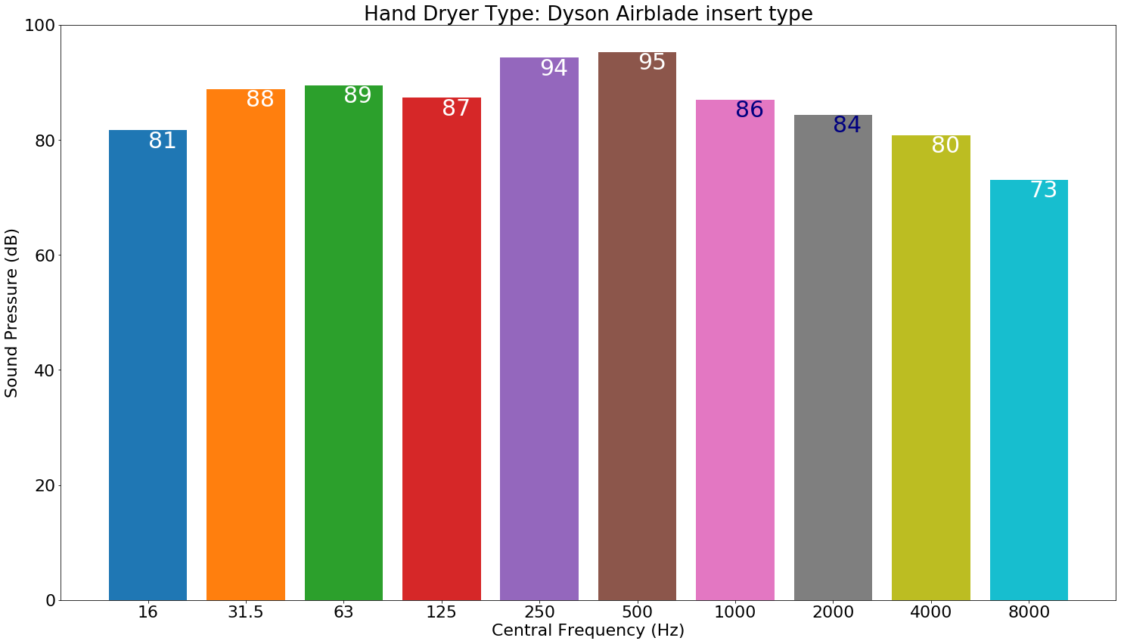
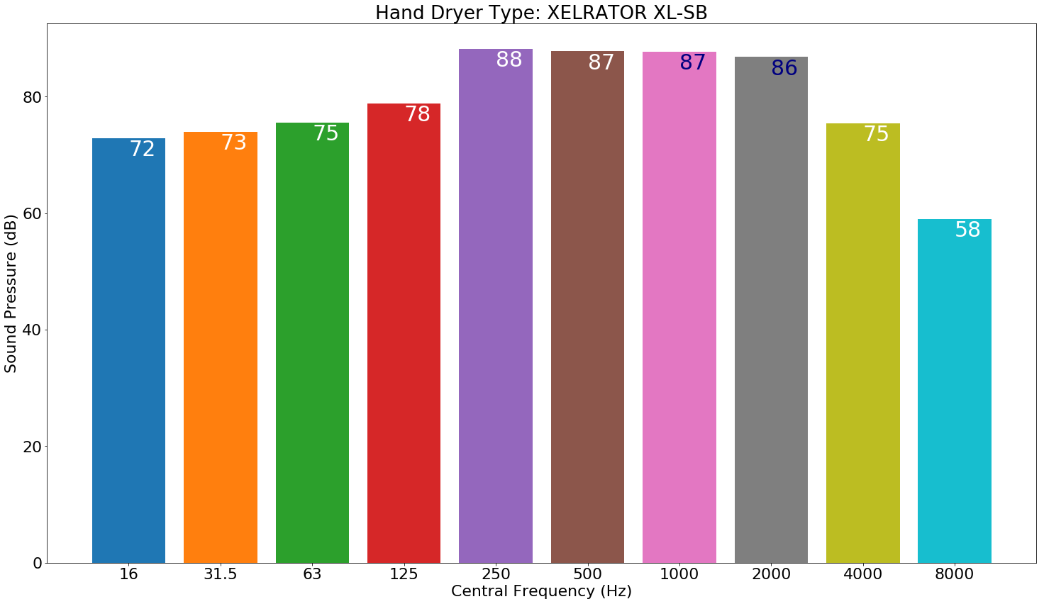
Octave Band (dB vs Frequency)

Slide 31
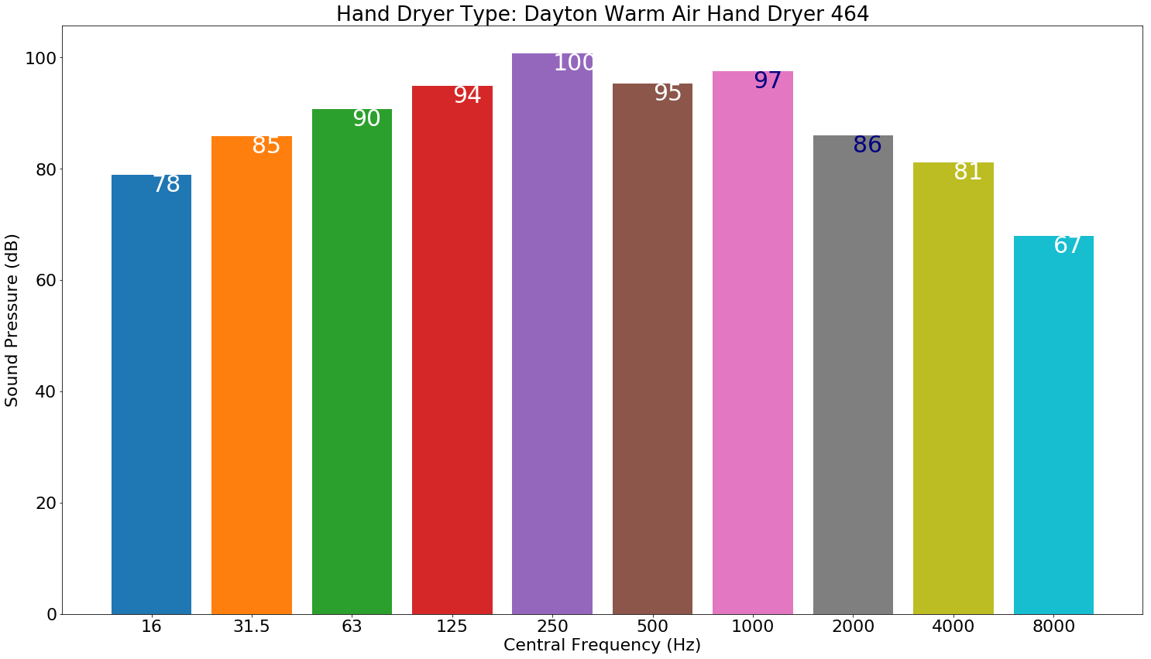
Octave Band (dB vs Frequency)

Slide 32
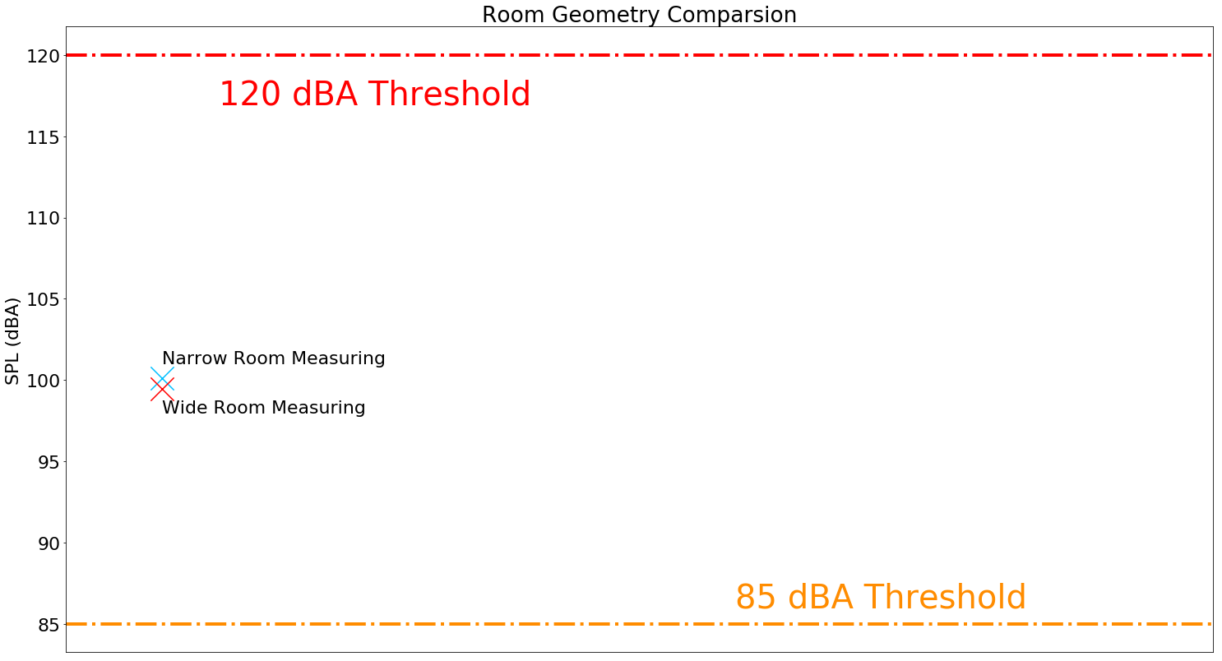
Room structure

Slide 33
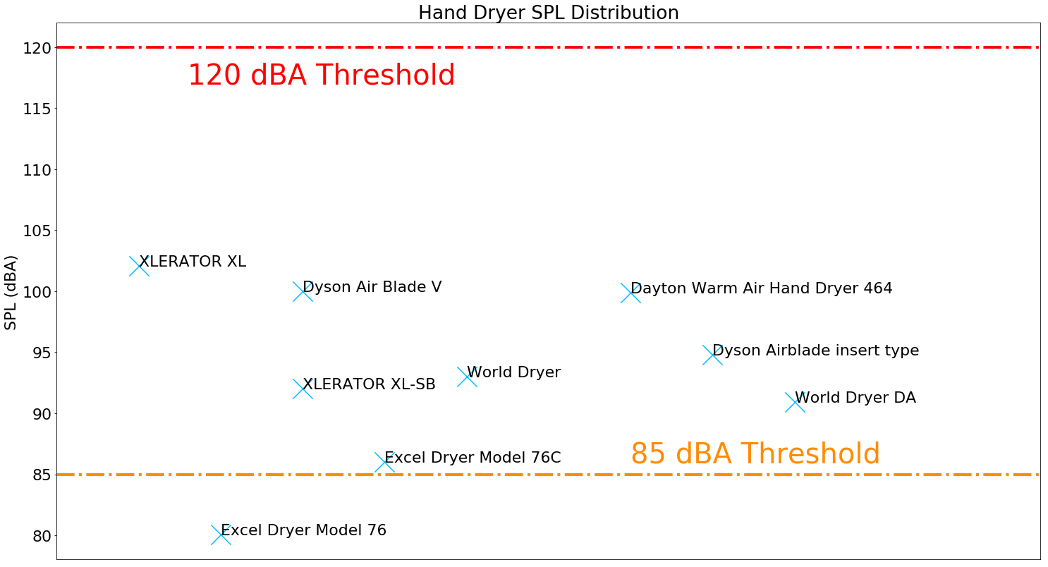
Result
Results from 9 types of different hand dryers around the campus.

Slide 34
Result
In this report, the noise levels of various models of hand dryers are measured. The measured SPL indicates that hand dryers' noise levels do not exceed the 120 dBA threshold; thus, immediate hearing damage is not likely to occur.
However, we also noticed that the closer we are to the hand dryers, the larger the SPL will be. When children are using the hand dryers, they are closer to the exhaust port than adults.

Slide 35
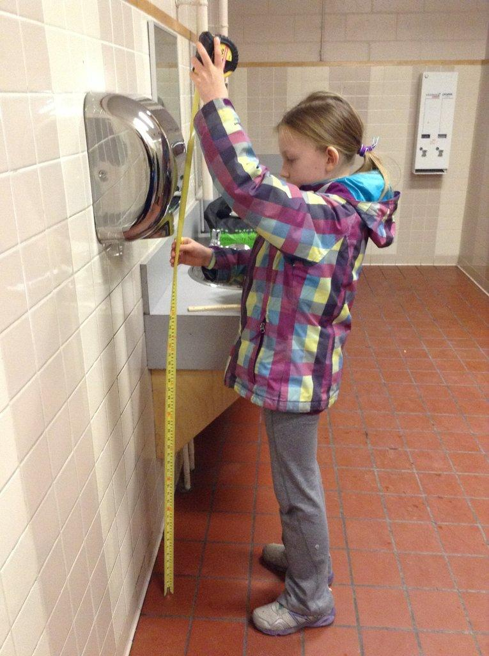
Result
However, we also noticed that the closer we are to the hand dryers, the larger the SPL will be. When children are using the hand dryers, they are closer to the exhaust port than adults.
Therefore, they may perceive a higher SPL. Children's hearing systems are also potentially more vulnerable to hearing damages compared to adults'. This finding is consistent with the result in Keegan (2013) that hand dryers could be potentially damaging to children's hearing.
Image Credit: Today.com

Slide 36
Future Works:
The device used to take the sound pressure from the hand dryers can also be used to take other sound measurements. The device can measure not only the sound pressure but also the sound frequency. We /present some further applications of this device:
Construction Zones
Firing Gun/Shooting Yard
Image Source: National Shooting Sports Foundation

Slide 37
Reference
Vishakha W.Rawool (2011) Hearing Conservation: In Occupational, Recreational, Educational, and Home Settings, Thieme.
Nora Louise Keegan, Children who say hand dryers ‘hurt my ears’ are correct: A real-world study examining the loudness of automated hand dryers in public places, Paediatrics & Child Health,, pxz046, https://doi.org/10.1093/pch/pxz046
McKinley, M. P., OLoughlin, V. D., & Bidle, T. S. (2019). Anatomy & physiology: an integrative approach. New York, NY: McGraw Hill Education.
Rothschild, M. A., Dieker, L., Prante, H., & Maschke, C. (1998). Schalldruckspitzenpegel von Schüssen aus Schreckschußwaffen. Hno, 46(12), 986–992. doi: 10.1007/s001060050346

