Slide 1
Latency of Cell Phone Communication
Presented by: Zhuozhen Cai, Chongwen Lu, Shunyue Yuan
Department of Physics University of Illinois at Urbana-Champaign
PHYS 398DLP, December 4, 2020

Slide 2
Network Latency
Definition
Network latency is defined as the time it takes for a source to send a packet of data to a receiver.
Possible Factors Contribute to Network Latency
Network speed.
Sheer size of the transmitted data packet.
Distance between the caller and answerer.
What We Measured in Our Project
Latency under different types of networks.
Stability of latency.

Slide 3
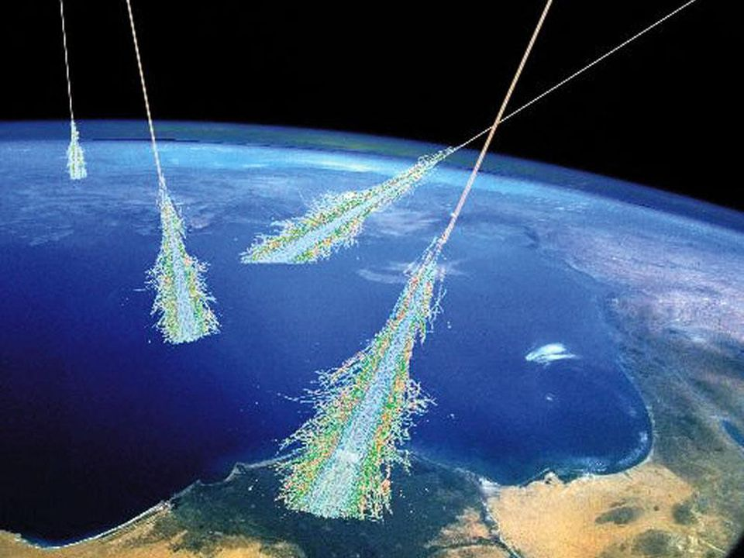
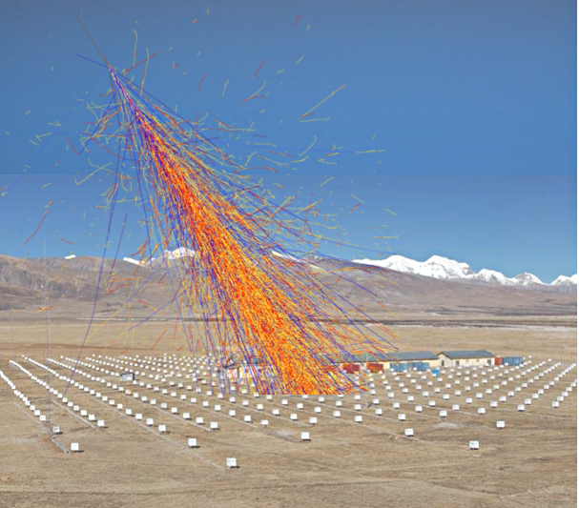
Motivation and Application
Cosmic rays shower particles by striking protons and atoms in the atmosphere.
Air Shower (Cosmic Ray Particle Shower)
Cascades initiated by cosmic rays interacting in the atmosphere.
Can be extensive.
Air Shower Array
Array of particle detectors (count the number of charged particles).
Alert sensors will tell other sensors to work when an air shower arrives.
Central computer of the array will collect the data from sensors periodically (typically every 30 sec).
Detectors are connected to a central computer via a network consists of cables.
Application of Our Project
Feasibility of employing cell phone networks in air shower arrays.
Image credit: Simon Swordy (U. Chicago), NASA.
Tibet AS𝛾 Collaboration Sensor Array
Image credit: Rene A. Ong (UCLA).

Slide 4
Measurements we made
Latency of Different Types of Network
4G VoLTE On
4G VoLTE Off
3G
Long Term Stability
One measurement every 10 minutes.
Total length of 8 hours.
Short Term Latency
One “measurement” every 5 seconds.
Total length of two minutes.

Slide 5
How did we measure the latency
Instrumental layout of latency measurement process. Image credit: C. Lu
The caller and answerer start a phone call.
Both caller and answerer start running data acquisition program (DAQ) on their devices. The DAQ will record time and start audio recording.
The caller plays audio via speaker.
After the audio ends, both caller and answerer will stop the DAQ from recording.
The latency is the delay the receiver received the sound compare with the sender.

Slide 6
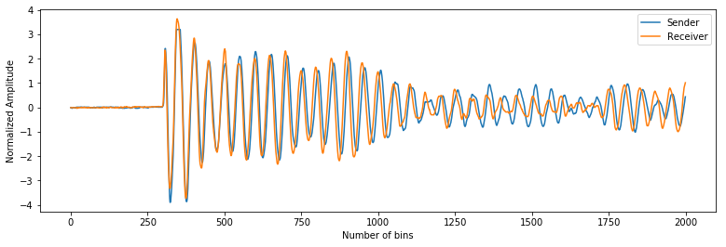
How did we measure the latency
Compare the Time Difference Between Recordings
Envelopes of sender and receiver’s recording.
Two envelopes match well after shifting receiver envelope along x-axis.
Choice of Sound - Chirp
Frequency increases or decreases with time.
Distinguishable peaks.
800-900 Hz

Slide 7
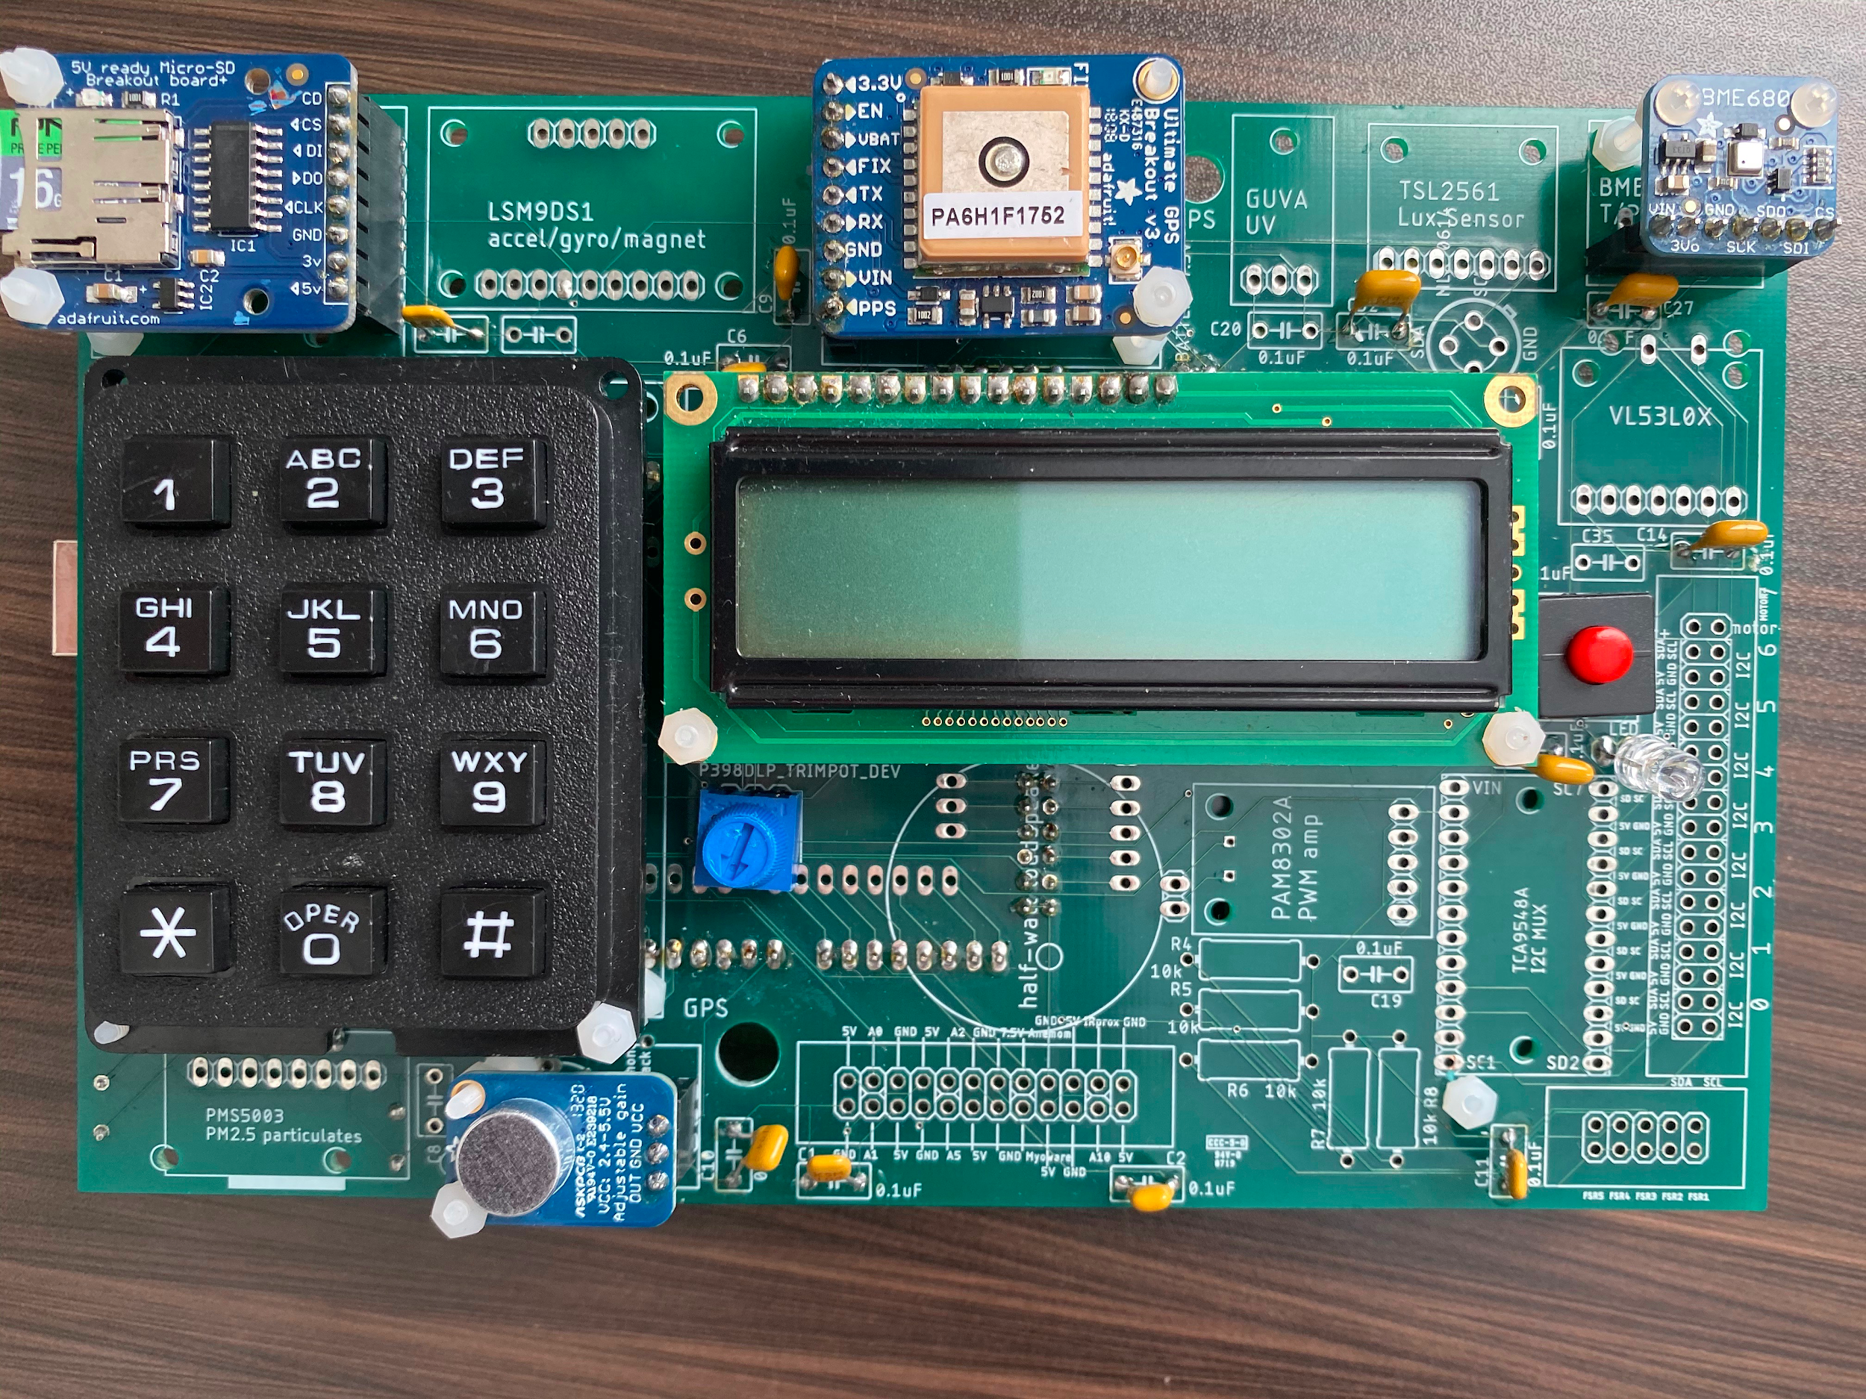
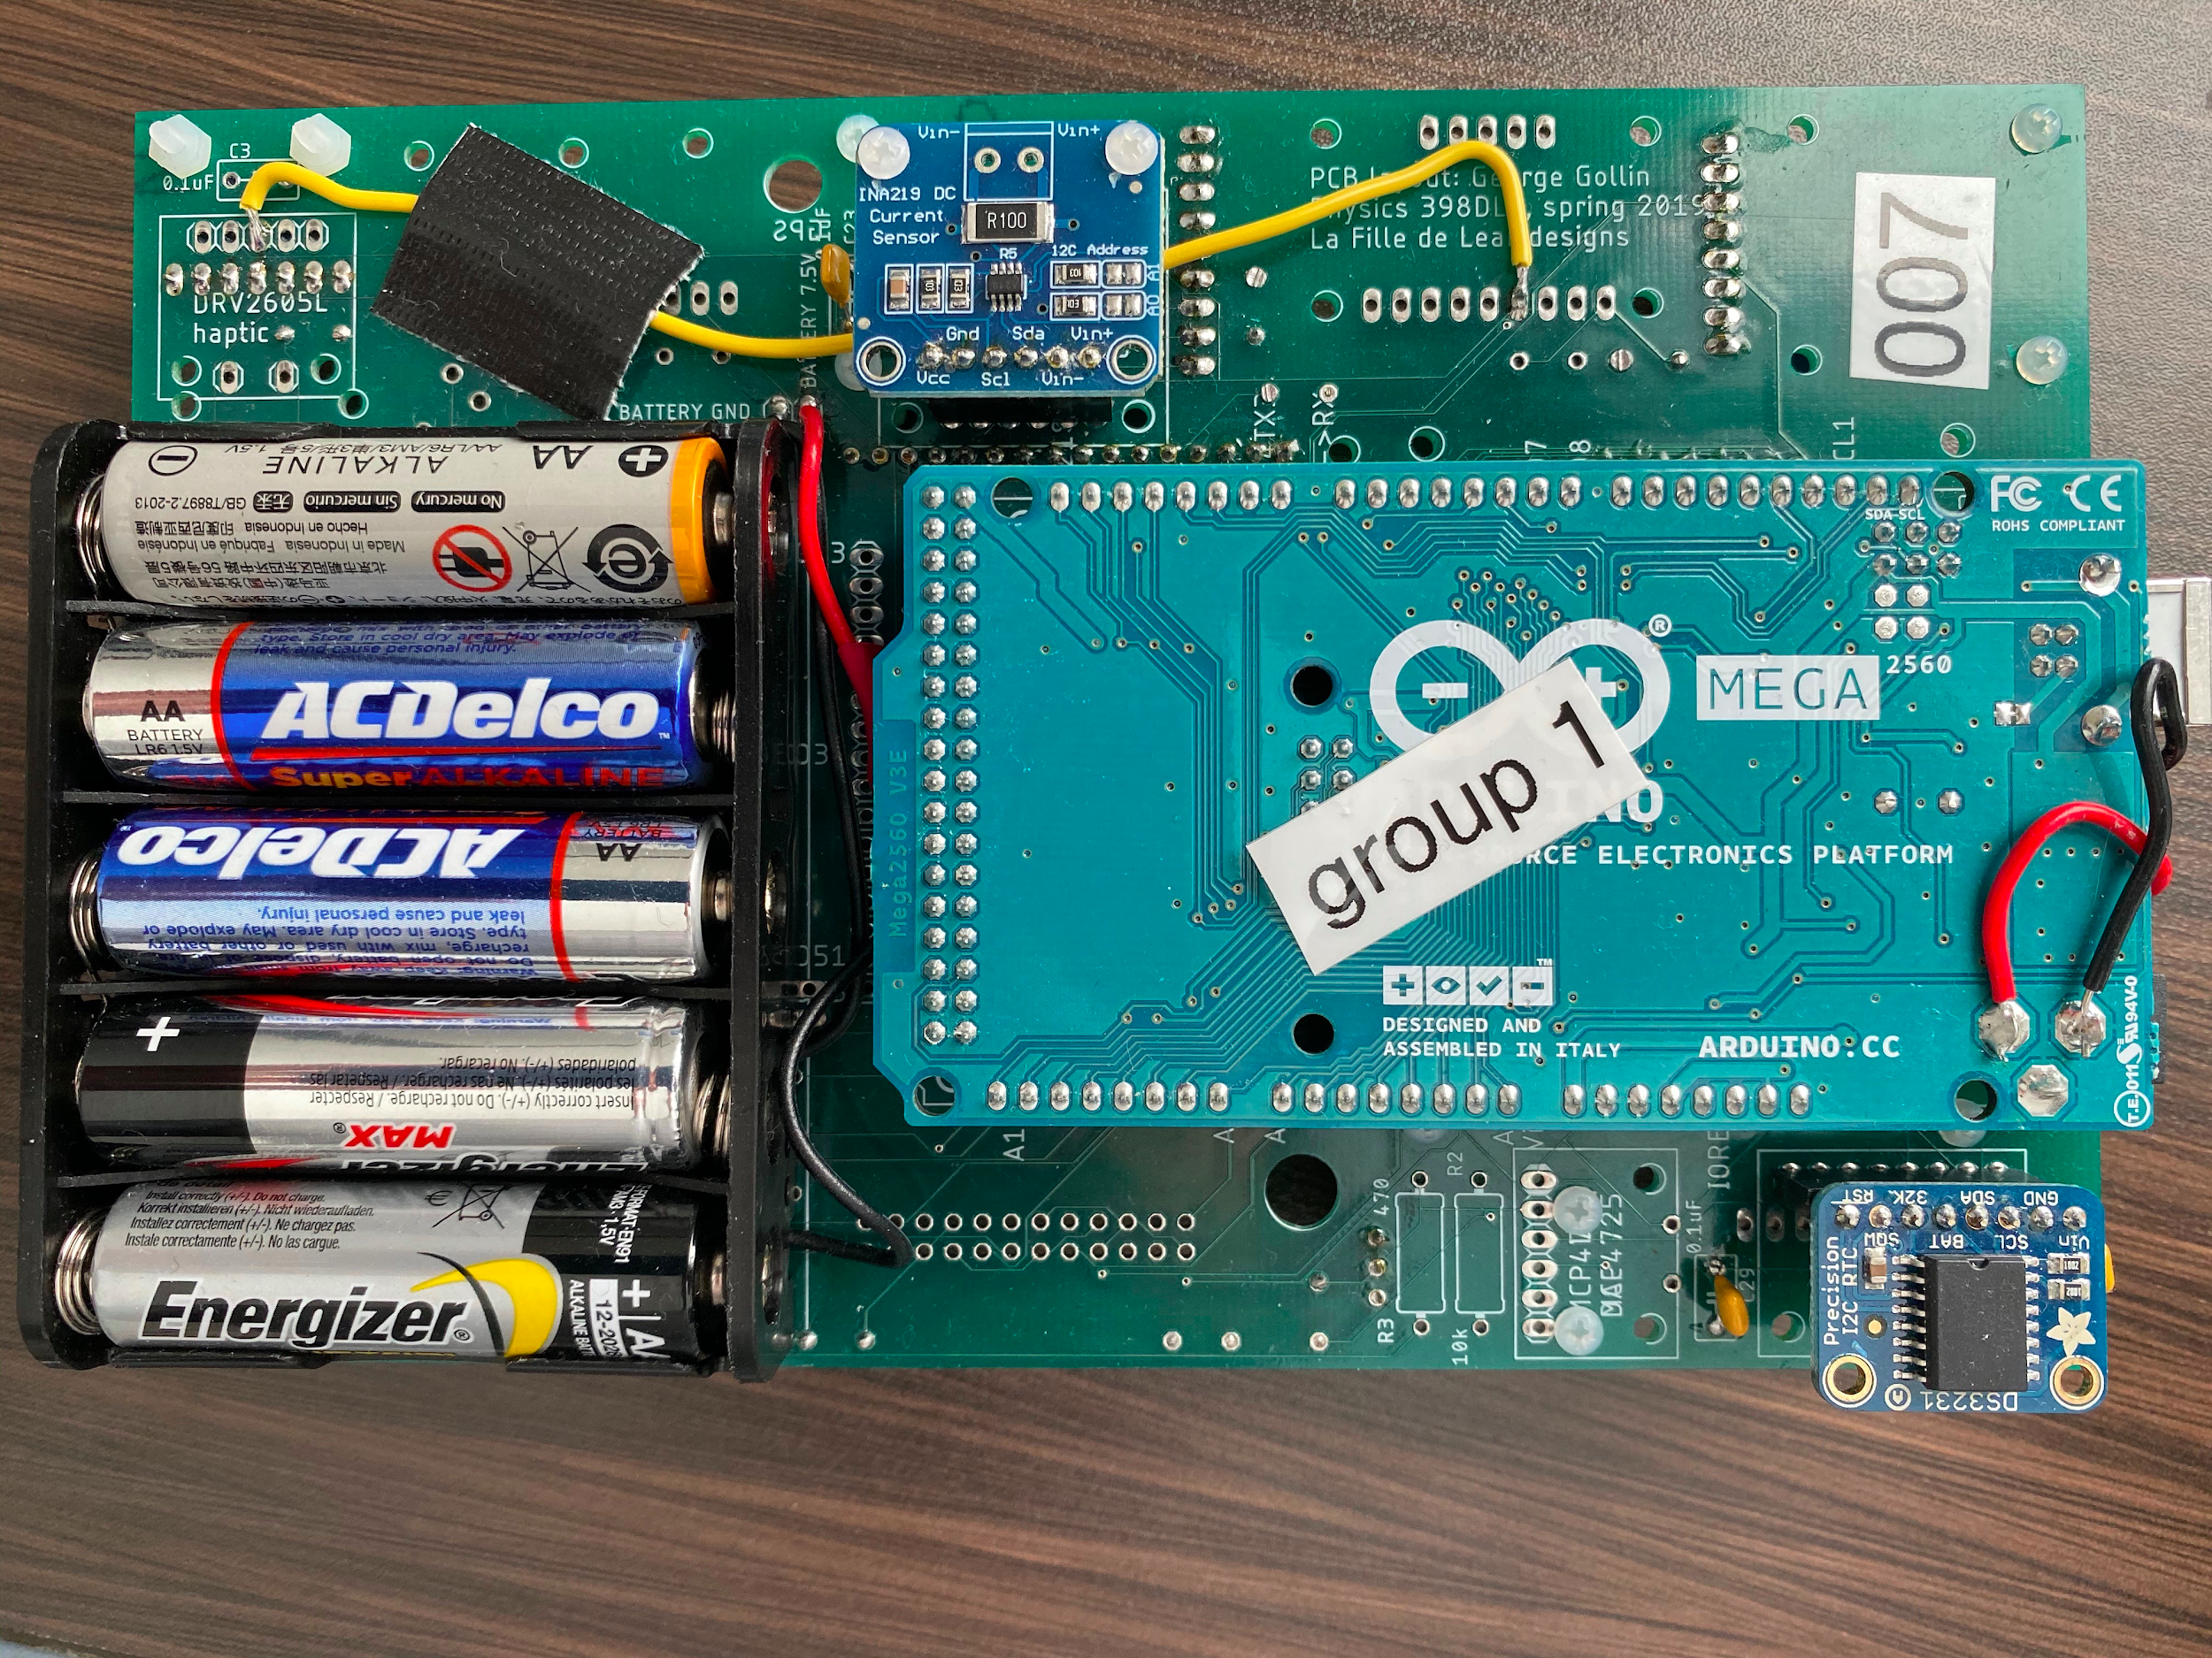
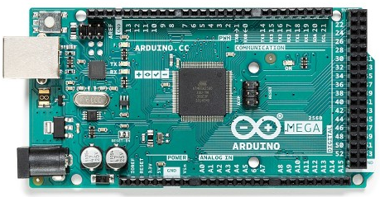
Hardware
Arduino
An open-source hardware and software company.
Microcontroller
A small computer on a single metal-oxide-semiconductor integrated circuit chip.
Execute the DAQ and control the sensors by wiring the microcontroller with sensors.
Printed Circuit Board (PCB)
Supports and electrically connects electronic components using conductive tracks.
PCB with microcontroller, power supply, LED, keypad and various sensors
Arduino Mega 2560 Microcontroller

Slide 8
Hardware
GPS
Get location information.
Get accurate time information - calibrate the real time clock (RTC).
Real Time Clock (RTC):
Keeps track of the current time and that can be used to program actions at a certain time.
Drift of ±2 microseconds per second.
Microphone
Record sound of frequency between 20 - 20 KHz.
BME 680
A 4-in-1 sensor with gas, humidity, pressure and temperature measurement.
Keypad and LED
Control and communicate with the microcontroller.
SD Breakout Board
Enables microcontroller to write and read from SD card.
Adafruit Ultimate GPS
DS 3231 Real Time Clock
MAX 4466 Electret Microphone

Slide 9
Data Collection
At a scheduled time, we pressed the keypad to start recording. DAQ will collect the locations from GPS and the time information.
Time duration (tCPU) between writing the time into a file and microphone starting recording.
Time duration by GPS (tGPS).
tGPS/tCPU can be used to calibrate the length of recording.
The selected chirp signal would be played by the sender.
Press again to stop the recording.

Slide 10
Some Definitions
Sample rate of our recording: 40kHz
It means the microphone takes a sample every 25 microseconds.
Each sample is a number that describes the amplitude of sound.
A sample = A bin
Recording will be stored as a binary file (bin file), and be converted to a numpy array.
Shift the data in the array by subtracting its mean and dividing by its std.

Slide 11
Python analysis includes
functions that calculate the exact starting time of the recordings from sender and receiver
getAudioMicros: takes the GPS time information and returns the starting time of the recording
adjustMicros: returns the needed time adjustment due to tiny inconsistencies.
plot_shift function: calculates the chi-square between the sender and the receiver.
chi_square function: the main function
takes sample data and relevant timing information,
and outputs the calculated time latency between the sender and receiver.
recursively searches for bin shifts where the chi-square value is the lowest
s_drift / r_drift values: the drifting values of the CPUs on two Arduino boards
microStart function: outputs the latency in milliseconds.

Slide 12
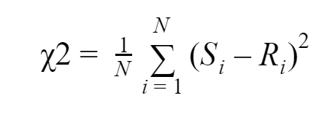
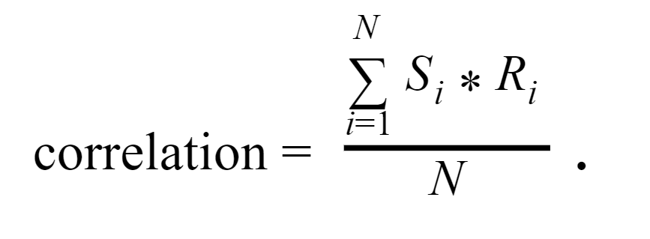
Mathematics
Chi-squared test
statistical hypothesis test: measure the match of two statistical distributions
latency will be calculated by locating the decimal bin number with minimal chi-square value
Correlation test: to check the results from the chi-square test

Slide 13
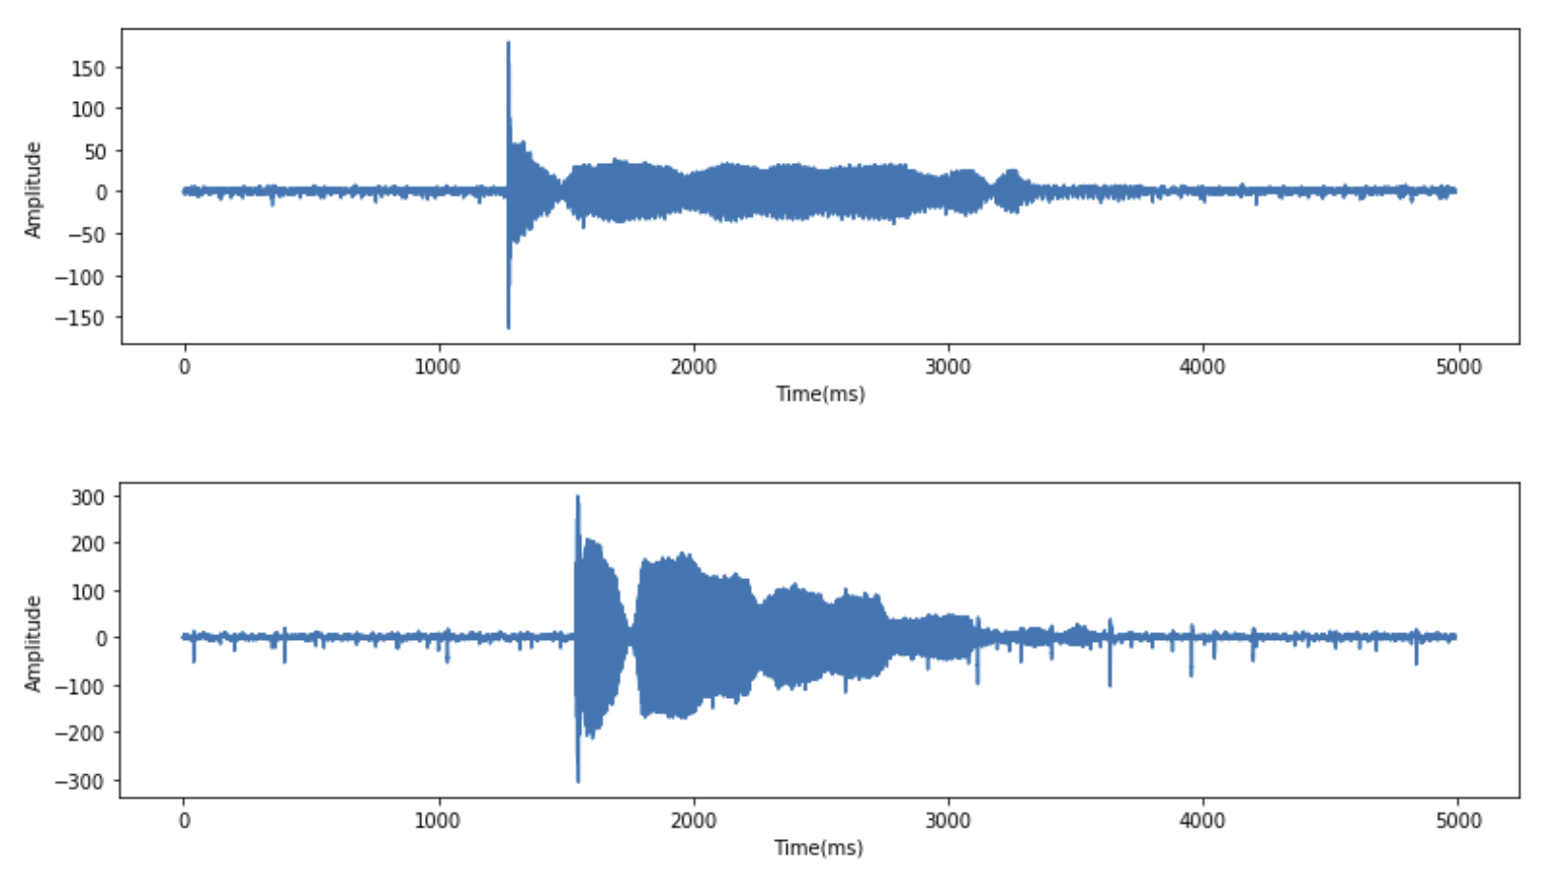
Minimize Chi Square
1. Plot directly from sender envelope (top) and receiver envelope (bottom)

Slide 14
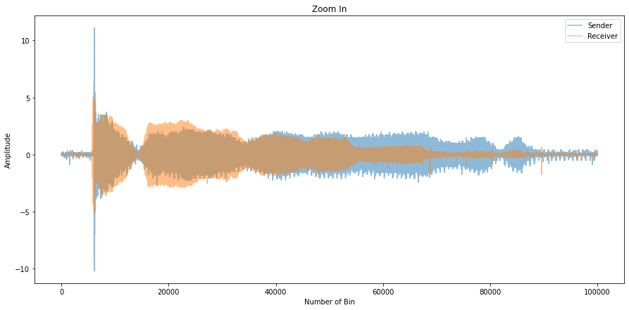
Minimize Chi Square
2. Crop the data:
Sender_Start_Bin=45000
Receiver_Start_Bin=56000,
both have a length of 100000 bins.

Slide 15
To Further Minimize Chi Square
Convert Bins Shifted to Corresponding Time
3. Shift the receiver envelopes again, and get the number of bin shifted corresponding to the smallest chi square value
Given tCPU and tGPS calibrated and recorded, we calculated the time calibration index for sender and receiver by
And assume our recordings start at the same time, the corresponding time latency is calculated by
BS: Bin Shift
SSB: Sender Start Bin ; RSB: Receiver Start Bin
SCI: sCalibrationIndex ; RCI: rCalibrationIndex

Slide 16
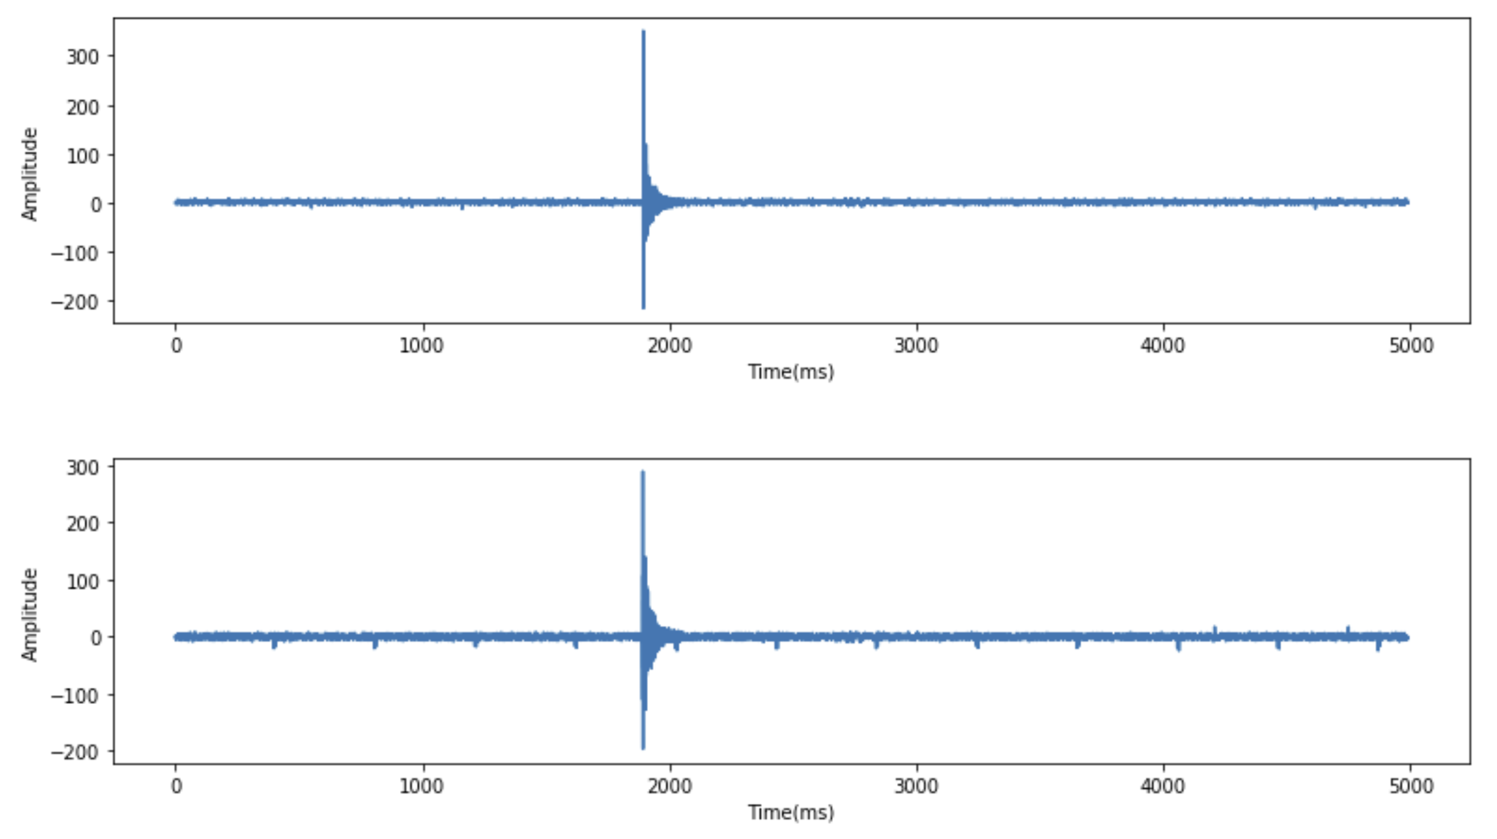
Calibration
Time Accuracy of DAQ
Fig: Instrumental Layout of Calibration
Use a delta-function-like sound source
compare the difference of time when the envelopes reach their first peaks.
Fig: Overall envelopes of recorded binary files from PCB1 (left top) and PCB2 (left bottom) separately.

Slide 17
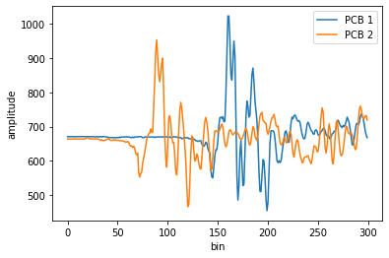
Calibration
Time Accuracy of DAQ
Fig: Zoomed in plot of PCB 1’s and PCB 2’s recordings. Both are cropped so that start from bin = 75700 and have a length = 300 bins.

Slide 18
Calibration
Time Accuracy of DAQ
Average calculated distance ≈ 14.80 cm, with a range of only 0.02 cm.
Time accuracy ≈ 6 microseconds.
Fig: Instrumental Layout of Calibration
Table: Calibration of DAQ, Actual Distance = 15.00 cm
 | Test #1 | Test #2 | Test #3 | Mean (cm) | Range (cm)
Calculated Distance (cm) | 14.80 | 14.80 | 14.78 | 14.80 | 0.02
Error (%) | 1.3% | 1.4% | 1.5% | 1.4% | 0.1%

Slide 19
Calibration
Accuracy of DAQ and python analysis code
Table: Calibration of DAQ & Analysis Code
 | Test #1 | Test #2 | Test #3 | Test #4 | Test #5 | Mean
Actual Distance (cm) | 6.60 | 9.80 | 10.00 | 13.00 | 13.10 | /
Calculated Distance (cm) | 7.84 | 10.67 | 10.45 | 12.61 | 14.36 | /
Absolute Error (cm) | 1.24 | 0.87 | 0.45 | 0.39 | 1.26 | 0.84
Percentage Error (%) | 18.8 | 8.88 | 4.50 | 3.00 | 9.62 | 8.96

Slide 20
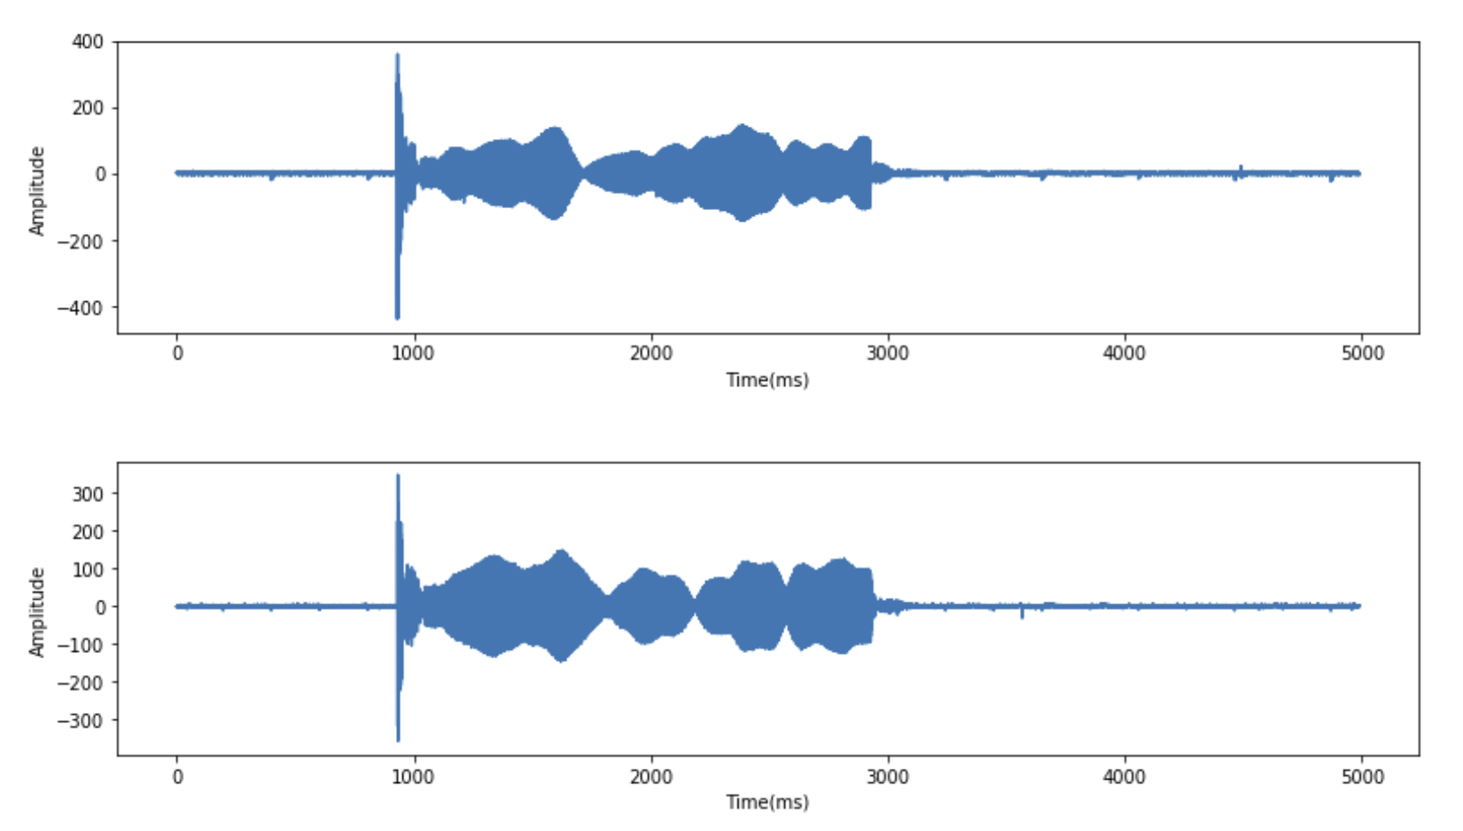
Calibration
Accuracy of DAQ and python analysis code (Example: L= 6.6cm)
Fig: Overall envelopes of recorded binary files from PCB1 (top) and PCB2 (bottom).

Slide 21
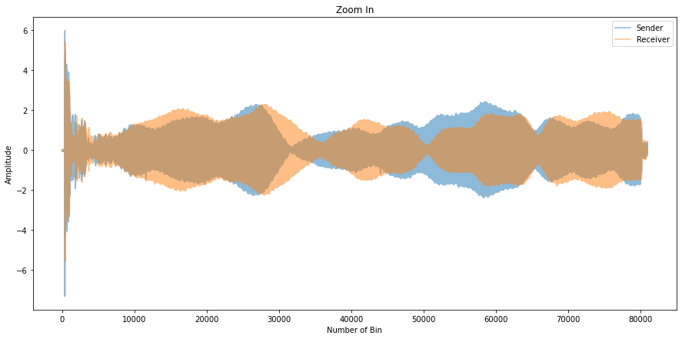
Calibration
Accuracy of DAQ and python analysis code (Example: L= 6.6cm)
(Top) Zoomed in signal patterns between PCB1’s recording (blue) and PCB2’s recording (orange). Both are cropped so that start from bin = 37000 and have a length = 81000 bins.
(Bottom) Zoomed in plot of PCB1’s and PCB2’s envelopes. PCB1’s envelope starts from bin = 37000, PCB2’s envelope starts from bin = 37052, both have a length of 2000 bins.

Slide 22
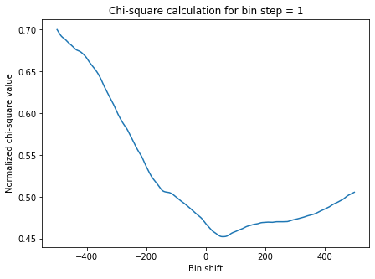
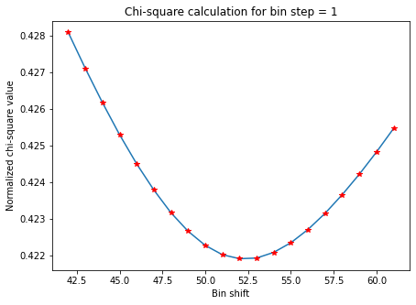
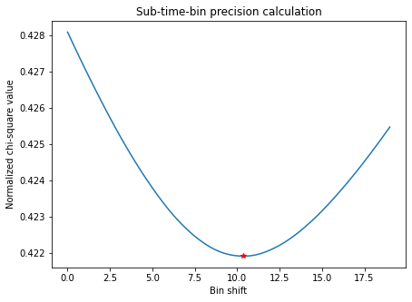
Calibration
Accuracy of DAQ and python analysis code (Example: L= 6.6cm)
Decimal bin shift corresponding to minimum chi square is 52.37.
Time delay is 228.58 microseconds.
Calculated distance is 7.84cm.

Slide 23
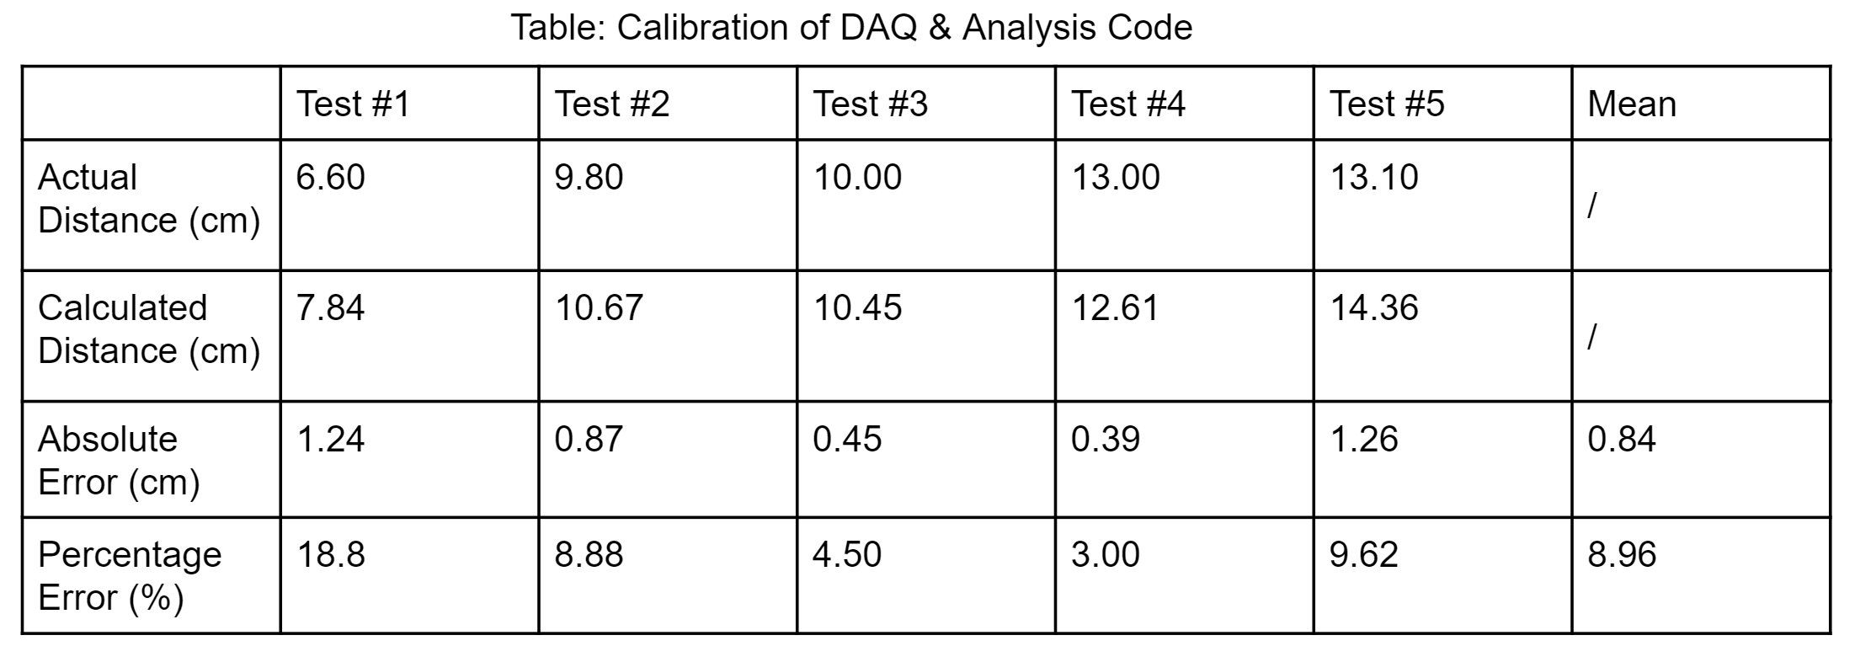
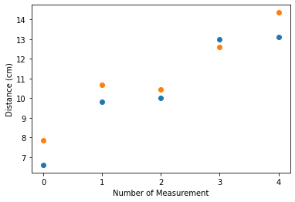
Calibration
Correlation (Actual, Calculated) = 0.969, which is very close to 1. It suggests that our calculations agree with the actual values.
Fig: Plot of actual distances and calculated distances.

Slide 24
Analysis and Result
Calls under different types of network
3 Calls under 4G network, VoLTE on (at the midnight of Nov 11, 2020)
3 Calls under 4G network, VoLTE off (at the midnight of Nov 11, 2020)
6 Calls under 3G network (at the midnights of Nov 10 & Nov 11, 2020)
Stability of latency
Stability of latency during daytime (long term behavior)
Stability of latency during daytime (short term behavior)
Calls under different distances

Slide 25
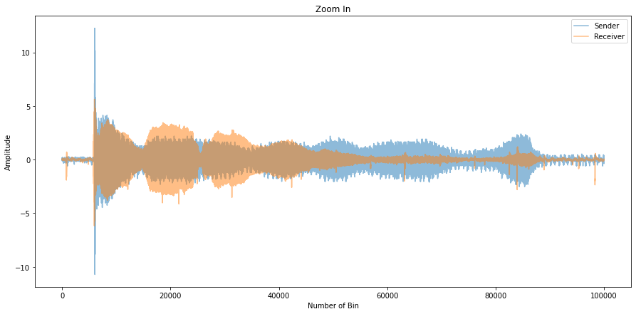
Call Under 4G Network, VoLTE On (Midnight of Nov 11, 2020)
Overall envelopes of recorded binary files from sender (top) and receiver (bottom) separately.
Zoomed in signal patterns (after cropping) between the sender side (blue) and the receiver side (orange).

Slide 26
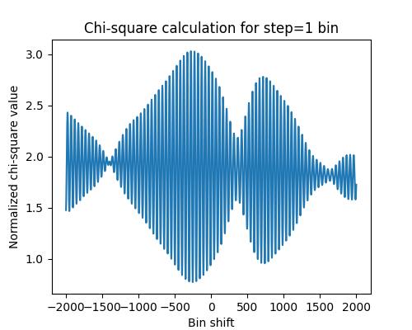
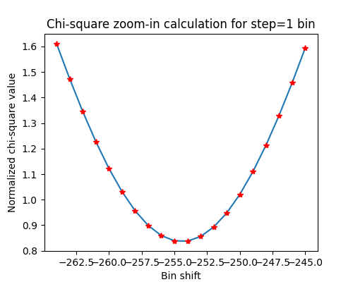
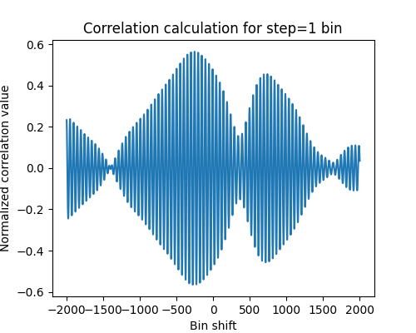
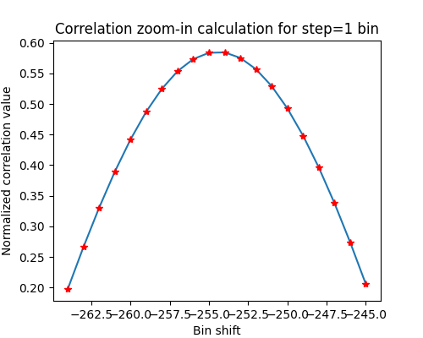
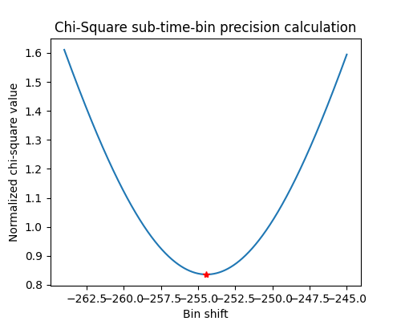
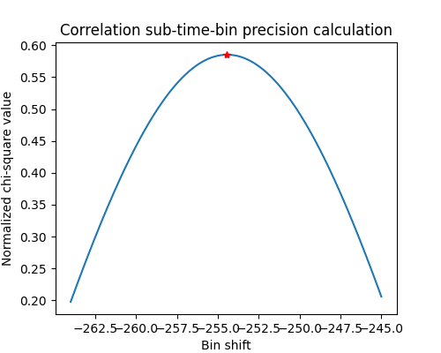
Call Under 4G Network, VoLTE On (Midnight of Nov 11, 2020)
The minimum chi square corresponds to a decimal bin shift of -254.44 with error ±0.0355. The maximum correlation corresponds to a decimal bin shift of -254.44 with error ±0.0503. The corresponding latency is 243.77 milliseconds.

Slide 27
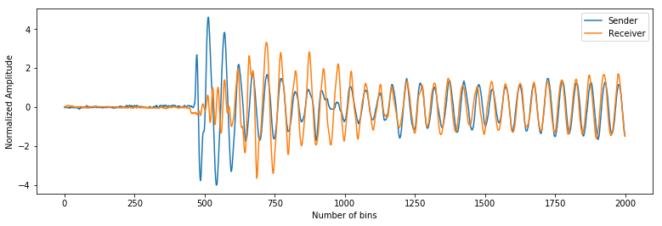
Call Under 4G Network, VoLTE On (Midnight of Nov 11, 2020)
Zoomed in plot of sender and receiver envelopes after chi-square and correlation match.

Slide 28
Results of Latency Test with 4G Network, VoLTE On
 | Sender Calibration Index (SCI) | Receiver Calibration Index (RCI) | Bin Shift At Min χ2/ Max correlation | Latency (ms)
Test 1. | 1.00034 | 1.00021 | -254.44 | 243.77
Test 2. | 1.00033 | 1.00021 | -347.05 | 266.45
Test 3. | 1.00031 | 1.00021 | 903.8 | 222.68

Slide 29
Summary of Results - Latency Change Under Different Type of Networks
Test # | Network Type | Time | Latency (ms) | Mean (ms) | Standard Deviation (ms)
1 | 4G VoLTE On | Midnight Nov 11, 2020 | 243.77 | 244.28 | 17.86
2 |  |  | 266.41
3 |  |  | 222.68
4 | 4G VoLTE Off | Midnight Nov 11, 2020 | 266.01 | 280.27 | 20.89
5 |  |  | 264.99
6 |  |  | 309.81
7 | 3G | Midnight Nov 11, 2020 | 401.74 | 436.22 | 40.77
8 |  |  | 413.43
9 |  |  | 493.48
10 | 3G | Midnight Nov 10, 2020 | 360.68 | 357.81 | 2.04
11 |  |  | 356.58
12 |  |  | 356.18

Slide 30
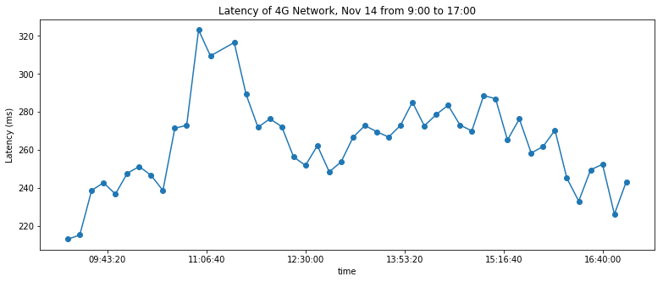
Stability of Latency During Daytime (Long Term Behavior)
Latency change in milliseconds during 9:00 to 17:00, Nov 14, 2020. Sample collecting rate = 6 per hour.
Mean = 263.94 ms; Standard Deviation = 22.74 ms;
Maximum Latency = 323.10 ms; Minimum Latency = 213.22 ms.

Slide 31
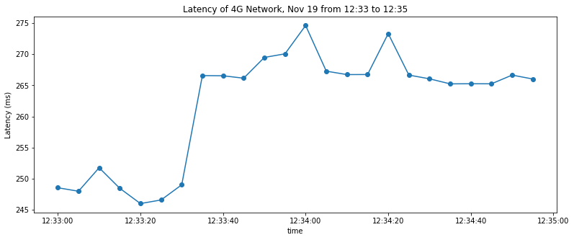
Stability of Latency During Daytime (Short Term Behavior)
Latency change in milliseconds during 12:33:00 to 12:35:00, Nov 19, 2020. Sample collecting rate = 12 per minute.
Mean = 261.95 ms; Standard Deviation = 9.06 ms;
Maximum Latency = 274.60 ms; Minimum Latency = 246.02 ms.

Slide 32
Summary of Test Results - Stability of Network
Test Type | Network | Time | Average Latency (ms) | Standard Deviation (ms) | Range (ms)
Long Term Stability (day scale) | 4G VoLTE On | 9:00 - 17:00 Nov 14, 2020 | 263.94 | 22.74 | 109.88
Short Term Stability (minute scale) | 4G VoLTE On | 12:33 - 12:35, Nov 19, 2020 | 261.95 | 9.06 | 28.58

Slide 33
Conclusions
No obvious difference in latencies measured under different distances.
Latency mainly depends on the speed of the cell phone network: faster the speed is, the smaller the latency becomes.
4G VoLTE on latency is about 244ms, 4G VoLTE off latency is about 280 ms, and 3G latency is around 400ms. Given the latency’s dominant factor is Information Density/Speed, it agrees with the fact that 3G network’s speed is much slower than 4G network.
For long time behavior, we found that the latency was smallest at around 9:00 AM on that day, which is about 213 ms. For short time behavior, the average latency is 261.95 ms. This suggests that the latency of cell phone network in a short term is stable, and it is possible to employ cell phone networks for signal cross-timing in extended sensor arrays.

Slide 34
References
[1] Bang, S. (2020). Cosmic Rays May Reveal New Physics Just Out Of LHC's Reach. Retrieved 4 December 2020, from https://www.forbes.com/sites/startswithabang/2016/11/29/cosmic-rays-may-reveal-new-physics-just-out-of-lhcs-reach/?sh=7fcece14669b
[2] Chicago Air Shower Array. (2020). Retrieved 4 December 2020, from https://en.wikipedia.org/wiki/Chicago_Air_Shower_Array
[3] LTE (telecommunication). (2020). Retrieved 4 December 2020, from https://en.wikipedia.org/wiki/LTE_(telecommunication)
[4] Ong, R. (2019). Highest Energy Astrophysical Photons Detected. Physics, 12. Retrieved from https://physics.aps.org/articles/v12/87
[5] Voice over LTE. (2017). Retrieved 4 December 2020, from https://en.wikipedia.org/wiki/Voice_over_LTE
[6] 3G. (2011). Retrieved 4 December 2020, from https://en.wikipedia.org/wiki/3G

