Slide 1
Acoustic Direction Finding with Arduinos
PHYS 398, Group 2
Zhuo Chen, Peng Cheng, Leyang Liu, Wenqing Wang, Kaiwen Hu
Dec. 2020

Slide 2
Introduction
Acoustic point-source locating has been widely studiedin the context of military and civil use.
Applications include:
Military use: artillery sound ranging
Civil use: gunshot detector
Sensing method categorization:
Passive acoustic location (widely used in civil application)
Particle Velocity
Steered Response Power Phase Transformation
Time Difference of Arrival (our method)
Active acoustic location

Slide 3
Time Difference of Arrival
Only have access to the difference of arrival times of the sound signal
Two detectors
—a hyperbola
Three detectors
—two hyperbolas
—two source location candidates
Four or more detectors
—locate the source
Source
Detector
Detector
Source candidate
Detector
Detector

Slide 4
Locate the Source in a Perfect World
Without errors, the locations and arrival times must satisfy
$$\left|\vec{⬤}−{\vec{\text{➕}}}_{1}\right|−\left|\vec{⬤}−{\vec{\text{➕}}}_{2}\right|=c\left(τ_{1}−τ_{2}\right)$$
$$\left|\vec{⬤}−{\vec{\text{➕}}}_{1}\right|−\left|\vec{⬤}−{\vec{\text{➕}}}_{3}\right|=c\left(τ_{1}−τ_{3}\right)$$
$$\left|\vec{⬤}−{\vec{\text{➕}}}_{1}\right|−\left|\vec{⬤}−{\vec{\text{➕}}}_{4}\right|=c\left(τ_{1}−τ_{4}\right)$$
$$\left|\vec{⬤}−{\vec{\text{➕}}}_{2}\right|−\left|\vec{⬤}−{\vec{\text{➕}}}_{3}\right|=c\left(τ_{2}−τ_{3}\right)$$
$$\left|\vec{⬤}−{\vec{\text{➕}}}_{2}\right|−\left|\vec{⬤}−{\vec{\text{➕}}}_{4}\right|=c\left(τ_{2}−τ_{4}\right)$$
$$\left|\vec{⬤}−{\vec{\text{➕}}}_{3}\right|−\left|\vec{⬤}−{\vec{\text{➕}}}_{4}\right|=c\left(τ_{3}−τ_{4}\right)$$
Source
$$τ_{1}$$
$$τ_{2}$$
$$τ_{3}$$
$$τ_{4}$$

Slide 5
In a Not So Perfect World
The original equation may not have a solution
Instead, minimize the cost function
$$\hat{\vec{⬤}}=\underset{\vec{⬤}}{arg min}{\sum_{i, j}{{\left[\left|\vec{⬤}−{\vec{\text{➕}}}_{i}\right|−\left|\vec{⬤}−{\vec{\text{➕}}}_{j}\right|−c\left(τ_{i}−τ_{j}\right)\right]}^{2}}}$$
Same solution for the source location $\vec{⬤}$ if no errors
With random noise, the equation finds the expectation of the source location $\vec{⬤}$
The more detectors $\vec{\text{➕}}$, the more accurate is the predicted $\hat{\vec{⬤}}$

Slide 6
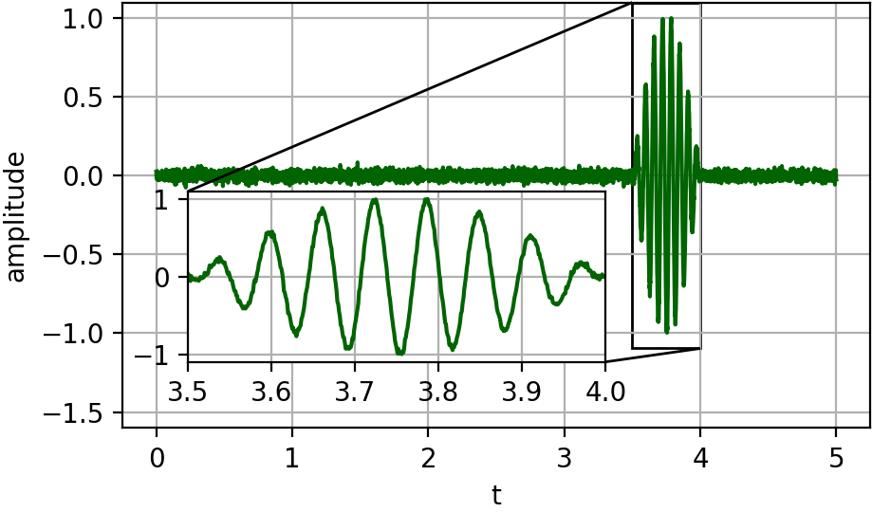
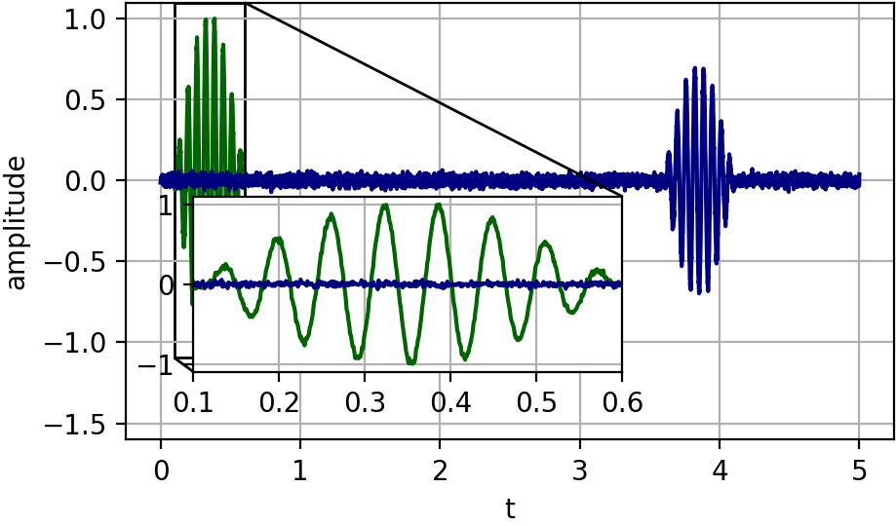
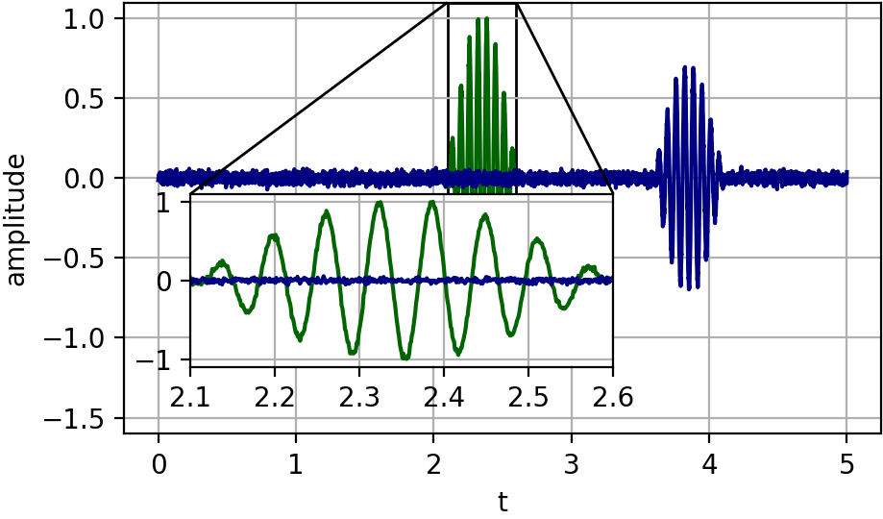
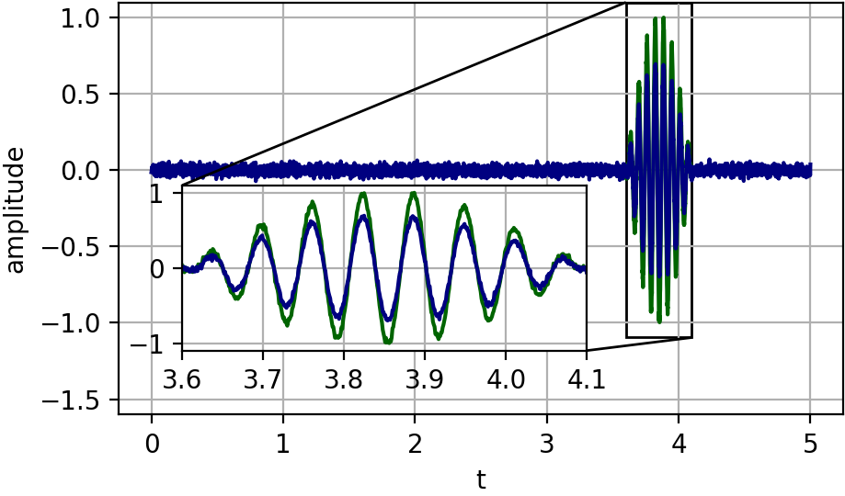
Extract Signal Arrival Times from Recordings
Identify the signal
Find the signal in other recordings by comparing the signal against the recordings at different time shifts
Write down time shift $τ_{i}$ of the best match

Slide 7
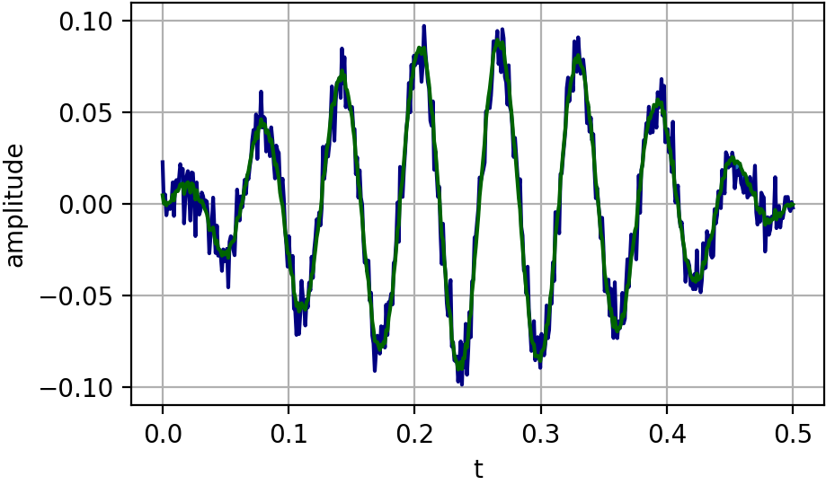
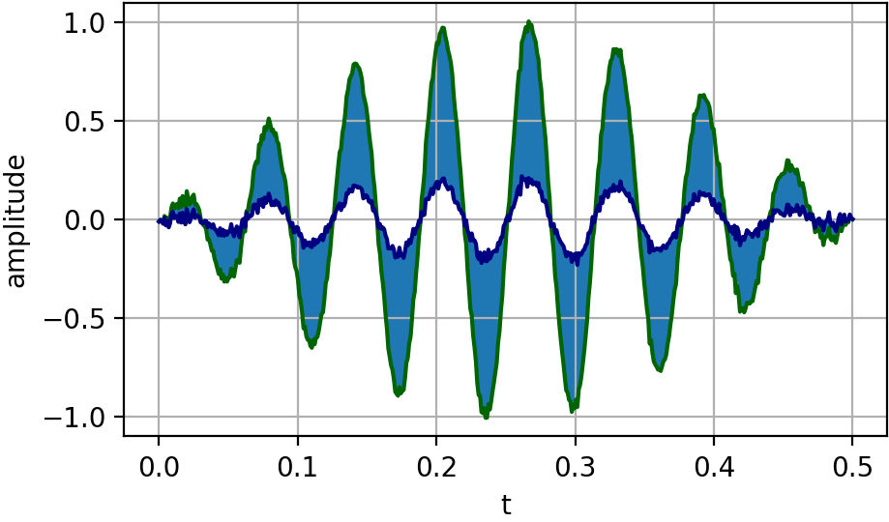
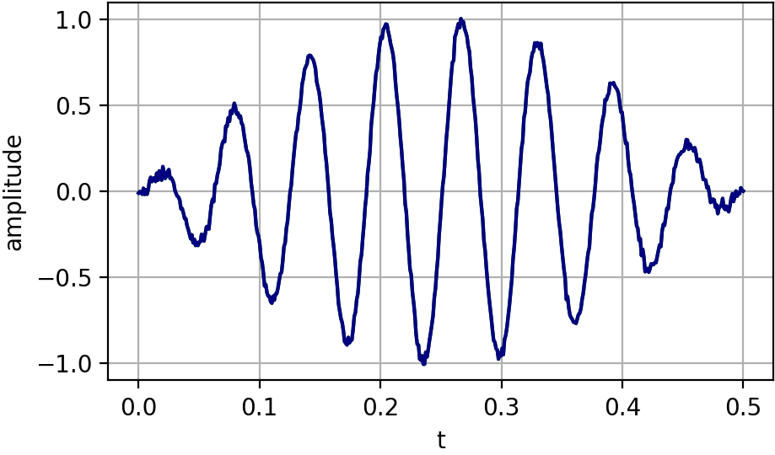
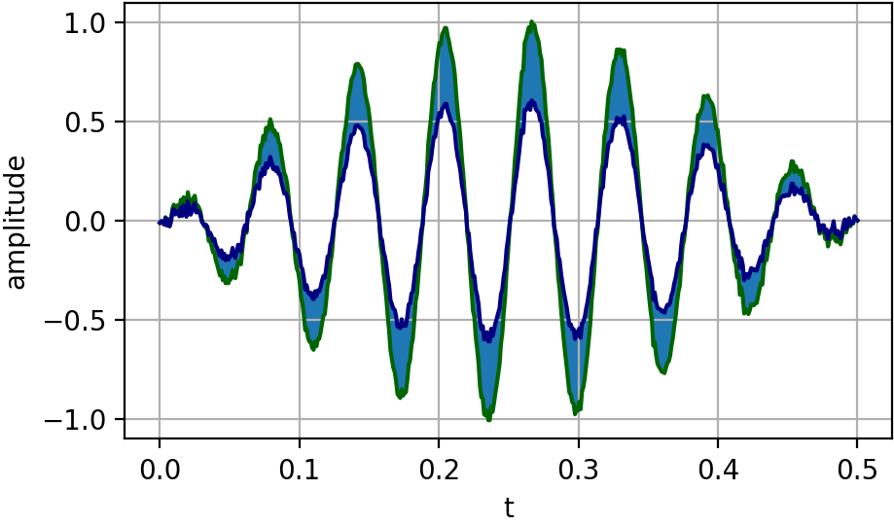
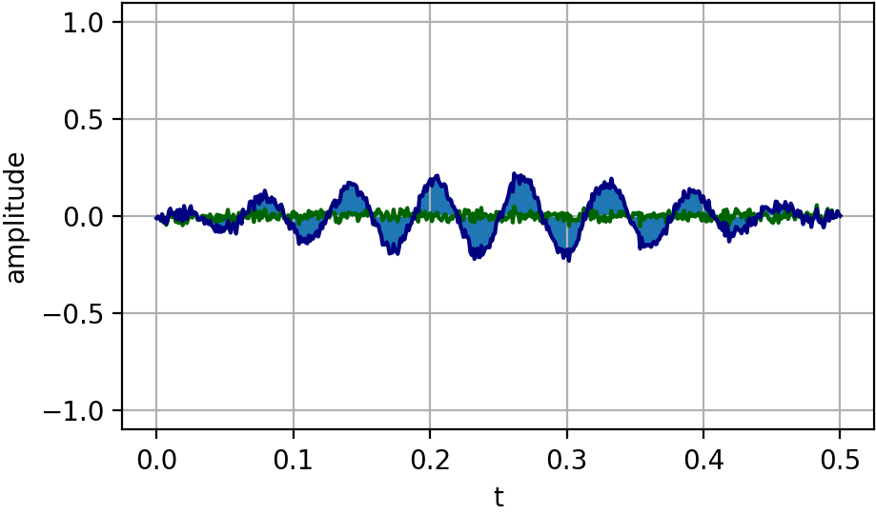
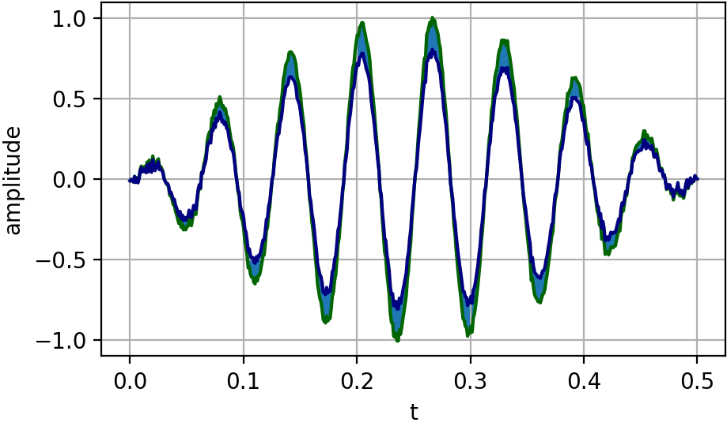
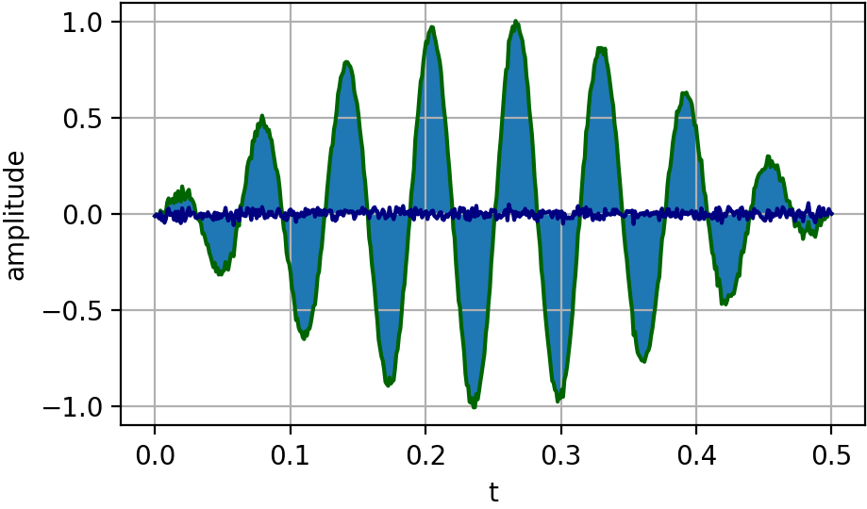
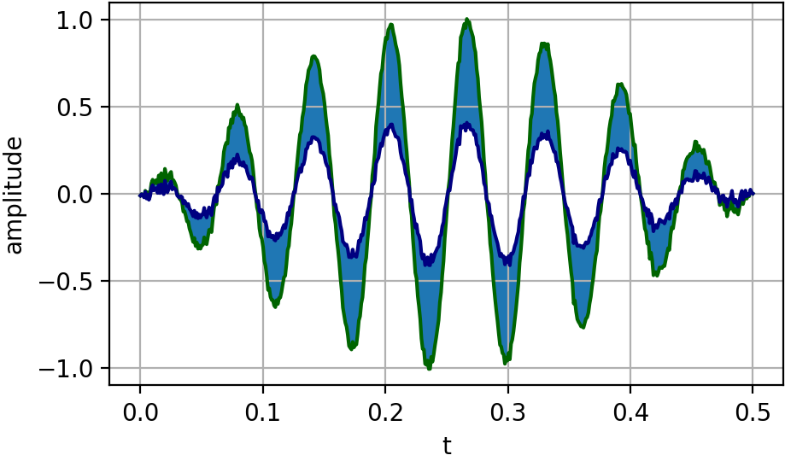
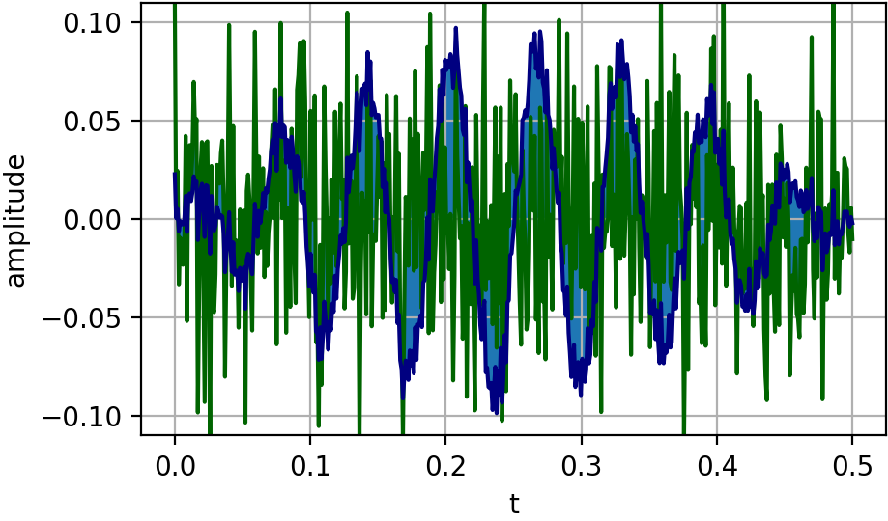
Matching Signals
$$\vec{a}−\vec{b}$$
Subtract signals at each time and sum (them)² up
Small issue
—volume
$L_{2}$ (square) normalization
Another perspective
—Euclidean distance between high dimensional vectors
$$\vec{b}$$
$$\vec{a}$$
$$\frac{\vec{a}}{\left|\vec{a}\right|}−\frac{\vec{b}}{\left|\vec{b}\right|}$$
$$\frac{\vec{b}}{\left|\vec{b}\right|}$$
$$\frac{\vec{a}}{\left|\vec{a}\right|}$$

Slide 8
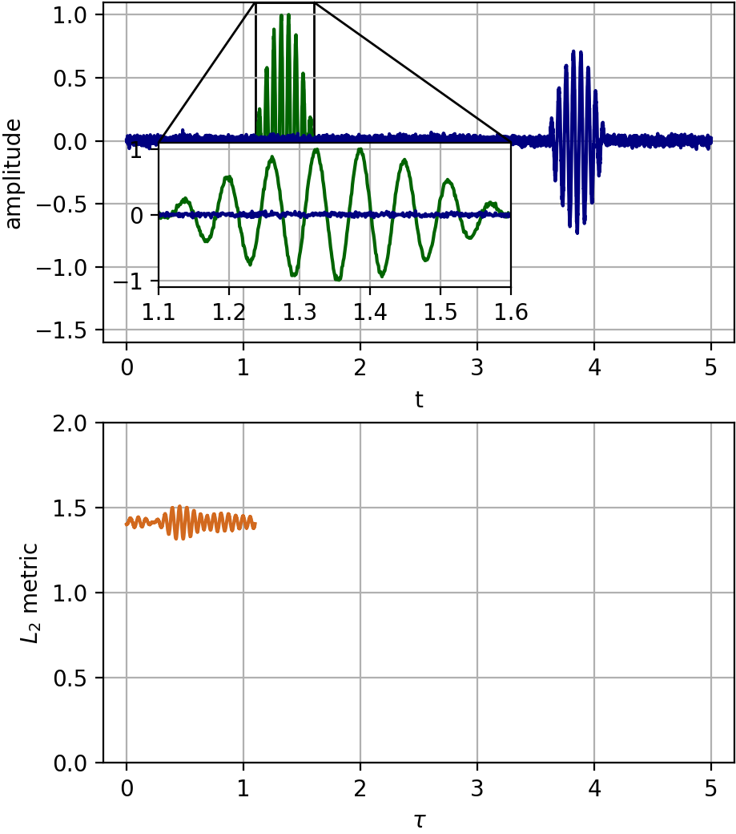
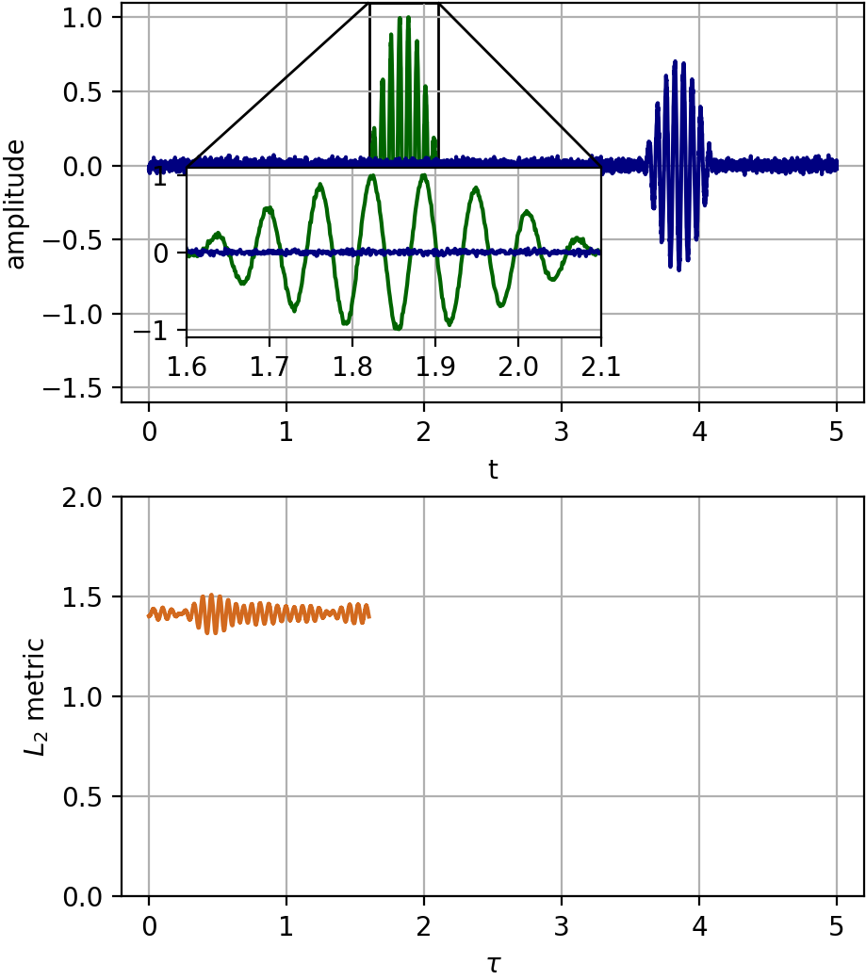
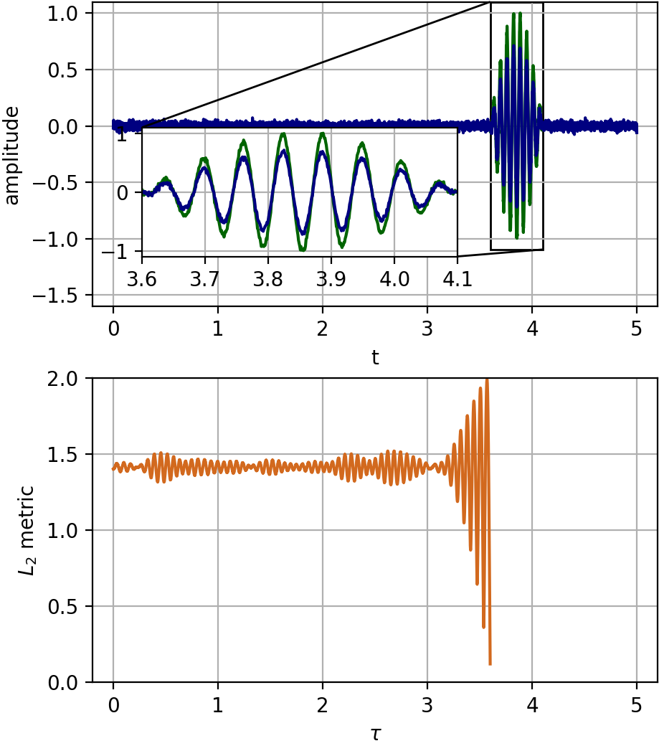
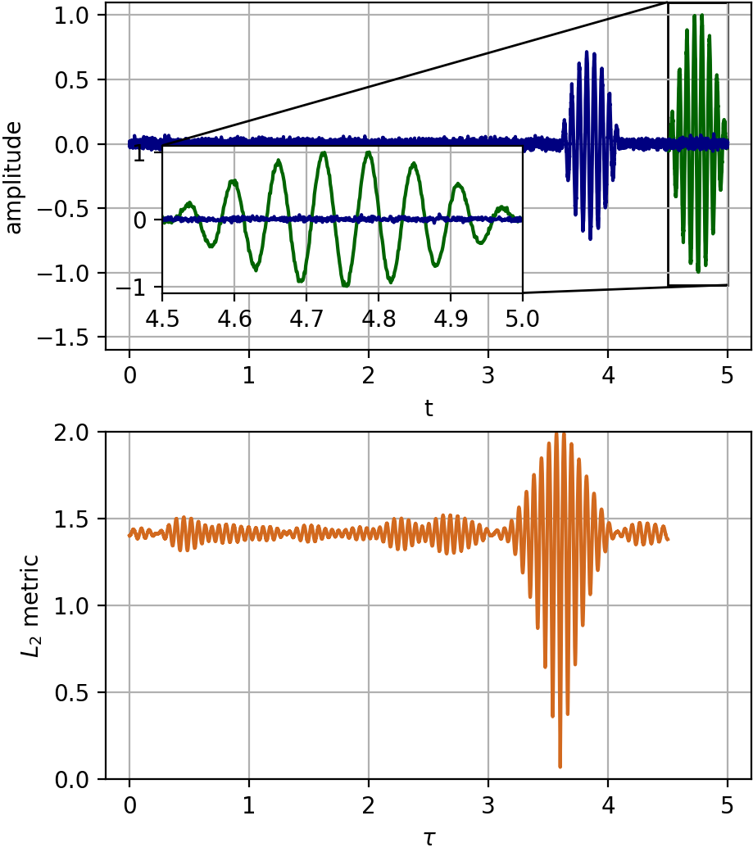
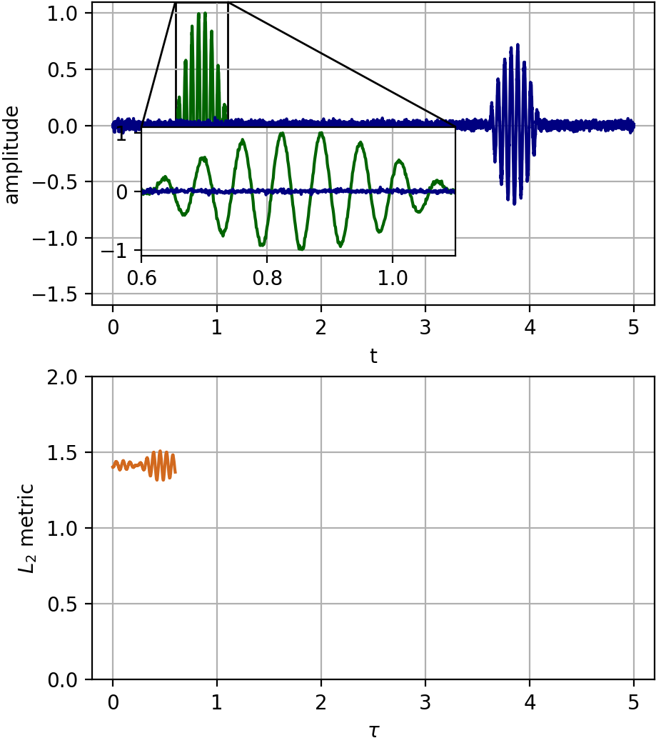
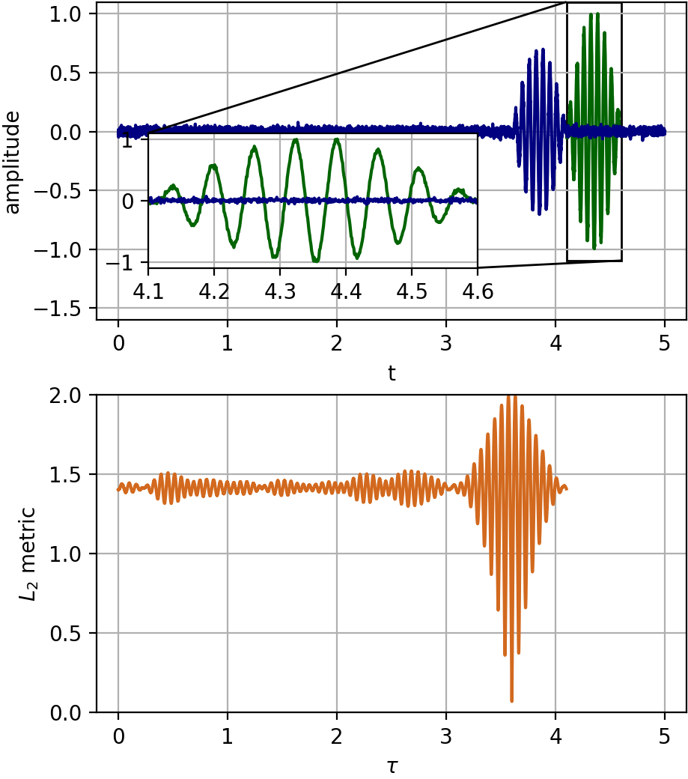
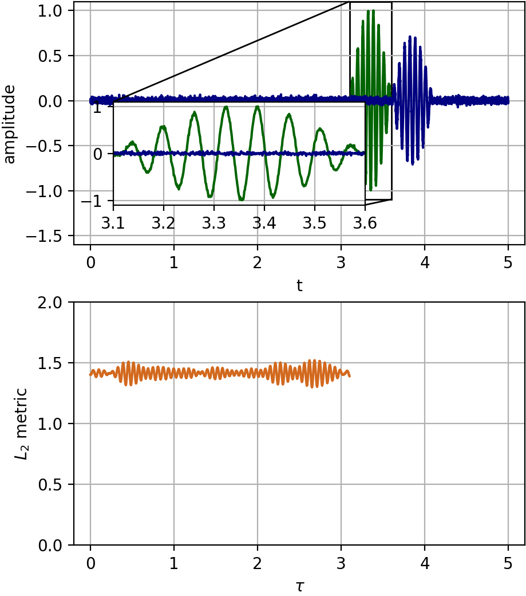
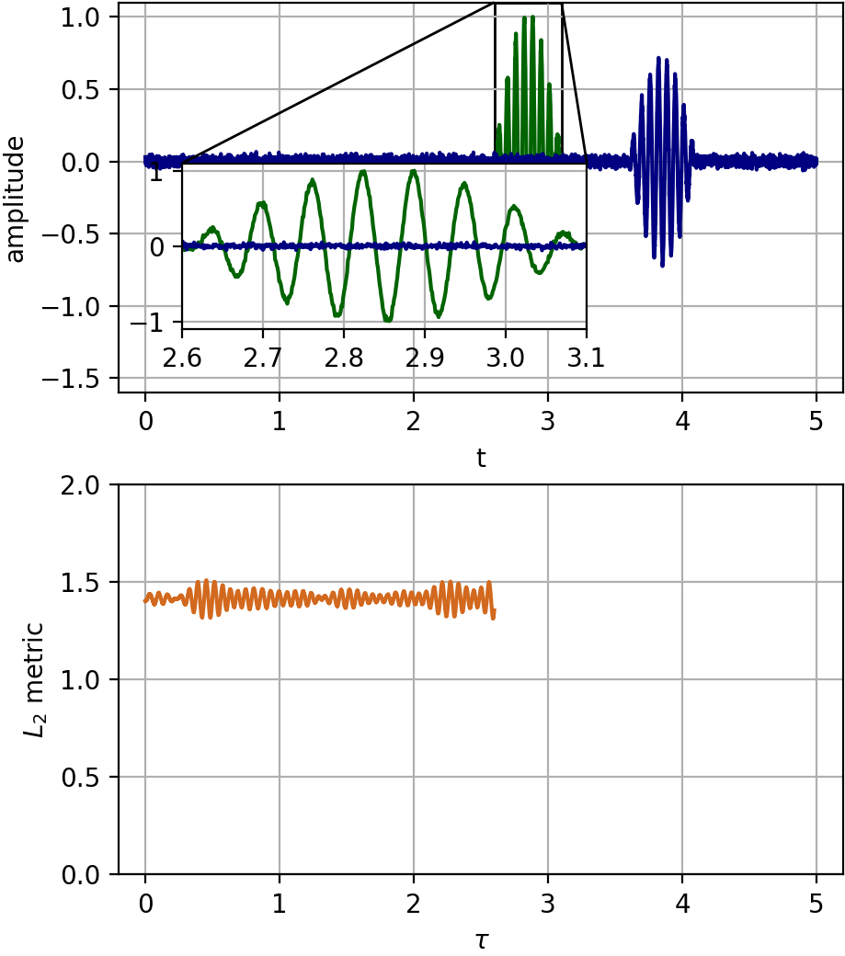
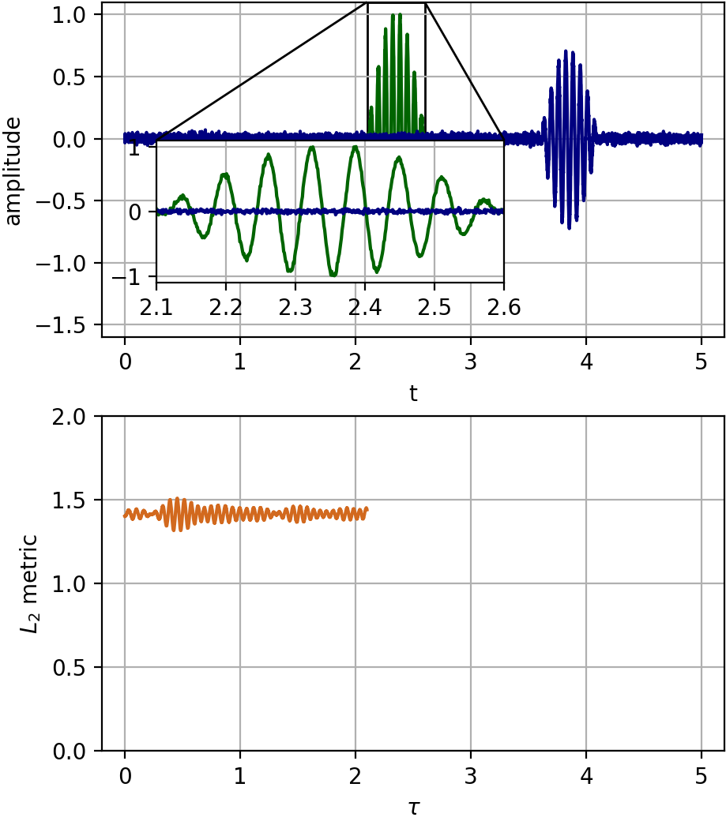
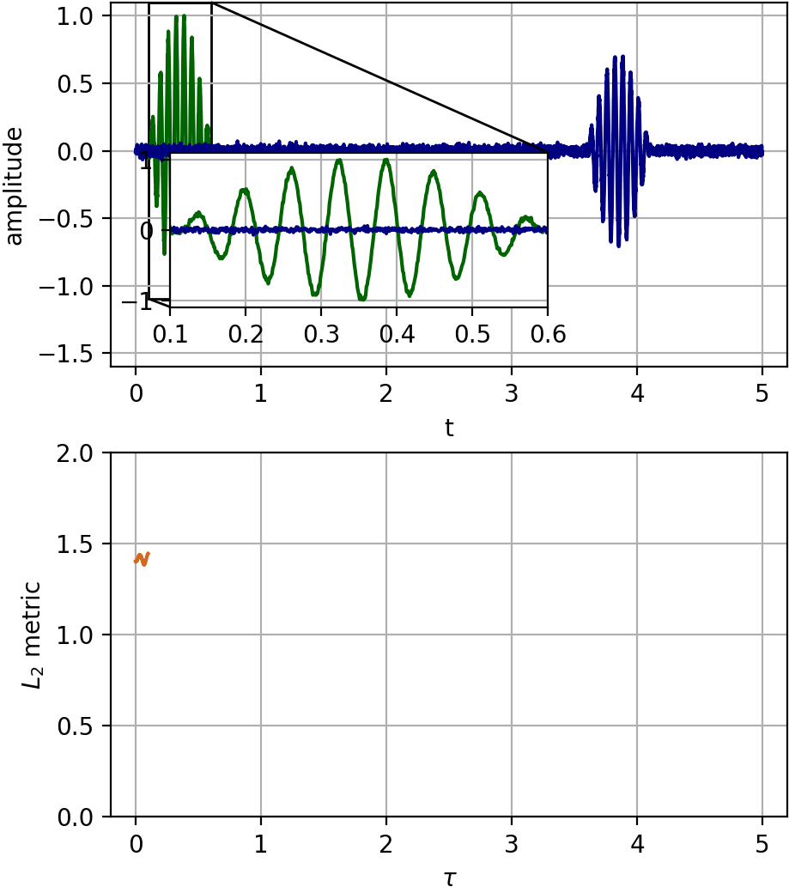
Find the Best Match
Compute the $L_{2}$ metric defined previously between the signal and the recording at all possible time shifts
$$L_{2}\left(τ\right)={\left\|\frac{\tilde{s}\left(t\right)}{{\left\|\tilde{s}\left(t\right)\right\|}_{2}}−\frac{\tilde{r}\left(t+τ\right)}{{\left\|\tilde{r}\left(t+τ\right)\right\|}_{2}}\right\|}_{2}$$
Pure noise $L_{2}≈\sqrt{2}$
Perfect match $L_{2}=0$
Look for $τ$ that minimizes $L_{2}$
$$τ=3.6$$

Slide 9
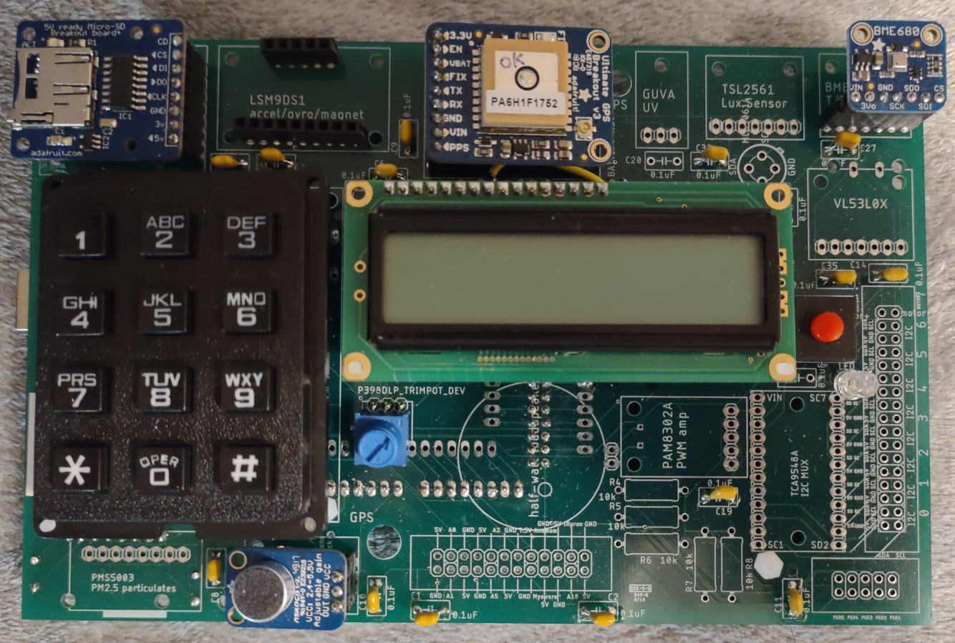
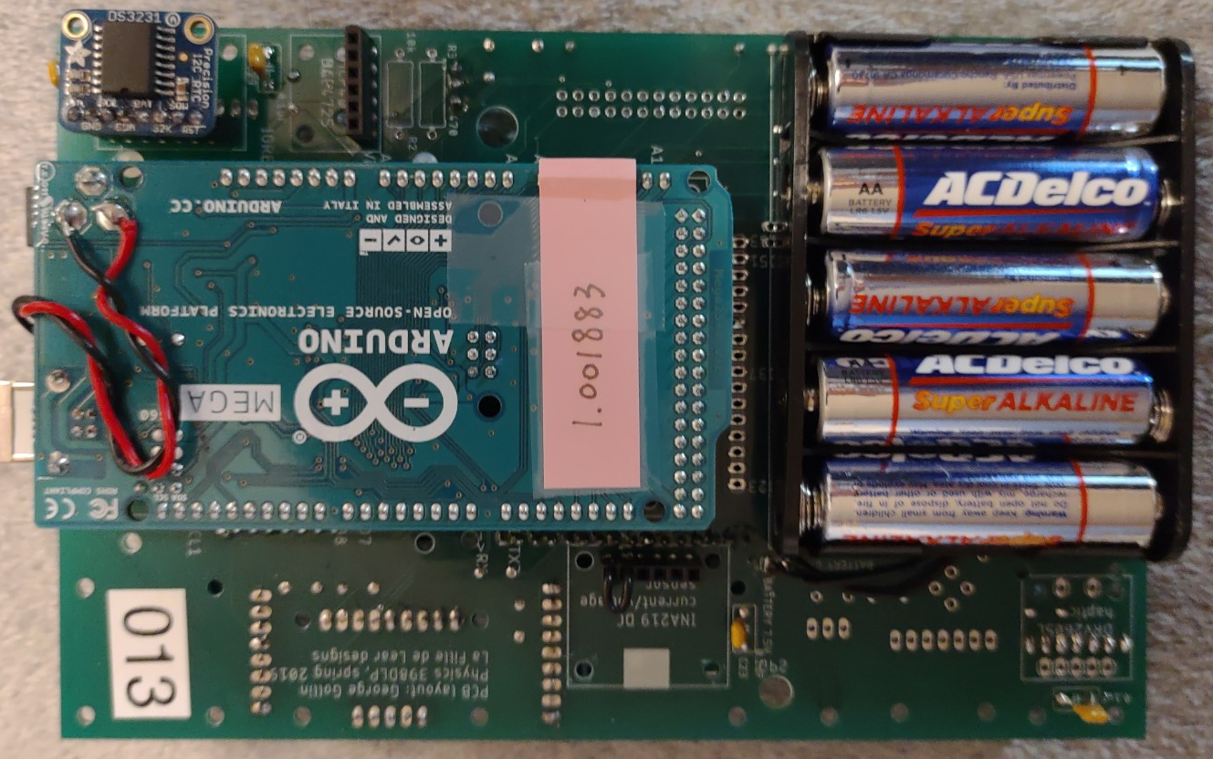
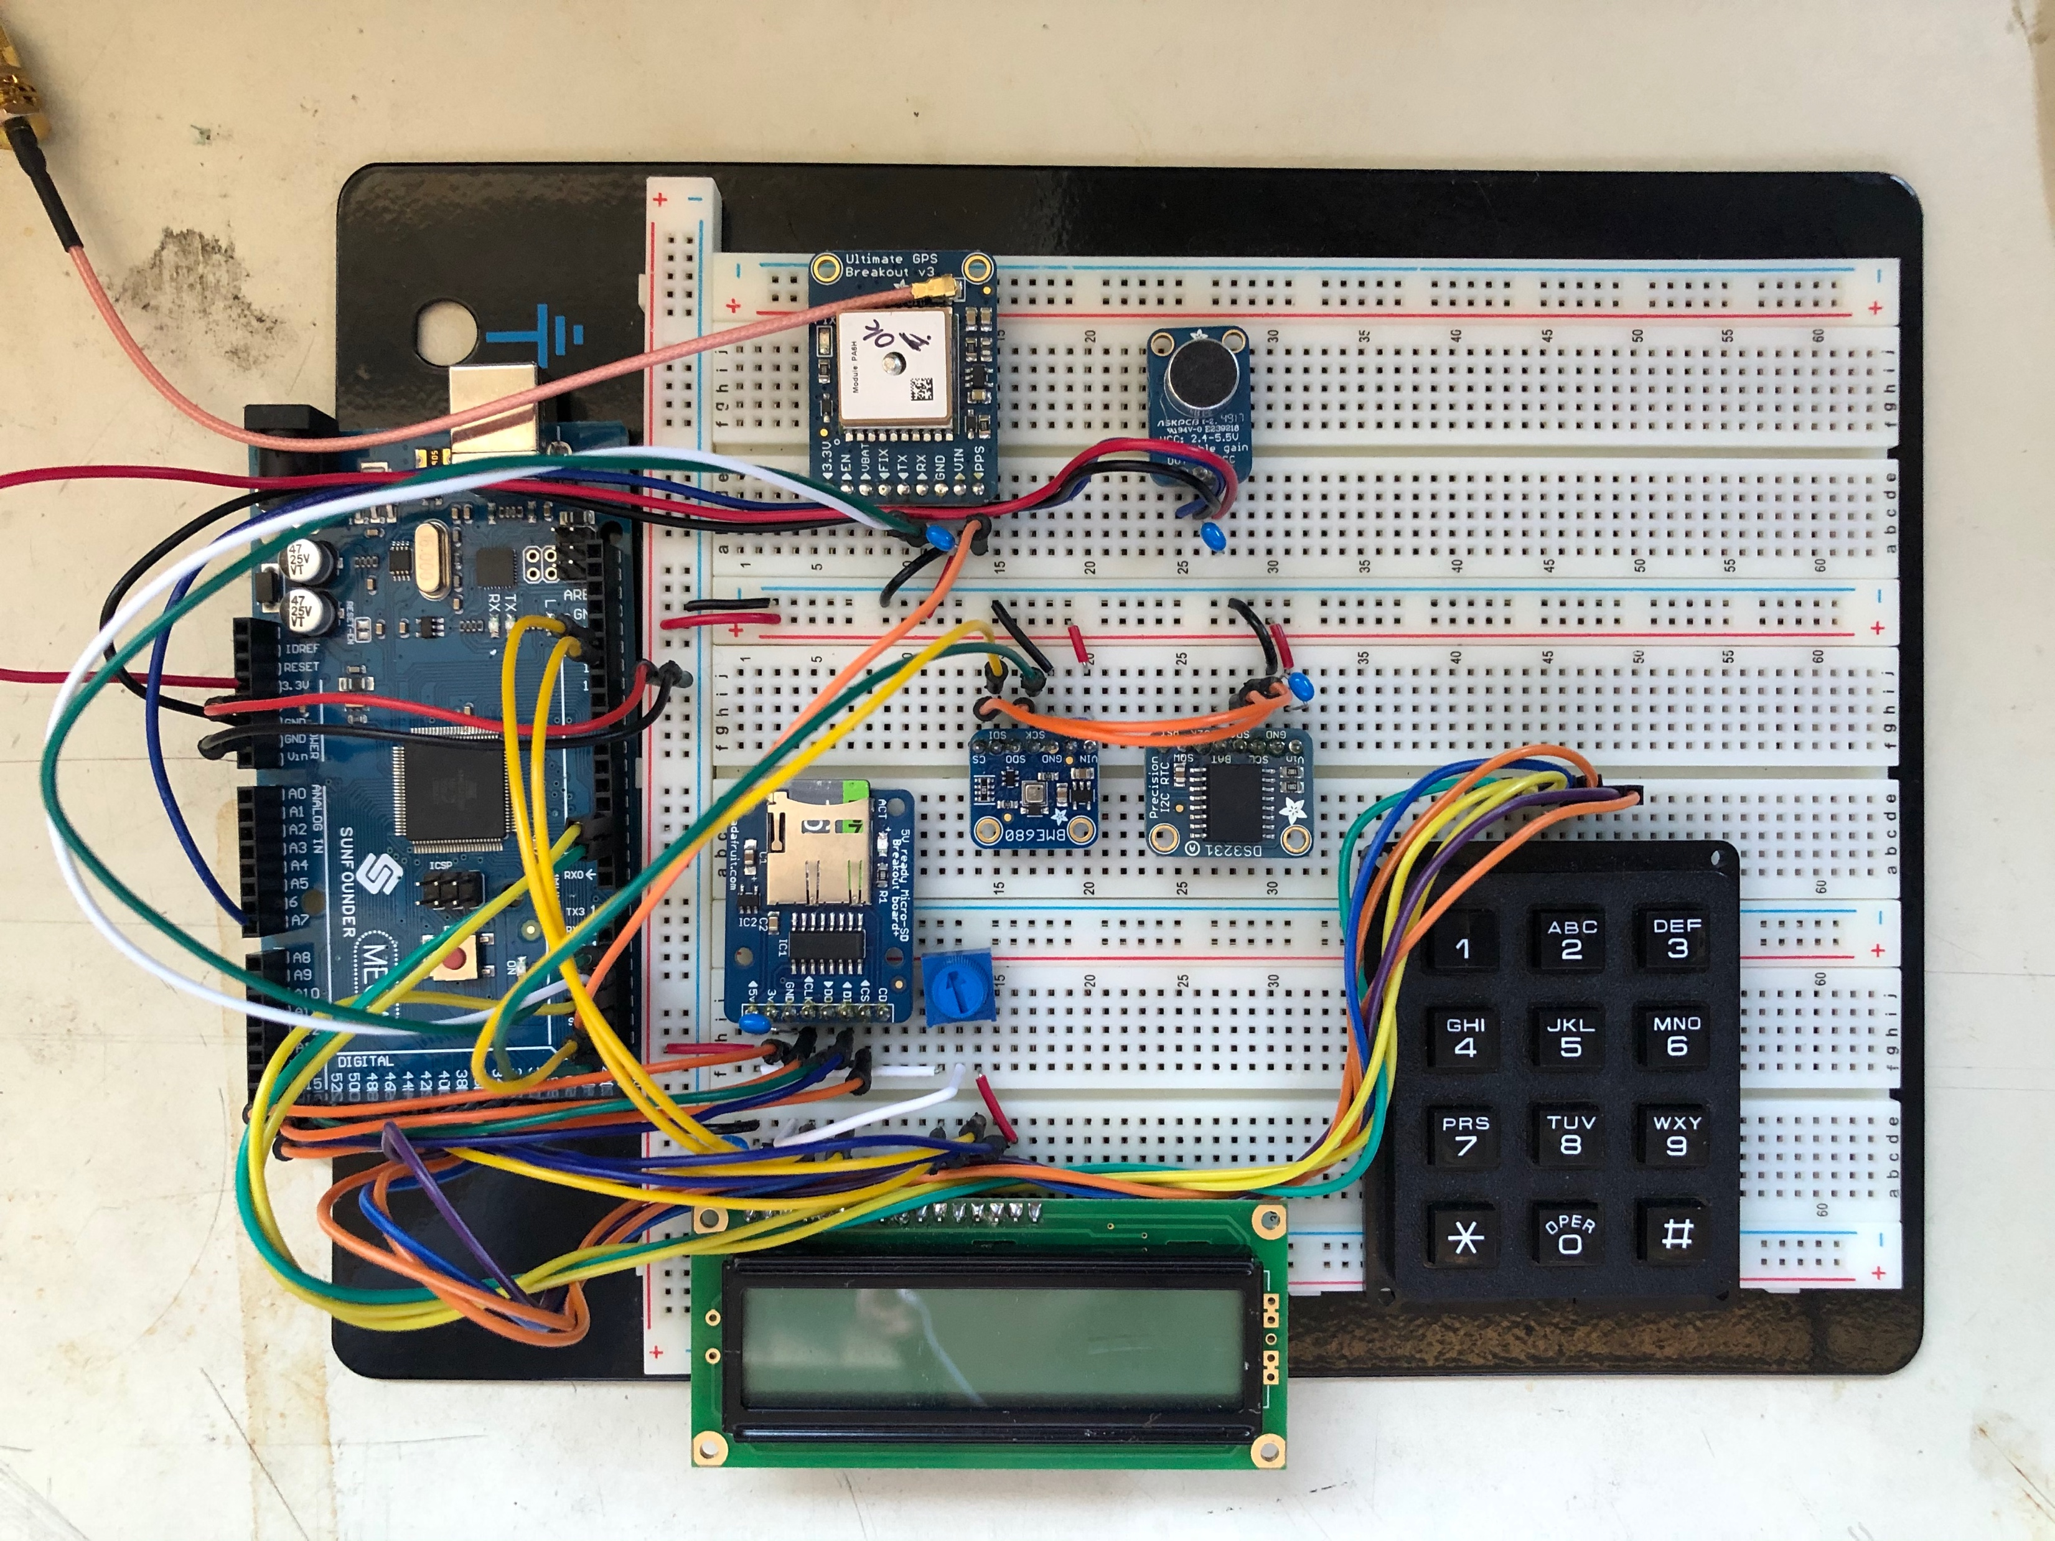
Data Acquisition
Components: Arduino Mega2560, LCD, Keypad, Microphone, MicroSD breakout board, RTC, GPS, BME680
Features:
Record audio and store the file in a MicroSD card
Synchronize and calibrate the internal clock of Arduino with GPS
Set staring and ending time with LCD display and keypad interface
Record temperature, air pressure, and humidity information
Antenna
GPS
Microphone
MicroSD
RTC
BME680
Arduino Mega2560
Keypad
LCD display
Breadboard version of the DAQ
PCB version of the DAQ

Slide 10
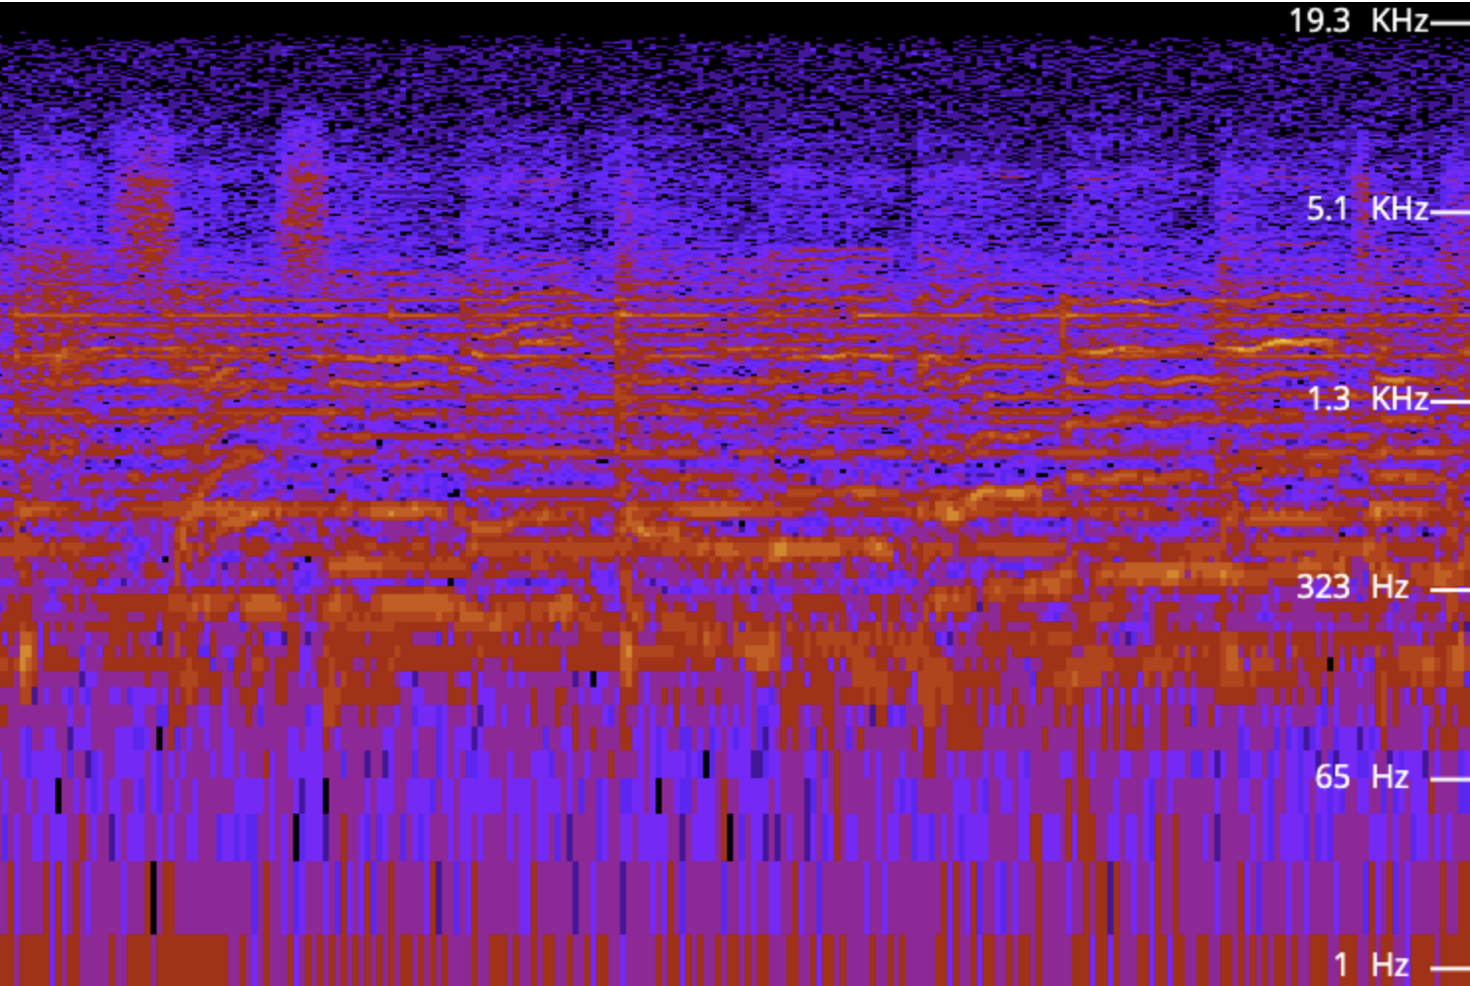
How to record audio with Arduino
Microphone converts the sound signal to voltage signal
Arduino serves as an ADC (Analog-Digital converter) and measures the output of the microphone
The processer puts the audio data in buffers in SRAM (Static random access memory) first and then move them to the MicroSD card
With a third-party library (SdFat), the recording quality can be up to 10-bit 40 kHz or 8-bit 55 kHz
Processer
Mic
MicroSD
SRAM
Arduino
Audio sample 10-bit 40 kHz

Slide 11
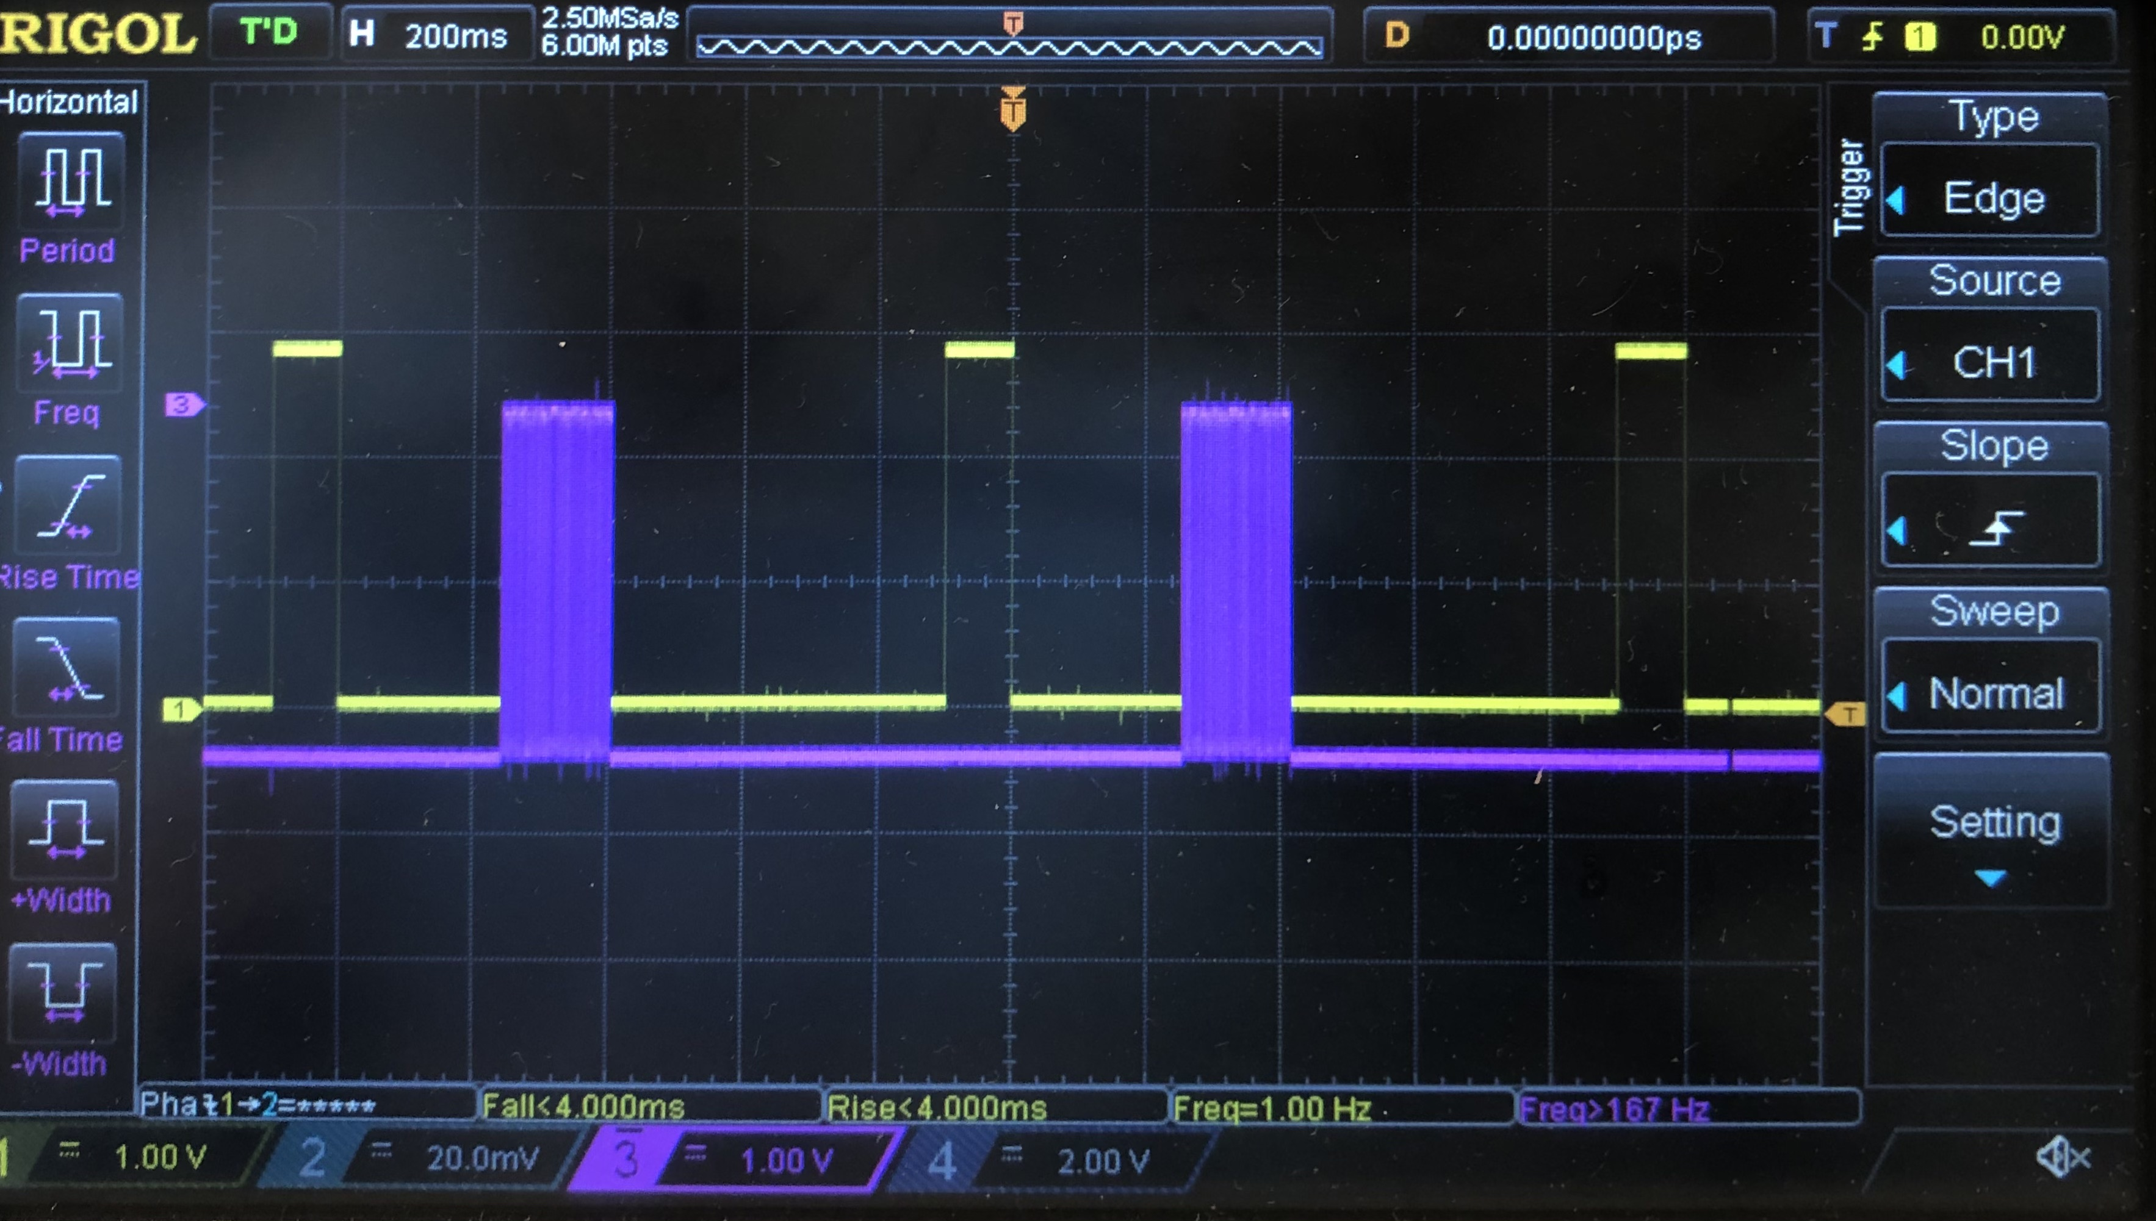
How to synchronize and calibrate the time
The GPS breakout board provides an accurate time signal by PPS (Pulse-Per-Second) pin, which sends a 100-ms pulse every second. The time error is about hundreds of nanoseconds
Synchronize: The Arduino would wait for a rising edge from PPS pin to start recording
Calibrate: Use the internal clock of the Arduino to time the duration of five PPS pulses. Obtain the absolute speed of the clock from the results
Formula for the process:
For a series of data $a_{i}$, with the index $i=1,2,3,…$
The exact time when $a_{i}$ was recorded
$$t_{i}=t_{0}+αΔt×i$$
Where $t_{0}$ is the starting time, $Δt$ is the nominal time interval, $α$ is the time calibration coefficient such that $αΔt$ is the real time interval
This method can only deal with linear errors
1 second
PPS pin and serial pin of the GPS

Slide 12
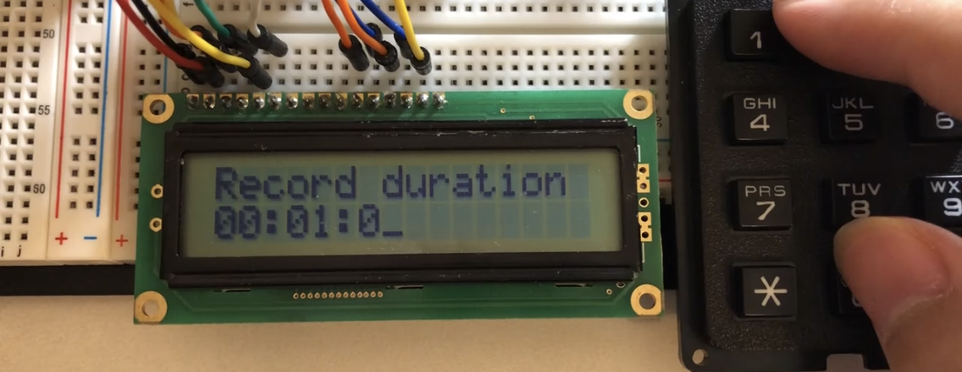
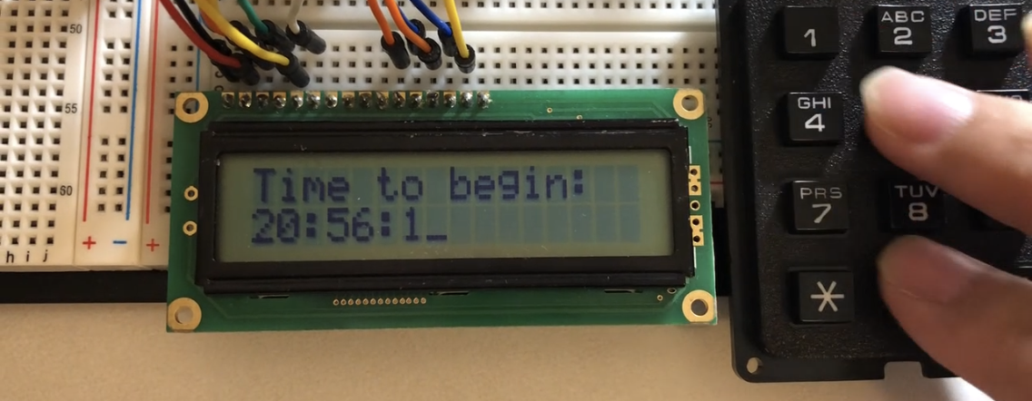
Other features
Convenient user interface: use LCD display and keypad to set the beginning and ending time
Record temperature, air pressure, and humidity information with BME680 after recording to estimate the sound speed
Use interrupt serve routine to increase time accuracy
Automatically waiting for GPS signals and set the time for the real time clock
……
User interface: set record duration and starting time

Slide 13
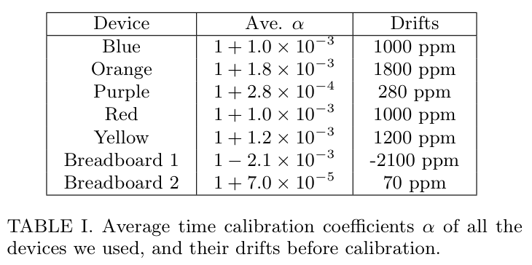
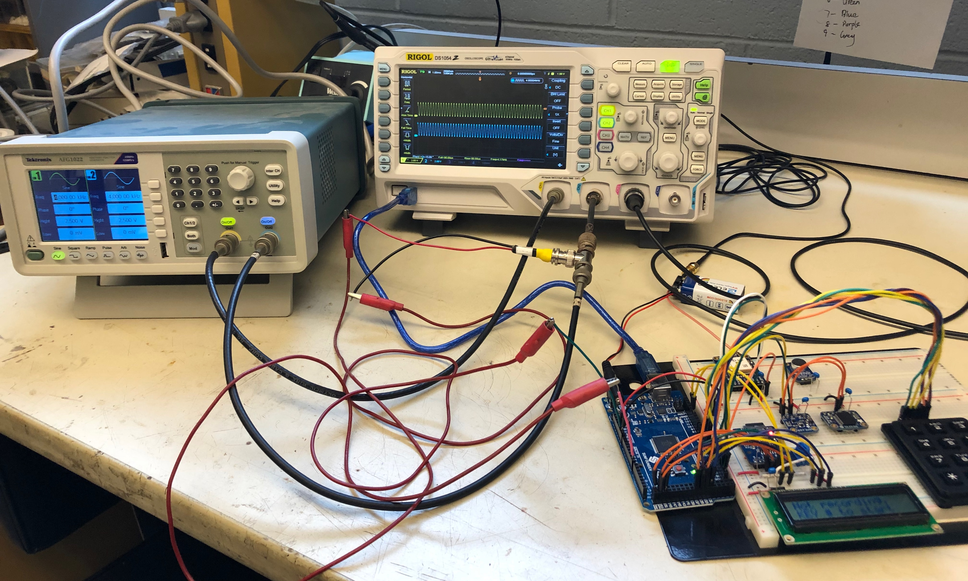
Accuracy Analysis
Let the DAQ measure the signals produced by a commercial function generator and compare the results
Before calibration: the time drifts were about $±0.2\%$
After calibration: the time drifts are smaller than 10 ppm
Testing devices: a function generator (Tektronix AFG1022, time accuracy ±1 ppm), an oscilloscope (RIGOL DS1054).

Slide 14
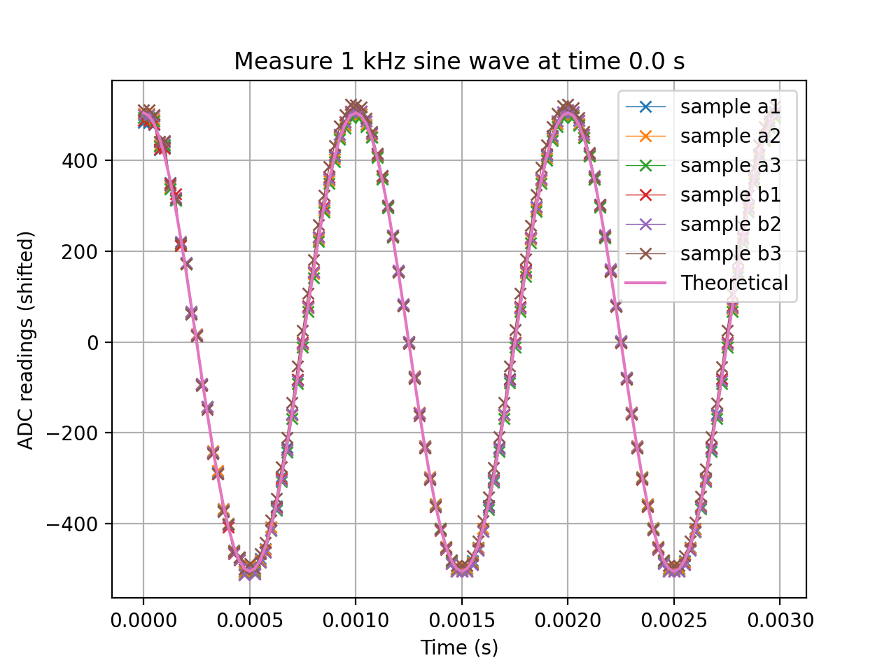
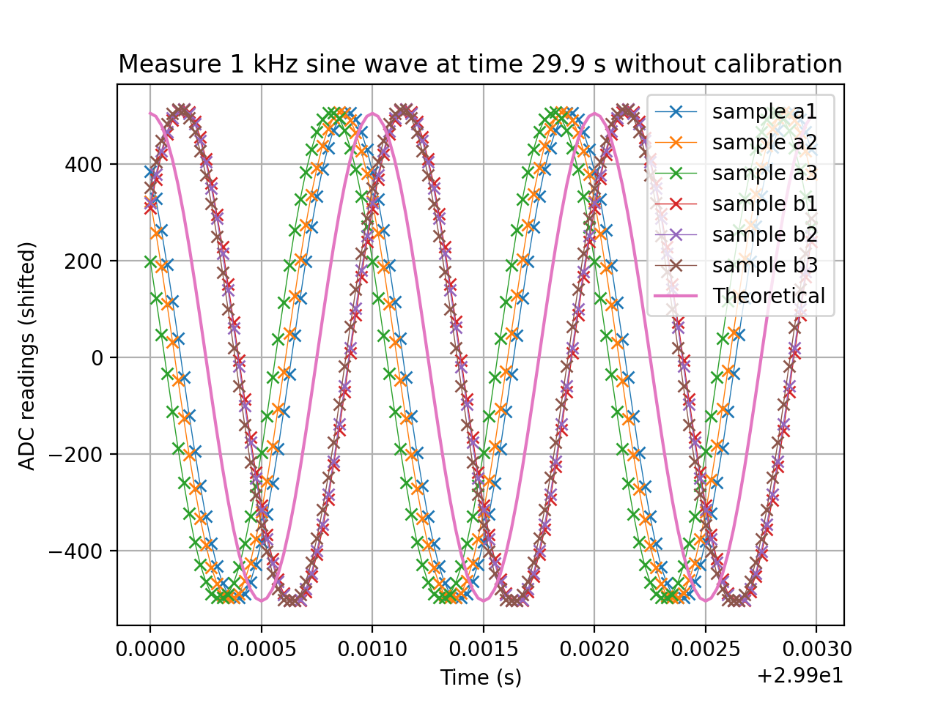
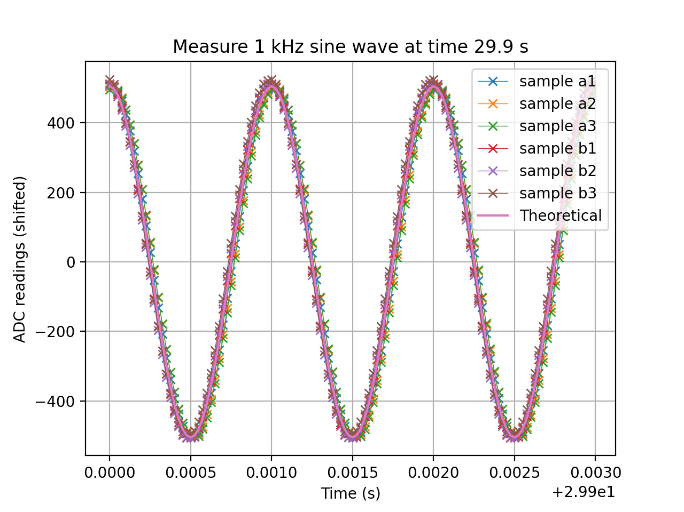
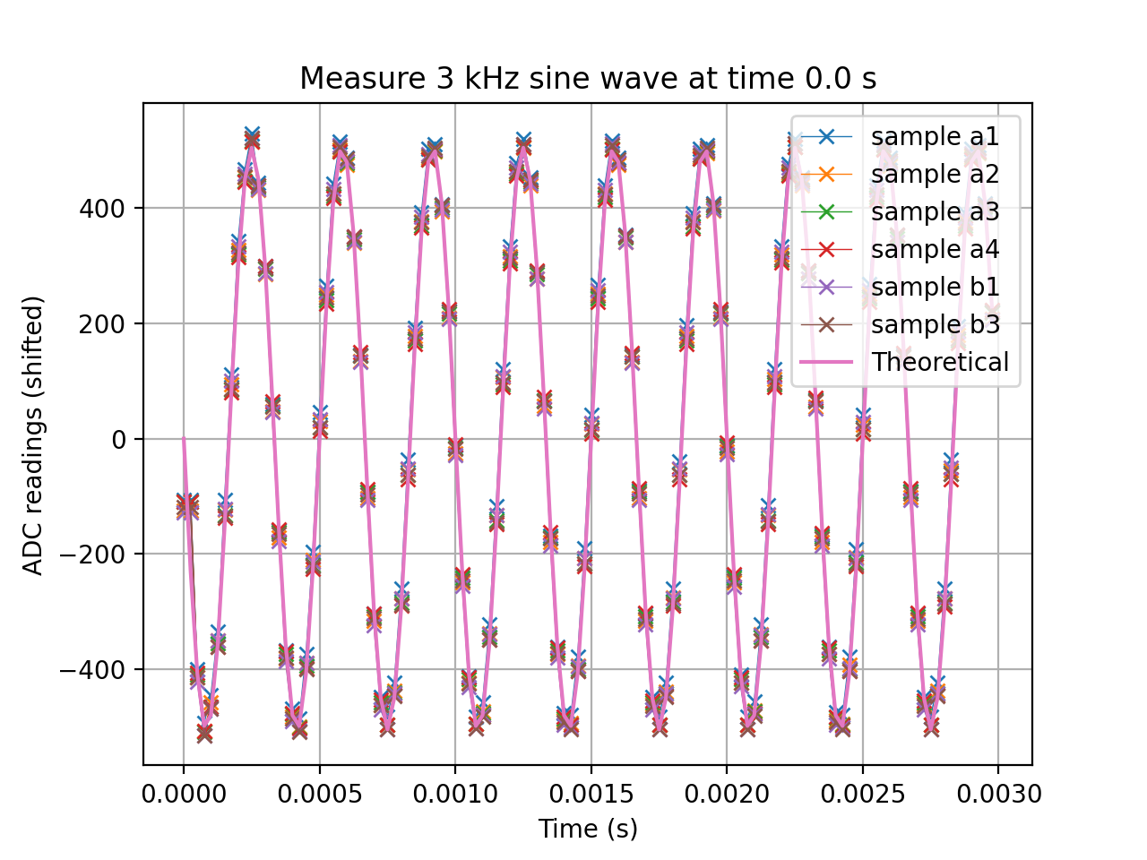
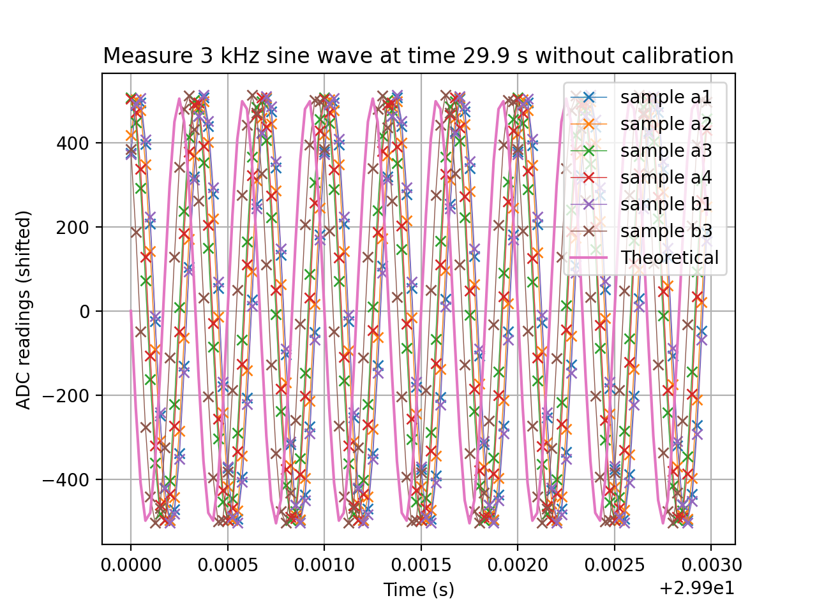
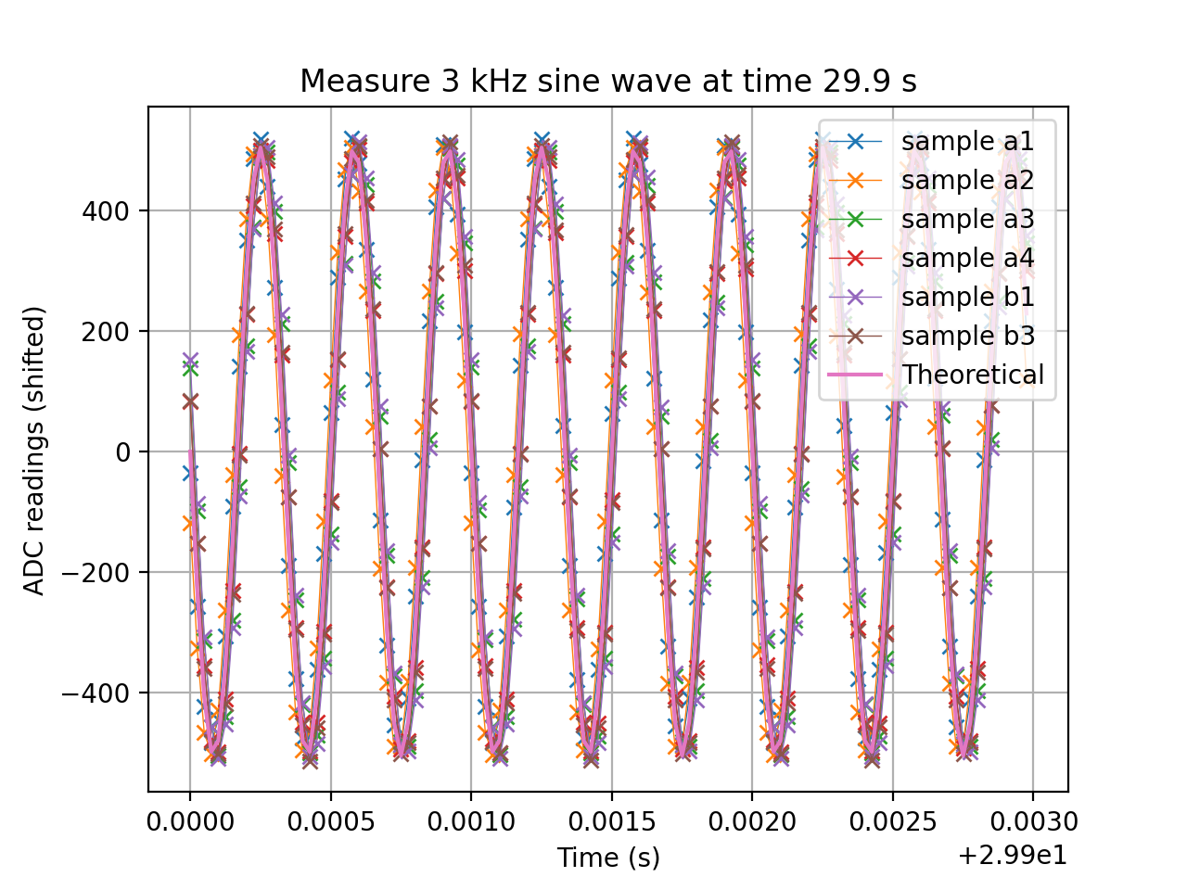

Slide 15
Experiment Setup
Experimental setup
The locations of the Arduinos form a square diamond with each vertex 5 or 10 meters from the center
The sound sources (car beep or chirp) are located at the red circle marks
(a) car beep
(b) chirp

Slide 16
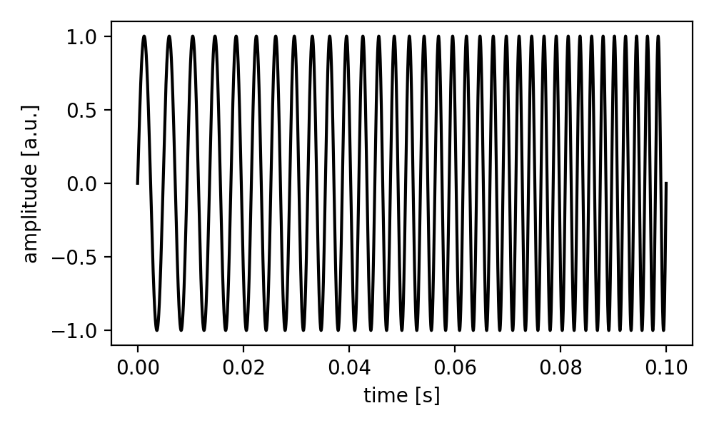
Chirp Signal

Slide 17
Experiment Process
Open ground, less wind weather
Five Arduinos are put on the vertices of a diamond/square, marked in red circles
There are two Arduinos at the left vertex and the remaining three Arduinos are at the other three corners
The car is directly at the right vertex and plays a beep sound
Illustration of an experiment setup.

Slide 18
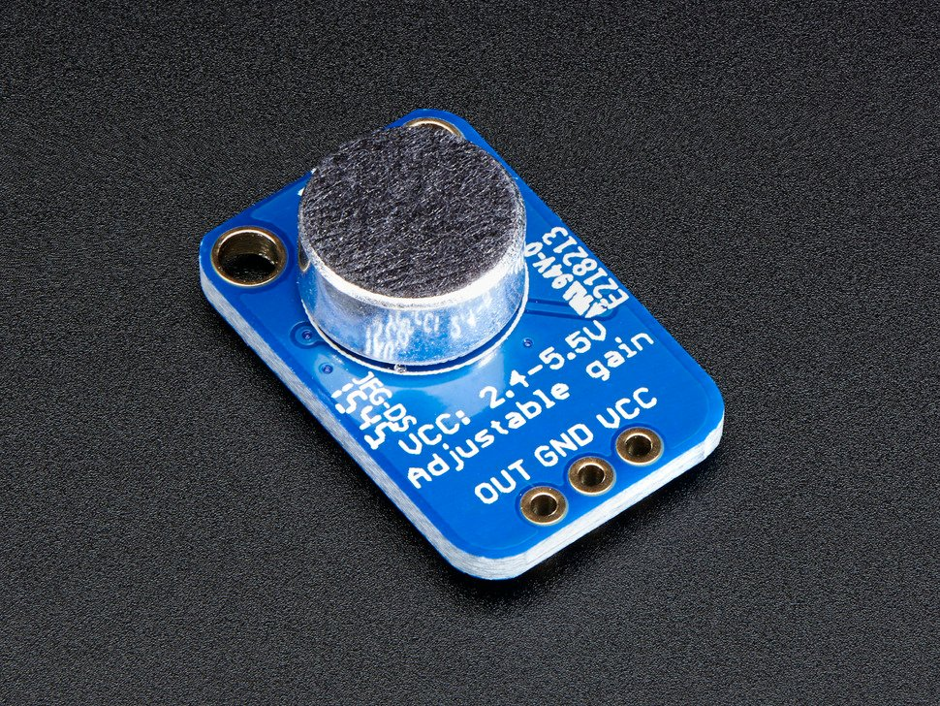
Recordings
In each test, we collect data and identify the sound signals from one of the recordings
Then we obtain the arrival times (time shifts) in other recordings by comparing them with the signal using the L₂ metric
With all the arrival times, the source location can be calculated by minimizing the cost function

Slide 19
Raw audio recordings
Used Chirp as the sound source
The zoom-in window shows the start of the audio signals

Slide 20
L₂ metric
Choose red signal as the reference
Minimize $L_{2}$ metric to obtain the time shift $τ_{i}(t)$
The zoom-in window shows the lowest for each recording to identify optimal time shift $τ_{i}(t)$

Slide 21
Audio Signals
Extracted the audio signals $s_{i}(t)$ from $r_{i}(t)$
The zoom-in window shows the matching between audio signals
Audio signals increase/decrease simultaneously

Slide 22
Source at Different Locations
Four microphones’ locations form a square diamond
The sound source (chirp) is at the red circle at different locations for different tests
The signal at the left vertex $\left(−10, 0\right)$is the reference signal

Slide 23
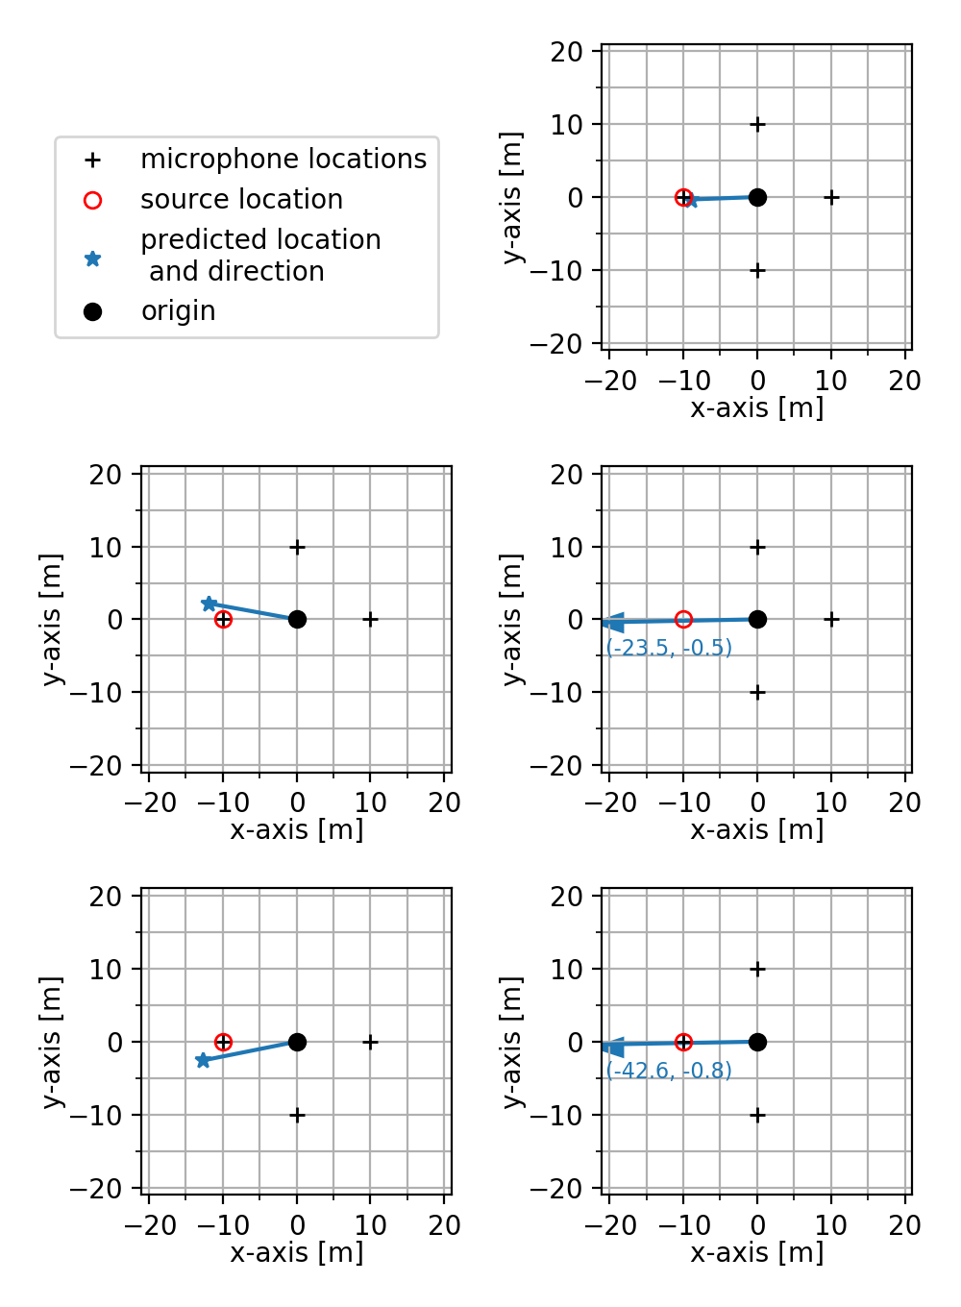
Different Combinations of Detectors
Different combinations of detectors for Test 3
The one below uses all detectors whereas the right four use different combinations of three detectors

Slide 24
Analysis and Discussion
Using chirp as the sound source performs better than using car beep
Car beep has only one frequency
Car beep may saturate the microphone
Using all devices is in general better than the prediction using only a subset of the devices
Random error will average out better with more devices

Slide 25
Conclusion
We worked as a team to design a sensing system to locate a sound source and make measurements:
We successfully synchronized time and recorded sound signals with Arduino
We developed robust algorithms to calculate the location accurately
We did dozens of measurements using simple recording devices
We designed a custom case cover
Our result predicted the location of the source signal correctly in a well-controlled environment
The results could be improved if switched to more advance sound recording system or adding more microphones
We appreciate the help from Professor Gollin and Shubhang during the entire project
Zhuo Chen
zhuoc3@illinois.edu
Peng Cheng
chengp7@Illinois.edu
Leyang Liu
Leyangl2@illinois.edu
Wenqing Wang
wenqing2@illinois.edu
Kaiwen Hu
kaiwenh2@illinois.edu

