Slide 1
A Study of the Energy Efficiency of Various AA Batteries
David Cruz Lopez, Enrico Ruffolo, Oishee Nandy, Lavanya Upadhyaya PHYS 398 DLP | Professor Gollin | Fall 2020

Slide 2
Reason behind this project
Initially wanted to focus on a topic relating to energy, such as studying wind turbines or examining renewable power via solar panels. However, we couldn't find a project that seemed feasible with our resources.
Therefore, we chose to study battery technology, since these devices are fundamental to producing, storing, and consuming energy. Similarly, with the push for clean energy solutions, having optimal methods of energy storage increases the overall effectiveness of clean energy.
The goal of our project was to find the energy efficiency of different kinds of batteries in various temperatures, which will help us understand how different chemical composition withstand different environments.

Slide 3
Purpose of the Project
This experiment aimed to investigate the energy efficiency of three types of AA batteries -- Lithium-Ion, Nickel Cadmium, and Nickel-Metal Hydride -- at different temperatures.
A method of data collection was developed using Arduino Mega 2560 board and various Adafruit sensors.
The reliability of our collection system was adequately documented and then results were analyzed.
The final results were ratios of energy input through the charger versus energy that was able to be discharged through a load.
Our results showed that some batteries work better in different temperatures ranges, but in general, the efficiency decreased as the temperature decreased.

Slide 4
AA Batteries
Two Types of batteries
Galvanic - able to discharge energy through a spontaneous redox reaction
Electrolytic - able to use energy through a non-spontaneous redox reaction
Primary v. Secondary
Criteria of AA Battery
Size - length of 49.2–50.5 mm and diameter of 13.5–14.5 mm.
Steady state voltage - 1.2-1.5 Volts
Differing capacities, chemical compositions, internal designs, which lead to different characteristics in charging and discharging
Notes:
Cells can be described as galvanic or electrolytic. A galvanic cell derives energy from spontaneous redox reactions taking place between the anodes and cathodes, while an electrolytic cell utilizes energy to perform non-spontaneous redox reactions. Primary batteries have solely galvanic cells, meaning the reaction utilized to generate electrons at a higher potential is not reversible. Secondary batteries, such as rechargeable batteries, can reverse the reaction by applying a potential to the cathode which restores the anode ). All three of the batteries used in this project are secondary batteries, and therefore rechargeable.

Slide 5
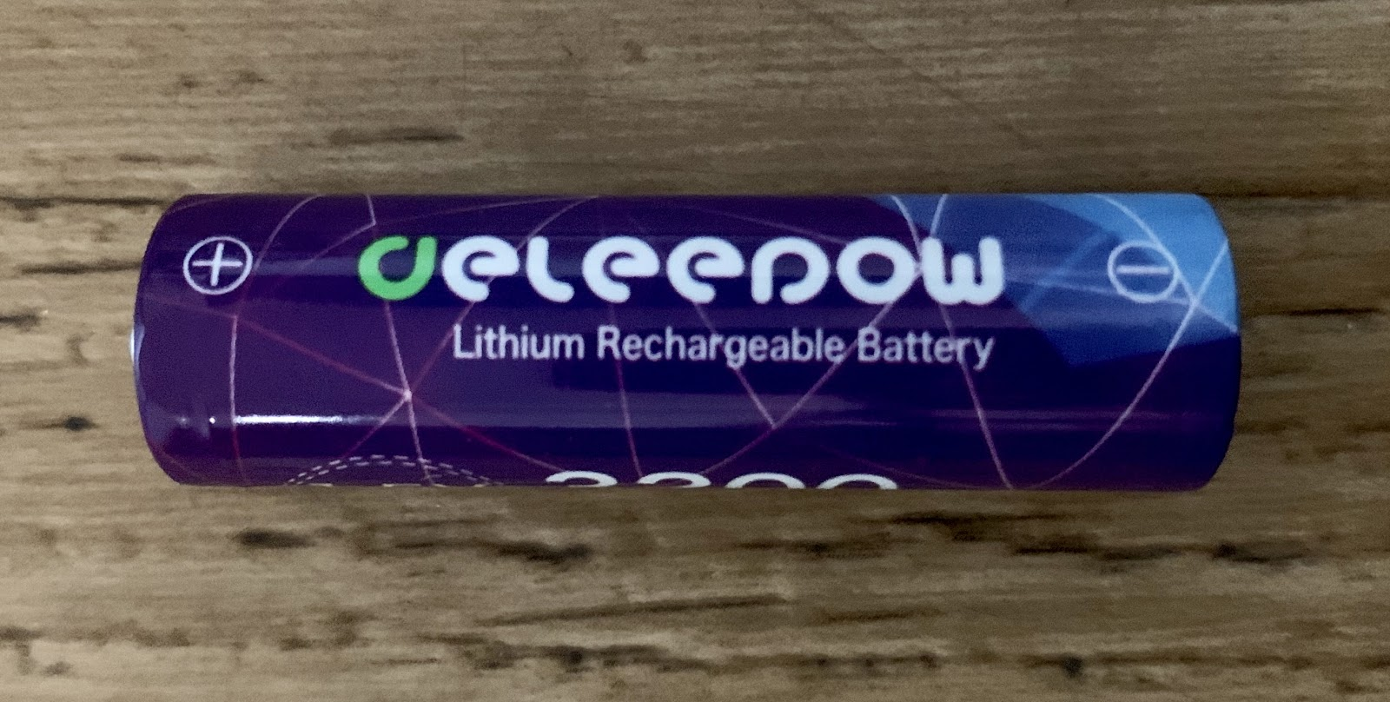
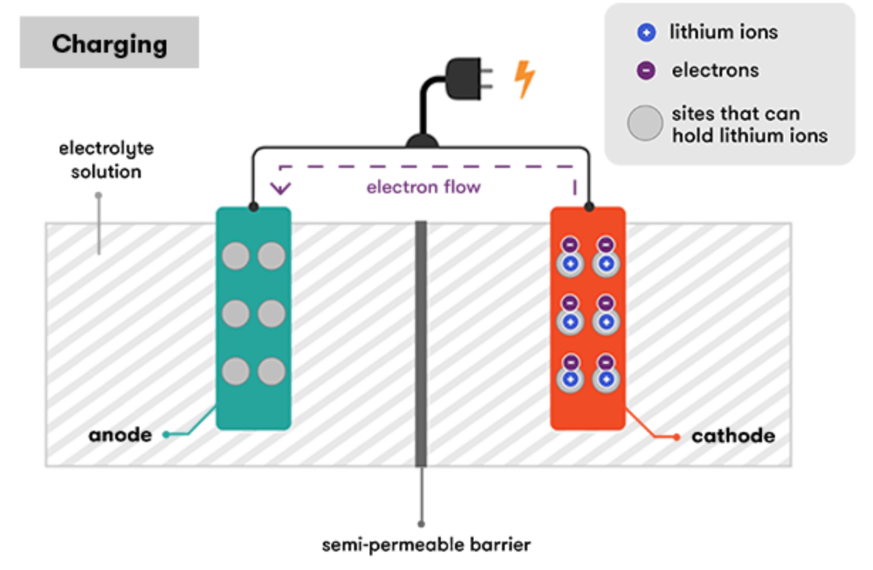
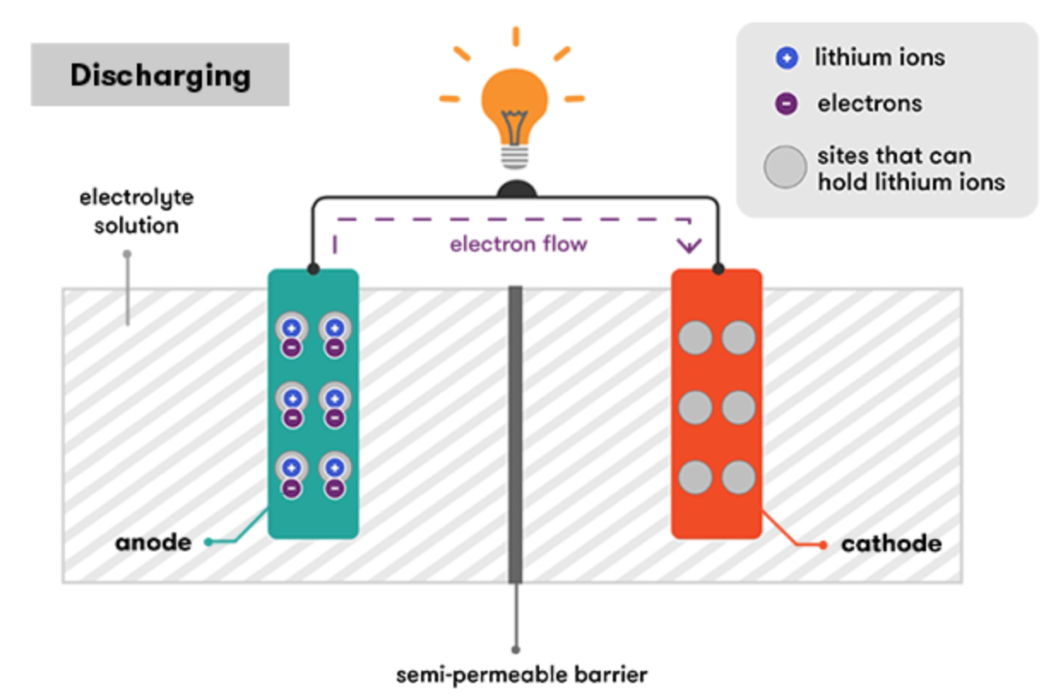
Batteries used
Lithium-Ion
Constructed from two positive and negative electrodes separated by a liquid chemical electrolyte, such as diethyl or ethylene carbonate
Work well in various systems and environments due to their high power density, lightweight, long lifespan, and thermal stability.
Typically have built-in regulators to decrease cell voltage and prevent damages such as overheating, complete discharge, and overcharging

Slide 6
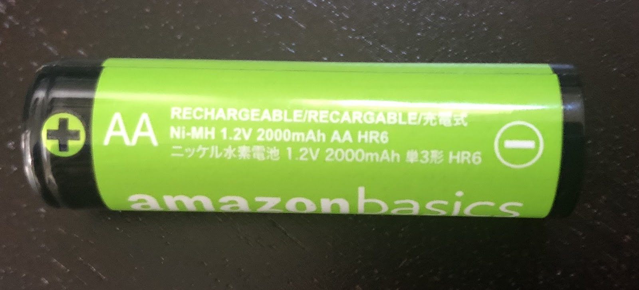
Batteries used continued
Nickel Cadmium
Electrochemical reaction: Cd (s) + NiO₂ (s) + 2H₂O ↔ Cd (OH)₂ (s) + Ni(OH)₂ (s)
Older technology but reliable within cooler conditions due to smaller natural discharge rates
Typically used within heavy duty power systems that require high current, as NiCd sees increased efficiency
Nickel-Metal Hydride
Electrochemical reaction: M + Ni(OH) ₂ (s) → MH + NiO(OH) (s)
Newer nickel-based battery which uses metallic alloys to store hydrogen
Functions similar to a hydrogen battery
Has significantly higher capacity than NiCd, but very heavy due to mainly metal components

Slide 7
Information about our batteries
The table below shows specifications for the batteries used in our experiment. This information helped us analyze the accuracy and clarity of our results as we were performing the experiments. We found specific information from manufacturers about different kinds of batteries, which we then checked with our results to prove efficiency via power ratios.

Slide 8
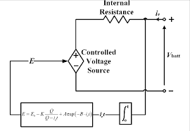
METHODOLOGY

Slide 9
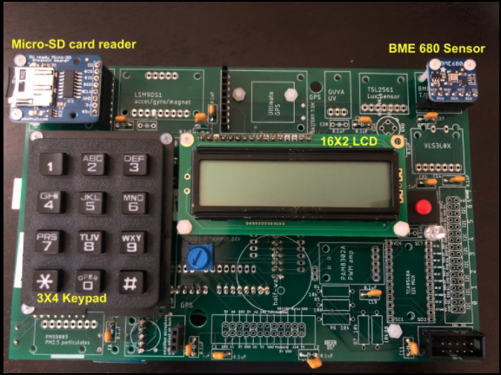
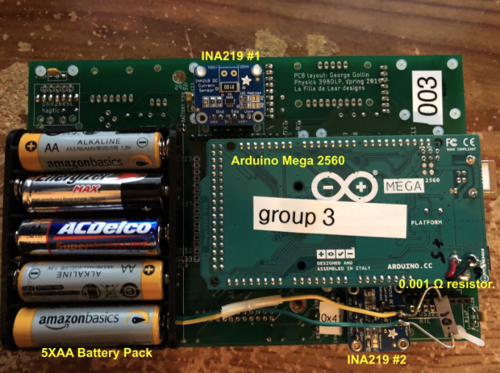
Experimental Design – I: General Instrumentation
Notes:
The Arduino Mega 2560 board was interfaced with the following sensors to collect and store data:
Adafruit INA219 #1: Used to monitor the current, voltage (shunt and load), and power of the 5*AA batteries on the PCB.
Adafruit INA219 #2: Used to monitor the current, voltage (shunt and load), and power of the test battery on the proto board.
Adafruit BME680: For measuring the ambient temperature, atmospheric pressure, and humidity that the batteries were exposed to.
16X2 LCD display: To display menus within the testing program, as well as the data being collected.
10kΩ Trimpot: To control the LCD contrast.
3X4 Keypad: Used to input the selections for the battery and test type to call the appropriate functions in our data acquisition system.
Micro-SD board and card: Used to read, write, and save data collected from INA219 and BME680 sensors.

Slide 10
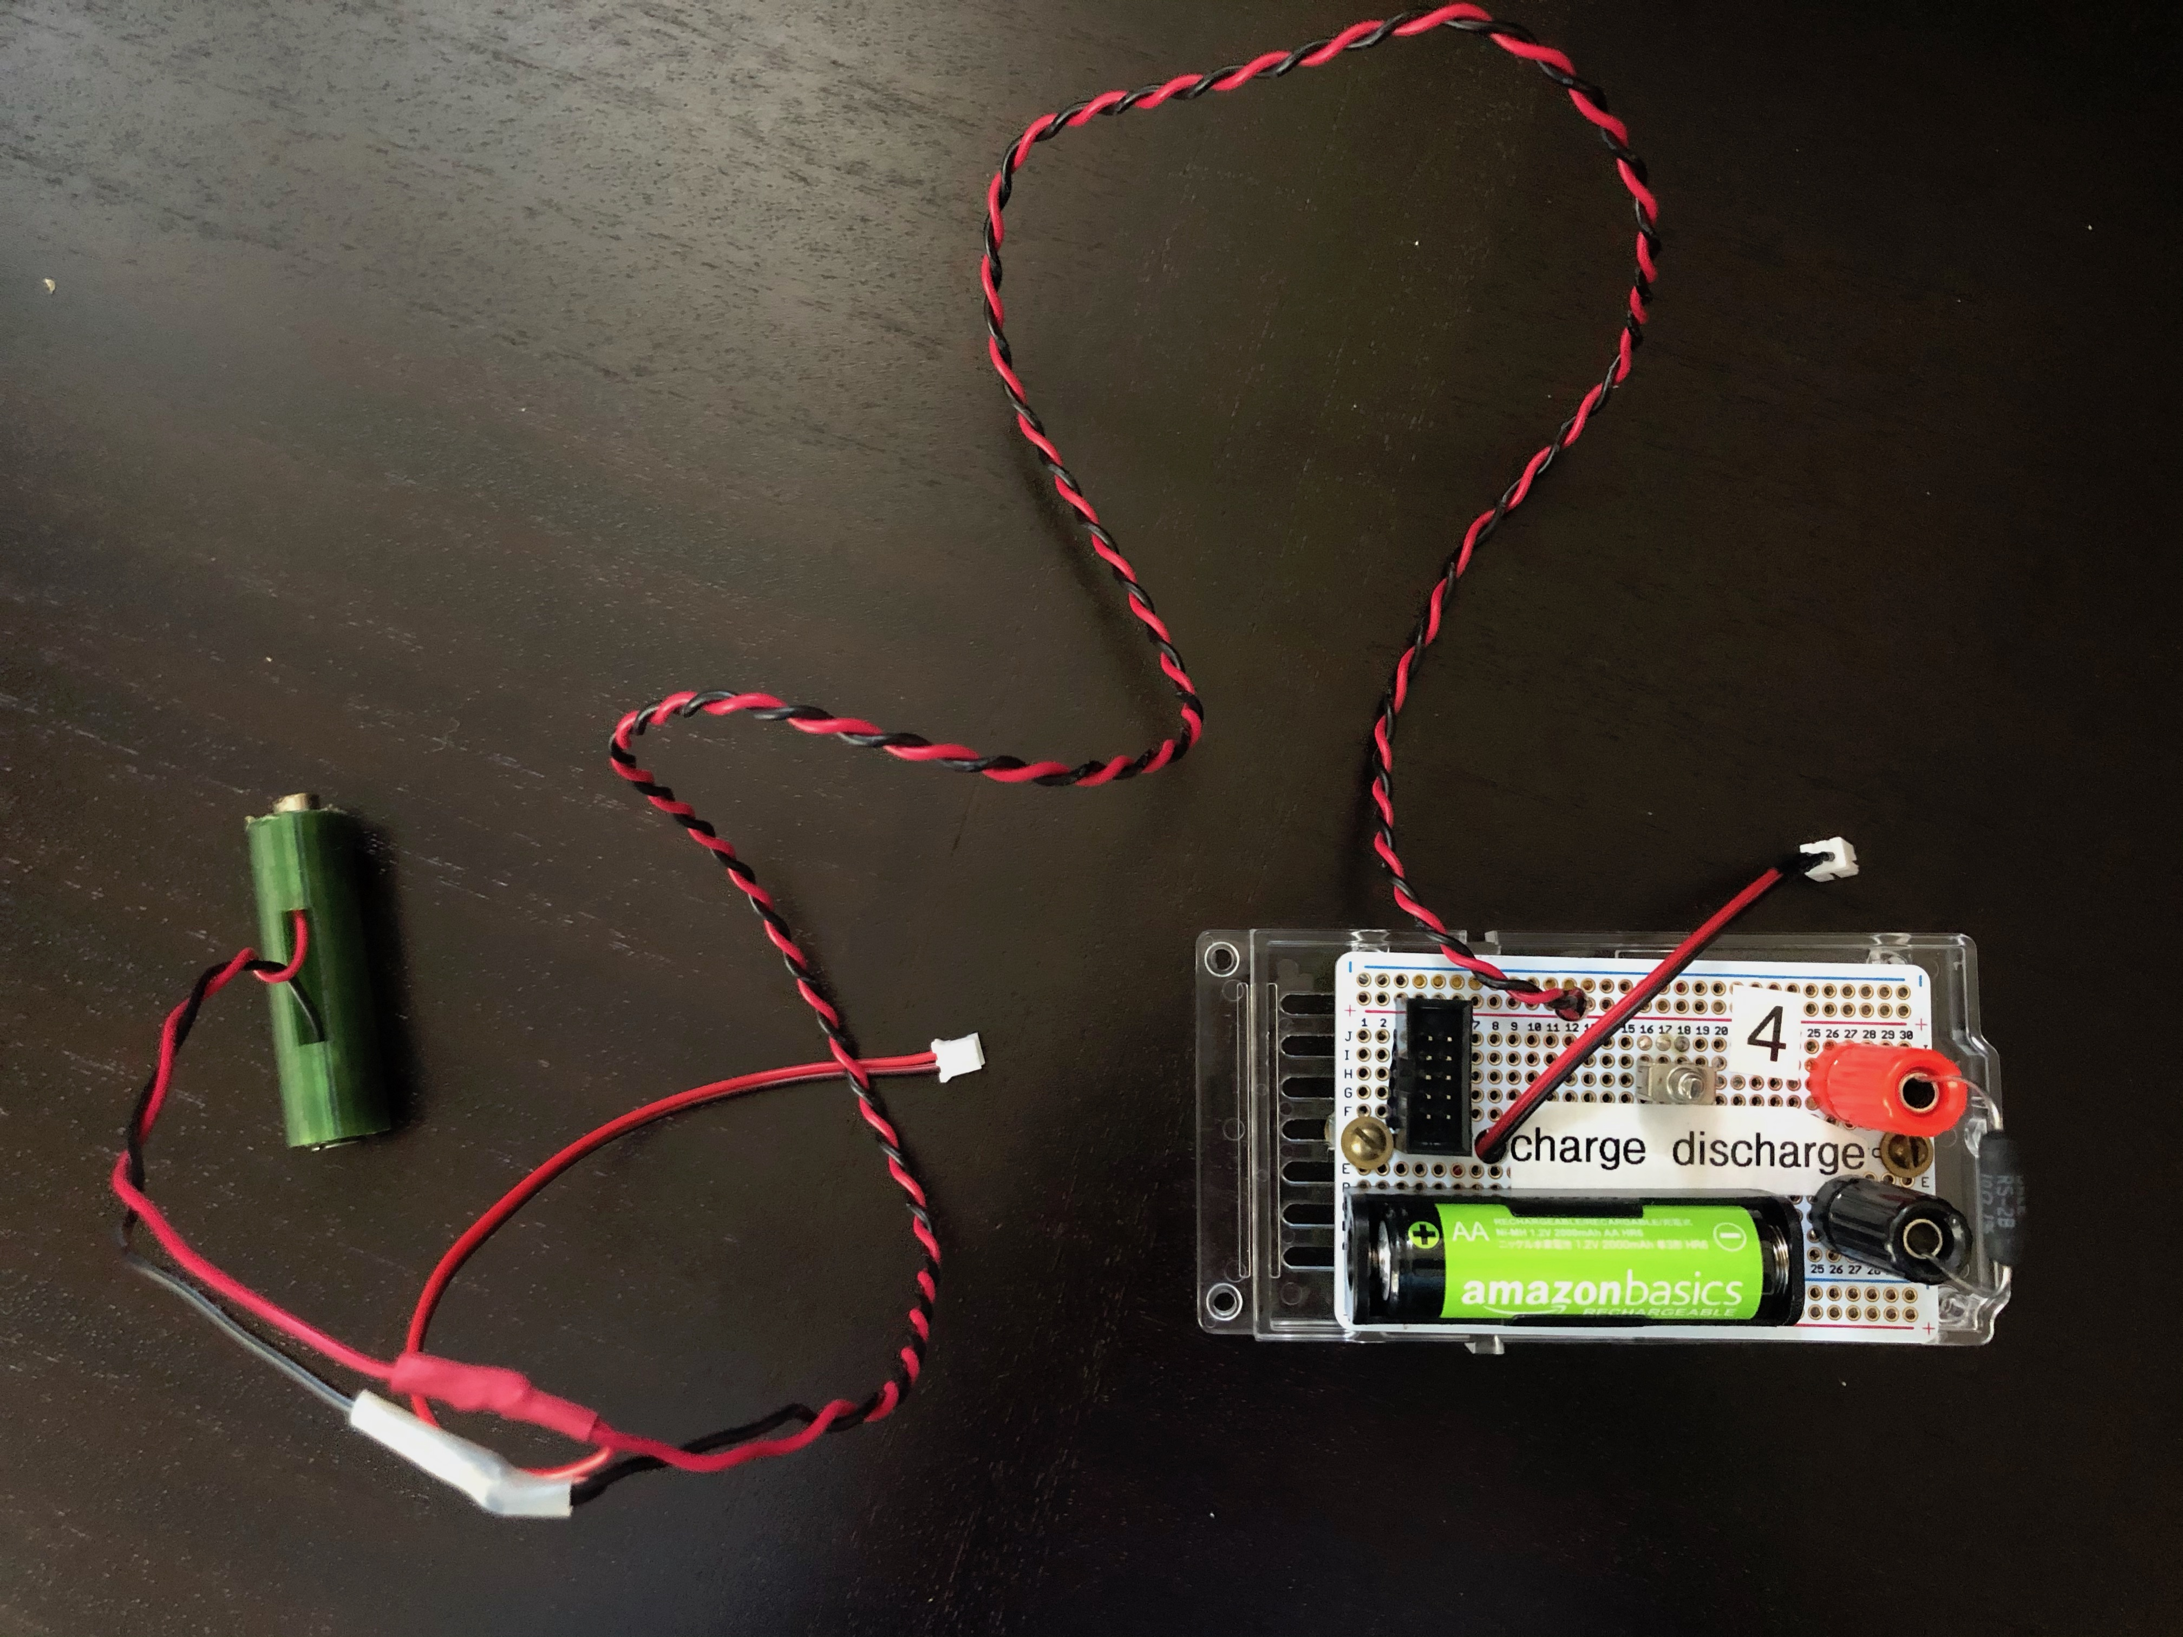
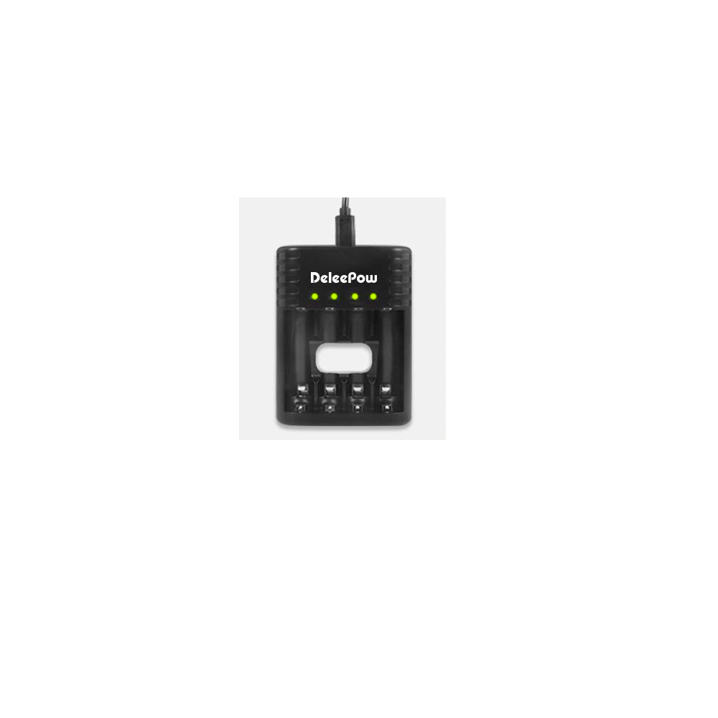
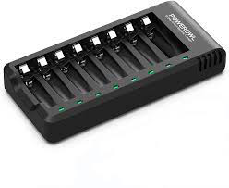
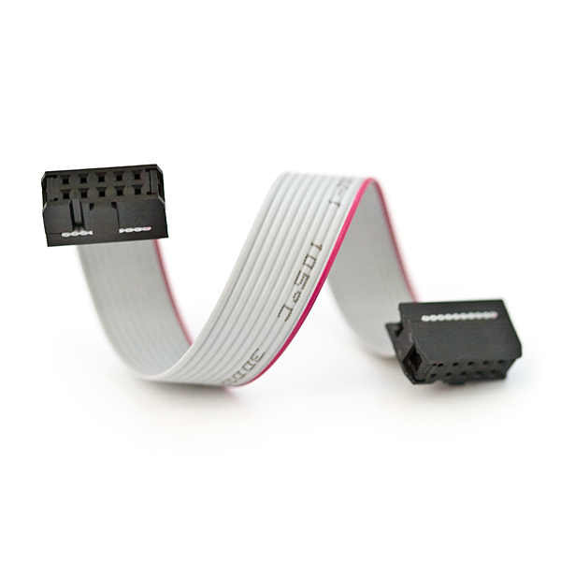
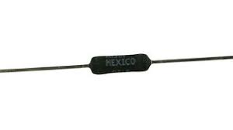
Experimental Design – II: Instrumentation specific to our project
Additional Componets Used :
Protoboard: Battery socket, fake battery, and screws
Resistors : Two 10Ω resistors & One 0.001Ω precession resistor
Ribbon cable connector : Connects PCB to proto board
Battery chargers : POWEROWL, AmazonBasic, and DeleePow
Notes:
Other than the Arduino Mega board and its interfaced sensors, we used the following components :
Precision resistors : 2 10 ohm resistors used to discharge the battery and 1 0.001 ohm resistor used to modify the INA219.
Ribbon cable connector : Used to connect the PCB (containing the Arduino Mega and sensors) with the proto board (containing the test battery and precision resistors)
Battery chargers : POWEROWL NiCD Charger, AmazonBasic NiMH Charger, and DeleePow Li-Ion Charger.
They all contain internal circuitry that helps dynamically determine how to charge the battery.

Slide 11
Testing Procedure

Slide 12
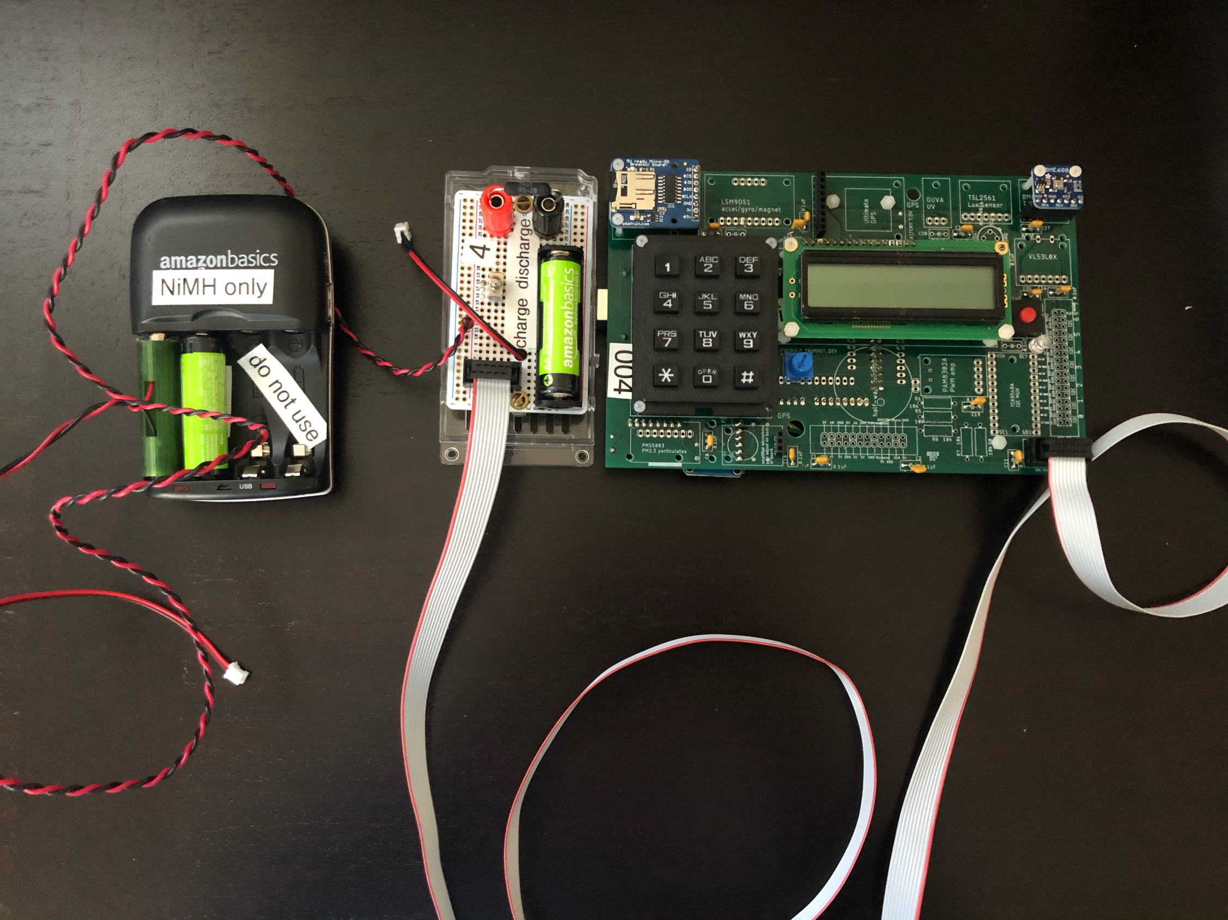
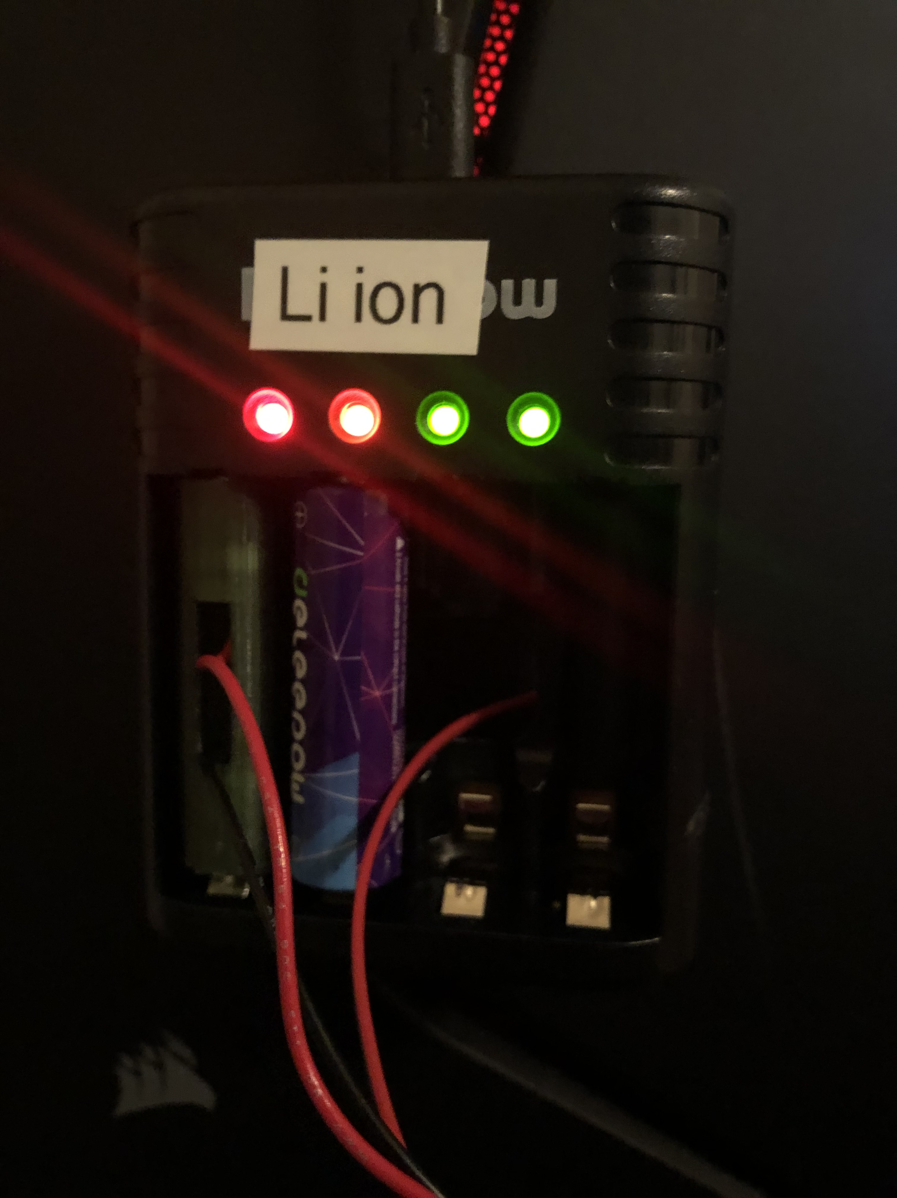
Test set up

Slide 13
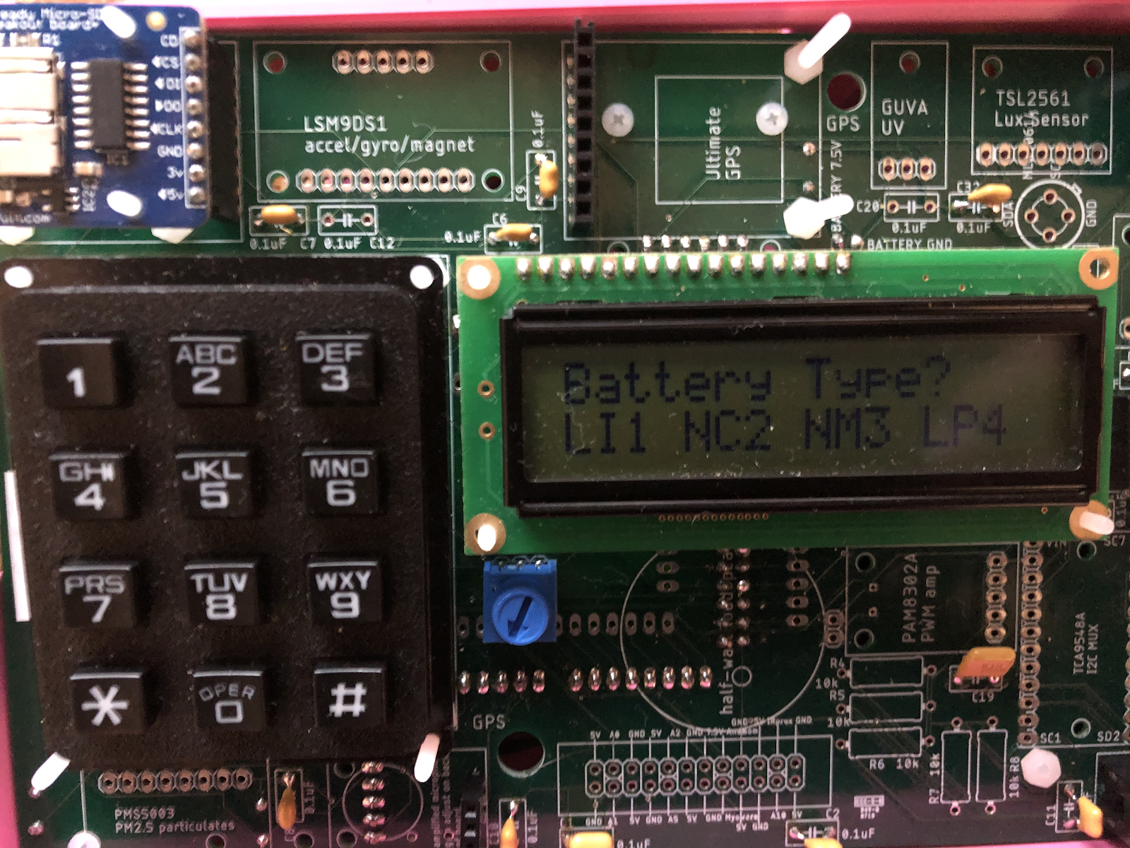
Data Acquistion (DAQ)
User input on keypad tags datafiles with criteria relating to testing parameters
Text files are used to store periodic measurements of voltage, current, ambient temperature, ambient pressure, humidity, and milliseconds
Time step between measurements is about 1/3 a second
No DS3231 or GPS
Second program developed to take burst of high frequency measurements to analyzing charging cycles
Duty cycle analysis

Slide 14
Offline Analysis
Text files were imported into analysis as Pandas dataframes
Analysis of INA219 noise was performed using Lomb-Scargle analysis
Graphing
Charging and Discharging
Voltage, current, and integrated power shown as functions of time
Integrated power was calculated with Reimann sum approximations in accordance with duty cycle
Duty Cycles
Cycles within charging current shown as function of time

Slide 15
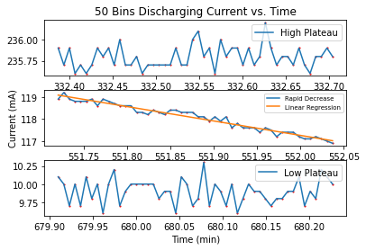
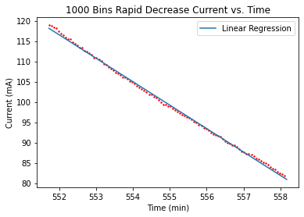
Examination of Noise from the INA219
Using NiMH discharge to study INA219. This is because their discharges are suppose be continuous and provide little oscillation (Vassal, 1999).

Slide 16
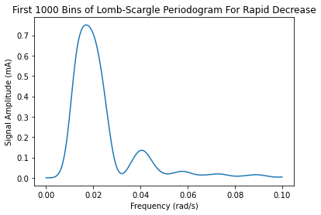
LOMb-Scargle Analysis

Slide 17
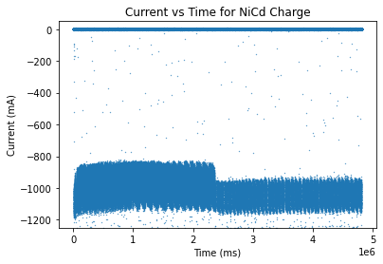
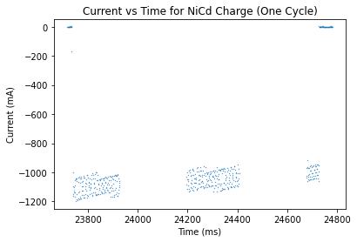
Duty cycle analysis

Slide 18
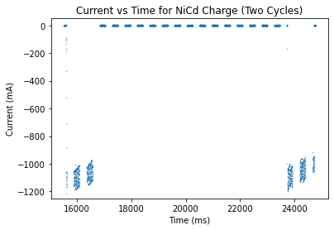
Duty cycle analysis continued
NiCd duty cycles were approximately 15% and 3%, while NiMH had cycles of approximately 80% and 99%. These ratios were consistent with lower frequency measurements and as a result, netted little effect on our calculations.

Slide 19
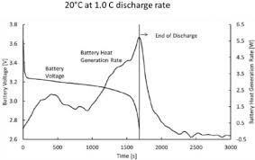
RESULTS

Slide 20
Overview
Two temperature conditions were analysed – normal conditions (room temperature of 25°C) and cold conditions (5°C)
Plots were made showing the relationship of current and voltage as a function of time for every chemical composition
Furthermore, plots were made to demonstrate the ratio of energy emitted during the discharge process to the energy transferred during the charging process to show the efficiency of the batteries in different working conditions.

Slide 21
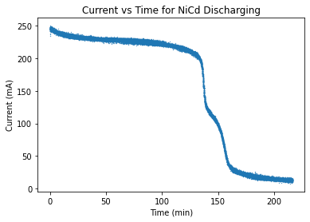
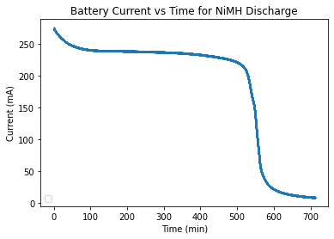
Normal Conditions (25°C) - Discharge
The Li-ion discharge curve can be described as a Heaviside function. The presence of the voltage regulator in the Li-ion battery is evident from the graph above.
The nickel-based batteries appear to follow a similar curve with slight differences depending on the capacity. The curve is a continuous current curve, which eventually decreases rapidly when the available energy is depleted.
The manufacture mentioned capacity of the battery gives a good estimate of how much current a discharging battery will provide and for how long.
Integrating these curves will give us an understanding of how much usable energy a completely charged battery contains.
Notes:
Taken from paper -
Other than the basic similarities in the curves of the nickel based batteries, evidence of overcharging is displayed by the higher current at the beginning of trials. In the case of the Li-ion battery, which has a voltage regulator, it can be seen that the voltage decreases to precisely 1.45 volts when a discharge begins. This is less than half of the nominal cell voltage, but within the regulations of a AA battery. This voltage is maintained until the battery is unable to supply enough power to maintain this voltage through the regulator. At the 297 minute mark, the current and voltage immediately drop to 0 indicating the regulator is not able to maintain the specified voltage and turns off. Approximately two hours into the Li-ion test, a slight drop in current values is recorded. This fluctuation is the result of measurements barely reaching a lower quantization within the INA219 ADC.
For each battery, the amount of current supplied for the specified time corresponds with the capacity estimation given by the supplier. For example, in Figure 30, the NiMH took approximately 520 minutes to begin losing voltage, and therefore current, rapidly. This data would correspond with 8.66 hours of 240 mA current, or 2080 mAh which is very close to the approximate 2000 mAh capacity given by the supplier. Each value can be seen to correspond with the capacity estimates provided by the manufacturers. Integrating the power from these discharge curves, we are able to gather an understanding of how much usable energy a battery contains after being completely charged. However, for this to be useful, a similar understanding of the charging data must be developed which we will explain further.

Slide 22
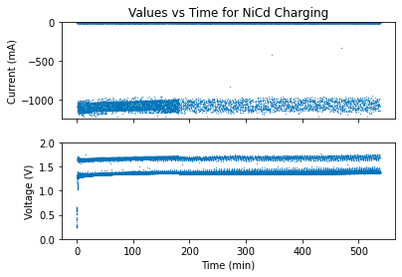
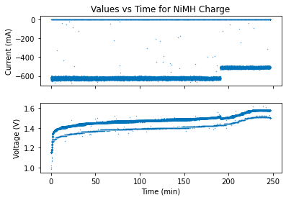
Normal Conditions (25°C) – Charge
The Li-ion charge curve is split into 3 parts - constant current, saturation current, and topping current. The charging process closely monitors voltage and supplies currents until a steady nominal voltage of 4.2 volts is reached.
The NiCd charge curve shows bimodal segmenting in the voltage curve. This is due to the changing duty cycle. The values within this plot shows that this battery charges at a significant current compared to other batteries, especially compared to its capacity.
The charging curve for NiMh batteries shows that with nearly three times the capacity, but half the charging current, NiMH batteries charge in half the time of NiCd batteries
Notes:
Taken from paper -
Li ion : Li-ion chargers work on a constant, dynamic feedback loop, attempting to maintain nominal cell voltage. The charging process is broken down into three sections: constant current, saturation current, and topping current. During the constant current region, voltage rises linearly at very small rates. When voltage peaks, a new current called saturation current continues charging the battery. However, saturation current decreases overtime. In most chargers, this decrease is exponential, but here we see a linear trend from minute 40 to 65. After another peak in voltage, the topping current begins. This process closely monitors voltage and supplies currents in accordance until a steady nominal voltage of 4.2 volts is reached. As a result, current is maximized while voltage is maintained allowing for less lithium plating to develop on the anode. However, this feedback loop does not actually function off voltage in most cases. Most chargers function off of internal resistance values, which will be proven problematic.
NiCd : The bimodal segmenting of the voltage is the result of a charging duty cycle, as discussed previously. In the case of the NiCd charger, the manufacturer has two different percentage cycles. Approximately 3 hours into this charging cycle, the charger switches from a 15% duty cycle to a 3% duty cycle. The duty cycle changes when a specific internal resistance value, and the corresponding battery temperature, has been reached. The difference in the percentage duty cycles can be seen by the density of the scatter plot decreasing after the 3 hour mark. The values within this plot shows that this battery charges at a significant current compared to other batteries, especially compared to its capacity. In general, NiCd batteries tend to charge at rates between 0.1-0.5 C, but in extreme cases can even approach 1C without seeing lasting effects on a battery's capacity. However, there are conflicting results as our smartcharger used a current of approximately 2C. Since the charger operates with a duty cycle, charging at high currents is possible. As stated previously, Ni-Cd batteries charge more efficiently at higher currents, but are not capable of maintaining these currents for long periods of time. As a result, the charger pulses high current at low duty cycles that allow for a trickle charge of 0.125 C, but at a current of 2C. While studying our data, the periodic measurements resulted in a similar density of expected measurements, even with larger spaced sampling. As a result, duty cycle was not required to be factored into integrating the power transferred.
NiMh - The ability to make comparisons between NiMH charging and other battery types shows the importance of charging cycles. With nearly three times the capacity, but half the charging current, NiMH batteries charge in half the time of NiCd batteries. Such a difference can be explained by the significantly higher duty cycle used within this charger. The fact that the charger runs at a 80% duty cycle for the first charging portion and 99% for the second translates into a charging rate of .25 C for the NiMH, despite the current being about .35 C. This behavior allows for a more effective charging of NiMH batteries which typically charge better under steady conditions. As was found in the previous data, the duty cycles were well represented within the collected data as the ratio of zero measurements matched the duty cycle percentages. As a result, there were no required alterations to the raw data collected when calculating the integration of power from the charger.

Slide 23
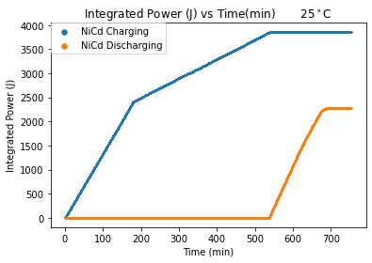
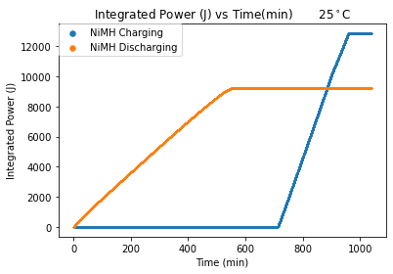
Normal conditions (25°C) – Energy ratios
The magnitude of integrated power differs for each battery due to the different capacities of each battery.
The ratio of the system’s input energy versus output energy can consequently show the energy lost throughout the process
While these curves emphasize previously established relations, the important relationship is the ending magnitudes of the curves. When averaged, they led to general ratios of :
70% for Li ion
59% for NiCd
72% for NiMh
Notes:
Taken from paper -
In order to measure battery efficiency for each battery, input and output energy ratios were generated from current and voltage collected from the INA219. These were integrated, through a riemann sum procedure, over the course of the entire charge and discharge cycle. The results of these integrations are shown in the graphs above.
The integrated power for each battery test will be of a different magnitude due to the differing capacities of each battery; however, the ratio of the system’s input energy versus output energy can consequently show the energy lost throughout the process of energy storage and data collection. Within each of these plots, the blue curve represents the integration of power during the charging process, while the yellow shows the results from discharging. These plots emphasize previously established relationships, such as the change of duty cycle in the NiCd charging causing a change in the slope. Similarly, the NiMH slope remains constant throughout the entire charging process, establishing the constant rate of power transfer discovered in Section 3.2. Finally, a very steep charging rate for the Li-ion battery, which charged at around 1 C, is observed. However, the important relationship is the ending magnitude of the curves. Over the course of many tests, these calculations were performed to generate ratios of the magnitudes. These room temperature ratios, when averaged, led to general ratios of 59%, 72%, and 70% for NiCd, NiMH, and Li-ion respectively.

Slide 24
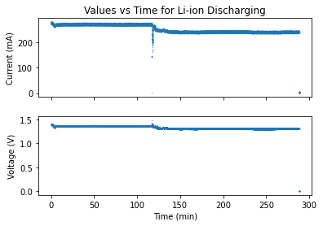
Cold conditions (5°C) - Charge & discharge for li-ion
Charge curve :
At lower temperatures internal resistance is lowered. Since this resistance is what is used to determine the timing within the cycle, the battery is overcharged.
Similar observations can be made on the voltage curve too.
Discharge curve:
At low temperatures, the internal regulator of Li-ion batteries behaves in a different way than it did at room temperature.
At low temperatures, the effects of the regulator, shown by the discharge curves, are amplified significantly.
Notes:
Taken from paper -
As was expected, the charging process proved dangerous. It is well known that charging batteries below, or around 0°C, is ill-advised. Even though it is possible, charging at these temperatures leads to voltage peaking which causes lithium plating to form on the anode. This can prove disastrous when this plating leads to the development of dendrites that cause battery failure. Within the charging plot, the faults of the charger, as mentioned previously, come to a head. The charger does not utilize voltage measurements as a means of determining the cycle switches, and as a result, the battery is overcharged. When in a lower temperature environment, the internal resistance of the battery is lowered. As this is the primary measurement used to determine the timing within the cycle, the battery is overcharged. The voltage across the battery is affected by the amount of current flowing through the battery. Regardless of the irreparable damage caused by the charging process, we see similar performance while discharging at lower temperatures.
The effects of the regulator seen in the discharge curve for li-ion at room temperature, are amplified significantly. The voltage drop is nearly 4 times higher than that at room temperature, showing the significant effects of temperature on the regulator. Other than that, the discharge processes differ by minutes and maintain similar currents.

Slide 25
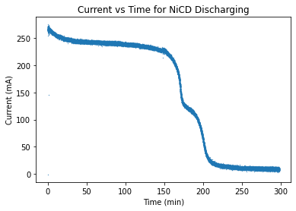
Cold conditions (5°C) - Charge and discharge for nicd
Charge curve :
NiCd batteries are expected to work well in cold temperatures.
The charging curve shows slight differences when compared to the curve for charging at room temperature.
This is attributed to the fact that the process takes less time and the duty cycle switch occurs later
Notes:
Taken from paper -
When charging Ni-Cd batteries in lower temperatures, relatively little change in performance is expected. As mentioned previously, NiCd batteries are the hallmark for maintaining functionality within cooler conditions. The charging curve shows slight differences, as the process takes less time and the switch between duty cycles occurs later. Both of these are expected because lower temperatures lead to the internal resistance of the NiCd battery appearing lower, resulting in the duty cycle switch occurring later. As a result of the increased time within the first duty cycle, the time required decreases but the internals of the battery are likely affected. This is confirmed in the voltage peaking that occurs at values greater than 0.5 V above the nominal values at room temperature.

Slide 26
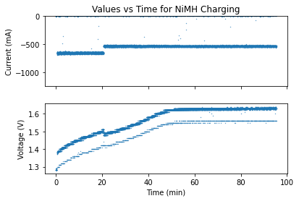
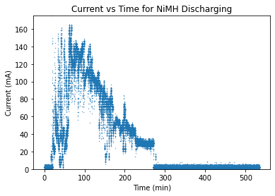
Cold conditions (5°C) - Charge & DISCHARGE FOR NIMH
Charge curve :
While the charging process follows a similar layout to the charge curve at room temperature, it undergoes a cycle change significantly earlier.
In the second duty cycle, a similar timeframe to the one at room temperature is observed.
Overall charging time is decreased by 40%.
Discharge curve :
The process of discharging shows similar issues.
Might be better to examine the internal temperature and pressure of the battery to understand its erratic behavior.
Notes:
Taken from paper -
The supposed working ranges of NiMH should include 5 °C. However, drastic changes are observed. The charging process follows a similar layout, but undergoes the cycle change significantly earlier within the process due to the voltage peaking quickly. However, in the second duty cycle, a similar timeframe to the control is observed. The overall charging time is decreased by around 40%, leading to significantly less energy transfer. The process of discharging shows similar issues as steady currents are never obtained. Within this plot, little reasoning behind the erratic behavior can be found. The overall trend shows no signs of patterns. To better understand the improper functioning of a NiMH battery at this temperature, a method of collecting internal temperature and pressure may prove useful.

Slide 27
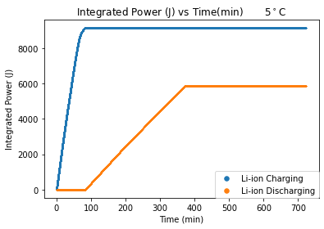
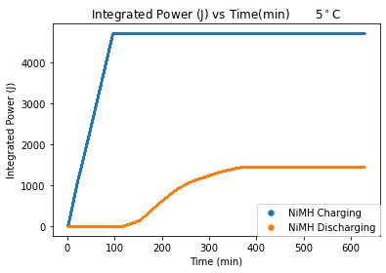
Cold conditions (5°C) - Energy ratios
The energy ratios in cooler conditions decrease when compared to room temperature ratios.
Overall capacity of NiCd increased, while the capacity of Li-Ion declined slightly. NiMH was unable to accept and output energy in these working conditions.
After averaging the results of multiple tests, the following general ratios were obtained :
Li-ion : 64%
NiCd : 52%
NiMh : 31%
Notes:
Taken from paper -
The energy ratios for batteries in cooler conditions decrease when compared to room temperature ratios. Differences in the power ratios can be attributed to the different charging cycles and chemical inefficiencies.
The graphs above display the integrated power vs time plots for the three batteries at colder temperatures of 5°C. The amount of energy transferred into a NiCd battery at 5 °C is significantly larger than that at 25 °C. In general, over 2000 more joules are transferred over in this process, which consequently resulted in less than 600 J of usable energy. The Ni-MH power curve shows that significantly less energy was transferred and available for usage. For Li-ion, there is relatively little effect on the charging process and also output energy. This behavior is expected considering Li-ion batteries tend to lose only 10% of their capacity in cold temperatures. After averaging the results of many tests, NiCd, Ni-MH, and Li-ion ratios averaged at 52%, 31%, and 64% respectively.

Slide 28
CONCLUSIONS

Slide 29
Integrated Power Ratios
The results form our experiment from all three batteries gave an understanding of duty cycle applications
Test results for all three batteries conducted at various temperatures are shown below:
After examining the computed ratios shown above, we can see negative energy efficiency trends associated with the decreasing of temperature. The capacity and amount of energy needed to achieve full capacity depended on the chemical composition of each battery.

Slide 30
Further conclusions and possible improvements
Further investigation of the conclusions will require data collection at various temperatures and output currents, as well as a statistical analysis of the various data collected to provide an understanding of the variance and confidence intervals of our results.
While trying to test higher temperature conditions, the testing equipment was proven to be unreliable. As resistance plays a large role within the circuit, the increased temperature resulted in similar charger errors. As a result, higher temperature tests were not successful and not included.
To better understand the improper functioning of a NiMH battery at this temperature, a method of collecting internal temperature and pressure may prove useful.

Slide 31
References
Abdin.Z, Khalilpour K.R (2019). Chapter 4 - Single and Polystorage Technologies for Renewable-Based Hybrid Energy Systems. Polygeneration with Polystorage for Chemical and Energy Hubs, 77-131. https://www.sciencedirect.com/science/article/pii/B 9780128133064000045
Battery University (2019, July 30). BU-304:Why are Protection Circuits Needed?. Battery University. https://batteryuniversity.com/index.php/learn/article/safety_circuits_ for_modern_batteries
Battery University (2019, November 21). BU-407: Charging Nickel-cadmium. Battery University. https://batteryuniversity.com/learn/article/charging_nickel_based_batteries
Battery University (2018, April 24). BU-409: Charging Lithium-ion. Battery University. https://batteryuniversity.com/learn/article/charging_lithium_ion_batteries
Battery University (2017, May 9). BU-303: Confusion with Voltages. Battery University. https://batteryuniversity.com/learn/article/confusion_with_voltages
Battery University (2017, September 15). BU-410: Charging at High and Low Temperatures. Battery University. https://batteryuniversity.com/learn/article/charging_at_ high_and_low_temperatures
Berthold. E (2019, October 4). Lithium-ion batteries. Australian Academy of Science. https://www.science.org.au/curious/technology-future/lithium-ion-batteries
Energizer Brands, LCC (2020, December 1). Nickel Metal Hydride (Ni-MH). Energizer Metal Hydride. https://data.energizer.com/PDFs/nickelmetalhydride_app man.pdf
Hymel, S (2020, November 15). What is a Battery? SparkFun. https://learn.sparkfun.c om/tutorials/what-is-a-battery/all
Libretexts. (2020, July 17). 1.1: Galvanic Cells. https://chem.libretexts.org/Courses/Uni versity_of_California_Davis/UCD_Chem_002C/UCD_Chem_2C:_Larsen/Text/Unit_1:_Electrochemistry/1.1:_Galvanic_Cells
ReLiON, (2015, October 19). The Seven Top Uses For Rechargeable Lithium-Ion Batteries.Blog.https://relionbattery.com/blog/the-seven-top-uses-for-rechargeable-lithium-ion-batteries
Vassal, N., Salmon, E., & Favarque, J.-F. (1999). Nickel/Metal Hydride Secondary Batteries Using an Alkaline Solid Polymer Electrolyte. Journal of The Electrochemical Society, 146 (1) 20-26.https://citeseerx.ist.psu.edu/viewdoc/download?doi=10.1.1.905.8 258&rep=rep1&type=pdf

