Slide 1
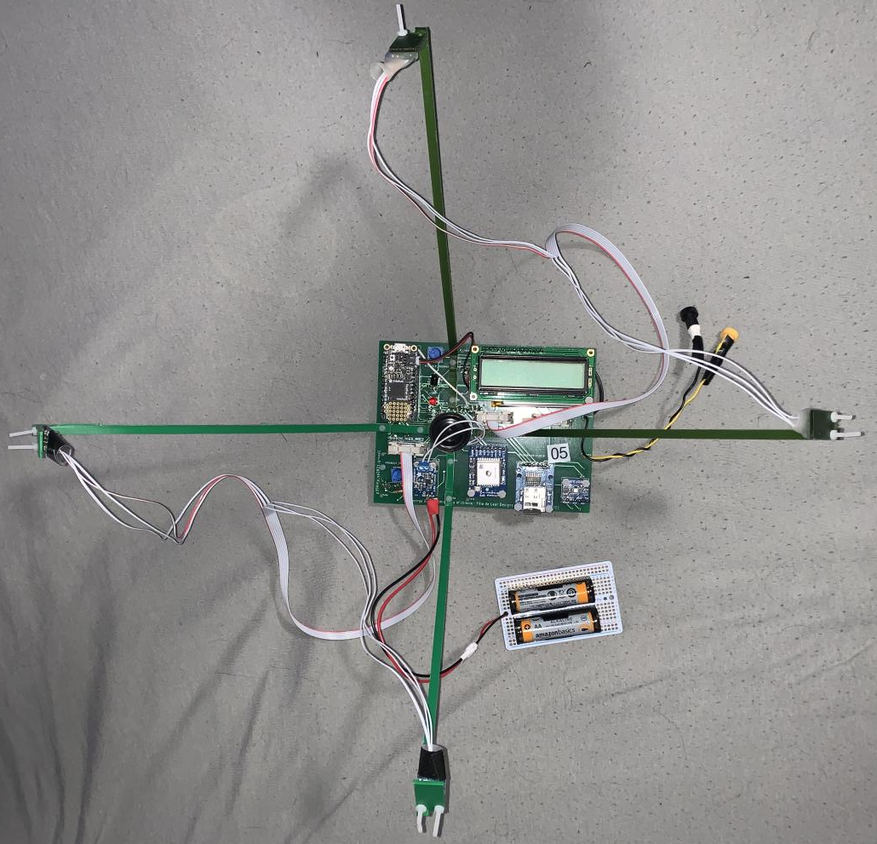
Measuring Wind Speed with Sound
By Matt, Nathan, Mina, Lele, and Riley

Slide 2
The Original Idea
The purpose of our experiment is to explore the feasibility of measuring wind speed and direction through sound.
Our intent in exploring the effects of wind speed on sound is to build a machine that sound engineers at outdoor concert venues can use to determine wind speed and direction .
Sound engineers could adjust speaker phase according to wind condition and improve sound quality for listeners.
Notes:
Matt

Slide 3
The Original Idea
When wind speeds vary at different sections of an outdoor venue, sound waves are shifted in time and phasing issues occur.
Areas of a venue have uneven loudness.
Ideally, a setup of our final product would consist of multiple boards which would be placed at various points throughout the venue.
Theoretically, local wind speed and direction could be determined at each “field station,” which would create a comprehensive wind vector map for a sound engineer.
Notes:
Matt

Slide 4
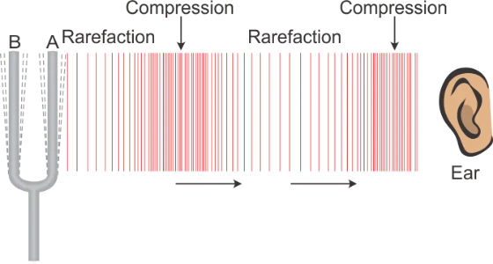
Brief Review of Sound
Sound is a wave that propagates through a medium.
The source of a sound creates a sound wave by producing vibrations in surrounding air molecules.
Vibrations travel out from the source in the form of a longitudinal wave, which is a wave that moves in the same direction it vibrates.
Like other waves, sound waves can be described by their amplitude, frequency, and speed.
The speed of a sound wave traveling through air is 343 meters per second.
Frequency of sound is measured in hertz..
Frequency corresponds to pitch of a sound.
When listening to a wave with a high frequency, one would hear a high pitch sound. Typically, humans can hear sounds within the frequency range of 20 Hz to 20,000 Hz.
Notes:
Lele

Slide 5
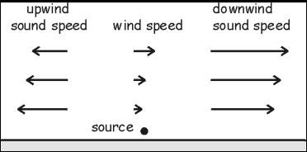
Effects of Wind on Sound
Frequency and speed are related to another through wavelength (λ).
v = λf
Noise
Other macroscopic effects
The small change in the speed of sound caused by a gust of wind can slightly alter the arrival time of a sound at a microphone.
Notes:
Lele

Slide 6
Effects of Wind on Sound
Consider two microphones, one placed at +x and the other placed at -x.
If the velocity of the wind is in the +x direction, then the sound will travel slightly faster towards the +x microphone than the -x microphone.
If a tone is played at x=0, it will reach the +x microphone slightly sooner than the -x microphone.
This difference in arrival time creates a measurable time offset which we will use to determine wind speed.
Notes:
Matt

Slide 7
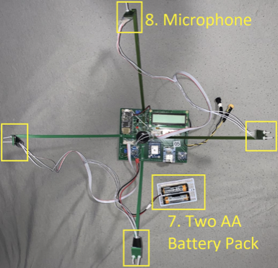
Our Board: Main Components
Four Adafruit Max 4466 microphones connected via ribbon cables.
A tone emitting speaker.
Adafruit DS3231 Real Time Clock (RTC)
Adafruit PAM8302A Class D amplifier
Connected to the tone emitting speaker and connected to an external battery pack that gives the amplifier power separate from other components of the circuit.
Adafruit Feather M4 Express.
The brain of our board.
Notes:
Nathan

Slide 8
Our Board: Supporting Components
Liquid Crystal Display (LCD)
External battery located underneath LCD is used to power the M4 when it is not connected to a computer.
Global Positioning System (GPS) module.
BME680
RFM9x LoRa Radio transmitter
Micro-SD breakout board
Notes:
Nathan

Slide 9
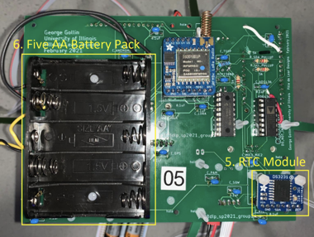
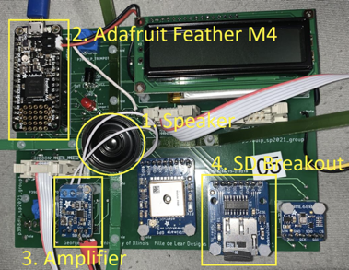
Our Board
Notes:
Nathan

Slide 10
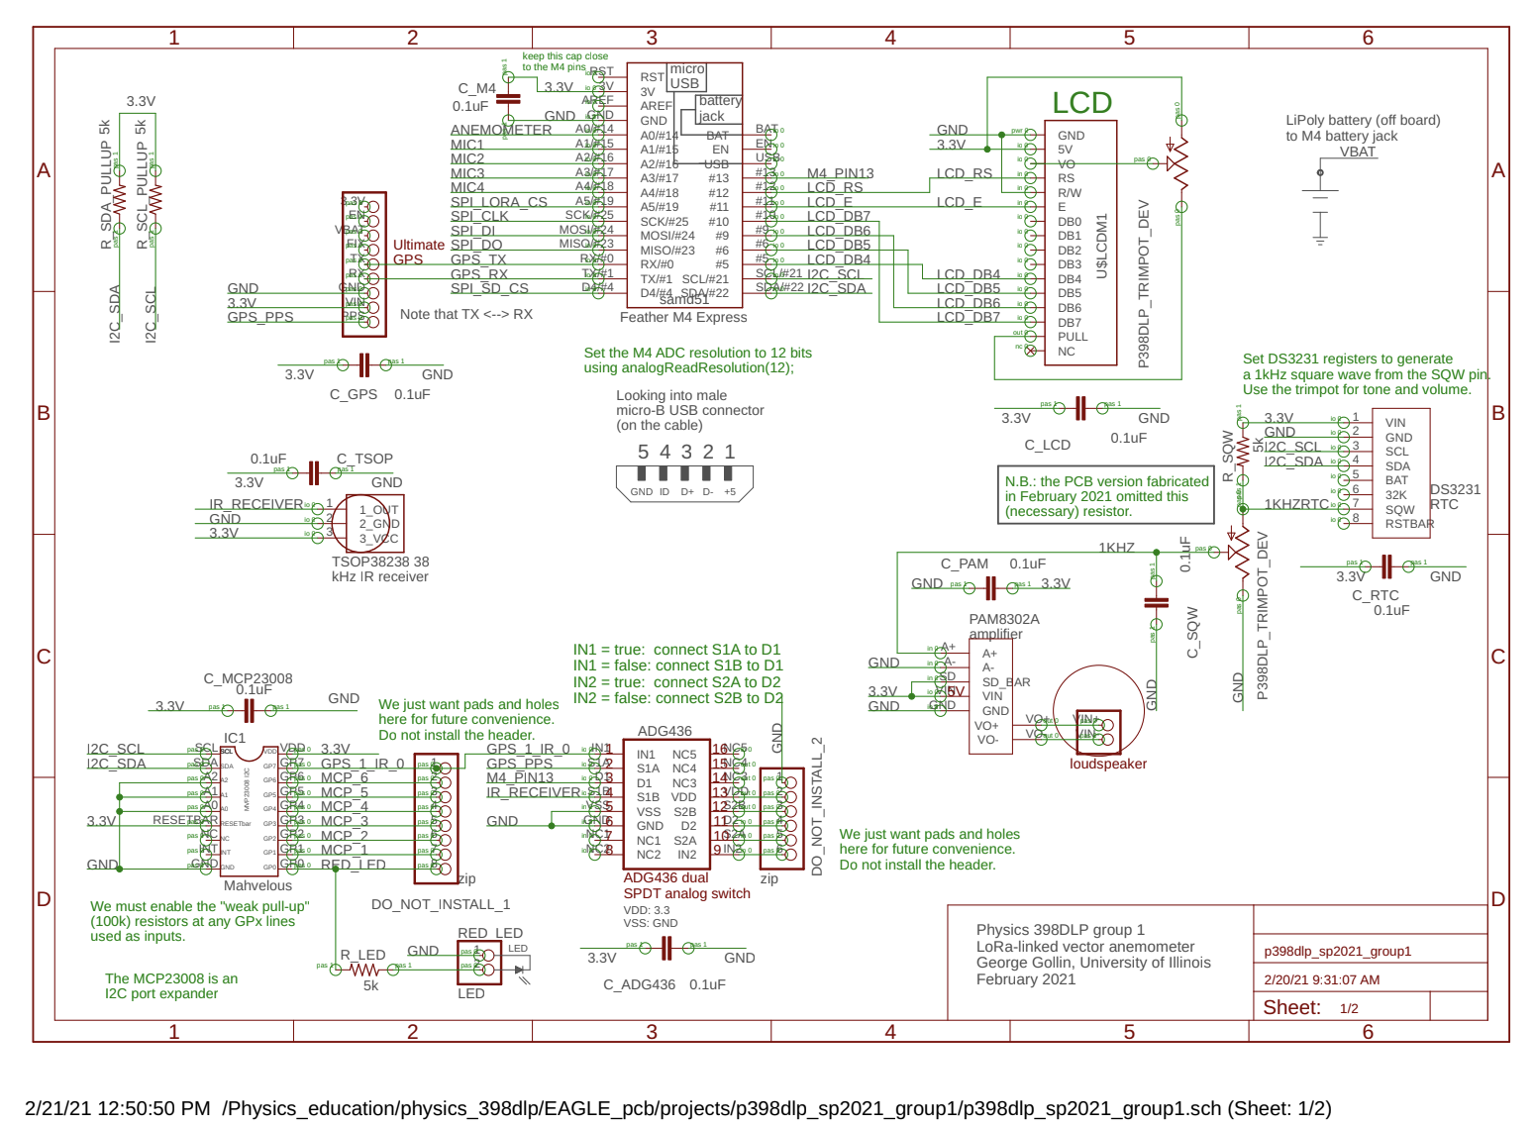
Notes:
Nathan

Slide 11
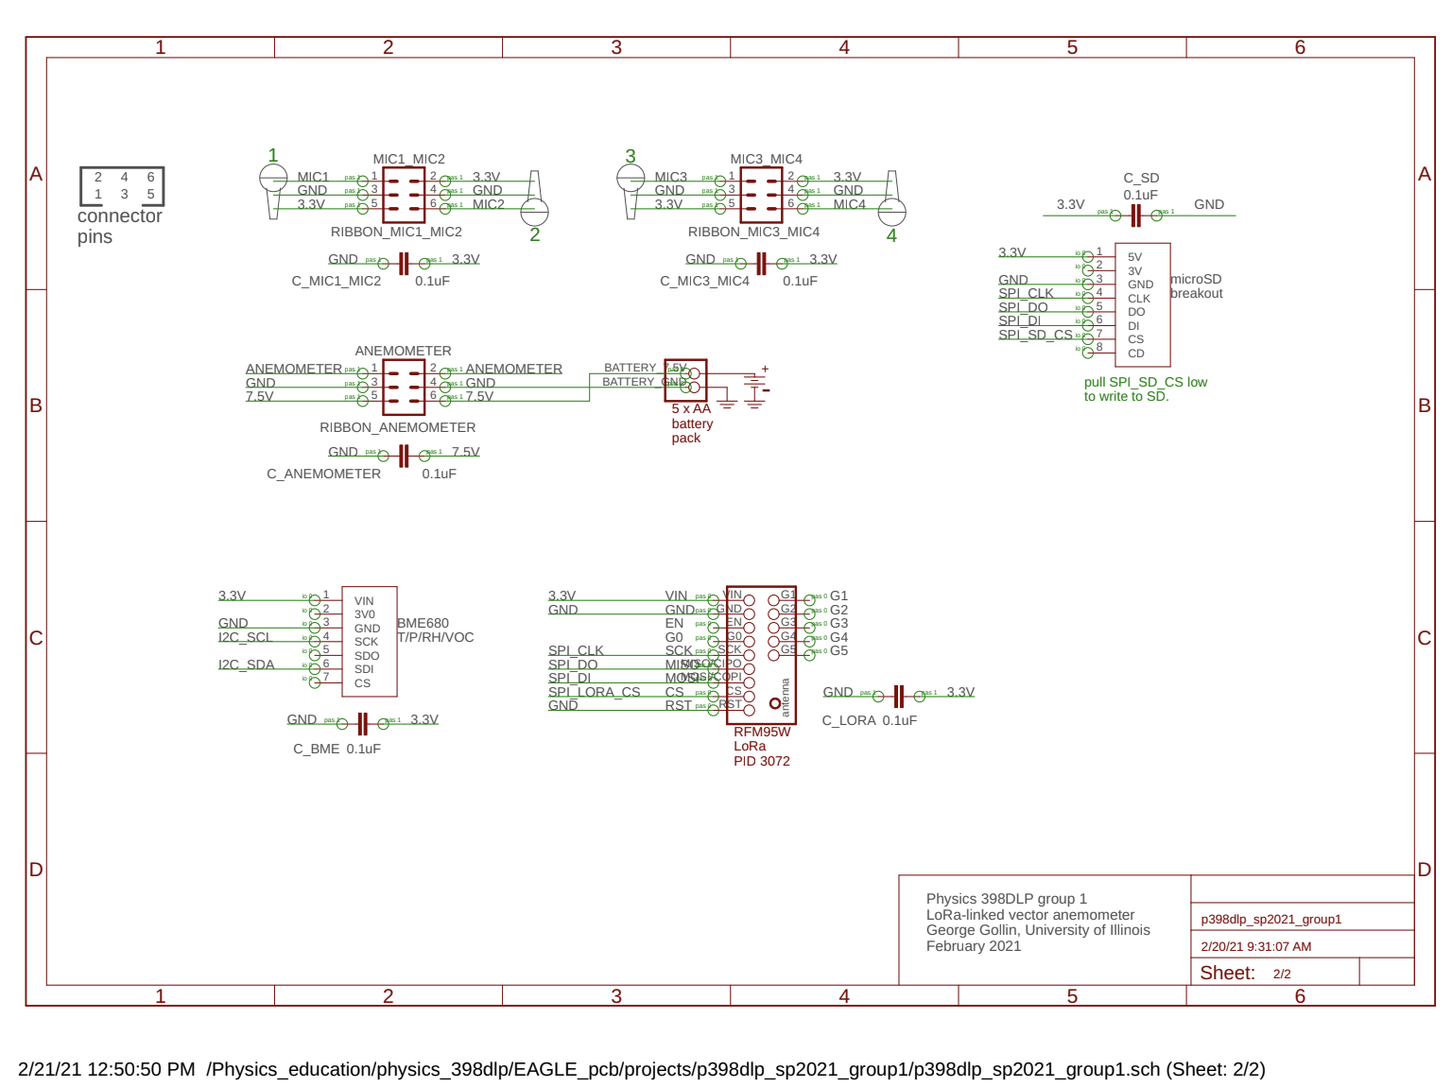
Notes:
Nathan

Slide 12
Our Plan
We will determine wind speed and direction by looking at the offsets in arrival time at each microphone.
Offsets are determined through a set of calculations made using a series of code that lies in the Feather M4.
The code digitizes the sound each microphone hears and attempt to “slide” the digitized waves so that the digitized wave from each microphone lies on top of each other. The amount of “slide” per digitized wave will be calculated and will be used to determine the time offset of sound arrival between microphones.
Notes:
Matt

Slide 13
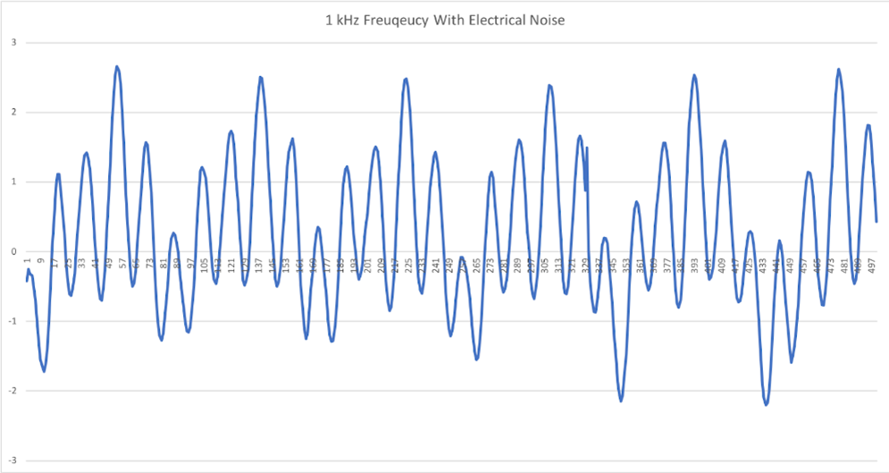
Visualizing Digitized Waves
Digitized output of a 1 kHz wave received by a microphone.
The microphones record nearly simultaneously and record 80,000 times a second.
1 kHz signal is being distorted by additional harmonic oscillation.
More on this later.
Notes:
Matt

Slide 14
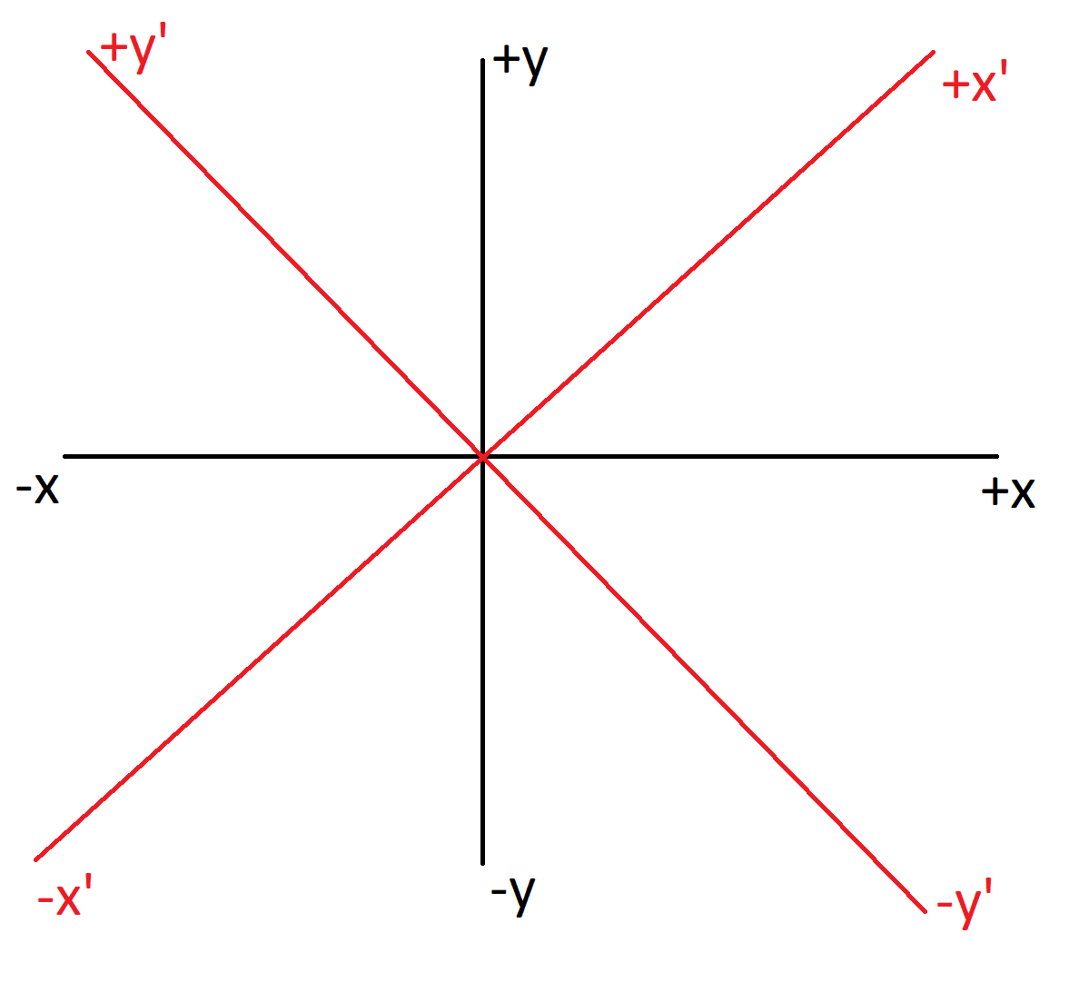
Geometry of Microphones
Notes:
Mina
Hey Mina, here’s a couple different diagrams you could use. I have them saved on the report, so just delete any you don’t want.

Slide 15
Trials
One trial using this device consists of one iteration of the code inside of the microprocessor:
The speed per 4-ADC read is calculated
Each microphone is read 10,000 times in alternating pairs of two
offsets between microphone pairings are calculated and analyzed.
Each trial outputs a wind speed, direction, and precision to the device’s LCD screen, while also printing the offset calculations and statistical analysis in the device’s serial monitor. Our methods for measuring accuracy of the devices often require running multiple trials.
Notes:
Mina

Slide 16
Chi-Squared Goodness of Fit (GoF) Value
The Chi-Squared Goodness of Fit value is a number that represents how close two samples are to each other
The assumption is that both samples are the same
Lower means better, and the best is zero
The number is calculated by summing up the differences squared
GoF = (x₁ - x₂)² for every x
Our project compared the pressure values for periodic waves
For each comparison, we try adding artificial offsets between -10 and 10 and get 21 GoF values
We can use the GoF values to know which artificial offset is the closest to the real offset
6 total comparisons by combining the mics into pairs (A1 vs. A2, A1 vs. A3, A2 vs. A4, etc)
Notes:
Riley

Slide 17
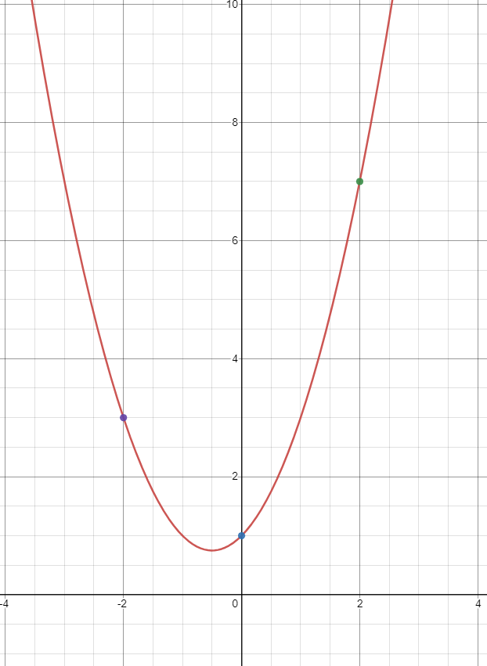
Parabola Vertex for Chi-Squared Curve
Any parabola can be constructed from 3 points. See Right:
We construct a parabola with the x-axis showing offset and y-axis showing GoF value
We use the point with the lowest GoF and its two adjacent neighbors
Then we can calculate the parabola vertex
Linear algebra is used to create three equations and three unknowns
Solving for these lets us find the general equation, and then we solve for vertex
This gives us an x-value for time offset, as well as a y-value for GoF
This calculated offset represents the true time offset of the data sample
Notes:
Riley

Slide 18
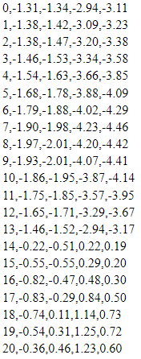
Measurements
Example of the raw data:
The left value is time, and the other values are the recorded microphones
Going down the lines increases time
Printing out this data allows us to easily graph it if need be
Notes:
Mina

Slide 19
Measurements
x-axis is bin number, ie time
y-axis is normalized sound amplitude
Comparing two microphone pairs
Left has no wind (still air), right has some wind
Some graphs line up very well, other less so
The key is to quantize this difference
Notes:
Riley

Slide 20
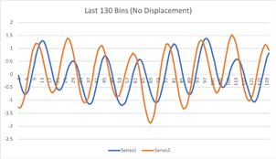
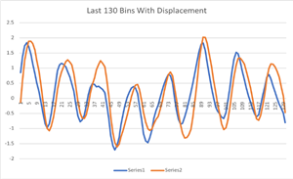
Measurements
These two graphs compare the difference in physical offset
In this case, no physical displacement has an offset
However, a physical displacement counteracted that offset
Shows that our device is able to measure physical changes
Notes:
Riley

Slide 21
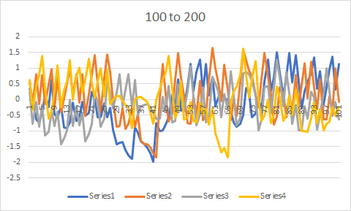
Measurements
This graph demonstrates the electrical “noise”
All mics are disconnected from the board
When the feather m4 reads the pins, it gets random inputs instead of null
Note the y- axis normalization; this actually less the half the standard normalization constant we normally get
This is still a source of error, but of limited significance
Notes:
Riley

Slide 22
Statistical Analysis
6 total offset calculation
First we calculate for the entire 10,000 bin sample
This gives us a very accurate offset
Next we slice the data into smaller batches, around a few hundred in size
Run the same calculations will these smaller amounts and get a set of offsets
Now we calculate mean and standard deviation
The standard deviation will give us a time offset and a corresponding precision value,
We now have a number for how accurate the batches are in respect to the total 10,000
We can analyze these smaller bin sizes to calculate time offsets faster, within a degree of relative precision.
Notes:
Riley

Slide 23
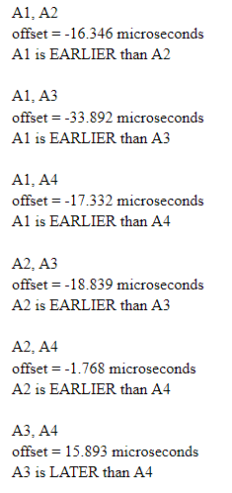
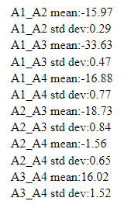
Outputs from Our Code
Left: Output of full data
Right: Output of batched data
Bottom: Output of combined wind velocity
All same sample data
Able to put offsets together in order to calculate wind speed and direction
Had we used the lower batch size of 340:
Our calculations would be of by the standard deviation shown
But we could run the recording every 4 * 10⁻³ seconds!
Notes:
Riley

Slide 24
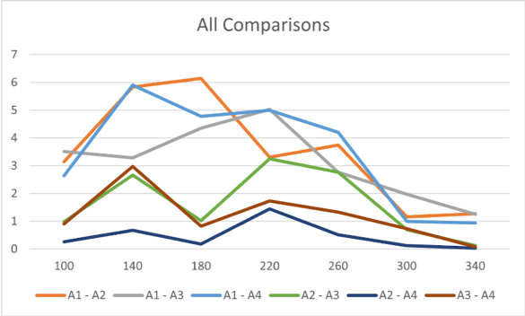
Accuracy and Precision
Standard deviation was calculated by comparing slices of the whole recording
When increasing slice size the standard deviation decreased
From this trial 340 bins was the lowest average value for standard deviation which is 0.648.
Only 3.88 milliseconds to determine wind speed and direction efficiently according to this measurement
Notes:
Nathan

Slide 25
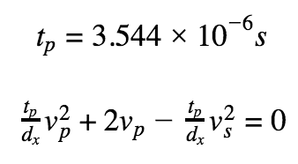
Accuracy and Precision
The average standard deviation of each microphone comparison from three recordings in still air was 3.544
This can be used to calculate a precision using our equation to solve for wind speed
we found the precision of wind speed to be 1.097 m⁄s which is 2.454 mph
Having longer struts on our board would increase the sensitivity
For example if strut length were doubled the precision of wind speed would be half the amount
Notes:
Nathan

Slide 26
Variables that Affect Accuracy and Precision
Sound Interference
Messier periodic signals being driven from the RTC
Materials used
Weather conditions and altitude
Notes:
Nathan

Slide 27
Calibration
Tuning:
Three to five trials are performed in a quiet, wind-free environment
find the average offset between each of the six microphone pairings.
These values are input into the code as 6 offset variables.
When completing a trial with these values entered in the code, these offset variables are subtracted from the calculated offset values. In still air, the board should then give a reading of little to no wind.
When tuning, our boards report an average value of 1.7 mph in still air.
Notes:
Mina

Slide 28
Difficulties and Revisions
We first encountered difficulty with our amplifier. It produced extra noise that made it hard for us to see the sinusoidal waves in our data.
Our microphones did not produce sensible values.
COVID-19
Notes:
Lele

Slide 29
Further Experimentation
Further experiments could look at possible interference caused by background noise.
Our testing was done primarily in quiet environments with little outside sound. However, additional noise could render the device significantly less accurate.
Additional experiments could look at the effects of different speaker tones.
Notes:
Lele

Slide 30
Summary of Findings
Our goal for this project was to create a highly accurate way to measure wind speed and direction using four microphones and a tone generator.
We were able to successfully create a device that could record data from four microphones and then compare the arrival time of a 1 kHz wave at each microphone.
Our device takes readings at a rate of approximately 80 kHz and is capable of measuring wind speeds of 2.454 mph and above.
By comparing offsets between different microphones, our device also determines wind direction.
Notes:
Lele

Slide 31
Summary of Findings
Our device can be further modified for accuracy by extending the length of the microphone struts. A future experimenter could design new struts with changeable lengths so future experiments have the ability to quickly change the distance between the microphones and speaker.
Each measurement from our device consists of 10,000 samples total from the four microphones. However, we found that we could lower the sample size to 340 without significant loss in precision. A sample size of 340 corresponds to a recording of 3.88 milliseconds.
Overall, we have a device that provides a highly accurate measurement of wind speed in a very short amount of time.
Notes:
Matt

Slide 32
Works Cited
“The Frequencies of Music.” PSB Speakers, 1 Apr. 2021, www.psbspeakers.com/the-frequencies-of-music/.
Nichols, Phillip. “5 Ways to Address Phase Issues in Audio.” IZotope, 22 Apr. 2021, www.izotope.com/en/learn/5-ways-to-adjust-phase-after-recording.html.
“Noise - Basic Information.” Canadian Centre for Occupational Health and Safety, 29 Apr. 2021, www.ccohs.ca/oshanswers/phys_agents/noise_basic.html?=undefined&wbdisable=true.
“Sound Waves.” Tuttee, www.tuttee.co/blog/phys-sound-waves.
Z, David. “How to Calculate the Vertex of a Parabola Given Three Points.” Stack Overflow, 1 Jan. 1958, stackoverflow.com/questions/717762/how-to-calculate-the-vertex-of-a-parabola-given-three-points.

