Slide 1
Pressure Difference Analysis Across Face Masks
Akash Prasad
Alex Huynh
Grace Chiou

Slide 2
Introduction
Since the Covid-19 pandemic, face masks are considered a norm in daily life to protect against airborne diseases.
This study quantifies how effective each of the four most common types of face mask are able to block the spread of diseases.
Most studies has been done in vitro by using the machines that mimic human breathing.
This study in particular is performed with human participants instead.

Slide 3
Procedure

Slide 4
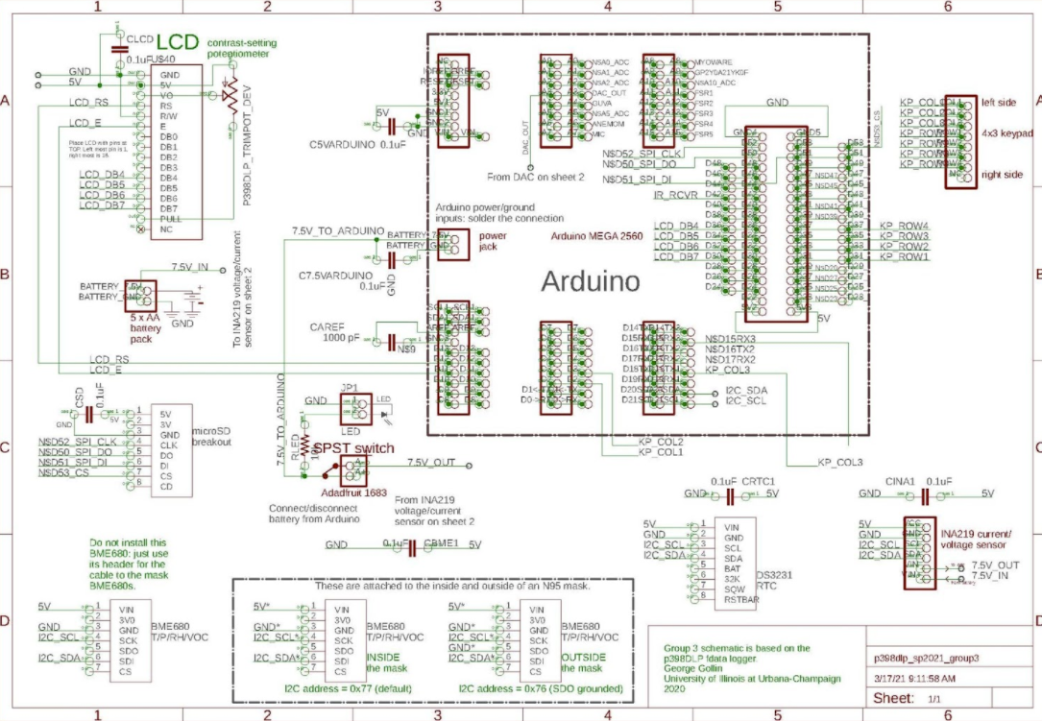
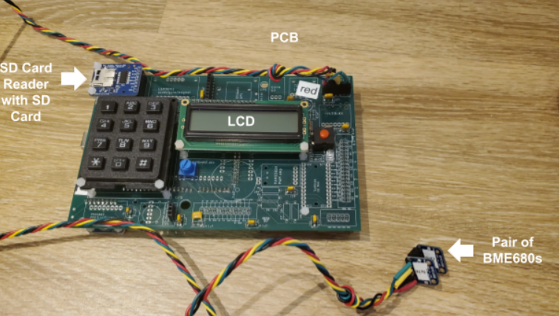
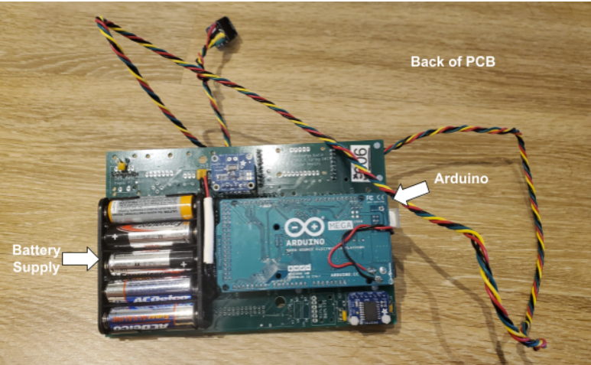
Arduino
The printed circuit board devices were provided by Professor George Gollin and made by JLCPCB.
The most important component in this PCB was the Adafruit BME680, as shown in the pair.
MicroSD card is to record data, collected by the BME680 sensors.

Slide 5
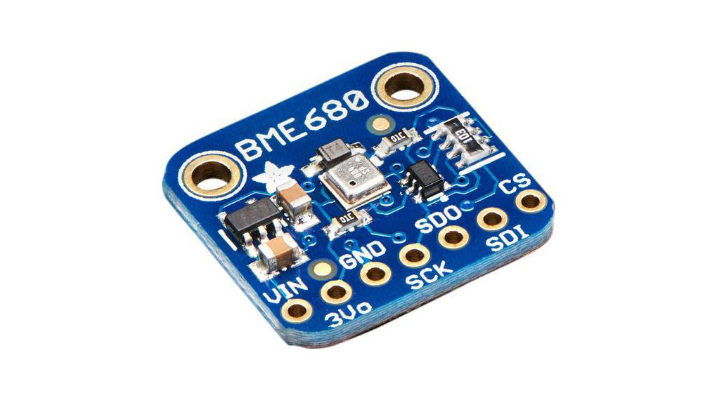
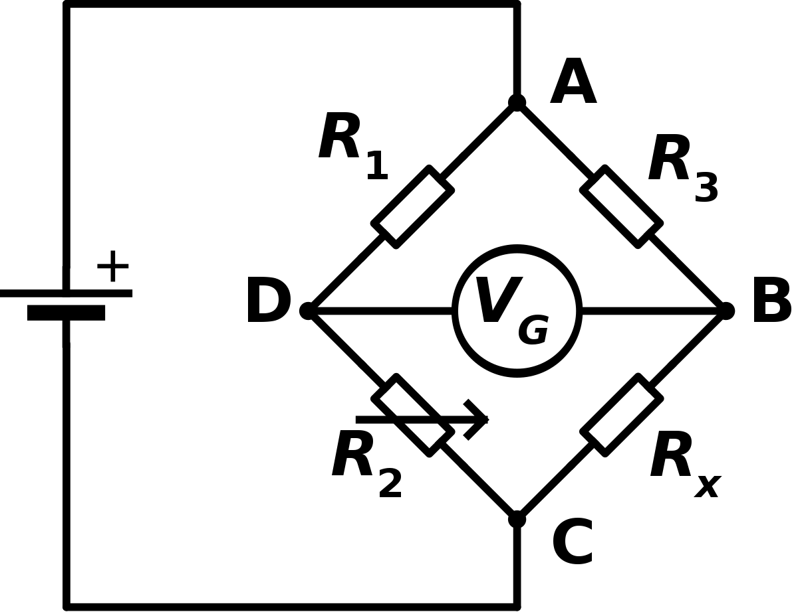
Adafruit BME680
4-in-1 environmental digital sensor that can measure four parameters: Temperature, Pressure, Humidity, and Gas.
Operating Range and Accuracy:
Temperature
Range: -40 to 85 °C
Accuracy: ±1 °C
Pressure
Range: 300 to 1100 hPa
Accuracy: ±1 hPa
Humidity
Range: 0 to 100%
Accuracy: ±3%
In particular, how does the pressure sensor works?
A pressure sensitive device captures the external pressure and converts it into digital signals.
That device consists of phizo-resistive in which the mechanical strain changes the electrical resistivity.
Strain gauges detects this change and is connected to the wheatstone-bridge, that converts this readings into volts.

Slide 6
How BME680 was used in this experiment
Shown from a couple slides back, a pair of BME680’s were connected together. One side of the BME680 (0x77) was on the outer-side from the face mask, while the other side (0x76) was on the inner-side from the face mask.
Written under the Arduino Integrated Development Environment (IDE), the data acquisition software (DAQ) programs the PCB for the purposes of collecting data from the sensors readings from the BME680’s.
The volatile organic compound sensor within the BME680 is disabled in the IDE software in order to improve the rate of data collection.

Slide 7
How the data collection works in this experiment
Having a two BME680’s planted on either sides of the face masks, pressure, temperature and humidity are collected independently. The program subtracts the differences between each pair from the parameters. The collected and the calculated data is then stored in a .CSV data file and into the microSD card.
The length of a datafile can be specified to a user in terms of number of datapoints in a single trial, with a trial lasting for approximately in one minute.
The procedure of a data collection is given as follows:
Step 1: Make sure the variables are constant, i.e. breathing in a specific mask and breathing in a specific manner.
Step 2: Run the DAQ.
Step 3: Data points are being collected from the pair of BME680s until it hits the total number of data points specified by a user.
Step 4: Close the file and save it on the MicroSD.
Step 5: Use the data from SD to perform offline analysis.
In the offline analysis, Python (ran under Spyder), was used to extract the data from the .CVS datafile containing set number of datapoints, each containing time (in milliseconds), pressure, temperature and humidity from both pairs of BME680s and its differences. They are then plotted accordingly while highlighting the patterns of the breath needed to make sense of the data.

Slide 8
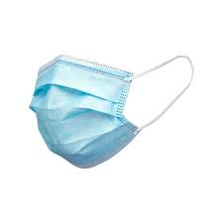
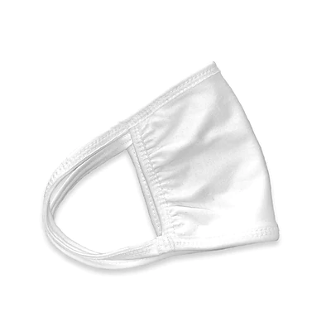
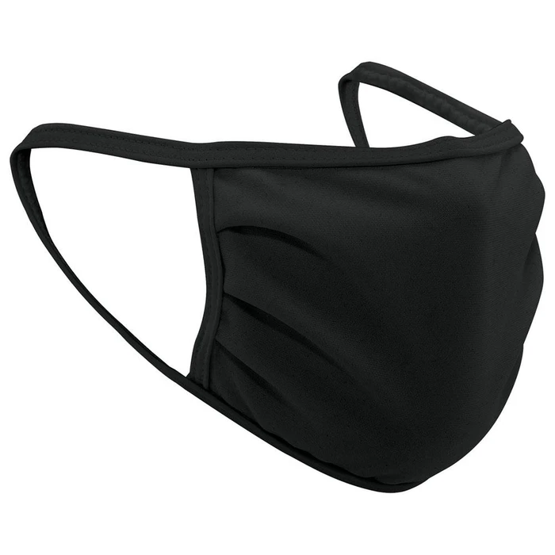
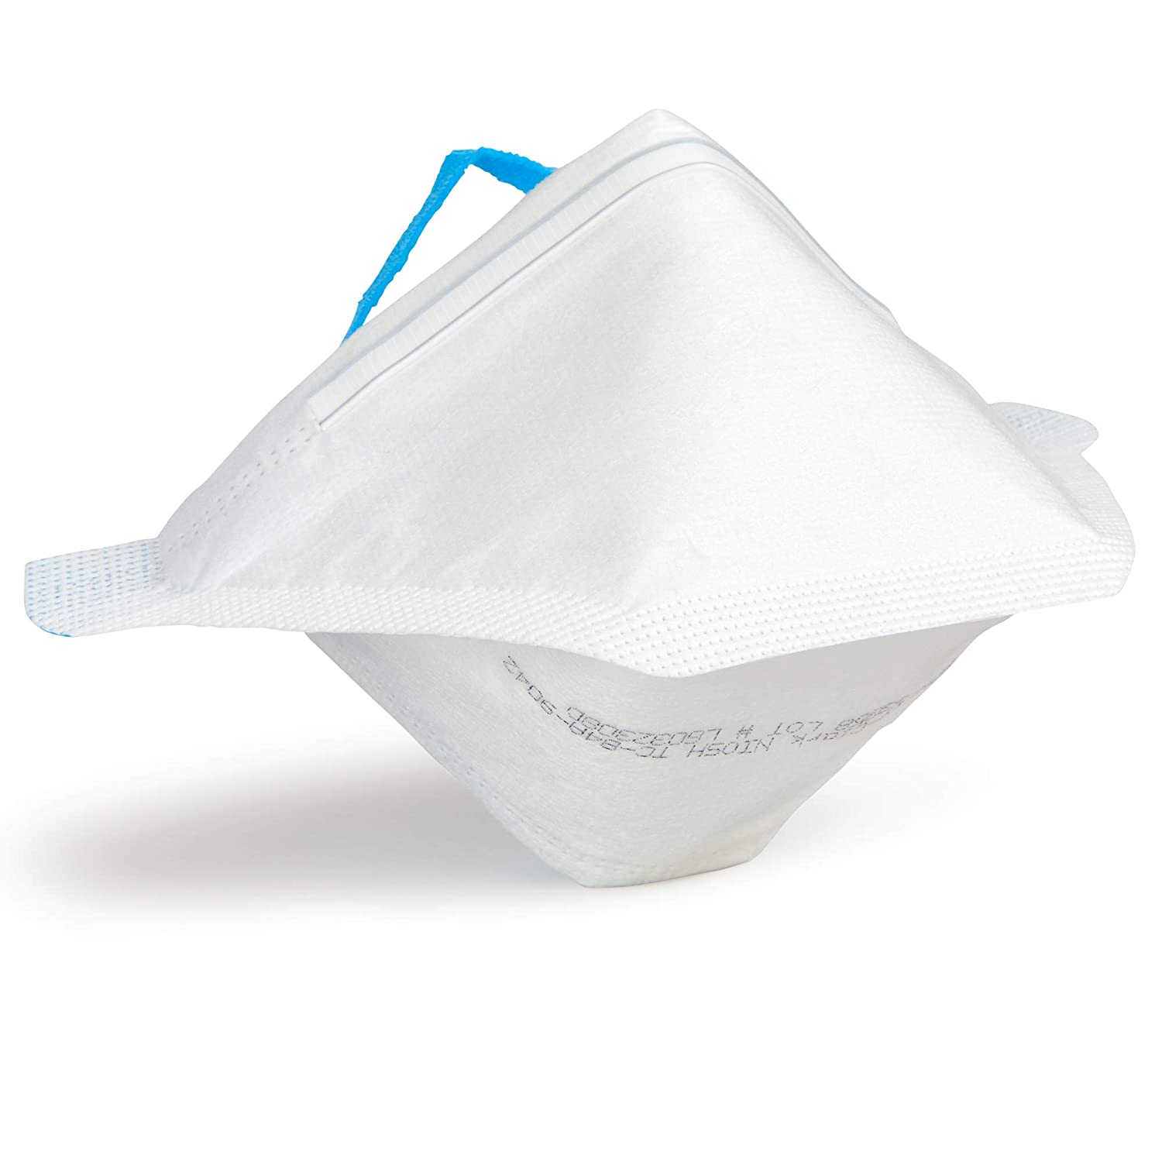
Four different types of masks
3-ply surgical mask: effective against large particle airborne particulates.
ATA Reusable SILVADUR™ 930 FLEX: an antimicrobial white cloth face mask, with a 3-ply cotton construction.
3-ply 100% polyester: black face mask with a non-woven liner.
Kimberly-Clark N95: Pouch respirator, filtration efficiency of at least 95% of 0.3 micron particles. NIOSH-approved.

Slide 9
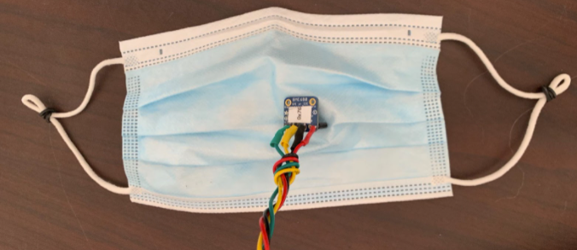
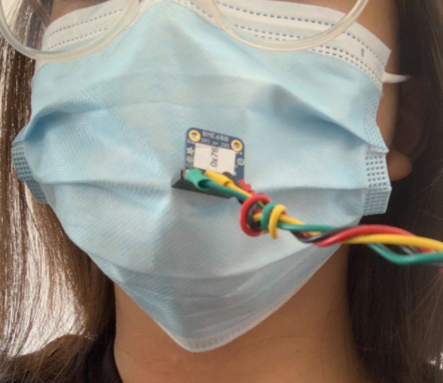
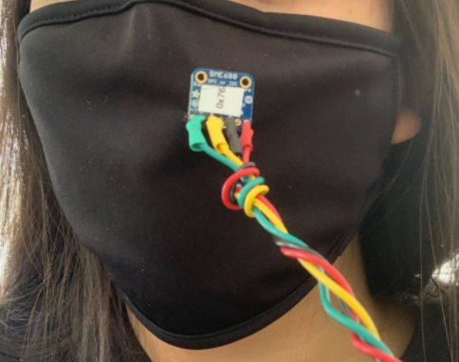
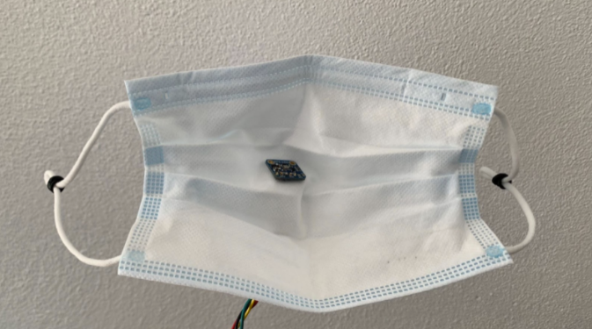
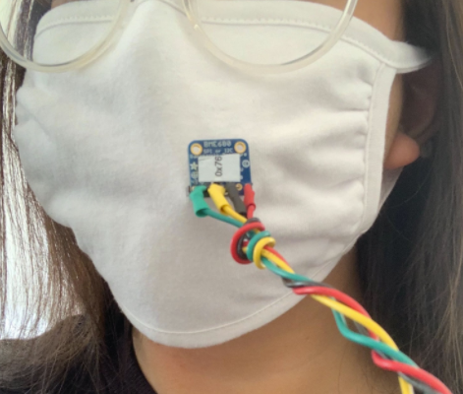
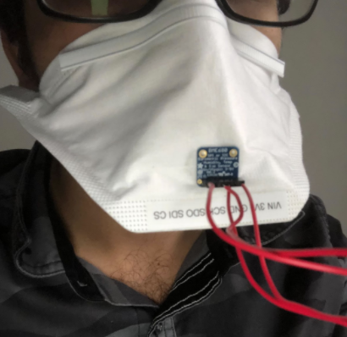
How BME680 were attached to the face masks
The pin needles, used to connect two BME680s together, is punctured through the mask.
The masks are ensured to fit tightly among the participants.

Slide 10
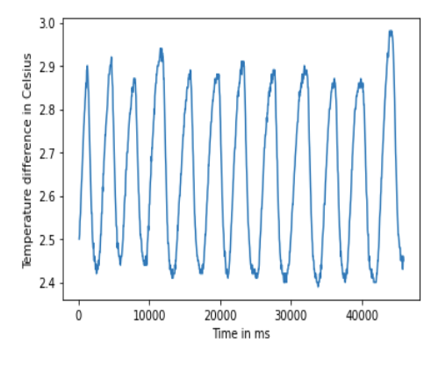
Methods
To get an idea in order to make sense of data, respiration rate data is collected. Each participant picks any mask to wear with BME680s attached and breath normally to determine respiration rate.
Looking specifically at the temperature difference plot as shown, we estimate to around 15 breaths per minute
To calculate the intrinsic parameter differences between two BME680s, baseline data is collected by allowing the experimental pair of BME680s to rest
To mimic the daily life of masks being worn, four types of breathing conditions were tested:
Normal breathing
Deep breathing
Talking
Smiling

Slide 11
Results and Discussion

Slide 12
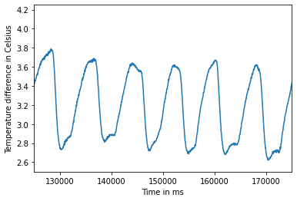
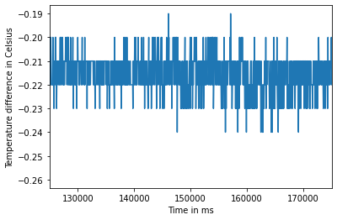
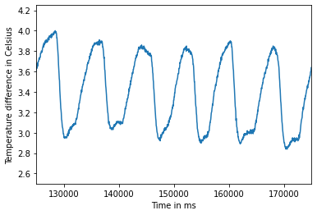
Finding Actual Difference from Baseline and Experimental Differences
-
=
Experimental Temperature Difference
Baseline Temperature Difference
Actual Temperature Difference

Slide 13
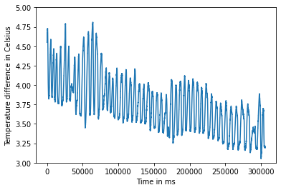
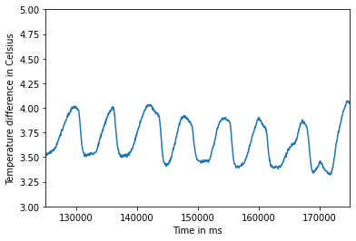
Measuring the Average Pressure Difference Across One Breath Cycle
Decrease the time range (x-axis) to see the respiration pattern

Slide 14
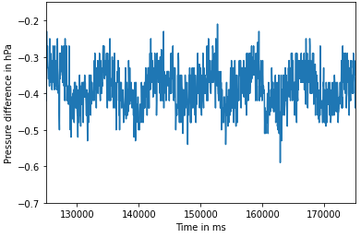
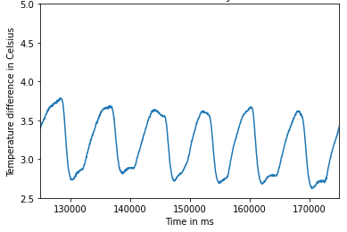
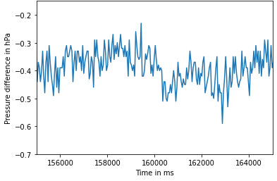
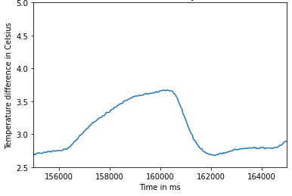
Measuring the Average Pressure Difference Across One Breath Cycle
Pressure Difference Graphs of Black Polyester Mask with Normal Breathing
Temperature Difference Graphs of Black Polyester Mask with Normal Breathing
Correlate the pressure difference pattern to the respiration pattern found in the temperature difference graph

Slide 15
Comparing Pressure, Temperature, and Humidity Differences Across Different Mask Types
 | Average Pressure Difference ± Standard Error (hPa) | Average Temperature Difference ± Standard Error (Celsius) | Average Humidity Difference ± Standard Error (%)
Surgical Mask | -0.10032 ± 0.01009 | 3.72137 ± 0.072902 | 21.7661 ± 0.55141
White Cloth Mask | -0.145742 ± 0.02209 | 3.693565 ± 0.2073 | 27.26249 ± 2.766
Black Polyester Mask | -0.093143 ± 0.01944 | 3.782359 ± 0.1015 | 8.349148 ± 2.403
N95 Mask | -0.337138 ± 0.00712 | 3.769949 ± 0.3431 | 16.61645 ± 0.4123
Notes:
The numbers presented is the result after taking the difference from the pair of BME680s when breathing with a mask and the baseline measurements, all after averaging several trials in each mask.
For pressure difference, the order of the greatest difference to the least is N95, white cloth, surgical and then black polyester.
For temperature difference, it follows black polyester, N95, surgical and then white cloth.
For humidity difference, it follows white cloth, surgical, N95 and then black polyester.

Slide 16
Effect of Activity Type on Average Pressure Differences with Surgical Mask
 | Normal Breathing | Deep Breathing | Talking | Smiling
Surgical Mask | 0.1051864 ± 0.01789 hPa | 0.091398 ± 0.004694 hPa | 0.09778483 ± 0.0122 hPa | 0.0899286 ± 0.01348 hPa
White Cloth Mask | 0.0661465 ± 0.00196 hPa | 0.0475176 ± 0.01029 hPa | 0.0527999 ± 0.00948 hPa | 0.0439836 ± 0.01062 hPa
Black Polyester Mask | 0.38807625 ± 0.0104 hPa | 0.38523818 ± 0.0187 hPa | 0.38746021 ± 0.0068 hPa | 0.34915286 ± 0.0361 hPa
N95 Mask | 0.347856 ± 0.00227 hPa | 0.3323795 ± 0.00269 hPa | 0.3174194 ± 0.00566 hPa | 0.3083359 ± 0.00329 hPa

Slide 17
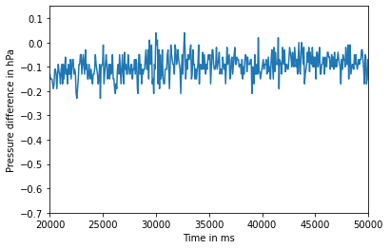
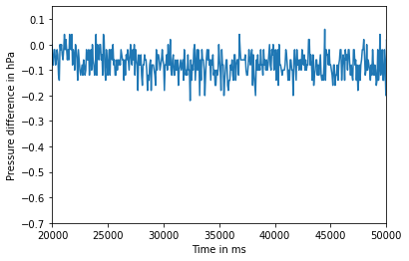
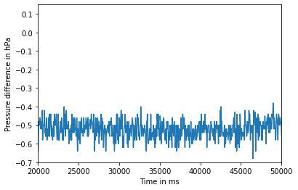
Comparing Baseline Pressure Difference Between Three Pairs of BME680s
Baseline Pressure Difference of Akash’s Pair of BME680s
Baseline Pressure Difference of Alex’s Pair of BME680s
Baseline Pressure Difference of Grace’s Pair of BME680s
Average Baseline Pressure Difference: -0.097245 hPa
Average Baseline Pressure Difference: -0.078132 hPa
Average Baseline Pressure Difference: -0.51296 hPa
Notes:
Among the three pairs of BME680s, Akash’s and Alex’s pairs have relatively similar average baseline pressure differences. Grace’s pair of BME680s, however, has an average baseline pressure difference of around -0.51296 hPa. When considering the accuracy range specifications of the BME680s, as was listed above in Section 2.1, the combined pressure accuracy range of two BME680s should not exceed double the amount of the pressure accuracy range of one BME680. Therefore, since one BME680 has an accuracy range of +/- 1 hPa, it is reasonable for two BME680s to have ~0.5 hPa difference between them.

Slide 18
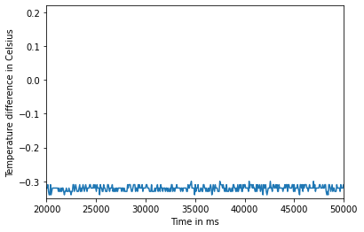
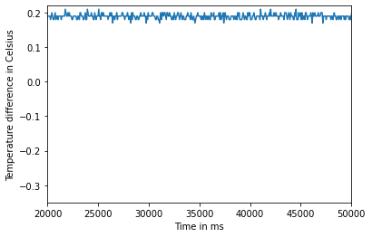
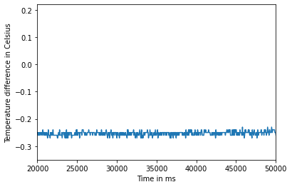
Comparing Baseline Temperature Difference Between Three Pairs of BME680s
Baseline Temperature Difference of Akash’s Pair of BME680s
Baseline Temperature Difference of Alex’s Pair of BME680s
Baseline Temperature Difference of Grace’s Pair of BME680s
Average Baseline Temperature Difference: -0.33719 Celsius
Average Baseline Temperature Difference: 0.19465 Celsius
Average Baseline Temperature Difference: -0.26492 Celsius
Notes:
Looking at the baseline temperature differences of the three pairs of BME680s, a noticeable difference between the average baseline values is that Alex’s BME680s measure a positive difference between the two BME680s, whereas the other two pairs measure a negative difference. A positive baseline temperature difference means that Alex’s “inside” BME680, on average, measures a larger temperature value than the “outside” BME680, even when there is no mask attached between the two BME680s. A negative baseline temperature difference means that the “outside” BME680, on average, measures a larger temperature than the “inside” BME680, which appears to be the case for both Akash and Grace’s pairs of BME680s.
Again considering the accuracy ranges of a single BME680, which notes that the temperature accuracy range for one BME680 is +/- 1 degree Celsius, it is reasonable to see that the baseline temperature differences between two BME680s are less than a 0.4 degree Celsius difference in magnitude.

Slide 19
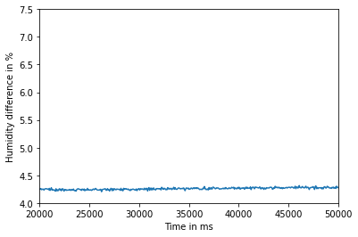
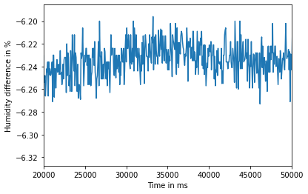
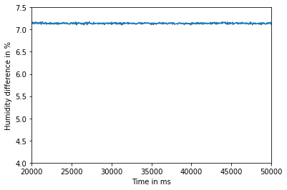
Comparing Baseline Humidity Difference Between Three Pairs of BME680s
Baseline Humidity Difference of Akash’s Pair of BME680s
Baseline Humidity Difference of Alex’s Pair of BME680s
Baseline Humidity Difference of Grace’s Pair of BME680s
Average Baseline Humidity Difference: 4.27361 %
Average Baseline Humidity Difference: -6.23758 %
Average Baseline Humidity Difference: 7.16544 %
Notes:
Regarding the baseline humidity differences of the three BME680 pairs, the same difference in sign can be seen in Alex’s pair of BME680s. While Akash and Grace’s pairs of BME680s, on average, register a positive difference in humidity, Alex’s pair of BME680s registers a negative difference in humidity. A negative baseline humidity difference means that Alex’s “outside” BME680, on average, measures a larger humidity value than the “inside” BME680, even when there is no mask attached between the two BME680s. A positive baseline humidity difference means that the “inside” BME680, on average, measures a larger humidity than the “outside” BME680, which appears to be the case for both Akash and Grace’s pairs of BME680s.
Considering the humidity accuracy range of +/- 3 % for one BME680, having a baseline humidity difference of 6-7% (as is seen in Alex and Grace’s pairs of BME680s) is stretching the reasonable range of accuracy for two BME680s. However, the difference is not too drastic, and does not provide any reasonable evidence for the BME680s not working as expected.

Slide 20
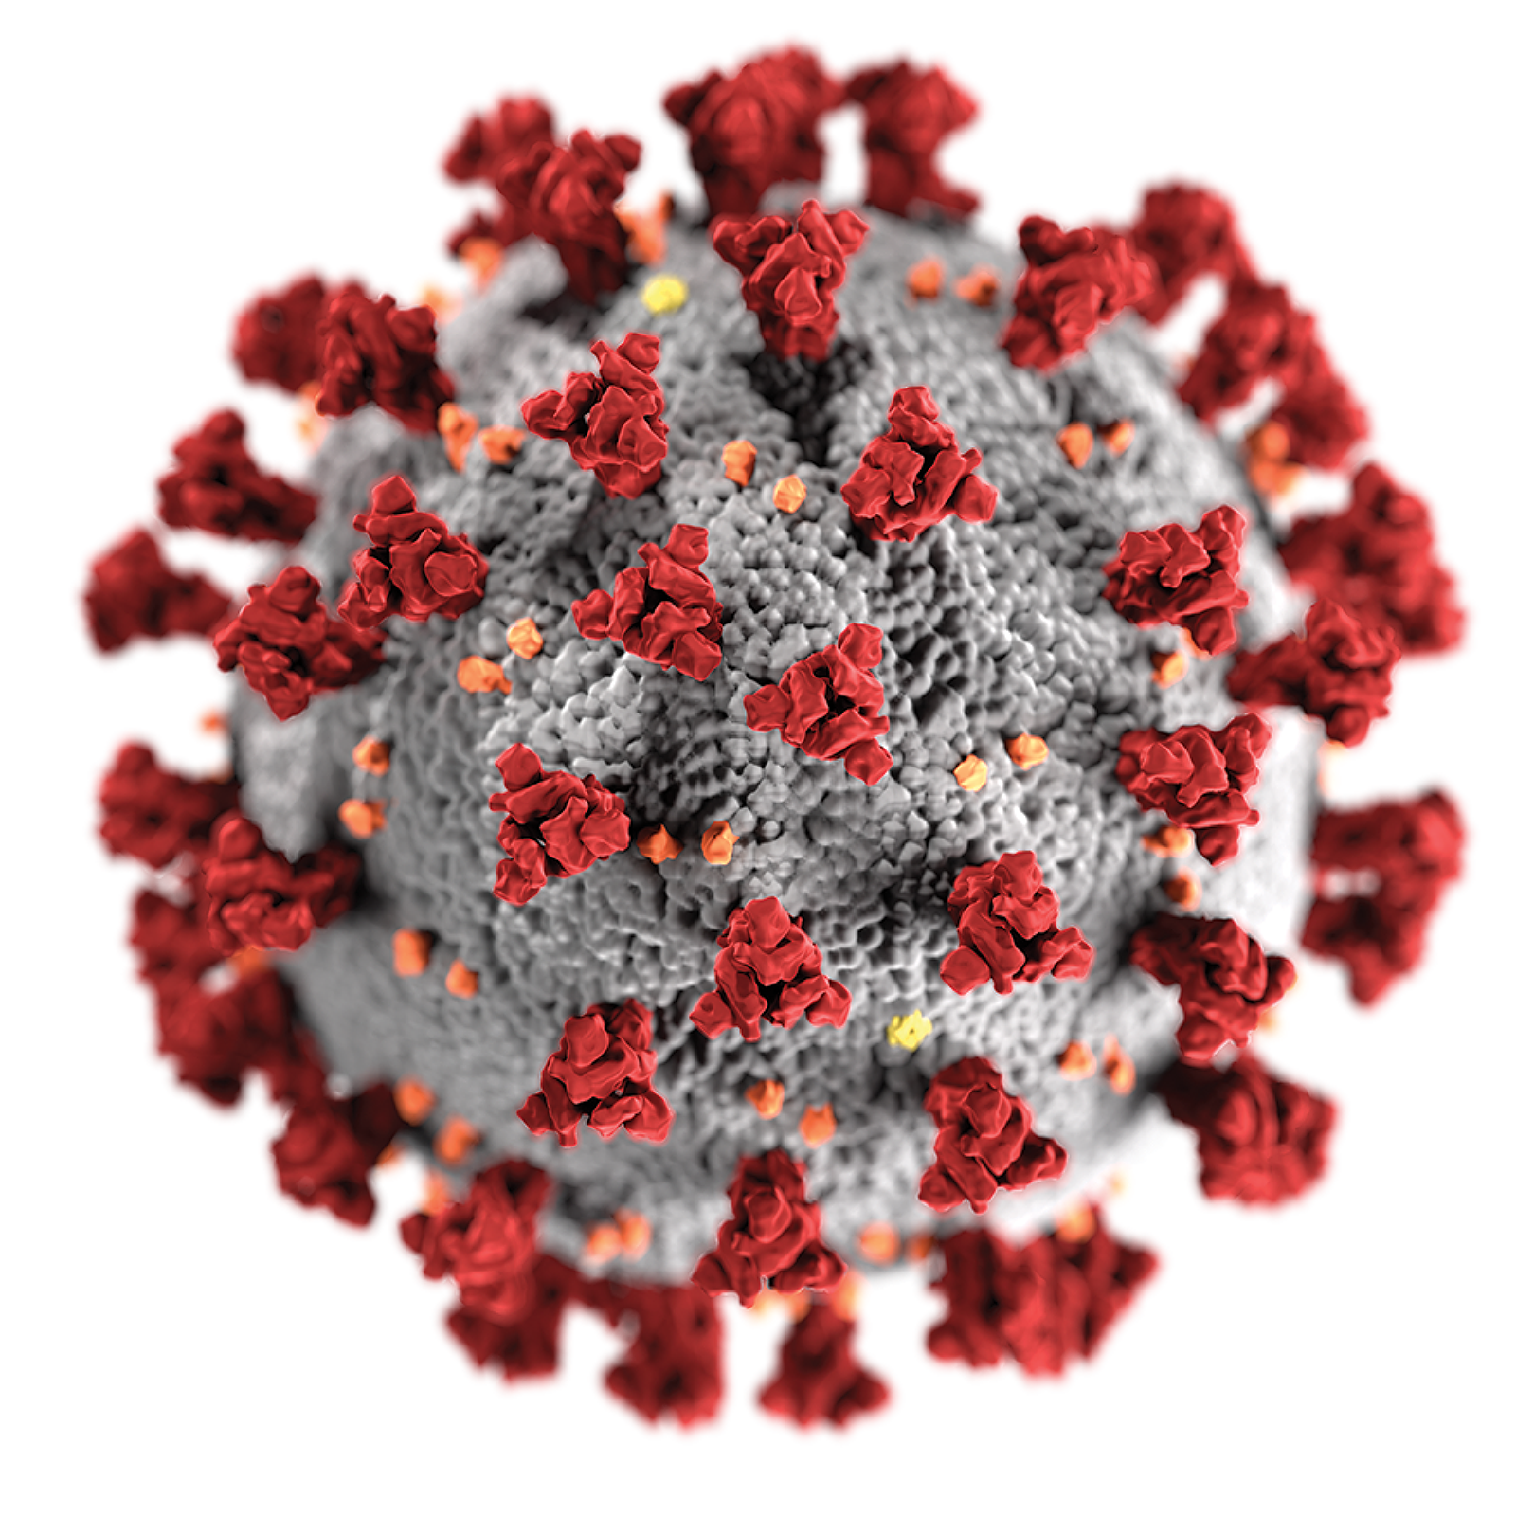
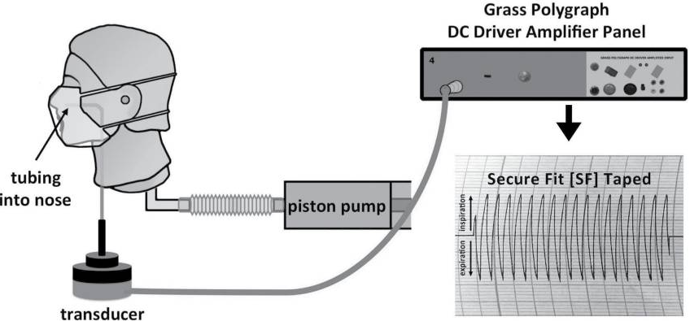
Conclusion
Skaria and Smaldone (2014)

Slide 21
Pressure
Filtration Power
Temperature
Filtration Power
Humidity
Filtration Power
Pressure
Filtration Power

Slide 22
References
Abdel-Rehim, Zeinab S., et al. “Textile Fabrics as Thermal Insulators.” AUTEX Research Journal, Vol. 6, No. 3, September 2006.
Allen, Jordan. “Tracking Coronavirus in Illinois: Latest Map and Case Count.” The New York Times, 2021, https://www.nytimes.com/interactive/2021/us/illinois-covid-cases.html. Accessed April 2021.
Cary Hill, W, et al. “Testing of Commercial Masks and Respirators and Cotton Mask Insert Materials Using SARS-CoV-2 Virion-Sized Particulates: Comparison of Ideal Aerosol Filtration Efficiency versus Fitted Filtration Efficiency.” Nano Letters, ACS Publications, 28 Sept. 2020, pubs.acs.org/doi/10.1021/acs.nanolett.0c03182.
Joshi, Manish & Khan, Arshad & Sapra, Balvinder. (2020). Quick laboratory methodology for determining the particle filtration efficiency of face masks/respirators in the wake of COVID-19 pandemic. Journal of Industrial Textiles. 10.1177/1528083720975084.
Skaria SD, Smaldone GC. Respiratory source control using surgical masks with nanoﬁber media. Ann. Occup. Hyg. 2014;58: 771–781.
Tcharkhtchi, Abbas & Abbasnezhad, Navideh & Zarbini Seydani, Mohammad & Zirak, Nader & Farzaneh, S. & Shirinbayan, Mohammadali. (2020). An overview of filtration efficiency through the masks: Mechanisms of the aerosols penetration. Bioactive Materials. 6. 10.1016/j.bioactmat.2020.08.002.
Wein, Harrison, et al. “Humidity from Masks May Lessen Severity of COVID-19.” National Institutes of Health, U.S. Department of Health and Human Services, 23 Mar. 2021, www.nih.gov/news-events/nih-research-matters/humidity-masks-may-lessen-severity-covid-19.
“N95 Respirators, Surgical Masks, and Face Masks.” U.S. Food and Drug Administration (FDA), Center for Devices and Radiological Health, www.fda.gov/medical-devices/personal-protective-equipment-infection-control/n95-respirators-surgical-masks-and-face-masks.

