Slide 1
Group 2: Light Measurements from LED and Incandescent Bulbs
Arjun Sivakumar and Josh

Slide 2
Introduction
Manufacturers of LED and incandescent bulbs both provide color temperatures which intends to describe the bulb’s light emission spectra (the various electromagnetic waves that the emitted light consists of)
This study identifies the relationship between these provided temperatures and actual color temperatures of incandescent and LED bulbs to understand the relationship between the light emission spectra of the two types of bulbs
The study demonstrates how the color temperature is irrelevant in the case of LEDs, and shows the lack of meaningful relationship between the light emitted and the temperature

Slide 3
Procedure (Arduino)
The experiment is based on the Arduino Mega 2560
Components include
Adafruit AS7341 10-Channel Light / Color Sensor Breakout
DS3231 RTC
microSD Breakout

Slide 4
Procedure (The Boxes)
An SD Card is placed in the Arduino, which is duct taped inside a small, black box with a tube outside it and holes for light and cables
This box is placed inside another, larger, black box with a light sources inside it and a hole for the cable to come out
The light source is plugged into a Variac Transformer and the cable runs to the laptop

Slide 5
The Boxes

Slide 6
The Procedure (running an experiment)
The Light Bulb will be powered on, light shining upon the sensor
It starts at one hundred volts and is increased incrementally to one hundred thirty
The SD Card is then removed and the counts of light from the different wavelengths are measured
What are Counts?

Slide 7
ADC
Our project revolves strongly around a measurement called Counts
Counts comes from the ADC
ADC refers to Analog to a Digital Converter
When the sensors register an input, they release a voltage
The voltages are then interpreted as a frequency representative of the voltage amplitude
This frequency is Counts

Slide 8
Incandescent
Illuminated by heating a filament until it glows
Produces a lot of heat, which means Infrared Light
Very inefficient
about 90% of energy is heat!
Resemble a Black Body Spectrum

Slide 9
LEDs
Use Semiconductors and Electrons
Produce light by crossing an energy threshold called the Band Gap
Are capable of producing one specific color at a time
No Infrared!
Don’t produce a Black Body Spectrum

Slide 10
Why this comparison matters
Patterns can be found in their emittance
Light comes in many wavelengths that we can compare to each other
“White” Lights aren't actually white, but instead are an uneven mix that correlates to the Black Body Spectrum
LEDs don't have this spectrum as they are only one color
But White LEDs artificially mimic the spectrum!

Slide 11
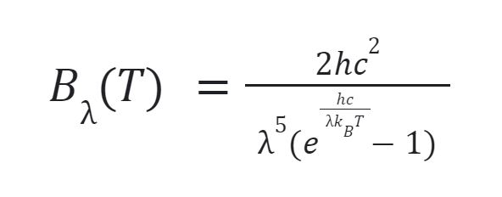
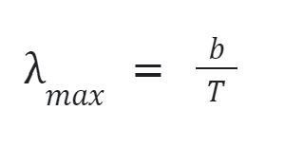
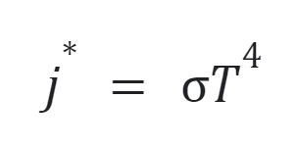
Key equations used for the report
The equation for spectral emittance was used to create a line of best fit for the measured values based off of black body emission spectra
B(T) is the spectral radiance, with units of [power / (area * solid angle * wavelength)]. h is the planck’s constant, c is the speed of light, kB is the Boltzmann constant, is the wavelength, and T is the temperature.
Wien's displacement law is a relationship between the wavelength at which the emission spectrum peaks and the temperature of the black body (b is the constant of proportionality)
Stefan-Boltzmann law establishes relationship between temperature and power, using the Stefan-Boltzmann constant

Slide 12
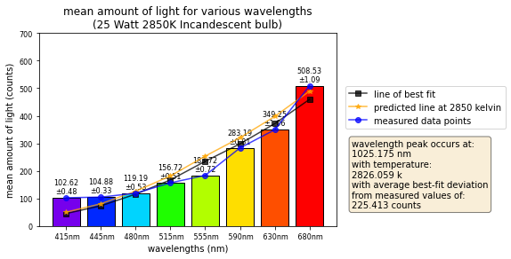
Results

Slide 13
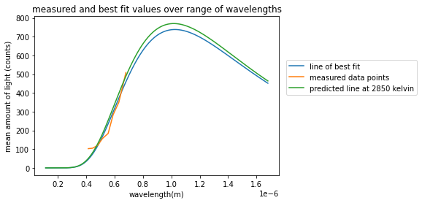

Slide 14
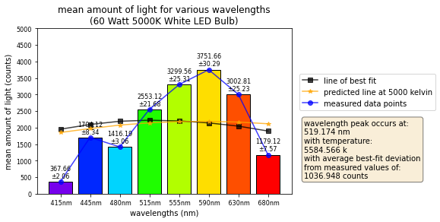

Slide 15
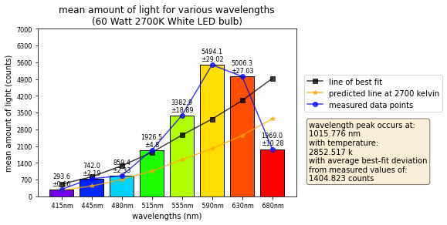

Slide 16
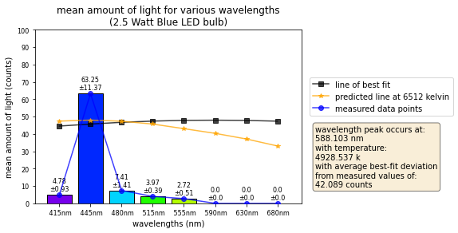
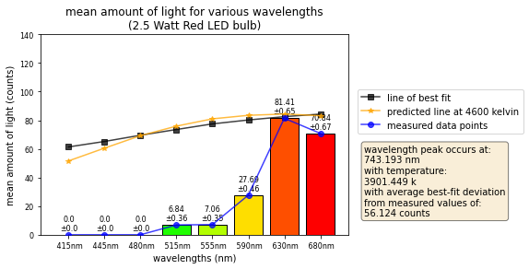
Red and Blue LEDs emission spectra

Slide 17
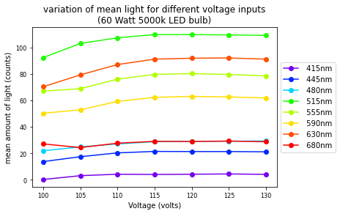
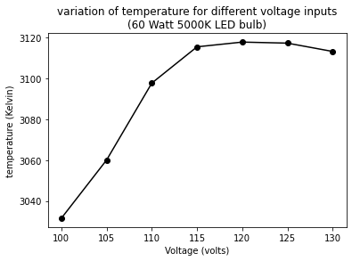
Change in light emission and temperature over voltage changes

Slide 18
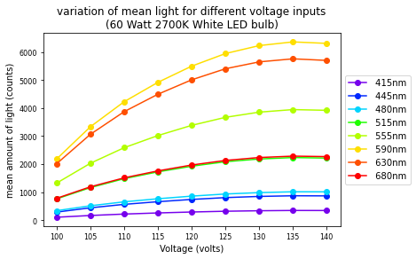
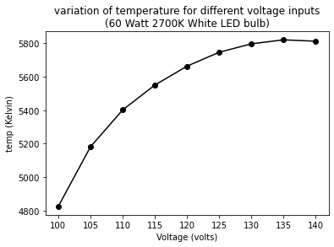

Slide 19
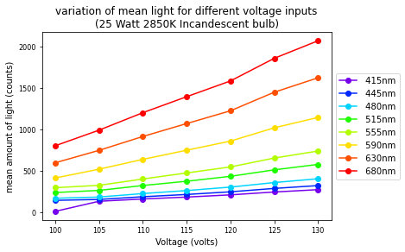
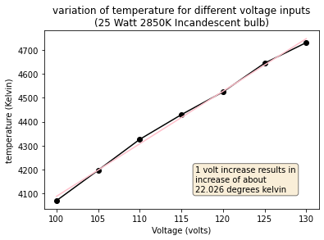

Slide 20
Conclusion
The data demonstrates that LEDs are not black body objects, and do not have a black body radiation which can be described by a color temperature, unlike an incandescent bulb
This can be seen with the black body fits, where the incandescent bulbs show a greater match between measured and predicted black body line of best fits in comparison to LED bulbs
Furthermore, the changes in voltage demonstrated an exponential relationship between temperature and power for the incandescent bulb. This again proves that incandescent bulbs are close to black body objects, and LEDs are not

Slide 21
Citations
Barnes, John. “How an Incandescent Light Bulb Works - Ideas & Advice: Lamps Plus.” Ideas & Advice | Lamps Plus, Lamps Plus, 20 Nov. 2019, https://www.lampsplus.com/ideas-and-advice/how-an-incandescent-light-bulb-works/.
“Led Lamp Components Explained.” Superior Lighting, https://www.superiorlighting.com/lighting-resources/light-bulb-learning-center/led-light-bulbs/led-lamp-components-explained/. ced
Shawn-Yu, Lin, and Kim Yong-Sung. “A Cool Light Bulb.” SPIE Homepage, https://spie.org/news/1199-a-cool-light-bulb?SSO=1.

