Slide 1
Analyzing Paper Production in Fresh Press Lab
Léo Loubières & Emily Pasetes
University of Illinois at Urbana-Champaign
April 29, 2022
Image courtesy of Fresh Press Studio

Slide 2
Overview
Fresh Press
Goals of Project
Calibration & Initial Measurements
Hardware & Software
Fieldwork & Analysis
Conclusions & Future Directions
1

Slide 3
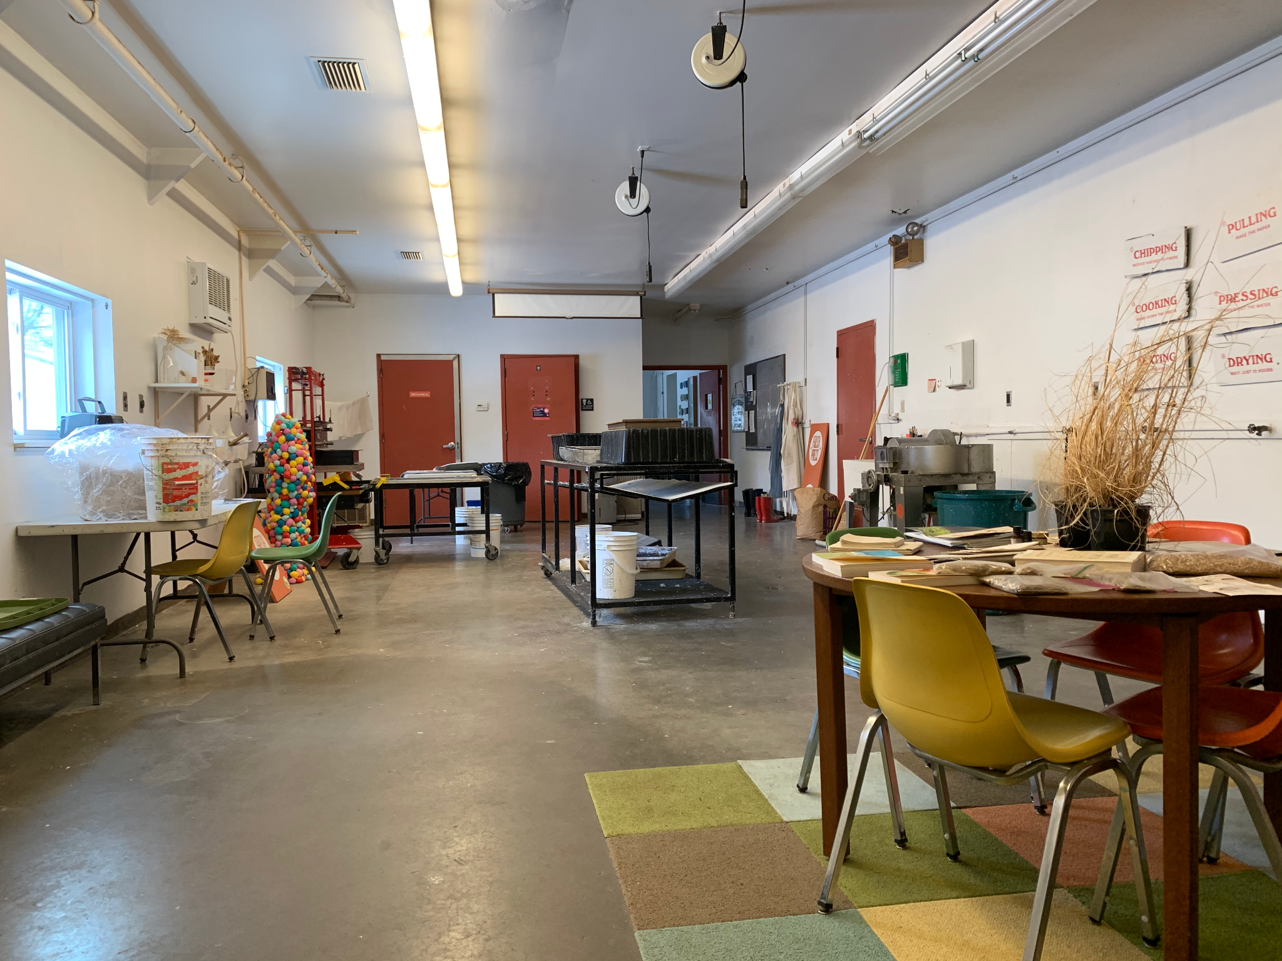
Fresh Press Lab
Paper production lab on campus
Started in 2011 in FAA
Funded through research grants & sales to the public¹
Interior of paper lab, reception area & wet room
¹From Fresh Press website, “About Our Paper,” https://www.freshpress.studio/ourpaper.
2

Slide 4
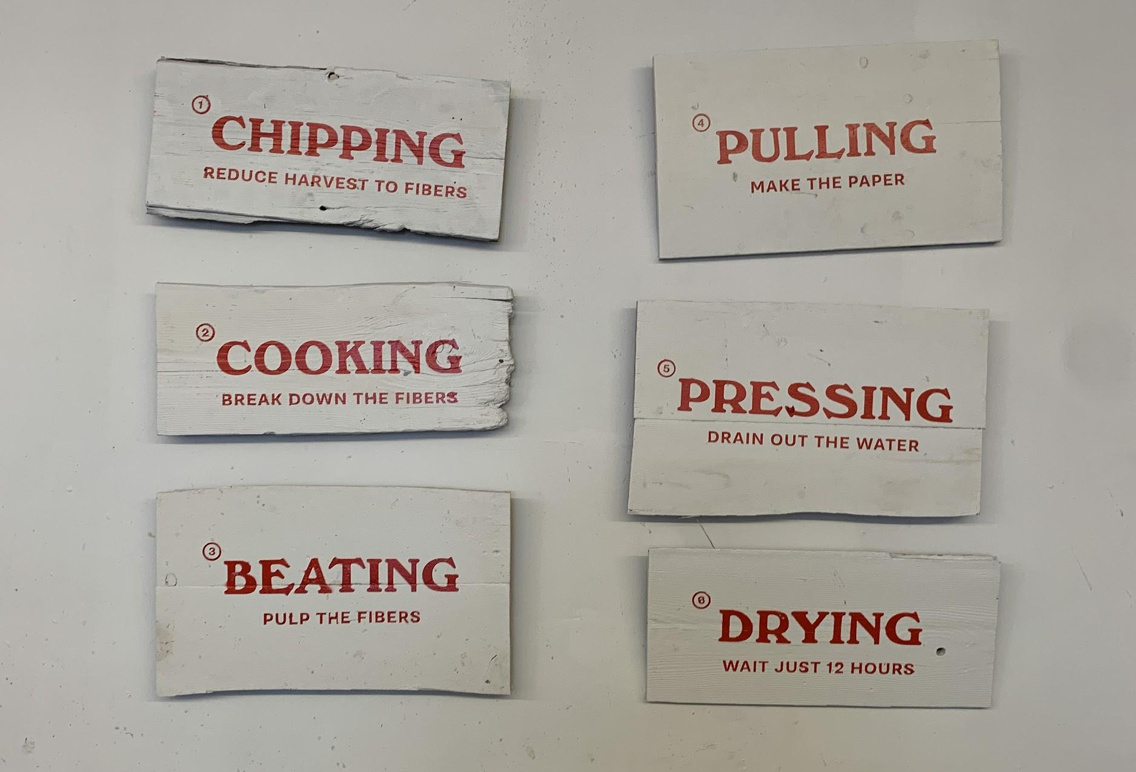
Papermaking Process
Work that involves organizations across campus
Experimental (qualitatively & niche
Two main “rooms,” wet & dry
3

Slide 5
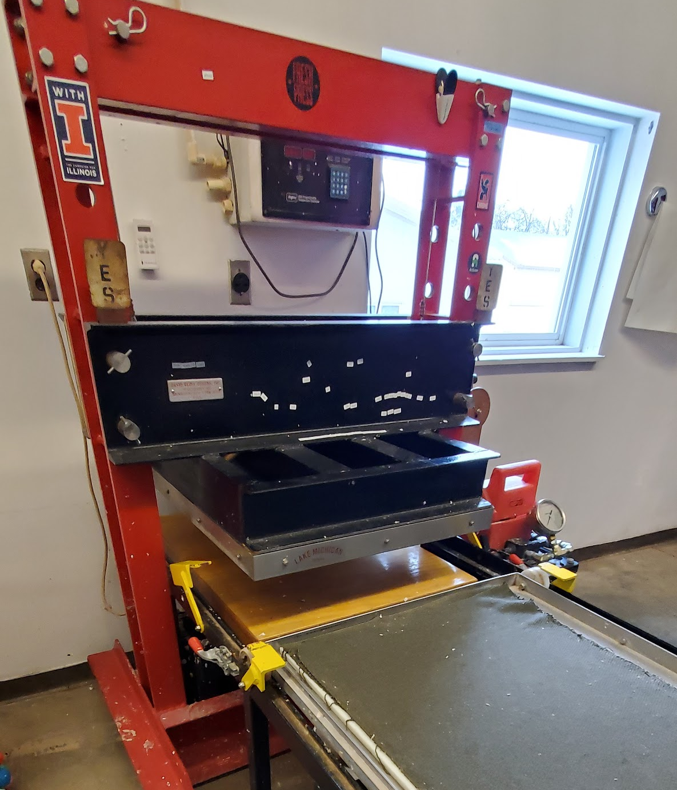
Papermaking Process: Wet Room
BEATING: Paper Beater
PULLING: Straining
PRESSING: Wet Press
4

Slide 6
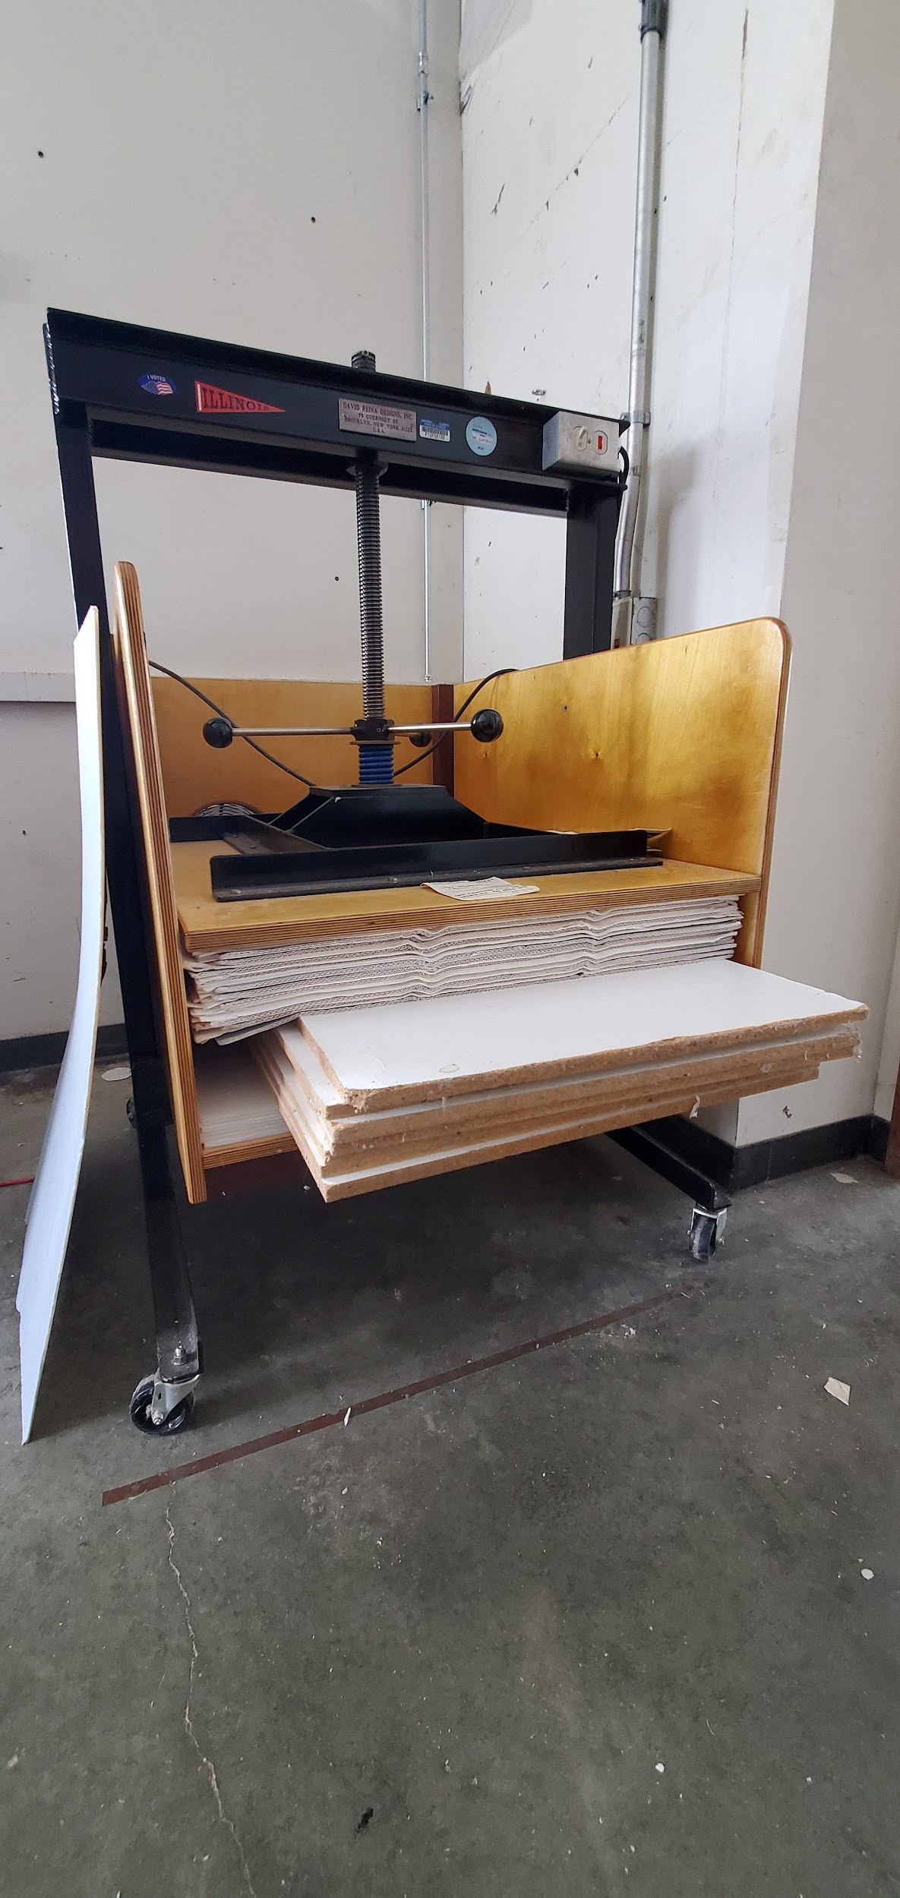
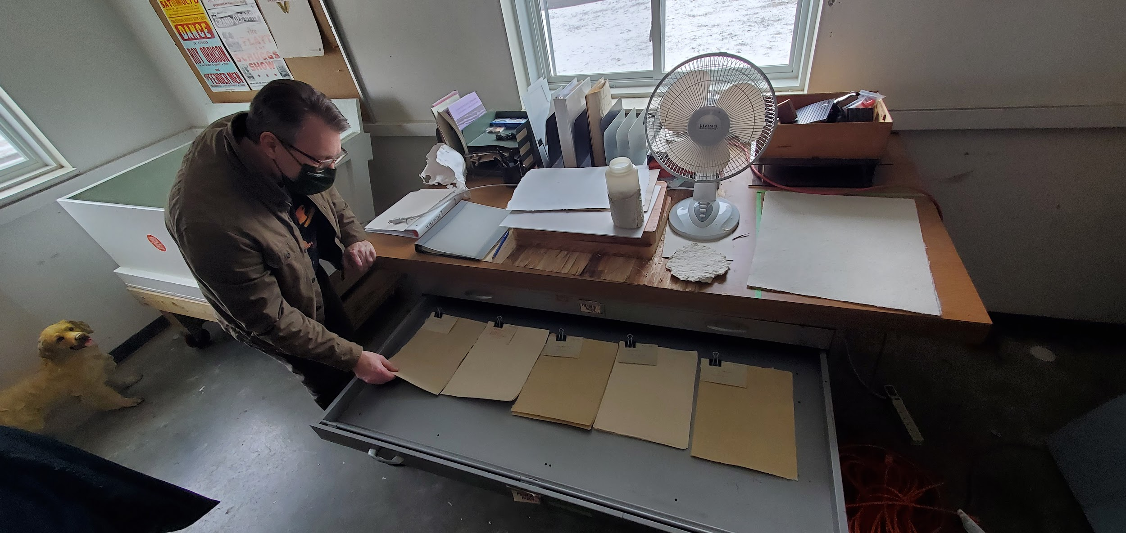
Papermaking Process: Dry Room
DRYING: Drying Box
Storage
5

Slide 7
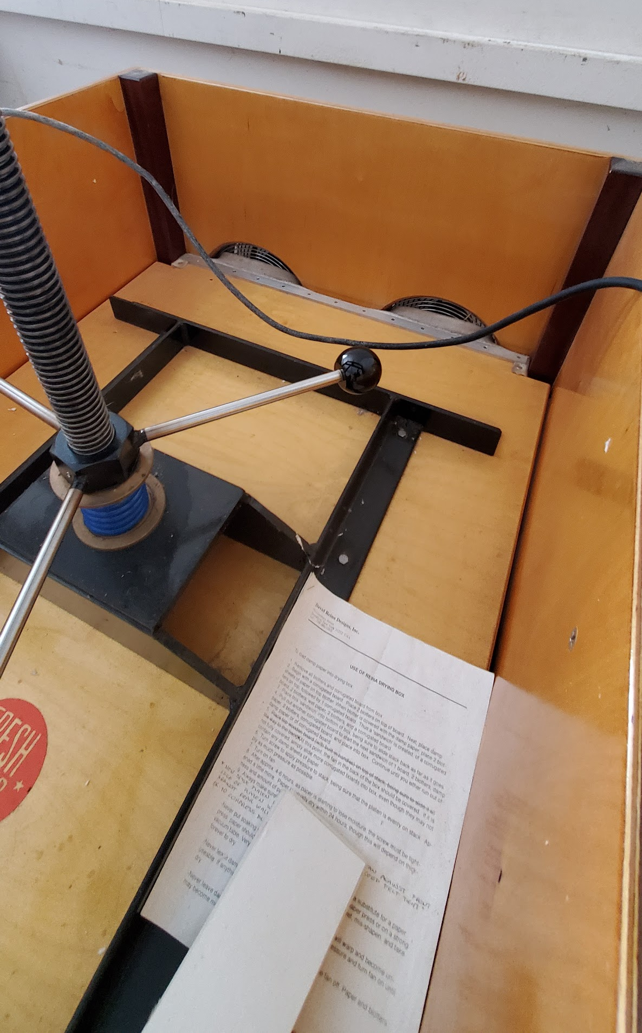
Papermaking Process: Drying Box
Paper layered with corrugated cardboard
PLAN: Concentrate BME680s in drying box to measure conditions throughout the drying process
Fans
“Placeholder” material
6

Slide 8
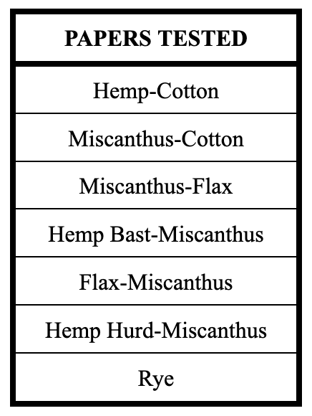
Measuring Paper “Sound” (types of paper)
Noticed paper makes different “sounds” when shaken
Tested 7 samples from Fresh Press
What will frequency correspond to?
7

Slide 9
Measuring Sound: Fourier Analysis
Representing complex waveform, x(t), as a sum of sines and cosines²
Fourier coefficients
²Maria Bell, 2013. “Fourier Analysis in Music,” https://www.projectrhea.org/rhea/index.php/Fourier_analysis_in_Music.
8

Slide 10
Goals of Project
1
Measure environmental conditions (humidity, temperature, pressure & VOC concentration) in the paper drying box
2
Record and analyze the sounds produced by shaken paper
9

Slide 11
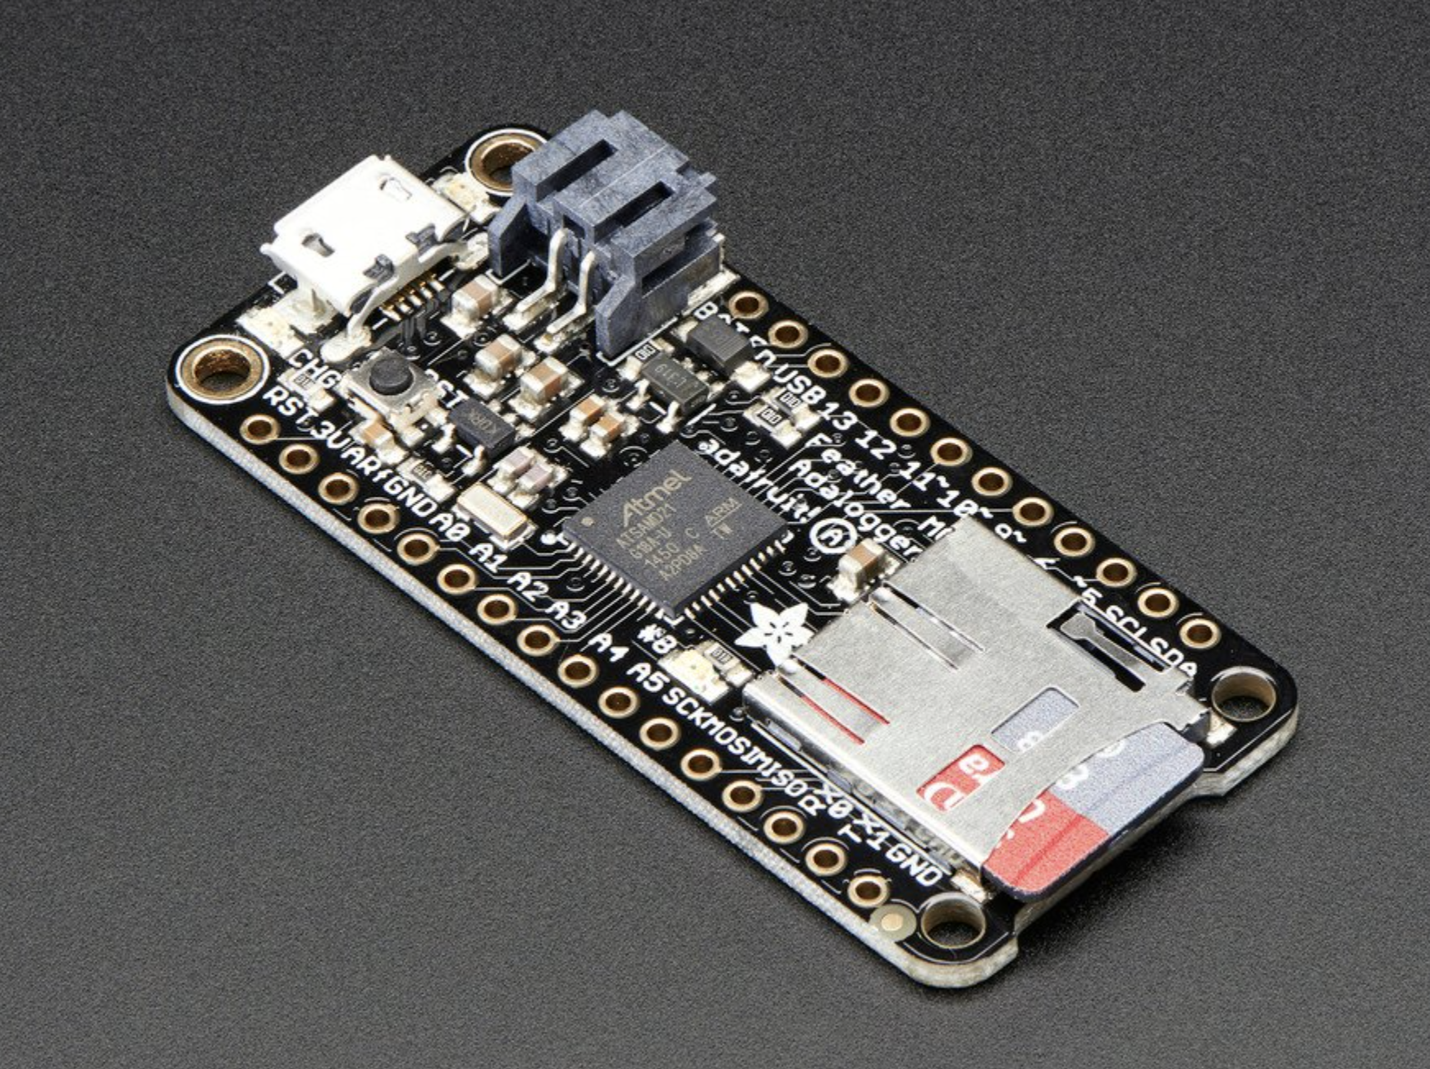
Hardware: Adalogger
48 MHz (4x Mega2560)³, faster speed to process audio
12 bits
Built-in microUSB
Image courtesy of Adafruit Industries
³From Adafruit product description, “Adafruit Feather M0 Adalogger,” https://www.adafruit.com/product/2796.
10

Slide 12
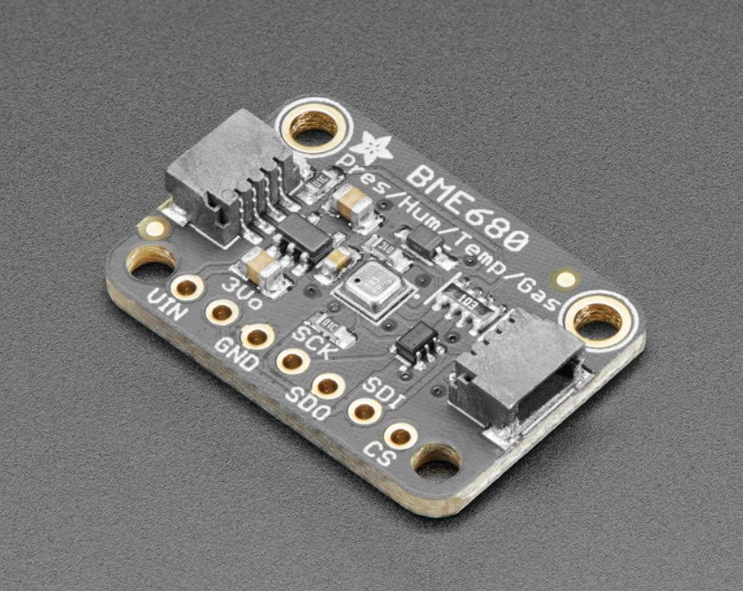
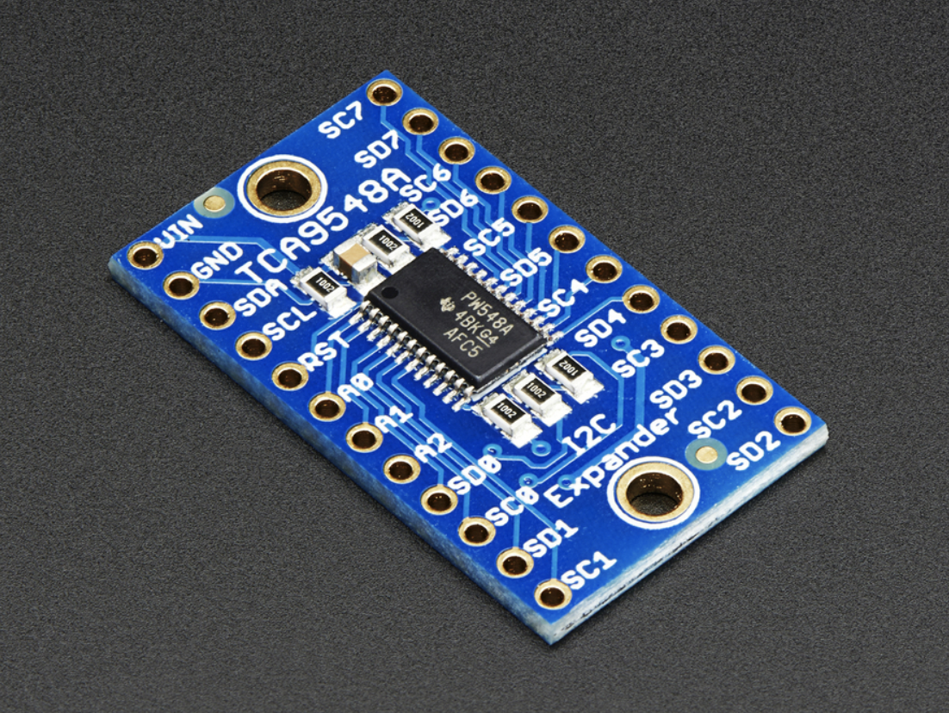
Hardware: BME680s & I2C Multiplexer
Measure temperature, pressure, humidity, and VOC concentration⁴
Metal-oxide (MOX) detector
Multiplexer allows multiple I2C sensors with same address on the same microcontroller⁵
Images courtesy of Adafruit Industries
⁴From Adafruit product description, “Adafruit BME680 - Temperature, Humidity, Pressure, and Gas Sensor - STEMMA QT,” https://www.adafruit.com/product/3660.
⁵From Adafruit product description, “Adafruit TCA9548A 1-to-8 I2C Multiplexer Breakout: Overview,” https://learn.adafruit.com/adafruit-tca9548a-1-to-8-i2c-multiplexer-breakout/overview.
11

Slide 13
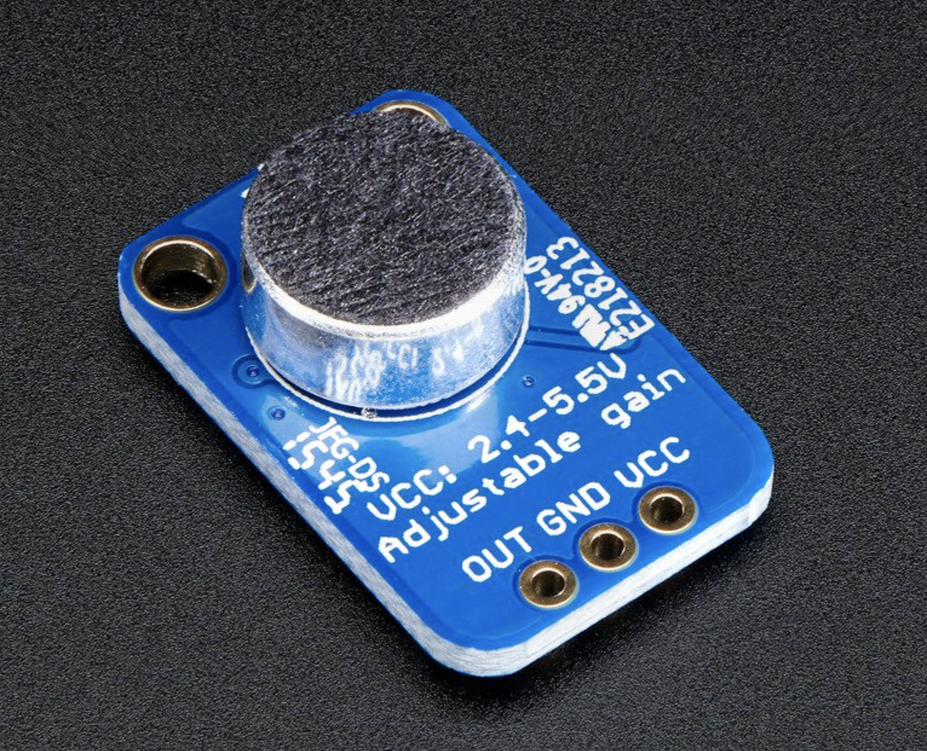
Hardware: Electret Microphone
Records between 20Hz and 20KHz⁶
Parallel plate capacitor with permanent dipole moment⁷
Output connected to analog pin
Image courtesy of Adafruit Industries
⁶From Adafruit product description, “Electret Microphone Amplifier - MAX4466 with Adjustable Gain,” https://www.adafruit.com/product/1063.
⁷George Gollin, private correspondence.
12

Slide 14
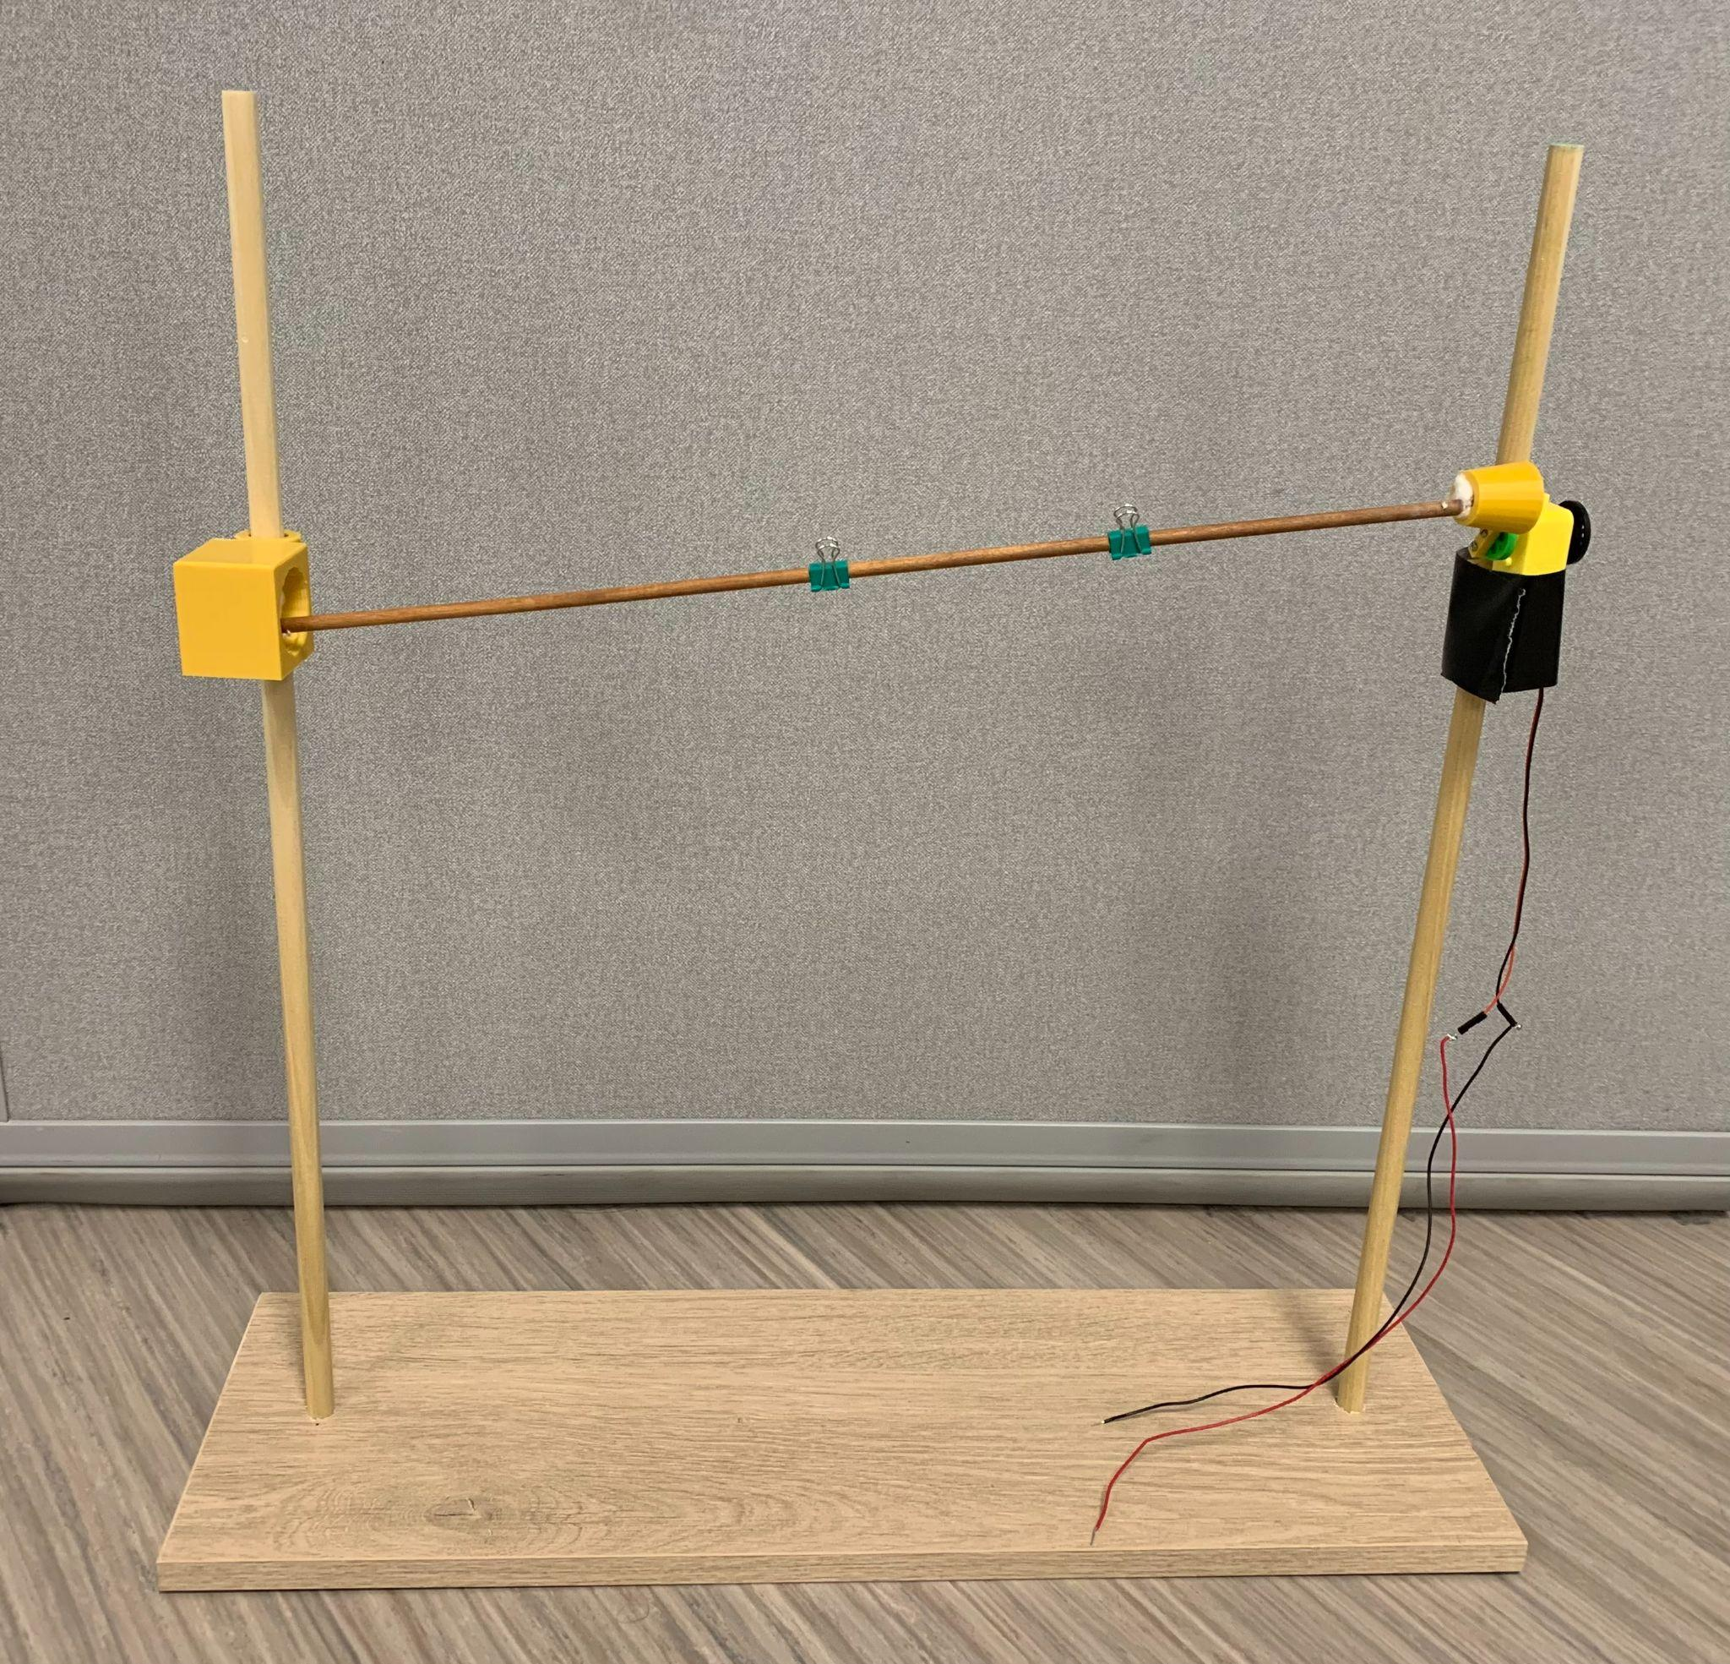
Hardware: Paper Shaker
Binder Clips
Motor
Encoding Wheel
Dowel Holders
Connection to PCB
13

Slide 15
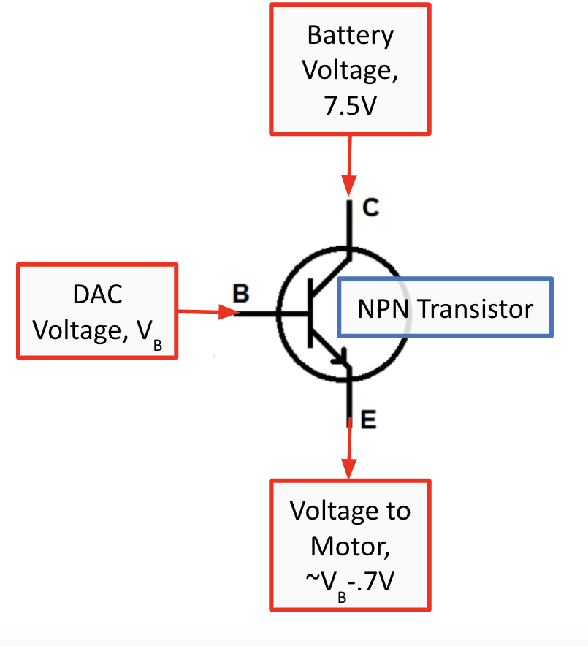
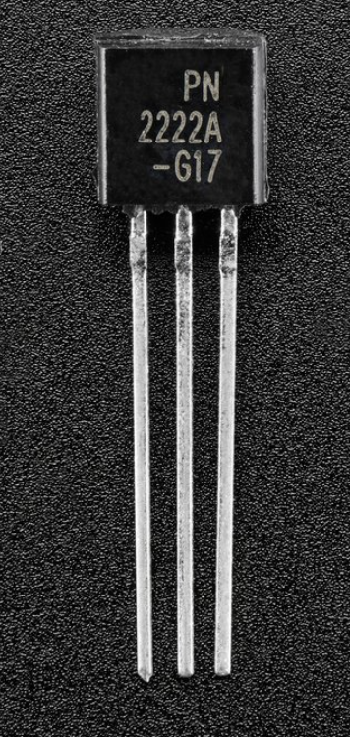
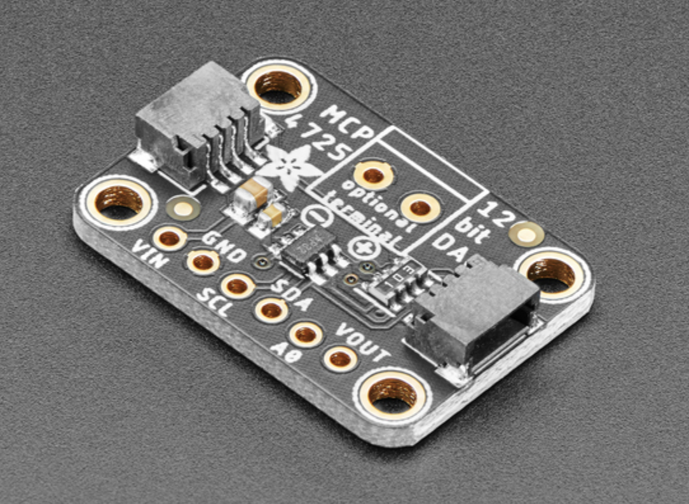
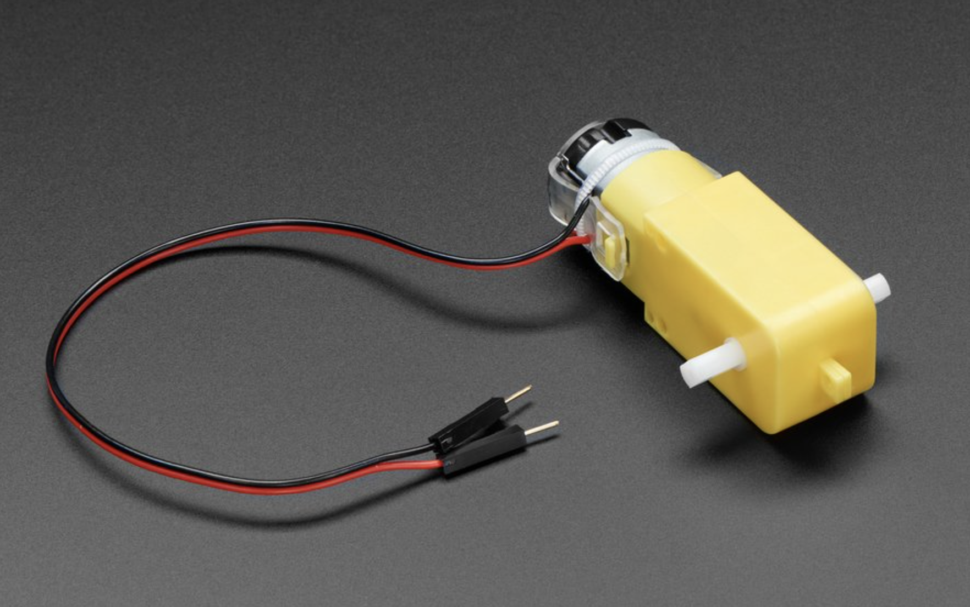
Paper Shaker: Powering TT Motor
Images courtesy of Adafruit Industries
V = IR
14

Slide 16
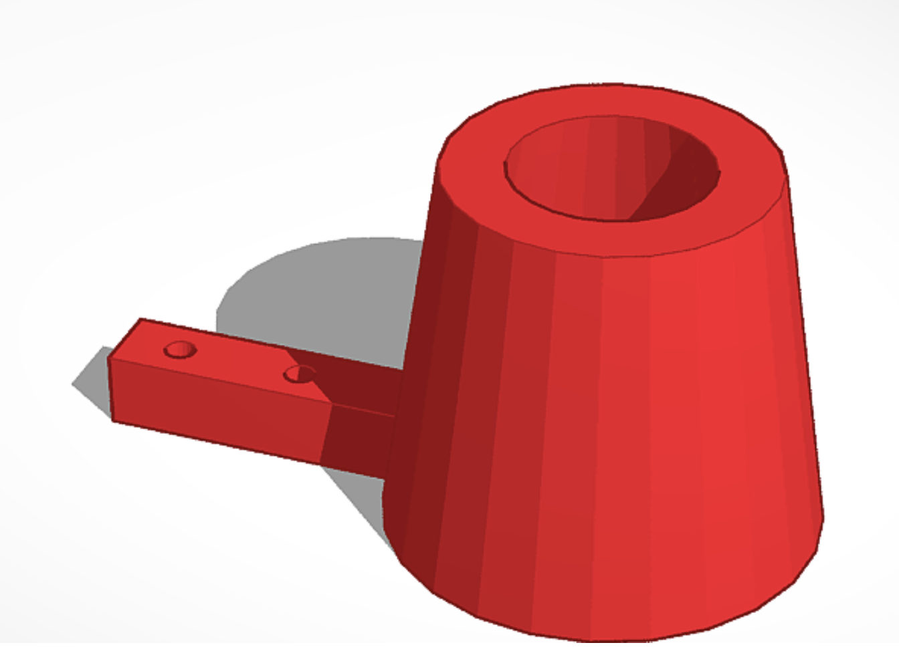
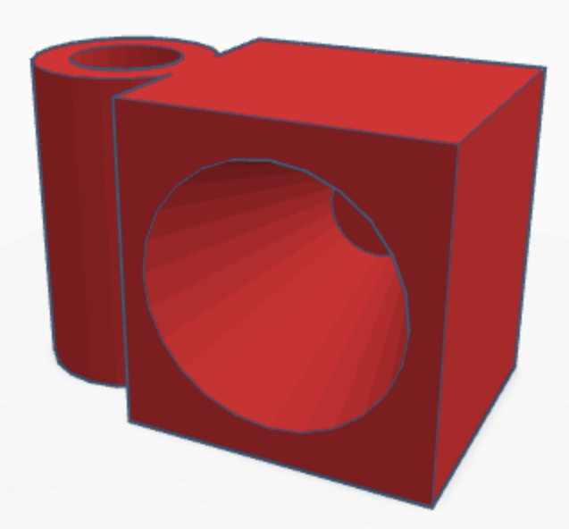
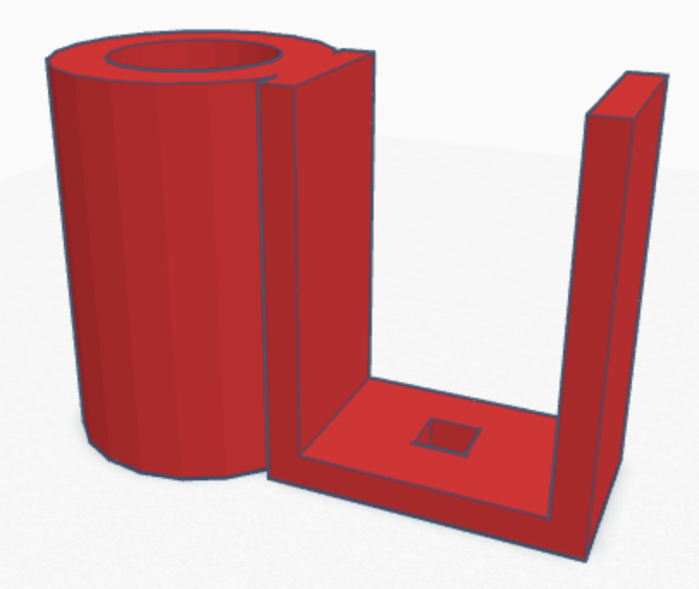
Paper Shaker: Designing the “Shake”
Designed holders to connect motor/quarter-inch dowel to half-inch dowels
Created in TinkerCAD according to manufacturer specs
3D printed
15

Slide 17
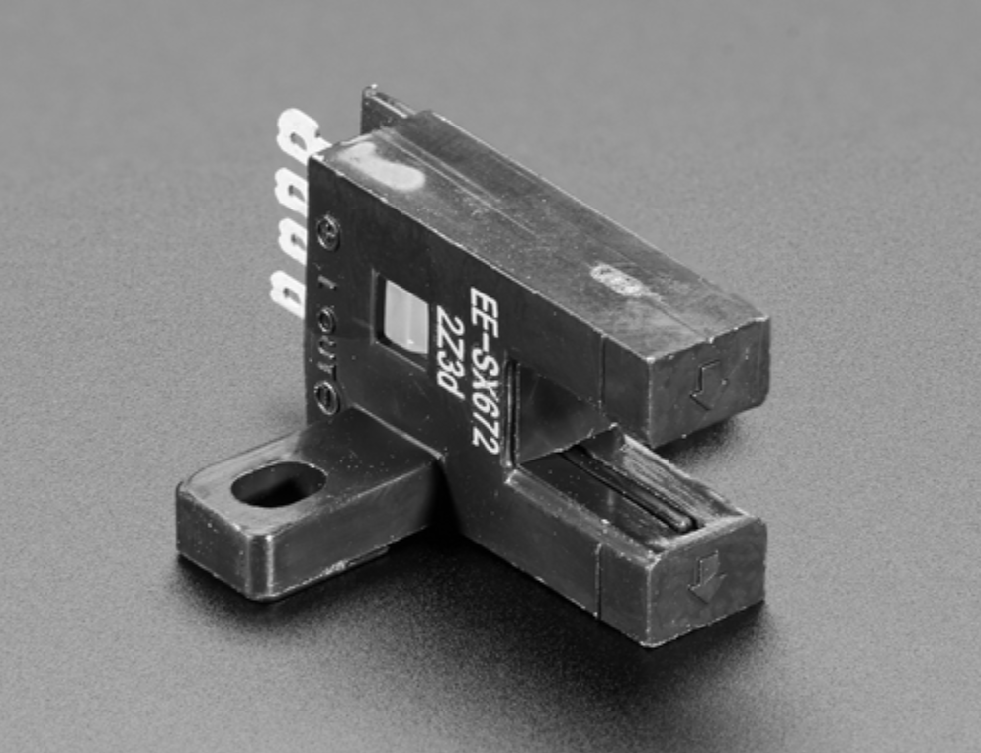
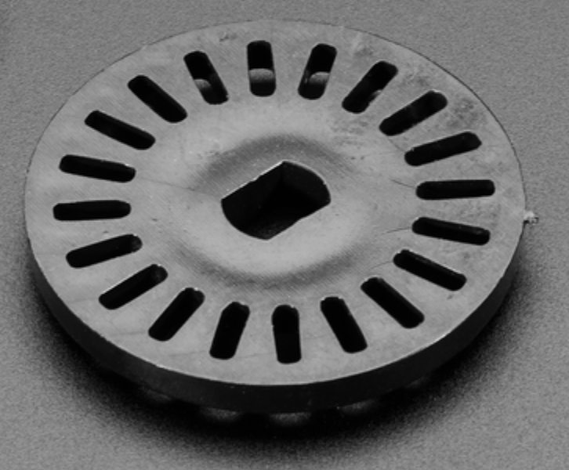
Paper Shaker: Recording Rotation Frequency
Photo Interrupter: IR LED emitted across a gap to IR detector⁸
TT motor encoder wheel
⁸From Adafruit product description, “T-Slot Photo Interrupter,” https://www.adafruit.com/product/3986.
16

Slide 18
SOFTWARE
Sound recording: Reads the ADC at ~16kHz, generates 20 audio files with 10000 samples representing a 0.6 second interval. Files have a 125 ms gap¹.
Corresponding Python file reads each audio file and plots its Fourier transform individually. No concatenating of files!
¹George Gollin provided code
17

Slide 19
SOFTWARE
To read and record BME680s: the software maintains one file in a CSV format to which all four BME680s record their data.
Corresponding Python file uses Pandas to open the generated file, cleans up the data, and plots the data.
18

Slide 20
Calibrating BME680s
A calibration test with both PCBs was run, with all BME680s next to each other.
For each PCB and variable recorded, a reference dataset was selected, and then the average difference with every other dataset of the same type on the same PCB was calculated.
This average difference was added to the data collected at the lab as a correction term.
The RMSD was calculated using both real and calibrated data.
¹Reference
19

Slide 21
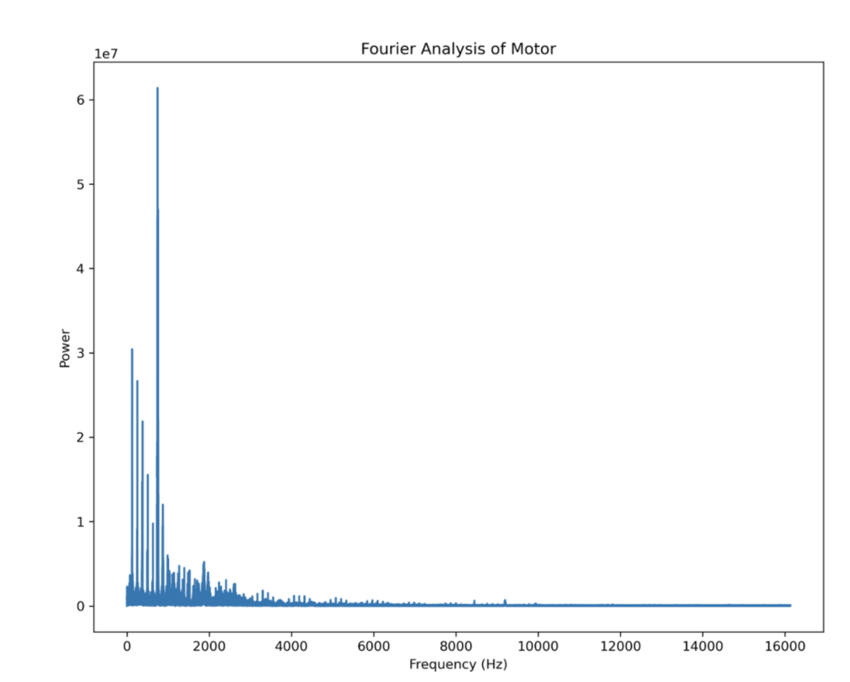
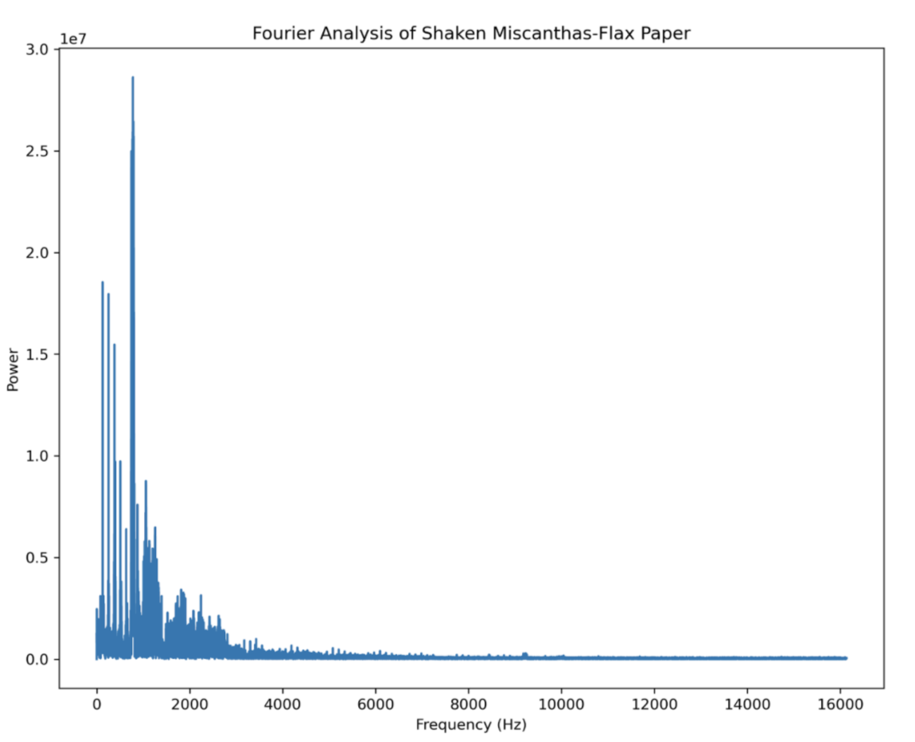
Abandoning the Paper Shaker…
2 Problems: Motor very LOUD, shaken paper very quiet
Difficult getting any interpretation from Fourier transforms
Side-to-side creates more sound rotational motion
20

Slide 22
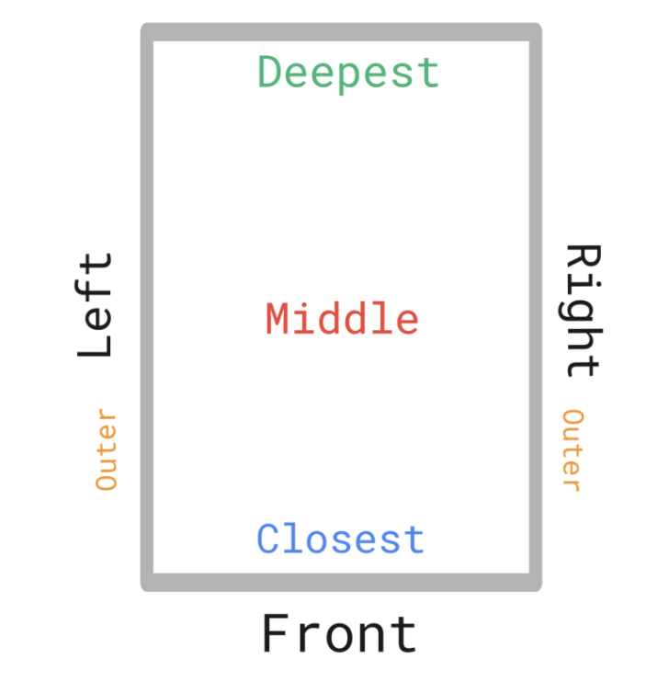
Recording in Drying Box
Placed 8 BMEs in drying box at Fresh Press lab
Took measurements every 5 seconds for ~70 hours
21

Slide 23
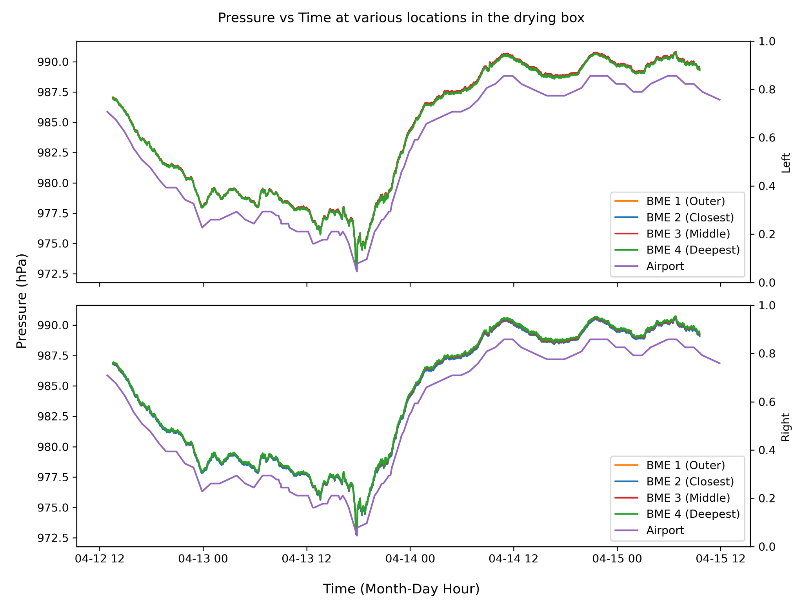
Pressure Results
22

Slide 24
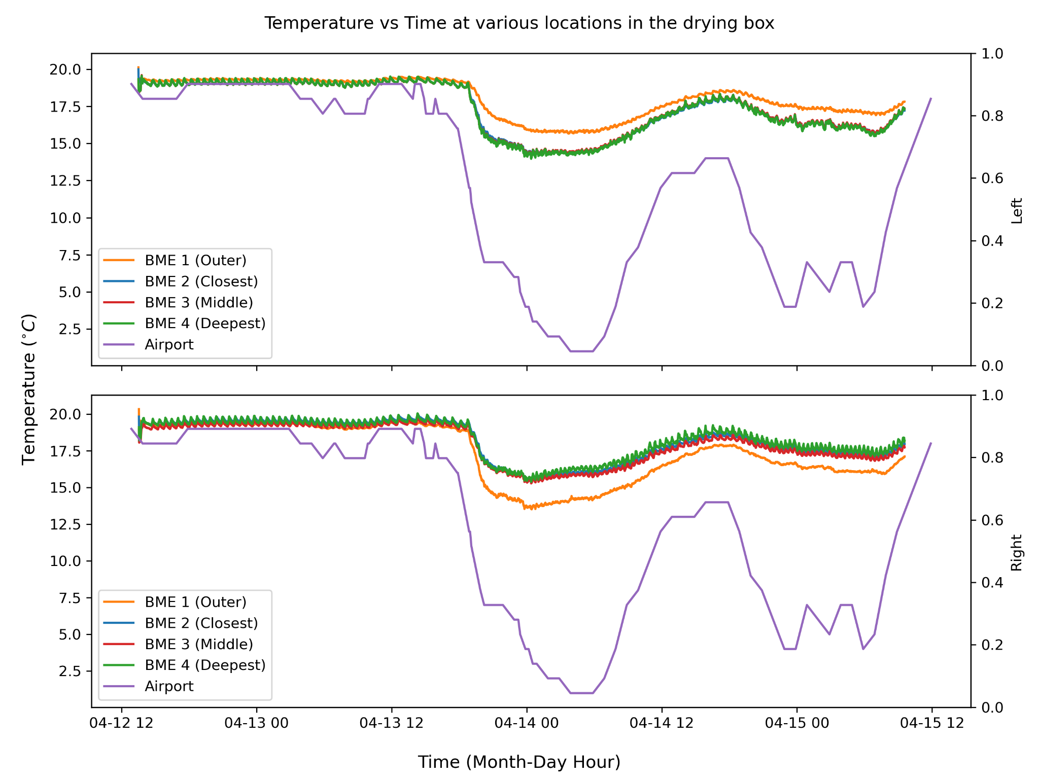
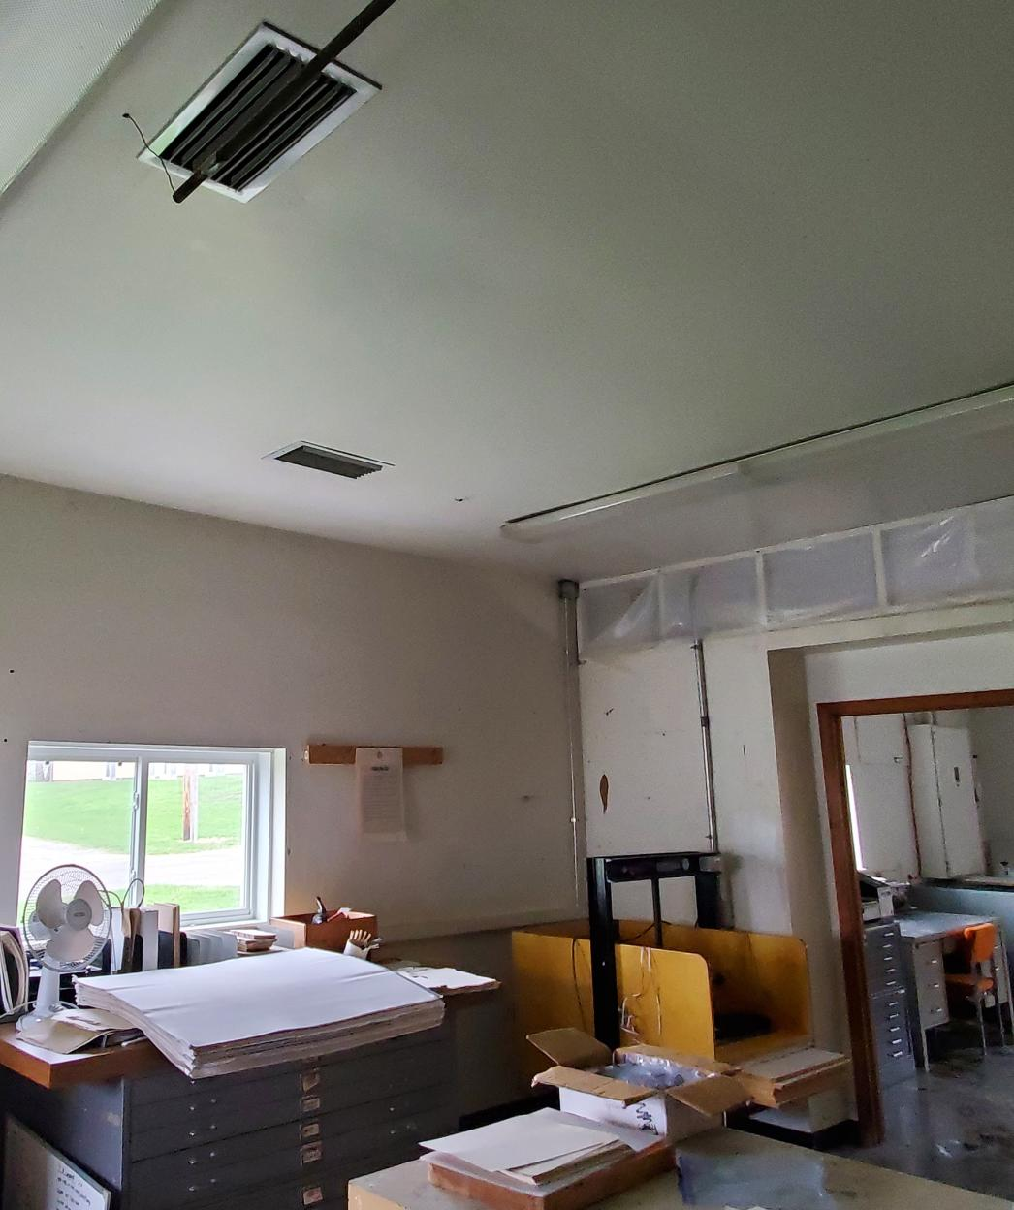
Temperature Results
Temperature consistency
Heater cycles
Proximity to window
23

Slide 25
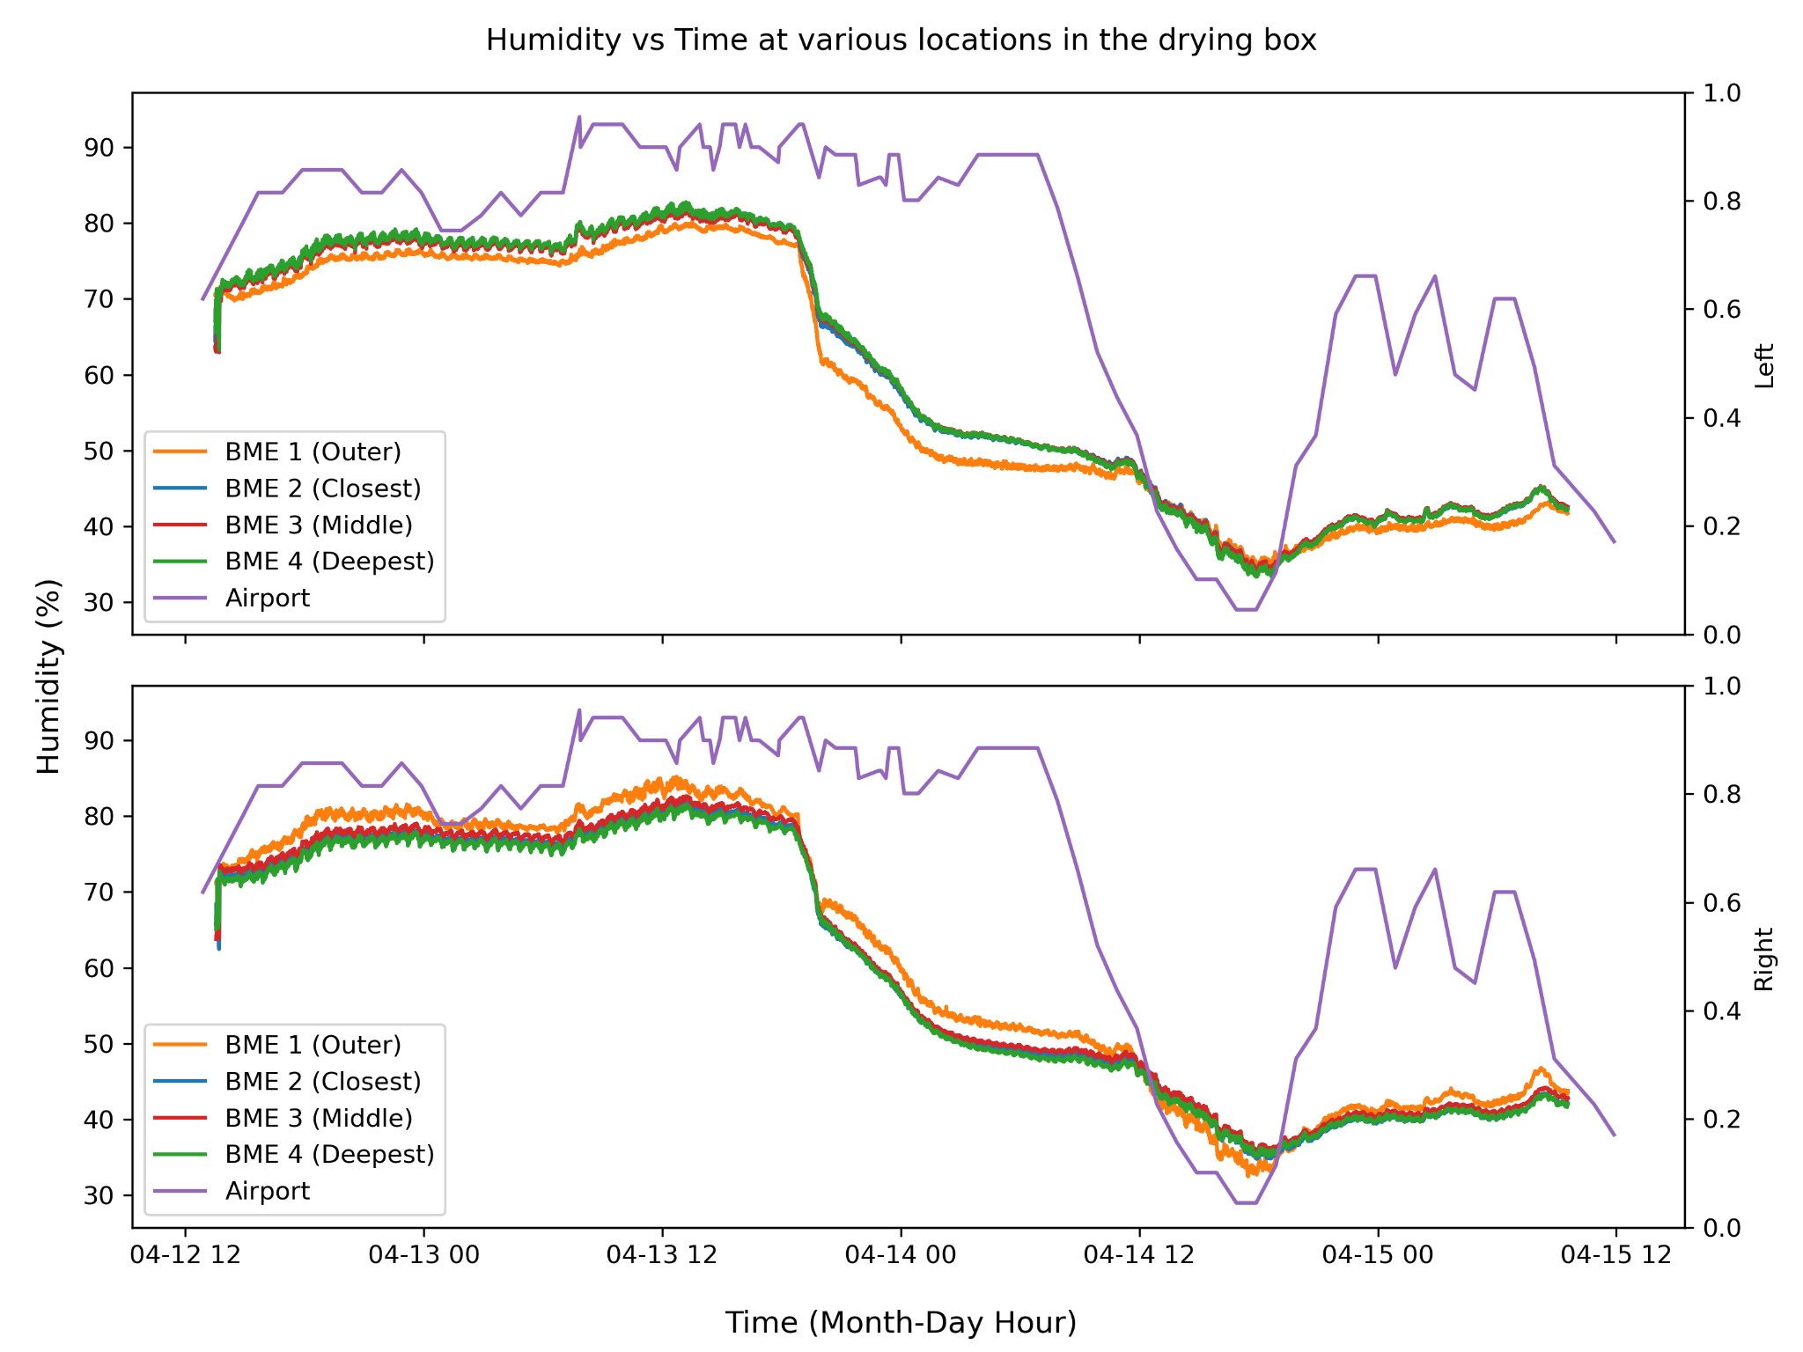
Humidity Results
Two “drops”
Window opening
24

Slide 26
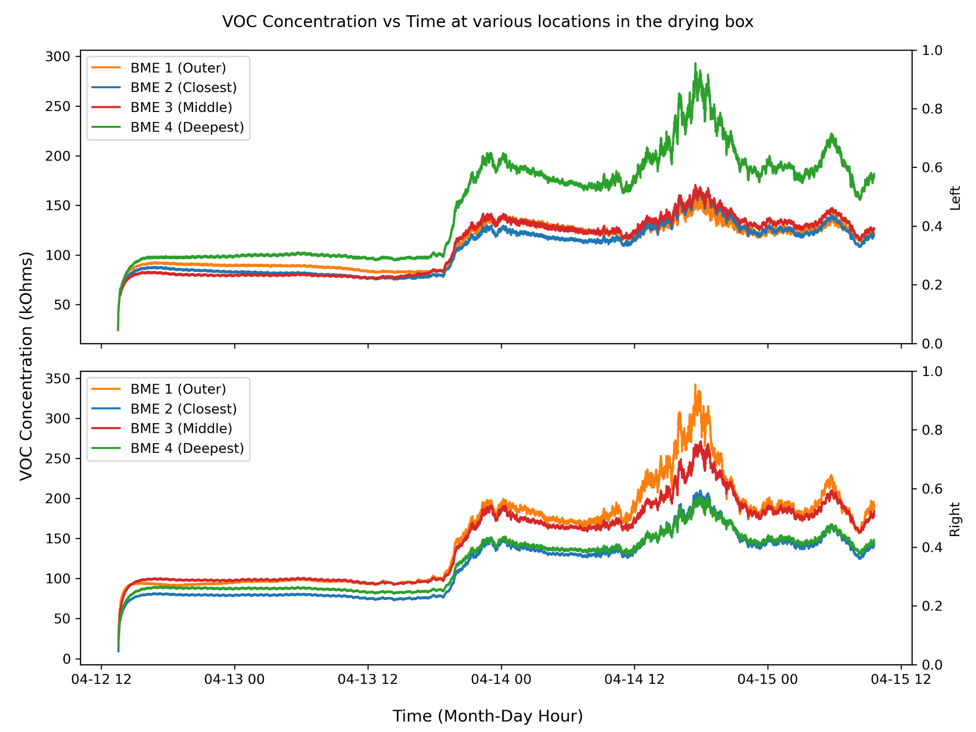
VOC Concentration Results
Lack of safe way to calibrate
Window opening
Bleaching floors
25

Slide 27
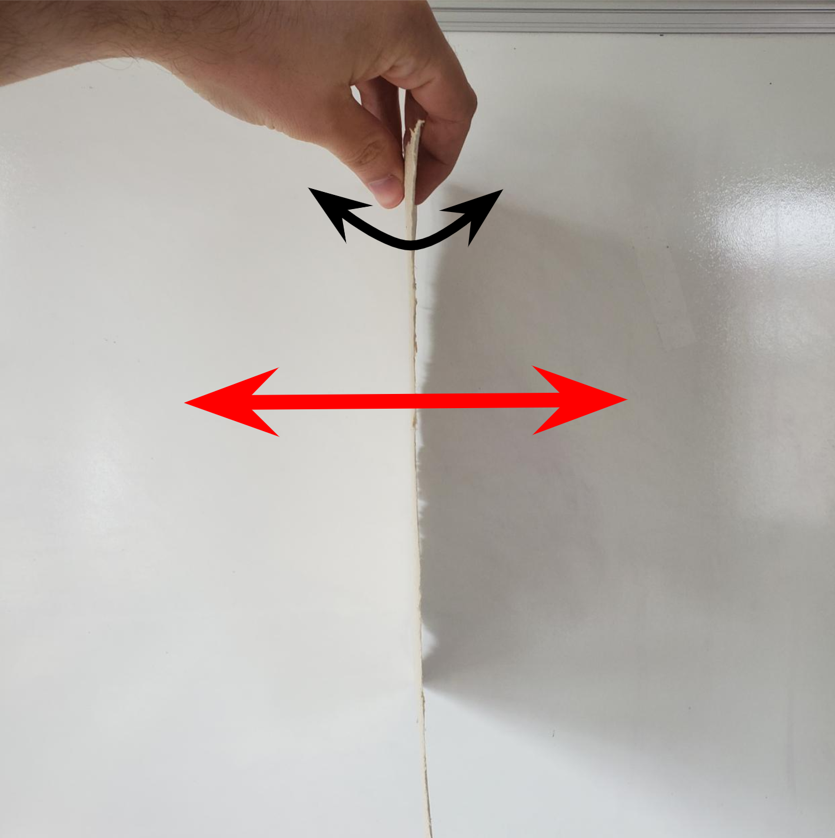
Recording Paper Sound
Recordings were performed in a music for minimum background noises.
Paper was held directly over the electret microphone and shaken until all 20 files had been written.
Hand-shaking is not as reproducible.
26

Slide 28
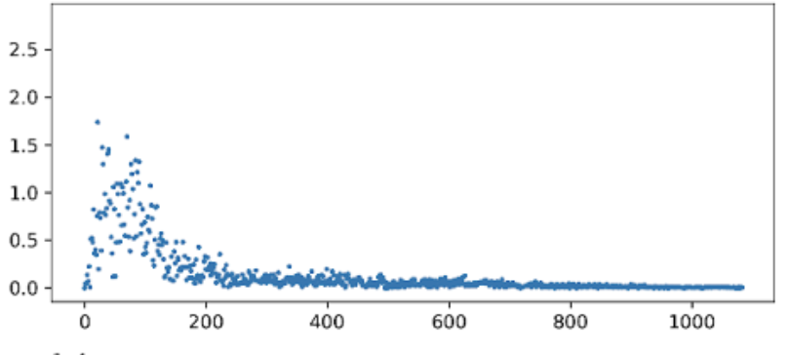
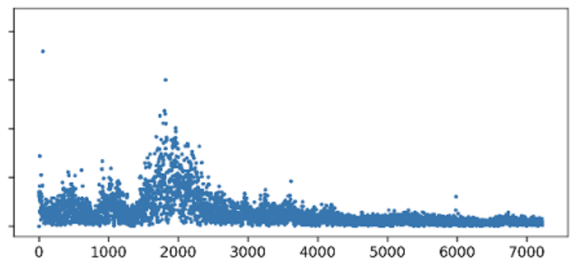
Sound Results: Comparisons
Thickest and thinnest sheet of paper = greatest differences in spectra
Range & peak frequency higher in thinner, less rigid paper
27

Slide 29
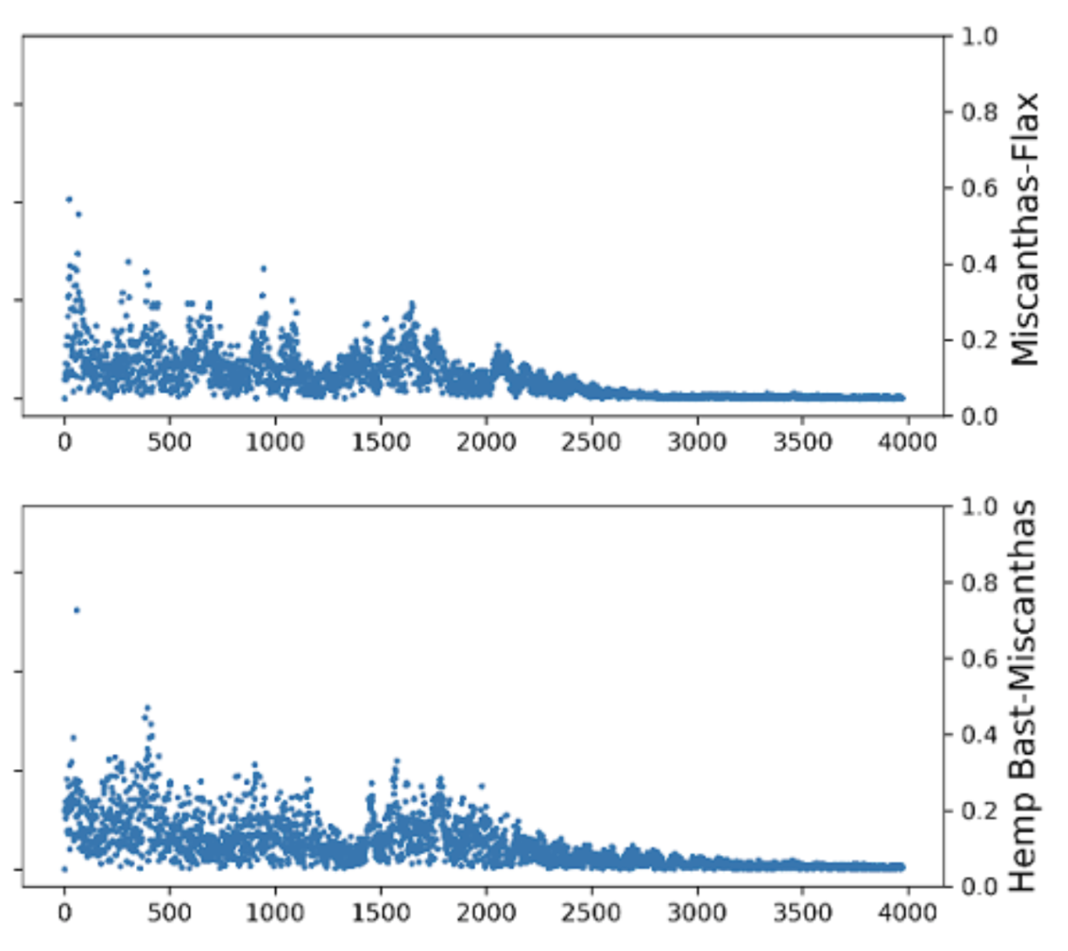
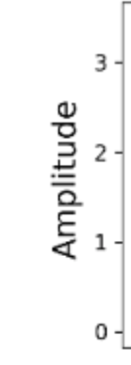
Sound Results: Comparisons
Similarity in spectra = similarity in thickness, rigidity
Similar peak amplitudes
28

Slide 30
Conclusions: Environmental Data
Temperature and pressure seem relatively unaffected by the drying process.
Humidity and VOC concentrations are likely to be affected by the drying process, but it requires more data and collection locations to find out exactly how.
Outside variables have a massive impact!
29

Slide 31
Conclusions: Paper “Sounds”
Perceived rigidity has high correlation with both peak characteristic frequencies and the range of frequencies produced.
Rigid, thick paper produces smaller frequency ranges and peaks at lower frequencies
Malleable, thin paper produces large ranges with high frequency peaks.
30

Slide 32
Acknowledgements
Thanks to Eric and Olivia of Fresh Press, Shubhang for his guidance and patience, and George Gollin for his wisdom, insight, equipment, time, emotional energy, etc etc etc
THANK YOU!
31

