Slide 1
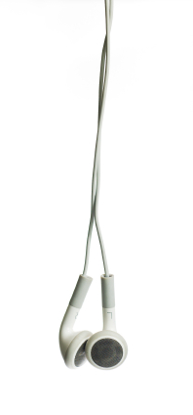
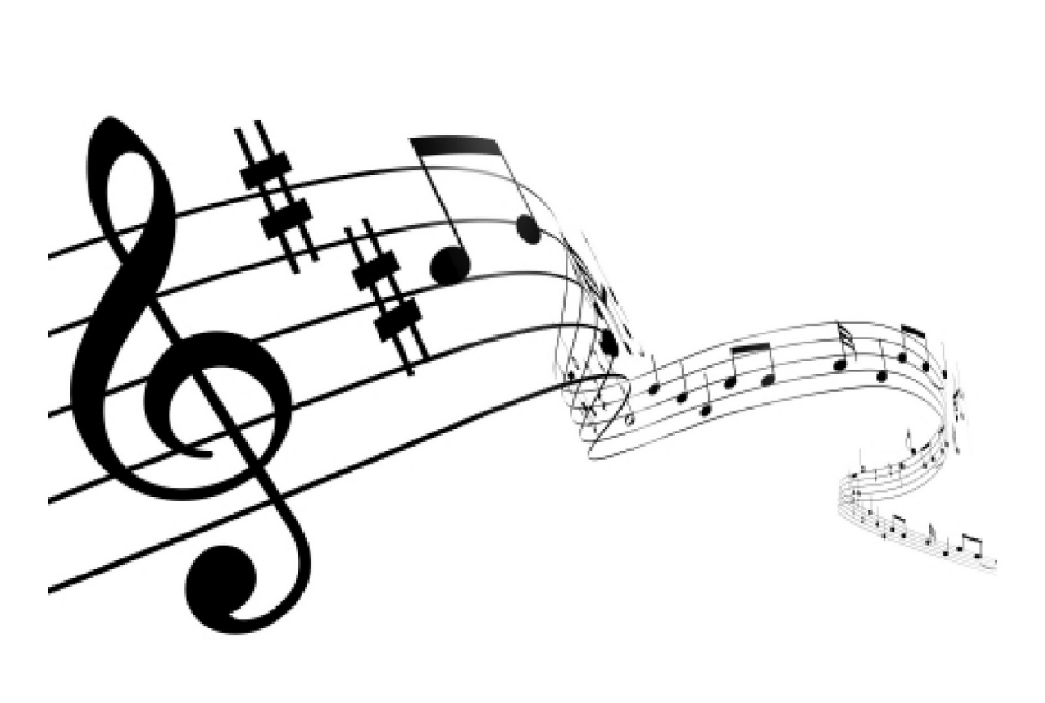
Graphene Electrostatic Loudspeaker
Kristin Holz
Advisor: Dr. Steven Errede
Research supported by NSF Grant PHY-1062690

Slide 2
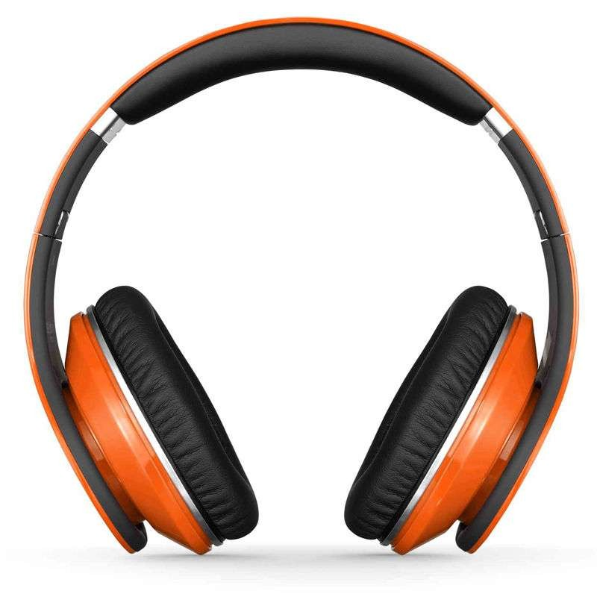
Summary
Background
Importance
Prototype
Frequency Response and Efficiency
Simulation

Slide 3
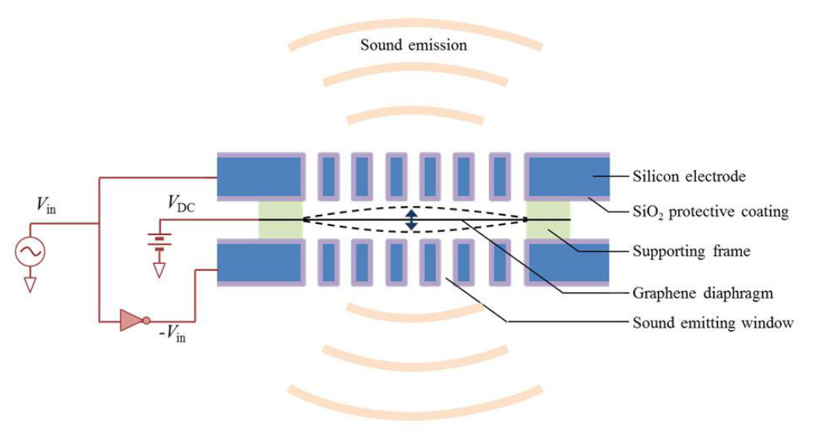
What is an Electrostatic Loudspeaker?
AC voltage perforated capacitor
Insulating frame
DC voltage biased membrane
$$F_{EM}=−2\frac{ε_{0}AV_{DC}V_{in}}{d^{2}}e^{iωt}\hat{z}$$

Slide 4
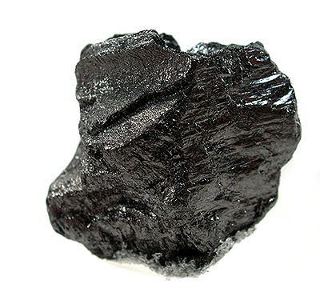
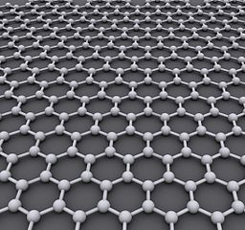
Graphene
One atom thick layer of graphite
Hexagonal pattern of carbon atoms
Low resistivity
Low mass
Low spring constant
High strength
Notes:
Graphite source: http://www.irocks.com/db_pics/pics/tn19a.jpg

Slide 5
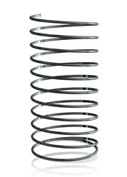
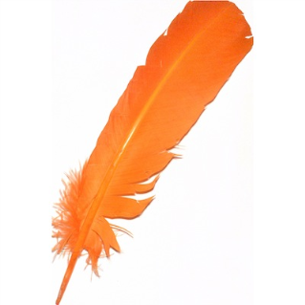
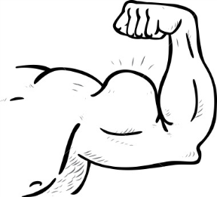
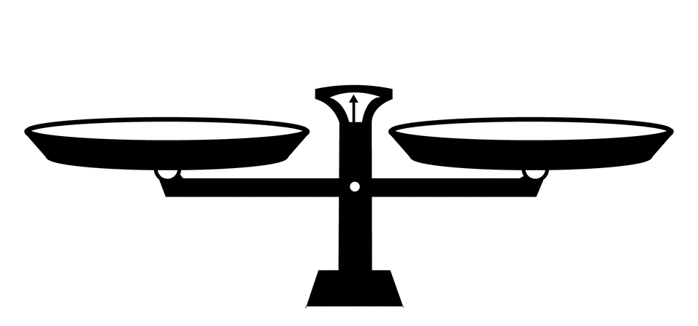
Why a Graphene Electrostatic Loudspeaker?
Thinness and low mass density allow for smaller sized speaker
Low mass, low spring constant, and high strength produces a great overall frequency response
High strength ensures better fidelity

Slide 6
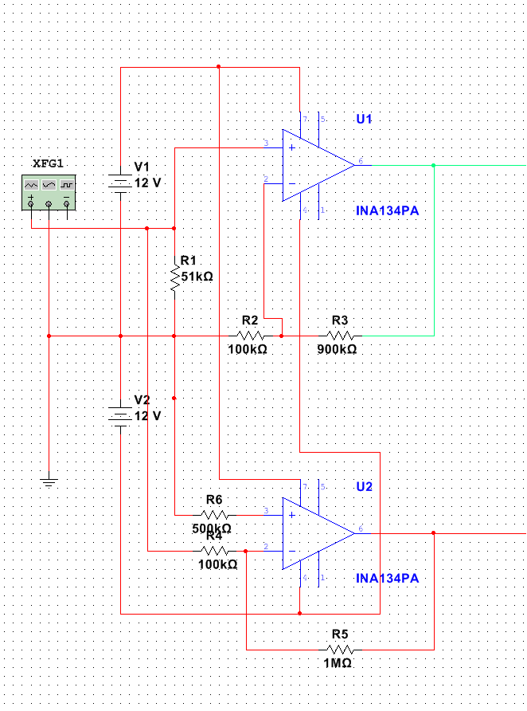
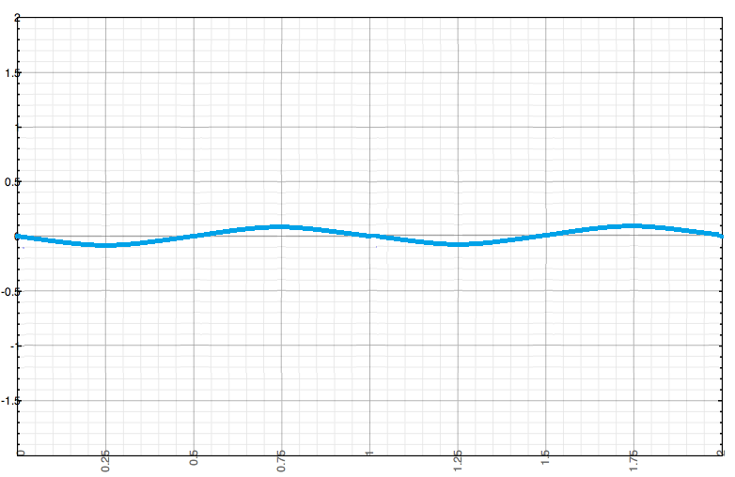
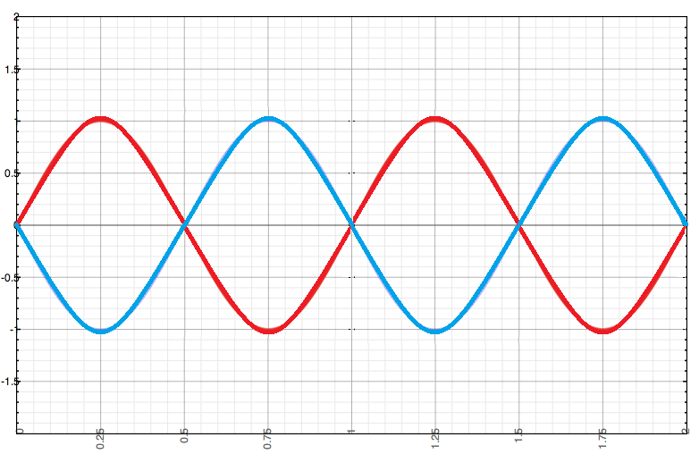
Voltage Driver Design
Op Amp
Input
Output
Inverting
Op Amp

Slide 7
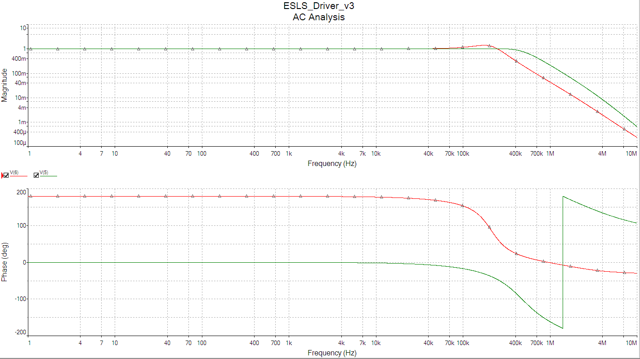
Frequency and Phase Response of Driver
Range of hearing

Slide 8
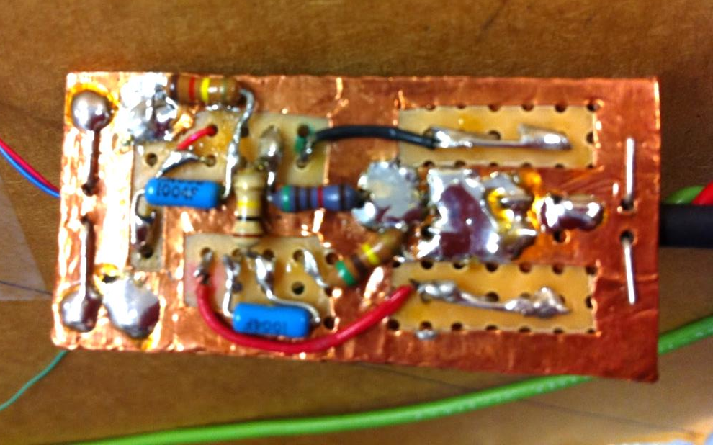
Voltage Driver
Top View
Capacitors
Copper Foil Grounding Plane
Trimpot Resistor
Bottom View
Op Amp Electronic
Component
Resistors

Slide 9
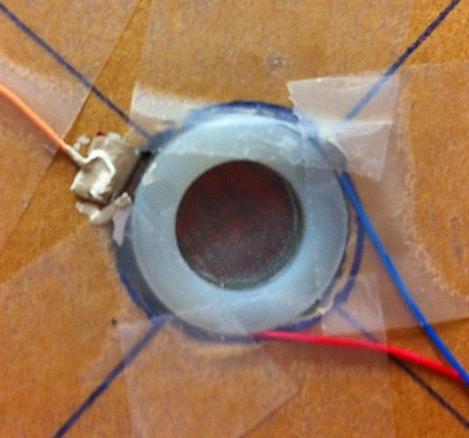
Electrostatic Loudspeaker Prototypes
Aluminized Mylar Membrane
Steel mesh capacitor plates
Nylon washer spacers (1.676 mm)
Graphited Mylar Membrane
Steel mesh capacitor plates
Hole punch reinforcement sticker spacers (0.127 mm)

Slide 10
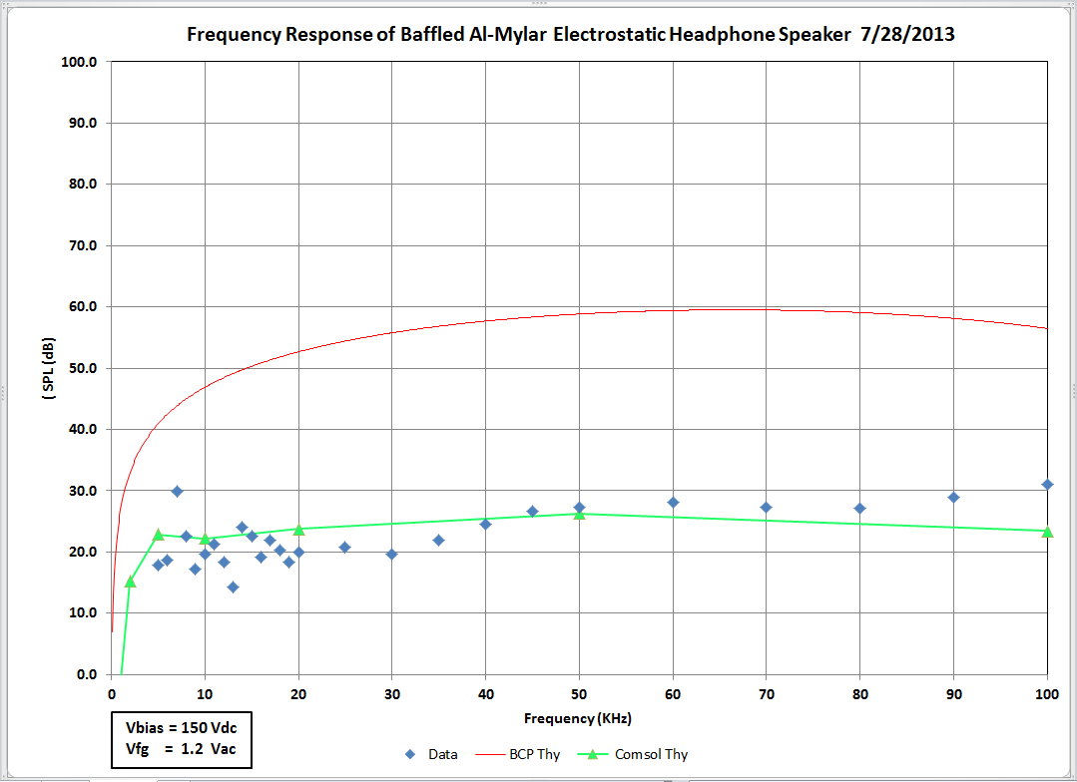
Aluminized Mylar Loudspeaker: Frequency Response and efficiency
$$d=1.676 mm$$
Comfortable headphone volume region

Slide 11
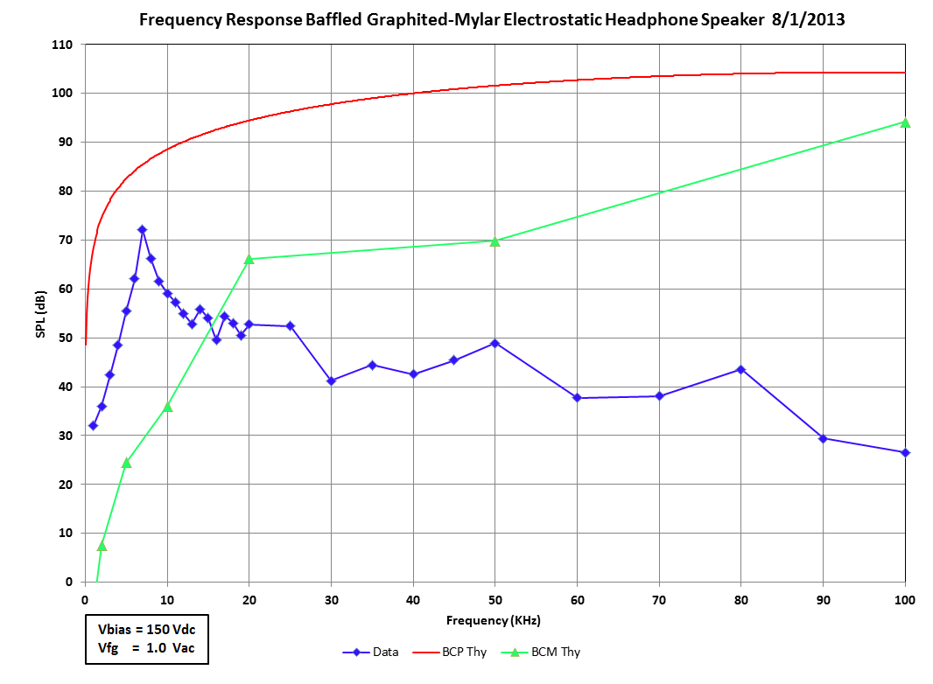
Graphited Mylar Loudspeaker: Frequency Response and efficiency
$$d=0.127 mm$$
Comfortable headphone volume region

Slide 12
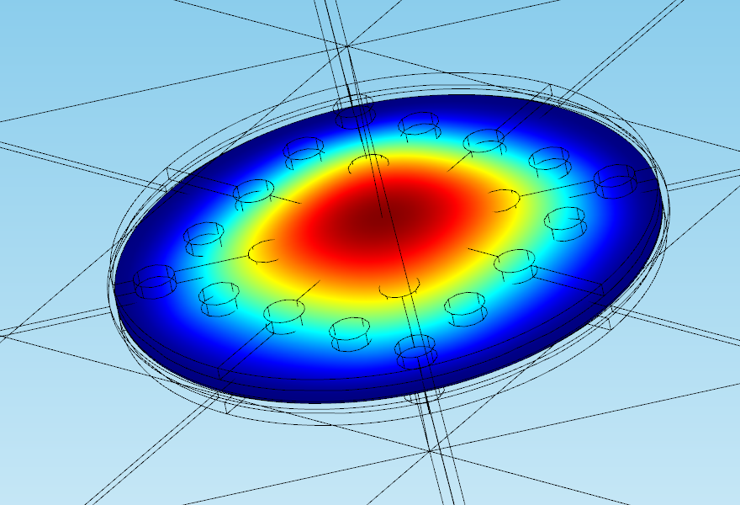
Simulation
Geometry
Displacement at 766.5 Hz
Sound Pressure Level at 1kHz
Acoustic Pressure Field at 1kHz

Slide 13
Conclusions
Graphene electrostatic loudspeakers should theoretically be better than current headphone speakers
The voltage driver circuit we made works well
The simulation produces results we expected
The prototypes produce results we expected
Now we just need the graphene sheet…

