Slide 1
Acoustical Physics Research in the UIUC Physics of Music/Musical Instruments Course(s) and Professional Careers in Acoustics Prof. Steven Errede UIUC Physics

Slide 2
I. Acoustical Physics Research in the UIUC Physics of Music/Musical Instruments Course(s)
Created/developed & have been teaching lecture-lab-demo UIUC POM course(s) for > decade (since 2000). Initially focused solely on stringed & electronic musical instruments; scope has now broadened/broadening out in many directions…
Upper-level Physics 406 course emphasizes the fully-complex nature of (arbitrary) sound fields. We primarily work in the frequency-domain, but also connect to time-domain (via Fourier Transforms), and vice-versa.
The theoretical/mathematical formalism and experimental techniques developed for acoustics course can used directly e.g. in E&M, optics, QM (with appropriate/ suitable modifications).
Very useful techniques for other physics courses, other fields of research!
We give (just) a few examples of UIUC POM acoustics results on following slides:

Slide 3
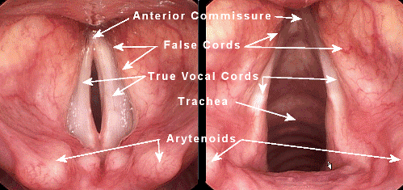
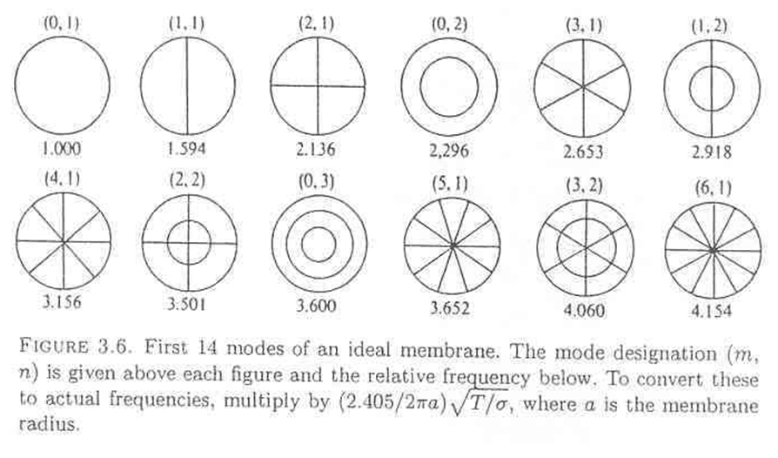
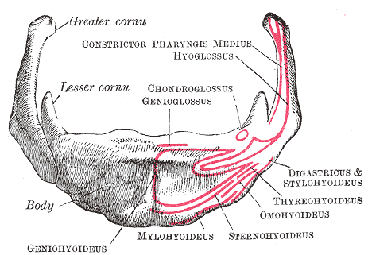
The Human Voice – The first / earliest musical instrument… unique to each human!
When singing (& talking), the human vocal cords vibrate as a 1-D system (e.g. like a guitar string) – production of integer related harmonics of fundamental:
n.b. If we instead had e.g. a 2-D circular membrane for producing musical sounds, would not have such a relation:
The hyoid bone (present in many mammals) is unique to Homo sapiens – enables production of a wide range of sounds that other animals cannot produce – allowing wider range of the tongue, pharyngeal and laryngeal movements – necessary for human speech (and song)…
This mathematical physics fact has important / profound consequences for the development of music and musical instruments by humans….
⇒ It is NO accident that the musical instruments that we humans have developed mimic the human voice, human rhythms….

Slide 4
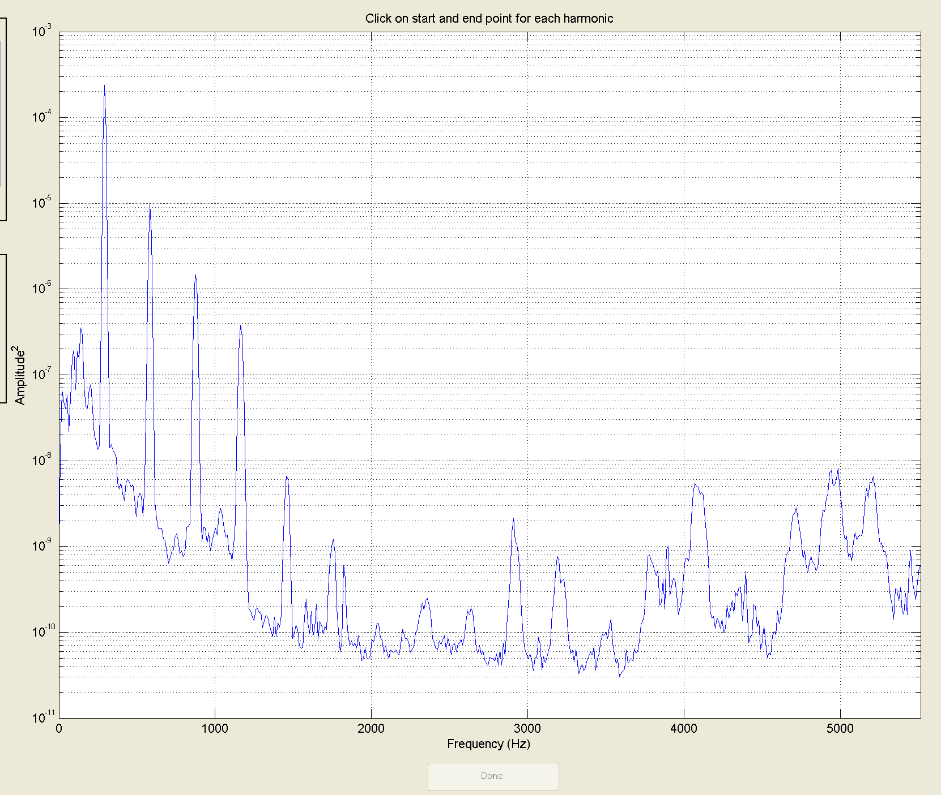
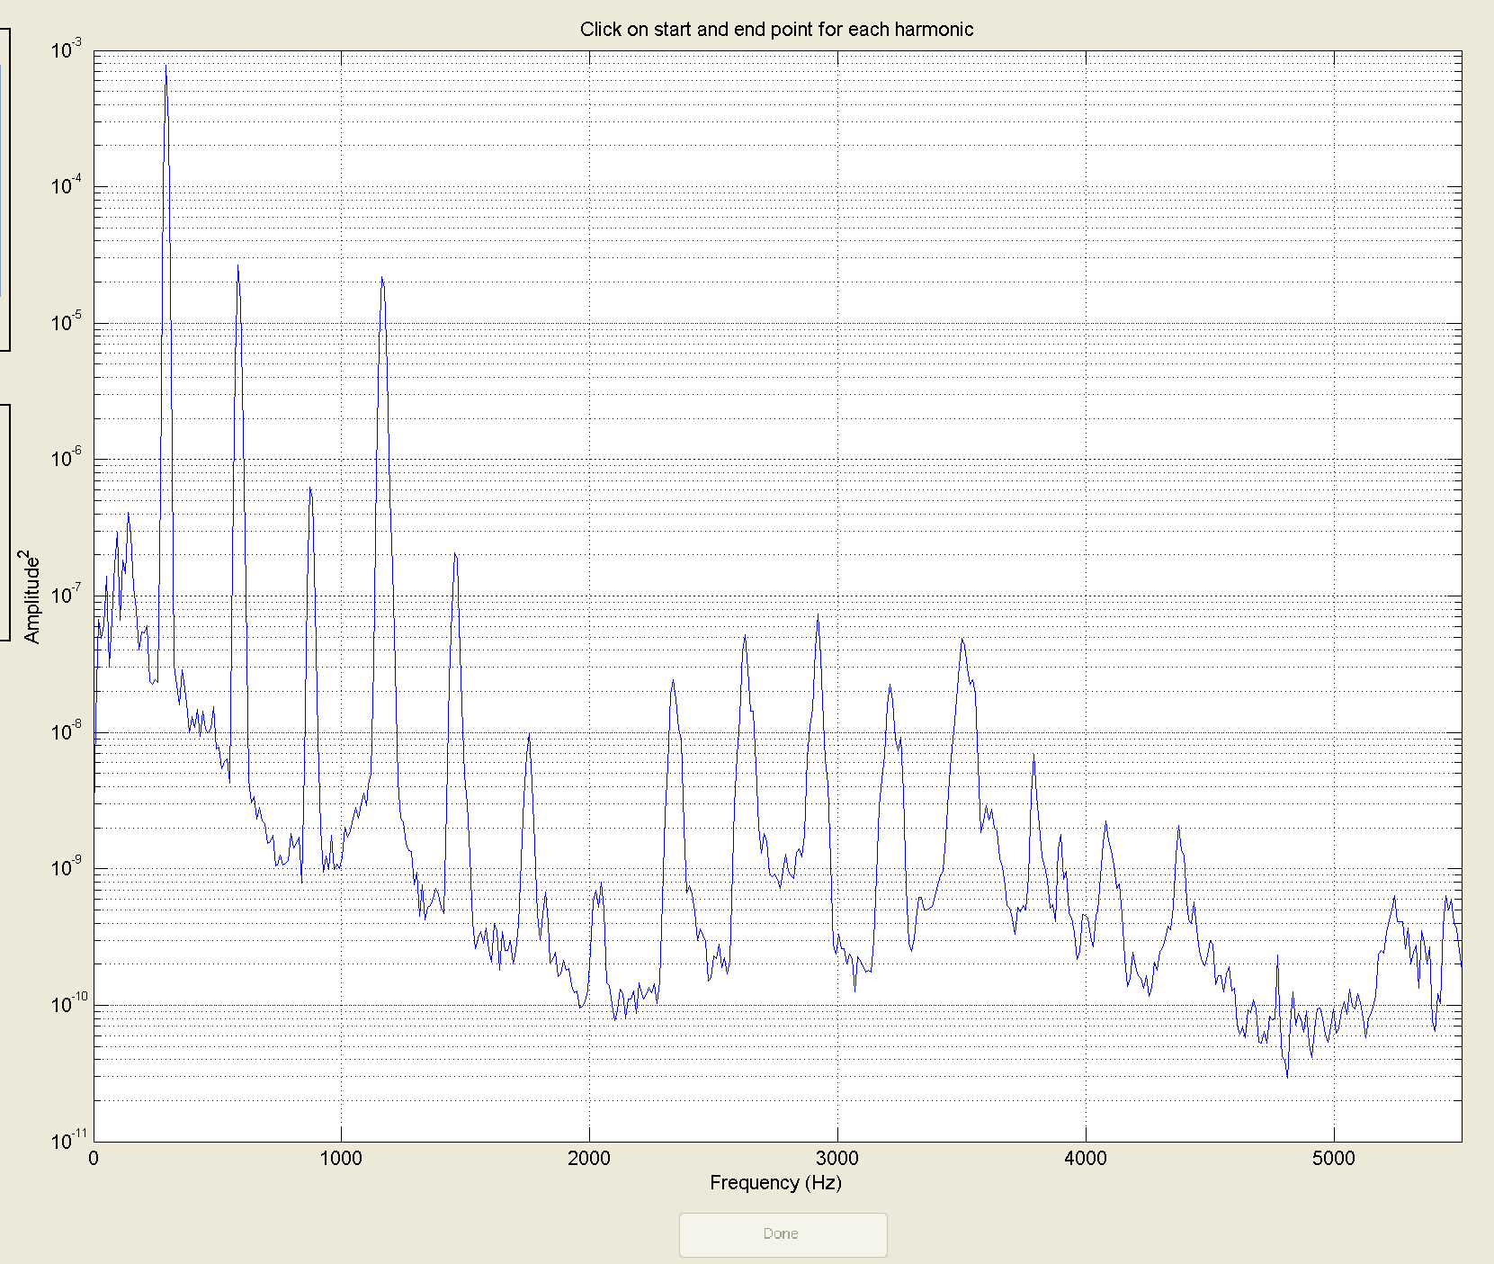
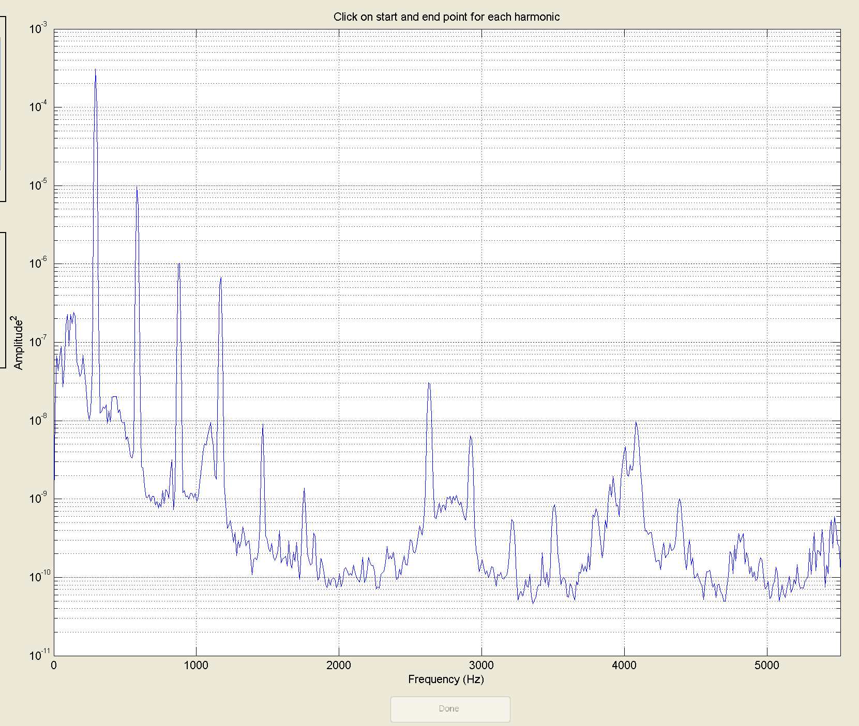
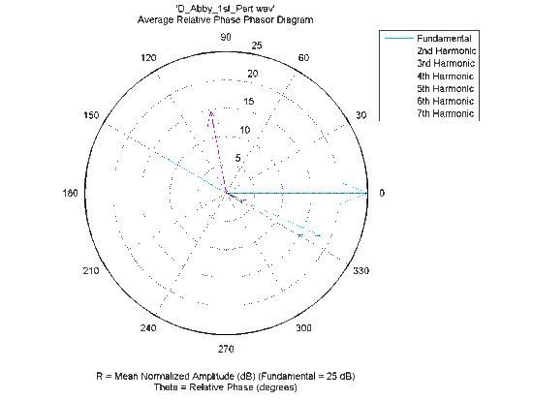
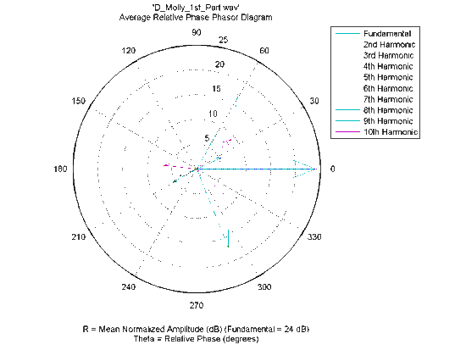
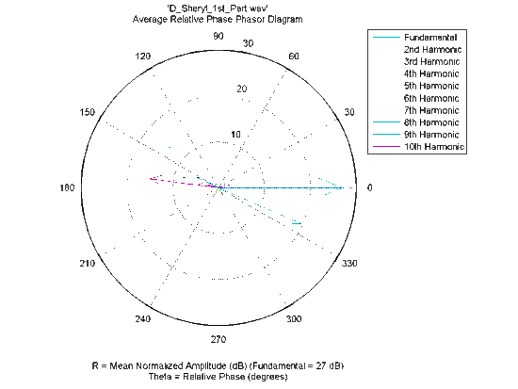
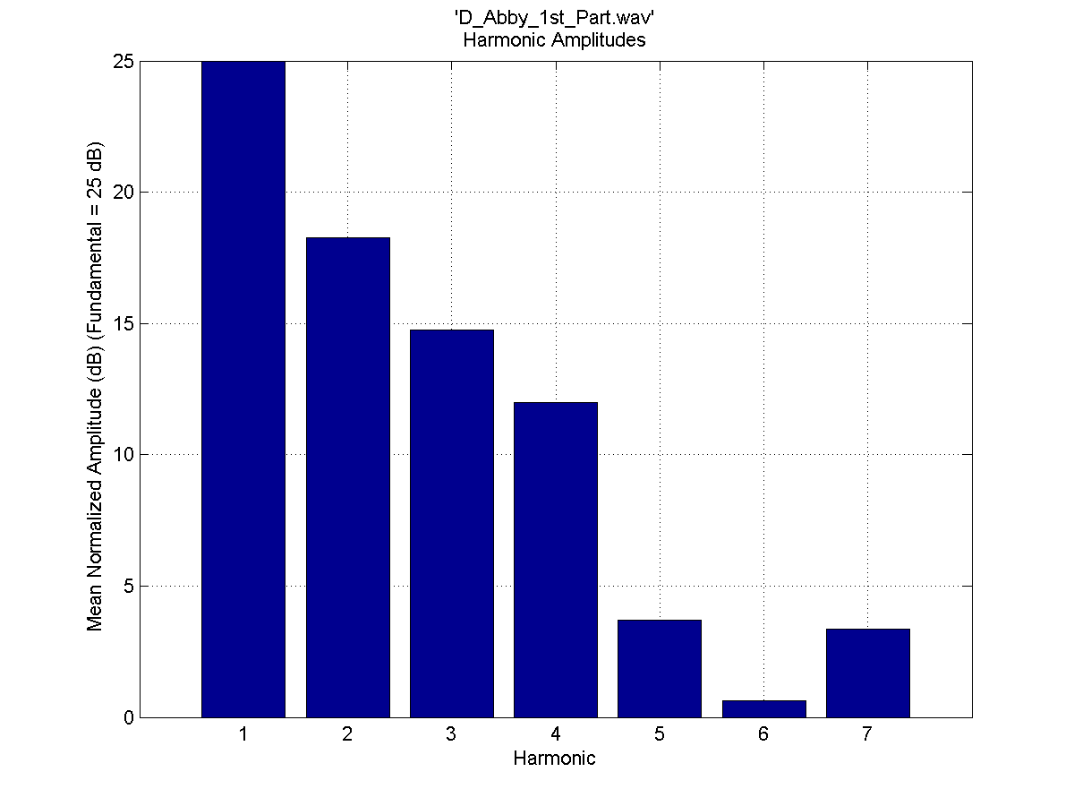
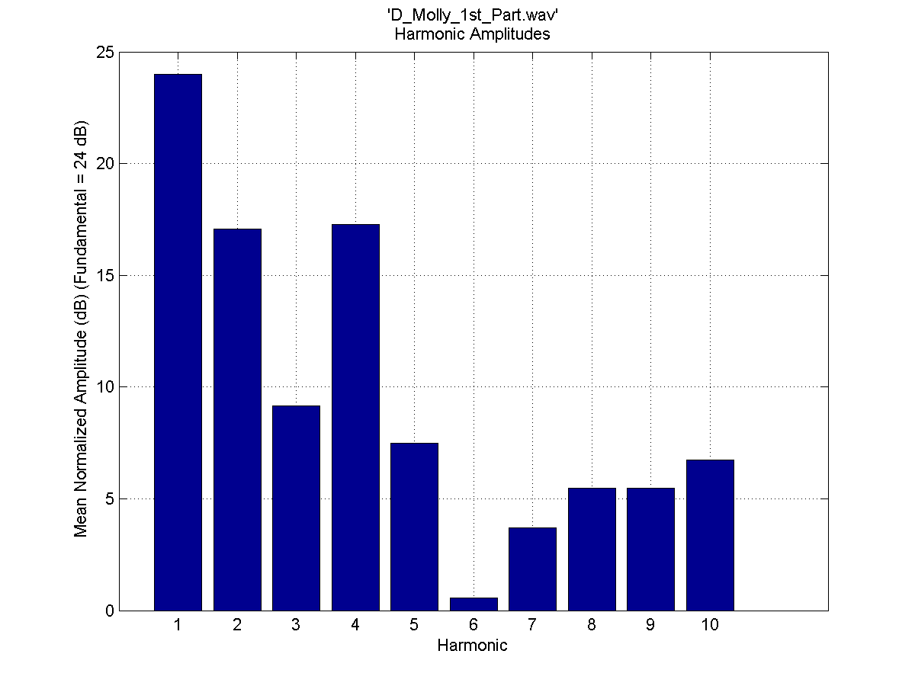
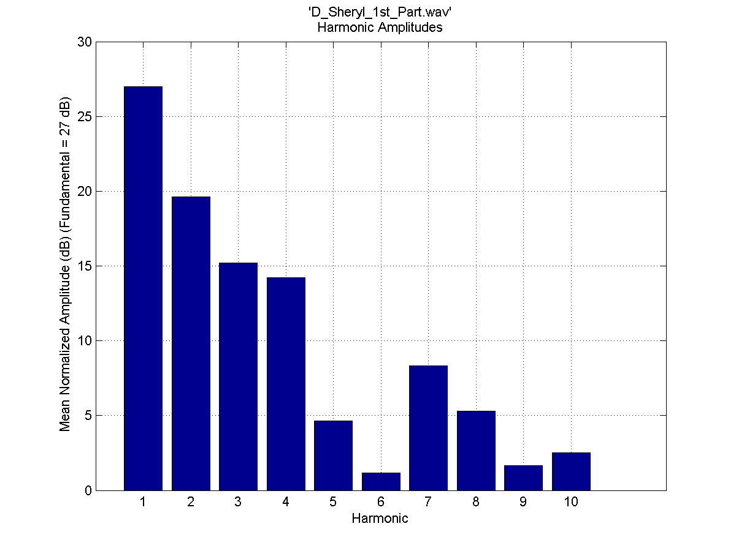
Harmonic Content of the Human Voice – First Human Musical Instrument: Comparison of 3 UIUC Physics 193POM/UIUC Women’s Choir students singing D4 “Ooooh” (293.66 Hz):
Abby
Molly
Cheryl

Slide 5
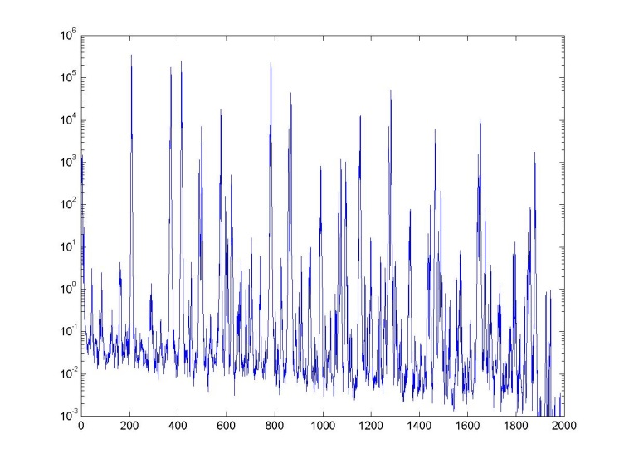
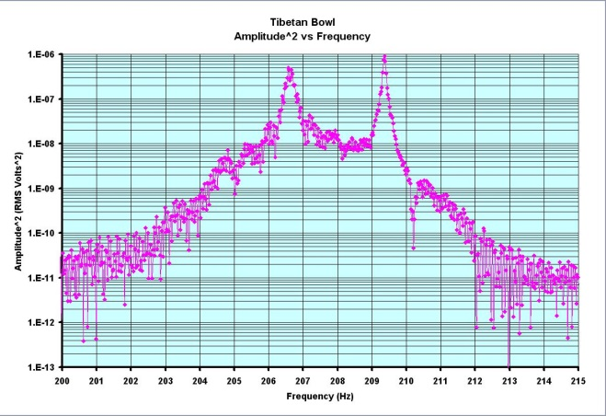
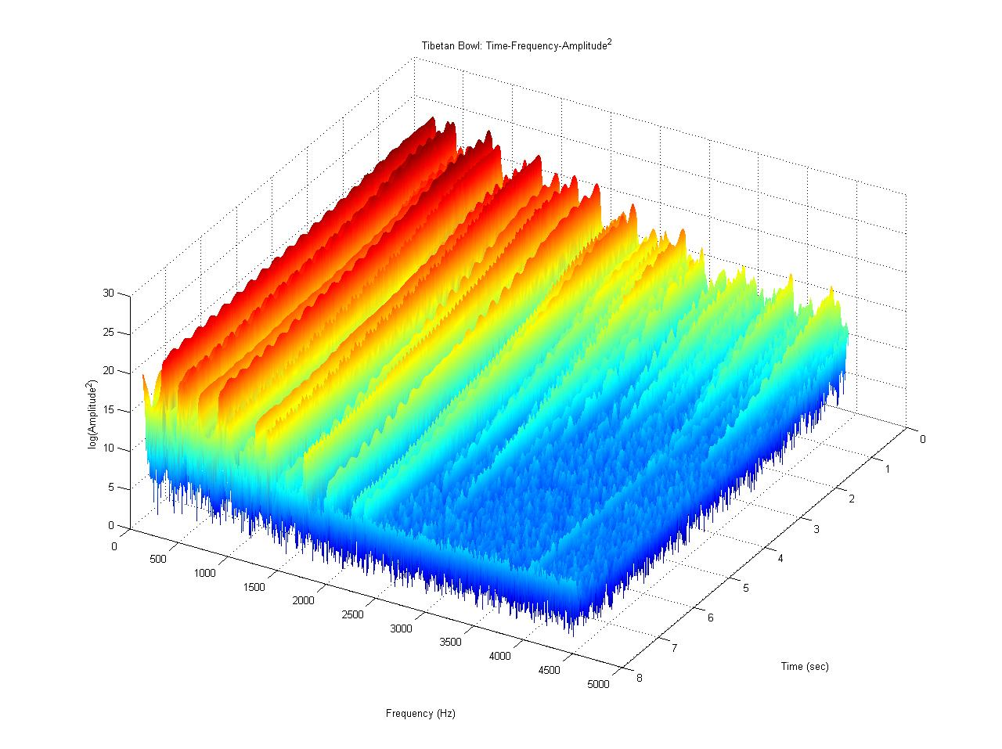
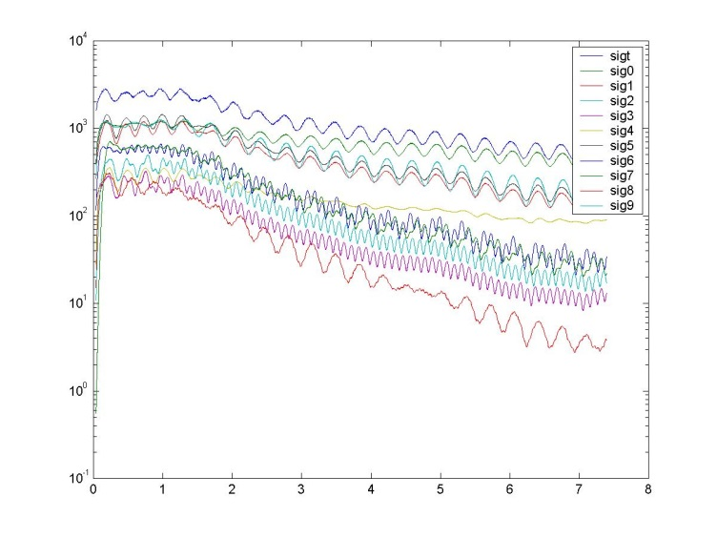
Some Experimental Results from UIUC Physics of Music/Musical Instruments Course(s):
Power Spectrum:
Analyze the harmonic content (amplitude, frequency and phase info vs. time) of quasi-steady complex sounds produced by musical instruments, human voice, etc. using 24-bit digital audio recorder + reference omni-directional condensor mic ⇒ .wav file e.g. Tibetan Bowl:
Digitally-filtered harmonics vs. time

Slide 6
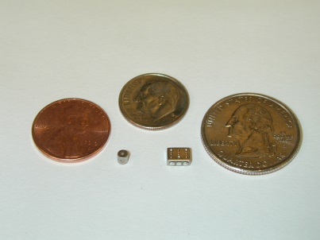
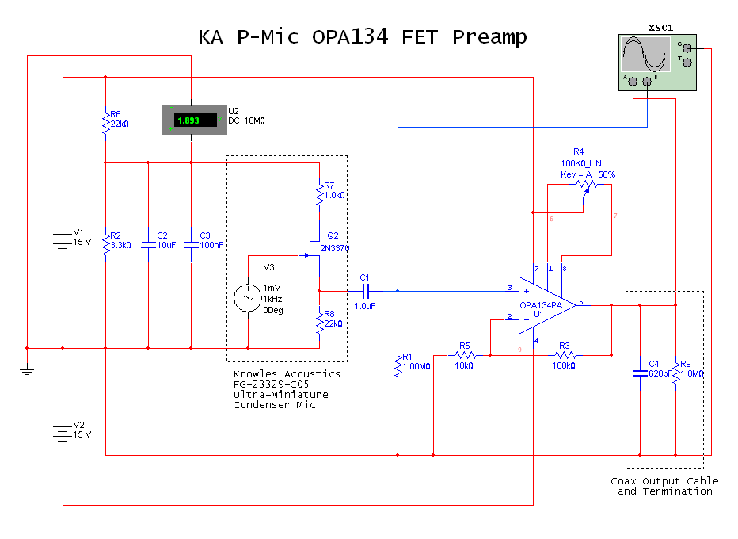
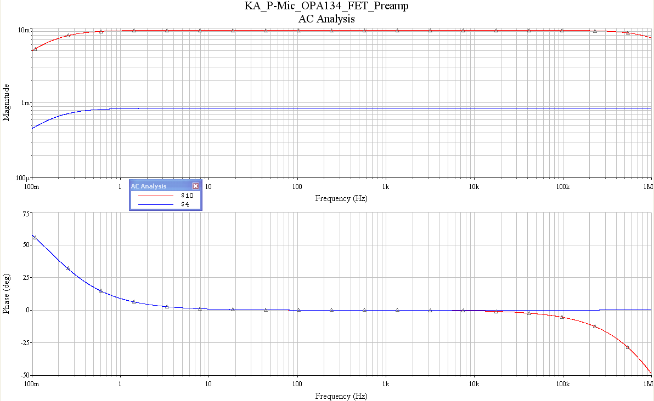
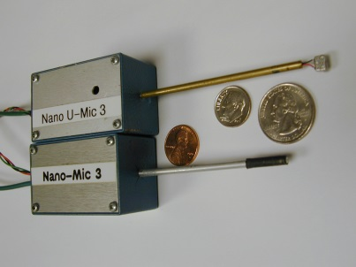
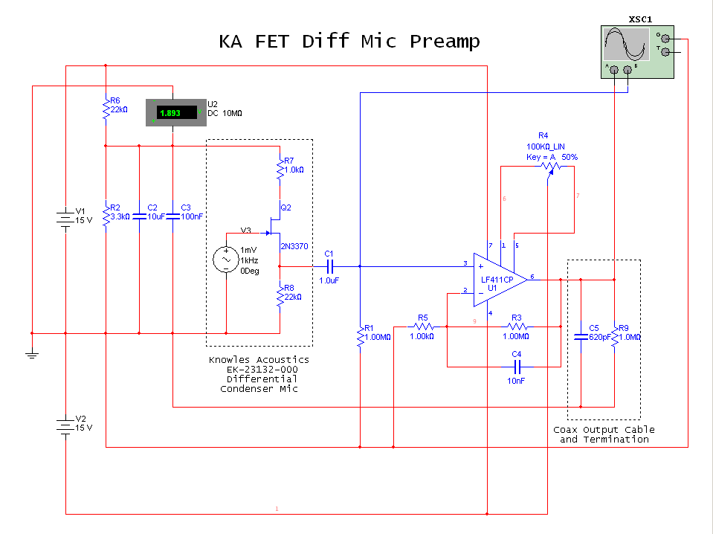
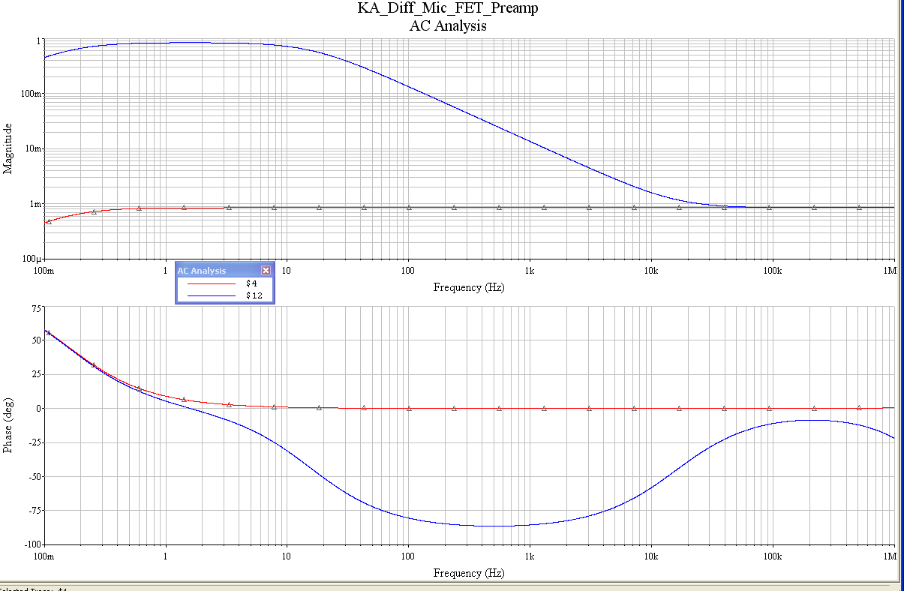
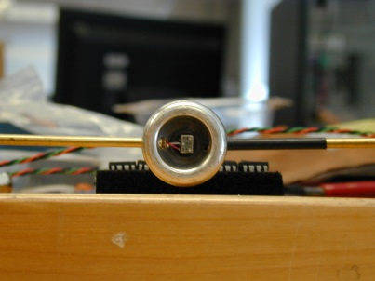
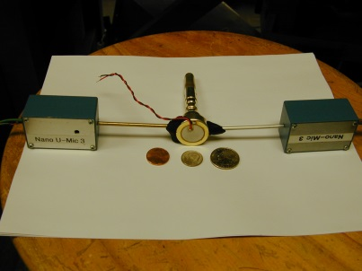
Frequency-Domain Measurements of Complex Harmonic/Periodic Sound Fields
Complex sound field at point in space uniquely determined if simultaneously measure pressure p and particle velocity u ( = <velocity> of air molecules, spatially averaged over an infinitesimal volume element d³V).
World’s smallest p & Δp condensor mics !!!
1-D Euler Eqn for inviscid fluid flow:
Integrate:

Slide 7
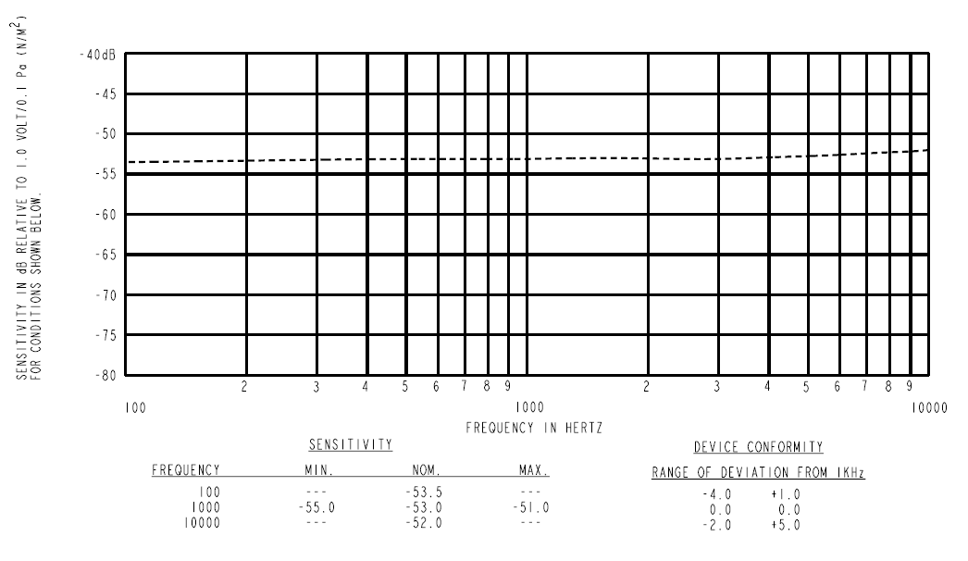
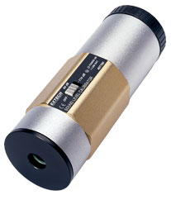
Sensitivity & Absolute Calibration of p/u-Mics
Omni-directional Condensor P-mic
Differential P-mic
Calibrate Mics e.g. in SPL = 94.0 dB sound field:
Extech SPL Calibrator

Slide 8
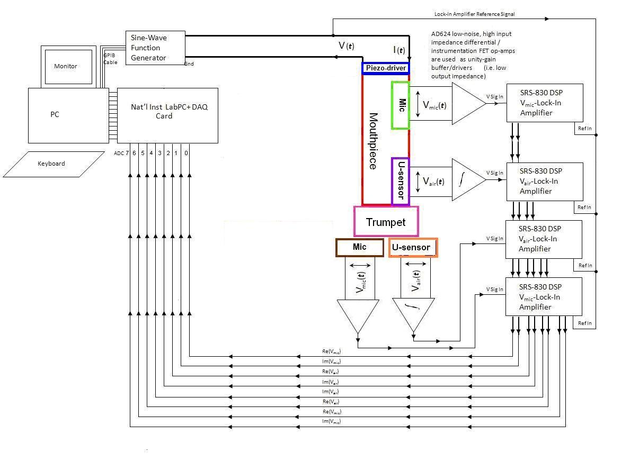
Block Diagram of PC-Based DAQ System
Lock-in Amplifiers (LIA’s) measure the in-phase (=“Real”) and 90º out-of phase {aka “quadrature”} (=“Imaginary”) amplitude components (w.r.t. reference sine-wave function generator signal, e.g.
p(t) = p_{o}cos(ωt + ϕ)
= p_{o}cos ωt cos ϕ
− p_{o} sin ωt sin ϕ
Re {p} = p_{o}cos ϕ
Im {p} = p_{o} sin ϕ
y
Im {p} = p_{o} sin ϕ
p_{o}
ϕ
x
Re {p} = p_{o} cos ϕ

Slide 9
Real part of complex I, Z associated with propagating sound
Imaginary part of complex I, Z associated with non-propagating sound energy (e.g. in “near-field” r << λ of sound source, or e.g. in SWT (where Re{I, Z} ~ 0))

Slide 10
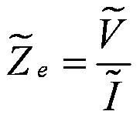
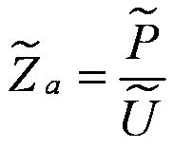
Acoustic Impedance Analogous to Electrical Impedance
Electrical
Impedance
Specific
Acoustic
Impedance
Frequency-dependent impedance mismatch @ bell end means wave reflection, constructive interference of standing waves @ mouthpiece reinforces buzzing of player’s lips!
|Z_{in}| maxima (@ pressure maxima, particle velocity minima) occur for
constructive interference) – corresponds to standing waves,
i.e. define the playable notes on the instrument!

Slide 11
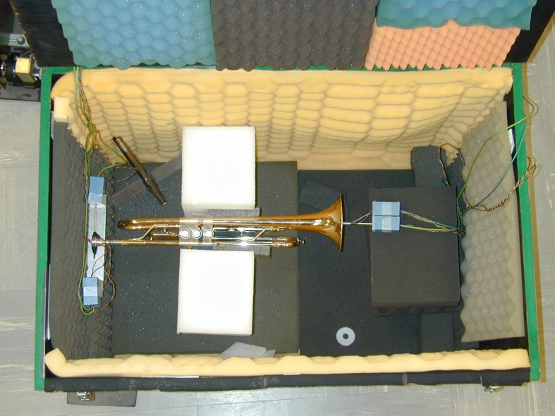
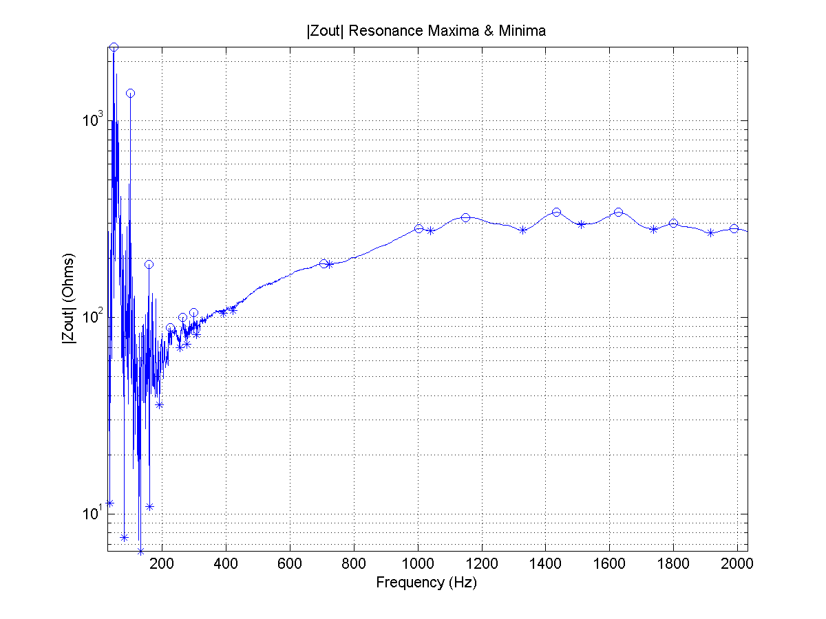
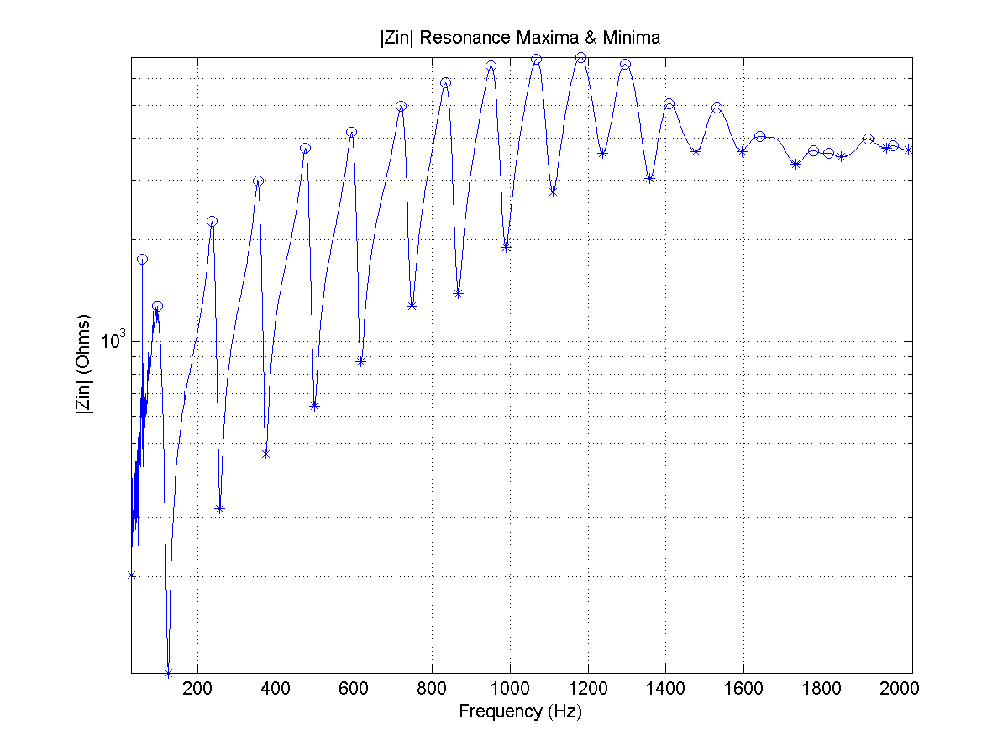
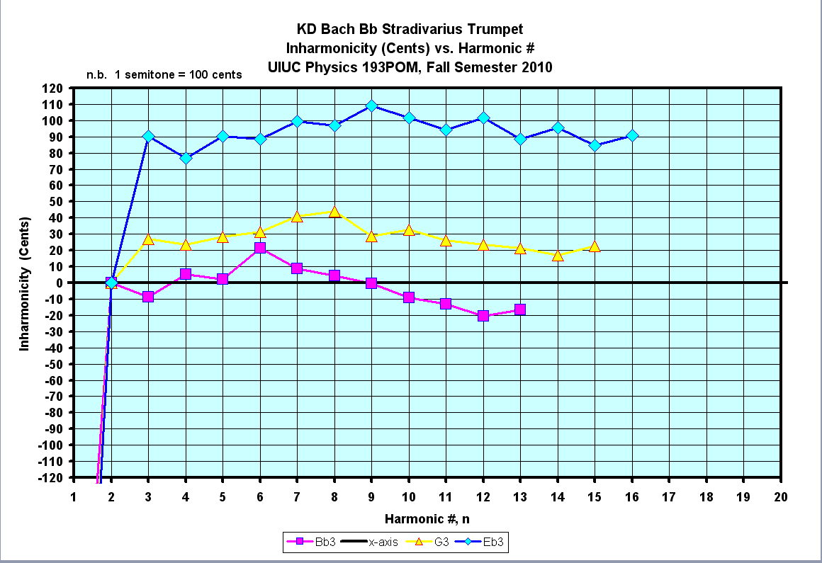
Measure input & output impedances Z(f) = p(f)/u(f) of brass/wind instruments ⇒ Maxima of Z_{in}(f) defines which notes are playable on the instrument:
Free-Field Z_{o}= ρ_{o}c
~ 415 Ac. Ohms
Trumpet Z_{out}
Trumpet Z_{in}

Slide 12
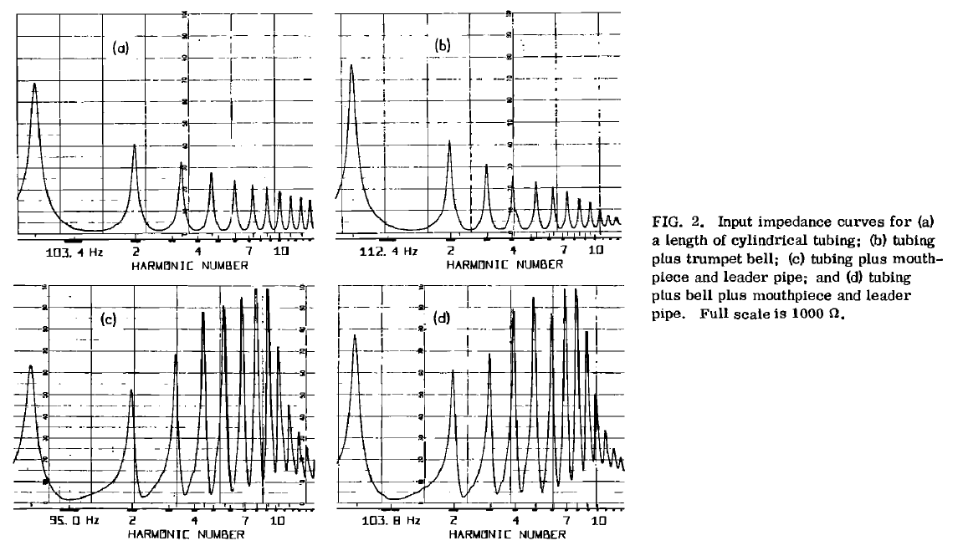
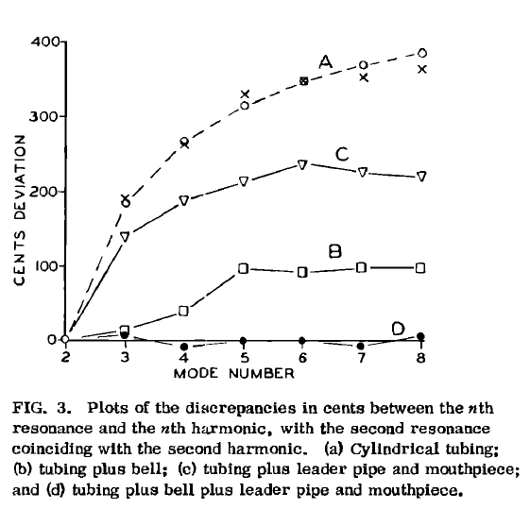
Acoustical Properties of Individual Components of Trumpet J. Backus, JASA 60, 460-80, 1976
(a) Z (Tubing)
(b) Z (Tubing + Bell)
Trumpet Inharmonicity:
(A) Tubing
(C) Mouthpiece + Leader Pipe + Tubing
(B) Tubing + Bell
“A miracle occurs!”
(D) MP+LP +Tubing + Bell
(c) Z (Mouthpiece + Leader Pipe + Tubing)
(d) Z (MP+LP +Tubing + Bell)
n.b. The design of the trumpet – centuries old instrument {1500 BCE; valves added ~ 1793) {as well as many other musical instruments} didn’t have the benefit of the modern scientific knowledge of acoustics that we have today – musical solution(s) arrived at iteratively, by persistent effort(s) !!!

Slide 13
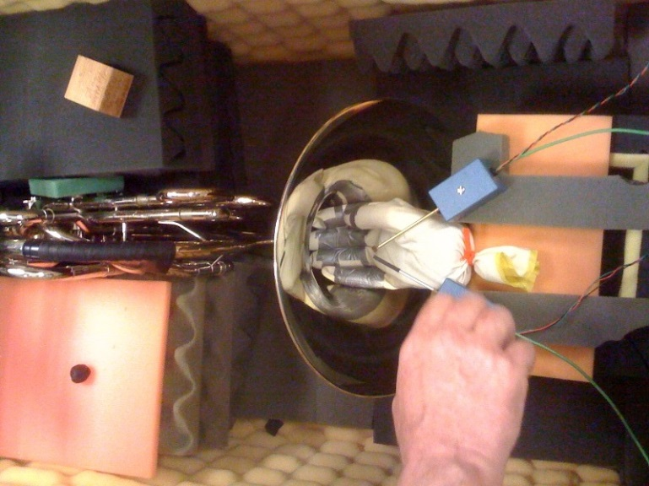
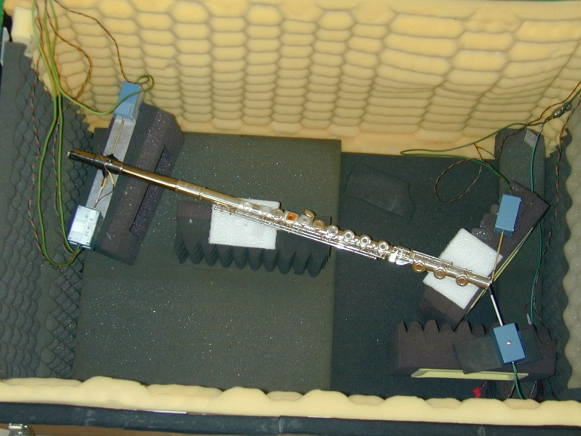
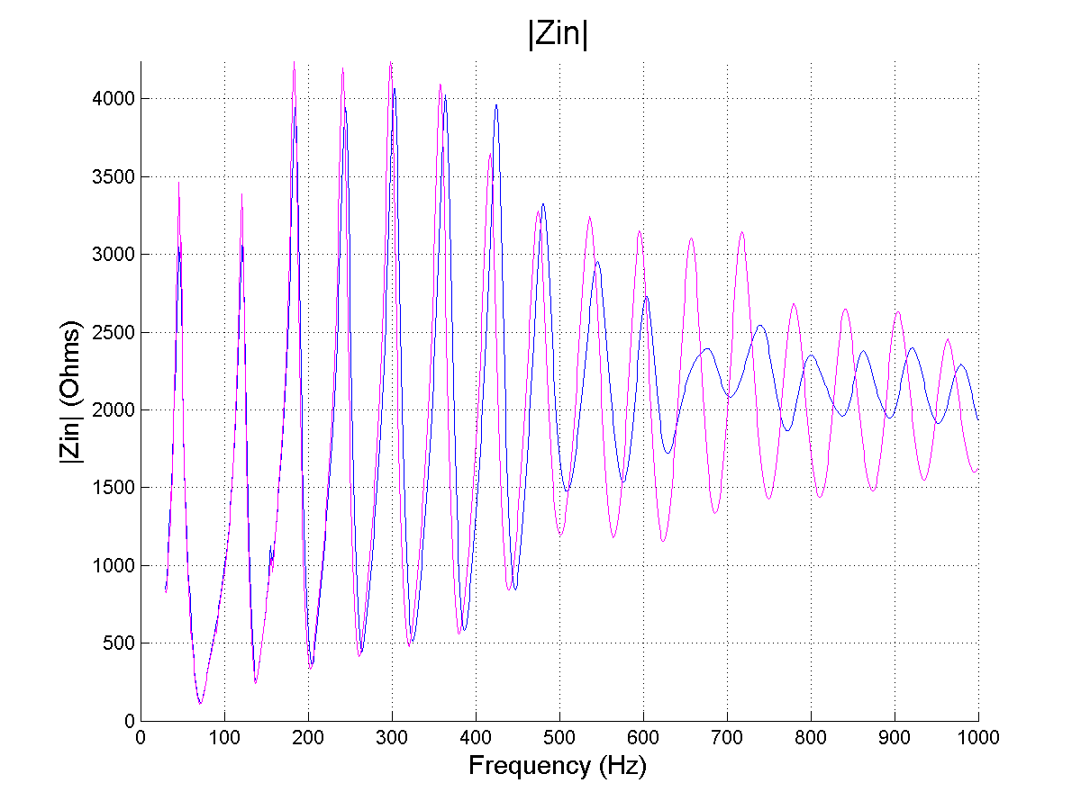
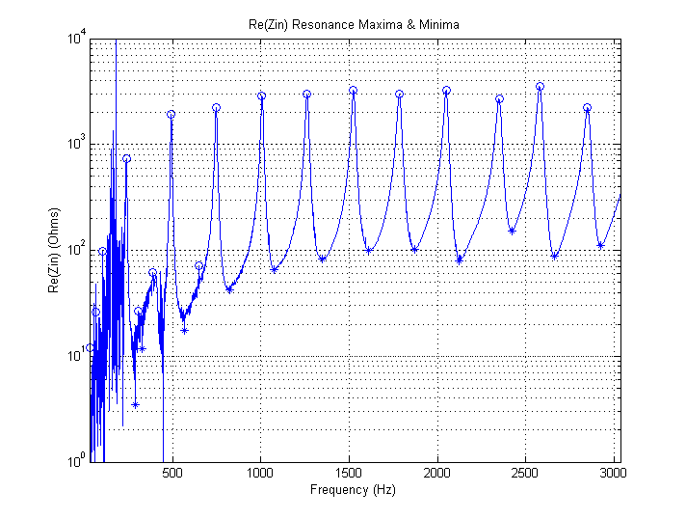
Have Measured Acoustic Properties of {Many} Other Brass/Wind Instruments, e.g.
Flute
French Horn: Blue = no hand Red = hand in bell

Slide 14
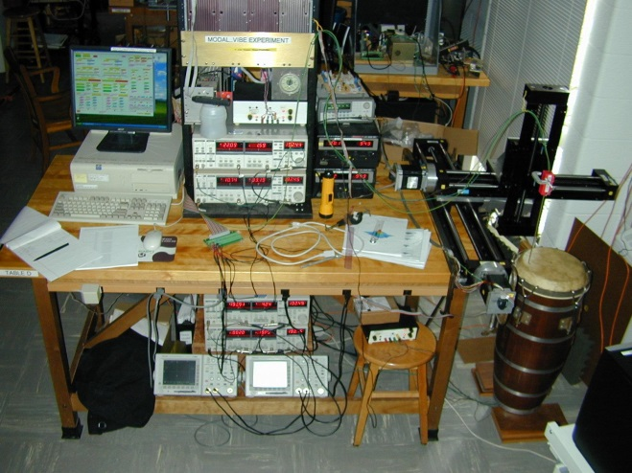
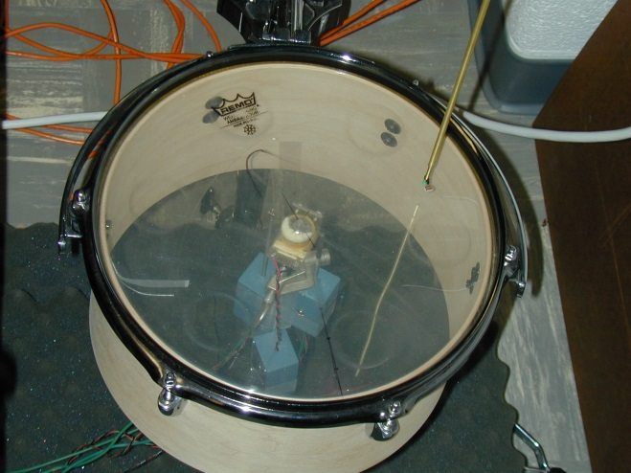
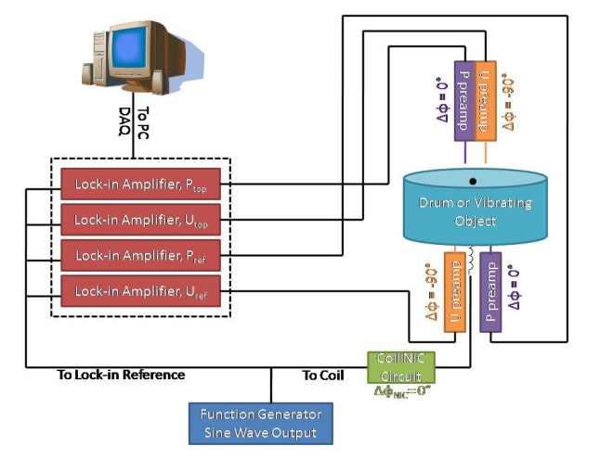
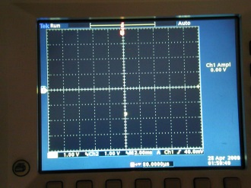
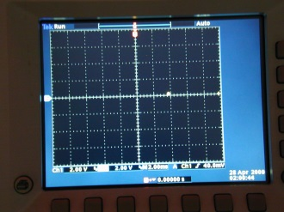
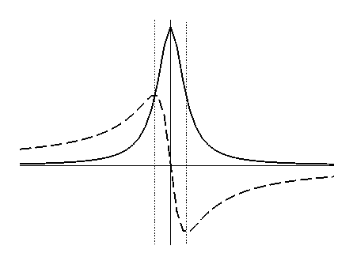
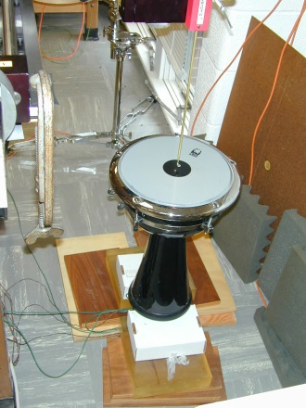
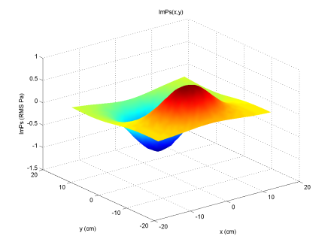
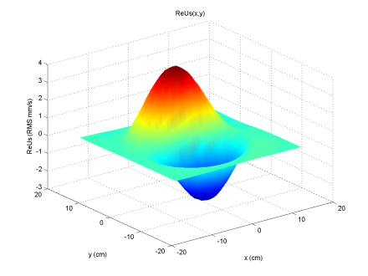
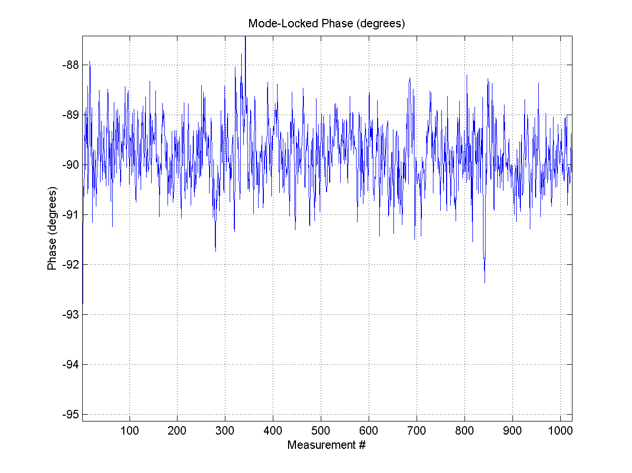
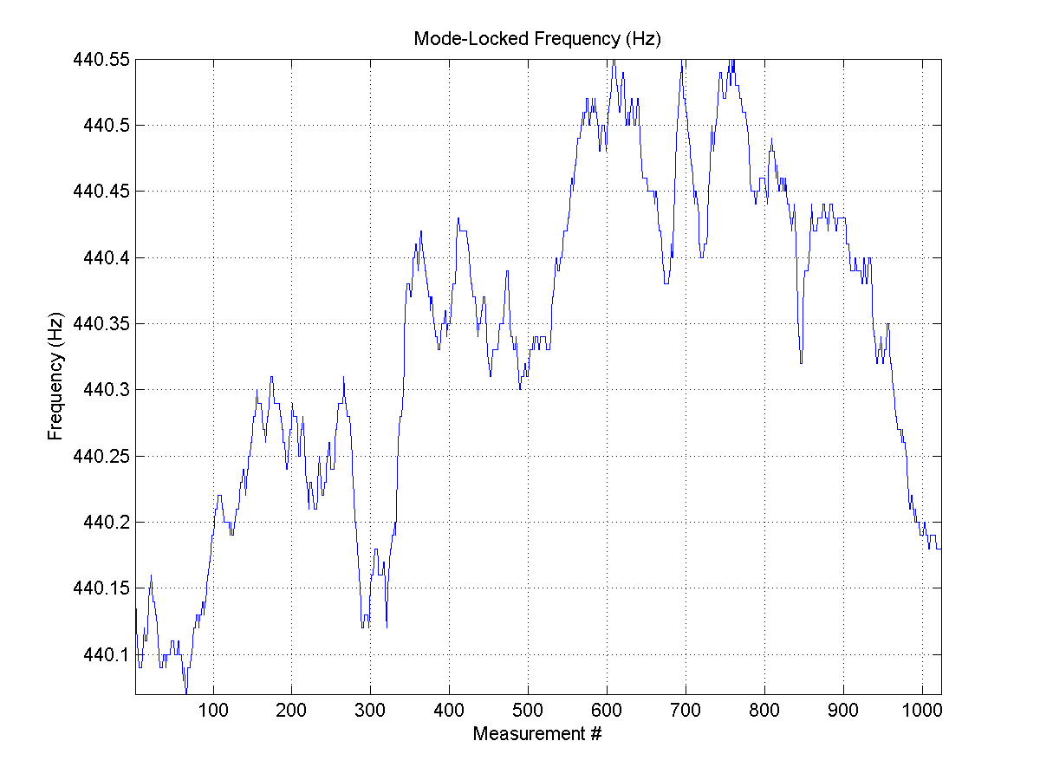
UIUC P406POM Modal Vibes DAQ Experiment: Phase-Sensitive Near-Field Acoustic Holography!
Block Diagram of Modal_Vibes DAQ System:
p_{mon}
u_{mon}
p, u monitor mics
CC NIC + coil driver + rare-earth magnet pair
p, u scan mics
Mode-lock to resonant frequency of drum:
Use for −ve feedback!
Im{p_{mon}}
p-complex plane u-complex plane
Re{p_{mon}}
Doumbek:
J₁₁ Vibrational Mode of Doumbek: (32x32 = 1024 scan points, 1 cm step size)
Im{p(x,y)}
Re{u(x,y)}
Phase{p_{mon}}
f_{res}
Drums very sensitive to ambient temperature changes!

Slide 15
Mechanical Modal Vibrations of Stringed Instruments:

Slide 16
Complex Sound Field of Loudspeakers/Arrays of Loudspeakers:
f = 1 KHz
f = 2 KHz
f = 5 KHz
f = 10 KHz

Slide 17
Auditorium/Room Acoustics:
Inject white noise (flat frequency spectrum) into a room, allow it to equilibrate, then adiabatically rapidly shut off sound source and measure exponential decay rate of sound vs. frequency (32 1/3-octave bands):
Blue = 1st ½ second time window Red = 2nd ½ second time window
Recording Studio, UIUC School of Music
n.b. Many other room acoustics quantities can be/are measured!
Time for sound to fall to 1 millionth of initial intensity
(ΔSIL = −60 dB = 10log₁₀(I_{final}/I_{init})

Slide 18
Marimba Studies:
Sculpting of underside of marimba bar tunes bar, and harmonic content: 1 (fund), 4th, 10th & 20th…
Mallet strike location – varies harmonic content/tone:
n = 1
n = 4
n = 10
Resonators underneath marimba = open-closed organ pipe, matched to fundamental of each bar.
f_{n} = nf₁, n = 1,3,5,7…{odd harmonics}
⇒ Boosts fundamental
n = 20

Slide 19
Marimba Studies – Measurement of the decay time(s) of harmonics of the C_{n} marimba bars (n = 2:7) and extraction of absorption coefficient η of rosewood
no resonator
with resonator
τ ∝ 1/f

Slide 20
A Test of My Own Long-Term Musical Memories: I played {electric} guitar in mid-60’s – mid-70’s; started playing again in ~ mid-90’s: “Faithful” modern-day re-issues of vintage guitars didn’t sound like the real deal to my ears... Due to false memories, or actual truth??? I explicitly checked : Measured Z(f) = V(f)/I(f) vs. f
Gibson P-90’s in Les Pauls, Les Paul Jr, …
Fender Stratocaster Pickups
Modern R.I.
Vintage
Modern R.I.
Vintage
X-ray of P-90 PUs from ’52 (top) vs. ’98 R.I. (bottom) Gibson Les Paul Guitars:
Gibson Firebird Pickups
Modern R.I.
Vintage

Slide 21
Examples of Other Academic Acoustics Research Topics:
Acoustic Black Holes – ADS/CFT Correspondence
3-D Acoustic Cloaking
Acoustic Zeeman Effect
Acoustic Casimir Effect
Acoustic Aharonov-Bohm Effect
Acoustic Diodes/Sonic Crystals
Acoustical Lasers (UIUC Prof. R.L. Weaver)
Seismic Noise “Interferometry” (UIUC Prof. R.L. Weaver) – also relevant to e.g. ocean noise, room noise!

Slide 22
Much material (POM lecture notes, lab handouts, experimental results, acoustics-related software, student final reports, NSF Summer REU/UIUC Senior Thesis final reports, etc… posted/available on the 2 UIUC Physics of Music/Musical Instruments Website(s):
Physics 193POM – Freshman “Discovery” Physics of Music/Musical Instruments (less technical):
http://courses.physics.illinois.edu/phys193/
Physics 406 – Acoustical Physics of Music (upper-level undergrad (juniors/seniors – more technical):
http://courses.physics.illinois.edu/phys406/
UIUC Undergrad Acoustics Research Opportunities:
Prof. Errede: P193POM & P406 courses, Senior Thesis, Indep’t. Study
Prof. Weaver: Senior Thesis, Indep’t. Study
ECE Profs: ECE Acoustics Courses (Labs), Senior Thesis, Indep’t. Study
There also exists support – from the UIUC Office of the Provost – for Undergrad Research – see website:
http://provost.illinois.edu/our/
See also UIUC CoE Illinois Scholars Undergraduate Research (ISUR) Program:
https://wiki.engr.illinois.edu/display/isur/Home
Will need to Upload Application & Project Proposal (deadline is: Friday, March 19, 2014 at 11:59 pm):
https://wiki.engr.illinois.edu/display/isur/Application+Forms

Slide 23
Other Acoustics-Related Courses, Activities @ UIUC:
PhD Graduate Study in Acoustics:
Engineering Physics Custom Technical Option for Acoustical Physics (EPCTOAP)
ECE-210/211 Analog Signal Processing/Lab (prereq = ECE-110) 4 credit hours
ECE-310/311 Digital Signal Processing/Lab (prereq = ECE-210) 3 credit hours (optional)
ECE-473 Fundamentals of Engineering Acoustics (prereq = MATH 285/286) 3 credit hours
ECE-402 Electronic Music Synthesis (prereqs MUS-103, ECE-290, ECE-310) 3 credit hours (optional)
ECE-403 Audio Engineering (prereqs ECE-210 & ECE-310 ) 4 credit hours (optional)
ECE-417 Multimedia Signal Processing (prereqs ECE-313 & ECE-310) 4 credit hours (optional)
ECE-545 Advanced Physical Acoustics (prereq: ECE-473) 4 credit hours (optional)
____________________________________________________________________________________________
Phys-402 Light 4 credit hours (optional)
Phys-404 Electronic Circuits 4 credit hours (optional)
Phys-406 Acoustical Physics of Music/Musical Instruments 4 credit hours
Phys-497/499 Senior Thesis – Acoustical Physics 4 credit hours
____________________________________________________________________________________________
MUS-402 Musical Acoustics (prereqs MUS-101, MATH 112 or equivalent) 3 credit hours (optional)
See also other possible Music courses at http://ems.music.uiuc.edu/courses/, e.g.
MUS-407/409 Electro-Acoustic Music Techniques I/II
MUS-448 Intro to Computer Music
MUS-499 Advanced Computer Music
____________________________________________________________________________________________
There may also be courses in UIUC Speech and Hearing Science:
See http://shs.illinois.edu/Undergraduates/CoreCourses.aspx
____________________________________________________________________________________________
UIUC engineering undergrads very active in Audio Engineering Society (AES) – check out:
http://www.aes.org/sections/view.cfm?section=215, http://uiucaudio.tumblr.com/home
Contact(s): Prof. Lippold Haken l-haken@illinois.edu, UIUC AES: uiucaudio@gmail.com
US:
Penn State: http://www.acs.psu.edu/ , http://www.cav.psu.edu/
MSU: http://www.pa.msu.edu/acoustics/
Georgia Tech: http://www.acoustics.gatech.edu/
Virginia Tech: http://www.val.me.vt.edu/
Stanford: https://ccrma.stanford.edu/research
Boston U: http://www.bu.edu/me/research/research-laboratories-and-groups/acoustics-and-vibrations/
Purdue: http://www.purdue.edu/research/phase/
UT Austin: http://www.me.utexas.edu/areas/acoustics/
http://www.texasacoustics.org/
See also websites of:
Acoust. Soc.America: http://acousticalsociety.org/
see especially: http://asa.aip.org/asagrad/gpdir.cm.html
SAE International: http://www.sae.org/
see especially: http://www.sae.org/careers/
World:
Edinburgh: http://www.acoustics.ed.ac.uk/
New South Wales: http://www.phys.unsw.edu.au/music/
Adelaide: http://www.mecheng.adelaide.edu.au/avc/
Sydney: http://sydney.edu.au/architecture/
programs_of_study/postgraduate/audio_acoustics.shtml
Helsinki: http://www.acoustics.hut.fi/
Denmark (2 yr MSc): http://studyindenmark.dk/study-programmes/programmes-in-english/engineering-acoustics
Salford: http://www.salford.ac.uk/computing-science-engineering/research/acoustics
Southampton: http://www.southampton.ac.uk/engineering/
undergraduate/courses/acoustical_engineering_list.page
Liverpool: http://www.liv.ac.uk/architecture/research/
acoustics-research-unit/
Cambridge: http://acoustics.eng.cam.ac.uk/

Slide 24
II. Professional Careers in Acoustics
Many opportunities – all things acoustic – is an extremely broad field !!!
Noise/Vibration Reduction: Living Environment(s), Appliances, Automobiles, Airplanes, Rockets, Boats/Submarines, Lawn Equipment, Wind Turbines/Wind Farms, Hearing Protection, etc.…
Musical Instruments – all kinds/all types – develop new ones !!!
Concert Halls, Recording Studios, Control Rooms, Home Audio, Cinema/Theater, Churches, …
Live Sound Reinforcement, Sound Engineers – Live or Recording Studio…
Voice/Sound Recognition/Identification
Telecommunications Industry, Internet Audio, etc.
Desktop/Laptop PC’s, Cellphones, etc.
Biomedical/Ultrasound Imaging Applications
Doppler Laser Holography/Velocimetry - N & V, fluid flow, medical applications, …
Typical <salary> ~ $65-85K. Starting salary (obviously) less, senior people e.g. @ Apple ~ $140K
Many summer internship opportunities in acoustics – e.g. use Google!

Slide 25
Partial/Non-Exhaustive/Incomplete List of Acoustics-Related Organizations:
Acentech Incorporated: Architectural Consultants http://www.acentech.com/
Acoustical Systems, Inc: Enclosures, Noise Reduction http://www.acousticalsystems.com/
ACO Pacific, Inc: Measurement Microphones http://www.acopacific.com/
Boeing: Aircraft & Aerospace Products http://www.boeing.com/boeing/
Bose Corporation: Sound Reinforcement http://www.bose.com/
D’Addario: Strings, Drumheads, Reeds http://www.daddario.com
E-A-R/Aearo Co.: Hearing Protection http://earsc.com/
Fender Electric Guitars/Amplifiers http://www.fender.com/careers/
Fleetguard, Inc: Vehicle Exhaust Systems http://www.cumminsfiltration.com/
JBL Professional: Loudspeakers http://www.jblpro.com/
Klipsch: Loudspeakers http://www.klipsch.com/
Knowles Electronics: Microphones http://www.knowles.com/
Meyer Sound, Inc: Loudspeakers http://www.meyersound.com/
NASA: Many aspects of acoustics! many websites !!!
Raytheon: Sonar Systems http://www.raytheon.com/
Shure, Inc: Microphones http://www.shure.com/
Wenger Corp: Architectural Acoustics Products http://www.wengercorp.com/
Wyle Acoustics: Architectural Acoustics Products http://www.wyleacoustics.com/

Slide 26
List of UIUC Undergrad Students in POM Class or NSF Summer REU Who Now Have/Are Pursuing Acoustics-Related Careers:
Noam Pikelny Master Banjo Player http://noampikelny.com/
Ben Juday/Ben Hay/Rob Marshall Started Own Company (2003)! www.analogoutfitters.com
Alan Carter Johnson Controls
Matt Winkler Analytical & Recording Engineer
Chuck Stelzner RAND Corporation
Robby Regalbuto Shure Incorporated
John Nichols Knowles Electronics
Rob Marshall Shure Incorporated
Eric J. Macaulay Acoustics Grad Student @ MSU
Gregoire Tronel Acoustics Grad Student @ GA Tech
Analog Outfitters Booth @ 2014 NAMM Show, LA

