Slide 1
The new invariants
World lines
4-dimensional physics
Causality
The twin "paradox"
Next:
Accelerated reference frames and general relativity
Term paper topic due March 17
HW4 due on Thursday

Slide 2
Space-time diagrams
Future (here)
time
space (present)
Past (here)

Slide 3
Space-time diagrams
Future (here)
time
Light cone
Can reach
timelike
Spacelike
inaccessible
space (present)
Can detect
Past (here)

Slide 4
Spacetime from rocket
Future (here)
time
Light cone
Can reach
timelike
Spacelike
inaccessible
space (present)
Can detect
Past (here)

Slide 5
Space-time diagrams
Future (here)
Particle world line
time
Light cone
Can reach
timelike
Spacelike
inaccessible
space (present)
Can detect
Past (here)

Slide 6
What does “Nothing can travel faster than the speed of light” mean?
We know that
  no ordinary mass can go faster, because that would require infinite energy.
  no conserved quantity can go faster, because then it would not be conserved in some reference frames.
  If we believe that causation must go forward in time, then we know that no "information" can go faster than c, because that would allow backwards-in-time causation.
    What happens if you can send info backward? Say you send your grandma info that somebody much cuter than your grandpa was about to move into her neighborhood. Then you aren't born. Then the info doesn't get sent. So you are born, so …….

Slide 7
What does "no object travels faster than c“ mean?
If "no object travels faster than c", then the following aren't objects:
  The bright spot made by a beacon shining on a wall.
  The cutting point of a scissors.
  The crest of an E-M wave in matter. (Certain materials have index of refraction less than 1 over some frequency range, hence a "phase velocity" greater than c for some light.)
What are we then claiming?
The repetitive pattern carries no info!
Only the breaks in the repeating pattern must travel slower than c.
If we are to describe the world as having some primary constituents, with various higher-level phenomena just being patterns in the constituents' behavior, we want to restrict the primary constituents to those which don't travel faster than light. We claim there exists some complete description of the world in terms of constituents which don't travel faster than c.

Slide 8
Causality in Special relativity
Things:
  One version of positivism tried to reduce all statements to simple relations among "things".
  You are all familiar with statements such as "No two things can be in the same place at the same time."
  We see statements like "No thing can travel faster than the speed of light."
So what is a “thing”?
  Is the Mississippi river a thing? (What would Heraclitus have said?)
  Is a person a thing?
  Is a moving bright spot on the wall a thing?
If you believe in external reality, is it necessary to believe it consists of well-defined things?
  If not, what becomes of statements like those above?
  Do things exist outside our description of events?

Slide 9
What has SR changed philosophically?
The old invariants (t, lengths, m …) (things which were "real" in that they were observer-independent) have been tossed out. They are replaced with new invariants (c, d²-c²t², E²-c²p²…) which have a slightly more complicated relation to our customary observations.
If we had evolved experiencing many relative speeds close to c, there would be absolutely nothing philosophically exotic or particularly "relativistic" about "relativity". The Lorentz transformations would make sense to us in the same way that the Galilean transformations make sense. We would just have a different set of invariants.
That's why Einstein wanted to name the theory "Invariants theory.”
The philosophical excitement comes from the transformation from one theory to the other- ideas that seemed immutable turned out to be mutable, and there's a lesson to be learned from that process.

Slide 10
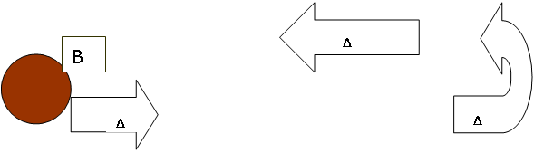
The twin paradox
Suppose Alice and Beth are twins. Alice sets off in her rocket so fast that the time dilation factor becomes 10. She travels away from Earth for 10 years, as measured by Beth, who has remained on Earth. Alice then turns around and returns to Earth at the same rapid pace.
When Alice returns home, Beth has aged 20 years. How much has Alice aged?
There appears to be a paradox. According to the Lorentz transformation, during the time Alice is travelling:
Beth says: I measure Alice’s clock to be running slow by a factor of ten, so she has aged only two years.
Alice says: My clock is fine. I measure Beth’s clock to be running slow by a factor of ten, so she has aged only 2 years.
They start and end standing right next to each other, so a direct comparison of clocks is possible. Who is correct?

Slide 11
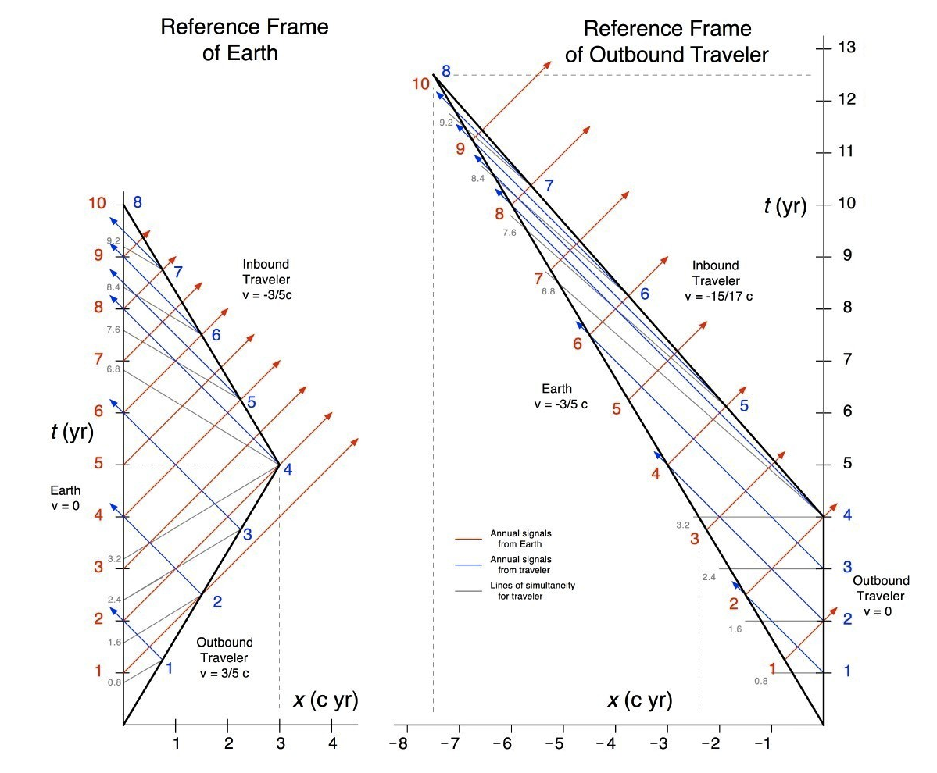
Spacetime diagram
Notes:
Unknown sourse

Slide 12
Twin Non-Paradox
The answer is that Alice, the twin who turned around, has aged less.
The situation is not symmetrical, because in order to return to Earth, Alice must have accelerated. Our descriptions of how things looked to different observers (Lorentz transformations) so far do not describe accelerated observers, so we only know how things look to Beth.
Of course Alice must agree that Beth is older, when they now stand side-by side. Now we can put together a conclusion about how Beth must have looked to Alice while Alice was accelerating. While turning back (accelerating toward earth), Alice must observe Beth's clock to be running fast, not slow.
So this is not a paradox at all but just a reminder that the SR transformations only work between reference frames which are not accelerating (at least with respect to each other, leaving aside the question of absolute acceleration.) But you can also see that from SR we can draw conclusions about how things must look to accelerating observers.
Let's go further in seeing how things look to accelerating observers. In particular, let's look for ways in which the simple laws of physics might get messed up in their frames.

