Slide 1
Arrows of Time
Term paper drafts due today!

Slide 2
Main Arrows of Time
Psychology: we remember the past, but we calculate the future.
Entropy: always increases (2nd Law)
Quantum measurement: the ambiguity in practice always concerns future states, not past ones.
Cosmology: the universe is expanding, maybe forever.
Black holes: the reversed object, a white hole, has never been found.
Radiation: the E-M radiation field is determined by the sources it comes from, not the places it's going to.
The weak nuclear force is not reversible.

Slide 3
Psychological impressions of times arrow
Intuitive: time moves forward
Knowledge of past and future: we remember the past we guess the future
Existence: things in the past are objective; things in the future do not yet exist. How does relativity change this?
Possibility: the past is unchangeable, one has a choice about the future (free will)
Causation: the past conditions influence the future not the other way around.
Concern: Our death concerns us, not our birth.

Slide 4
Space-time diagrams
Future (here)
time
Light cone
Can reach
timelike
Spacelike
inaccessible
space (present)
Can detect
Past (here)

Slide 5
Spacetime from rocket
Future (here)
time
Light cone
Can reach
timelike
Spacelike
inaccessible
space (present)
Can detect
Past (here)

Slide 6
Space-time diagrams
Future (here)
Particle world line
time
Light cone
Can reach
timelike
Spacelike
inaccessible
space (present)
Can detect
Past (here)

Slide 7
Relativity says there exists 3 categories of events relative to us (here and now):
The past timelike
The future timelike
The present: spacelike
Other observers will disagree.
Einstein: All of space-time is already determined. There is no uncertain future. The flow of time is just psychological.

Slide 8
Psychology and entropy
(see Sklar, Hawking)
There is a close connection between our mental asymmetry and the entropic asymmetry. For starters, in an equilibrated world (entropy already maximized, no entropic time asymmetry) there is no information (that's why Maxwell's demon can't function) so there could be no minds whatever.
The low-entropy property of the past is needed to allow some information about it to be conveyed with a relatively small number of bits. I.e. a photograph of some place tells you a lot about it, but a photograph of some equilibrated mush conveys essentially no information. When we find some highly ordered artifact, (say a fossil) we use it primarily to find out about the past, not the future. The ability of the past to leave informative records reflects its order.
Memories, like pictures, etc. are also an informative record of the past, stored in a small fraction of the number of particles represented. It is natural to informally associate the direction in time for which such mental records exist with the direction in time for which ordinary physical records exist. There is no formal proof that that direction is the same as the lower-entropy direction, since the near future is also very far from equilibrium and therefore in principle could also leave traces. Still, if you accept that the asymmetry between evidence of past and future states flows from their entropic asymmetry, there is no reason to exclude mental evidence. Probably the psychological arrow flows from the entropic arrow.

Slide 9
Electromagnetism?
Maxwell’s Eqs. Are time reversal invariant if we change B to –B.
The radiation field in E-M is given as a function of the past positions, velocities, accelerations of charged particles. There is no reason in the formalism not to include future sources as well. Why the asymmetry?
Actually, a given radiation field can be described either way, in terms of where it's coming from or in terms of where it's going to. It's a convention to always use the past sources not the future ones. This convention is strongly motivated by the other time asymmetries, specifically the entropic one.
In an equilibrium condition, with particles emitting and absorbing radiation thermally, there would be no reason to pick the past over the future as the "source" of the radiation.
We can dump radiation into the environment. “boundary conditions”
So the radiation arrow is really another example of the entropic and (quantum measurement?) arrow.

Slide 10
Psychology and quantum measurement.
Let's imagine a world in which reversed QM measurements occurred. The current physical state of every object, including our brains, would be a potential outcome of the evolution of any of a number of macroscopically distinct prior states, just as in our world it could evolve into any one of a number of macroscopically distinct subsequent states.
It would no more be possible to simply remember a unique past than it is now possible to accurately foresee a unique future in QM experiments (or anything else). In other words it would be impossible in principle to tell if a time-reversed cat had been alive or dead previously! Both memories would be equally valid.
Philosophers would debate whether there really had been multiple distinct pasts, or if there were anti-collapses, in which the wave function acquired properties which looked just like those that would have been inherited from non-existent pasts.
So the psychological distinction between past and future is very similar to the asymmetry of the QM measurement process.
It is unclear if, without some coherent memory, any mind could develop to the point of wondering about symmetries. I.e. the QM measurement asymmetry may be a prerequisite for consciousness.

Slide 11
Entropy and Quantum Measurement
Actual QM measurements often allow one
macroscopic world to evolve into any of
several possible distinct outcomes.
The reverse process is not observed.
Statistical mechanics describes events in
which a large number of distinct
possibilities evolve into results which are
so macroscopically similar as to be
practically indistinguishable.
The result is that our world is consistent with only one past but many futures in precise detail (QM irreversibility) but macroscopic events are often consistent with a huge variety of macroscopically distinct predecessors, while often giving macroscopically unique consequences. This combined situation provides a possible arena for memory, i.e. detailed physical states which give information about the past which is not implicit in miscellaneous macroscopic events.
Live cat
Live cat
Dead cat
Ice statue of cat
puddle
Ice statue of dog

Slide 12
What about the "collapse of the wave function"?
Its standard description sounds highly irreversible.
Let's assume that the collapse actually happens. That means that a system which was in a single quantum state, which could turn out to have (say) two macroscopically distinct outcomes ends up in a state corresponding to only one of those. It's still in a single quantum state,
although not in one that could have been predicted ahead of time.
In principle, the wave equation allows the following time-reversed situation: a system is found in a state which could have arisen from either of two macroscopically distinct predecessors. Then we could argue about whether both of those predecessors really existed (a reversed MW picture) or whether there had been a discontinuous change in a state to make it look just like one that could have arisen from another state (a time-reversed collapse picture).
No time-reversed-measurement process has ever been observed.
Thus QM also has an observed "arrow of time”.

Slide 13
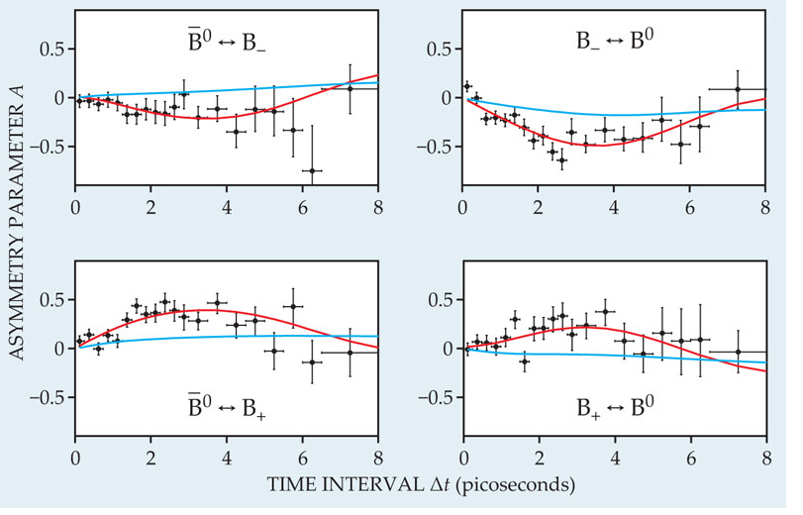
The one known failure of microscopic time reversal
Quantum field theory says that CPT (Charge-Parity-Time) symmetry is obeyed. This means if we film an antimatter world in a mirror, then show it backward, it will obey all the rules for a film of our own world running forward.
In principle the separate symmetries (C, P, T) don’t have to work.
If time reversal invariance (T) holds, then processes should run equally well forward and backward.
In elementary particle physics, there is a particle called the Kº meson. It has an antiparticle partner called the anti-Kº. the meson often decays: K ππ.
The reverse process does not have the same rate.
  For practical reasons (other arrows of time!), this is not what is measured.
  CPT is used to infer the reversed rate.
  Other processes involving the weak nuclear
  force show T-violation directly.
The one known microscopic asymmetry plays
no role in ordinary events,
but will be crucial to understanding the
matter-antimatter asymmetry of the universe.

Slide 14
Cosmology and Black-Holes
Various types of black holes (e.g. collapsed stars) follow naturally from the standard cosmological picture, together with the law of increasing entropy. There is no reason to expect there to be any white-holes (time-reversed black holes, with ordinary matter pouring out). However, they are also solutions of the G-R (reversible) equations. So there is presumably some connection between their absence and the other irreversibilities, but it is not yet elucidated.

Slide 15
Cosmology and entropy
If the increasing-entropy arrow of time is to be consistent, there must be no backward-in time loops in space-time geometry. Any such loops would prevent there from being ANY consistent global time-ordering for the whole space-time, as we noted when worrying about causality.
There have been many speculations that somehow the expansion of the universe and the increasing entropy are connected. Both at least affect all of the universe we know.
Would a slowly contracting universe would obey different local laws than a slowly expanding one. If the universe were to someday start to contract, how would the behavior of steam-engines, change?
Is irreversibility compatible with cyclic cosmologies?
  In certain cases, it seems so.
    Entropy associated with a given collection of matter goes up as it gets more entangled with other things.
    Some re-start phenomena (collisions of infinite branes, birth of baby universes by quantum fluctuations) restarts some subset with low internal entropy/particle by increasing number of particles, not by entropy loss overall.

Slide 16
Links between between measurement and entropy arrows?
Start with collection of little distinct non-interacting beads in an isolated container. Place them all in a small region. Each one's Ψ spreads out. Decoherence (via “measurement” entanglement with other things) would then split these spread-out Ψ's into different "worlds". After many repetitions of the process, the density of worlds (or potential worlds, if collapse happens) with any particle near any position would become uniform. If you haven't opened the box (i.e. let it interact enough with your mind to know the contents) the best guess you can make about its contents is based on that uniform probability density- the same one that the entropy maximization rule says to use.
So the arrow that says the universe starts with low entanglement between remote objects is the same as the arrow that ordinary local entropy terms start small.
If somehow the resolution of the measurement problem were to involve intrinsically non-linear irreversible violations of Schroedinger dynamics, that same fundamental irreversibility would also give the Second Law. That would get around the Loschmidt issue, of how to avoid the time-reversed version of Boltzmann’s argument. The postulated hypothetical physical process would allow only probabilistic predictions, but would allow deterministic retrodictions.

Slide 17
More speculative connections
The point of these speculations is not to provide reliable information, but rather to suggest how different aspects of these problems might tie together to form somewhat testable hypotheses in the future.
If some many-world picture holds, configuration space must expand if it is not to acquire a significant density of "worlds"- i.e. distinct blobs of wave-function. If it does acquire an increasing density of worlds, re-coherence processes start to become common. Then memory becomes impossible.
Why would configuration space expand? Perhaps because space is expanding. So if many-worlds holds, the cosmological expansion may have to connect, at least in the long run, to the arrow of quantum measurement, which in turn connects to the psychological arrow.

Slide 18
Why is there so much matter?
In the hot early universe, there should have been very near matter-antimatter symmetry, constant pair creation-annihilation.
Why was there an excess of matter on cooling? What broke the symmetry?
Cosmological history is strongly T-asymmetric.
There apparently was a point in one of the early phase transitions (very asymmetric in time) at which the asymmetrical T history generated a CP-asymmetric state. (Sakharov’s idea)

Slide 19
But why about the same amount (~5.5x) dark matter?
The Sakharov account may give a number for the ordinary matter density.
It doesn’t directly give any prediction for the dark matter density.
Why not much more or much less dark matter?
Possible reasons
  Anthropic constraint?
    I’m told that our usual excuse allows a large range of ratios, probably not tight enough for an explanation even if you accept anthropic arguments.
  Some leakage between ordinary and dark matter (via the weak interaction)
    But that would imply that it should be possible to detect dark matter particles via the same processes.
    So far, searches haven’t turned up any.
    But there’s still room in allowed parameter space for some dark matter WIMPs.

Slide 20
Main Arrows of Time
Psychology: we remember the past, but we calculate the future.
Entropy: always increases (2nd Law)
Quantum measurement: the ambiguity in practice always concerns future states, not past ones.
Black holes: the reversed object, a white hole, has never been found.
Radiation: the E-M radiation field is determined by the sources it comes from, not the places it's going to.
The weak nuclear force is not reversible.
All of these arrows can be related to the cosmological arrow
Cosmology: the universe is expanding, maybe forever.

Slide 21
New Topic: Infinities
We’ve used the idea of infinity a lot. How do we make sense of it?
How can we compare infinities? Are there different orders of infinity?
What we mean by two numbers being the same:
  Sets A and B are the same size iff there's a one-to-one map from A onto B.
  I.e. if you can match up their elements one-to-one.
There are different orders of infinity.
  integers, reals, subsets of reals, ……
  It’s easy to show #(integers)=#(even integers), etc.
  Also #(integers)=#(rationals) < #(reals) etc.
  How far does that go?
Even for infinite sets, the set of all subsets has more elements than the set itself. Thus an infinite number of infinities exist. See proof on next page.

Slide 22
Infinite Number of Infinities
Let A be any set, let B={all subsets of A}.
Let's assume A and B have the same cardinality, i.e.:
So even for infinite sets, the set of all subsets has more elements than the set itself. Thus an infinite number of infinities exist.
Have we missed any?
Is there any order of infinity in between that of the integers and that of the reals?

