Slide 1
Modern cosmology
Inflation and vacuum energy

Slide 2
Cosmology
We already discussed this a little in the context of GR. Now, let’s discuss it in the context of a larger view of physics. In particular, we’ll bring in the arrow of time, and quantum field theory, which will lead us to yet another reformulation of our conception of the nature of space.
Reminder: Evidence for the Big-Bang cosmology
  GR requires it
  the “red shift” of galaxies is about proportional to distance.
  The cosmic microwave background fits the picture
  the abundance ratios of light nuclei fit the picture
For a given expansion rate, there is a critical energy density, Ω_{o} , for which the geometry is flat. In a simple fixed-mass picture the mass density causes the expansion to decelerate. (now, Ω_{o}~ 10⁻²⁶ kg/m³, about 10 protons per cubic meter) In a fixed-density picture, the energy density causes the expansion to accelerate. If there were zero background density, Ω_{o} is the density just sufficient to bring the expansion to a halt. Ω > Ω_{o} would give a big crunch.
The gravitational dynamics of galactic clusters implies that they contain Ω » 0.3Ω_{o}, mostly non-stellar "dark matter."

Slide 3
The Cosmic microwave background (CMB)
When the universe was small, it must have been hot. It should be possible to see the afterglow. When the universe was about 10⁵ years old, T ~ 3000K. Below this temperature, atoms are not ionized, and the universe becomes transparent. The “relic photons” will have been red-shifted by the expansion of space to an effective temperature of only 2.7K.
The CMB is a nearly perfect “black body” spectrum. The only distortion larger than about a part in 10⁵ is an anisotropy that indicates that our galaxy is moving a few hundred km/s with respect to the matter that emitted the radiation.
Theories without a “hot big bang” need to propose alternative mechanisms for the CMB. None have been able to reproduce the spectrum.
At 10⁵ years the radius of causal connection corresponds to a ~1° circle in the sky. So, why is the CMB the same in every direction? There appears to be a deeper connection .
The fluctuations tell us something about how lumpy the matter distribution was at that epoch.

Slide 4
The main features of hot big bang cosmology
As the universe expands, it cools. The very early universe was very hot, and massive objects could be produced by the heat. Objects that are bound today were liberated then.
Density fluctuations increase with time. Way back then, the universe was very homogeneous, as shown by the CMB.
The overall density of the universe evolves away from Ω_{o}, the critical energy density needed for closure. Closer to t = 0, the density becomes closer to Ω_{o}.
One can’t extrapolate back to t = 0. Above about T=10³²K, one needs to be able to unify QM and gravity. New phenomena might appear first.

Slide 5
There are three big issues
Why is the universe so homogenous at early times? There hadn’t been enough time for the various regions that we can see to have communicated, so why do they look the same?
Why did the energy density of the universe start out so close to Ω_{o}? If it was so close to the critical value then (differing by about one part in 10⁻⁴² at the earliest times to which we think we can extrapolate known physics) why not exactly 1?
Entropy only increases with time. This implies that the universe was in a very low entropy state at early times. How is that consistent with high temperatures?
There is a proposed scenario to explain all this, but the last point needs some preliminary discussion

Slide 6
Entropy in the big bang
The universe is not in thermal equilibrium. One indicator of low entropy is that there are hot objects and cold ones. Life requires such disequilibrium.
If the universe was uniformly hot at early times, one would guess that the entropy was very high then, i.e. at thermal equilibrium. If so, how do we explain the low entropy at the present time?
In the early universe, the matter was very hot and in a high entropy state (thermal equilibrium), but spacetime was in a low entropy state, i.e., the curvature of spacetime was not “wrinkled”. Geometry itself has entropy.
  The formation of gravitationally condensed objects like the Sun, neutron stars, and black holes, increases entropy. So, as long as stuff can keep falling into gravity wells, there will continue to be regions of high and low entropy.
Why did spacetime start out in this special, low-entropy state?
If there is to be a big crunch, the universe will collapse back to a singularity, but it will have high entropy. Without some further constraint, there is no known reason why a very dense universe must have low-entropy.
If the universe were infinite, does it make sense to even discuss its total entropy?

Slide 7
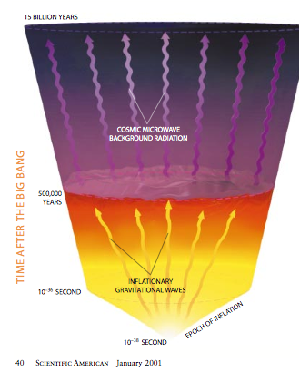
Inflation
The other two mysteries (large scale homogeneity and near flatness) might both be accounted for by a single explanation.
Remember that if "empty" space had a fixed positive energy density, space would expand exponentially. (Inflation) A period of such an expansion would:
  Pull causally connected regions far apart, so that simple extrapolation from a later Hubble constant would not reveal how close they had once been.
  Smooth out wrinkles in space.
  Dilute the concentration of magnetic monopoles

Slide 8
Spontaneous symmetry breaking in the vacuum
Our vacuum can have unusual properties that one would not expect from Newton’s or Leibniz’ (or even Einstein’s) space. It now makes sense to ask, “Are the virtual particles in our vacuum aligned in some way?”
In other words, do the underlying equations of physics have any symmetry that is not manifested by the world that we see?
The answer is yes. The symmetry is similar to the one that gives conservation of electric charge. It is not a spatial symmetry, but an “internal” one (i.e., a mathematical symmetry of the equations) called gauge invariance. In addition to enforcing conservation of charge, it also causes the photon to be massless, which is the reason the electrical force follows a 1/r² law. GR has a gauge invariance, as do the strong nuclear forces (QCD).
The gauge invariance of the weak nuclear force is spontaneously broken at the temperatures of the current world. The result of this loss of symmetry is that the particles (the W and Z bosons) that mediate the weak force are massive, and the force is not 1/r². At high temperature (e.g., in the early universe) the symmetry is restored. (like the symmetry of a magnet, or of a piece of ice.)

Slide 9
Spontaneous symmetry breaking in field theory
Let’s imagine a universe where every particle is massless. Suppose there is a particle which interacts with the other kinds of particles and with itself.
Consider a box containing these particles. How does the energy of the box vary as we increase the density of particles in the box? Normally, we would expect it to increase:
The graph is not linear, because the particles interact.

Slide 10
Phase Transitions of Fields
Suppose the particles have an attractive interaction such that above a certain density they begin to condense. Then the energy vs. density graph could look like one of these:
On the right two, the state of lowest energy has nonzero density!
There is nothing terribly exotic about these pictures of energy vs. density. Essentially identical pictures occur for ordinary gases, when you try to calculate whether they form dense liquids or stay as rarified gas. The difference arises in that we treat the gas molecules as coming from some reservoir with a fixed number of particles.
Here, in contrast, we're dealing with particles which can pop in or out of existence. Empty space itself provides the reservoir, and can always produce more particles.

Slide 11
“Symmetry Breaking”
Recall that the conservation laws follow from symmetries of laws. For example, angular momentum conservation follows from the invariance under rotations of the equations.
Nevertheless, the state of lowest energy doesn’t necessarily have to exhibit the symmetry.
Let’s consider an everyday example –
a piece of iron. Each atom behaves
like a little magnet, which we'll call
a spin.
Will the spins line up with each other?
The answer depends on the
temperature of the iron:
  At high temperatures, the spins point randomly. That's because there are many more quantum states with random-looking spins than there are with the spins in any simple pattern. The iron is not magnetized oriented and, on average, the material is isotropic.
  What happens at low T?

Slide 12
The spins have lower energy when they line up. At low T, that energy can make more entropy in the nearby reservoir than the spins lose by lining up. When the iron is cooled below about 770° C (the Curie temperature), the spins do align, maximizing the total entropy. The iron becomes magnetized.
However, they cannot align without
picking some particular direction to
align along. Now there is a preferred
direction, even though the physical
equations themselves contained
no special direction.
This process is called spontaneous symmetry breaking.
Rotational symmetry is broken in this example.
So is time reversal, since these are magnets, not little arrows.

Slide 13
Some symmetry remains unbroken
Symmetry breaking is described by a parameter whose value is zero when the symmetry is restored. Consider our magnetized iron:
At low temperature, the iron is not isotropic. There is a preferred direction.
The strength of the symmetry breaking is described by the magnetization.
  As that quantity goes to zero, the symmetry is restored.
If the symmetry is broken, how do we know it was ever there?
  A remnant of the original symmetry is always left behind.
  Depending on the details of the symmetry broken, there can be a variety of new types of excitations around the broken-symmetry state. E. g.
  There will be a new type of wave (a magnon) in which the spins twist a bit from the preferred orientation, and spring back due to torques from neighboring spins.
  There can be boundaries (domain walls, here) between regions which break the symmetry in different ways.

Slide 14
Other symmetries can spontaneously break
On the average, any position in a liquid is just like any other position. When the liquid cools, it can freeze into a solid, in which there is a distinction between the sites with atoms on them and the spaces in between. Spatial translation is the broken symmetry.
Some sugars (and other big molecules) have left-handed and right-handed forms, which twist polarized light opposite directions. Crystals form which contain only one type or the other. Within the crystal, PARITY (mirror-image) symmetry is broken. (If the interconversion rate between the two forms is big enough, all the molecules can end up in one crystal, breaking parity for the whole batch.)
We saw that physical laws can have various other symmetries, besides these simple spatial symmetries.
  time-reversal
  Lorentz transformations, …
Any underlying symmetry can be broken by the equilibrium physical state, just as the spatial symmetries were broken in the examples above.

Slide 15
What would drive inflation?
What energy density is to be used as the source of the gravitational effects? The zero-point energy would in principle be infinite. Even if we cut off the zero-point fluctuations at the Planck scale, where our current physics breaks down, the density would be ~10¹²⁵ times the critical density of cosmology. So the energy that counts seems to be only the energy above some reference vacuum state.
Consider the early, hot universe. Suppose that there is a scalar field which behaves as described earlier. Then, as time progresses, the free-energy-density graph will evolve.
The density of the field is zero at
  very early times, but as the temperature
  decreases, that is no longer the
  favored configuration. If the middle
  energy-density graph is
  correct, then the universe will become trapped in a false vacuum state, i.e. a state in which the free-energy is bigger than it has to be. Even if the last version is right, the universe will not instantly reach the true vacuum, but will spend a little time in false vacuum states. The false vacuum will cause the expansion of the universe to have unusual features.

Slide 16
Start and End of Inflation
(See Scientific American, Jan. 1999 for
articles on the difference between getting
stuck for a while in a false vacuum and
gradually rolling out of a false vacuum.)
The frozen symmetrical field has, at least
for a while, a fixed density- driving inflation.
In this scenario, the inflation was not caused by a change of the actual state of the vacuum but by the appearance of a new possible equilibrium state with lower energy. How does the universe know that there's a lower energy "real" vacuum?
Inflation may solve our two big cosmological problems.
Homogeneity. If the inflation lasted for 100 time constants, the universe expanded by a factor of e¹⁰⁰ = 10⁴³. The entire visible universe (10²⁵ m) was a basketball (~30 cm) just after inflation, but only a minute speck (10⁻⁴³ m) just before, much smaller than the causally connected region (10⁻²³ m) then.
Flatness. Suppose the universe wasn’t close to the critical density before inflation. This means, in the balloon analogy, that it was curved. Now, increase the radius of the balloon by x10⁴³. It will become indistinguishably close to flat.
Inflation could also account for the rarity of certain particles (magnetic monopoles) which should have been created, but have never actually been found.
Problem: The inflationary scenario requires some fine-tuning of the strength of competing terms in the interactions, in order for the inflationary period to end smoothly.

Slide 17
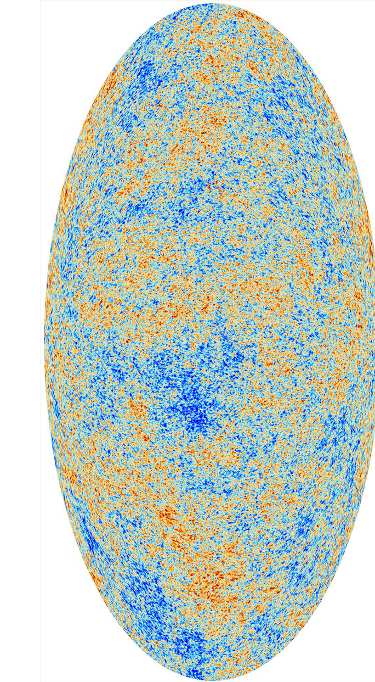
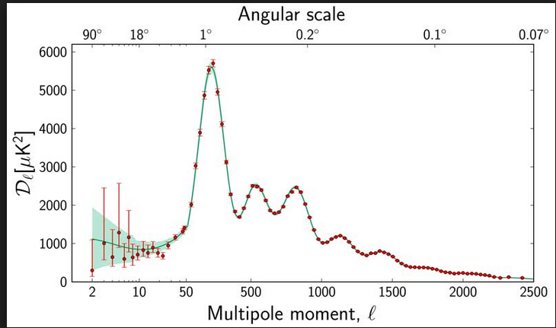
Why should we believe it?
There is no evidence for the proposed interactions, which require the existence of a new, previously unobserved, force.
Inflation did make predictions for the amount
of structure of various sizes in the universe,
especially in the background radiation.
Planck Result

Slide 18
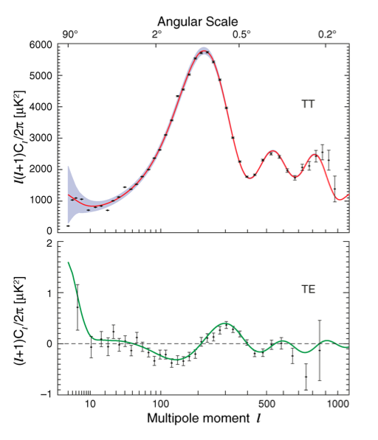
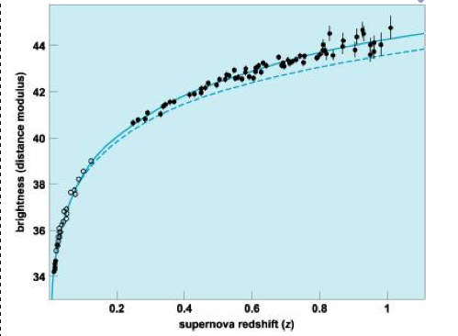
CMB Fits Theory
WMAP polarization
Does that mean that we are missing 70% of the matter in the universe, when we only find 30% of the critical density in galactic clusters?
No: the expansion of the universe is still accelerating according to pretty reliable measurements.
It looks like we're still in a period of weak inflation!
Hubble
revisited
So we have strong reasons to think that inflation made the total energy density very close to the critical value. If the same inflation that made the universe homogeneous also made it flat, the radius of curvature should be more than (10⁵)^{1/2} as large as the age of the universe times c. That means that the universe is extremely close to flat: right at the edge between open and closed.

Slide 19
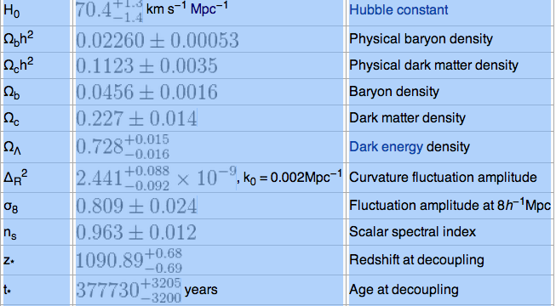
Parameters

Slide 20
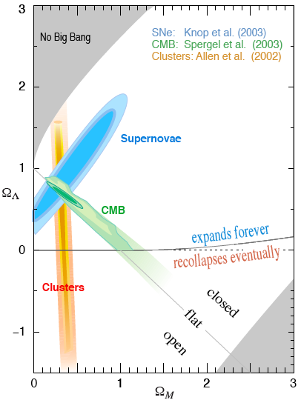
The Big Picture
You are here
The accelerating expansion from the background energy density, breaks the simple connection between energy density and the fate of the universe.
Depending on the ratio of the ordinary mass to the background density, you can have:
  Open/ always expands
  Closed/Collapses
  Closed/always expands
  Open/collapses
We’re almost exactly on the edge between open and closed, very near flat.

Slide 21
Key unanswered questions
If the field apparently causing the current acceleration of expansion remains constant, the expansion will continue forever. If it were to fall to zero, the expansion would still continue forever. But we really don't know what it is or what it will do.
What would make the background energy density so close to the matter density?
  In cosmological constant case, that would be a special recent historical feature. 1 billion years post BB, the background would be less than 1/1000 of the matter density.
What fine-tuned the inflation parameters to give it a smooth landing?

