Slide 1
String Theory, multiverse and many more
String theory
Multiverse theories
Final Exam Thursday, May 14, 7pm-10pm (here)
Open book, open note, open internet
Electronic submission encouraged, blue books available. 4 essay questions.
419 Term papers due on Thursday May 7 (no late papers accepted).

Slide 2
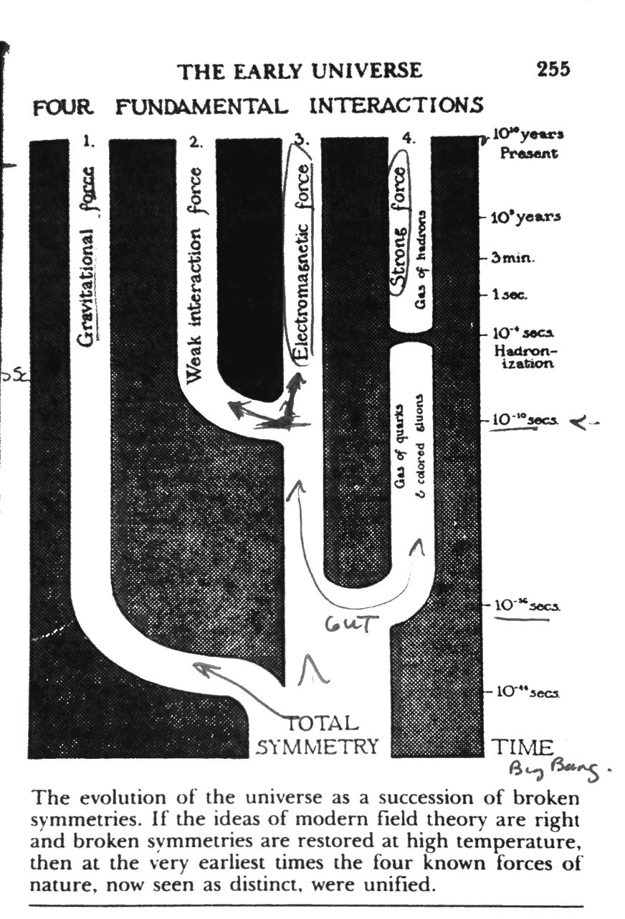
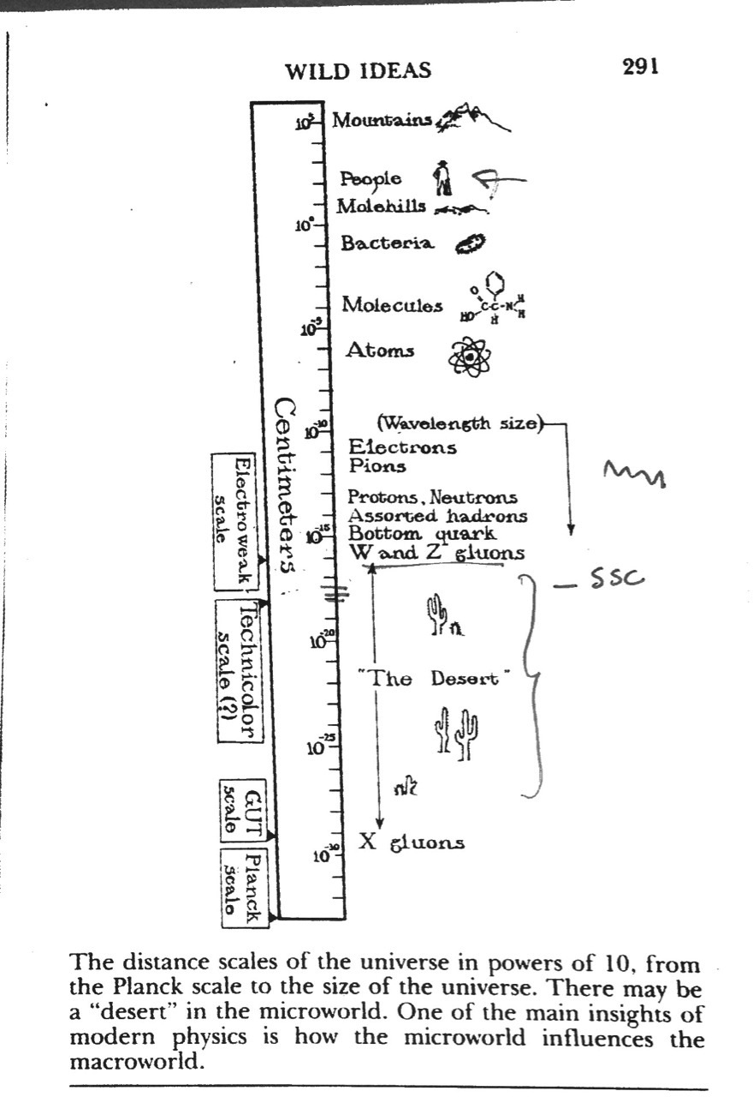

Slide 3
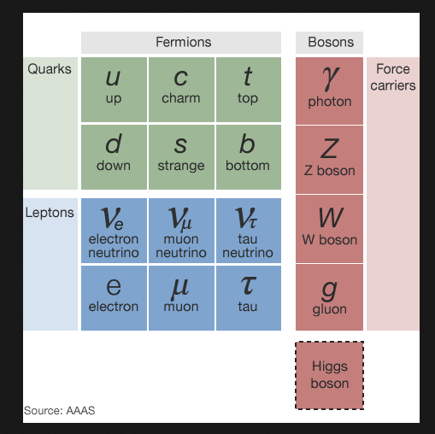
The “Standard Model” (1970s)
Table shows the basic particles (61)
3 leptons and 3 quarks
We never see free quarks
Neutrons and protons are 3 quarks
All particles have now been seen
The interactions between the particles is mathematically simple but very difficult to “solve” except on big computers
Almost complete agreement with all experiments. (0.02%)
BUT
Why so many parameters? (19)
How to combine with gravity
Are there more particles such as WIMPS for dark matter?
Matter/antimatter imbalance.

Slide 4
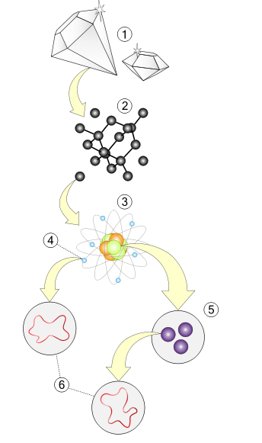
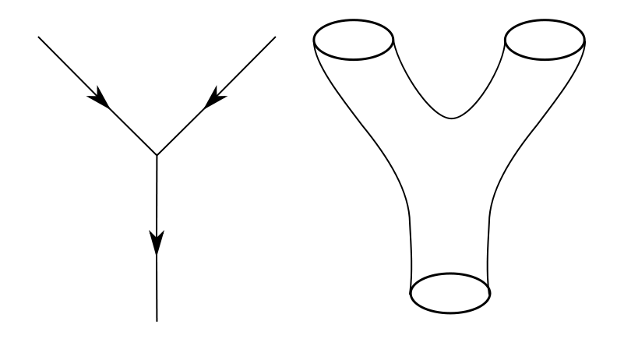
String Theory
Generalization of quantum field theory. Hot topic of last 20 years
Objects are not “points” but “Loops”
Particles are “vibrations” of the loops like tones on a guitar string.
One of the modes is a graviton that causes gravity
Open strings are photons.
Space time is in 10 dimensions. What happened to the other 4? Compactified so we cannot see them now.
Latest version is M-theory in 11 dimensions. Can contain “branes”: (membranes): generalizations of strings to higher dimensions.
More complicated, so fewer results

Slide 5
Successes (all disputed)
  Combines quantum mechanics and gravity
  Can predict black hole properties
  Why the universe is matter and not antimatter
  What the dark matter is
  Why quarks and leptons come in three similar families
  Cosmological history of inflation, flat space-time
Problems
  Too many possible theories (10⁵⁰⁰ theories) One can get many physical laws. Each describes a different universe
  Little or no experimental confirmation, energies too high (10¹⁴ times LHC@CERN), lengths too small.
  Have not yet explained “standard model” details, too complicated, too many theories

Slide 6
Why is the universe comprehensible? Is it?
What breathes fire into the equations? Why is there something rather than nothing?
There is a complete unified theory which we will discover if we are smart enough. (but will we ever be sure if we are right? Experiment can never prove anything but only make a predictive theory plausible. It can disprove theories.)
There is not an ultimate theory, just an indefinite sequence of more and more accurate theories.
There is no theory; some events cannot be predicted beyond a certain extent.
Descartes great deceiver?
Why mathematics?

Slide 7
Is the Universe a Simulation?
NYT Edward Frenkel Feb 14, 2014
…..It seems spooky to suggest that mathematical entities actually exist in and of themselves. But if math is only a product of the human imagination, how do we all end up agreeing on exactly the same math? Some might argue that mathematical entities are like chess pieces, elaborate fictions in a game invented by humans. But unlike chess, mathematics is indispensable to scientific theories describing our universe. And yet there are many mathematical concepts — from esoteric numerical systems to infinite-dimensional spaces — that we don’t currently find in the world around us. In what sense do they exist?
Many mathematicians, when pressed, admit to being Platonists. The great logician Kurt Gödel argued that mathematical concepts and ideas “form an objective reality of their own, which we cannot create or change, but only perceive and describe.” But if this is true, how do humans manage to access this hidden reality?
We don’t know. But one fanciful possibility is that we live in a computer simulation based on the laws of mathematics — not in what we commonly take to be the real world. According to this theory, some highly advanced computer programmer of the future has devised this simulation, and we are unknowingly part of it. Thus when we discover a mathematical truth, we are simply discovering aspects of the code that the programmer used.

Slide 8
This may strike you as very unlikely. But the Oxford philosopher Nick Bostrom has argued that we are more likely to be in such a simulation than not. If such simulations are possible in theory, he reasons, then eventually humans will create them — presumably many of them. If this is so, in time there will be many more simulated worlds than nonsimulated ones. Statistically speaking, therefore, we are more likely to be living in a simulated world than the real one.
Very clever. But is there any way to empirically test this hypothesis?
Indeed, there may be. In a recent paper, “ Constraints on the Universe as a Numerical Simulation,” the physicists Beane,Davoudi and Savage outline a possible method for detecting that our world is actually a computer simulation. Physicists have been creating their own computer simulations of the forces of nature for years — on a tiny scale, the size of an atomic nucleus. They use a three-dimensional grid to model a little chunk of the universe; then they run the program to see what happens. This way, they have been able to simulate the motion and collisions of elementary particles.
But these computer simulations, Professor Beane and his colleagues observe, generate slight but distinctive anomalies — certain kinds of asymmetries. Might we be able to detect these same distinctive anomalies in the actual universe, they wondered? In their paper, they suggest that a closer look at cosmic rays, those high-energy particles coming to Earth’s atmosphere from outside the solar system, may reveal similar asymmetries. If so, this would indicate that we might — just might — ourselves be in someone else’s computer simulation.

Slide 9
Multiverse
If the universe we see around us is the only one there is, the vacuum energy is a unique constant of nature, and we are faced with the problem of explaining it. If, on the other hand, we live in a multiverse, the vacuum energy could be completely different in different regions, and an explanation suggests itself immediately: in regions where the vacuum energy is much larger, conditions are inhospitable to the existence of life. There is therefore a selection effect, and we should predict a small value of the vacuum energy. …
We can't (as far as we know) observe other parts of the multiverse directly. But their existence has a dramatic effect on how we account for the data in the part of the multiverse we do observe. It's in that sense that the success or failure of the idea is ultimately empirical: its virtue is not that it's a neat idea or fulfills some nebulous principle of reasoning, it's that it helps us account for the data. Even if we will never visit those other universes.
Science is … about explaining the world we see, developing models that fit the data. But fitting models to data is a complex and multifaceted process, involving a give-and-take between theory and experiment, as well as the gradual development of theoretical understanding... In complicated situations, … mottos like "theories should be falsifiable" are no substitute for careful thinking about how science works. Fortunately, science marches on, largely heedless of amateur philosophizing. If string theory and multiverse theories help us understand the world, they will grow in acceptance. If they prove ultimately too nebulous, or better theories come along, they will be discarded. The process might be messy, but nature is the ultimate guide.
Sean Carroll edge.com

Slide 10
A Brief History of the Multiverse - by Paul Davies (New York Times 04/12/2003)
Imagine you can play God and fiddle with the settings of the great cosmic machine. Turn this knob and make electrons a bit heavier; twiddle that one and make gravitation a trifle weaker. What would be the effect? The universe would look very different --so different, in fact, that there wouldn't be anyone around to see the result, because the existence of life depends rather critically on the actual settings that Mother Nature selected.
Scientists have long puzzled over this rather contrived state of affairs. Why is nature so ingeniously, one might even say suspiciously, friendly to life? What do the laws of physics care about life and consciousness that they should conspire to make a hospitable universe? It’s almost as if a Grand Designer had it all figured out.
The fashionable scientific response to this cosmic conundrum is to invoke the so-called
multiverse theory. The idea here is that what we have hitherto been calling ''the universe'' is nothing of the sort. It is but a small component within a vast assemblage of other universes that together make up a ''multiverse.’’
It is but a small extra step to conjecture that each universe comes with its own knob settings.
They could be random, as if the endless succession of universes is the product of the proverbial
monkey at a typewriter. Almost all universes are incompatible with life, and so go unseen and
unlamented. Only in that handful where, by chance, the settings are just right will life emerge;
then beings such as ourselves will marvel at how propitiously fine-tuned their universe is.
But we would be wrong to attribute this suitability to design. It is entirely the result of
self-selection: we simply could not exist in biologically hostile universes, no matter how many
there were.

Slide 11
This idea of multiple universes, or multiple realities, has been around in philosophical circles
for centuries. The scientific justification for it, however, is new. One argument stems from the ''big bang'' theory: according to the standard model, shortly after the universe exploded into existence about 14 billion years ago, it suddenly jumped in size by an enormous factor. This ''inflation'' can best be understood by imagining that the observable universe is, relatively speaking, a tiny blob of space buried deep within a vast labyrinth of interconnected cosmic regions. Under this theory, if you took a God's-eye view of the multiverse, you would see big bangs aplenty generating a tangled melee of universes enveloped in a superstructure of frenetically inflating space. Though individual universes may live and die, the multiverse is forever.
Some scientists now suspect that many traditional laws of physics might in fact be merely local
bylaws, restricted to limited regions of space. Many physicists now think that there are more
than three spatial dimensions, for example, since certain theories of subatomic matter are
neater in 9 or 10 dimensions. So maybe three is a lucky number that just happened by accident
in our cosmic neighborhood -- other universes may have five or seven dimensions. Life would probably be impossible with more (or less) than three dimensions to work with, so our seeing three is then no surprise. Similar arguments apply to other supposedly fixed properties of the cosmos, such as the strengths of the fundamental forces or the masses of the various subatomic particles. Perhaps these parameters were all fluke products of cosmic luck, and our exquisitely friendly ''universe'' is but a minute oasis of fecundity amid a sterile space-time desert.

Slide 12
How seriously can we take this explanation for the friendliness of nature? Not very, I think. For
a start, how is the existence of the other universes to be tested? To be sure, all cosmologists
accept that there are some regions of the universe that lie beyond the reach of our telescopes,
but somewhere on the slippery slope between that and the idea that there are an infinite
number of universes, credibility reaches a limit. As one slips down that slope, more and more
must be accepted on faith, and less and less is open to scientific verification.
Extreme multiverse explanations are therefore reminiscent of theological discussions. Indeed,
invoking an infinity of unseen universes to explain the unusual features of the one we do see is
just as ad hoc as invoking an unseen Creator. The multiverse theory may be dressed up in
scientific language, but in essence it requires the same leap of faith.
At the same time, the multiverse theory also explains too much. Appealing to everything in
general to explain something in particular is really no explanation at all. To a scientist, it is just
as unsatisfying as simply declaring, ''God made it that way!''
Problems also crop up in the small print. Among the myriad universes similar to ours will be
some in which technological civilizations advance to the point of being able to simulate
consciousness. Eventually, entire virtual worlds will be created inside computers, their
conscious inhabitants unaware that they are the simulated products of somebody else's
technology. For every original world, there will be a stupendous number of available virtual
worlds -- some of which would even include machines simulating virtual worlds of their own,
and so on ad infinitum.

Slide 13
Taking the multiverse theory at face value, therefore, means accepting that virtual worlds are
more numerous than ''real'' ones. There is no reason to expect our world -- the one in which you
are reading this right now -- to be real as opposed to a simulation. And the simulated
inhabitants of a virtual world stand in the same relationship to the simulating system as human
beings stand in relation to the traditional Creator.
Far from doing away with a transcendent Creator, the multiverse theory actually injects that
very concept at almost every level of its logical structure. Gods and worlds, creators and
creatures, lie embedded in each other, forming an infinite regress in unbounded space.
This reductio ad absurdum of the multiverse theory reveals what a very slippery slope it is
indeed. Since Copernicus, our view of the universe has enlarged by a factor of a billion billion.
The cosmic vista stretches one hundred billion trillion miles in all directions -- that's a 1 with 23
zeros. Now we are being urged to accept that even this vast region is just a minuscule fragment
of the whole.
But caution is strongly advised. The history of science rarely repeats itself. Maybe there is some
restricted form of multiverse, but if the concept is pushed too far, then the rationally ordered
(and apparently real) world we perceive gets gobbled up in an infinitely complex charade, with
the truth lying forever beyond our ken.

Slide 14
A pervasive idea in fundamental physics and cosmology that should be retired: the notion that we live in a multiverse in which the laws of physics and the properties of the cosmos vary randomly from one patch of space to another. According to this view, the laws and properties within our observable universe cannot be explained or predicted because they are set by chance. Different regions of space too distant to ever be observed have different laws and properties, according to this picture. Over the entire multiverse, there are infinitely many distinct patches. Among these patches, in the words of Alan Guth, "anything that can happen will happen—and it will happen infinitely many times". “Theory of Anything” Any observation or combination of observations is consistent with a Theory of Anything. No observation or combination of observations can disprove it. Proponents seem to revel in the fact that the Theory cannot be falsified. The rest of the scientific community should be up in arms since an unfalsifiable idea lies beyond the bounds of normal science. Yet, except for a few voices, there has been surprising complacency and, in some cases, grudging acceptance of a Theory of Anything as a logical possibility. The scientific journals are full of papers treating the Theory of Anything seriously. What is going on?
Paul Steinhardt, "Theories of Anything" edge.com’

Slide 15
Kuhn’s Postscript
Compared with the notion of progress most prevalent among both philosophers of science and laymen, however, this position lacks an essential element. A scientific theory is usually felt to be better than its predecessors not only in the sense that it is a better instrument for discovering and solving puzzles but also because it is somehow a better representation of what nature is really like. One often hears that successive theories grow ever closer to, or approximate more and more closely to, the truth. Apparently generalizations like that refer not to the puzzle-solutions and the concrete predictions derived from a theory but rather to its ontology, to the match, that is, between the entities with which the theory populates nature and what is “really there.”
Perhaps there is some other way of salvaging the notion of ‘truth’ for application to whole theories, but this one will not do. There is, I think, no theory-independent way to reconstruct phrases like ‘really there’; the notion of a match between the ontology of a theory and its “real” counterpart in nature now seems to me illusive in principle. Besides, as a historian, I am impressed with the implausability of the view. I do not doubt, for example, that Newton’s mechanics improves on Aristotle’s and that Einstein’s improves on Newton’s as instruments for puzzle-solving. But I can see in their succession no coherent direction of ontological development. On the contrary, in some important respects, though by no means in all, Einstein’s general theory of relativity is closer to Aristotle’s than either of them is to Newton’s.

Slide 16
Kuhn’s Postscript
5. Exemplars, Incommensurability, and Revolutions
….I have argued that the parties to such debates inevitably see differently certain of the experimental or observational situations to which both have recourse. Since the vocabularies in which they discuss such situations consist, however, predominantly of the same terms, they must be attaching some of those terms to nature differently, and their communication is inevitably only partial. As a result, the superiority of one theory to another is something that cannot be proved in the debate.
Debates over theory-choice cannot be cast in a form that fully resembles logical or mathematical proof. In the latter, premises and rules of inference are stipulated from the start. If there is disagreement about conclusions, the parties to the ensuing debate can retrace their steps one by one, checking each against prior stipulation. At the end of that process one or the other must concede that he has made a mistake, violated a previously accepted rule. After that concession he has no recourse, and his opponent’s proof is then compelling. Only if the two discover instead that they differ about the meaning or application of stipulated rules, that their prior agreement provides no sufficient basis for proof, does the debate continue in the form it inevitably takes during scientific revolutions. That debate is about premises, and its recourse is to persuasion as a prelude to the possibility of proof.
Nothing about that relatively familiar thesis implies either that there are no good reasons for being persuaded or that those reasons are not ultimately decisive for the group. Nor does it even imply that the reasons for choice are different from those usually listed by philosophers of science: accuracy, simplicity, fruitfulness, and the like.

Slide 17
Kuhn’s Postscript
There is no neutral algorithm for theory-choice, no systematic decision procedure which, properly applied, must lead each individual in the group to the same decision.
Two men who perceive the same situation differently but nevertheless employ the same vocabulary in its discussion must be using words differently. They speak, that is, from what I have called incommensurable viewpoints.
One central aspect of any revolution is, then, that some of the similarity relations change. Objects that were grouped in the same set before are grouped in different ones afterward and vice versa. Think of the sun, moon, Mars, and earth before and after Copernicus; of free fall, pendular, and planetary motion before and after Galileo;

Slide 18
Kuhn’s Postscript
6. Revolutions and Relativism
One consequence of the position just outlined has particularly bothered a number of my critics. They find my viewpoint relativistic,… it is in any case far from mere relativism.
….it should be easy to design a list of criteria that would enable an uncommitted observer to distinguish the earlier from the more recent theory time after time. Among the most useful would be: accuracy of prediction, particularly of quantitative prediction; the balance between esoteric and everyday subject matter; and the number of different problems solved. Less useful for this purpose, though also important determinants of scientific life, would be such values as simplicity, scope, and compatibility with other specialties. …Later scientific theories are better than earlier ones for solving puzzles in the often quite different environments to which they are applied. That is not a relativist’s position, and it displays the sense in which I am a convinced believer in scientific progress.

