Slide 1

Formation and Evolution of the Cherry-Pit Structure in Binary Immiscible Alloy Under Ion Irradiation
Shipeng Shu, Kenneth Tussey
5.12.2011

Slide 2
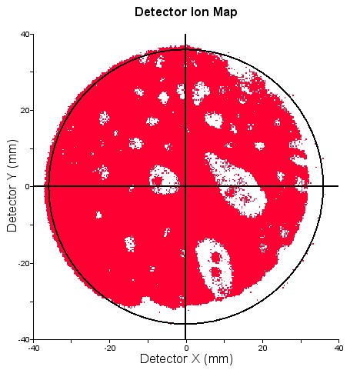
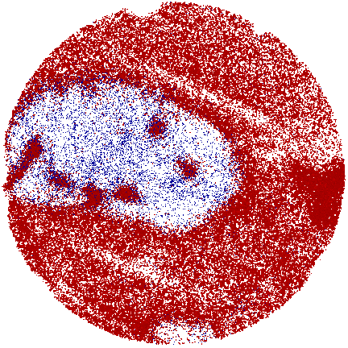
Experiment Observation
Fig.2 A 1-nm thick layer of atoms from the high-dose sample at 350°C in the same x-y cut plane. Fe atoms (blue) have been minimized to make the Cu atoms (red) located inside of the large Fe precipitate more visible.
Fig.1 A Cu-V tip that was pre-irradiated at RT to a dose of 5x10¹⁵ /cm², then irradiated at 450°C an additional dose of 3x10¹⁶ /cm².
Figures courtesy of B. Stumphy.

Slide 3
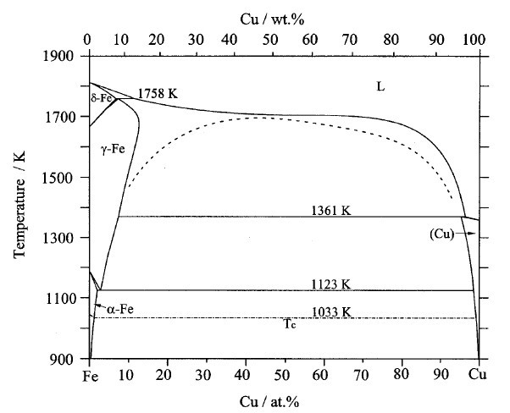
Cu-Fe phase diagram
The Cu-Fe phase diagram is asymmetric.
This work aims to address how the
asymmetry of the phase diagram affects the microstructure and its evolution, under ion irradiation.
Fig.3 Generally at low and medium temperatures, the solubility of Fe in Cu is larger than that of Cu in Fe.

Slide 4
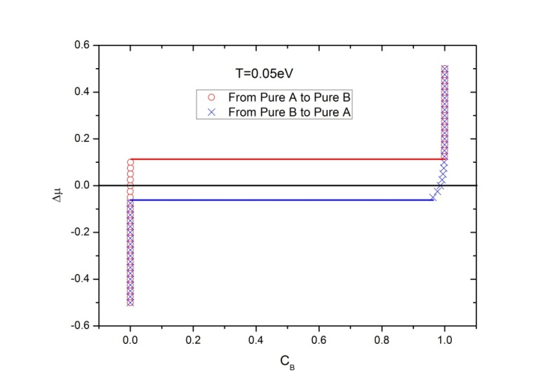
Construction of asymmetric PD
Fig.4 Δμ plot, by simulation started from pure A (red) and Pure B (blue)
Fig.5 Phase diagram constructed by MFA and GC calculation
W=0.0553eV, ε_{AAA} =0, ε_{AAB} =0.005eV, ε_{ABB} =-0.005eV, ε_{BBB}=0.

Slide 5
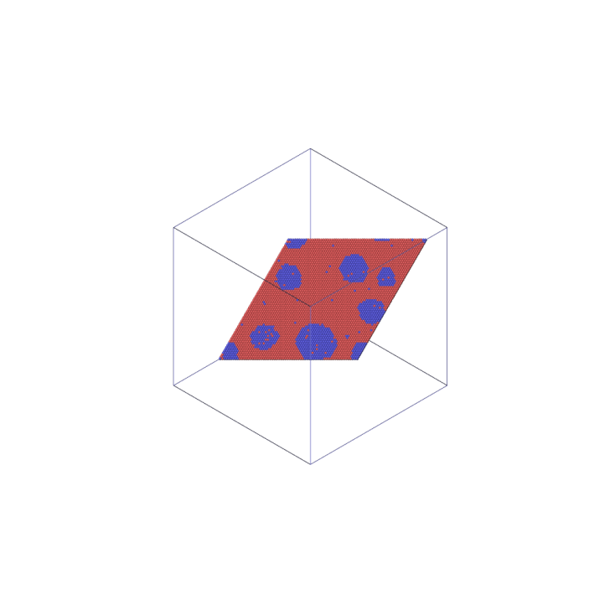
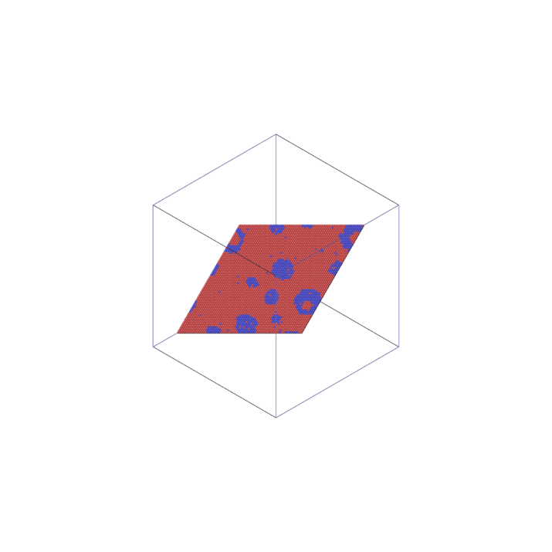
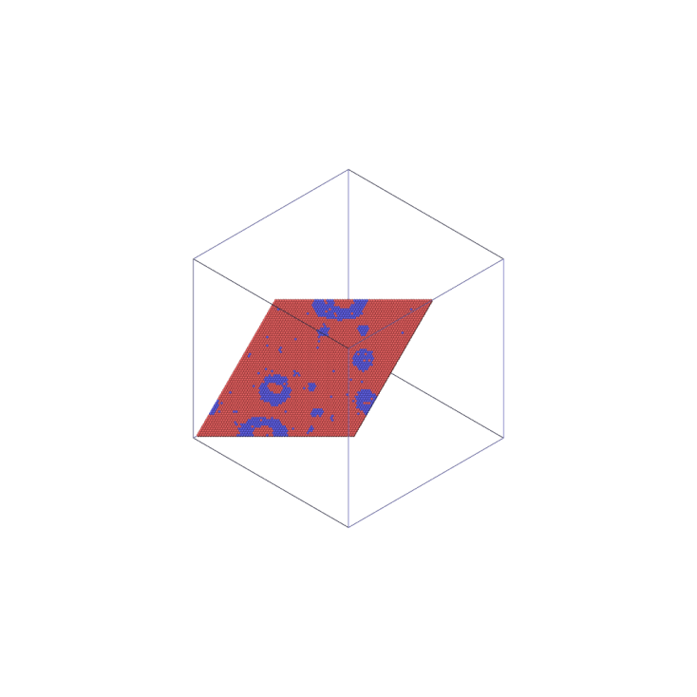
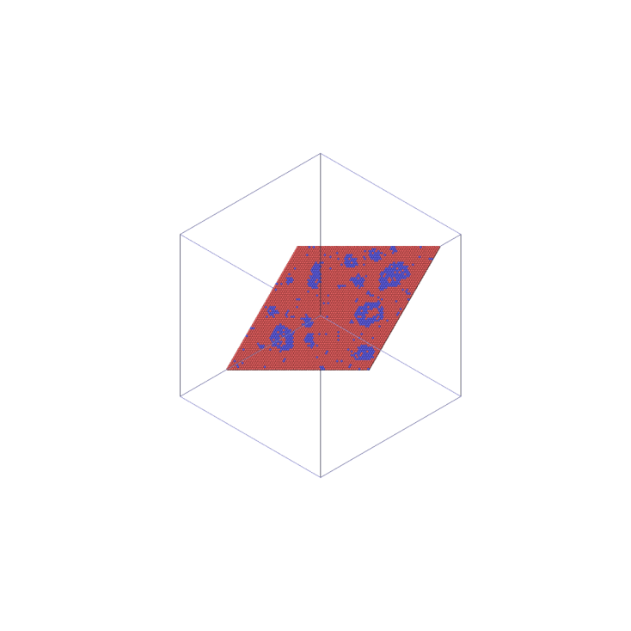
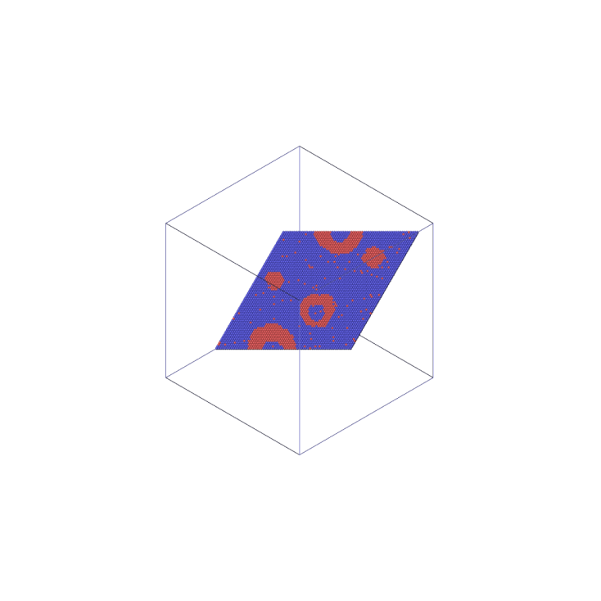

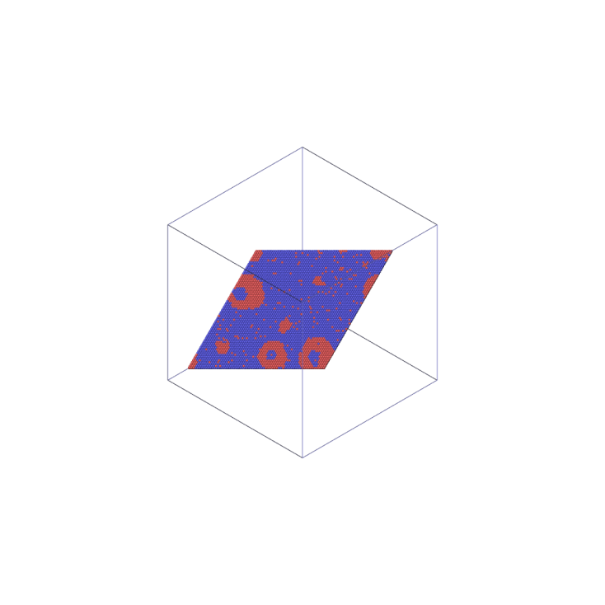
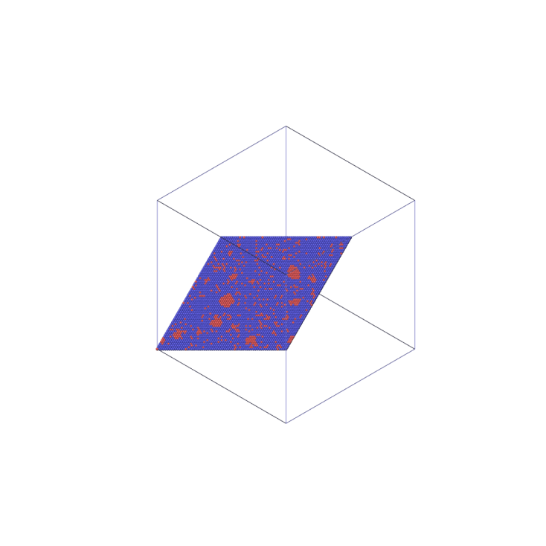
Cherry-Pit on both sides?
BF=0.3
BF=0.5
BF=0.9
BF=3.0
BF=0.3
T=0.036eV, W=0.0553eV, ε_{AAA} =0, ε_{AAB} =0.005eV, ε_{ABB} =-0.005eV, ε_{BBB}=0.
BF=0.3
BF=0.9
BF=3.0
BF=0.3
BF=0.5

Slide 6
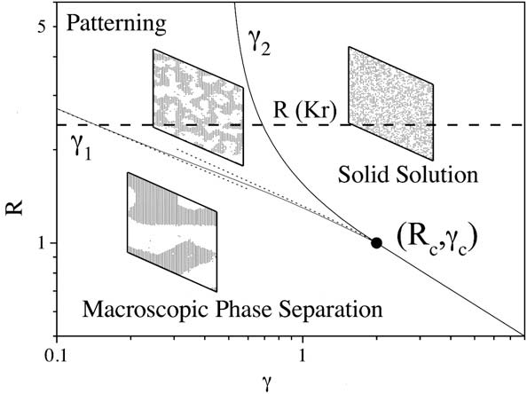
Regime test
A₈₅B₁₅ S(k)-k plot, T=0.036eV
Dynamic phase diagram of A₅₀B₅₀ alloy for symmetric phase diagram
For the A₈₅B₁₅ alloy, Cherry-pit structures are found in the macroscopic growth regime,
confirming Brad’s experiment.
In addition, for a alloy with asymmetric phase diagram, system could be in different regimes on different side of PD.
A₁₅B₈₅ S(k)-k plot, T=0.036eV

Slide 7
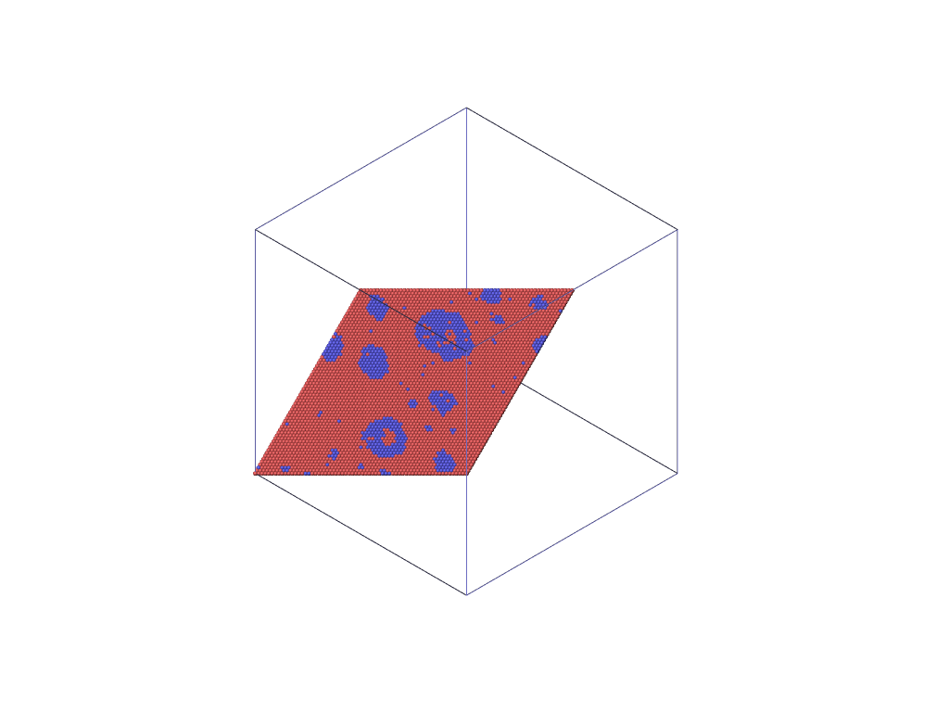




Simulation Observation
Cherry
and
Pit…
Cherry
without
Pit…
Grow and Burst Cycle

Slide 8
Gamma is Small: No Grow and Burst Cycle
Dynamic phase diagram of A₅₀B₅₀ alloy for symmetric phase diagram

Slide 9
Typical Grow and Burst Cycle
We observe grow and burst cycle.

Slide 10
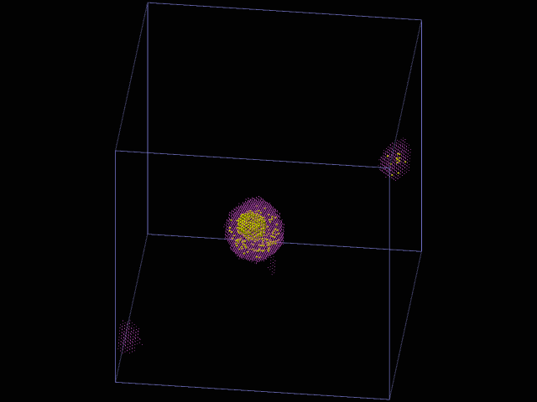
Nucleation and “Centering”
A₈₅B₁₅, Gamma=1, 300-400 iteration. Shown are the two largest B precipitate.
Picked from the 0.005 asymmetry simulation.

Slide 11
Does Pit Mobility Matters?
There could be two possible mechanisms that can lead to the bursting event of “cherry-pit” structure.
First, pit cluster can move to touch the cherry boundary.
Second, the fluctuation of the cherry sphere can also cause the burst.
We will look into the first possible reason.
Here we only consider the pairwise interaction between atoms, thus the phase diagram is symmetric.
Two sets of parameters are used to produce configurations with or without cherry-pit structures.

Slide 12
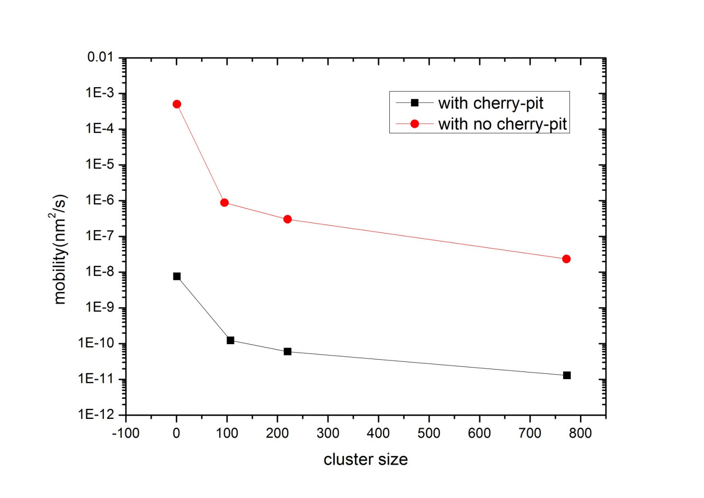
Cluster Mobility --pit mobility
These data are obtained from the pairwise interaction only situation.
The B cohesive energy plays an important role.
If we set E_{BB} = -4.340eV, and Gamma = 3, there are cherry-pits.
If we set E_{BB} = -4.174eV, and Gamma = 100, there are no cherry-pits.
The mobility of cluster of a certain size drops significantly in the cherry-pit forming case. The four cluster size are 1, 110, 220, 770, approximately.

Slide 13
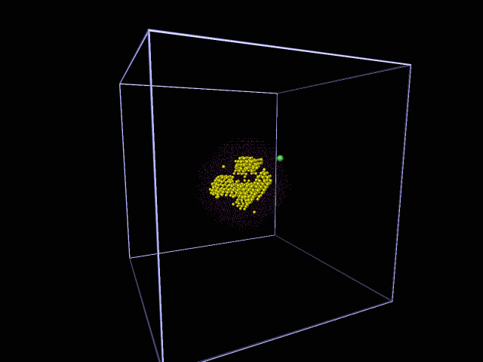
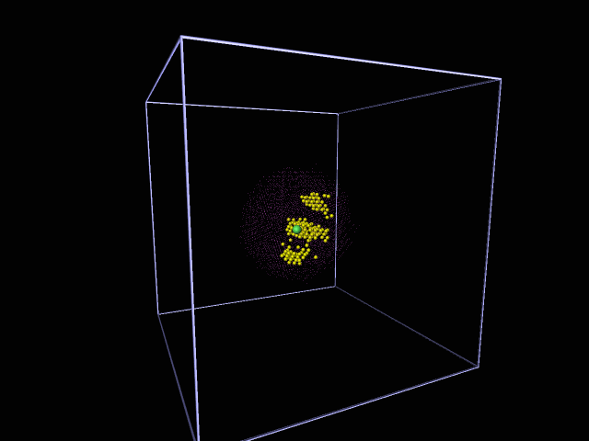
Thermal Annealing After Injection of Matrix Atoms
Both simulations begin from a well supersaturated injection of matrix atoms.
The right side movie is actually 2000 times faster than it seems to be.
Cherry-pit forming case.
No cherry-pit forming case.
It seems that, even when the pit is small enough, it lose atom from single atom movement, not by touching the boundary of the cherry as a cluster.

Slide 14
Let’s Make Up a Story, Shall We?
“Cherry-pits” on both sides of phase diagram:
If “cherry-pit" structure is presenting on one side of the phase diagram, it should also be observed on the other side, but with different Γ_{b} value.
Different regimes of dynamical phase diagram:
On different sides of the phase diagram, with the same simulation parameters, the system can be in different region of the dynamical phase diagram.

Slide 15
Let’s Make Up a Story, Shall We?
Formation of the cherry-pit structure:
First, we need a source of the matrix atoms.
Ballistic exchange gives the source.
Second, the concentration of matrix atom in the Cherry should be high enough to nucleate a stable pit.
Gibbs-Thomson effect matters.
Mobility of small clusters matters (actually, single atom).
Growing of the pit:
Once a stable nucleation forms, injected matrix atoms can be absorbed by the pit.
Possible “centering” phenomenon of the pit.

Slide 16
Let’s Make Up a Story, Shall We?
Bursting of the cherry-pit structure:
One may be convinced by both the movie and the cluster mobility plot, that the bursting of the cherry-pit structure should be a result of the shape fluctuation of the cherry sphere.
In addition, a stable “grow and burst” cycle need the cherry to be large enough.

Slide 17
Thanks for Your Attention!

Slide 18
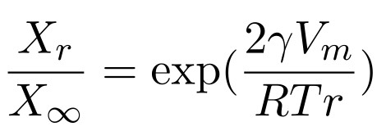
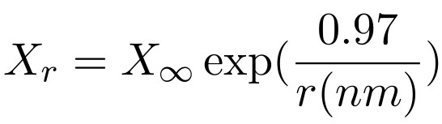
Gibbs-Thomson Effect
A practical effect of Gibbs-Thomson effect is that the solubility of β depend on the particle size.
X_{r} and X∞ are the solubility with a particle radius r and infinity (flat interface).
γ is the surface energy (we use 100 surface to estimate it).
V_{m} is the molar volume of the phase.
We use the ordering energy of 0.0553eV, T = 0.0408eV, lattice constant a = 0.361nm, to make a estimate.
From the GC simulation, X∞ is about 10 at T = 0.0408eV.
For a cluster of about 60 atom, r is about 0.55nm, giving a solubility of 60 atoms. (In the simulation, a cluster o 87 atoms actually dissolves completely.)

Slide 19
Measuring the Mobility (1 atom with ballistic jumps)

