Slide 1
Announcements
HW: Due Tuesday Oct 27th.
Start looking at an article to do your write-up on.
Best article is from Nature, Science, Cell.
(though can choose from any scientific journal)
Want an article that has a significant impact on field.
Thursday, Oct 29th, turn in the article, a secondary article that is a review of the field at which your article is about.
Turn in a paragraph, summarizing it.
The article’s general point, and why you’ve chosen it.
(why it’s important, interesting,
Send your write-up and PDF of article to me by email.
(It won’t be graded but will make sure it’s appropriate.)

Slide 2
Finish up Optical Traps
Move on to:
Seeing things with Microscopy
…Mostly fluorescence
Why can you see single particles
and get nanometer resolution
even with visible light

Slide 3
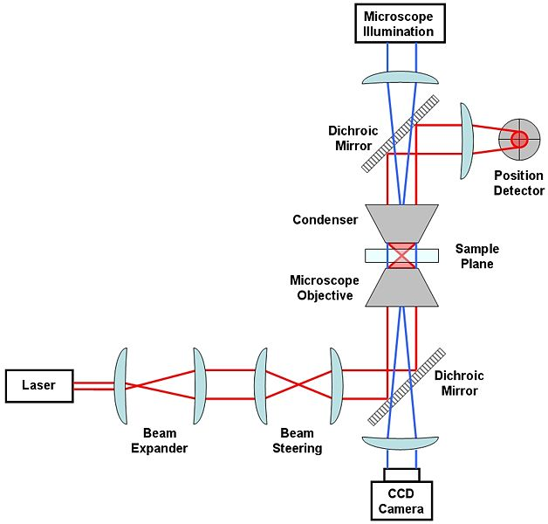
Optical Trap/ Tweezer
Basic Optical Trap set-up
http://en.wikipedia.org/wiki/Optical_tweezers

Slide 4
Requirements for a quantitative optical trap:
1) Manipulation – intense light (laser), large gradient (high NA objective), moveable stage (piezo stage) or trap (piezo mirror, AOD, …) [AcoustOptic Device- moveable laser pointer]
2) Measurement – collection and detection optics (Back Focal Plane interferometry)
3) Calibration – convert raw data into forces (pN), displacements (nm): Brownian Test force.

Slide 5
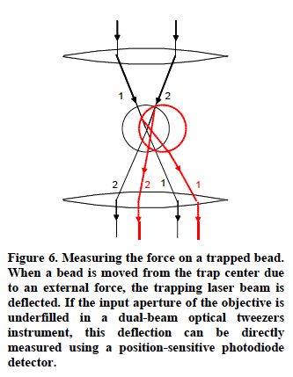
Measuring the position of a trapped bead
Want a Position Sensitive Detection to measure

Slide 6
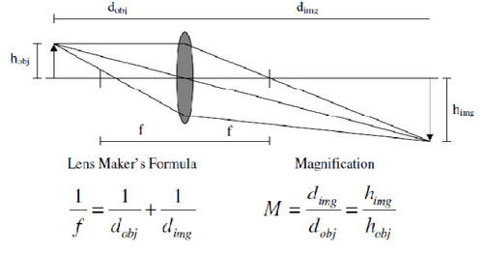
How you get parallel light?
Recall Len’s Maker’s Equation
Put object at the focal length of lens. Then image is at infinity.

Slide 7
2) Measurement: Back Focal Plane imaged onto detector
Trap laser
∑
specimen
Relay lens
PSD
BFP
Conjugate image planes
(Image at point P will
get imaged to point P’)
Notes:
Typically 1000 nm deflection for 1V of signal
10 uV noise is 0.1A !!!

Slide 8
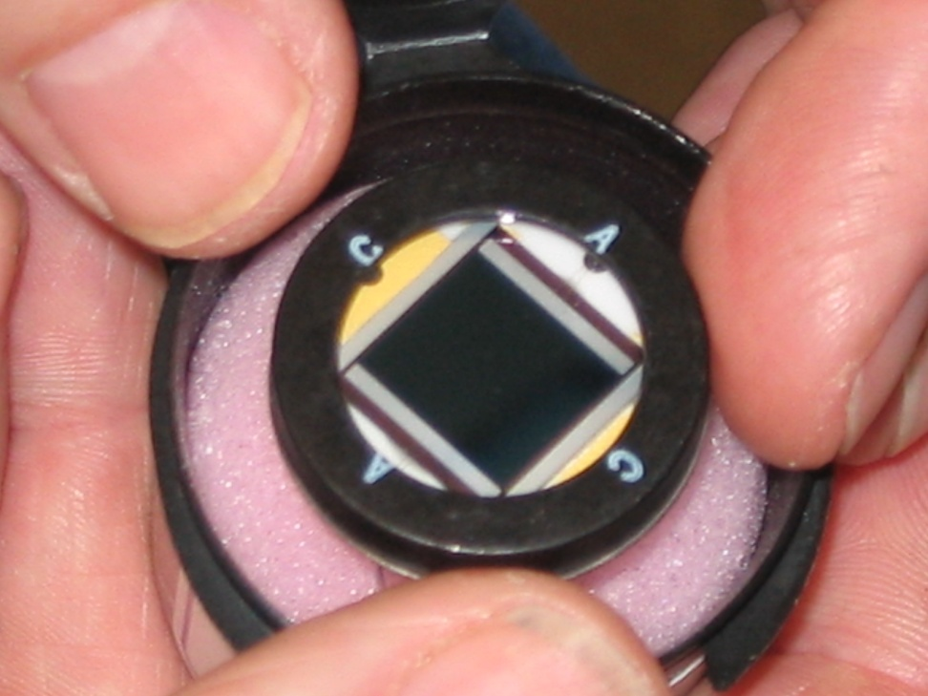
Position sensitive detector (PSD)
Out₁
Plate resistors separated by reverse-biased PIN photodiode
P
In₁
N
N
In₂
P
Out₂
Opposite electrodes at same potential
– no conduction with no light

Slide 9
Multiple rays add their currents linearly to the electrodes, where each ray’s power adds W_{i} current to the total sum.
Out₁
SIGNAL
P
In₁
N
N
In₂
POSITION
P
Out₂
Linear signal with position.
Can just read off signal, get position
ΔX ~ (In₁-In₂) / (In₁ + In₂)
ΔY ~ (Out₁-Out₂) /(Out₁+Out₂)

Slide 10
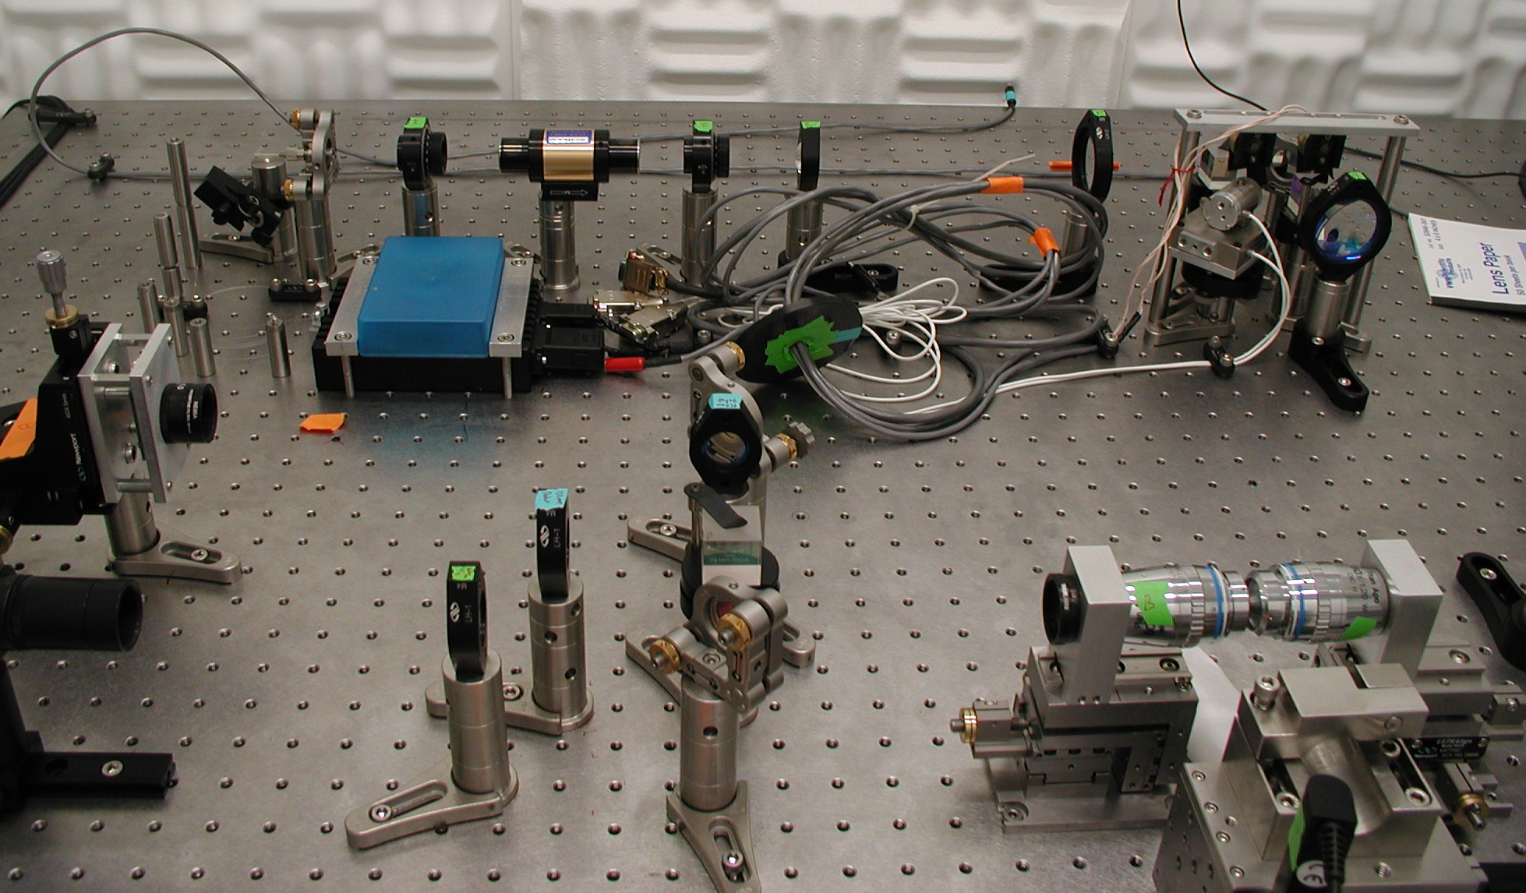
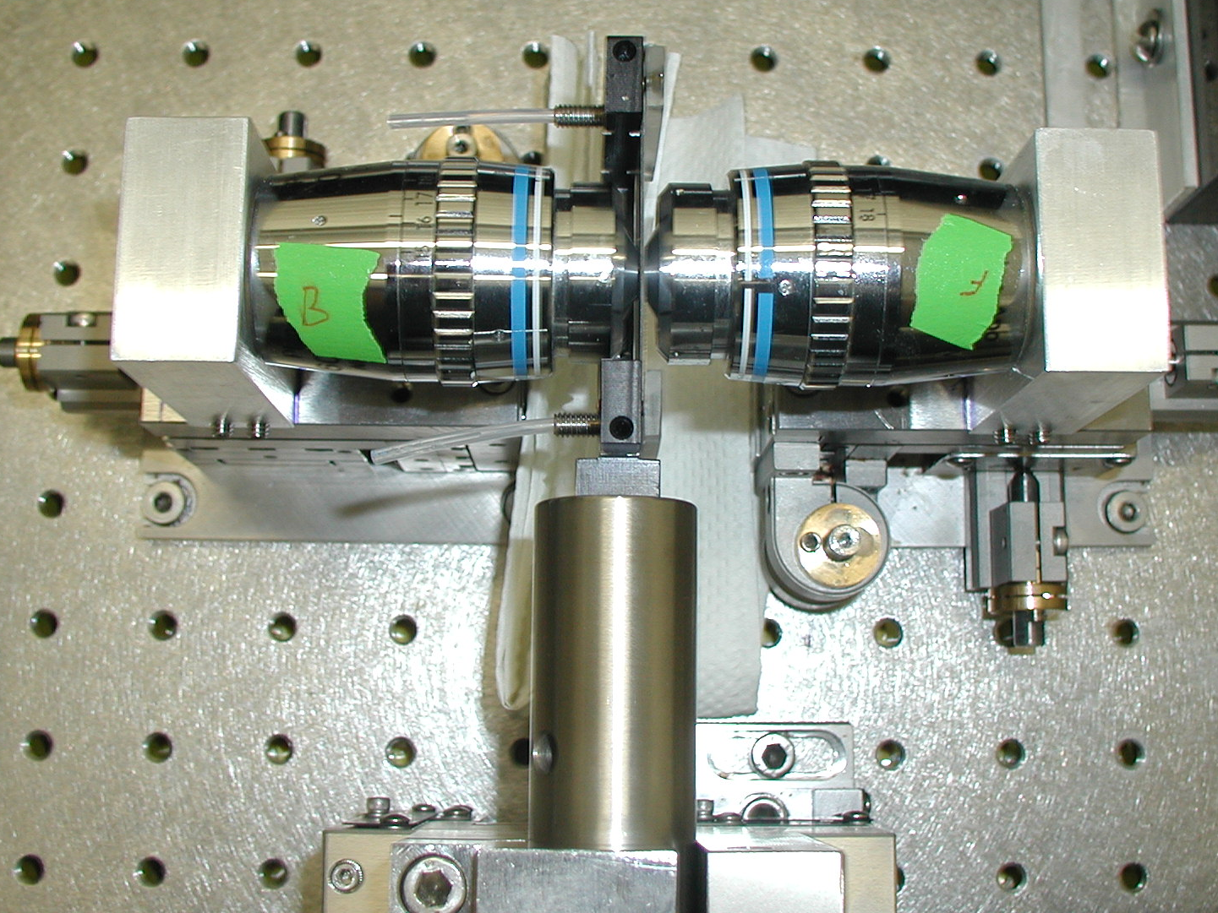
Laser
Beam expander
Photodetector
Condenser
Objective

Slide 11
What is noise in measurement?.
The noise in position using equipartition theorem
[For a typical value of stiffness (k) = 0.1 pN/nm.]
<x²>^{1/2} = (k_{B}T/k)^{1/2} = (4.14/0.1)^{1/2} = (41.4)^{1/2} ~ 6.4 nm
6.4 nm is a pretty large number.
[ Kinesin moves every 8.3 nm; 1 base-pair = 3.4 Å ]
How to decrease noise?
Hint: Equipartion Theorem calculates for noise at all frequencies (infinite bandwidth).
Reduce bandwidth. (Get to soon!)
Also: Operate at high force→ less noise due to finite Temp.
Also be clever about how to differentiate noise from signal.
Notes:
If you look at the expression for the power spectrum, amplitude at low frequency (basically the part which is flat in frequency) is 4*kT*gamma/k^2. (The alpha term is if you measure the power spectrum in V (volts): assume everything is converted into position (in nm), then you don’t need the alpha^2.)
To get the position noise, you need to integrate the power spectrum over frequency. If the bandwidth BW is smaller than the corner frequency, then it’s a simple integration, because the power spectrum is constant, with amplitude 4*kT*gamma/k^2.
So, the noise over bandwidth BW is 4*kT*gamma*BW/k^2.
To get the rms noise in the bandwidth, you take the square root: sqrt(4*kT*gamma*BW)/k
For a BW = 100 Hz, gamma = 1e-6, stiffness k = 0.1 you have: sqrt(4*4.14*1e6*100)/0.1
(all in units of pN, nm)

Slide 12
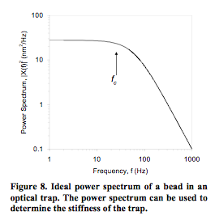
Solve Langevin’s Equation,
Get power spectrum of bead in an optical trap.
Noise is not distributed evenly across all frequencies in an optical trap. Most noise at low f.
= trap stiffness
γ = 6πηr (for sphere)
Bandwith = infinite:
limit to ~6 nm.
If use BW = 100 Hz
~ 0.4 nm = 4 Angstrom!!
Also, know how to cut out noise.
Take out frequencies where signal isn’t
Notes:
Noise = integrate power spectrum over frequency.
If BW < f_{c} then it’s simple integration because power spectrum is constant, with amplitude = 4k_{B}Tγ/k²

Slide 13
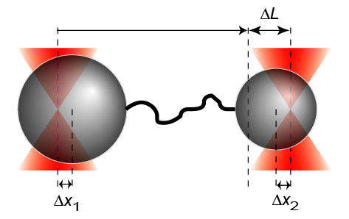
Basepair Resolution—Yann Chemla @ UIUC
Limit BW,
Eliminate noise
Take difference and sum.
Diff: no shaking of floor!
1
PNAS
1bp = 3.4Å
2
1
3
2
4
3
4
5
5
6
6
7
7
8
9
9
8
UIUC - 02/11/08
3.4 kb DNA
F ~ 20 pN
f = 100Hz, 10Hz

Slide 15
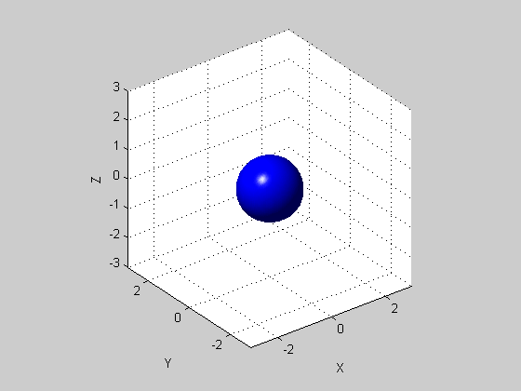
Calibrate w Brownian motion as test force
Langevin equation:
≈0
Trap force
Fluctuating
Brownian force
Inertia
term
(ma)
Drag force
γ = 6πηr
<F(t)> = 0
<F(t)F(t’)> = 2k_{B}Tγδ (t-t’)
Inertia term for μm-sized objects is always small
(…for bacteria)
Can solve equation
k_{B}T= 4.14pN-nm
Notes:
kT = 1.38e-23*300 = 4.14e-21 = 4.14pN nm
Sqrt(<x^2>) = sqrt(kT/k) = sqrt(4.14/0.1) = sqrt(41.4) ~ 6 nm

Slide 16
Class evaluation
What was the most interesting thing you learned in class today?
2. What are you confused about?
3. Related to today’s subject, what would you like to know more about?
4. Any helpful comments.
Answer, and turn in at the end of class.

Slide 17
Calibrate w Brownian motion as test force
Langevin equation:
≈0
Trap force
Fluctuating
Brownian force
Inertia
term
(ma)
Drag force
γ = 6πηr
<F(t)> = 0
<F(t)F(t’)> = 2k_{B}Tγδ (t-t’)
Inertia term for μm-sized objects is always small
(…for bacteria)
Exponential autocorrelation function
k_{B}T= 4.14pN-nm
Notes:
kT = 1.38e-23*300 = 4.14e-21 = 4.14pN nm
Sqrt(<x^2>) = sqrt(kT/k) = sqrt(4.14/0.1) = sqrt(41.4) ~ 6 nm

