Slide 1
Myosin V walks hand-over-hand: single fluorophore imaging with 1.5-nm localization. Science. Jun 2003 ; 300:2061–5 by
Yildiz A, Forkey JN, Mckinney SA, Ha T, Goldman YE, Selvin PR.
Abstract (Usually don’t show):
Myosin V is a dimeric molecular motor that moves processively on actin, with the center of mass moving ≈37 nanometers for each adenosine triphosphate hydrolyzed. We have labeled myosin V with a single fluorophore at different positions in the light-chain domain and measured the step size with a standard deviation of ≈1.5 nanometers, with 0.5-second temporal resolution, and observation times of minutes. The step size alternates between 37 + 2x nm and 37 – 2x, where x is the distance along the direction of motion between the dye and the midpoint between the two heads. These results strongly support a hand-over-hand model of motility, not an inchworm model.

Slide 2
Main Conclusion
Like many molecular motors, myosin V has two “legs” and moves around the cell in “hand-over-hand”, fashion, i.e. it “walks”, taking 74 nm steps.

Slide 3
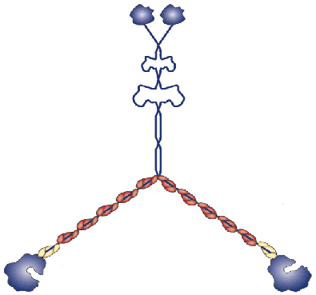
What is myosin?
Actin
One of 3 molecular motor families
Myosin, kinesin and dynein.
Myosin transports cargoes, e.g. other proteins, RNA, melanin just about everything…
It does this by moving on actin in ≈36 nm steps.
How does it move: hand-over-hand or walking?

Slide 4

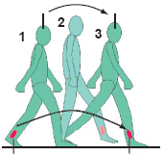
Myosin: Hand-over-hand or Inchworm?
37 nm, 37 nm
Actin
37 nm
37
37 nm
Problem: how to measure 74 nm
<< 250 nm, the classical diffraction limit
74 nm
74 nm
0 nm
74, 0, 74 nm, 0…

Slide 5
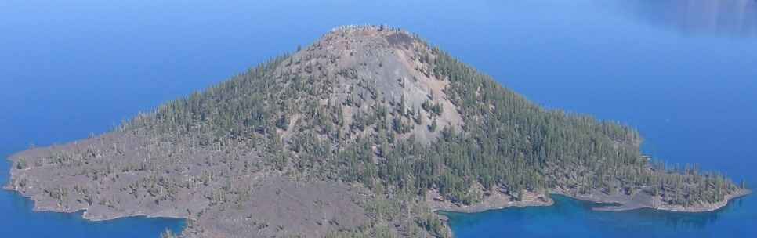

Super-Accuracy: Nanometer Distances
center
FIONA
Fluorescence Imaging with One Nanometer Accuracy
width
Very good accuracy:
1.5 nm, 0.5 sec
Center can be found much more accurately than width
S/N ≈ width /√N
250 nm: 10,000 photons
W.E. Moerner, Crater Lake

Slide 6
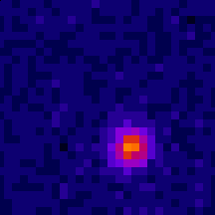
A Single Myosin V moving
86 nm pixel
37 nm or 74 nm?

Slide 7

Myosin V Steps: feet move 2x center-of-mass
74 nm +/- 5nm
Strongly supports
hand-over-hand
Steps: 75,0,75,0...
Yildiz,
Science, 2003

Slide 8
FIONA
Fluorescence Imaging with One Nanometer Accuracy
(1.5 nm, 1-500 msec)
Determined that Myosin V walks, 74, 0 nm

