Slide 1
Acoustic Characterization and Optimisation of a Krannert Center Dance Studio
Colton Dudley, Josh Jacobsen, Neng Ji, Christian Stanley

Slide 2
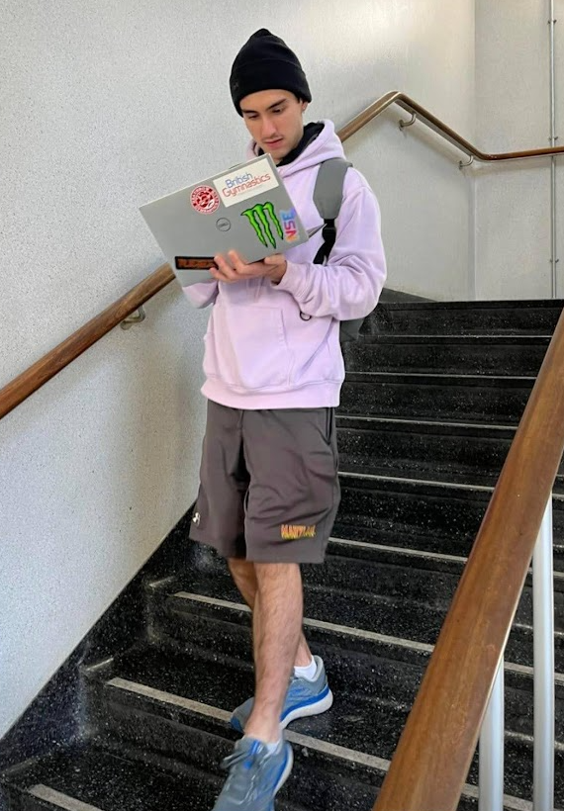
Colton
From London, England
Graduated from Imperial College London
Hobbies include making and eating stew
Favorite band: Smashing Pumpkins
Data taking and analysis

Slide 3
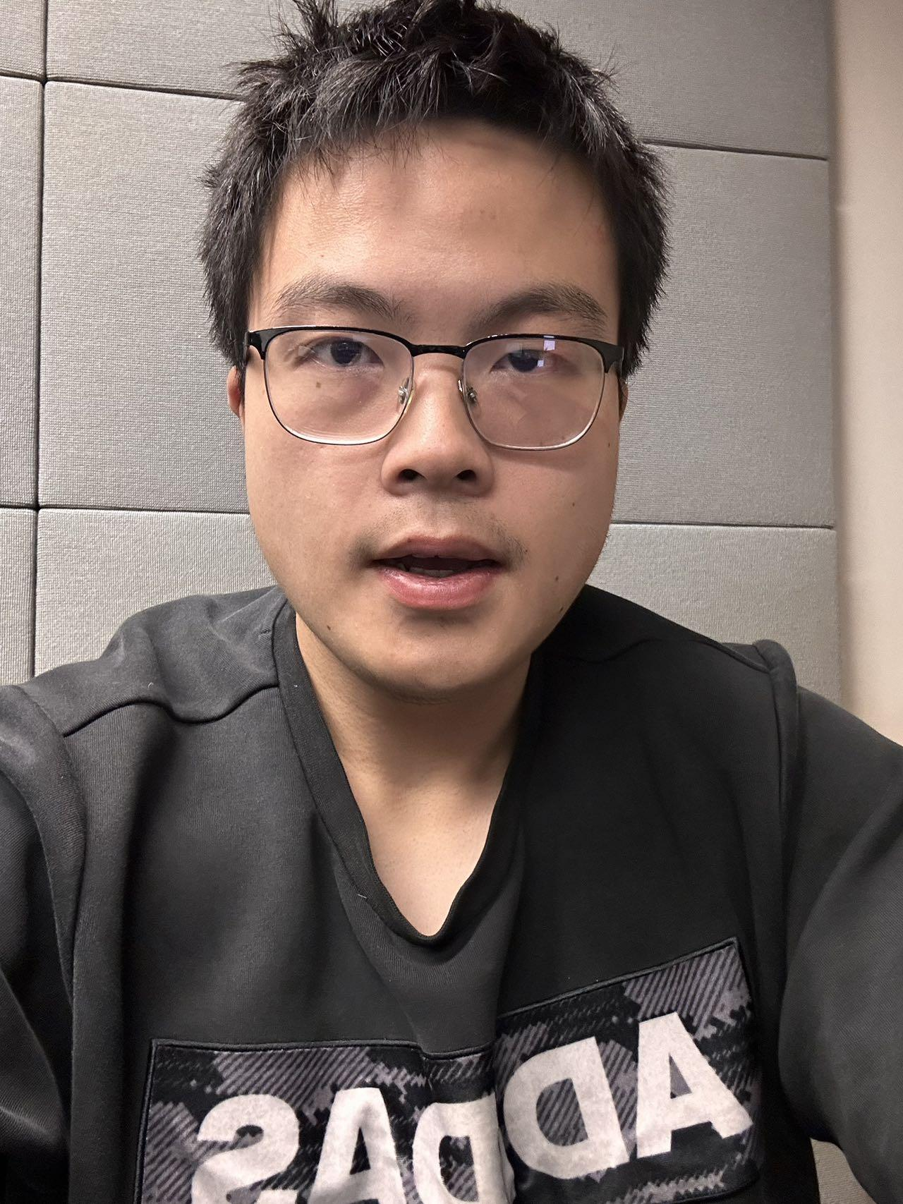
Neng’s Bio
From Szechuan, China
Graduated from University at Buffalo, NY
Favorite band: Eagles
Responsibilities: Logistics of data collection, Plot Generation (Curve fitting, Spectrogram), Data analysis

Slide 4
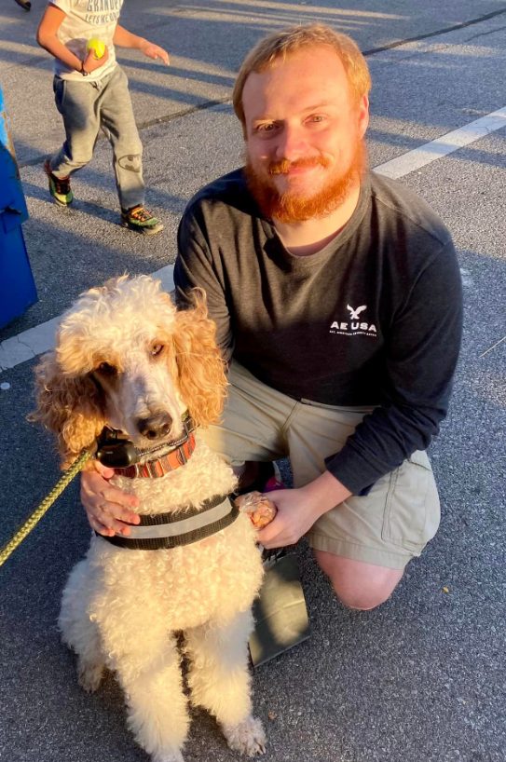
Christian’s Bio
From Greenfield, IN
Graduated from Purdue University, West Lafayette, IN
Hobbies: Roller skating, reading, taking care of my pets
Favorite Song: Here Comes the Sun - The Beatles
Favorite Dessert: Crème brûlée
Responsibilities: Sound board, tone generation.

Slide 5
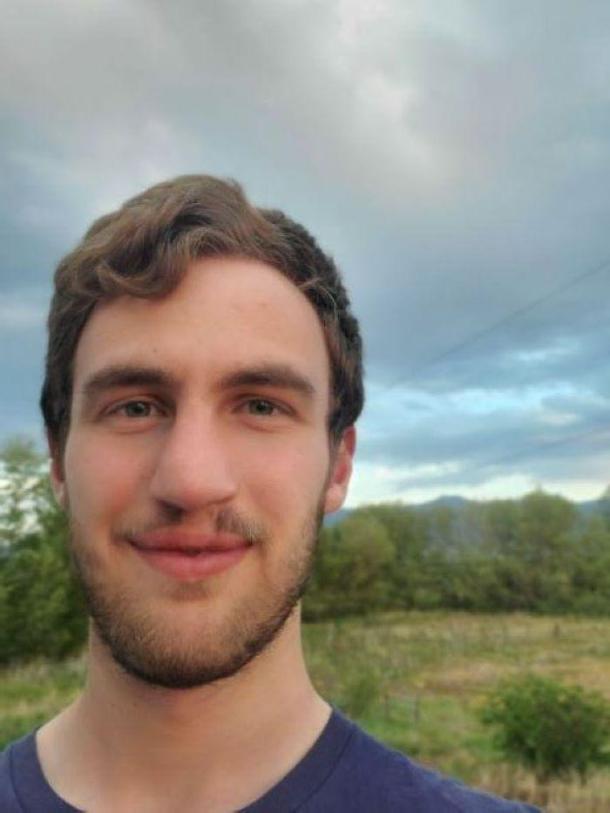
Josh’s Bio
From Alton, IL
Graduated from Concordia University, Irvine, CA
Hobbies: hiking/camping, music, board games
Favorite National Park: Yellowstone
Favorite Board Game: Seven Wonders
Responsibilities: Data Collection, PCBs, Data Analysis

Slide 6
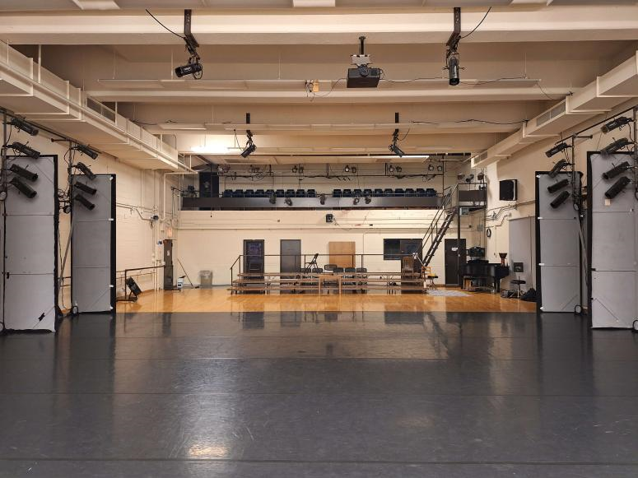
The Problem
Current acoustics of the dance studio are in desperate need of fixing
Room is too live for any speaking while music is playing
  Makes rehearsing difficult
Also not ideal for live performances

Slide 7
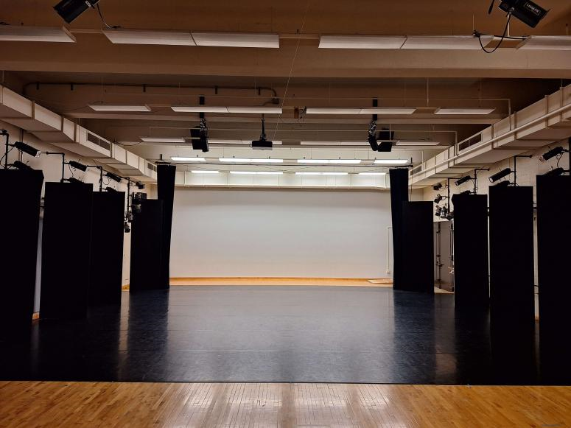
The Problem
Acoustic absorption panels are available for use
Need to know where the most sound is being reflected
  What height should they be placed at, are there any special features that are contributing more to the reverberation

Slide 8
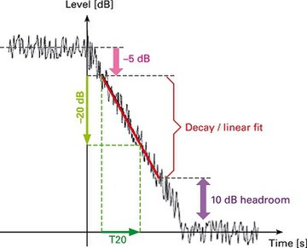

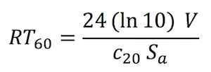
Theory
Sabine’s Equation
https://en.wikipedia.org/wiki/Reverberation#Sabine_equation

Slide 9
Devices
2 Devices: Tone Generator and Listening Board
Tone Generator
Listening Board
Emits a sine wave of a specified frequency
Tells data collection boards when to start listening
Electret Microphone converts pressure into voltage
Voltage information recorded in SD card

Slide 10
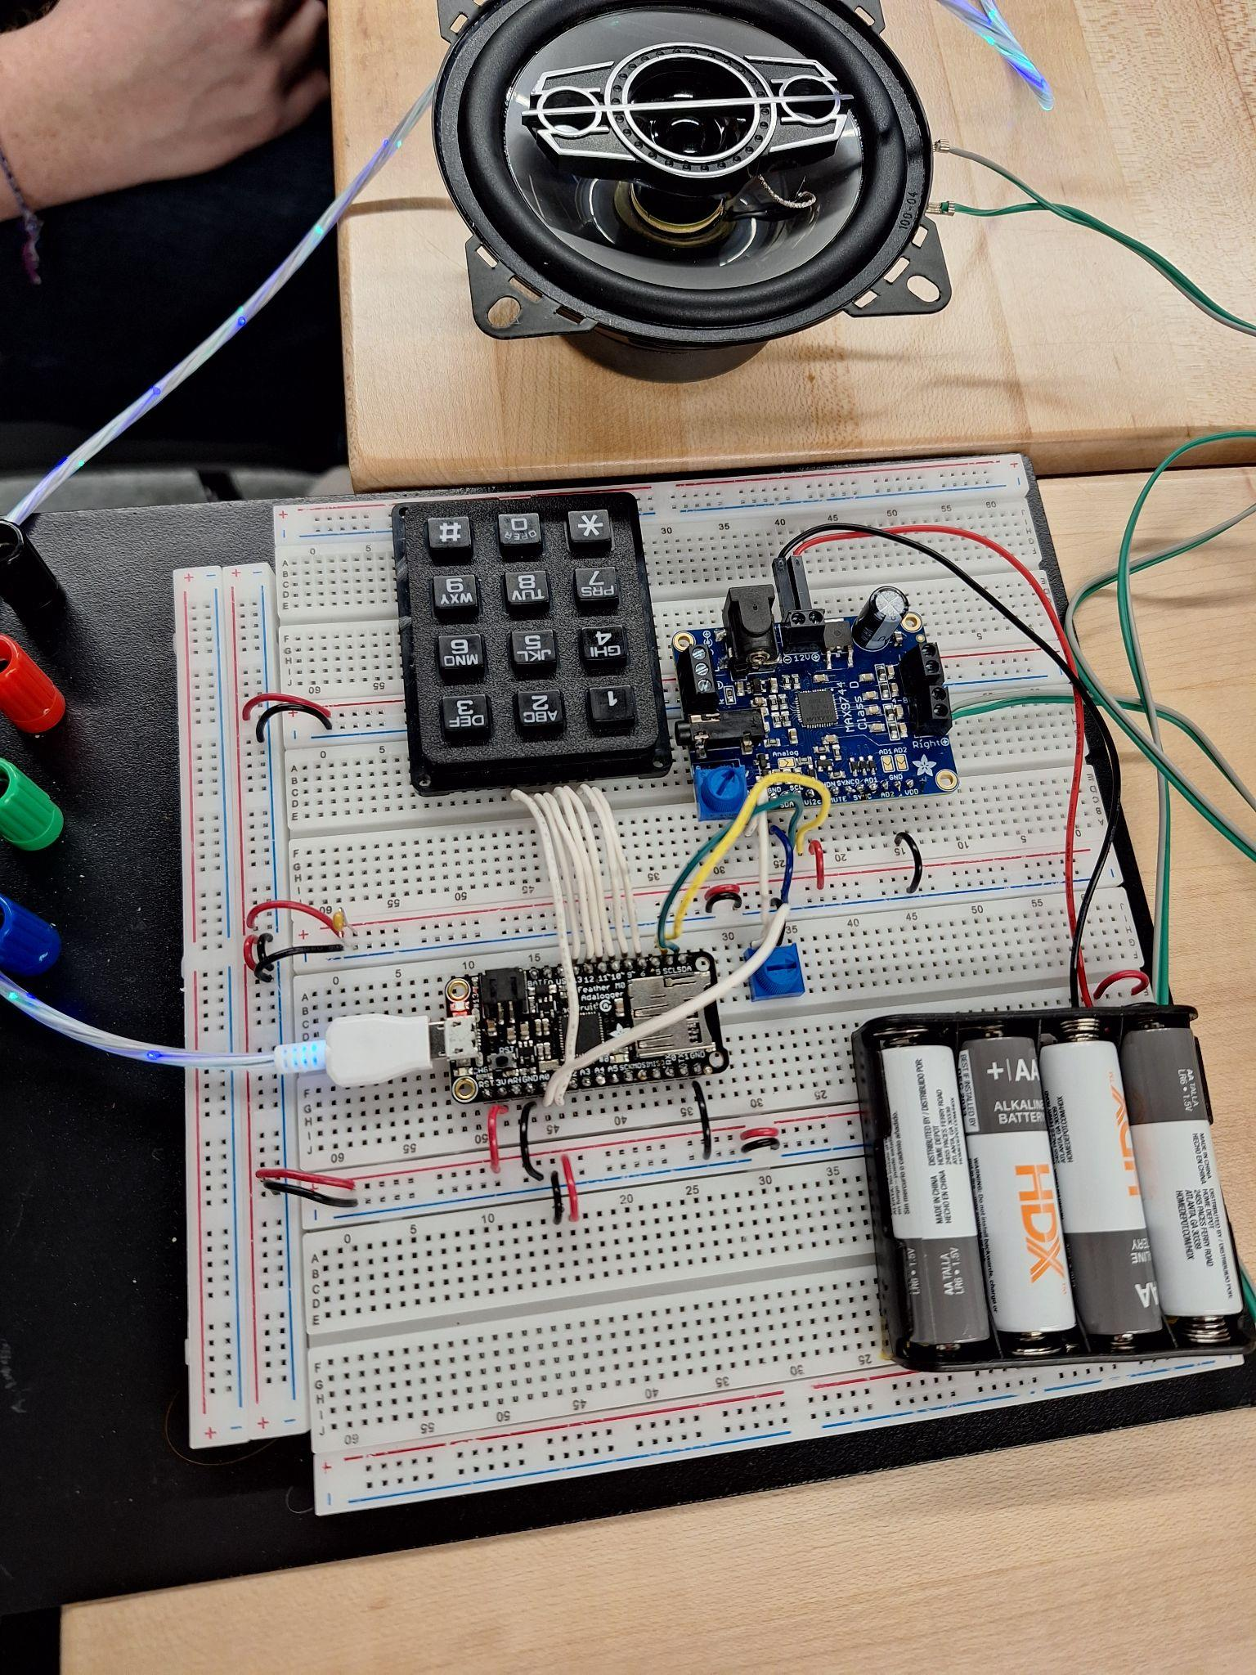
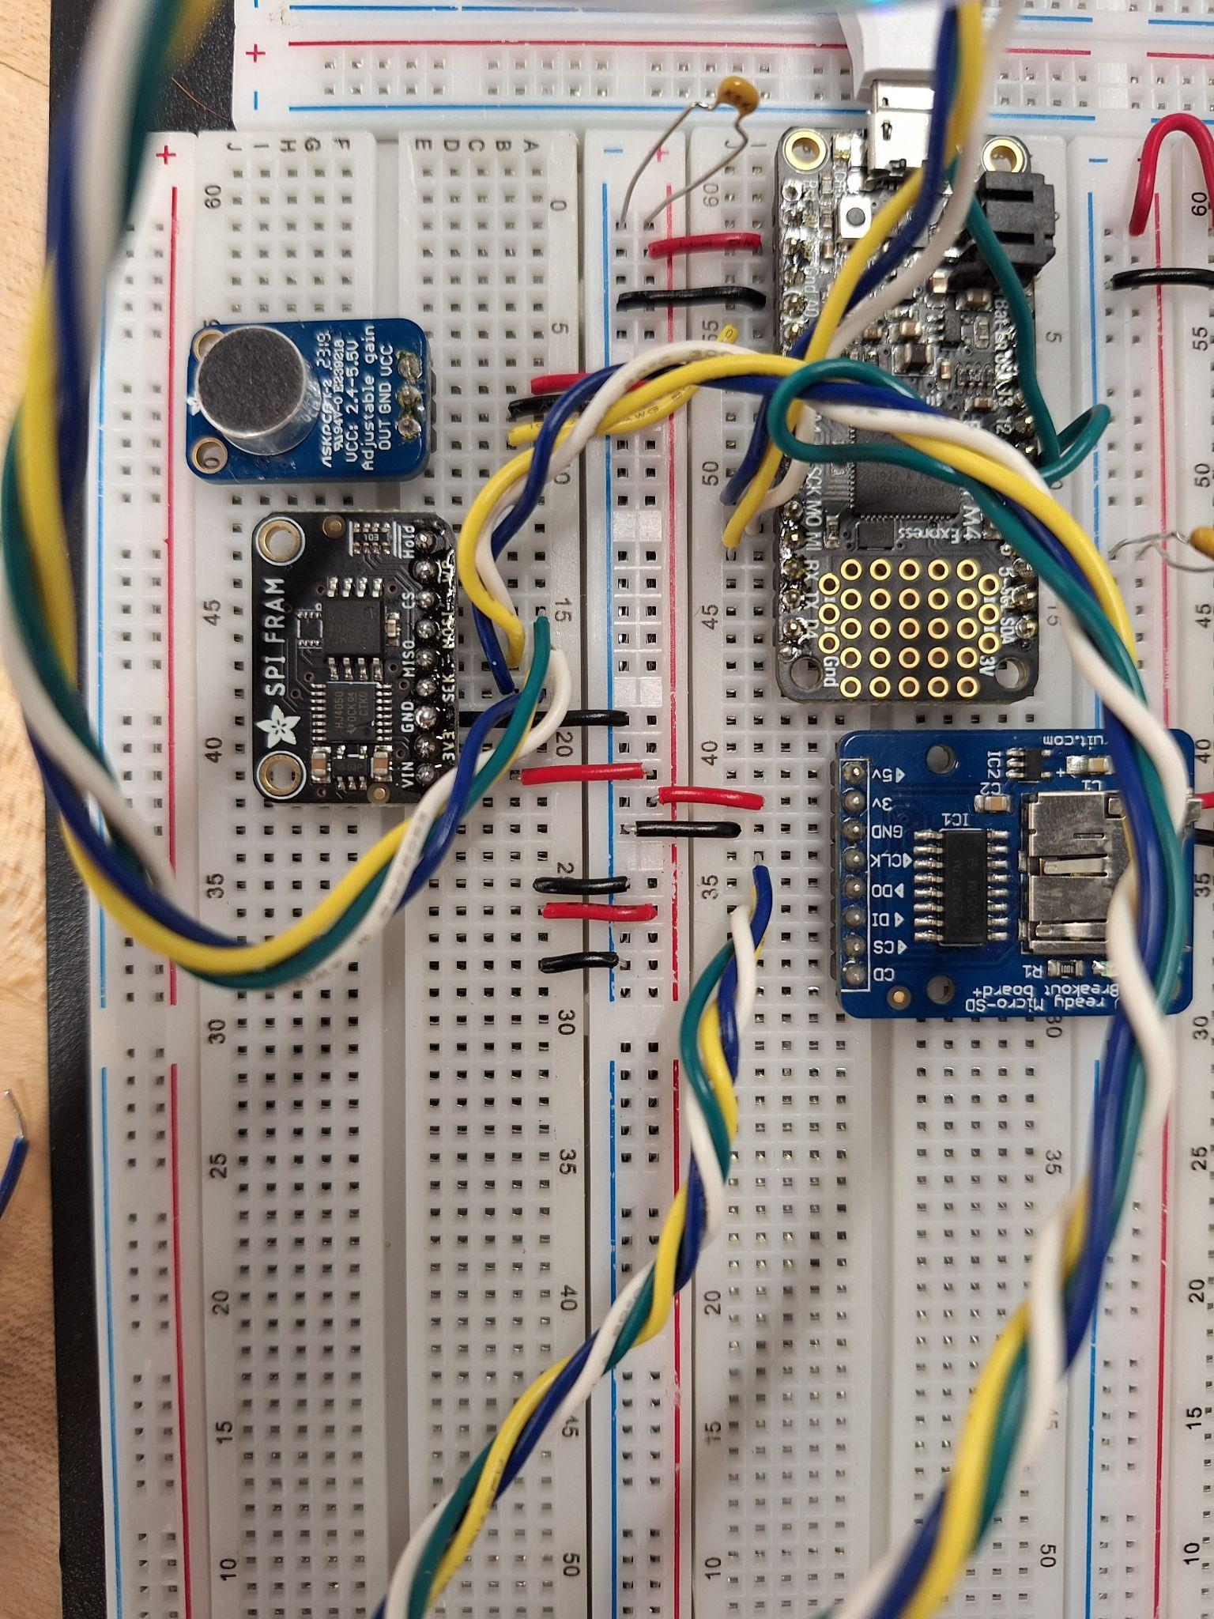
Prototype Boards
Tone Generator
Listening Board

Slide 11
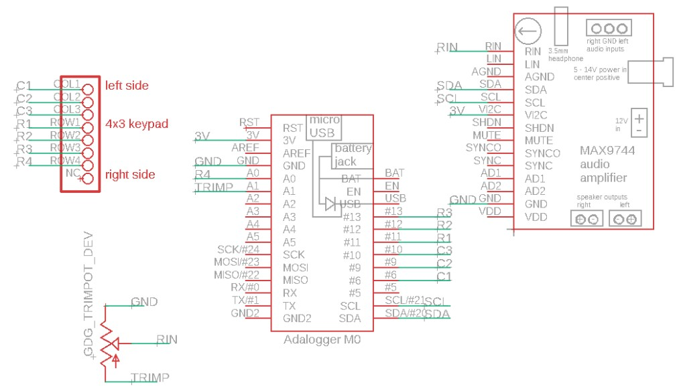
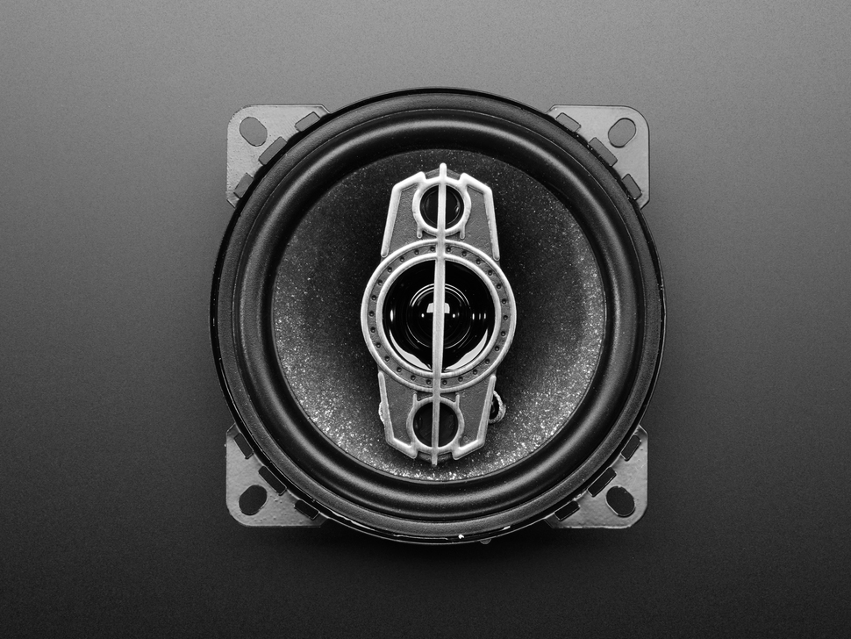
Tone Generator Board Composition
2. MAX9744 Class D Amp
2. Adafruit Keypad Model 1824
Image Source: Adafruit Store Product ID: 1732
1. Adafruit M0 Feather Adalogger
5. Adafruit model XS-GTF1027 Speaker
4. Potentiometer
Notes:
Here’s the schematic to the tone generator board.
There are five components to this board:
The Adafruit M0 Feather Adalogger acts as the brain.
A keypad lets us specify what frequency we want.
The Adafruit MAX9744 amplifier is connected to the Adalogger via an I2C protocol and is powered by four AA batteries.
A potentiometer separate from the amplifier lets us control the volume of the speaker (5).

Slide 12
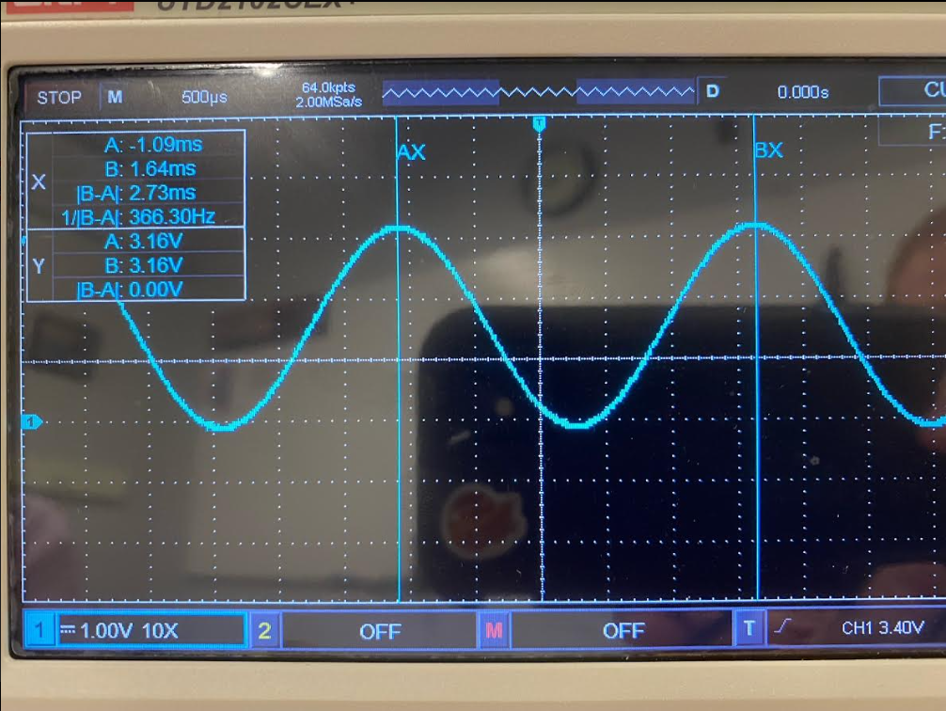
How Does It Work? The Short Answer
The user types in a frequency (in Hz) and submits with “#”.
Five tones close to* the desired frequency are generated.
  Six second intervals between sounds.
When finished, the device waits for a new input.
Notes:
So how does this part of the project work?
The short answer is as follows:
READ POINTS

Slide 13
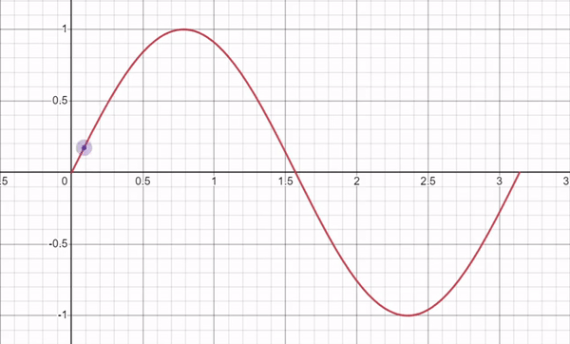
How Does It Work? The Long Answer
An empty array is filled with sine values for 10 periods at the input frequency.
  Values are read out and the closest frequency the Adalogger can achieve is saved.
A new array is filled with sine values of the new ‘allowed’ frequency for one period.
  Using only one period saves memory.
The new array is read out to the built-in DAC N times.
  N = sound_duration * allowed_frequency
Notes:
A more complete answer to how this works is that…
An empty array is filled with ten sine periods at the input frequency.
The array is read out and closest frequency the Adalogger can achieve is calculated.
A new array is then filled with sine values of this new frequency for just one period.
This new array is then read out to the digital to analog converter in the adalogger

Slide 14
Sine Wave vs. Square Wave Trade-offs
Making square waves is easy and has two approaches:
  ‘Manually’ switch an output pin to HIGH and LOW with delays proportional to 1/f.
  Use the Arduino IDE tone() function.
Higher order harmonics (3f, 5f, 7f, …) end up being recorded with square waves.
Generating sine waves at the desired frequency can be difficult.
  Picking up the correct frequency is much easier.
Notes:
Starting off, we had to decide whether to generate a square wave or sine wave.
There are trade-offs to using either one.
Generally speaking, making the square wave is easy and there’s a couple of different ways to do this:
Manually switching the output pin on the Adalogger to HIGH and LOW with delays between proportional to 1/f.
Using the built-in tone() function from the Arduino IDE
One of the problems we encountered with using the square wave was higher order frequencies are more easily picked up.
Making sine waves, while very non-trivial, can correct this.
Being able to pick up the fundamental frequency is much easier in this case.

Slide 15
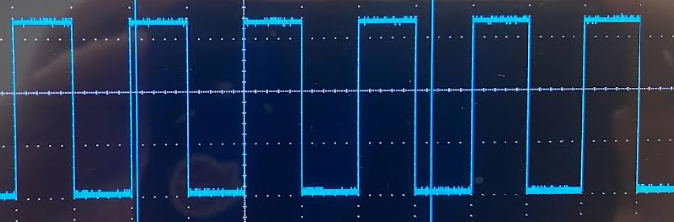
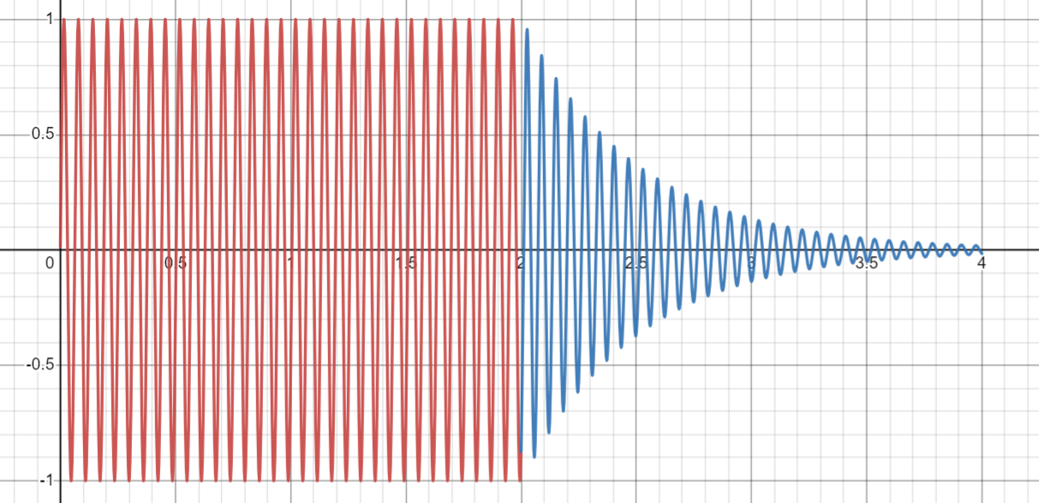
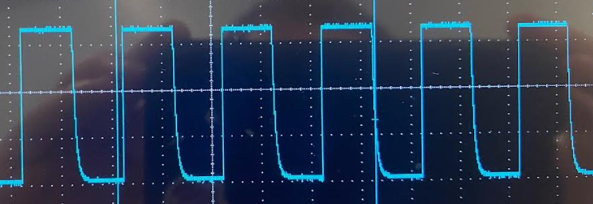
Other Notes About Sound Generation
Tone function (top) makes better square waves than the manual switching (bottom).
An artificial damping term was added to simulate reverberation time τ.
  Done in early stages of testing to see how closely we can calculate τ.
Notes:
Between the two square wave generation methods, the tone function from the Arduino IDE works best.
There’s a strange ‘drop off’ in the manual method.
To test our data taking abilities, an exponential artificial damping term was added to simulate the reverberation time in a room.
We used this ‘known’ drop off time as a reference (the closer we get to tau, obviously the better).

Slide 16
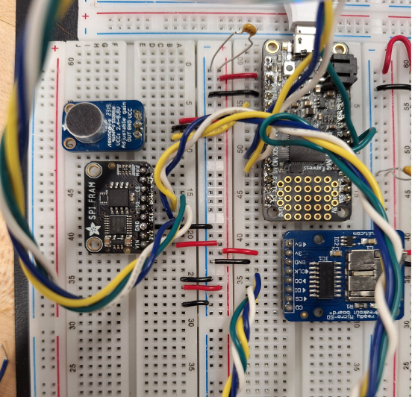
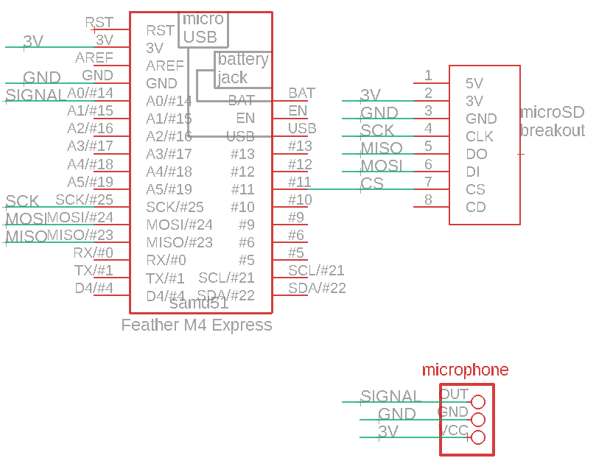
Microphone Board
Microphone
Feather M4
SD card reader
Additional RAM (not used)

Slide 17
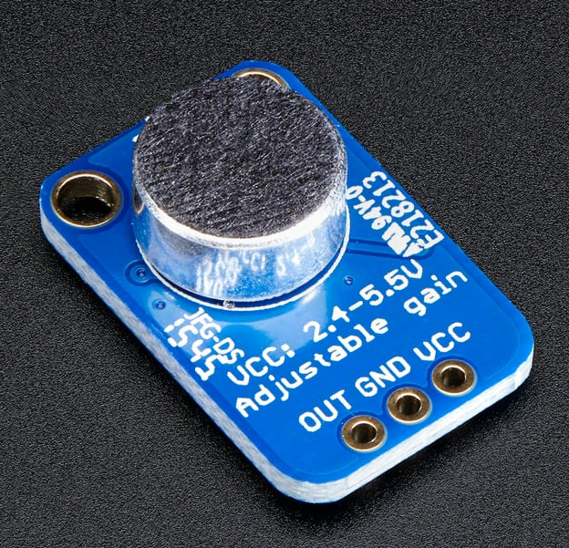
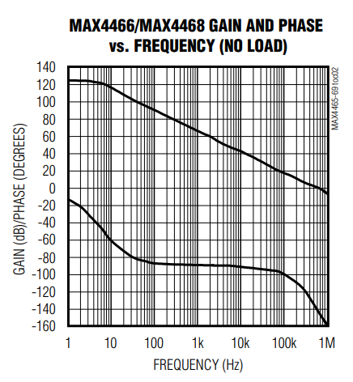
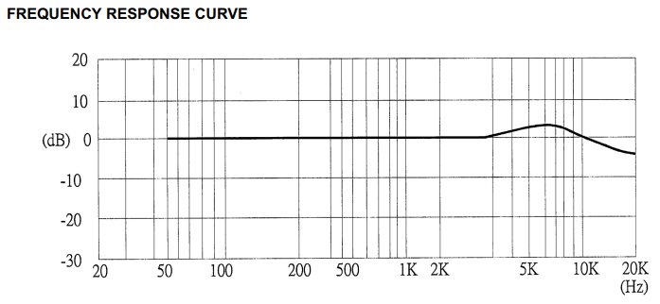
The Microphone
Electret microphone
MAX4466 amplifier
Reliable 20Hz - 20kHz
https://www.adafruit.com/product/1063
https://www.analog.com/en/products/max4466.html#product-overview

Slide 18
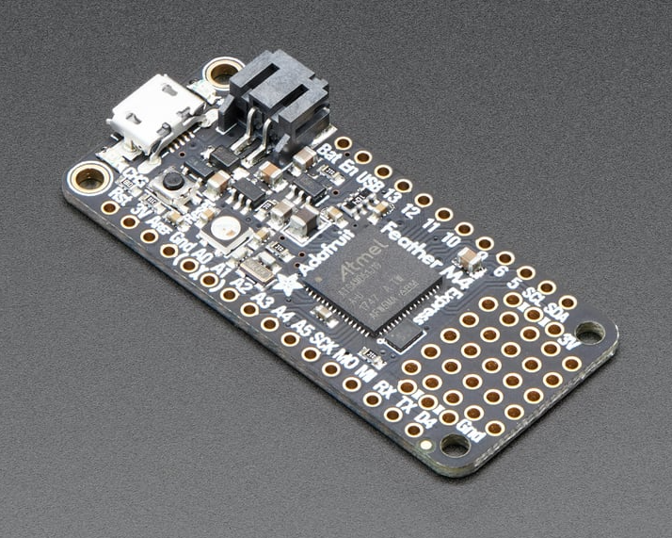
The Analog Inputs
12 bit data
analogRead() - 37 kHz
Could take faster data - 44.1 kHz (Red Book Audio
512 KB FRAM = 86000 samples = 2.5 s of data
https://www.adafruit.com/product/3857

Slide 19
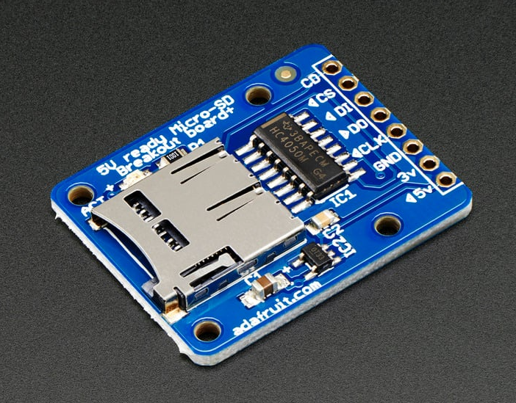
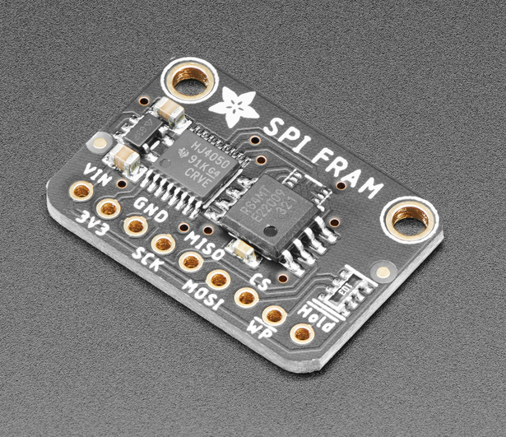
Card Reader and RAM
SPI protocol is not fast enough for desired sampling rate
FRAM not utilized but is a potential solution should we need to take more data
https://www.adafruit.com/product/4719
https://www.adafruit.com/product/254

Slide 20
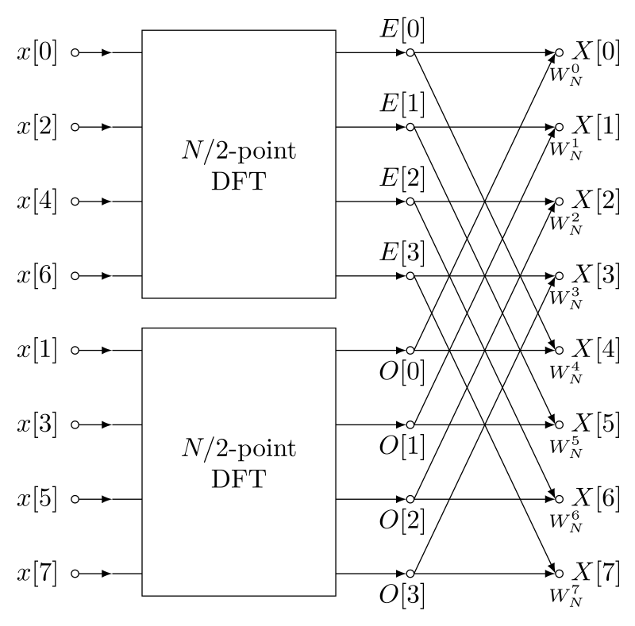
Triggering
Looking for consistent peak frequency to begin data taking
Utilizing arduinoFFT library
Needs to be tuned in order to avoid taking unnecessary data
Take 1024 data points (~0.1s)
FFT
Compare to previous peak frequencies and expected range
Repeat or start taking data
Notes:
FFT: uses symmetries in discrete fourier transform matrix to reduce problem to smaller matrix multiplications

Slide 21
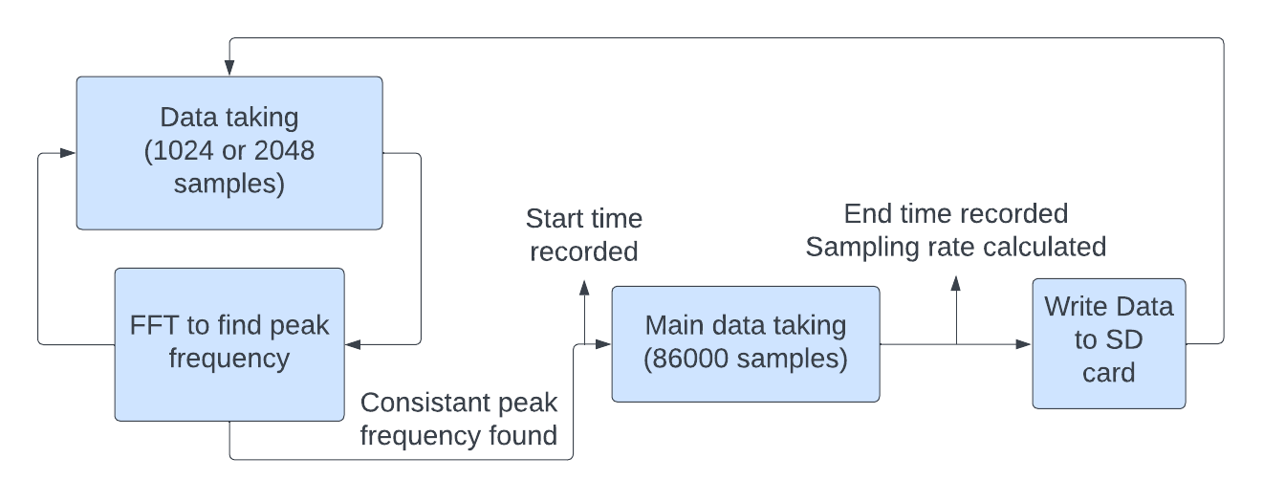
Data Taking - Full Program

Slide 22
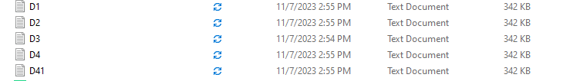
Logistics
We will have multiple data files from different devices
A Python script will automate the creation of a pandas DataFrame for each device.
Each DataFrame is tagged with a unique identifier for its trial (e.g., 'trial1', 'trial2').
Iteration (Assume only four devices)
Extract data for each device by loop in certain depository
Create Pandas DataFrame for each device

Slide 23
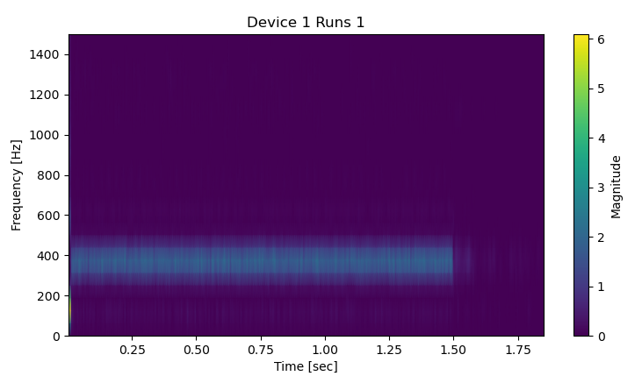
Spectrogram
The first subplot provides a spectrogram, which is crucial visualization that displays the frequency content of the signal across time

Slide 24
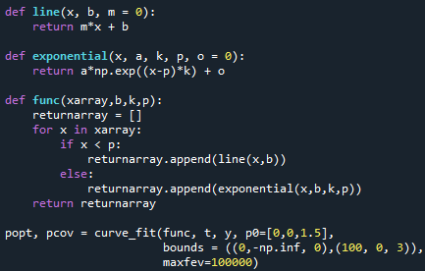
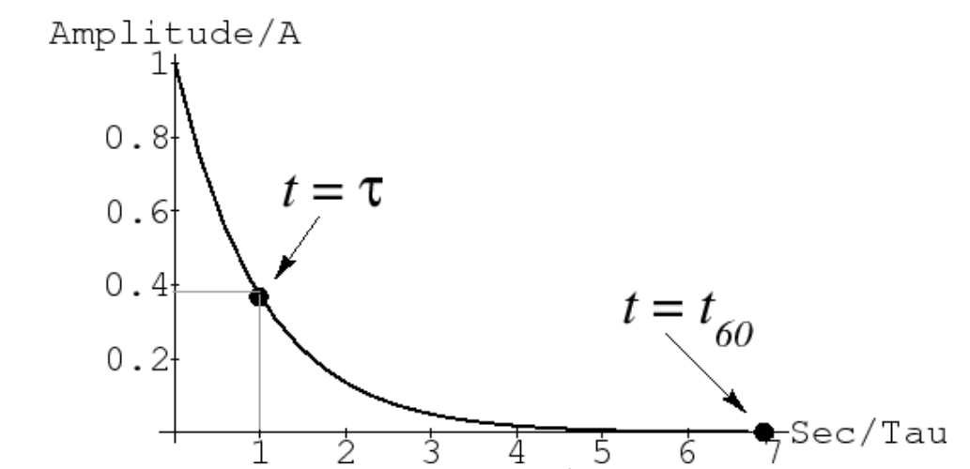

Curve Fitting
Python Code:
t60 was defined as the time to decay by 60 dB

Slide 25
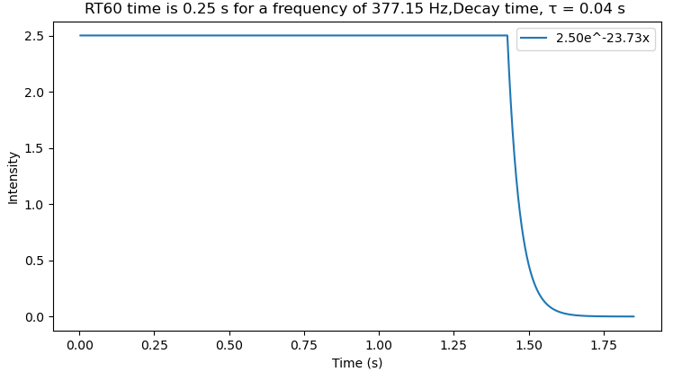
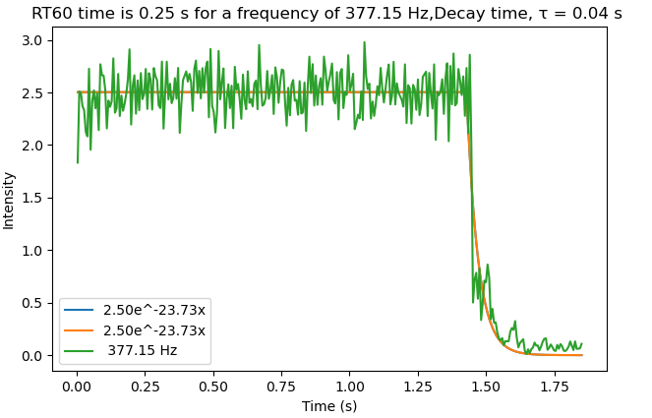
After curve fitting

Slide 26
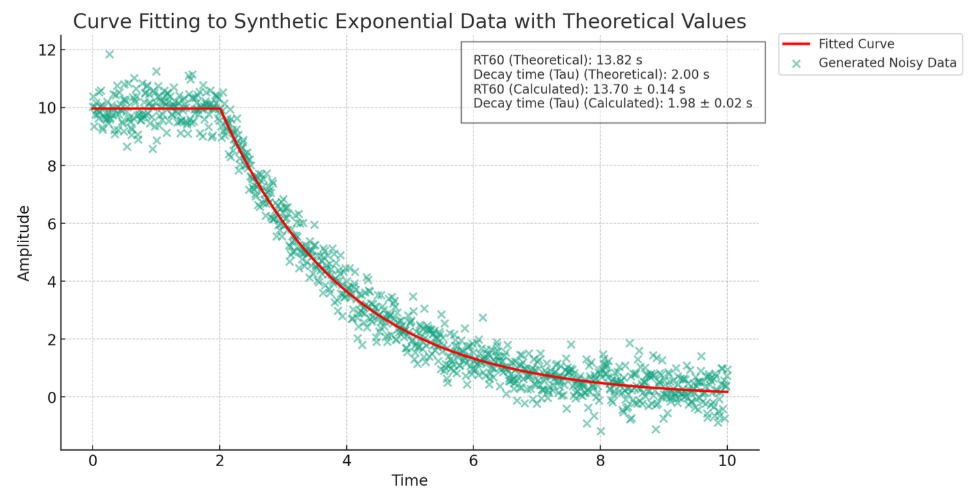
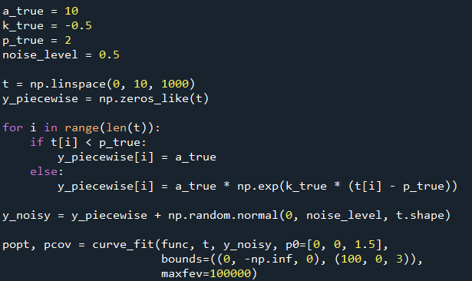
Testing the code

Slide 27
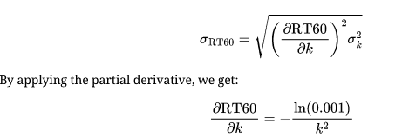
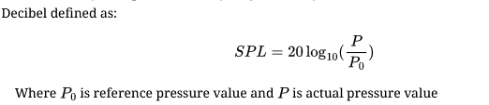


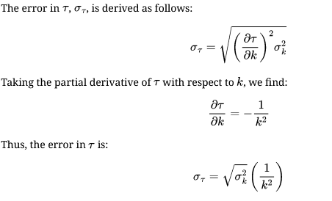
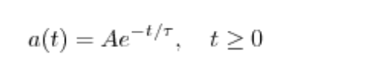


Parameter Derivation Error Derivation
Apply Propagation of uncertainty:
Equation for Decaying to -60 dB:
Definition of exponential decay
Simplified:

Slide 28


Code description
Parameter k given by pop[1]
Error given by covariance matrix (pcov[1,1])

Slide 29
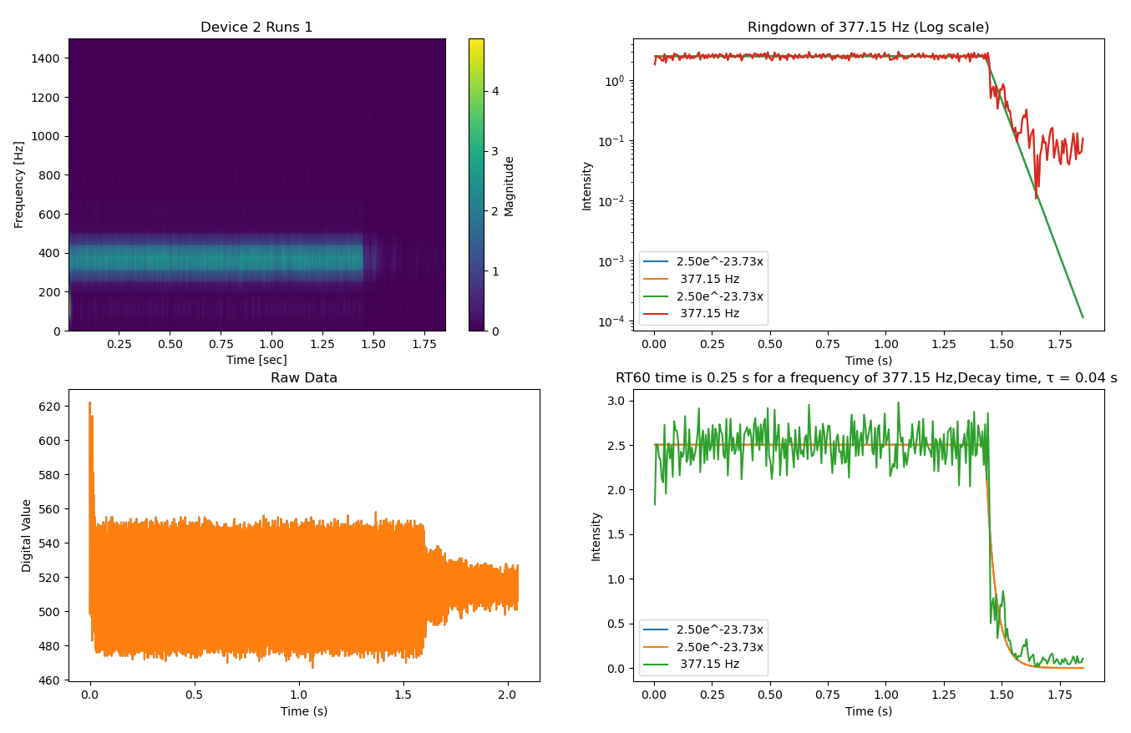
Subplot
In the end, it will generate multiple subplot for each device and each runs (trials)

Slide 30
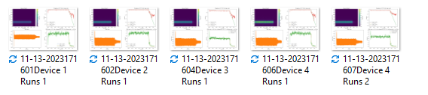
Saved and named
Automatically saved and named in certain format (Time, Device and runs)

Slide 31
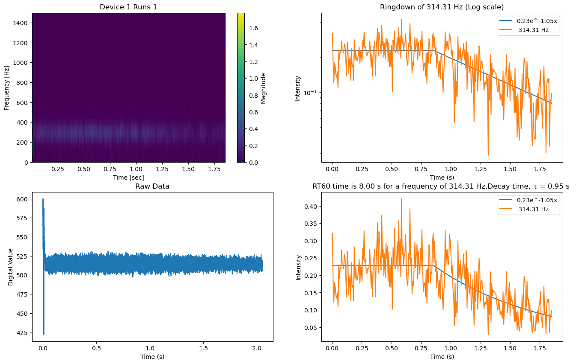
Testing With Known Decay Time
Five trials:
0.95 ± 0.13 s

Slide 32
Initial Test Procedure
Listening board was placed on the floor at one end of the room, centered
Tone generator was held in the air ~¾ of the room length away
4 different tones were played 5 times each
  260 Hz
  330 Hz
  440 Hz
  640 Hz

Slide 33
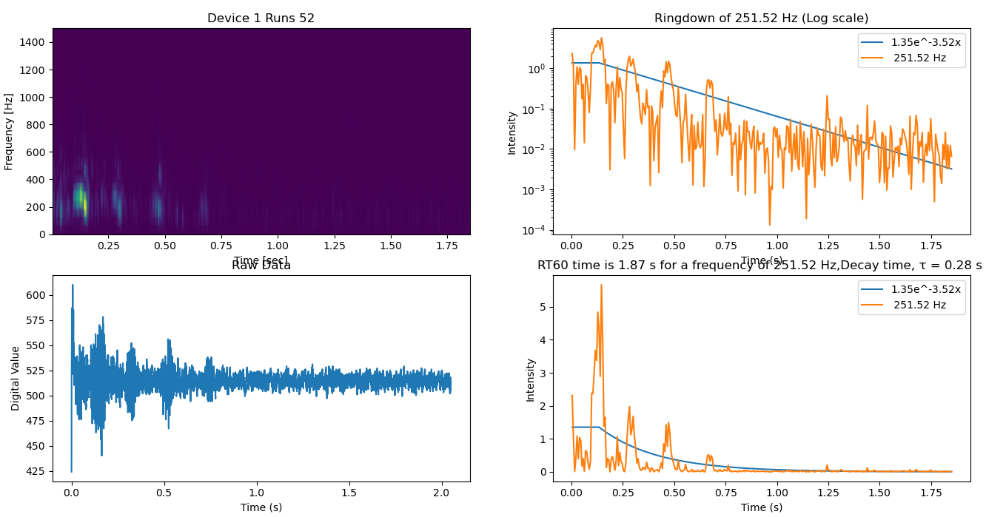
260 Hz

Slide 34
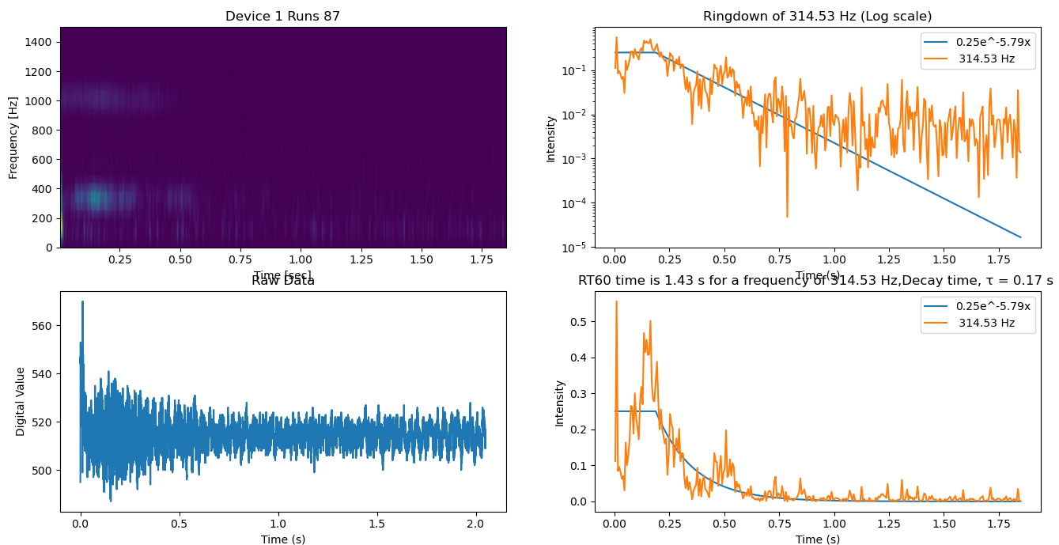
330 Hz

Slide 35
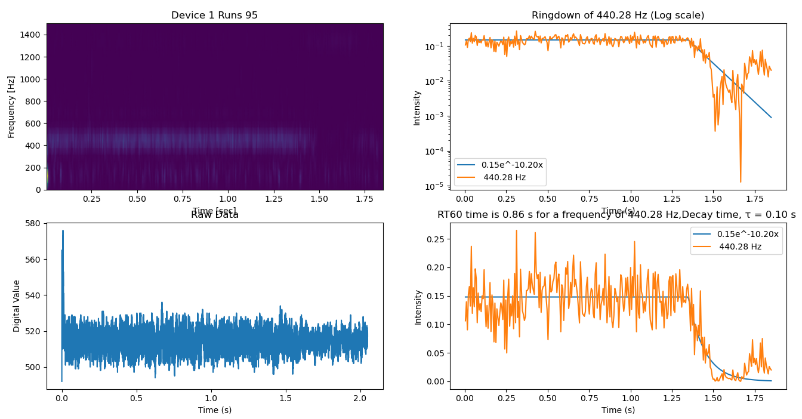
440 Hz

Slide 36
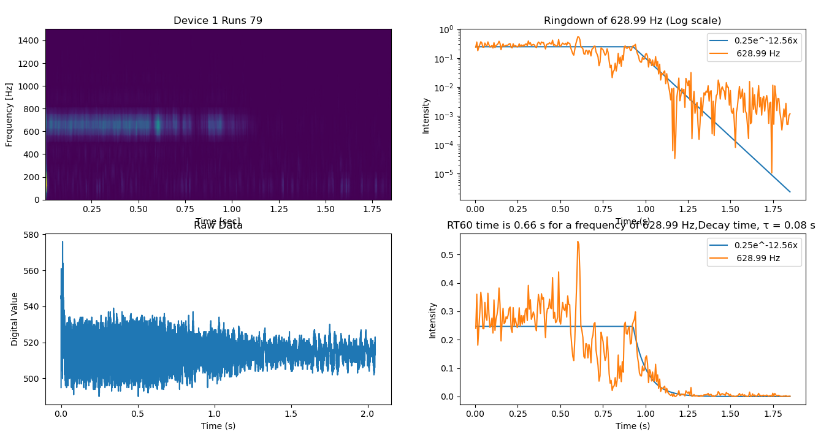
640 Hz

Slide 37
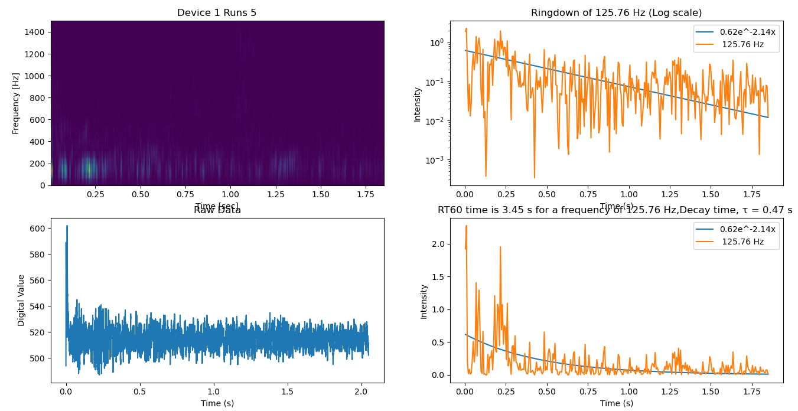
Noise

Slide 38
Near-Term Goals
Create a set procedure
  Determine frequencies to test
  Determine location of listening board(s)
Tune the code/boards
  Find sources of potential error
  Make the process more efficient
Run tests in a bare room
  No artificial acoustical absorption material

Slide 39
End Goals
Reduce the reverberation time
  First need an accurate measurement
  Ideal time would be ~1.5 s
  Will use currently available acoustic absorption panels
Determine what frequencies are being reflected the most
Minimize any visual changes to the dance studio
  Some features cannot be changed (i.e. mirror wall)

Slide 40
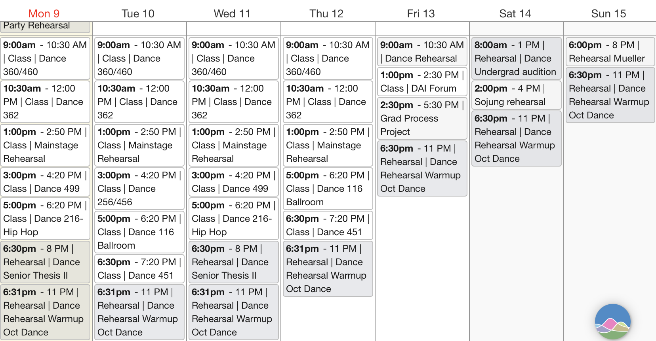
Scheduling Problems

Slide 41
Conclusions
Still some work to be done in refining the process
  Need to account for noise
Initial data suggests that low frequencies have longest reverb
  Supported by general observation

Slide 42
Acknowledgements
We would like to thank Professor George Gollin and Professor Yuk Tung Liu for their contributions, support, and guidance throughout the semester
We would also like to thank Professor Rick Scholwin for giving us access to and reserving time slots on our behalf for the dance center.

Slide 43
BACKUP SLIDES

Slide 44
Github Link
https://github.com/Cocoduds/Krannert-Acoustics

Slide 45
No Fall-Back Plan
Our only option to reduce the reverb time is the acoustical paneling
Is a proven solution
  Both in general and in other KCPA rooms

