Slide 1
PHYS 523 Project
Orion Arndt, Ferzem Khan, Jay Zhang

Slide 2
Problems
During the Covid-19 pandemic, many countries including the US experienced a severe shortage of ventilator machines for intubated patients
Given the huge loss of life and property during the Covid-19 pandemic, it’s imperative to prepare for the next global pandemic
Sharing a single ventilator between multiple patients is increasingly seen as a viable way to alleviate shortage of ventilators, thus saving more money and life
Patients have varying degrees of airflow needed, making effective, real-time airflow monitoring a necessity
Market vacuum of effective, affordable and convenient airflow monitors (e.g. the “PEEP-Alert Pressure and Flow Monitor” in FDA’s EUA)

Slide 3
Our Solution
An optimized ventilator flow meter. This device can:
Monitor airflow rates in ventilator tubes
Display airflow rates on its own LCD screen; both real-time data and line plots showing data over a period of time are available
Read time and compile it with airflow data
Store data to a micro SD card on the LCD display
Upload data to an online server (private IP address) with the help of improved integration into a hospital wireless network, thus realizing real-time, remote and reliable respiratory monitoring

Slide 4
Fluid Flow and Bernoulli Equation
P₁ +1/2ρ₁v₁² +ρ₁gh₁ =P₂ +1/2ρ₂v₂² +ρ₂gh₂
ρ₁ ≈ρ₂, h₁ =h₂, so P₁ -P₂ ≈1/2ρ(v₂² -v₁²)
u=Q/A. Assume Q=30L/min=5*10 m⁻⁴/s, A_{max}=38mm*60mm=0.00228m², A_{min}=10mm*60mm=0.0006m², so u_{max}=0.833m/s, u_{min}=0.219m/s
We will determine the airflow through the device by measuring the pressure difference between the inlet and central region of the flow tube with DPS310 pressure sensors.

Slide 5
Turbulent Flow
The Bernoulli equation applies to fluids undergoing laminar flow, not turbulent flow. Systems with R_{e}<2,300 will usually exhibit laminar flow, while those with R_{e}>2,900 will tend to show turbulence.
R_{e}=ud_{h}/v, where d_{h}=4A/C and v=1.506*10⁻⁵m²/s at 20°C
Use u_{max}=0.833m/s, d_{h,min}=2*10mm*60mm/(10mm+60mm)=17.143mm, d_{h,max}=2*38mm*60mm/(38mm+60mm)=46.531mm, so R_{e,min}=950.108, R_{e,max}=2578.864, so the air flow in our device is laminar, not turbulent

Slide 6
The Device
The future flow meter is a structure designed to utilize the bernoulli equation to know the pressure through the flow tubes of a ventilator
The information is passed through the circuit into the programming which records the raw data and calculates flow rate of air into and out of the lungs of various patients
This is then communicated via radio and/or wifi to the hospital electrical system, allowing the ventilator to potentially alter its flow

Slide 7
Roles
Orion
  Creating the flowmeter structure 3D model
  Creating the sensor board
  Researching possible part improvements and some material properties
  Occasional aid in coding
Jay
  Creating and updating the home board (both schematic design and PCB design)
  Researching documentation of related components (TFT LCD display, DPS310 sensor, etc.)
  Occasional aid in coding and testing

Slide 8
Roles continued
Ferzem
  Main contributor to Arduino IDE code and DAQ software development
  Prototype testing and calibration, offline data analysis
  Researching on Airlift capability for information exchange over wifi

Slide 9
Hardware
Adafruit Radio feather M0- what all other devices eventually connect back to, can use radio signals to communicate data
Adafruit Airlift Wifi- allows for sending data through wireless internet, is necessary as a way to communicate with hospital systems
Adafruit ST7735 TFT display- allows us to read data without serial monitors, prototype of the display that would be used at hospitals
DS3231 clock - used for time tracking within the programming, aids the DPS310 sensors in being in sync

Slide 10
Hardware continued
Capacitors- reduces voltage fluctuation for more consistent power
I2C multiplexer- connects the DPS 310 sensors to itself and allows multiple of the same I2C device to relay their information back to the Radio feather and to the display
Ribbon cable connectors on both the central and sensor boards
DPS310 pressure sensors- High accuracy, precision and frequency, one of these stays on a central board with the other hardware, while three are attached to separate boards and placed into a flow meter structure

Slide 11
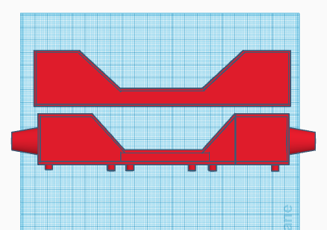
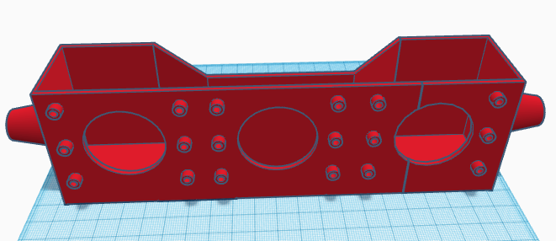
The Flow Meter Apparatus
The structure utilizes the Bernoulli equation by forcing the air through a smaller area
3 DPS 310 pressure sensors on separate boards will be sealed on with grease and EPDM o-rings, pressured into sealing by six screw forced into holes
The material currently used to print the flow meter structure is PLA

Slide 12
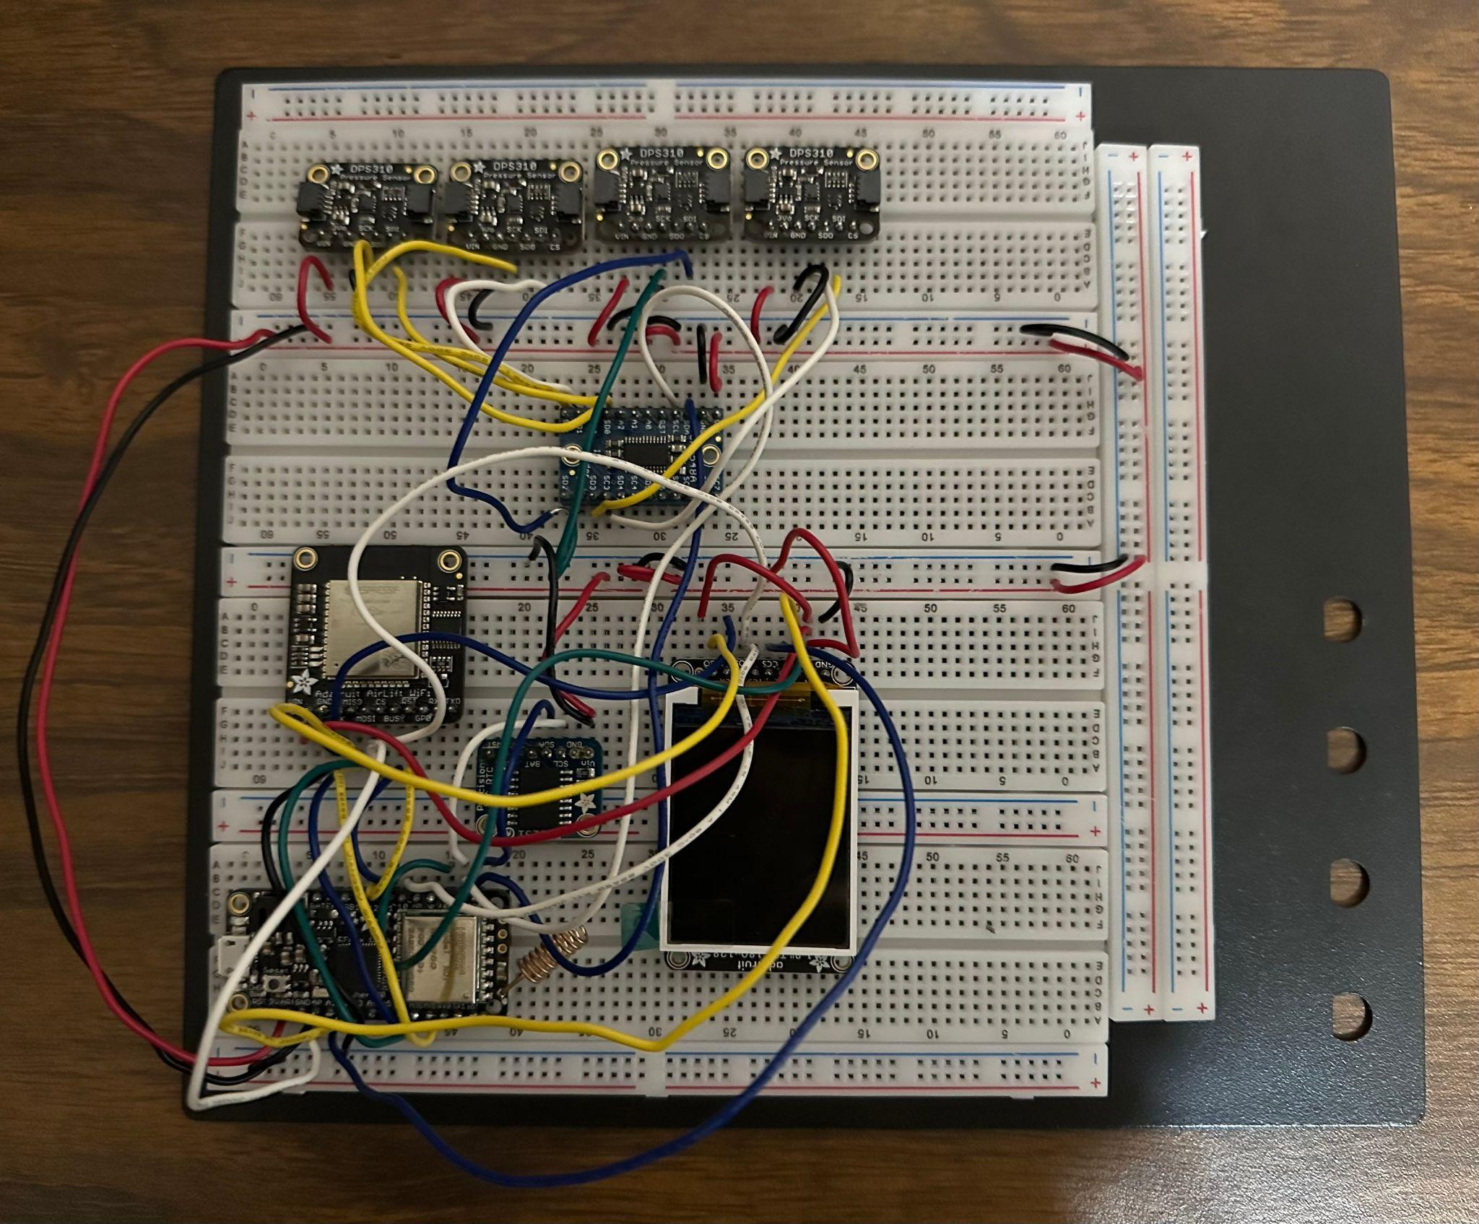
Testing Board
Board containing all necessary hardware for base function
Made for testing, not a prototype intended to function with tubing

Slide 13
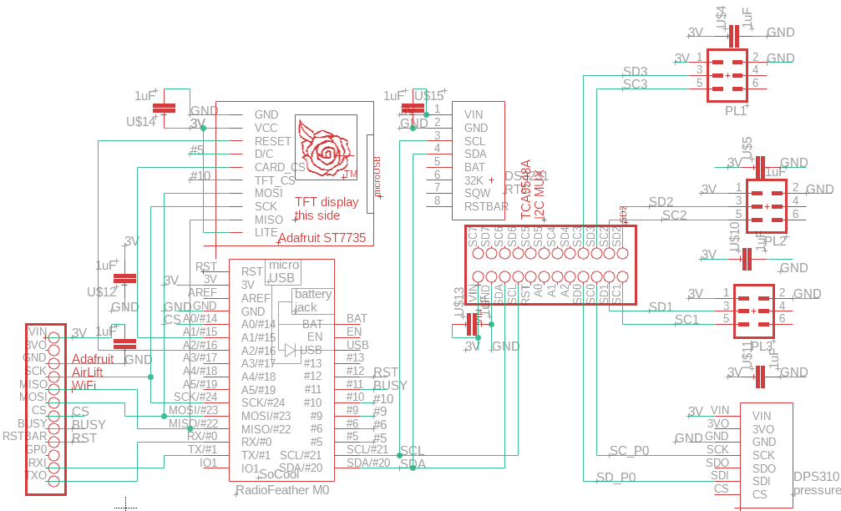
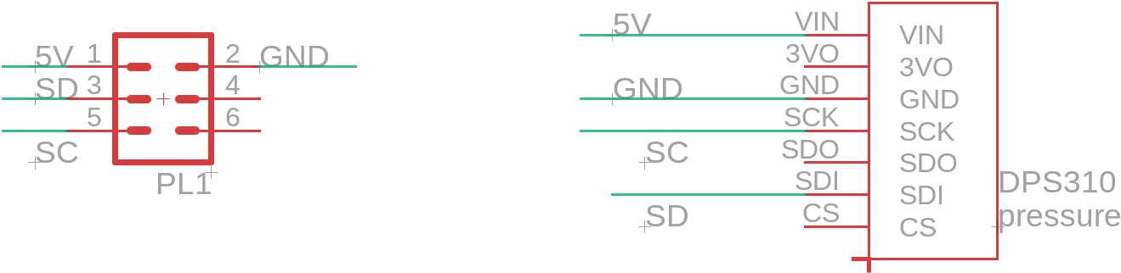
Schematics
Identical with the testing board except 1µF Capacitors
Uses three identical sensor boards
DS3231 Clock
Multiplexer

Slide 14
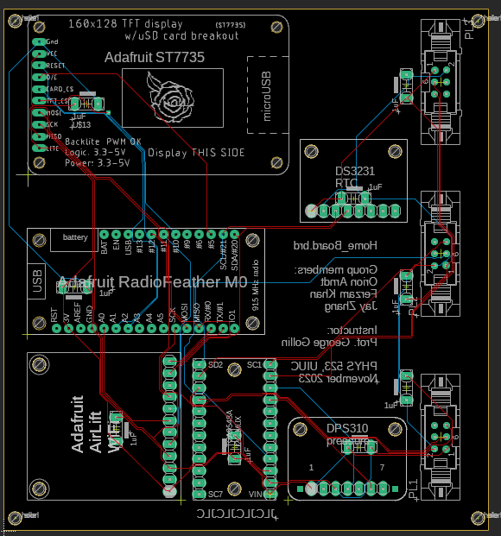
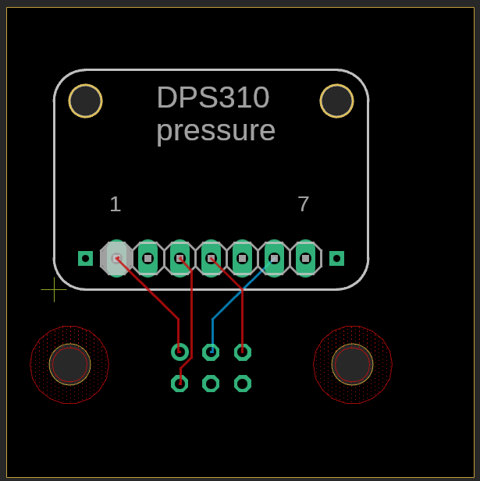
PCB Design

Slide 15
Software
Arduino IDE: Main goals
Data collection and calibration from DPS 310 sensors (pressure, temperature)
Local storage on to SD cards (upto 8 hours?)
Transmission of data to hospital network via wifi upon request - WiFiNINA
Arduino IDE: Secondary goals
Radio communication to base station
Python:
Offline data analysis

Slide 16
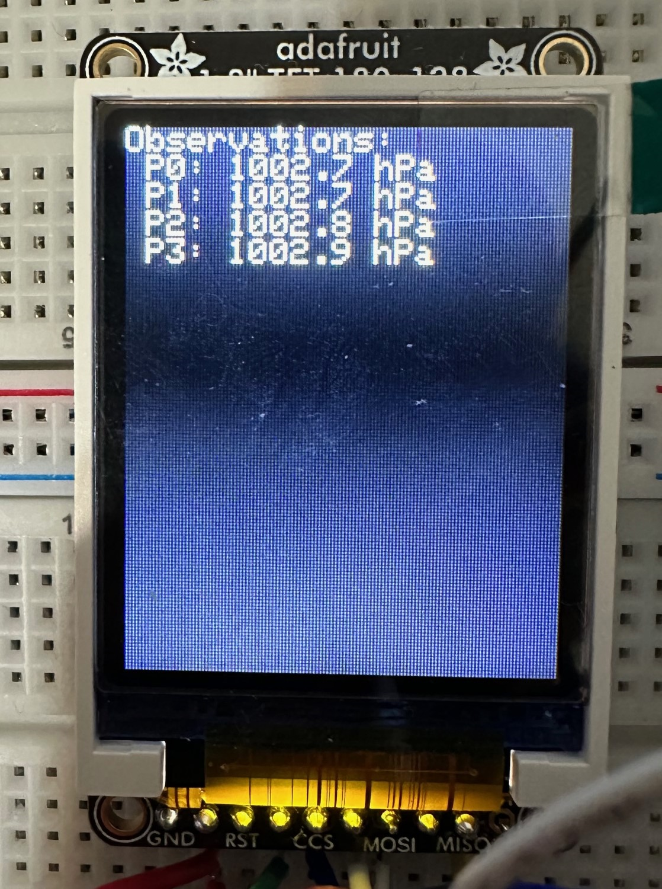
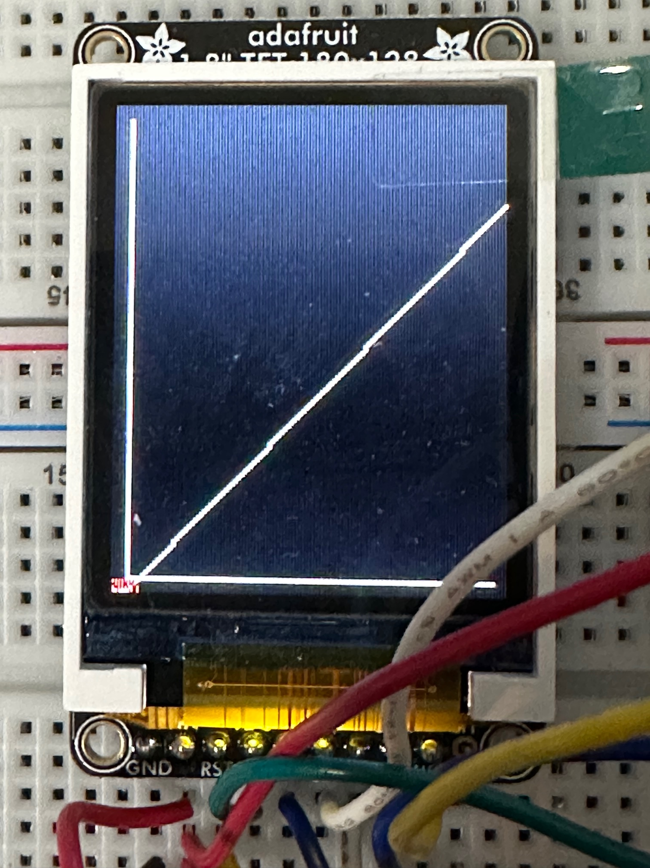
Data Acquisition
Calibration: During setup calculate average readings from each individual sensor (baselines), and corrected differences
Read raw data from DPS 310 sensors, use calibration to get corrected readings
Local storage to SD card, display to TFT, listen to Wifi client on server
Data rate from flow meter ~few hundred bytes per second

Slide 17
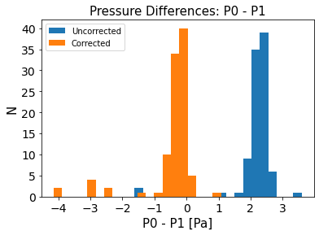
Calibration
DPS 310 Precision: 0.2 Pa
DPS 310 Temperature Sensitivity: 0.5 Pa/K
Take some initial readings to calibrate our pressure readings:
P_{avg} = ∑P_{i} / N
P²_{avg} = ∑(P_{i}² - P_{offset}) / N
(P_{i} - P_{j})_{avg} = (P_{i, avg} - P_{j, avg})
(P_{i} - P_{j})_{corrected} = (P_{i} - P_{j})_{uncorrected} - (P_{i} - P_{j})_{avg}

Slide 18
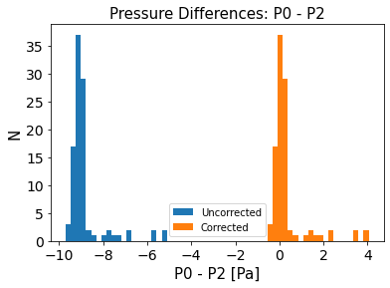
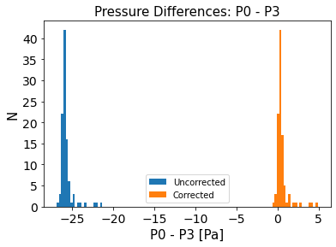

Slide 19
Integration with Hospital Systems
IEEE 802.11 wifi protocol (standard)
We use Arduino IDE’s WiFiNINA library to communicate over the internet using Airlift
Medical personnel send a request to our IP address using a specified port number, Airlift receives request and delivers data as a web page

Slide 20
Data Transmission
Know Airlift IP address and Network SSID (IllinoisNet_Guest), define specific port for client to listen to
Client sends an http request to the IP address
Once the Airlift detects a client connected to our specific server, prepare to begin transmitting data via an http response
After transmitting data, delay 1 ms to give web browser time to receive data, then close connection

Slide 21
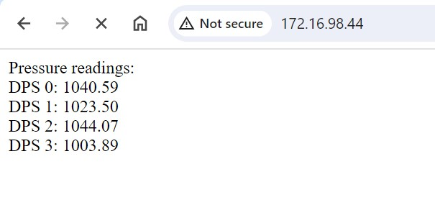
Data Transmission continued
Progress: Can successfully send raw sensor data in real time
Next steps: Learn how to receive and identify specific requests over extended periods of time (ex. Pressure difference between sensor 1 and 3 over the last 4 hours as a plot)

Slide 22
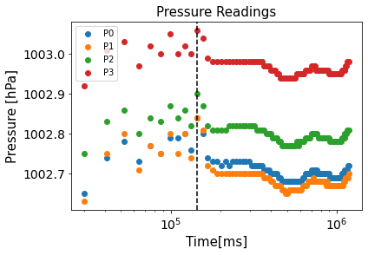
Analysis Plans
Testing and improving our calibration scheme
Analysis of pressure difference in flow meter for simulated lung air flow and comparison with theoretical values using Bernoulli equation
Comparison of prototype with Prof. Gollin’s existing prototype

Slide 23
Short Term Goals (End of This Semester)
Complete first prototype: PCBs ordered, 3D printed flowtube
Improvements to code:
  Full communication over wifi - specific requests instead of boolean request
  Improve local storage and display capabilities

Slide 24
Long Term Goals (End of Next Semester)
Extensive prototype testing and data analysis
Testing integration with Carle Illinois College of Medicine
Test different flow tube geometries
Patent

Slide 25
Possible Problems on the Horizon
Failure to compile our device into ventilator tubes due to size difference, unreliable connection, etc.
Failure to integrate our device into local hospital networks due to technical details
The cost of mass production of PCB boards, 3D models and related components may be unreasonably high
Local data storage management

