Slide 1

Skin Color-Corrected Pulse Oximetry
Joel Kelsey, Max Melendez, Clarissa Pavao, Jack Roberts

Slide 2




The Team
Joel Kelsey
Max Melendez
Clarissa Pavao
Jack Roberts
Software
Hardware
Theory!
Hardware
PCB & Design
Software
Hardware

Slide 3
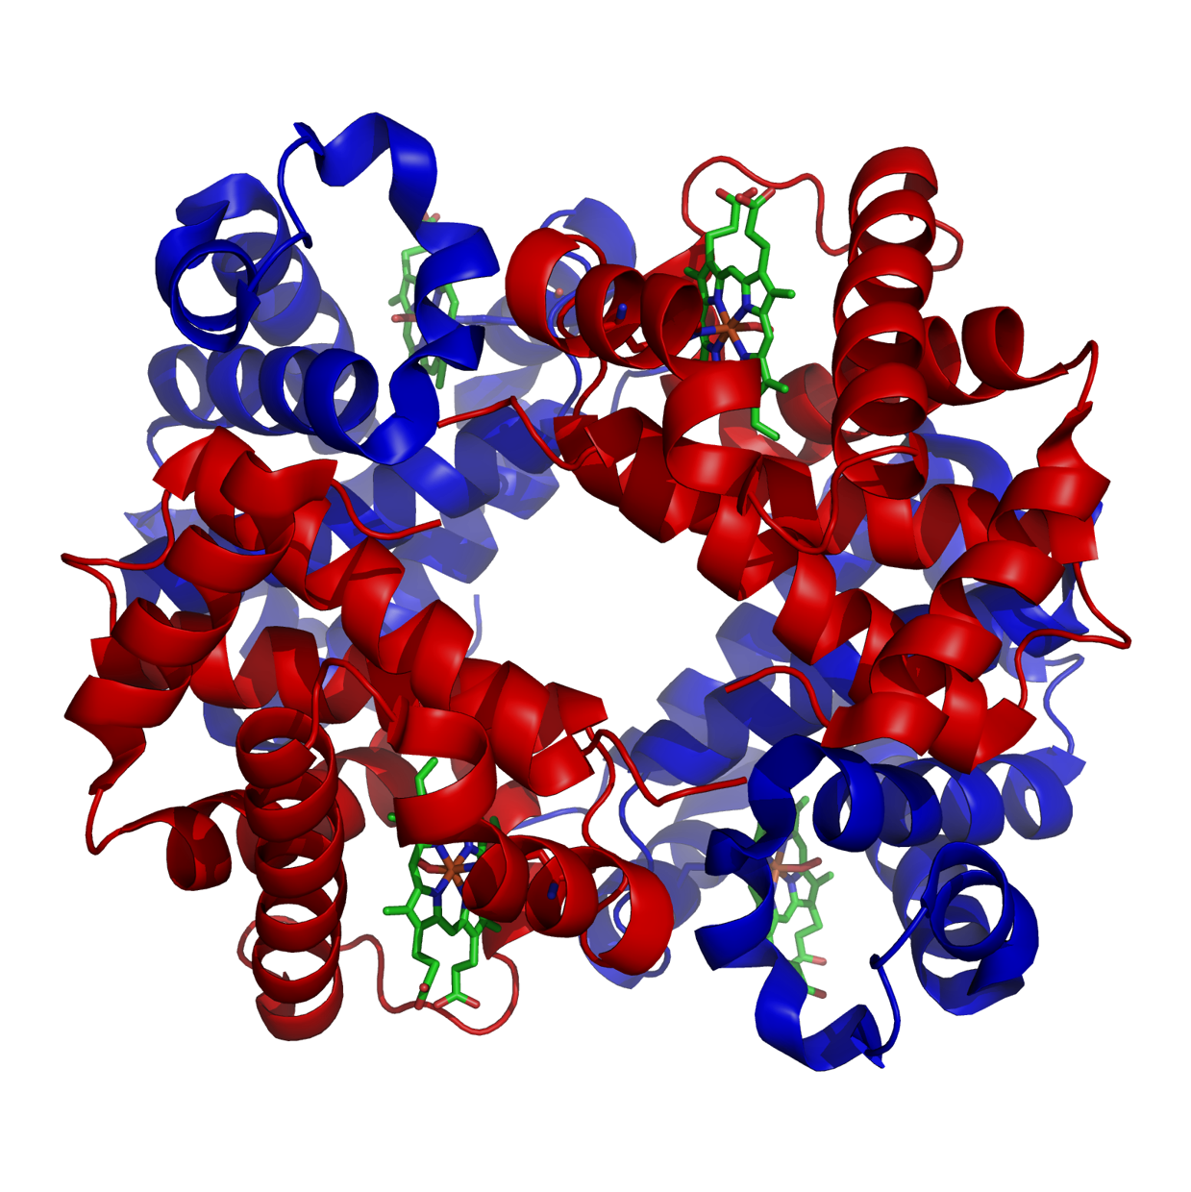
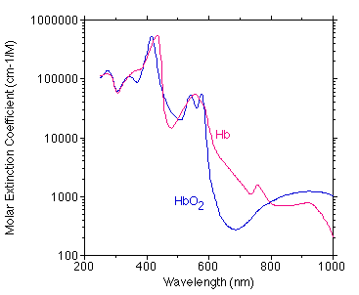
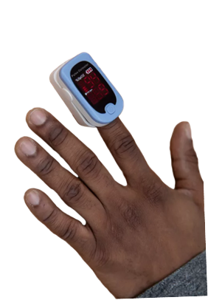
Background
Background
Oxygen saturation measured via light absorption of hemoglobin
Development of noninvasive oximetry
  From only red (early 1900s) to red-infrared ratio to pulse oximeter ratio-of-ratios (1972)
Multiwavelength (>2) pulse oximeters uncommon
Systematic bias in pulse oximetry against dark skin
Melanin absorbs light leading to an overestimation
Graph of the absorption of Hemoglobin by wavelength from “Optical Absorption of Hemoglobin” by Scott Prahl
Notes:
Darker Skin tones are under represented in the empirical calibration of pulse oximeters (along with other medical devices)

Slide 4
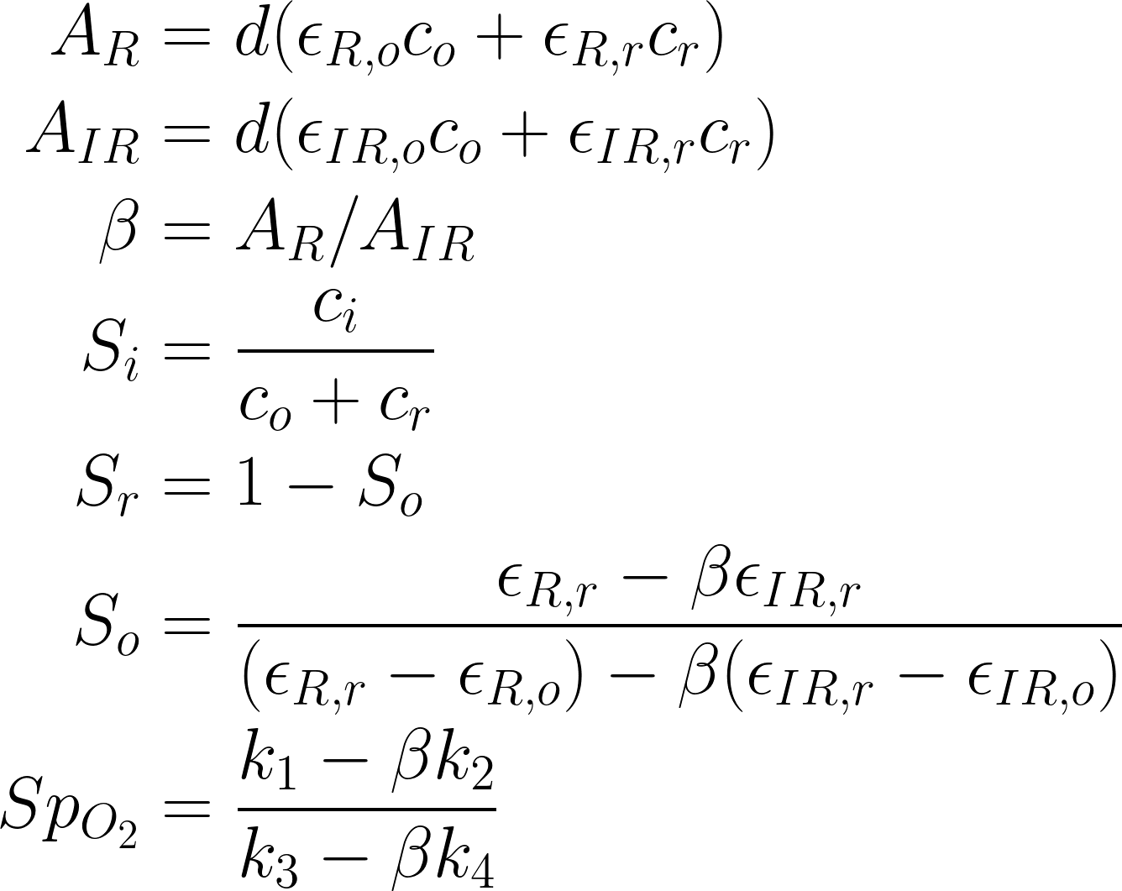
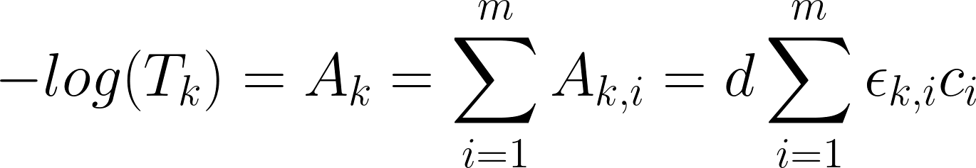
Beer-Lambert Law
Background
Relates optical attenuation to the absorption caused by concentrations of substances
Absorption due to multiple substances are linear
To find single concentration in multi-substance materials:
  Multiple Wavelengths
  Kramer Method for Systems of Equations
Coefficients usually empirically found for each pulse ox model
For the k-th wavelength:
T_{k} is Transmission, A_{k} is Absorption, d is path length,
c_{i} is the concentration of the i-th substance,
ε_{k,i} is the absorptivity or extinction coefficient of the i-th concentration
Notes:
Infesable to use extinction coefficients

Slide 5
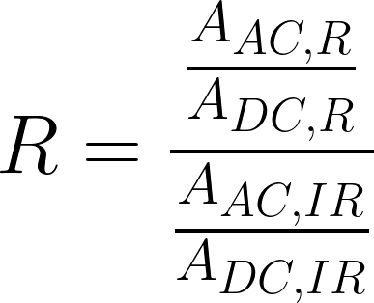
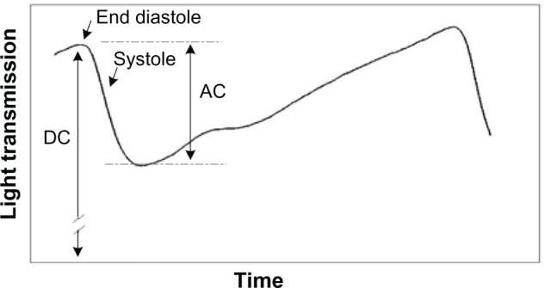
Pulse Oximetry: Method and Assumptions
Uses Systole to measure the assumed arterial blood (called the AC component) in comparison to the whole finger (DC component)
Uses Systole to measure the assumed arterial blood (called the AC component) in comparison to the whole finger (DC component)
Replace Simple Ratio with a Ratio-of-Ratios
Optical gains cancel! Only one calibration
Three Assumptions:
  All Hemoglobin is either HbO2 or reduced Hb
  No other absorber is except those present during empirical calibration
  All pulsating volume is arterial blood
The PPG signal of a pulse oximeter from “Pulse oximetry: fundamentals and technology update”

Slide 6
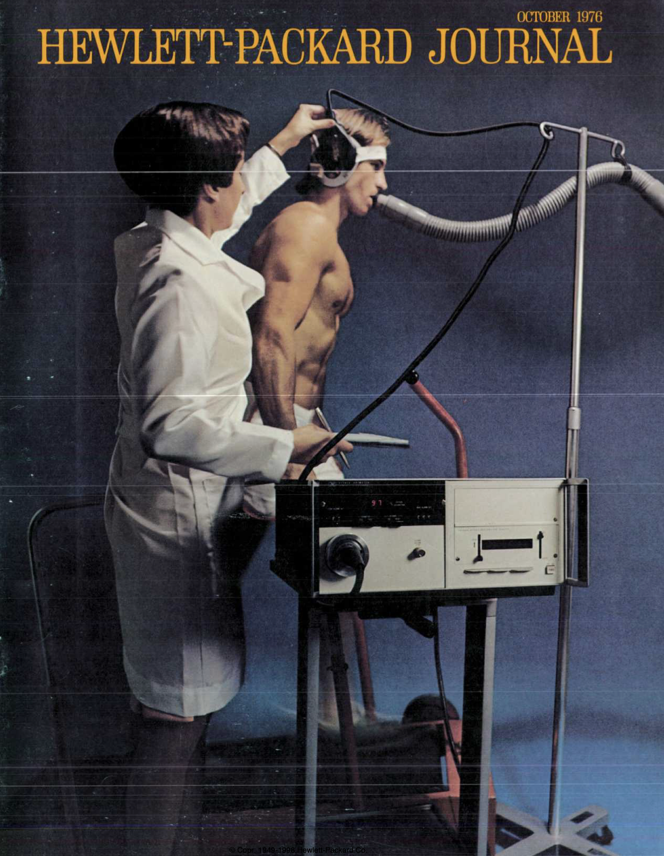
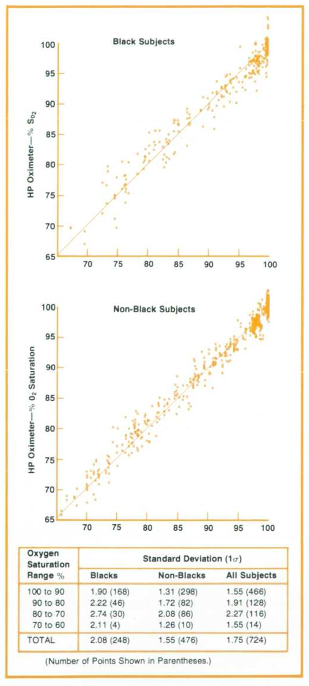
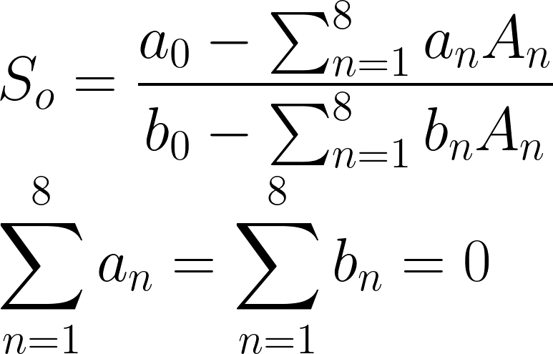
A Path Untread: Gold Standard Forgotten
Before Pulse Oximetry, HP developed the “Gold Standard” of oximetry (1976)
Overshadowed by more portable and affordable pulse oximeter developed a few years later
Used 8 wavelengths on ear
Tested to ensure efficacy for Black subjects as well as White ones
However, no ratios or ratio-of-ratios
Our project wants to integrate the pulse method with the multiwavelength method developed by HP

Slide 7
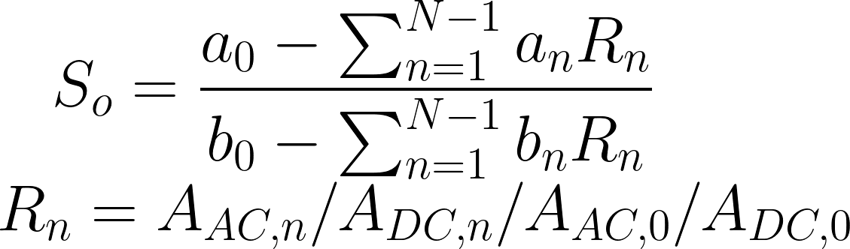
Project Overview
Our
Method
(Multi-wavelength ratios)
HP Method
(Multi-wavelength)
Current Method
(Single ratio)

Slide 8
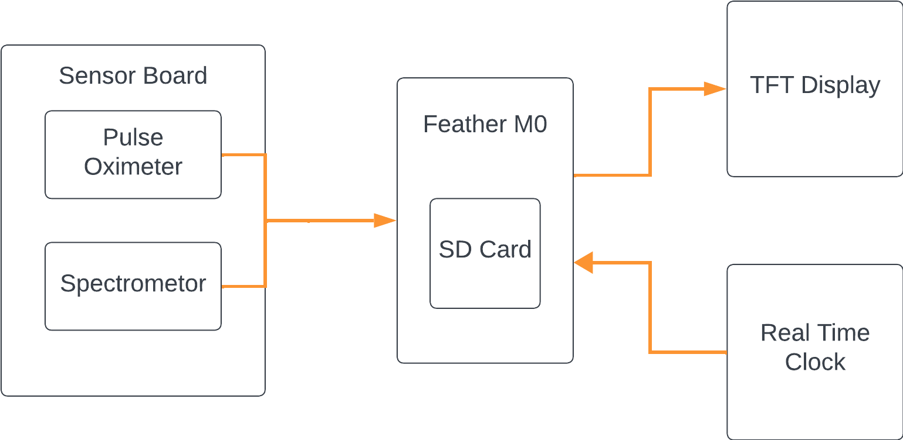
Description of the Device

Slide 9
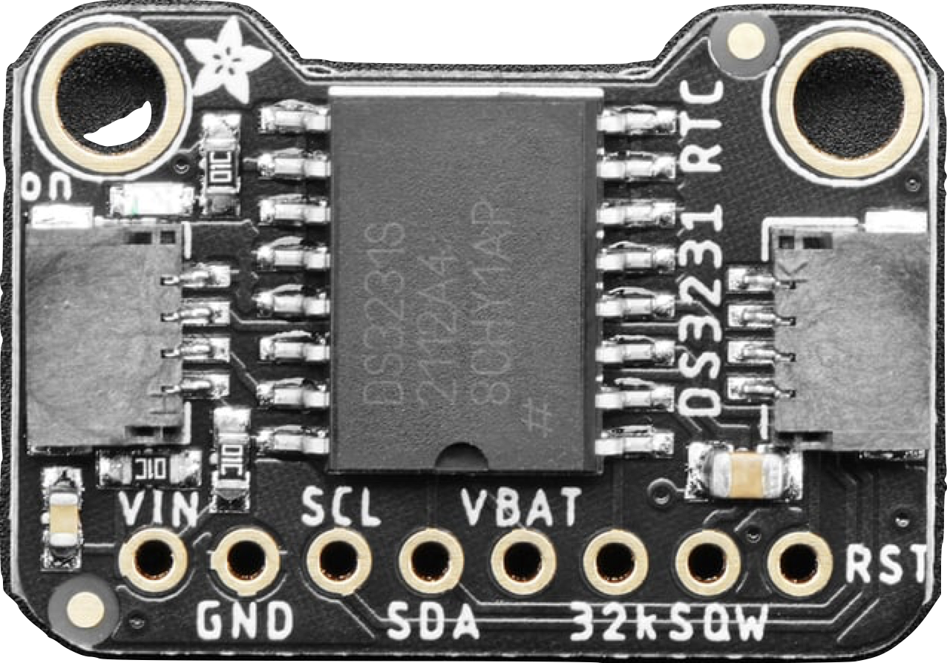
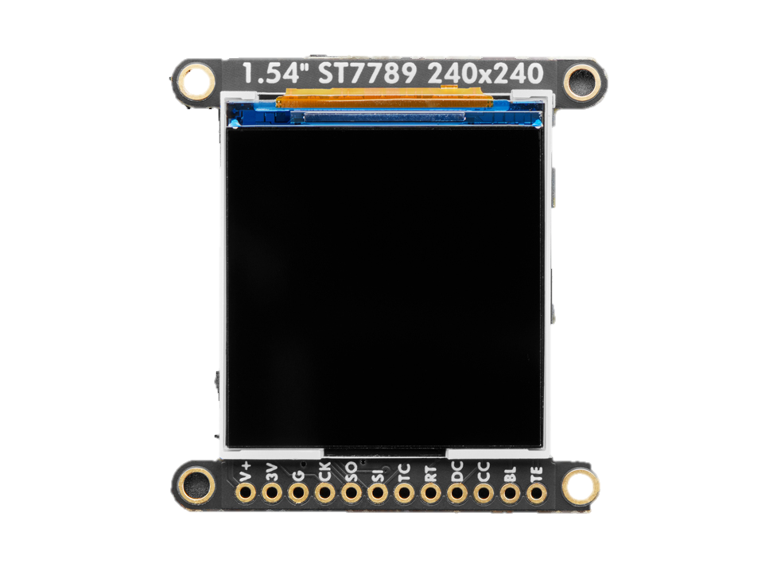
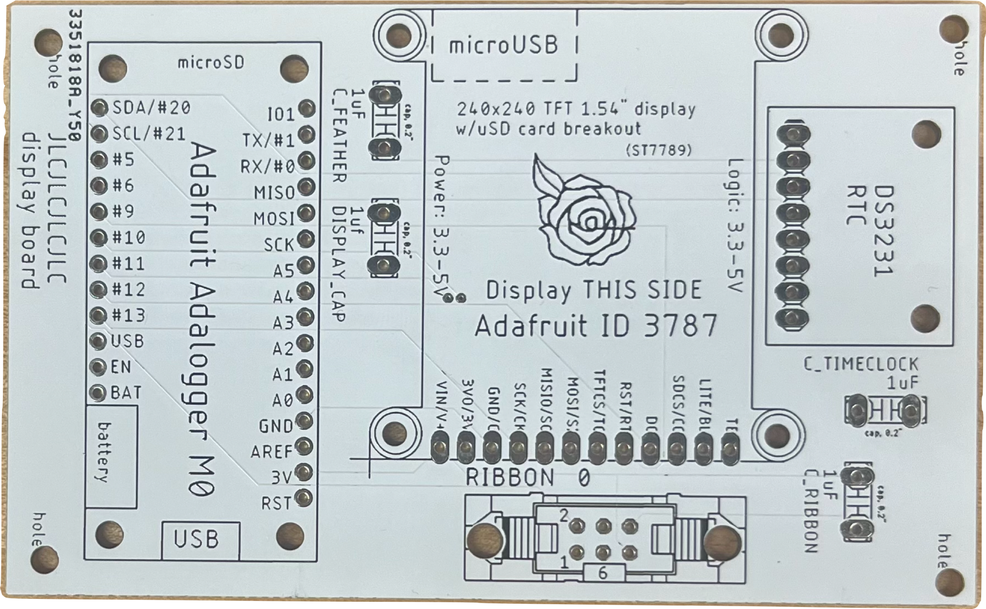
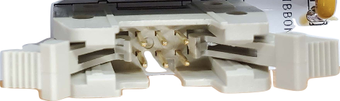
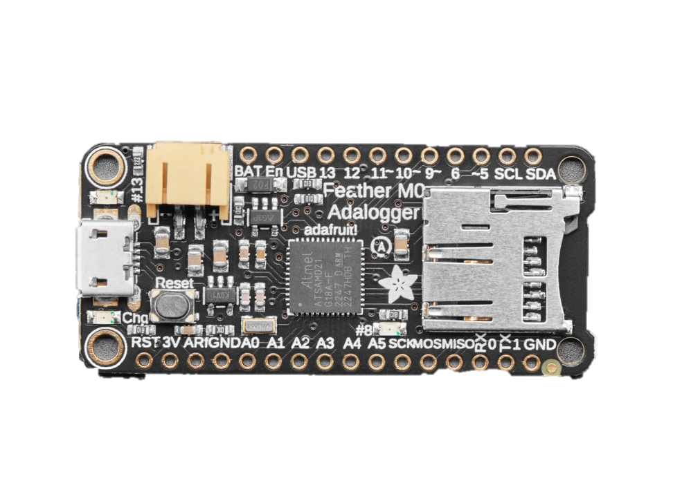
Main Board
Adafruit DS3231 RTC
Adafruit Wide Angle TFT LCD Display
Adafruit Feather M0 Adalogger
Ribbon Cable Connector
Notes:
Our device is time dependent, the signal we are measuring changes over time. The oxygenation of someone blood is analog. It is important to know when each of our measurements does happen. WIth our measurements we need at least millisecond accuracy because our heart beats from 60-100 bmp: 1 beat per second. With patients with heart defects, we need to be able to pick up on those with good accuracy. Does have a millisecond timer but it is internal to the adalogger. Internal is dependent on the internal clock of the feather which is not calibrated to a real time. It is only accurate to a certain degree. With the RTC is calibrated to give us accurate to seconds (external time source) we can use that time with conjugate with the feather to get millisecond accuracy.

Slide 10
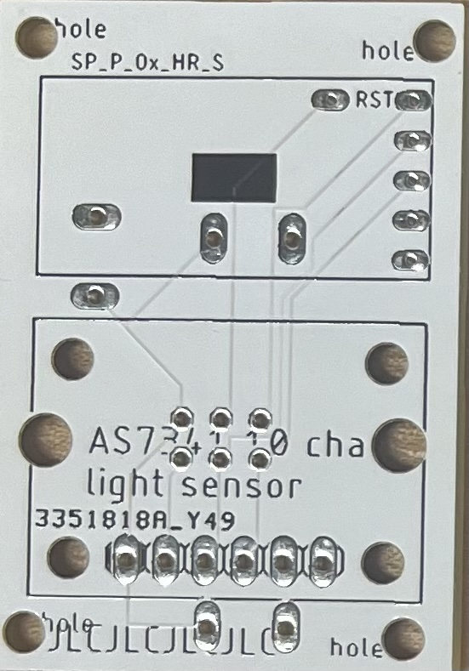
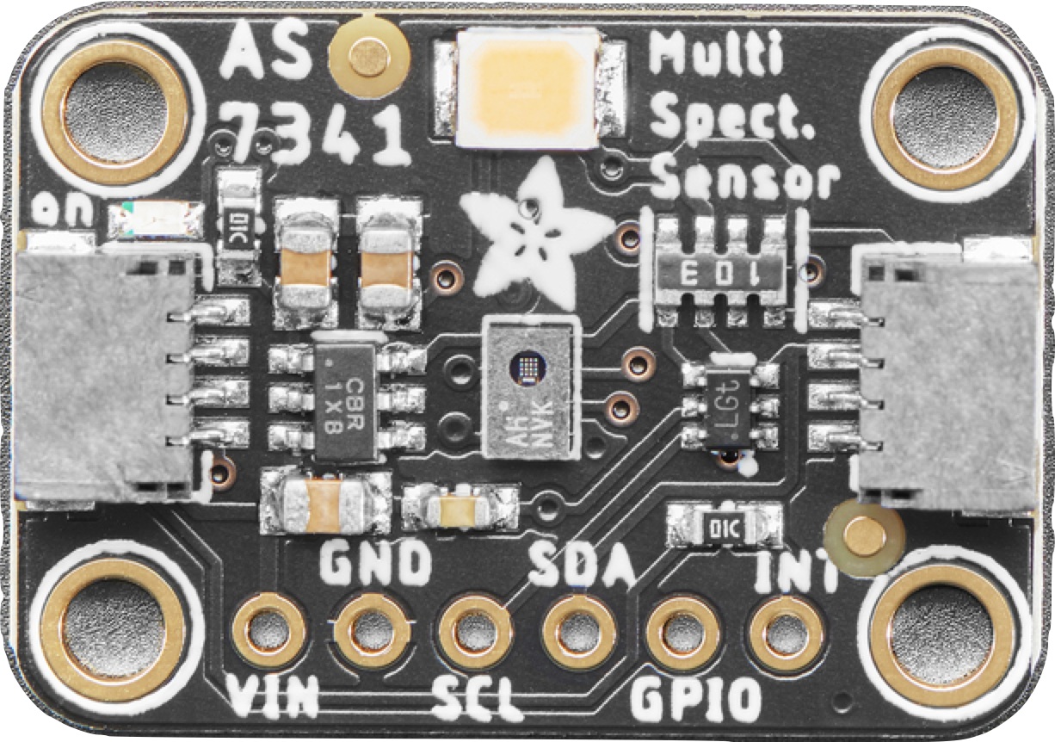
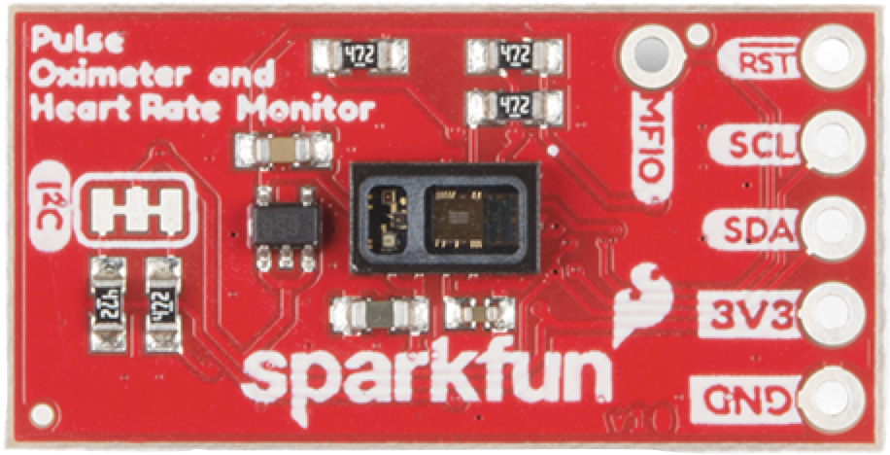
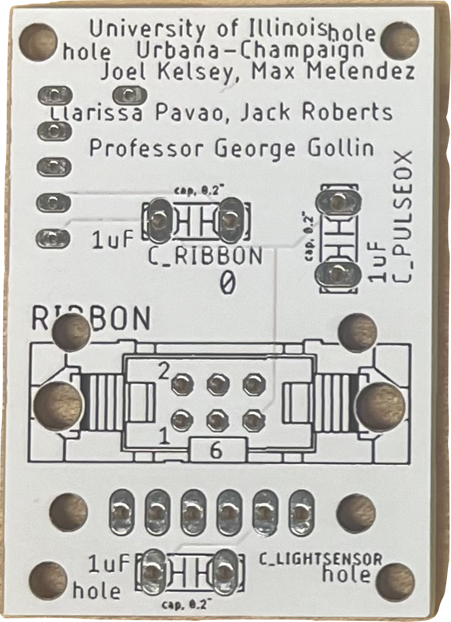
Sensor Board
SparkFun Pulse Oximeter and Heart Rate Monitor
Front
Adafruit AS7341 11 Channel Light/Color Sensor
Back
Ribbon Cable Connector
Notes:
The reason why we have two sensors is because we want to use the wide range of wavelengths the spectrometer has while
The spectrometer measurements multi- wavelengths. The spec allows us to compare with the pulse oximeter, and what our calculation from the spectrum says.

Slide 11
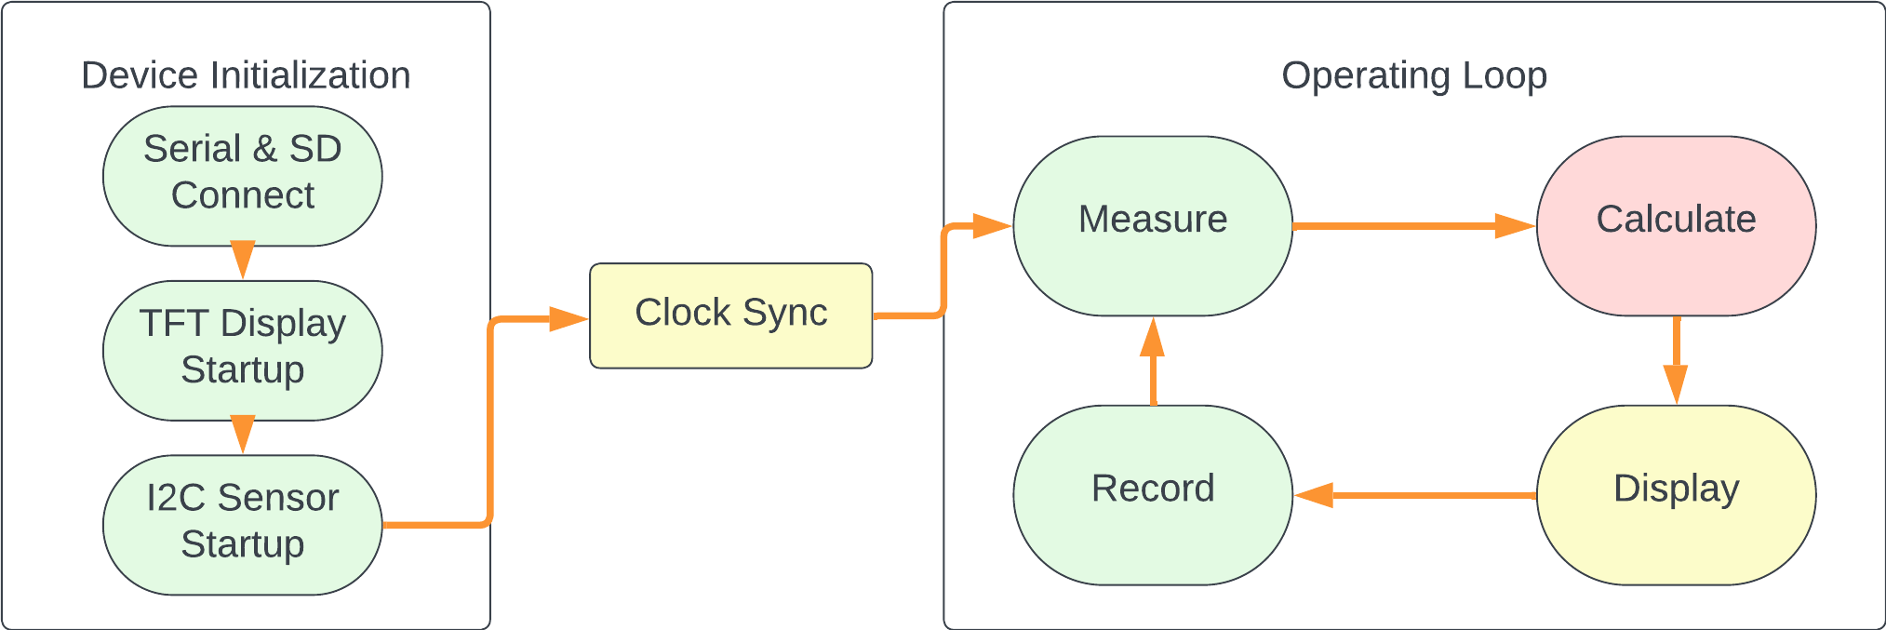
Software

Slide 12
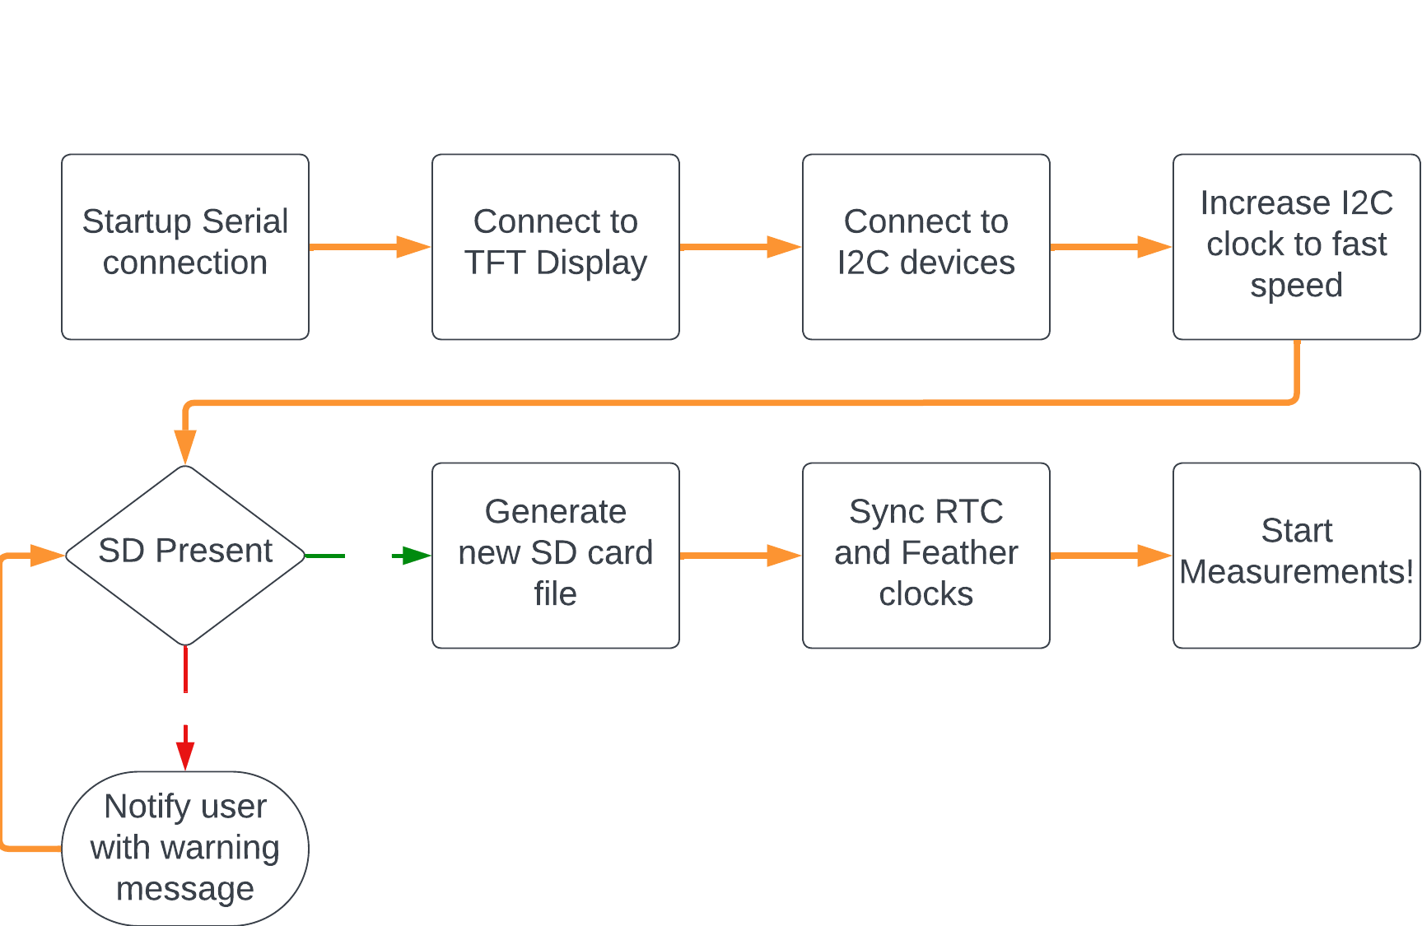
Device Initialization
I2C speed correlates with measurement speed
Procedure only keeps newest datafile
Runs when the device is powered on

Slide 13
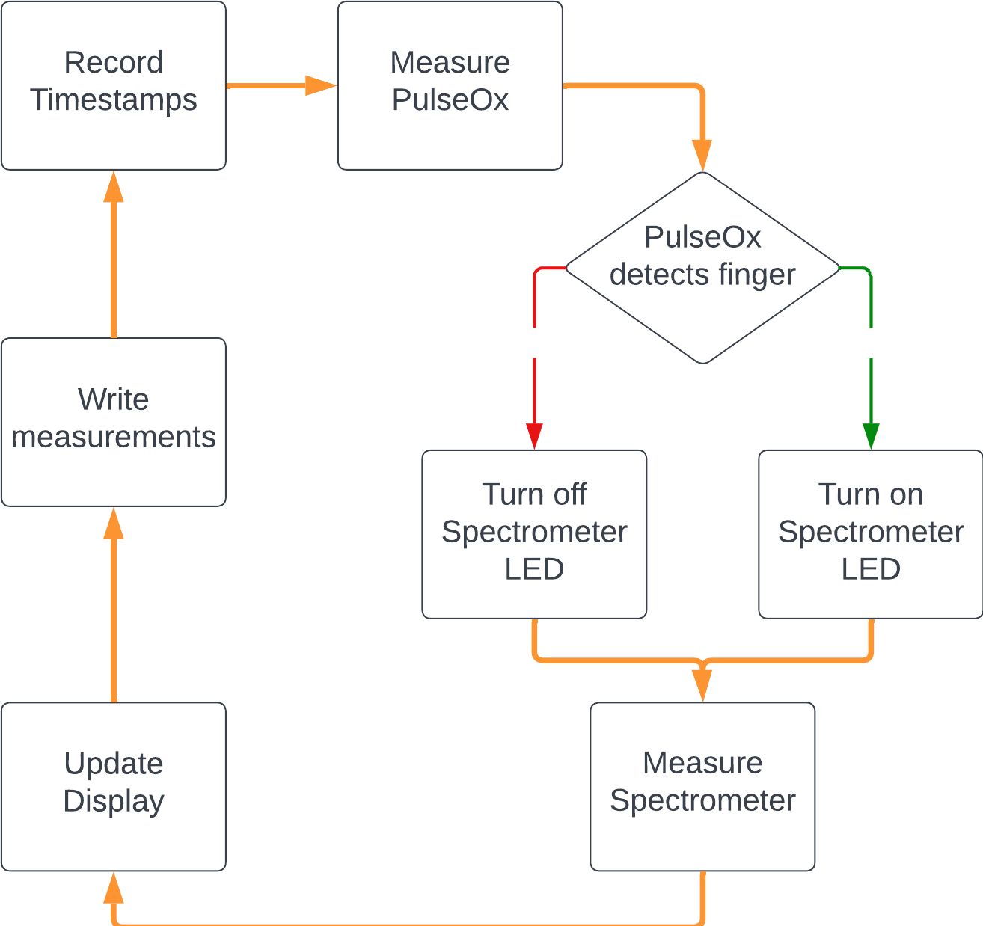
Operating Loop - Measure
The loop can only function as fast as the slowest part
LED toggle to prevent light in eyes
Repeats until finger is removed

Slide 14
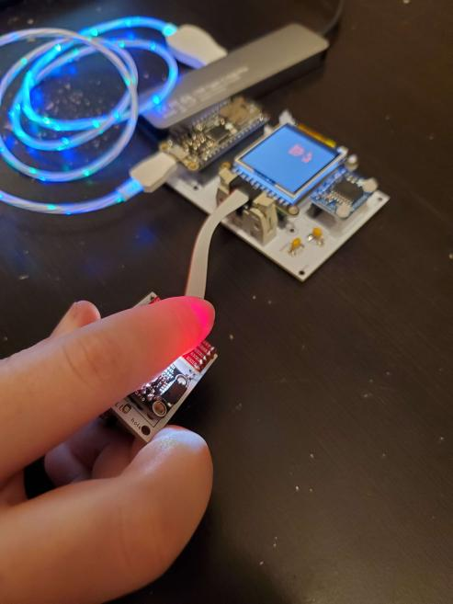
Data Acquisition
2 minute measurement
Timer is started when status 3 is achieved and oxygen saturation can be measured
Patient remains generally calm
Right pointer finger is placed with the pulse ox on the far side and the color sensor is closer to user

Slide 15
Data Acquisition
SD CSV Structure
Real time clock timestamp
  Unix timestamp
  Seconds precision
Feather internal clock timestamp
  ms precision
Timing Data
11 light channel counts
  415 nm - 680 nm
  950 nm
  Clear (unfiltered)
  Flicker detection
Spectrometer Data
Beats per minute
Pulse Ox Confidence
Oxygen Saturation
IR & R Counts
Pulse Ox Status
Pulse Oximeter Data

Slide 16
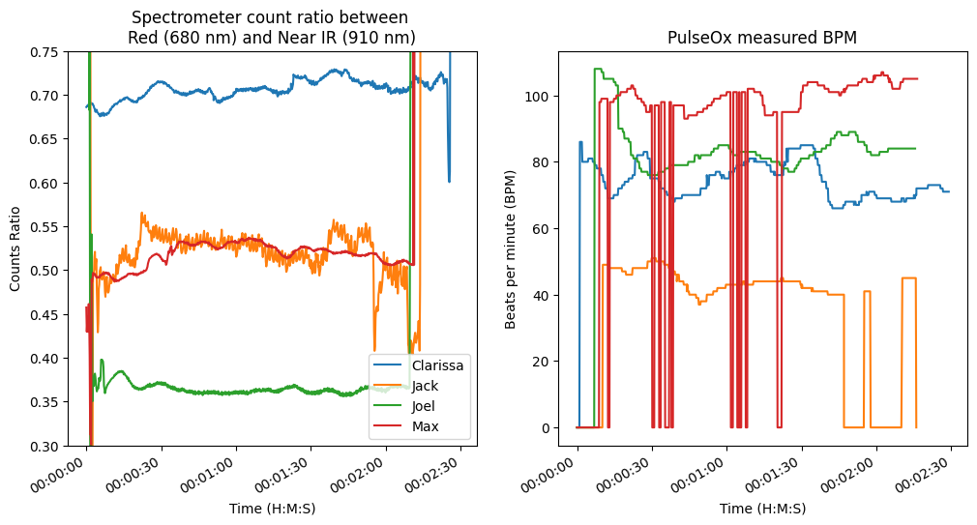
Data & Results

Slide 17
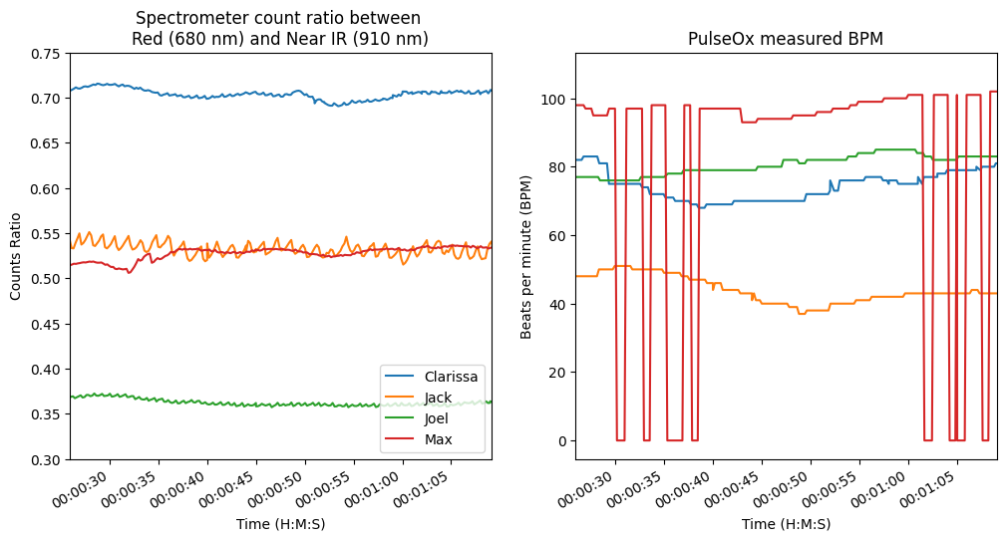
Data & Results
Spectral measures can see heartbeat
Lower heart rates are more clearly defined
Suggests increased speed is required
BPM drops are due to Pulse-Oximeter issue (in discussion)

Slide 18
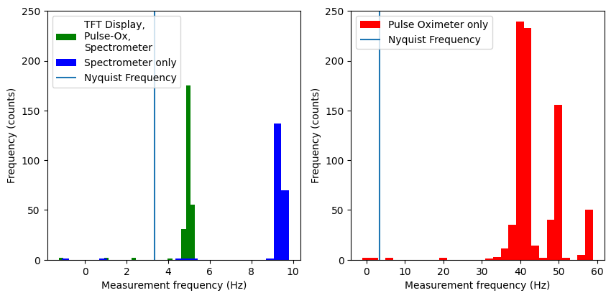
Discussion (measurement speed)
System bottleneck
Pulse Ox 40-60 mps
Spectrometer 9-10 mps
TFT/SD 5 mps
Measurements can only happen as fast as the slowest module

Slide 19
Discussion (BPM dropouts)
Pulse Oximeter drops measurements due to pressure
  Not too much
  Not too little
Causes sudden dips in BPM and oxygen measurements
Suggests we need a holder/case for correct pressure

Slide 20
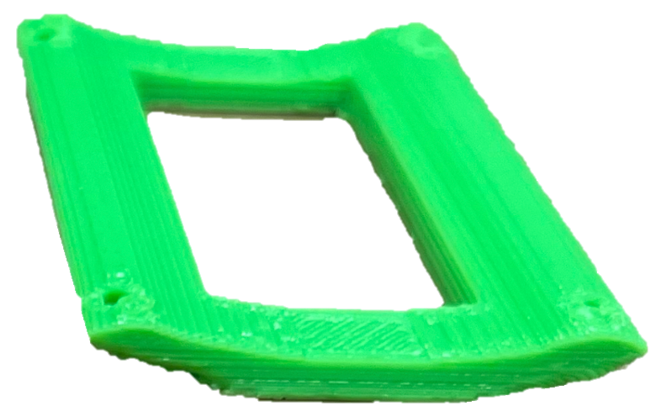
Problems on the Horizon
Future Plans
Sensors
Time sync issues
Data-taking speed
Implement multi-ratio Spo2 algorithm
Update PCB design
3D printed finger holding case
Notes:
Update the PCB design to include holes to attach the finger holding case

Slide 21
Questions?
Acknowledgements
George Gollin and Yuk Tung Liu
SparkFun
Carle Medical School

Slide 22
Backup Slides

Slide 23
Complete 2 Minute Measurements

Slide 24
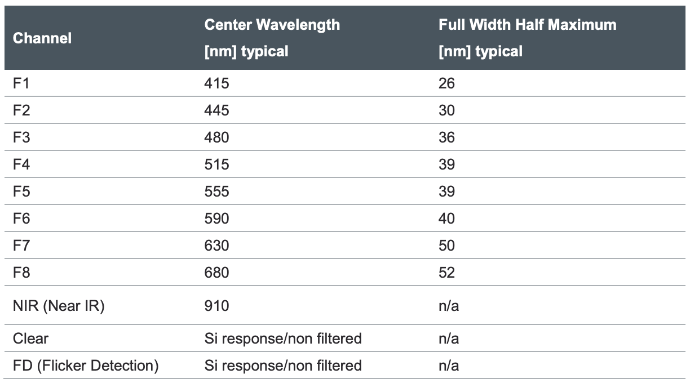
10 channels vs 11 channels
Disagreement between Adafruit and manufacturer
  Adafruit: 10 channels
  Manufacturer: 11 channels
11 total channels
  9 different wavelength bins
    415 nm - 910 nm
  Unfiltered response (Clear)
  Flicker detection (FD)
    Detects if the light is flickering
    Does this count?

