Slide 1
Expanding the RGB Color Gamut by the Forth Color

Slide 2

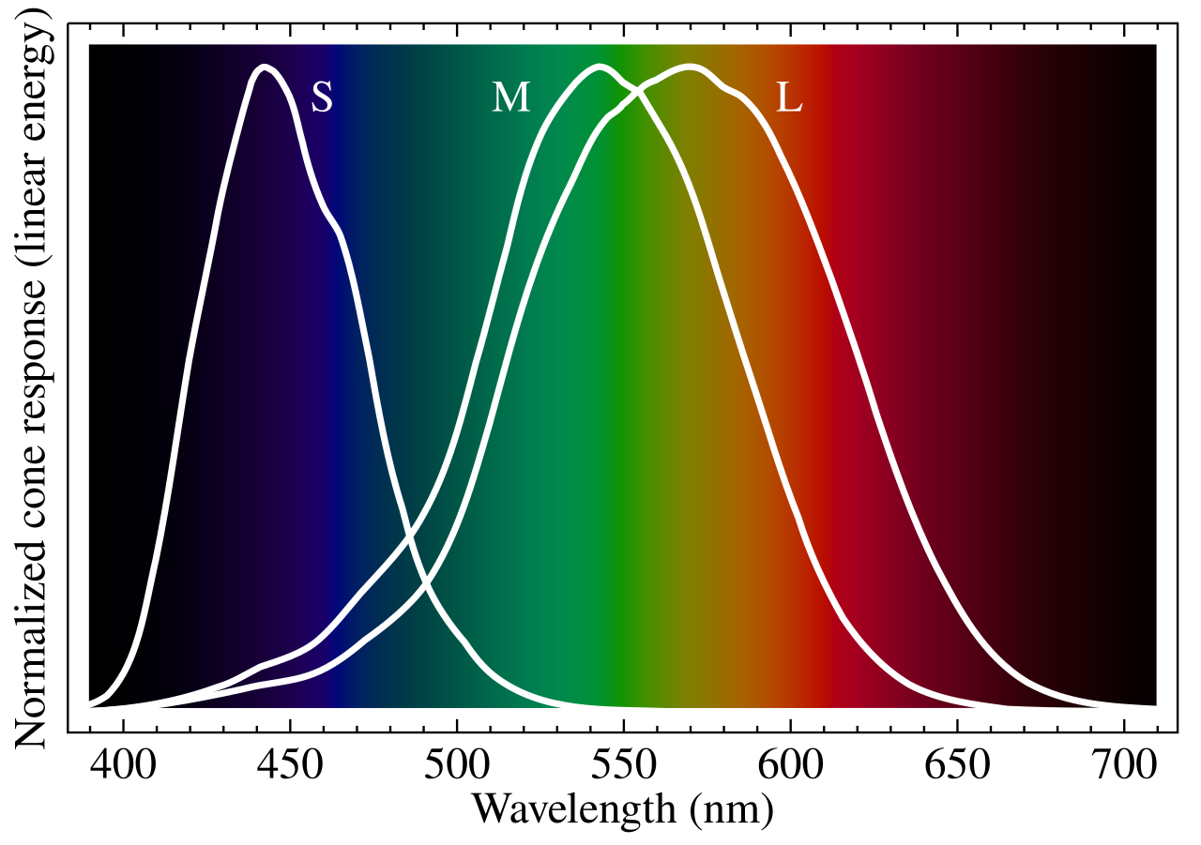
[1-3]
[4]

Slide 3
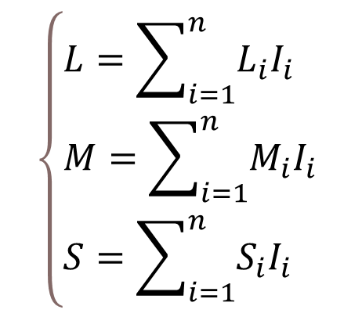
Brightness Normalization
A (0.3, 0.1, 0.8) and B (0.7, 0.2, 0.3) have the same brightness
C (0.2, 0.4, 0.8) and D (0.1, 0.2, 0.4) have the same chromaticity
Additive Color Theory [5]
$$\left\{\begin{aligned}&L=\sum_{i=1}^{n}{L_{i}I_{i}} \\ &M=\sum_{i=1}^{n}{M_{i}I_{i}} \\ &S=\sum_{i=1}^{n}{S_{i}I_{i}}\end{aligned}\right.$$

Slide 4
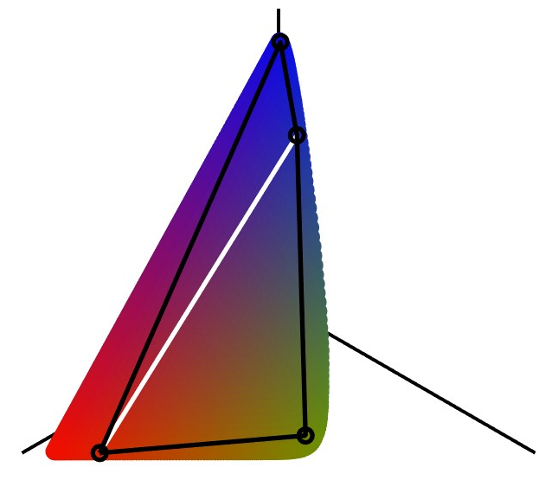









1
$$V$$
$$400 nm$$
$$B$$
RGB: 52% (White)
RGBV: 72% (Black)
$$S$$
$$L$$
0.5
0.75
1
$$M$$
1
$$R$$
$$G$$
$$700 nm$$

Slide 6
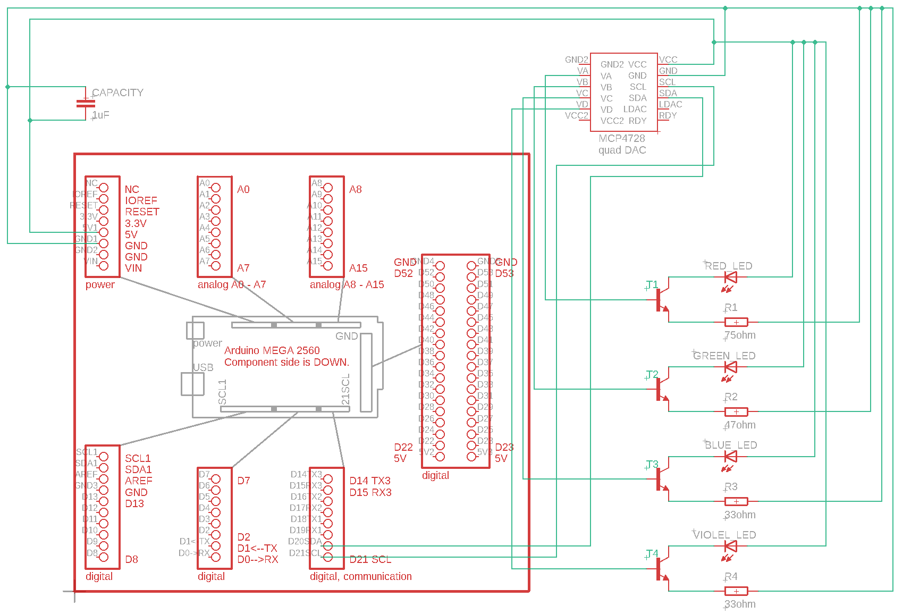

Slide 7
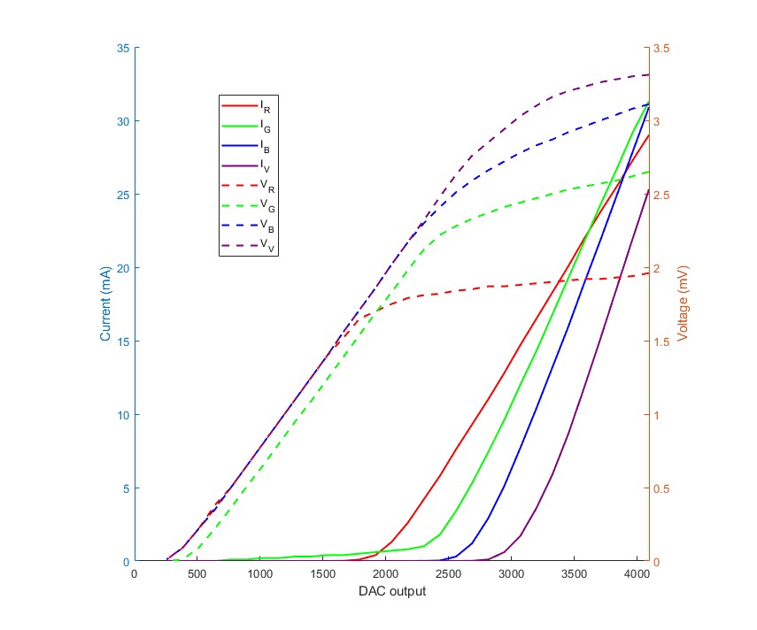

Slide 8
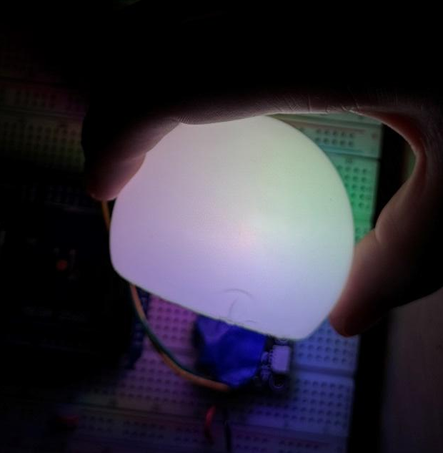

Slide 9
Reference
[1] Stockman, A., Sharpe, L., & Fach, C. (1999). "The spectral sensitivity of the human short-wavelength sensitive cones derived from thresholds and color matches." Vision Research.
[2] Stockman, A., & Sharpe, L. (2000). "The spectral sensitivities of the middle- and long-wavelength-sensitive cones derived from measurements in observers of known genotype."
[3] CVRL. "http://cvrl.ucl.ac.uk".
[4] Wikipedia. "https://en.wikipedia.org/wiki/Cone_cell".
[5] Berns, R. S. (2000). "Principles of Color Technology." John Wiley & Sons.

Slide 10
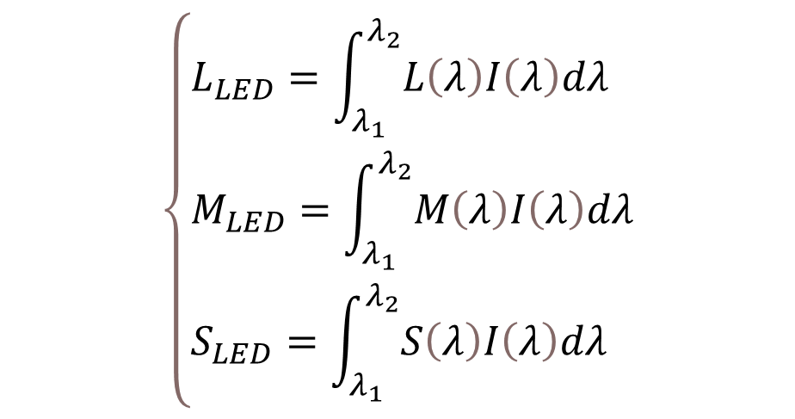
LED Cone Response
$$\left\{\begin{aligned}&L_{LED}=\int_{λ_{1}}^{λ_{2}}{L\left(λ\right)I\left(λ\right)dλ} \\ &M_{LED}=\int_{λ_{1}}^{λ_{2}}{M\left(λ\right)I\left(λ\right)dλ} \\ &S_{LED}=\int_{λ_{1}}^{λ_{2}}{S\left(λ\right)I\left(λ\right)dλ}\end{aligned}\right.$$

Slide 11
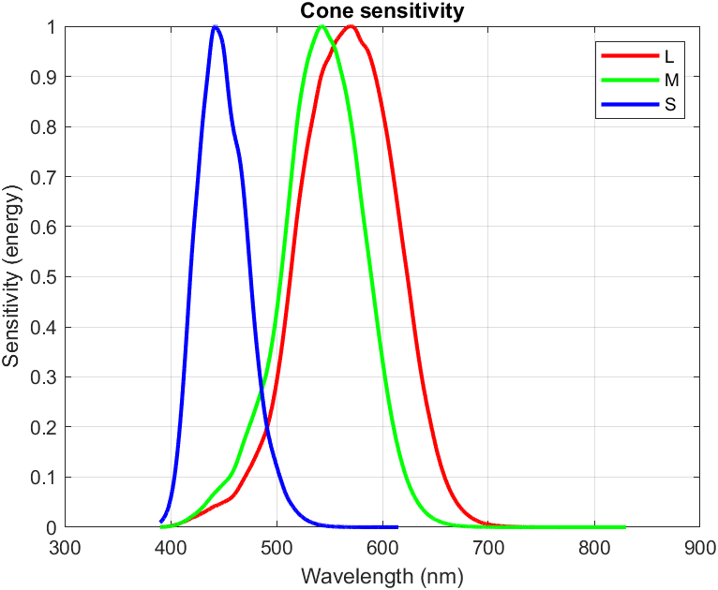

Slide 12

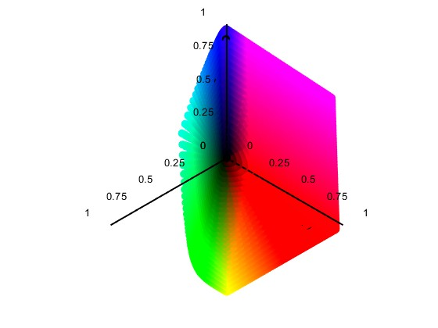
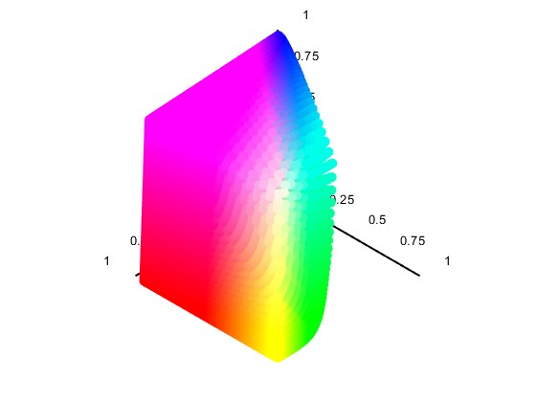
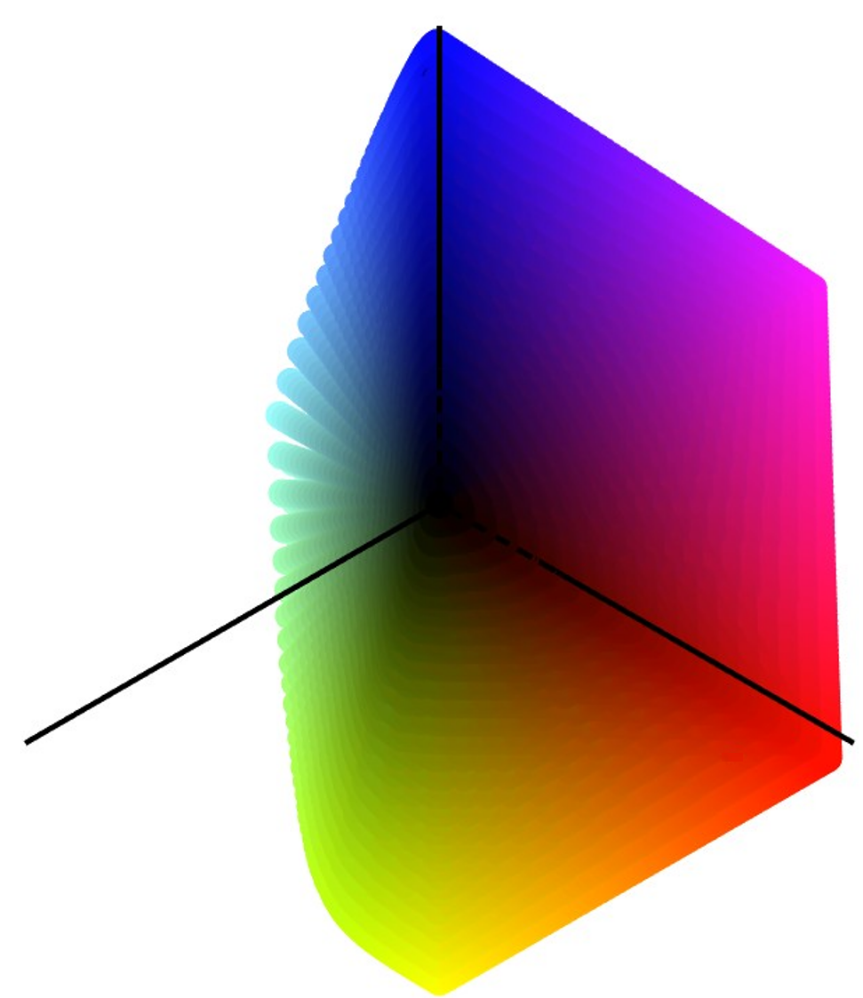
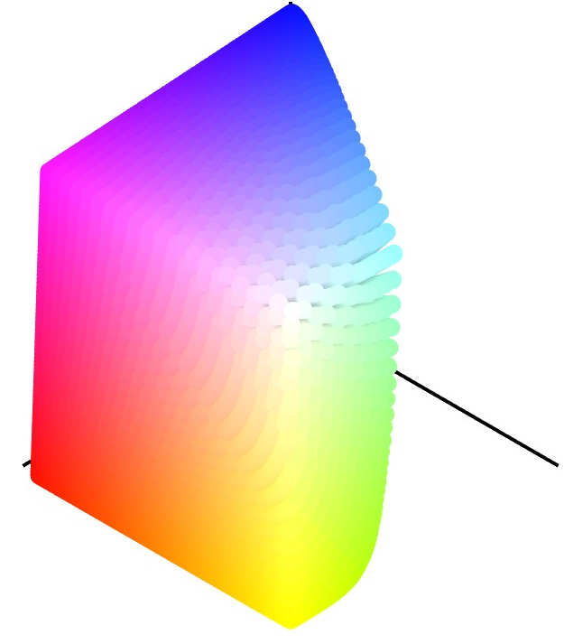







(a)
(b)
1
1
0.75
$$S$$
$$S$$
0.5
0.25
0.25
0.25
$$L$$
$$L$$
0.5
0
0.5
0.5
0.75
0.75
0.75
1
1
1
1
$$M$$
$$M$$

